Slide 1
Engineering Process Model Comparison
Susan Hallstrom
The “E” in STEM
October 2010

Slide 2

NASA Engineering Design Model
NASA Engineering Design Model
1. Identify the Problem
2. Identify Criteria and Constraints
6. Select an Approach
7. Build a Model or Prototype
3. Brainstorm Possible Solutions
4. Generate Ideas
5. Explore Possibilities
8. Refine the Design

Slide 3

The Dartmouth Engineering Design Process
1. Define the Problem
6. Analyze Alternatives by a Trade-Off Matrix
7. Identify a potential solution
2. Restate the Problem
3. Develop Constraints and Criteria
4. Brainstorm Ideas
5. Research Alternatives
8. Research in Detail a Potential Solution
13. Simplify if Necessary
9. Design a potential solution
10. Construct a Prototype
11. Evaluate Prototype
12. Reiterate if Necessary

Slide 4
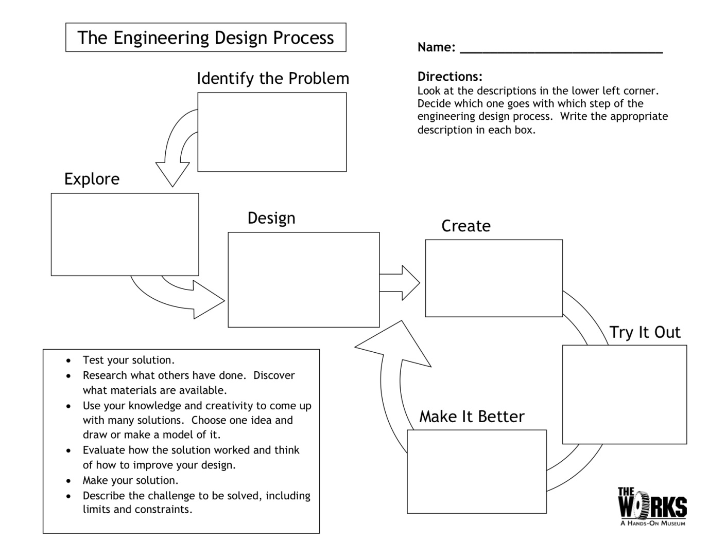
eGFI Engineering Design Model
Notes:
Engineering – Go For It

Slide 5
Brief Model Summaries

Slide 6
NASA Engineering Design Model
The NASA engineering design process involves a series of steps that lead to the development of a new product or system.
The appropriate application for each step in the process is explained at http://www.nasa.gov/audience/foreducators/plantgrowth/reference/Eng_Design_5-12.html
This site explains the steps in the process as they would be applied to the Lunar Plant Growth Chamber

Slide 7
The Dartmouth Engineering Design Process
The article referenced for this process may be found at http://www.questia.com/googleScholar.qst?docId=5002508094
The Dartmouth model uses a trade-off matrix that allows evaluation of possible solutions to specific criteria.
This model recognizes that two characteristics – compromise and teamwork – are key for successful engineering design.

Slide 8
eGFI Engineering Design Model
eGFI is sponsored by the American Society of Engineering Education (ASEE) as part of this group’s commitment to promoting and enhancing efforts to improve K-12 STEM and engineering education.
The information on the eGFI slide may be accessed at http://www.mos.org/eie/engineering_design.php
This model used fewer steps and is aimed at younger students.

Slide 9
Identify, Define, Ask…the Problem Correlations Among the Models
Nasa
1. State the problem
Dartmouth
1. Define the problem.
2. Restate the problem. This step ensures that the context of the problem is clear and the bias is eliminated.
eGFI
1. Ask
What is the problem?
What have others done?

Slide 10




Identify Criteria and Constraints Correlations Among the Models
Nasa
2. Identify criteria and constraints
Dartmouth
3. Develop constraints and specifications
eGFI
1. Ask
What are the constraints?

Slide 11

Brainstorming Correlations Among the Models
Nasa
3. Brainstorm
Dartmouth
4. Brainstorm
eGFI
1. Imagine
What are some solutions?
Brainstorm

Slide 12
Choose the Solution Correlations Among the Models
Nasa
Generate Ideas
Explore possibilities
Select an approach.
Dartmouth
Research the alternative
Anaylze with trade-off matrix.
Identify a solution
eGFI
2. Imagine
Choose the best idea

Slide 13

Create the Model/Prototype Correlations Among the Models
Nasa
7. Build the model.
Dartmouth
8. Research the solution.
9. Design solution
10. Build the model or prototype
eGFI
3. Plan
Draw the design
List the materials
4. Create
Follow the plan and create the model
Test it!

Slide 14
Evaluate, Improve, Revise, Refine Correlations Among the Models
Nasa
7. Refine
Dartmouth
Evaluate the Prototype.
Reiterate if necessary.
Simplify if necessary
eGFI
3. Improve
Discuss
Modify
Retest

Slide 15
Putting It All Together

Slide 16
Organization
The three models included in this evaluation have seven common threads.
These seven threads are:
Ask Identify the problem
Clarify Identify criteria and constraints
Imagine Brainstorm
Plan Research and Plan
Create Build the model or prototype
Evaluate Discuss, Refine, Retest

Slide 17
Graphical Depiction of Model
Ask
Identify the Problem
Clarify
Identify the Constraints and Specifications
Imagine
Brainstorm for Solutions; Choose a solution
Plan
Research the solution, Design he solution
Create
Use the plan to create the model
Evaluate
Discuss the results, Evaluate the performance, Refine the design, Retest

