Slide 1
Endeavor Leadership Presentation
Melissa Payton

Slide 2
Presentation
After the Fresno County Office of Education Interactive Science Notebook Workshop
May 30th and May 31st
Fresno County Educators Grades 6-12
Total of 22 Educators

Slide 3
Presentation Agenda
Introduction/Sign-in/Handouts
Pre-Survey
III. NASA Endeavor Program
IV. NASA Teacher Resources
V. Earth Science and Mars
VI. 5E’s Learning Cycle
VII. Friant Dam Lesson Plan
Interactive Science Notebooks
Post-Survey

Slide 4
Pre-Survey
Pre-Survey: Please answer the following questions.
How often do you use the NASA teacher resource website (circle one)?
Never Always
1 2 3 4 5 6 7 8 9 10
How familiar are you with the 5E’s Learning Cycle (circle one)?
Not at all Extremely
1 2 3 4 5 6 7 8 9 10
3. What would you like to learn from this presentation?
_____________________________________________________________________________________________________________________________________________________________________

Slide 5
NASA Teacher Resources
NASA Education
http://www.nasa.gov/offices/education/about/index.html
NASA Endeavor Teaching Credential
http://www.us-satellite.net/endeavor/index.cfm
NASA 3D Books
Hydro: http://www.3dview.org/resourcesnew/hydro/book/index.html

Slide 6
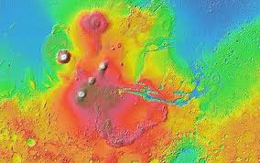
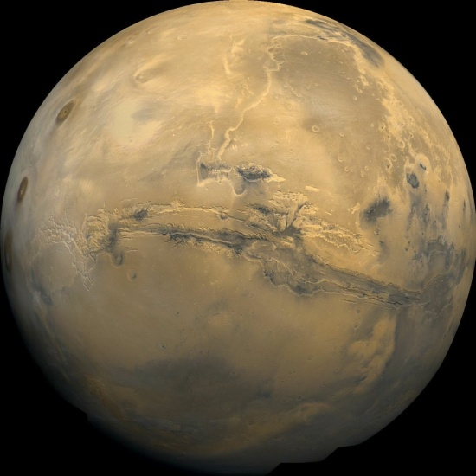
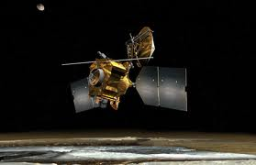
Earth vs. Mars
Use Mars to teach Earth science
Earth’s geological features compared to Mars
Orbiters and rovers take pictures
www.nssdc.gsf.nasa.gov
Google Mars
www.googlemars.com
NASA’s Mars Reconnaissance Orbiter (MRO)

Slide 7
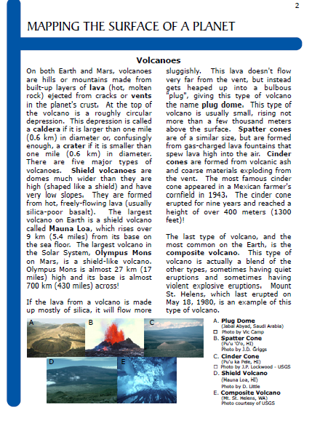
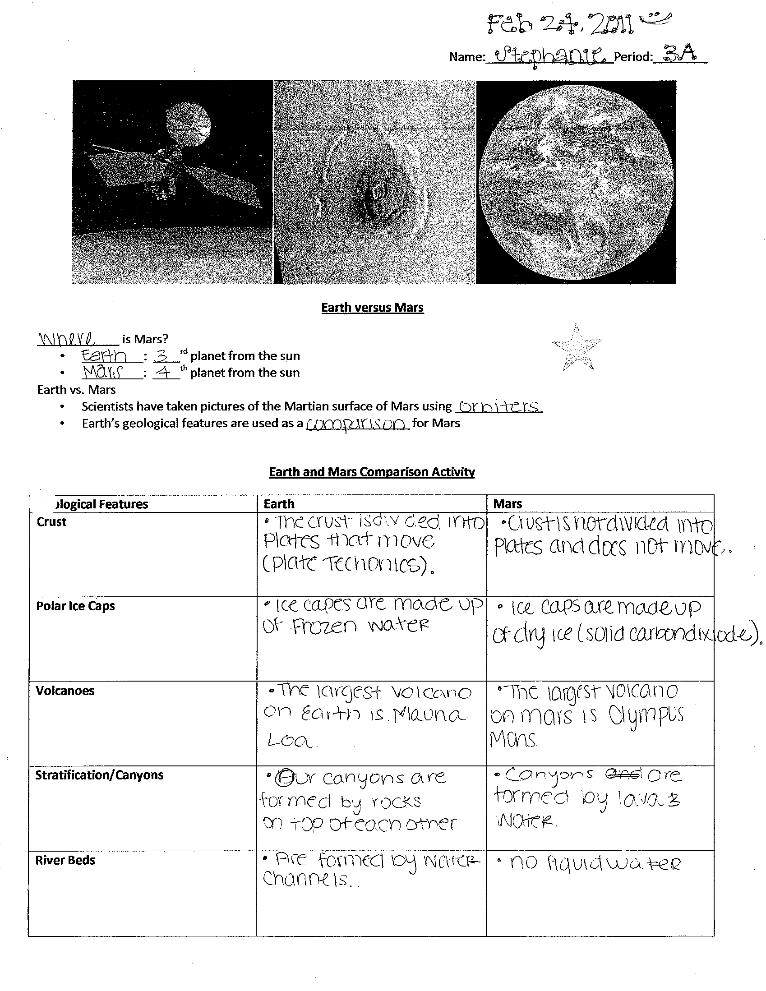
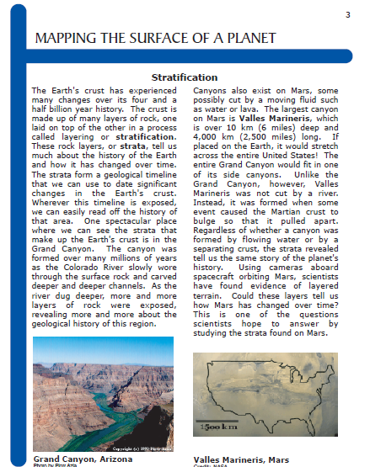
Earth vs. Mars

Slide 8
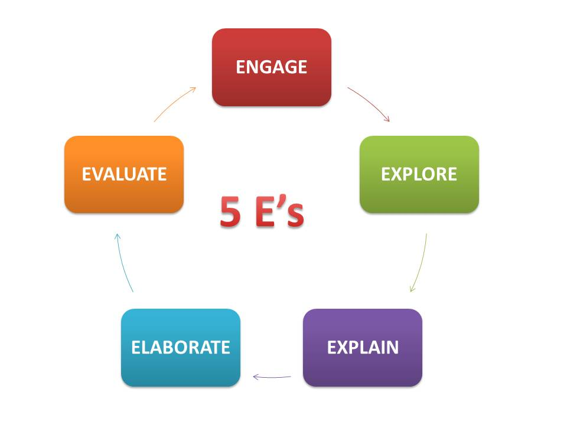
5E’s Learning Cycle
Engage: video, pictures
Explore: video, web search, hands-on activity
Explain: teacher or student discussion
Elaborate/Extend: hands-on activity, create a model, in-depth research
Evaluate: activity
rubrics, final projects

Slide 9
Friant Dam Lesson Plan
Utilizes 5E’s Learning Cycle format
Incorporates science literacy
Focuses on inquiry
Based on California science standards
Includes NASA material (3D View Book)

Slide 10

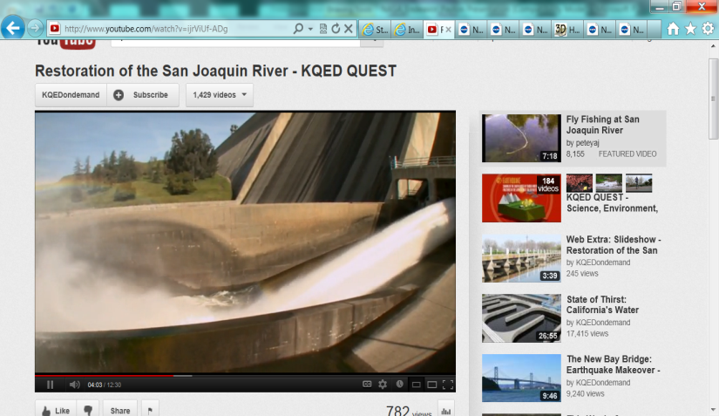
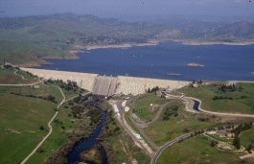
Friant Dam Lesson Plan
Engage: Video
Explain: Advance Organizer/NASA 3D View Book
Explore/Elaborate: Research
Extend/Evaluate: Research Poster
Extend/Evaluate: Debate

Slide 11
Post-Survey
Post-Survey: Please answer the following questions.
1. How often do you think you will use the NASA teacher resource website (circle one)?
Never Always
1 2 3 4 5 6 7 8 9 10
2. Do you believe using the 5E’s Learning Cycle for lesson planning is effective (circle one)?
Not at all Extremely
1 2 3 4 5 6 7 8 9 10
3. How often will you use 5E’s Learning Cycle for lesson planning (circle one)?
Never Always
1 2 3 4 5 6 7 8 9 10
4. Do you plan on incorporating the Friant Dam Lesson Plan in your curriculum (circle one)?
Yes No
5. Please write any comments/questions about this presentation. __________________________________________________________________________________________________________________________________________________________________________________________________________________________________________

Slide 12
Results
Pre-survey: Scale from 1-10 (1 is "never" and 10 is "always") | Mean | Standard Deviation
1. How often do you use the NASA teacher resource website? | 2.90909091 | 2.087985583
2. How familiar are you with the 5E's Learning Cycle? | 4.90909091 | 2.803160272
Post-survey: Scale from 1-10 (1 is "never" and 10 is "always") | Mean | Standard Deviation
1. How often do you think you will use the NASA teacher resource website? | 5.88888889 | 1.843554396
3. How often do you think you will use the 5E's Learning Cycle for you lesson plan? | 6.83333333 | 1.886484437
Comparison of Means | Calculated T | Student's T
T-Test Pre- (Question #1) and Post- (Question #1) NASA Questions | 2.44* | 2.021
T-Test Pre- (Question #1) and Post- (Question #3) 5E's Learning Cycle Questions | 2.49* | 2.021
*The means for both sets of questions are statistically significant.

Slide 13
Results
Will you use the Friant Dam Lesson Plan?
 | Total | Percentage
Yes | 11 | 61.11111111
No | 7 | 38.88888889

Slide 14
Conclusion
The presentation was overall successful
Teachers will be more likely to use the NASA website and 5E’s Learning Process
Most teachers will use the lesson plan

