Slide 1
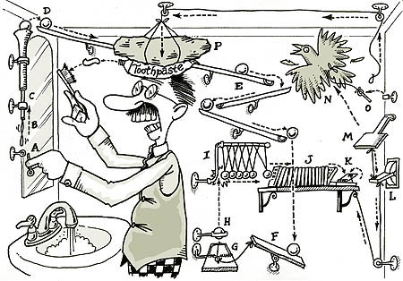
Simple Machines: Put It All Together
Engaging Context Lesson Plan
Elizabeth Gilmore

Slide 2
Topic of focus: Potential and kinetic energy using simple machines
Designed for 5th grade- can be adapted to other grades
Students will use their knowledge of potential and kinetic energy after studying mechanical energy to design a device to successfully complete the task of putting a marble in a cup.

Slide 3
Student Objectives
Design and create a Rube Goldberg device to put a marble in a cup using 10 or more steps.
Construct a device using a variety of materials
Collaborate with team members by effectively communicating throughout the development of the task process.
Analyze experimentation of device trials in order to successfully complete the task using problem solving skills.

Slide 4
Procedure
Teacher will review potential and kinetic energy
Students will be introduced to Rube Goldberg and his many small machine inventions.
Students will get in small to groups to complete the task of designing a Rube Goldberg device to put a marble into a cup.
Students will document their sequence of steps into their science notebook.
At the end of the designing and experimenting process, students will perform the task for the whole class.

Slide 5
Assessment
Teacher Observation
Science Notebook
Task Rubric

