Slide 1
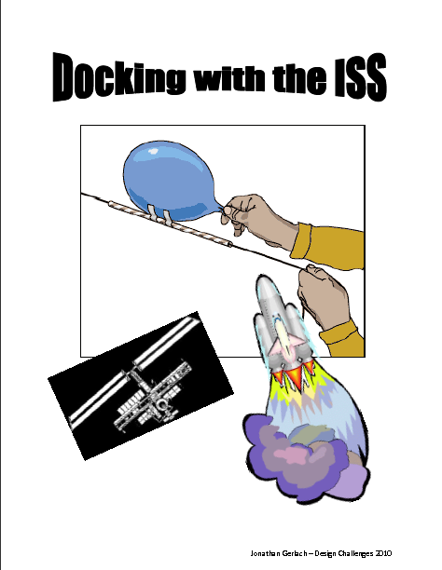
Challenge: Docking with the I.s.s.
You are an engineering developing a way to carry supplies to the ISS using a rocket instead of the shuttle.
Using provided materials, develop a way to get the supplies to the ISS using the teachers trajectory.

Slide 2
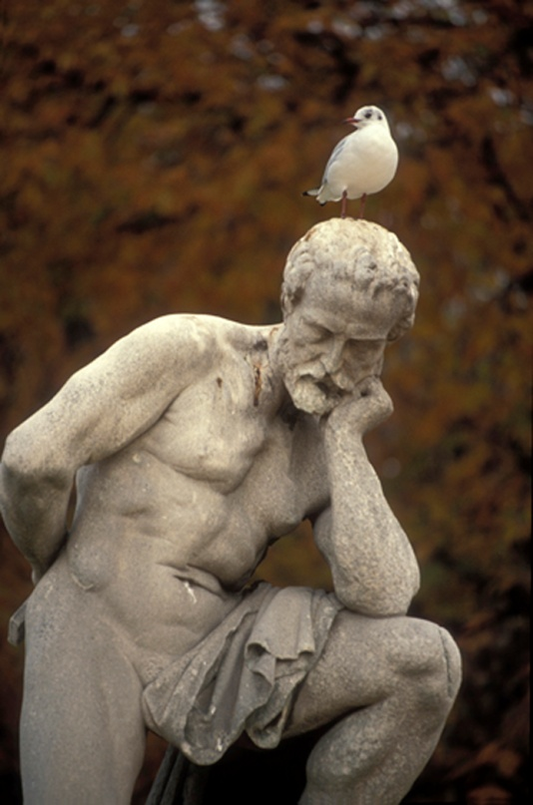
The Design Process
Design
Build
Test
Record Data
Analyze Results
Notes:
Pass out individual sheets of copy paper to each participant for next activity

Slide 3
DLE: Draw, Label, Explain
In your group:
- Diagram your launcher
- Label your launcher
- Explain how your launcher works

Slide 4
Importance of Blueprinting
Students often skip over or superficially skim diagrams, but when they do read the diagrams they are engaged in more high-level cognitive activity (Cromley 2009)
Science drawings also help you share your ideas and observations with other people.
Provide students with opportunities to manipulate objects and then explain, using words and diagrams…(2007 FCAT lessons learned)

Slide 5



Scientists must communicate!
What was your thinking for your design?
What worked/didn’t’ work?
This is where it ends…
or is it?

