Slide 1
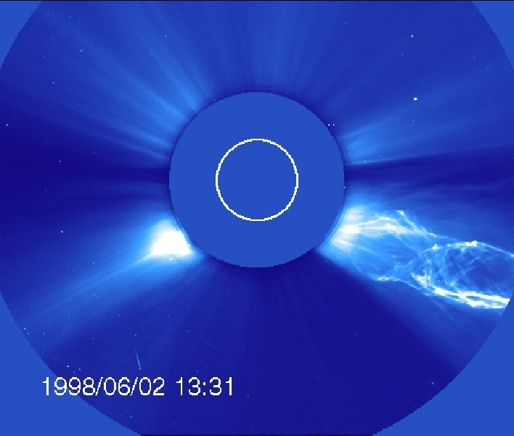
Data Connections
CME June 2, 1998
Christy Wood
August 5, 2009
Image from LASCO C2

Slide 2
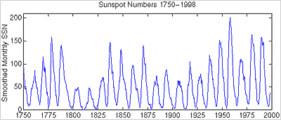
Sun Spots

Slide 3
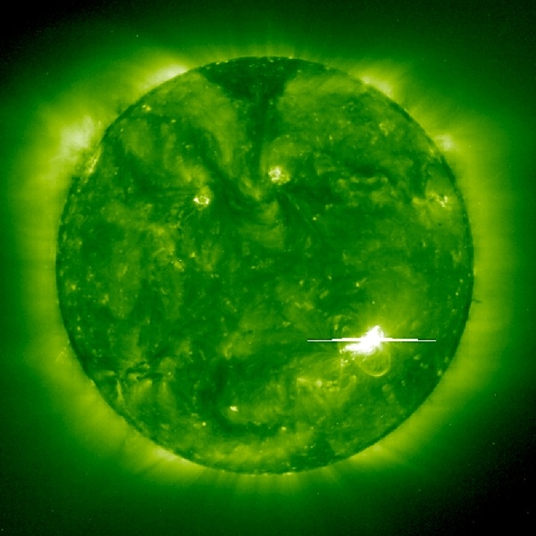
Solar Flares
EIT 195A ~ May 2, 1998

Slide 4
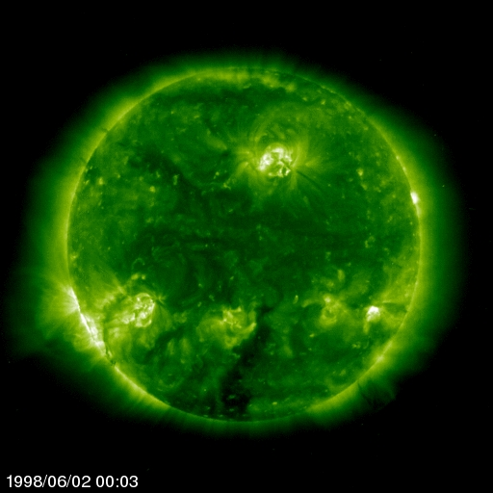
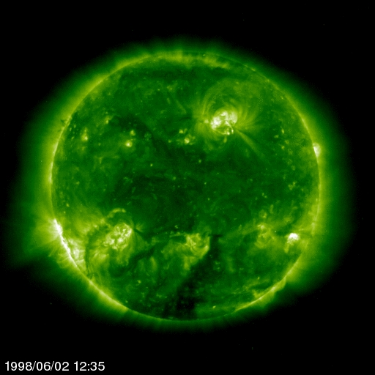
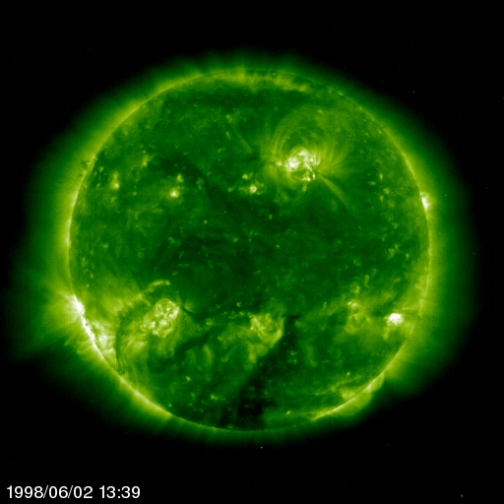
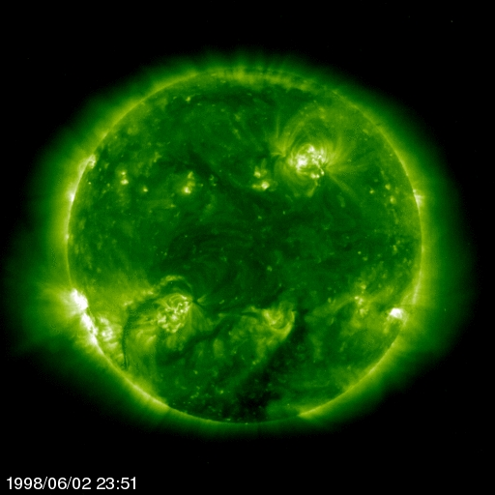
SOHO EIT 195
Prominence Eruption

Slide 5
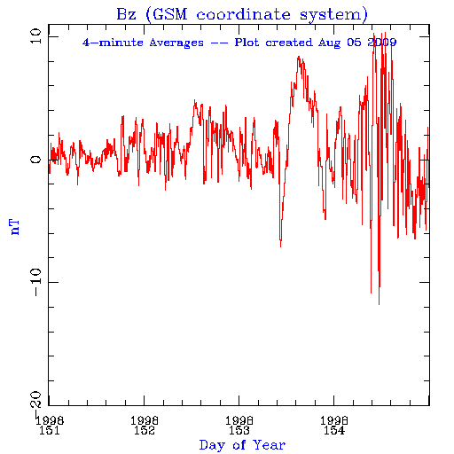
Magnetosphere
Image from ACE Magnetometer Level 2 Data

Slide 6
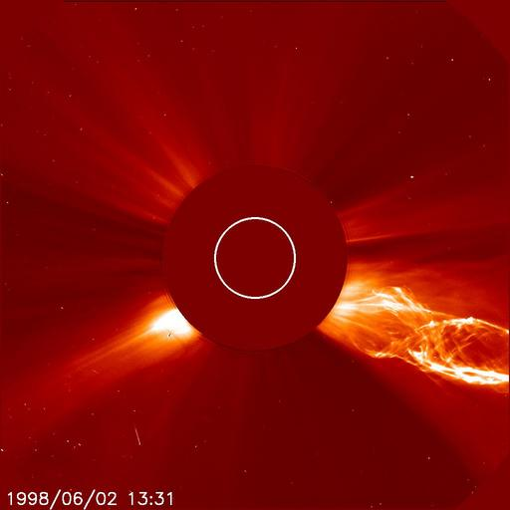
Corona Mass Ejection (CME)
LASCO C2

Slide 7
Images taken from NASA
SOHO
Tracking A Solar Storm
Space Weather Action Center

