Slide 1
Cook Inlet Region Earthquakes Increases and Intensifies Before Volcanic Eruption
Presentation by Christina T. Hill
Methods in Applied Science – Science Project

Slide 2
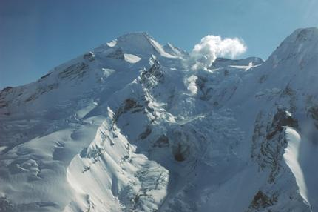
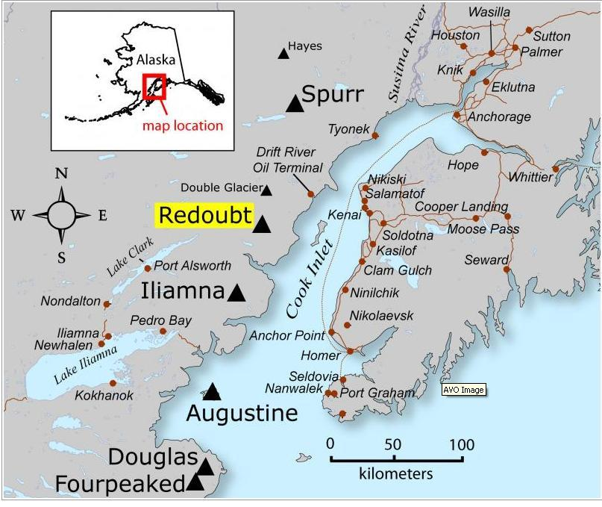
Mount Redoubt
Mt. Redoubt is an active stratovolcano located in the Chigmit Mountains in Alaska.
Mt. Redoubt is located in the Aleutian Trench - Pacific Ring of Fire. This zone displays frequent earthquakes and volcanic eruptions.
View west of the Upper Drift River valley and Redoubt Volcano. http://www.avo.alaska.edu/image.php?id=18105
Location of Redoubt volcano, in relationship to surrounding towns, roads, and other volcanoes. http://www.avo.alaska.edu/image.php?id=15524

Slide 3
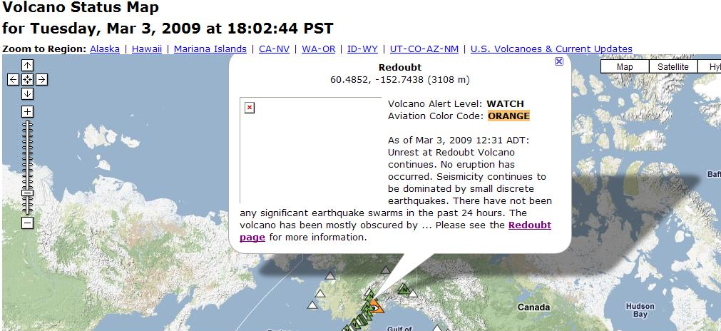
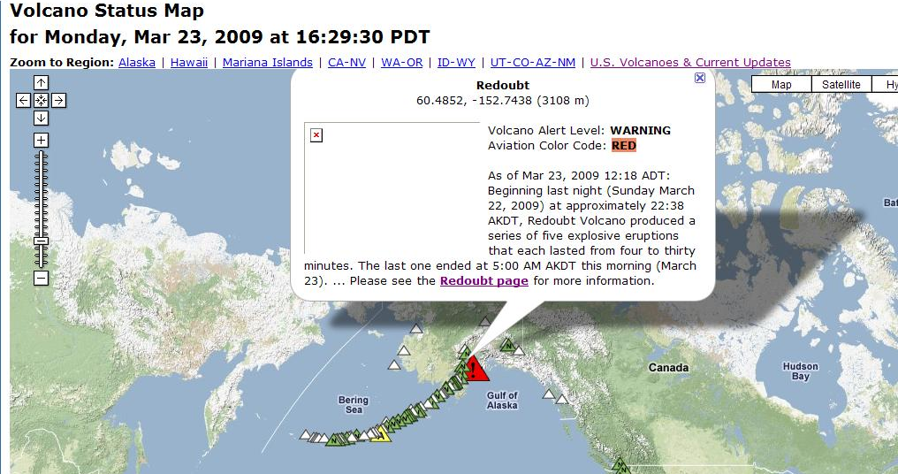
Mount Redoubt’s Status
These pictures were obtained from the United States Geological Survey’s Volcano Status Map webpage and was used to observe Mt. Redoubt’s status for thirty days.
On March 4, 2009, (AKST time) Mt. Redoubt’s exhibited an increase of seismic activity. Mt. Redoubt’s status is “Watch” (Top Right).
On March 22, 2009, (AKDT time) Mt. Redoubt began to erupt explosively (Bottom Right).
Volcano Status Map - http://volcanoes.usgs.gov/activity/;

Slide 4
Do earthquakes trigger an increase of activity in the volcano?
This research question remains unanswered. However, seismic activity near Mt. Redoubt increases and intensifies prior to its volcanic eruption.
Mt. Redoubt’s seismic activity began to increase in January 2009.
Seismic activity continued to increase on March 4, 2009 (Upper Right).
On March 22, 2009, Mt. Redoubt seismic activity increases and intensifies prior to its eruption (Bottom Right).

Slide 5
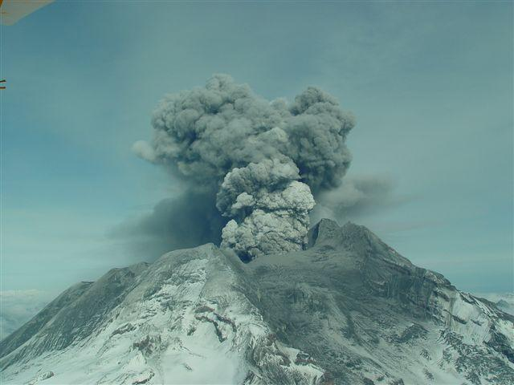
Earthquakes near a volcano should not be ignored!
The purpose of this study/presentation is to show why scientists are continuously monitoring volcanic regions for seismic activity through the United States Geological Survey.
Evidence supports that volcanic eruptions have occurred shortly after earthquakes.
Photograph of Redoubt volcano, March 31, 2009. http://www.avo.alaska.edu/image.php?id=17626

