Slide 1
My S.T.E.M. Experiences
David Carras-4th Grade-Phoenix, AZ

Slide 2
With help from the Endeavor Fellowship
Improve the excitement for learning and growing.
Break away from pencil and paper activities.
Increase knowledge of the world outside of Phoenix.
Incorporate NASA resources into all academic areas.
Improve the effectiveness of my teaching.

Slide 3
Water Pressure Bottle Rocket Activity
Courtesy of NASA’s “ROCKETS…A Teacher’s Guide with Activities in Science, Mathematics, and Technology”
The science of water and pressure.
The study of mathematics through measurement and angles.
The history of NASA space flight and accomplishment.

Slide 4
Water Pressure Bottle Rocket Activity
Students construct a water pressure powered rocket from a 2-liter bottle and construction paper.
Fill the bottle with 1.5 to 1.75 liters of water.
Place the rocket on the launch pad.
Increase the pressure inside the rocket with a bicycle pump.
Measure the angle and altitude of the rocket through the use of an altimeter.
Keep track of altitudes with a data sheet.

Slide 5
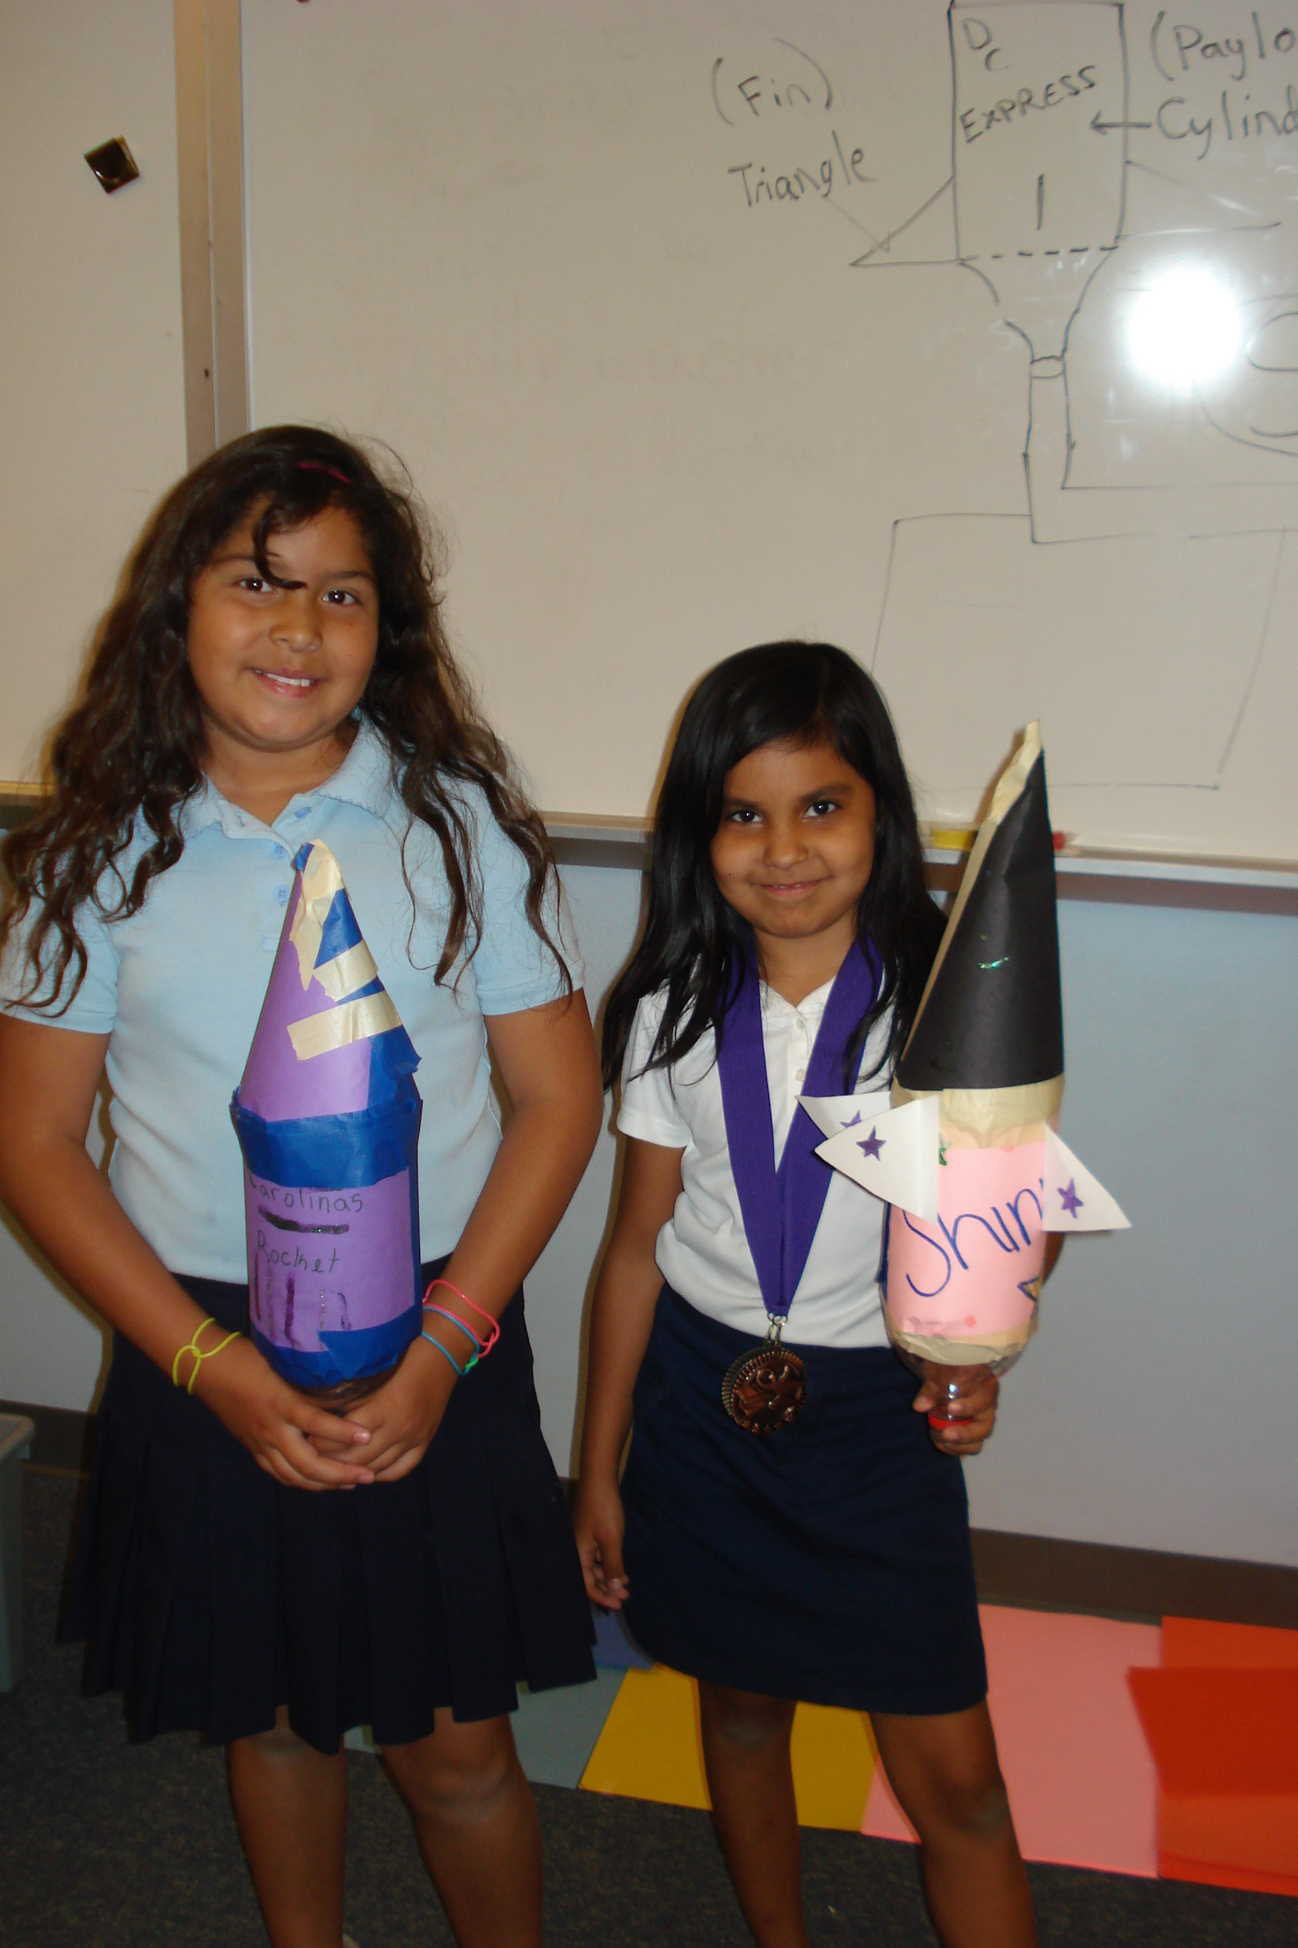
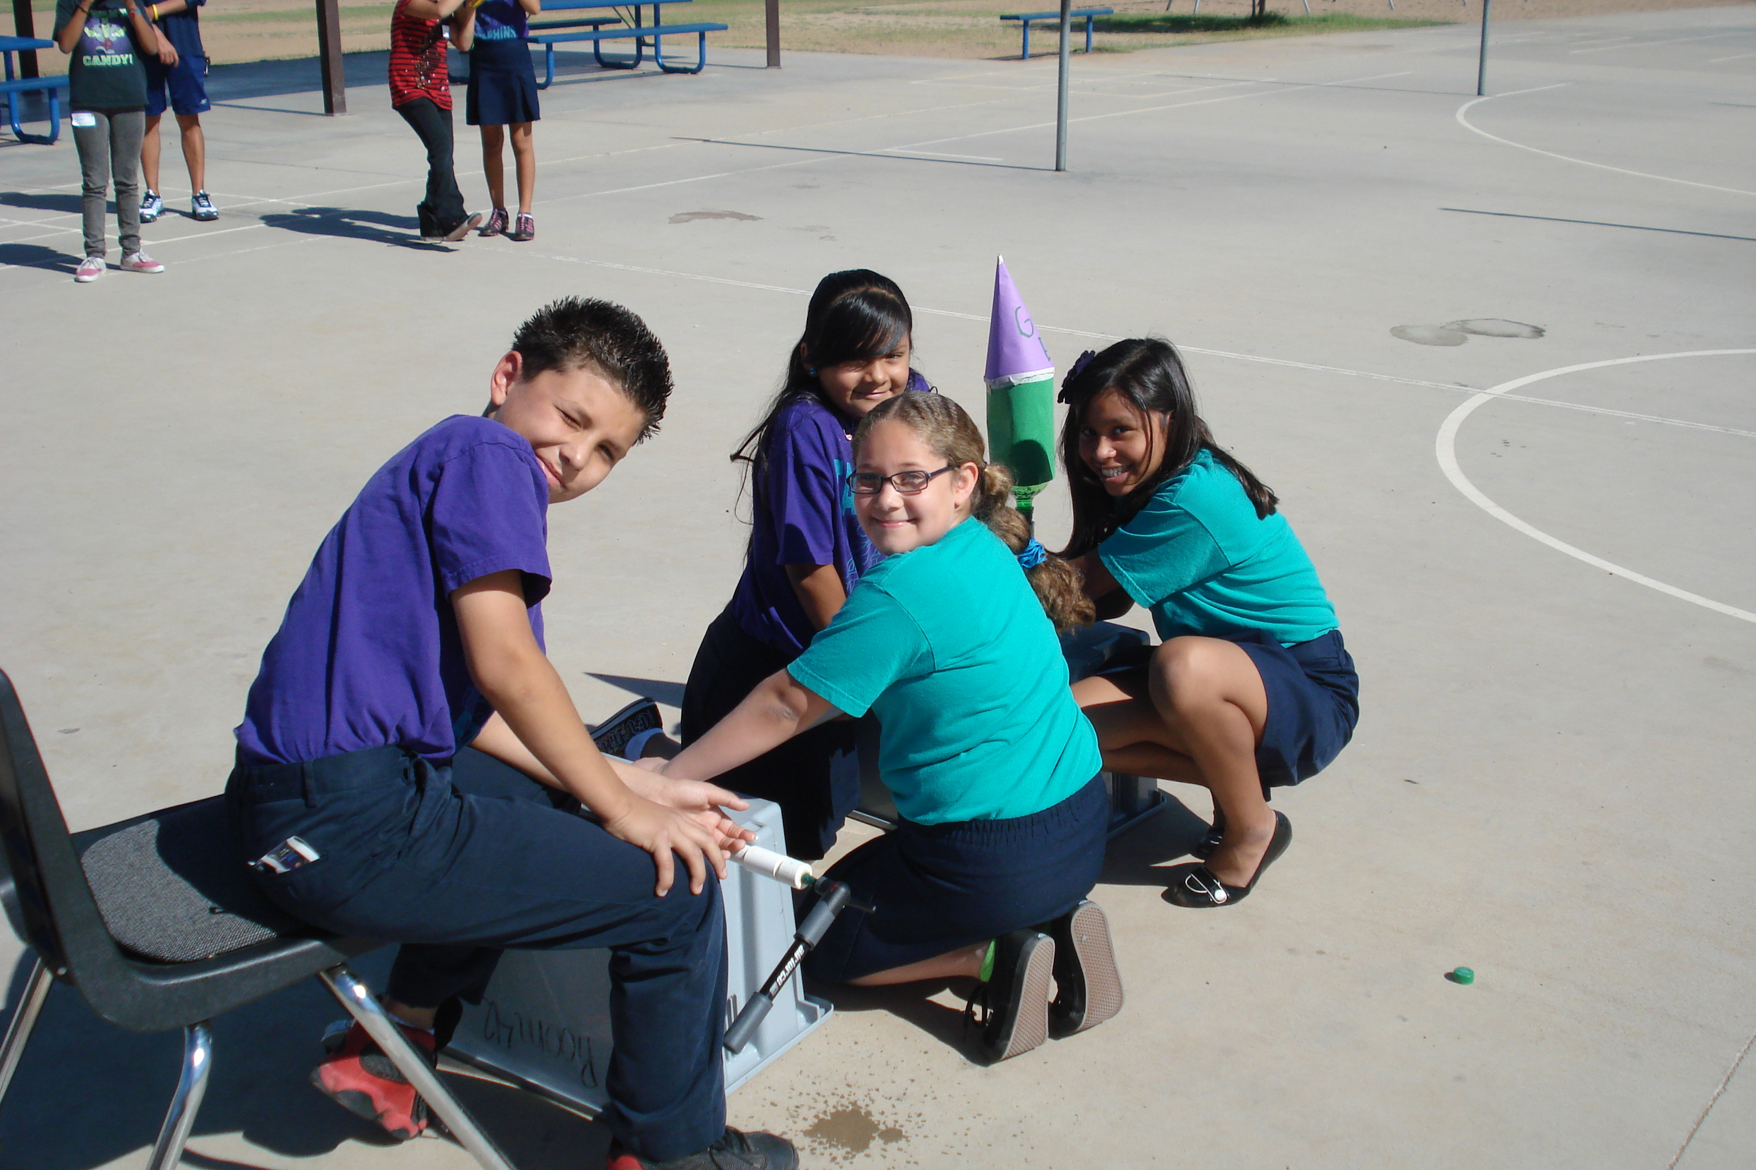
Water Pressure Bottle Rocket Activity

Slide 6
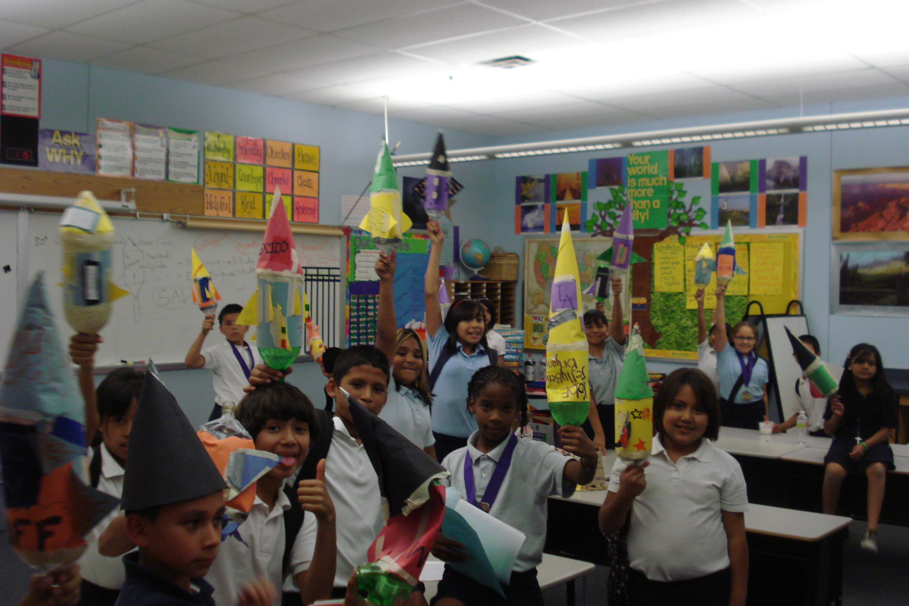
Water Pressure Bottle Rocket Activity

Slide 7
Water Pressure Bottle Rocket Activity
The students learned…
NASA’s History of Spaceflight.
The power of water.
Mathematics within rocket flights.
Creative uses of everyday materials.

Slide 8
Hungary Toxic Sludge Reenactment
The science of chemistry and the explanation of pH levels.
The science and power of water on a slope.
The mathematics of elevation change.
The engineering idea of recreating a toxic sludge spill.
The real world effects, half a world away.

Slide 9
Hungary Toxic Sludge Reenactment
Began with a FOSS Kit investigation of Water on a Slope.
Continued with a Main Idea/Detail Reading and Social Studies lesson.
Extension/Enrichment activity.
Technology implementation through the use of Google Earth.

Slide 10
Hungary Toxic Sludge Reenactment
Students brainstormed everyday materials they could use to recreate the toxic sludge.
Students brainstormed how to recreate the Danube River and the elevation change from Hungary to the Black Sea.
Students built their model and demonstrated the possibility of the spill reaching the U.S.

Slide 11
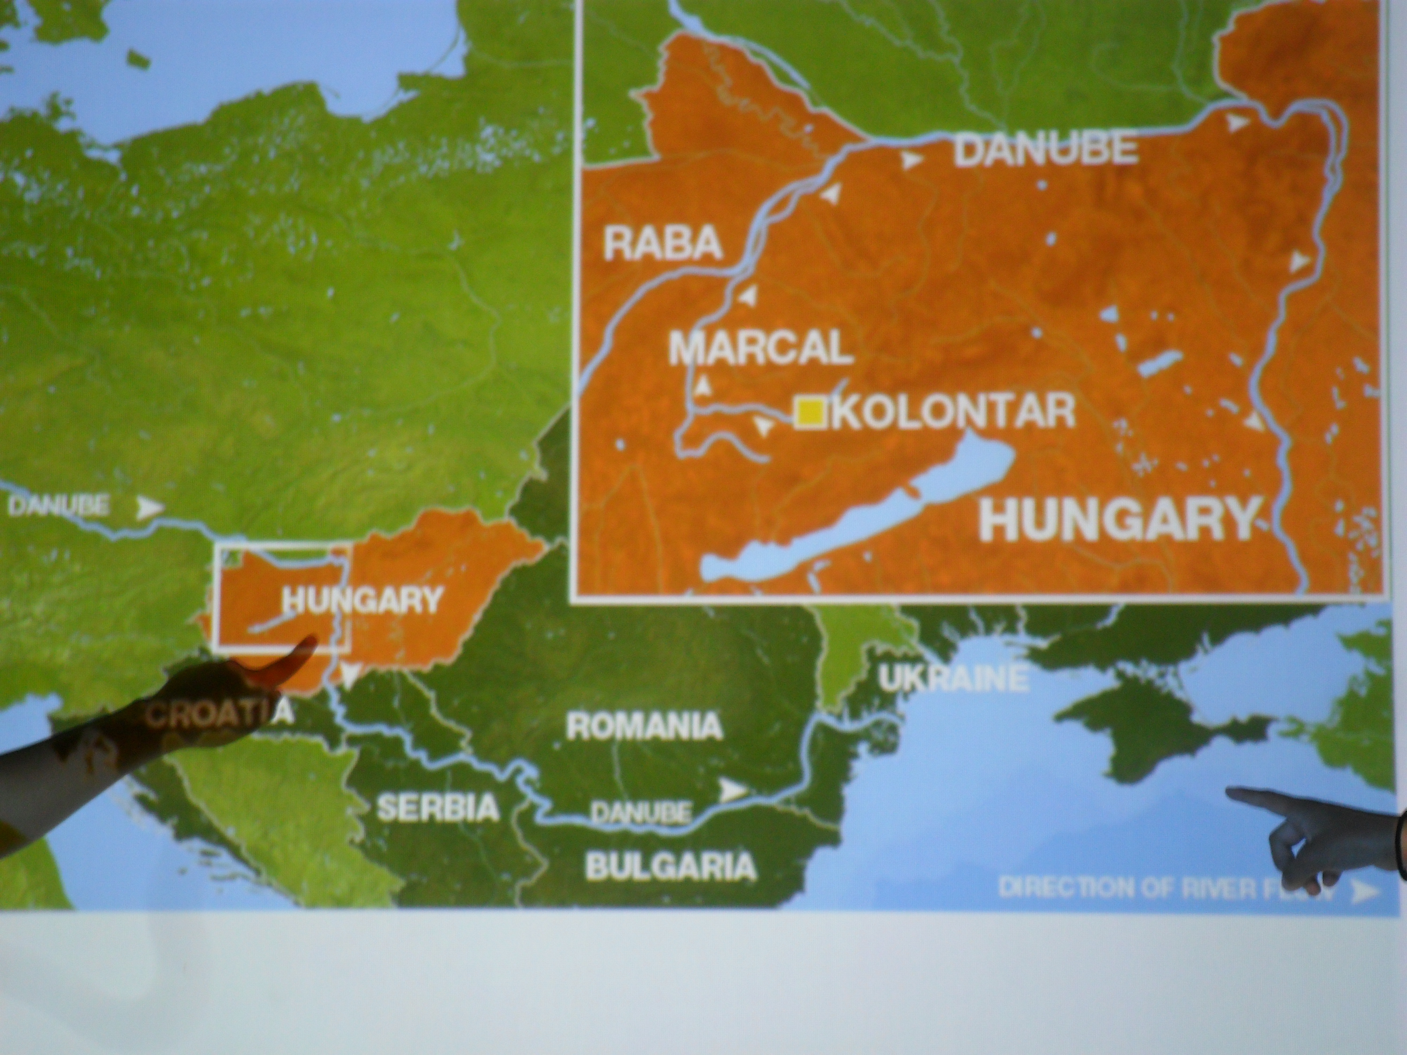
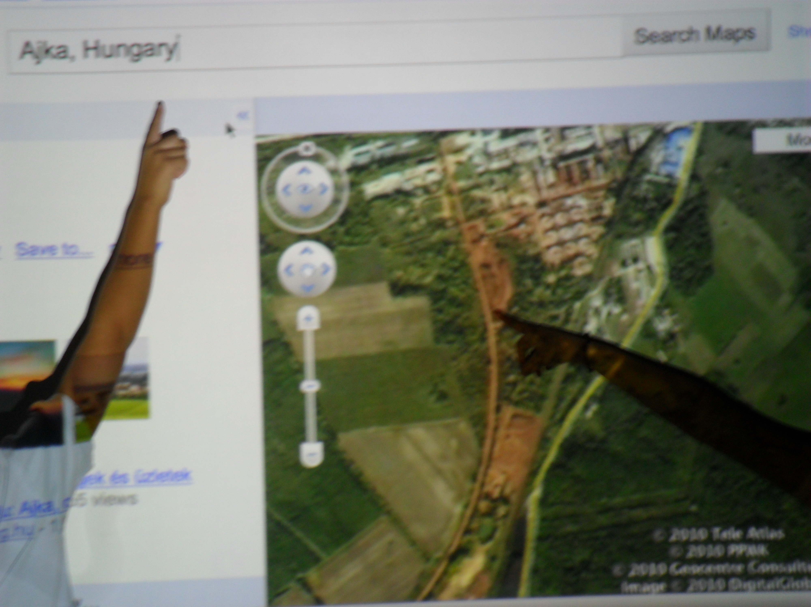
Hungary Toxic Sludge Reenactment

Slide 12
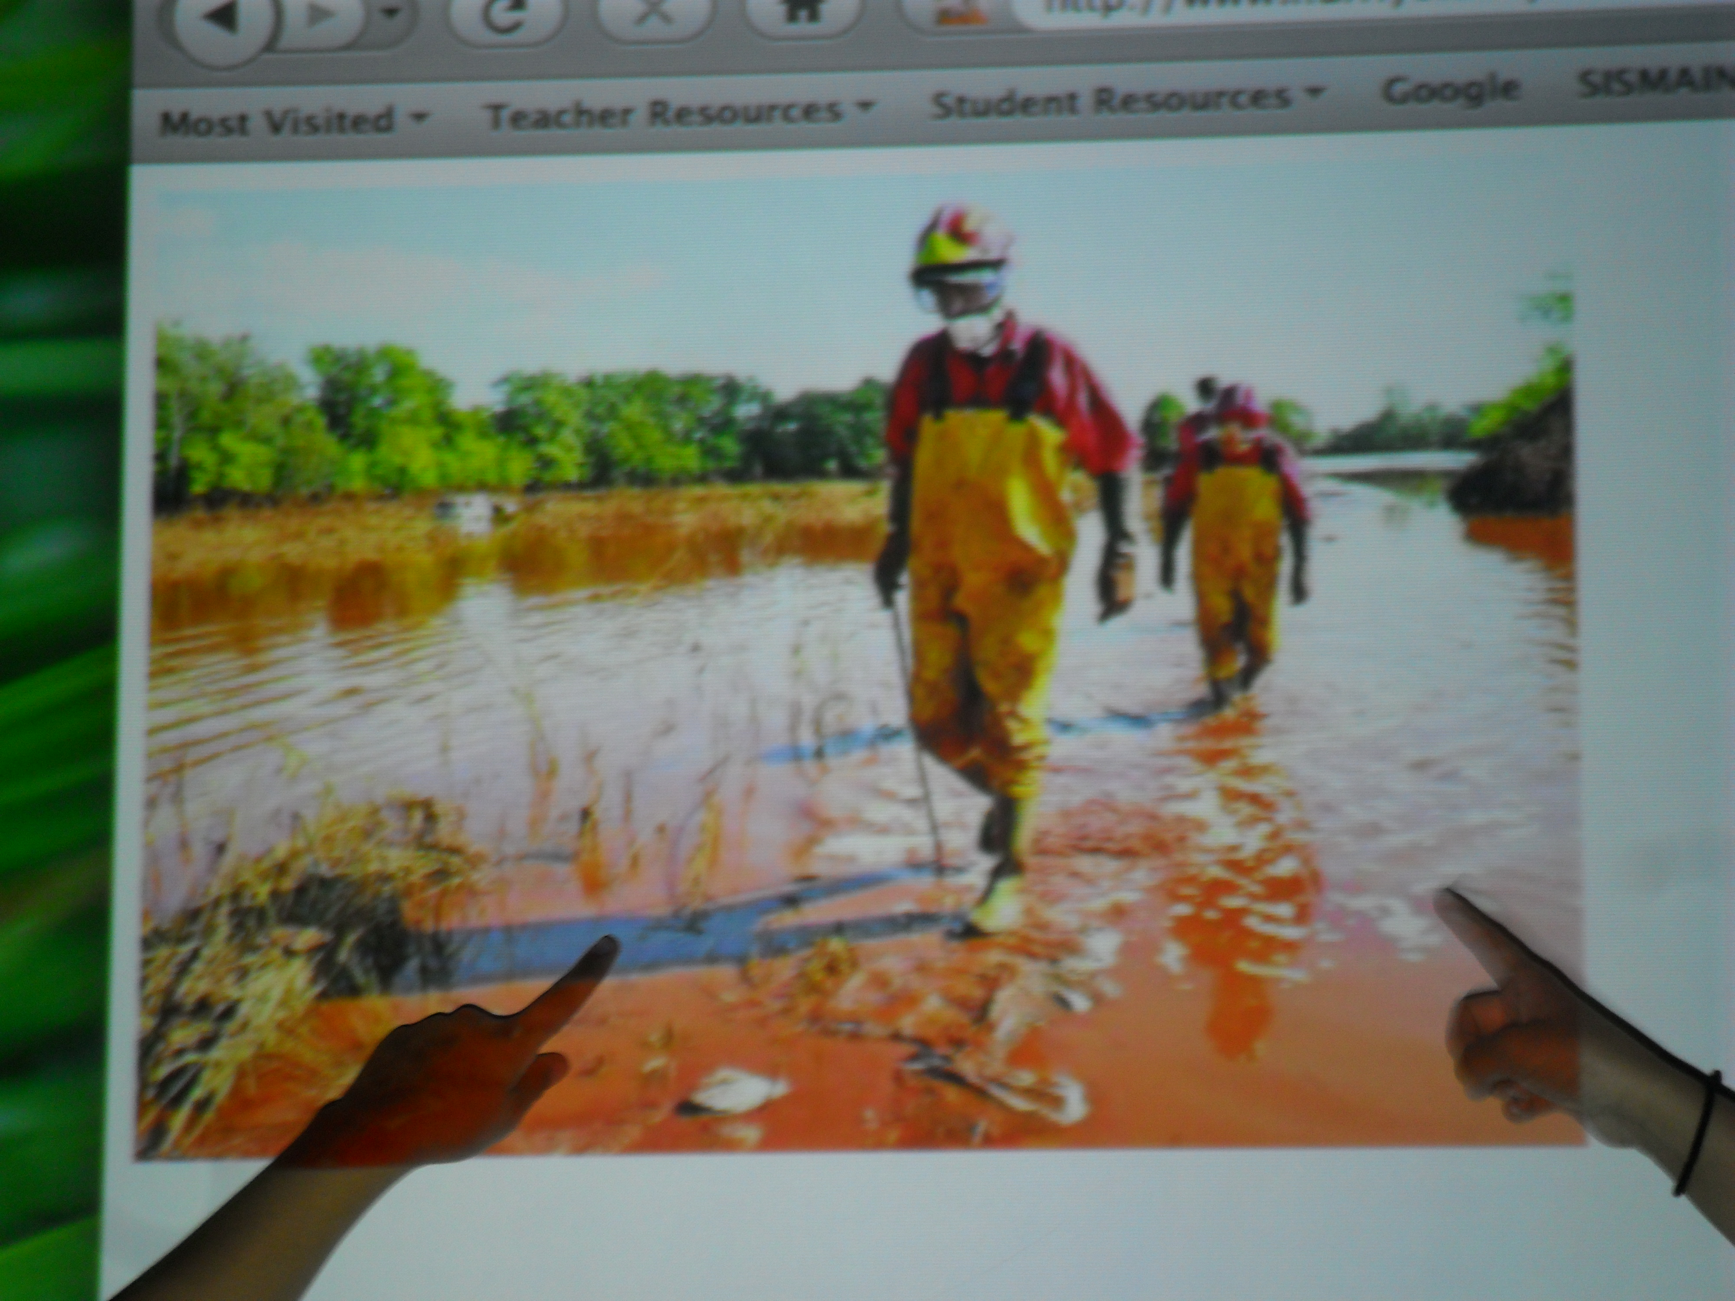
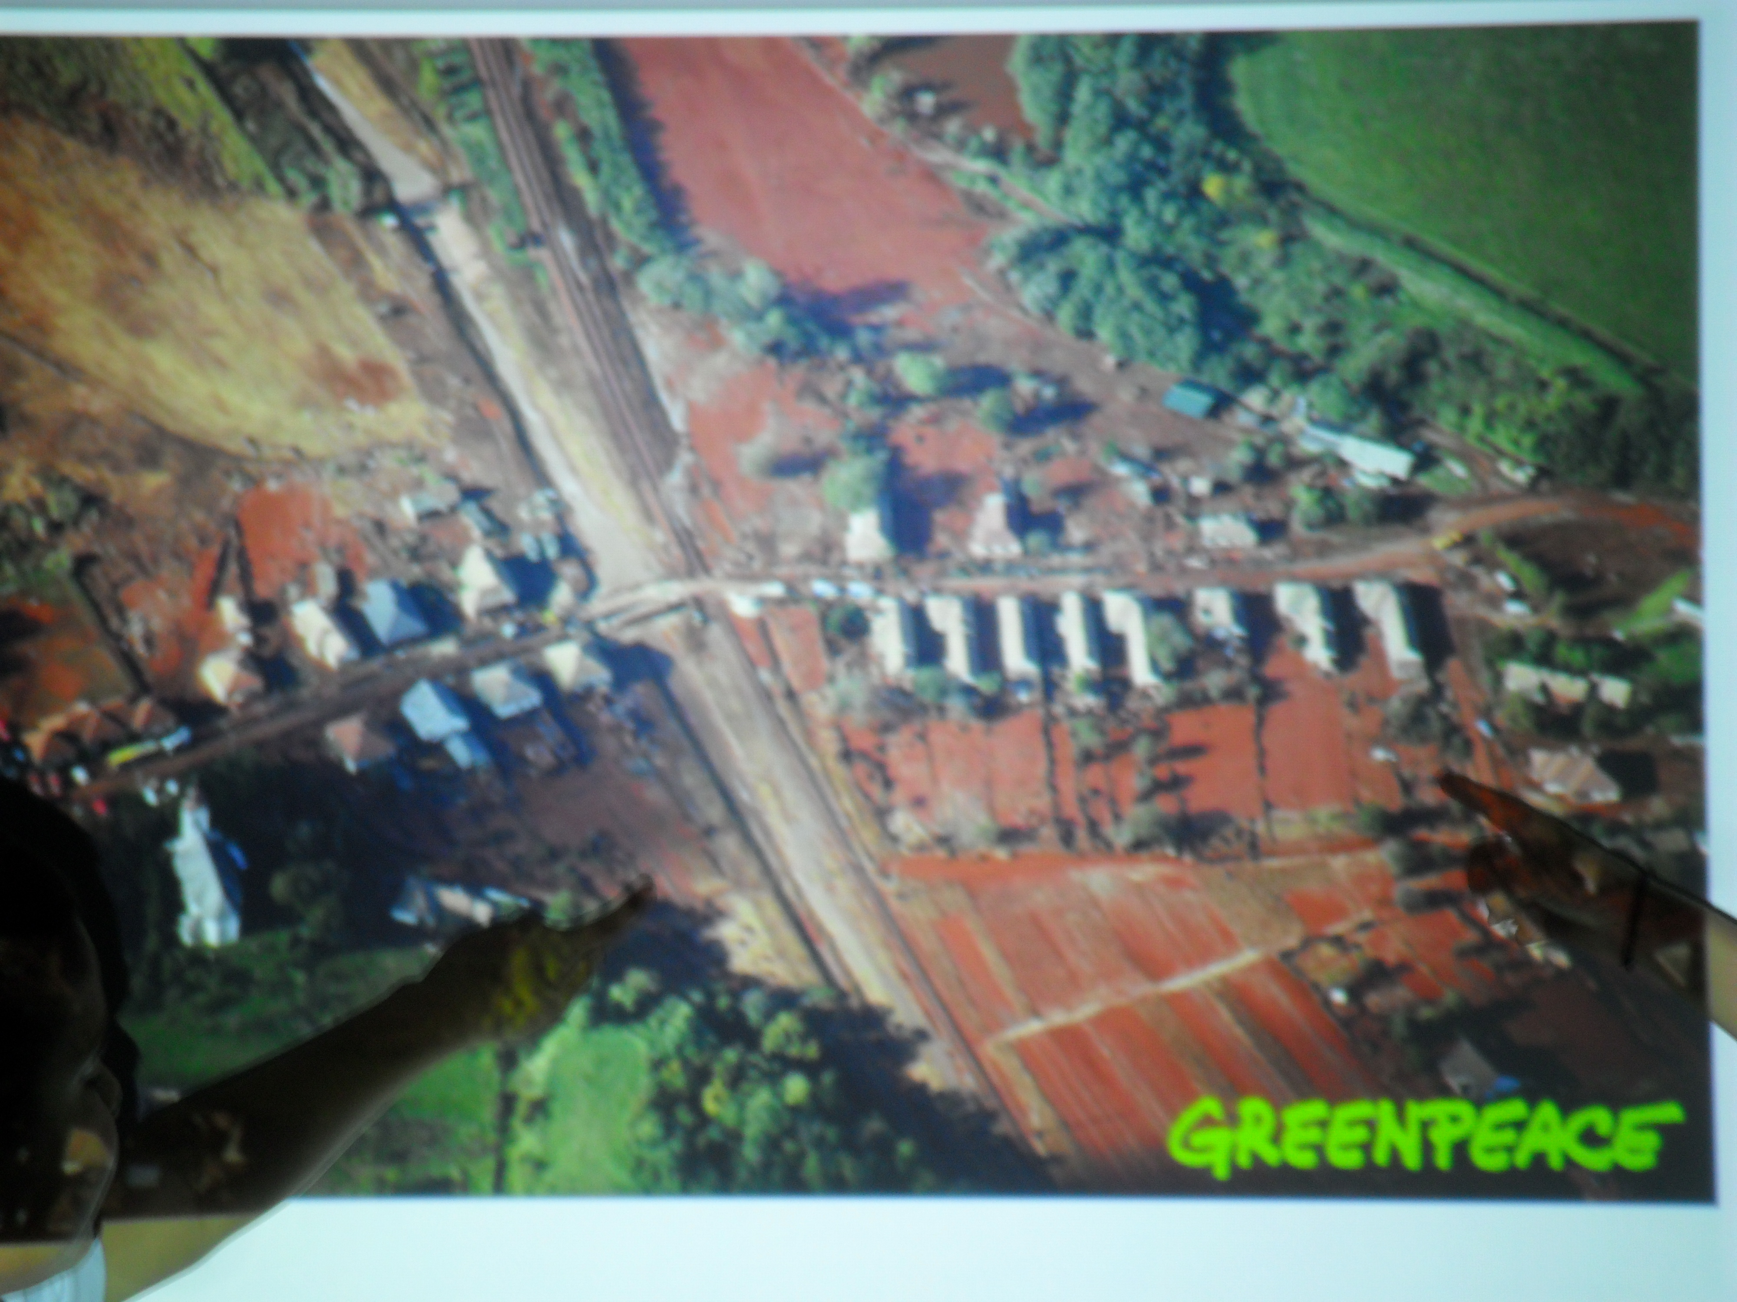
Hungary Toxic Sludge Reenactment

Slide 13
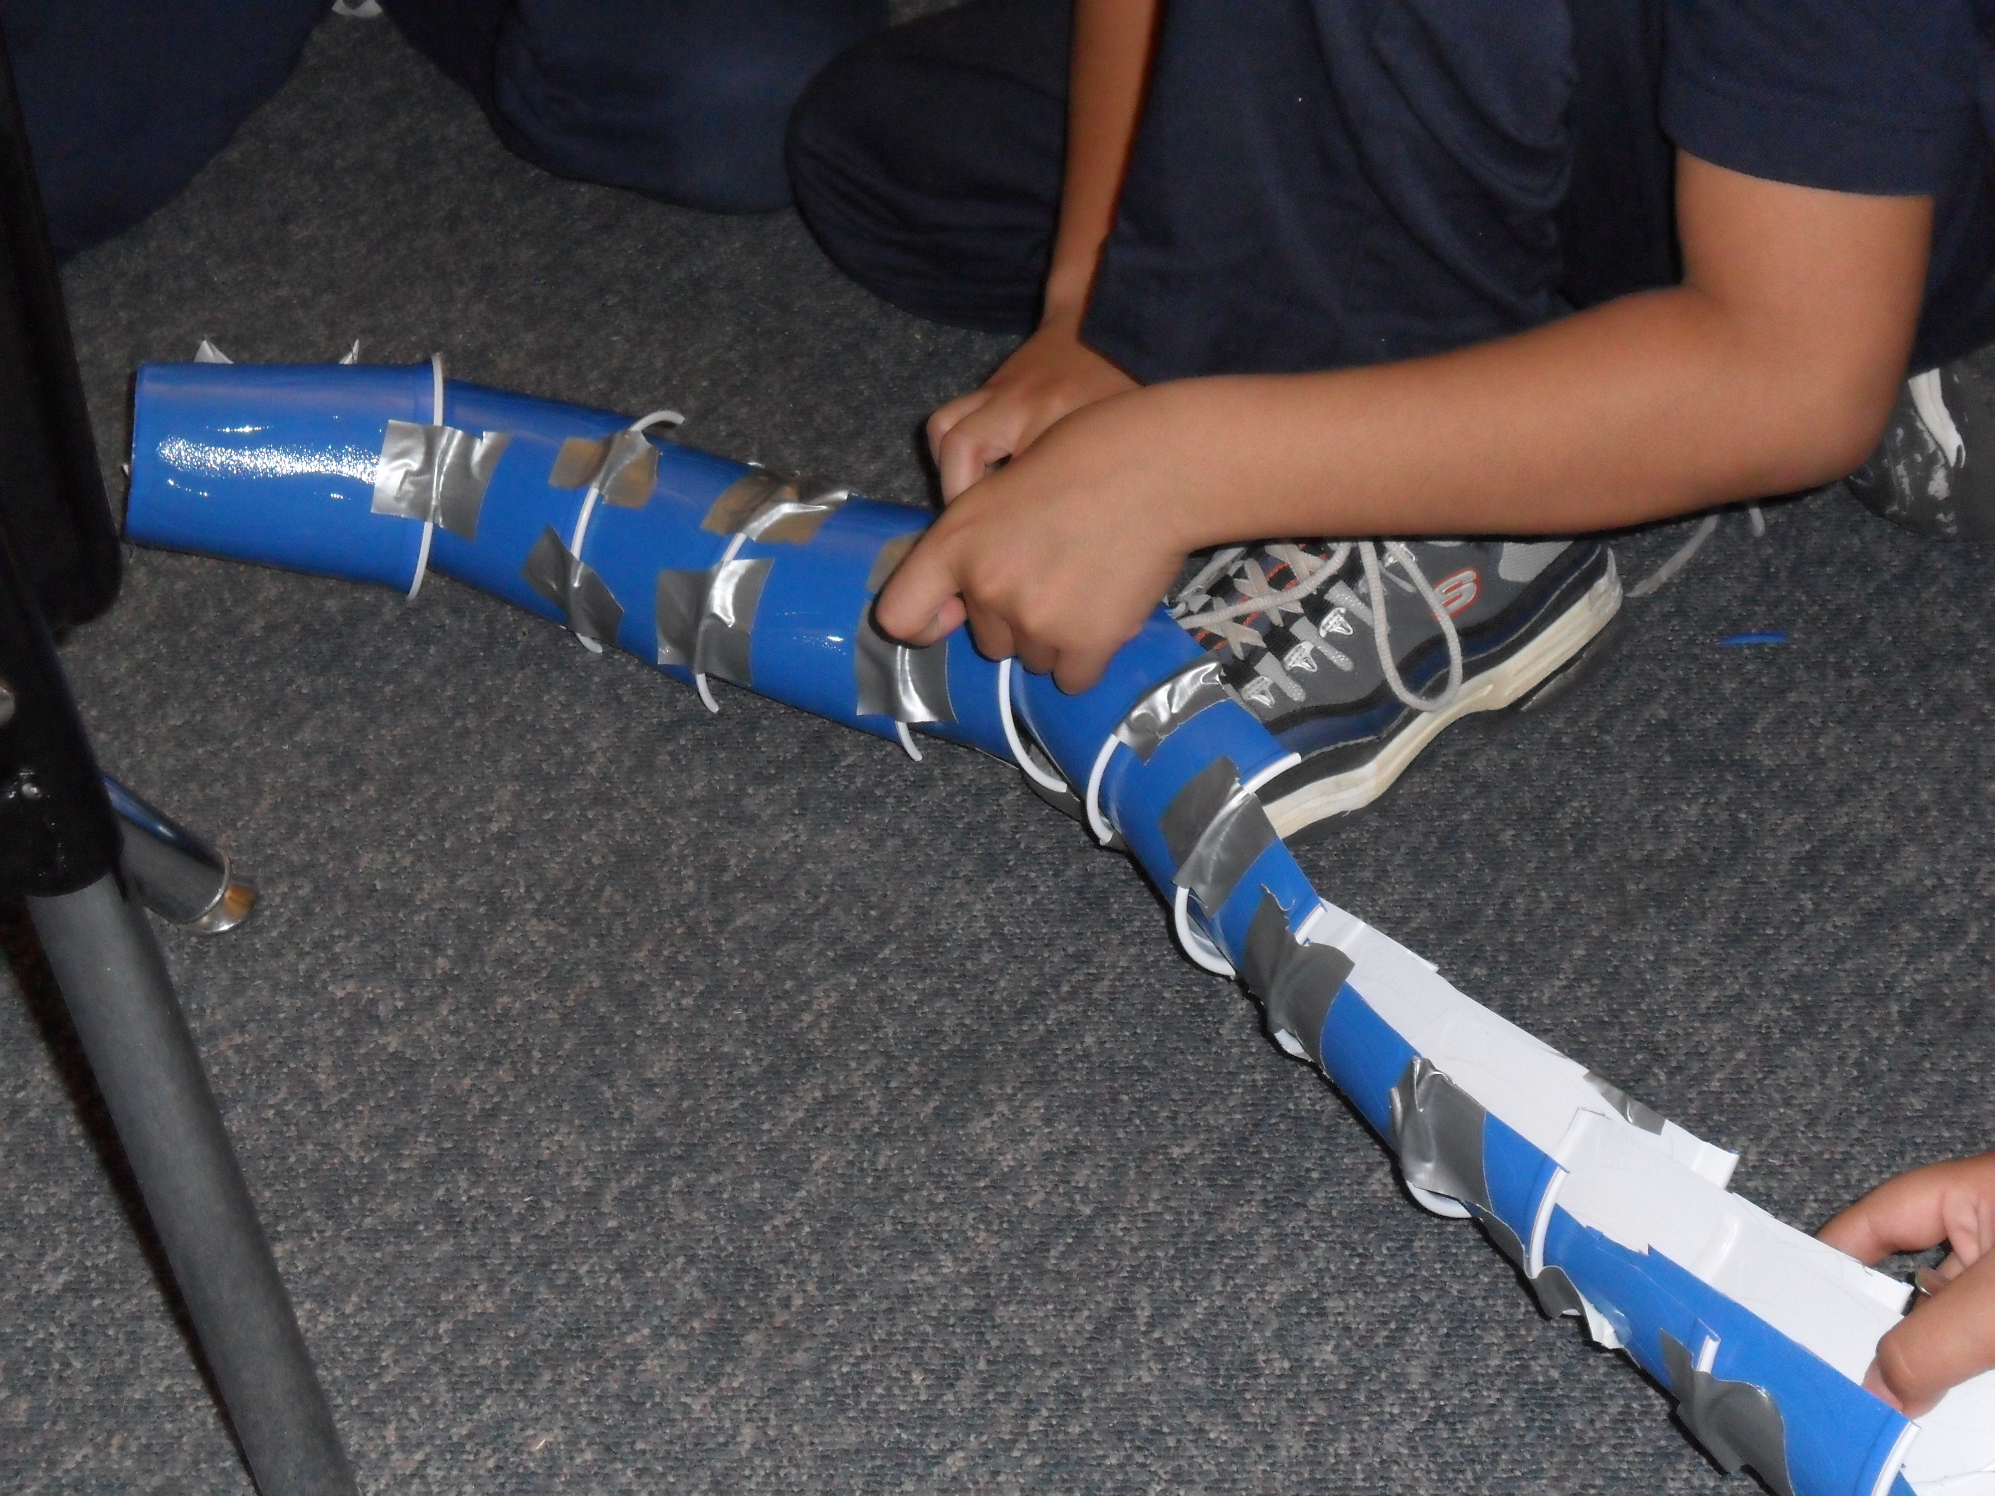
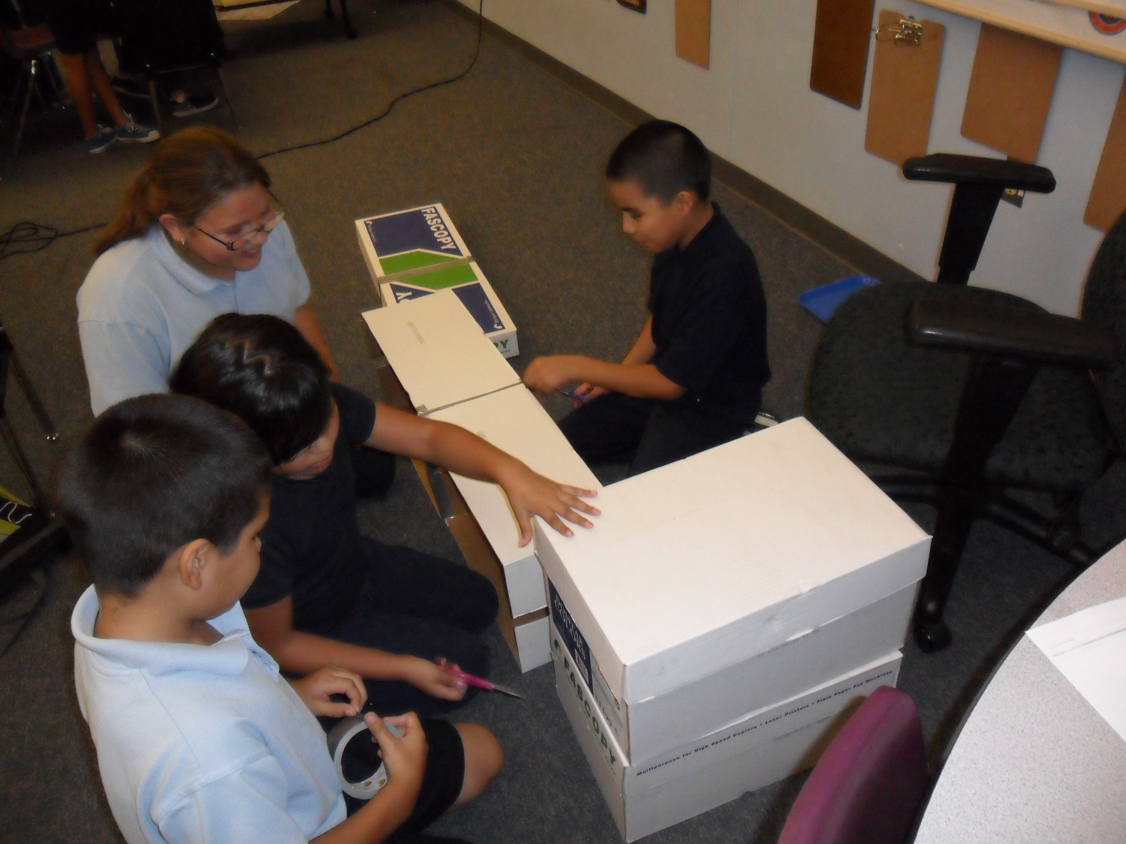
Hungary Toxic Sludge Reenactment

Slide 14
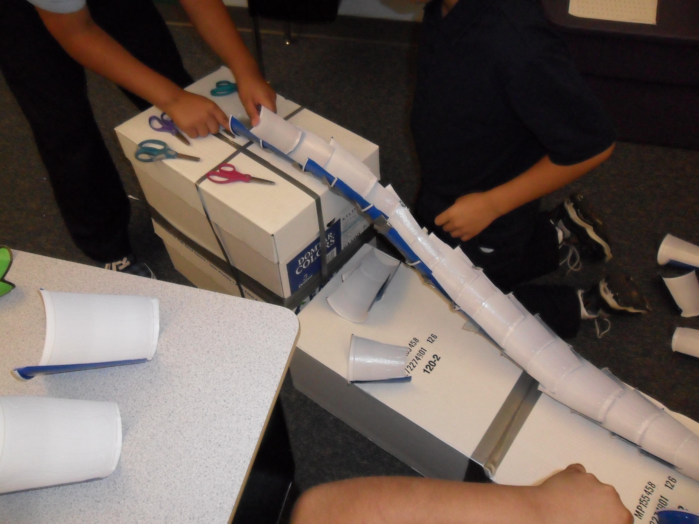
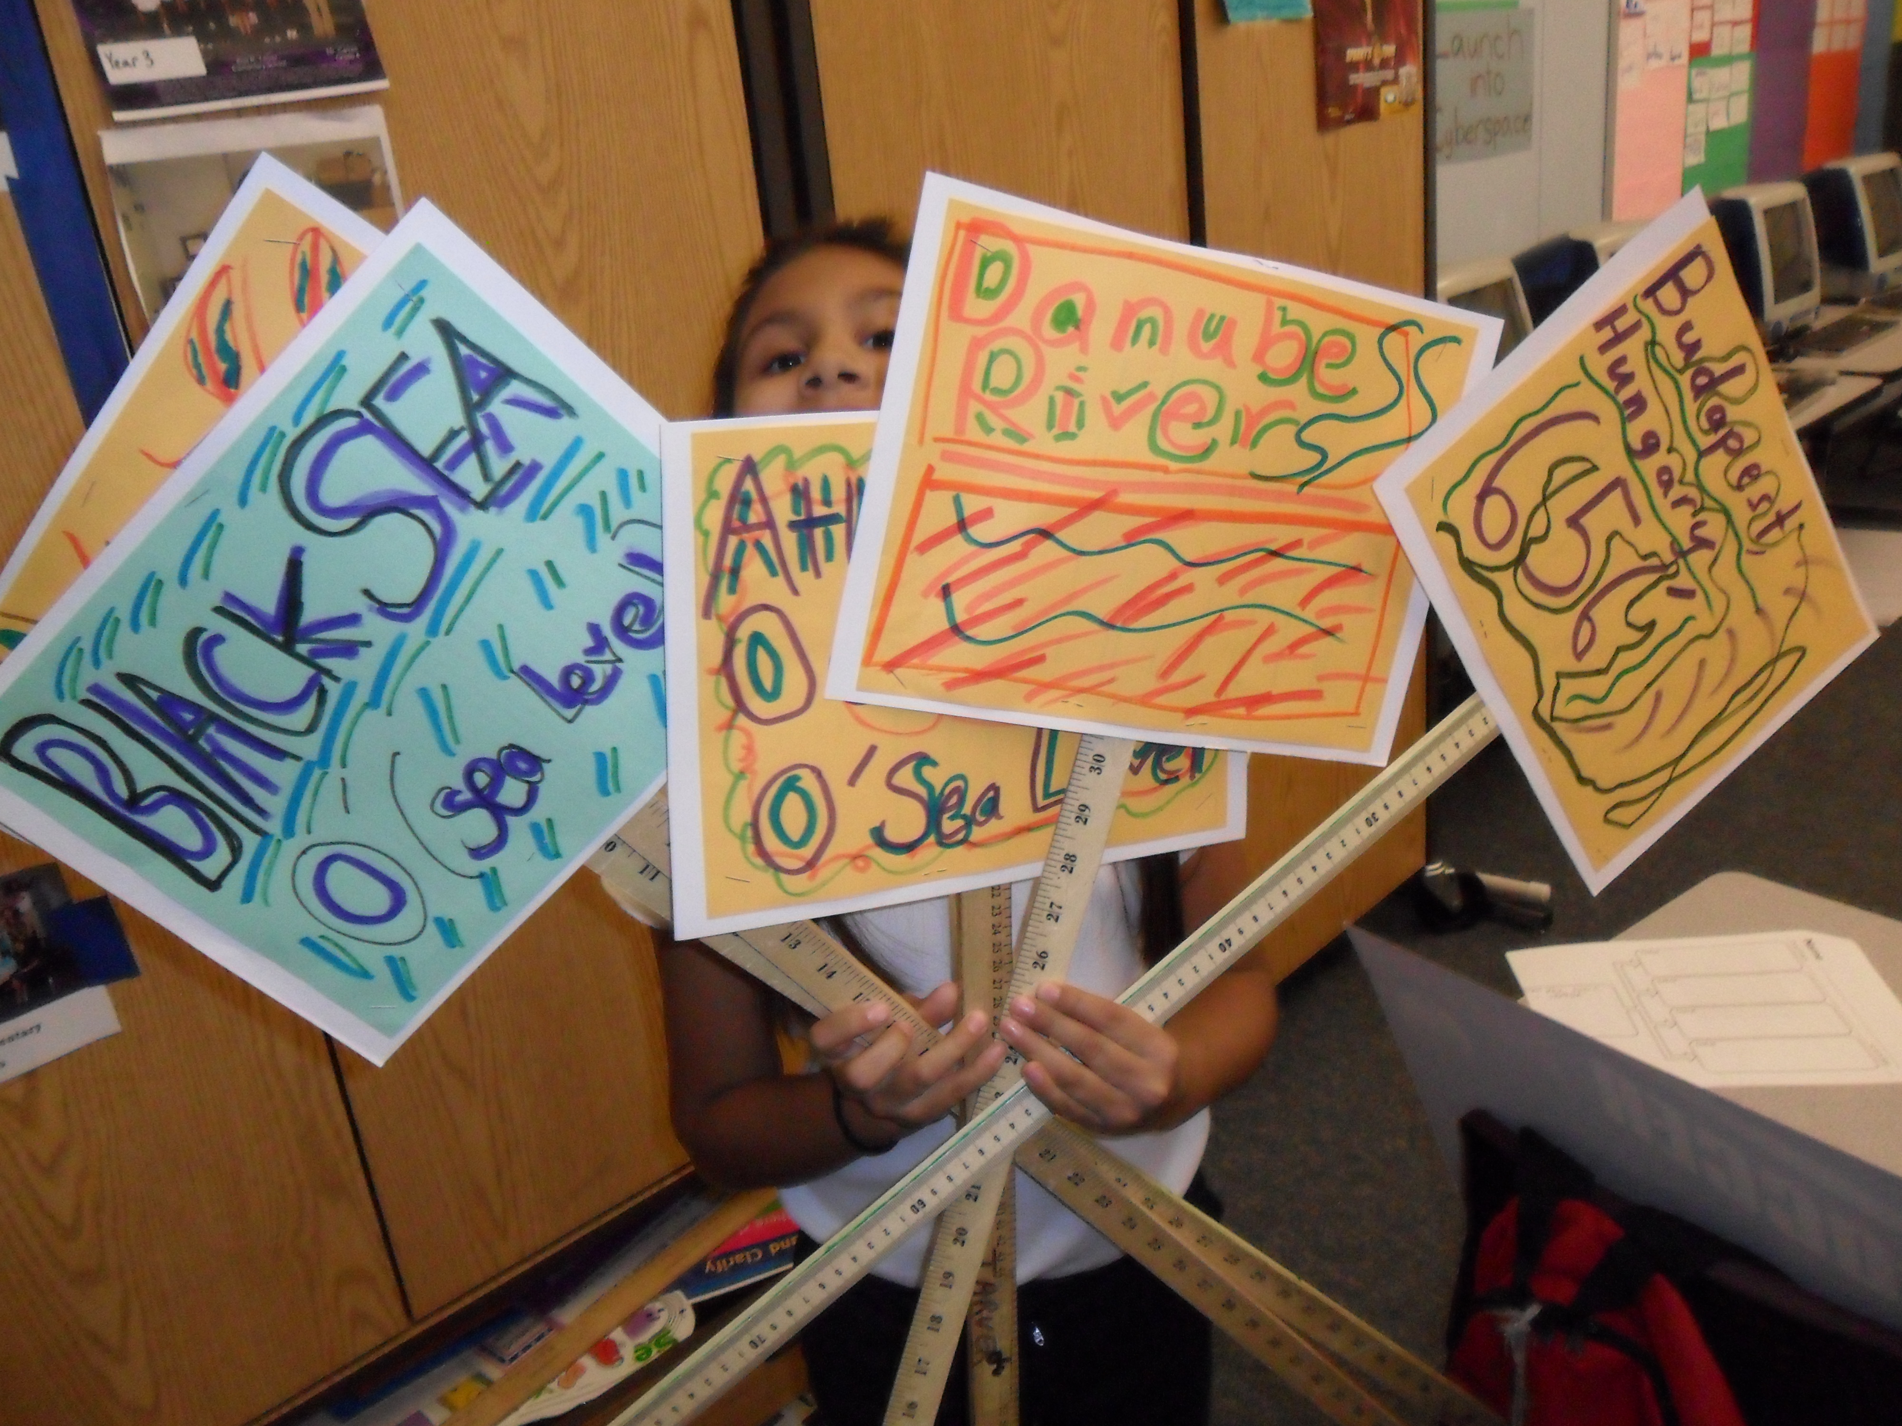
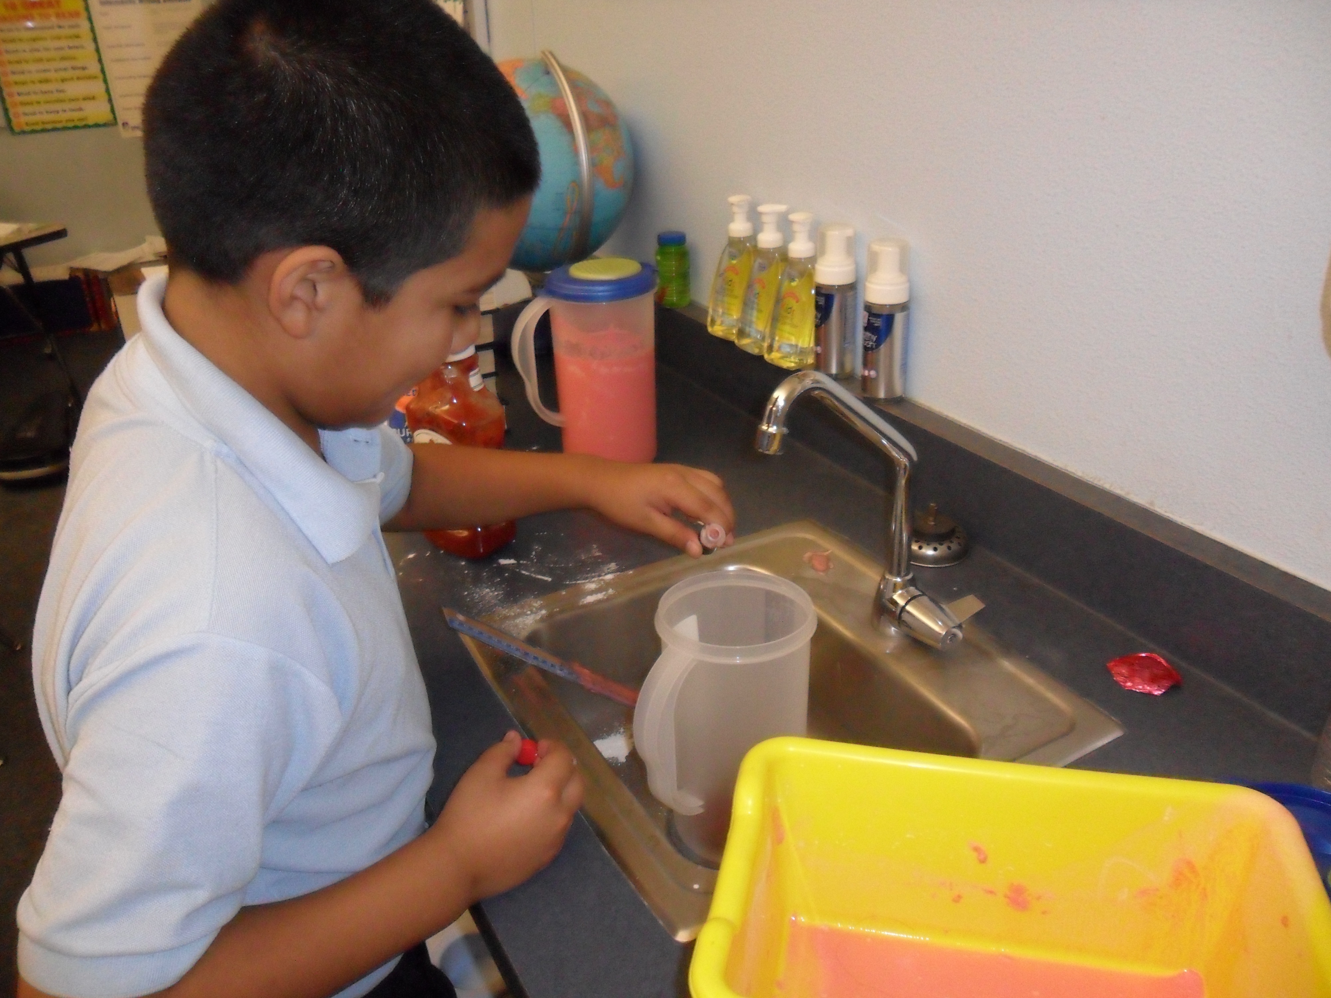
Hungary Toxic Sludge Reenactment

Slide 15
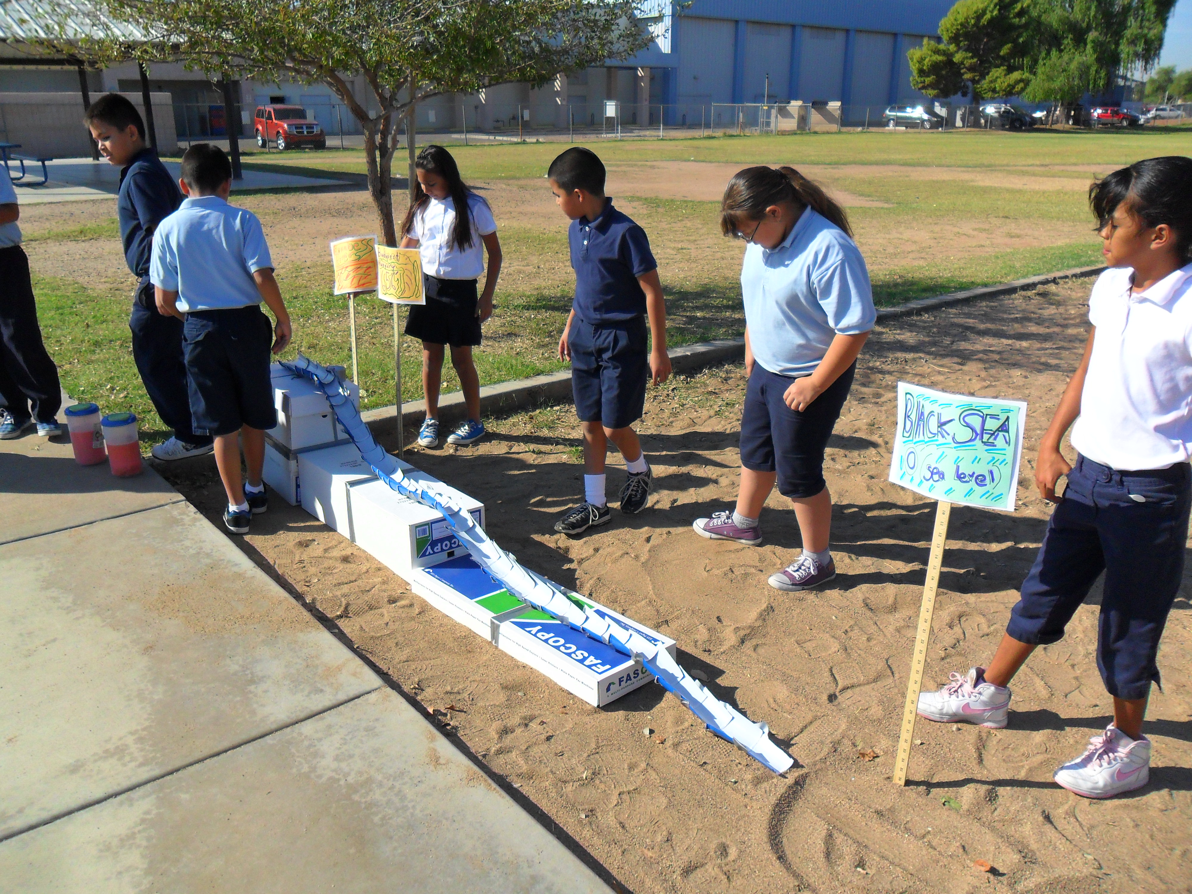
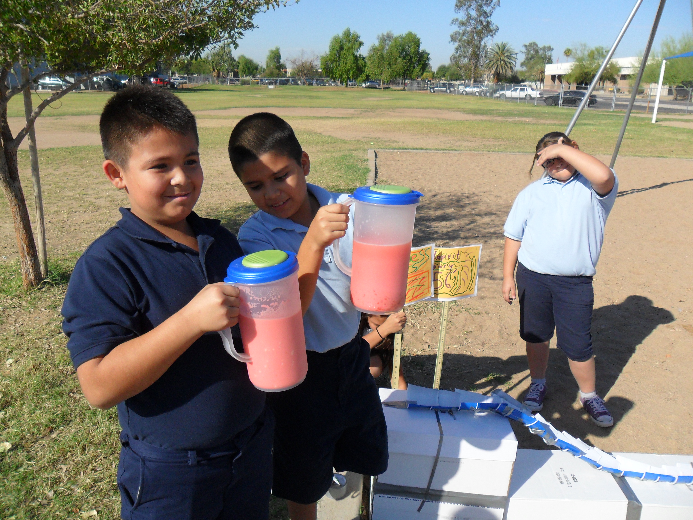
Hungary Toxic Sludge Reenactment

Slide 16
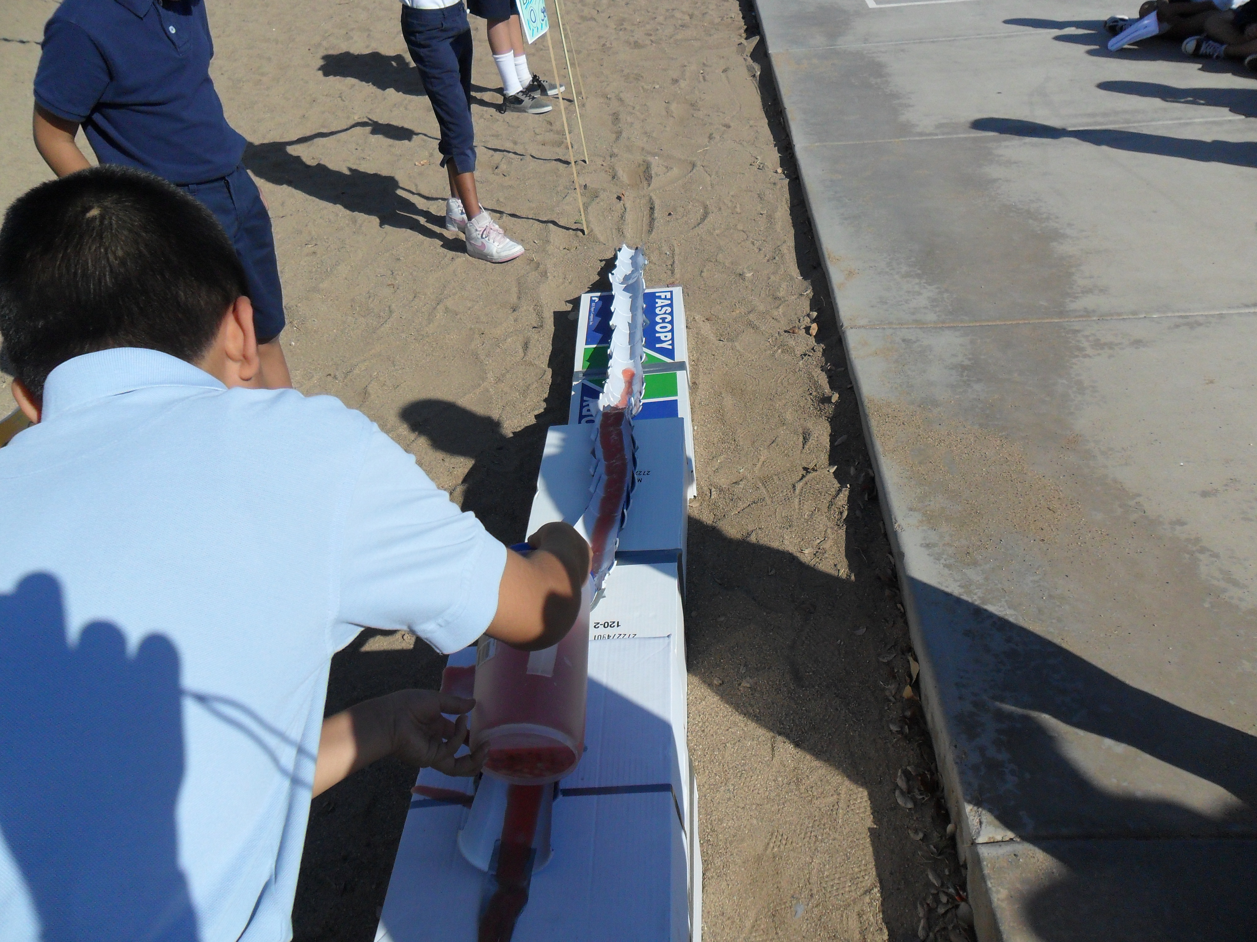
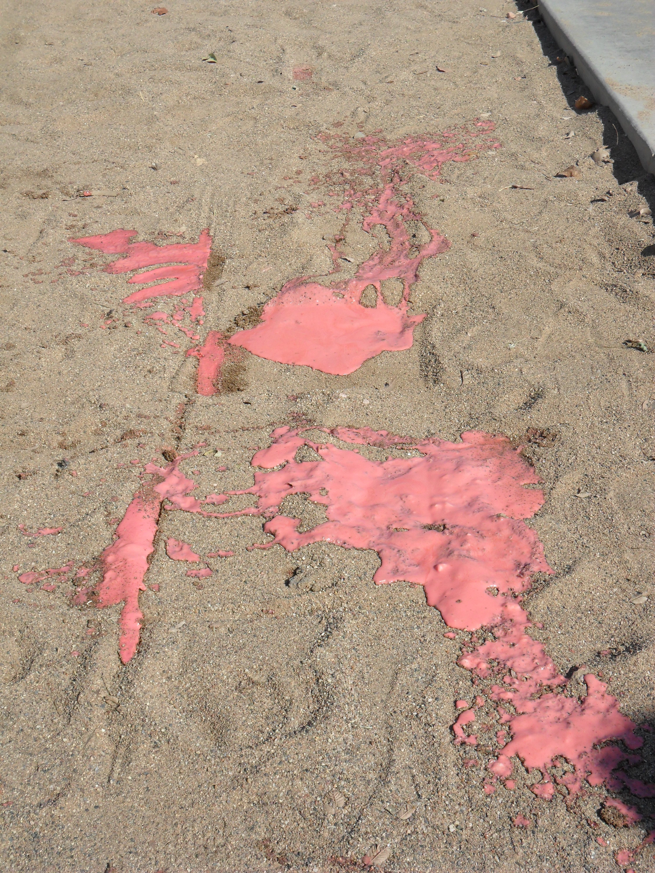
Hungary Toxic Sludge Reenactment

Slide 17
Hungary Toxic Sludge Reenactment
What the students learned…
Technology such as toxic waste reservoirs, can be both a benefit and a downfall to society.
A problem half a world away can affect their lives.
Every action has a positive or negative reaction.
Physics, Chemistry, Measurements, and Satellite Technology.

Slide 18
Campus Debris and the Ocean
The science of water and the effects debris can have on the oceans.
Impact debris can have on marine life and the food chain.
Compare and contrast debris found on campus and debris found on the California coast.

Slide 19
Campus Debris and the Ocean
Define what marine debris is and what it consists of.
Identify and explain different ways debris can get to the ocean and school campus.
Learn about the Pacific Garbage Patches.
Assign groups of three to be: 1 Recorder…2 Collectors.
Allow groups 15 or 20 minutes to collect campus debris.

Slide 20
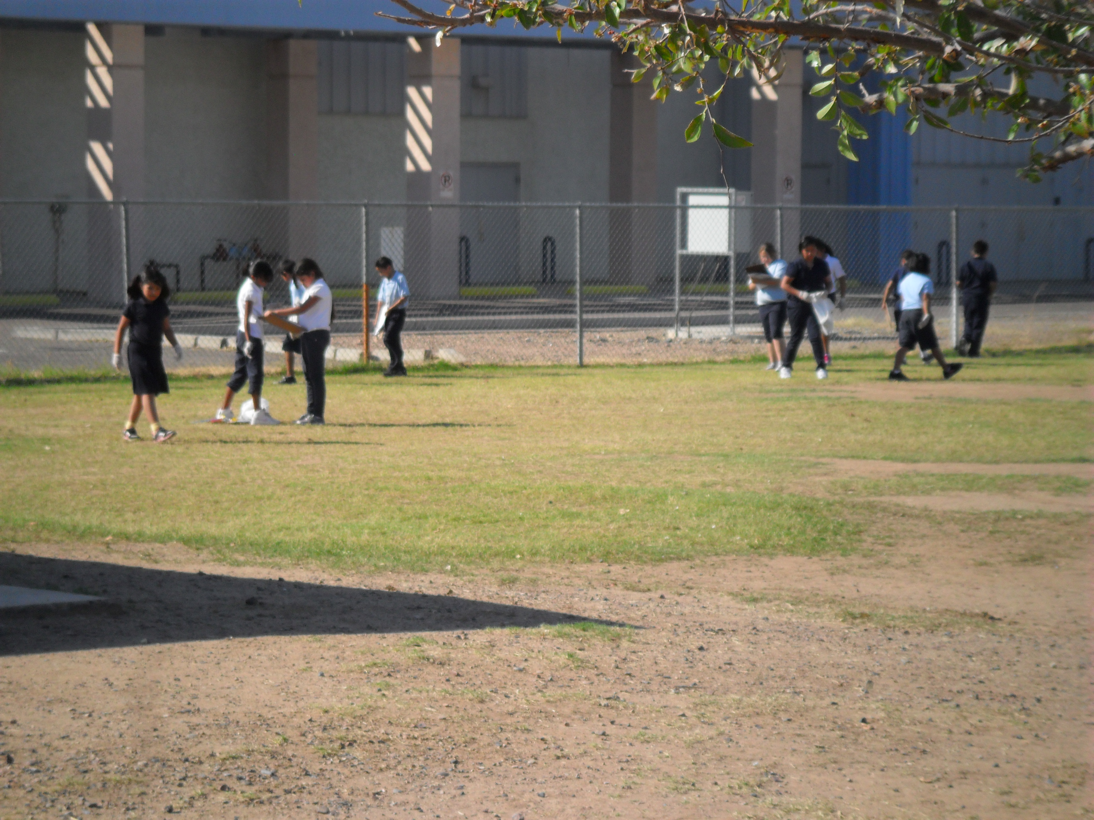
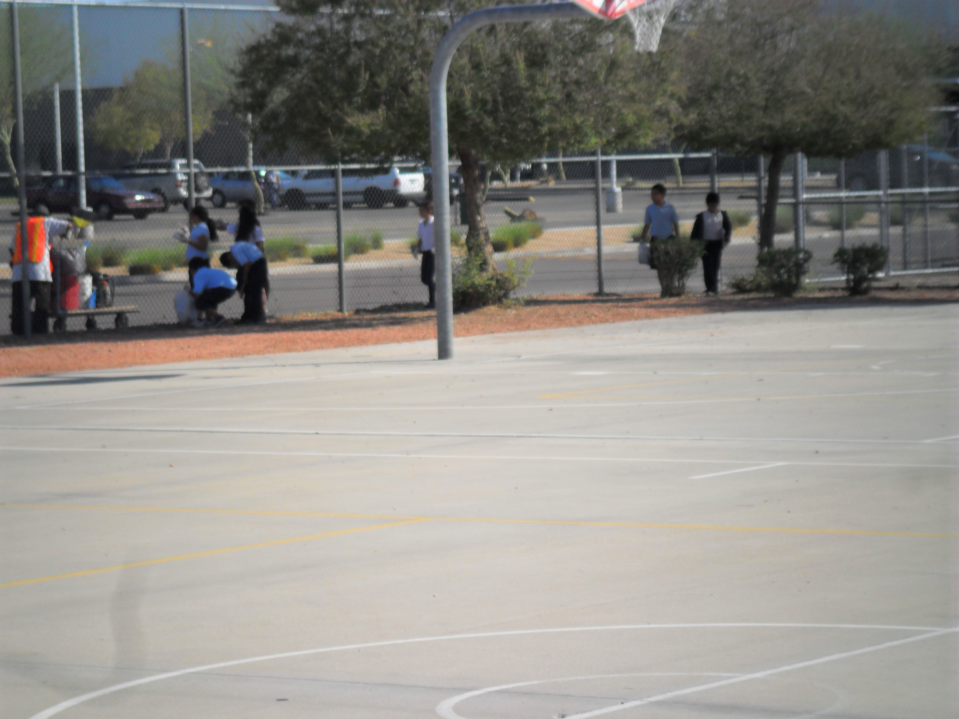
Campus Debris and the Ocean

Slide 21
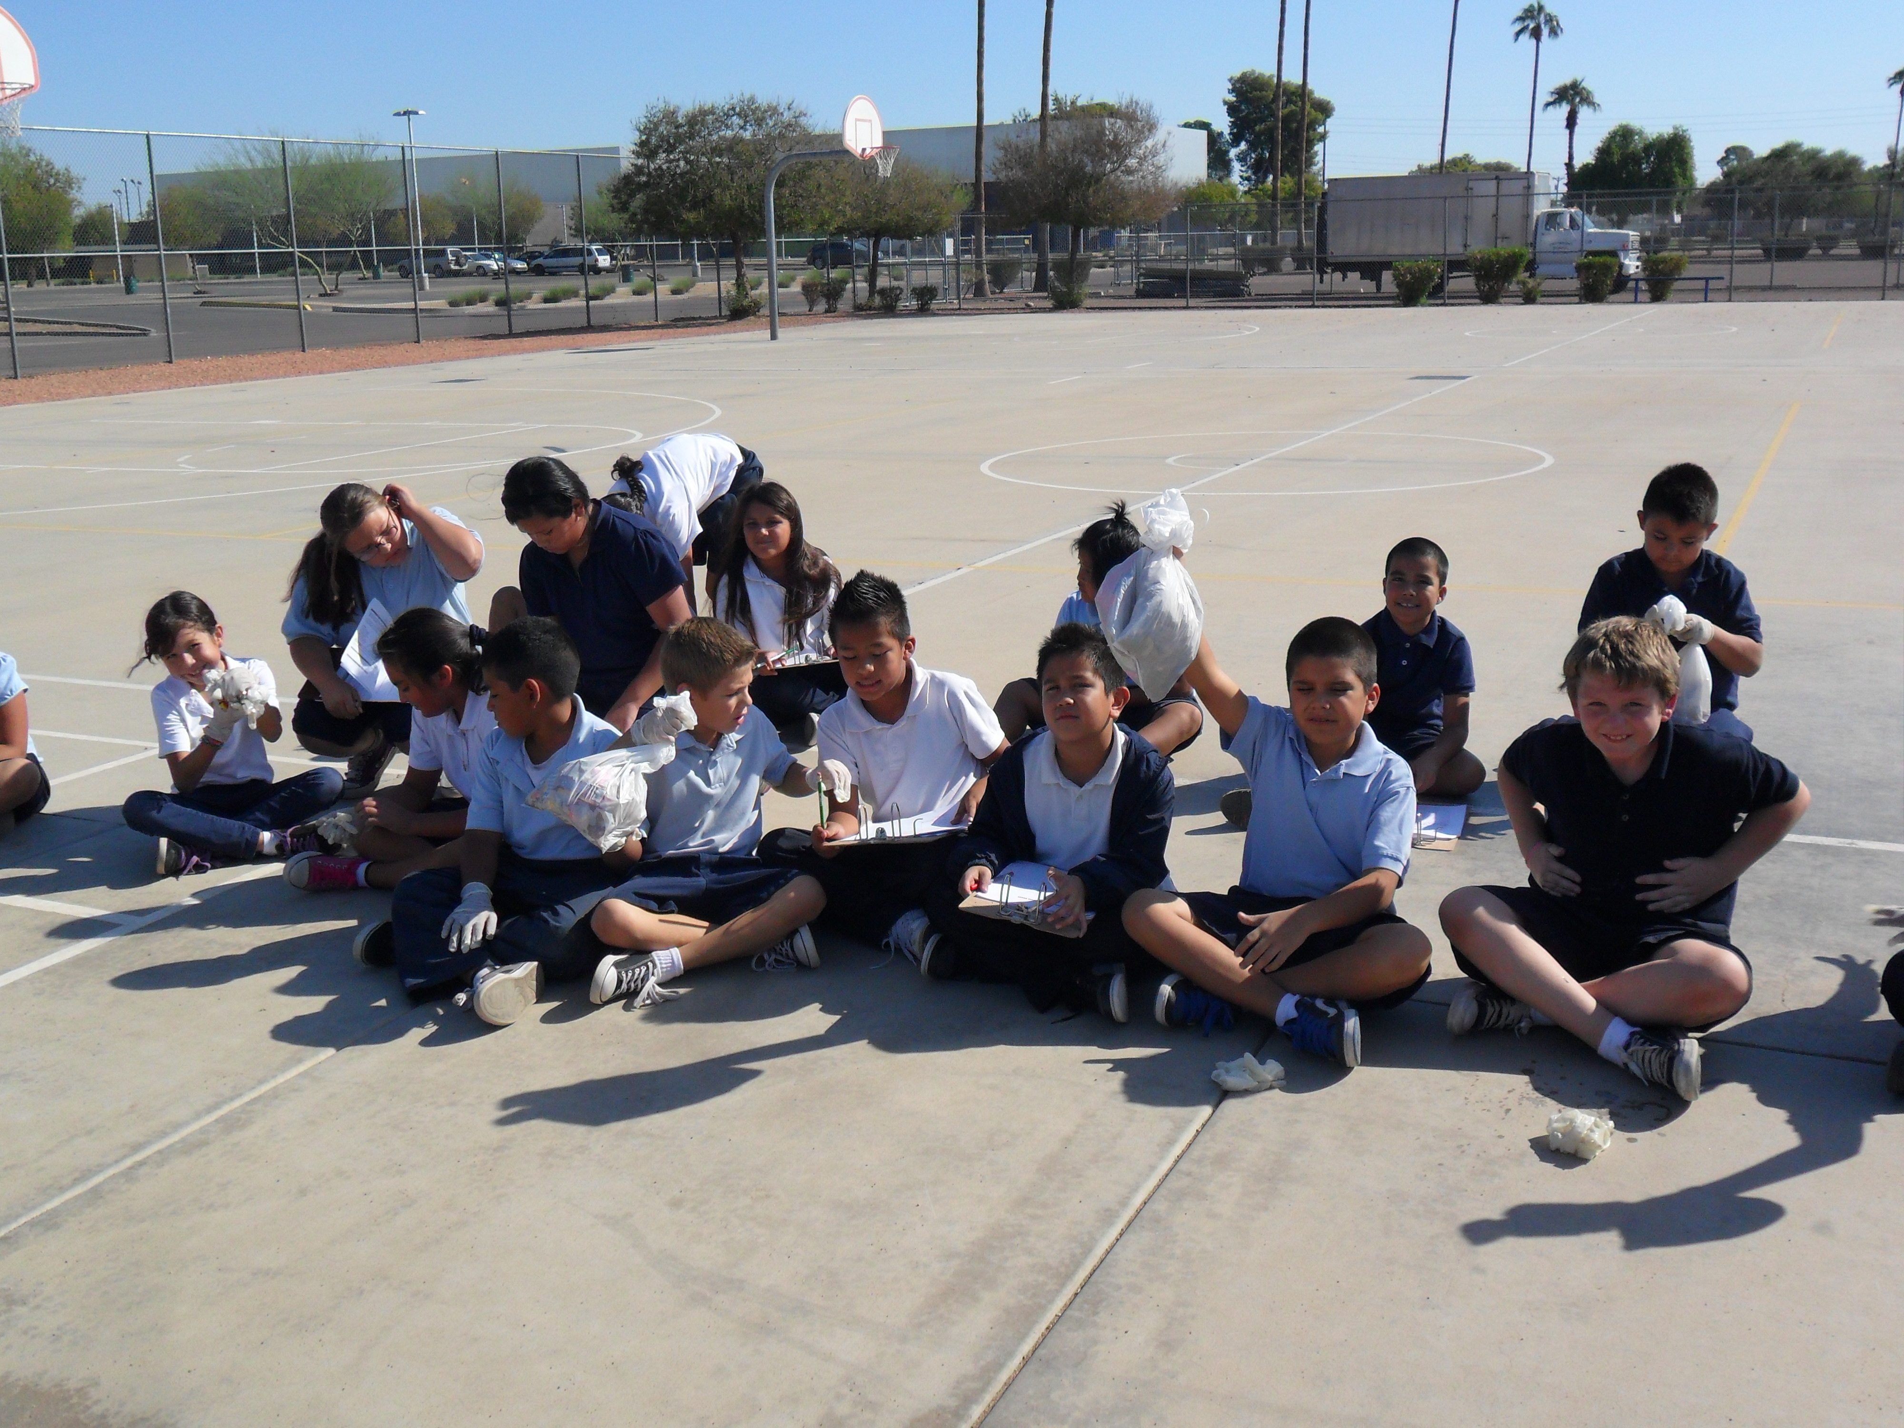
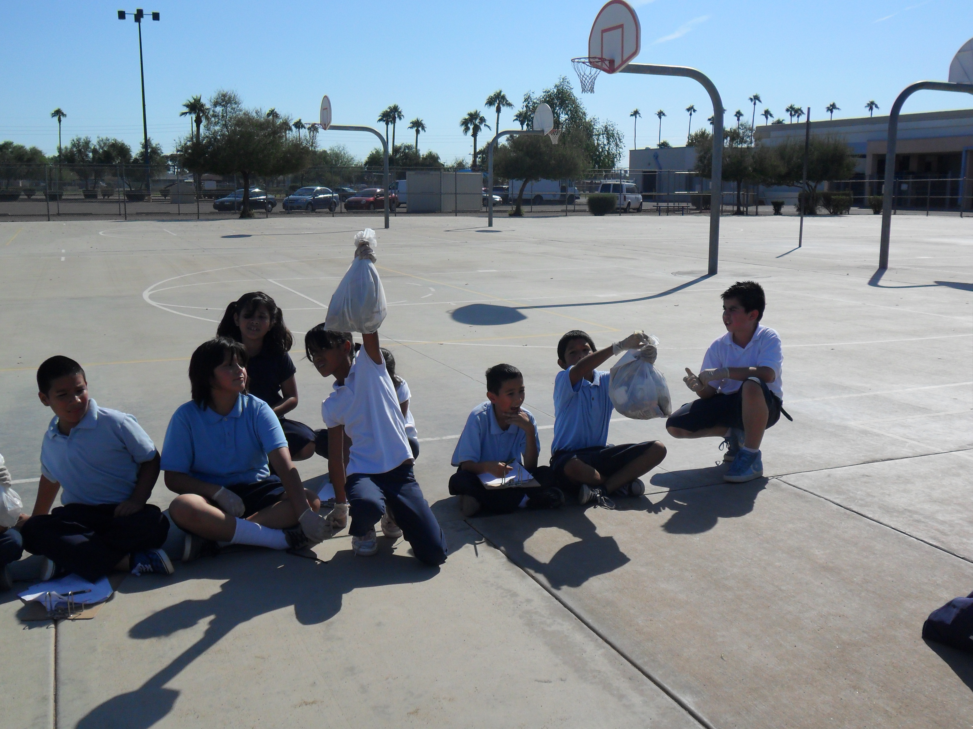
Campus Debris and the Ocean

Slide 22
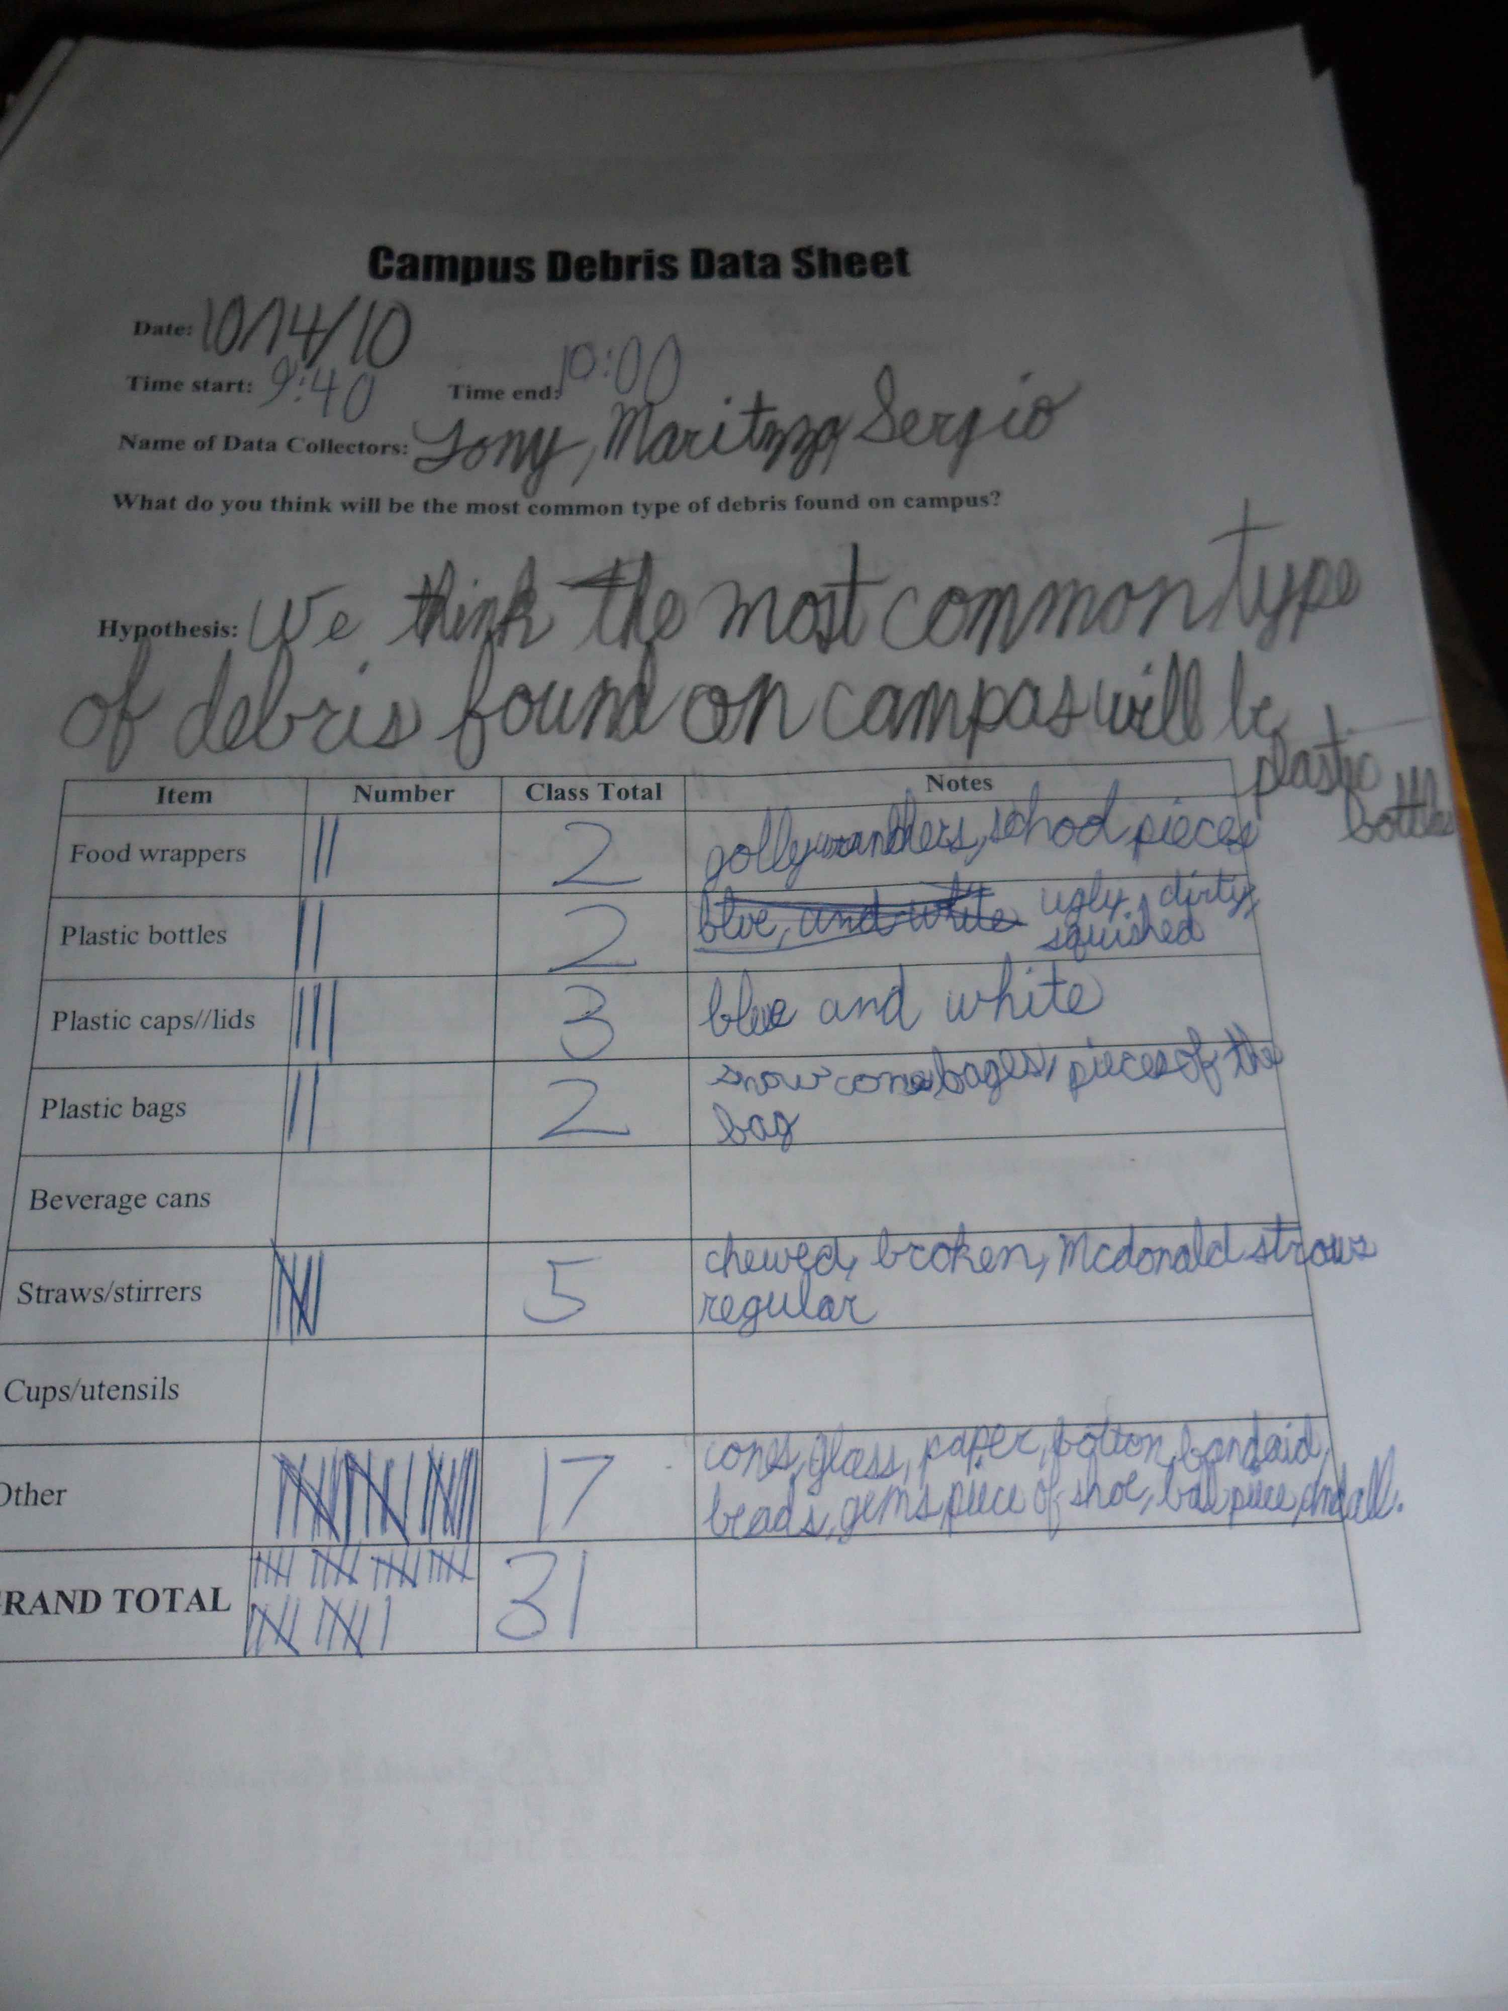
Campus Debris and the Ocean
Data Collections…

Slide 23
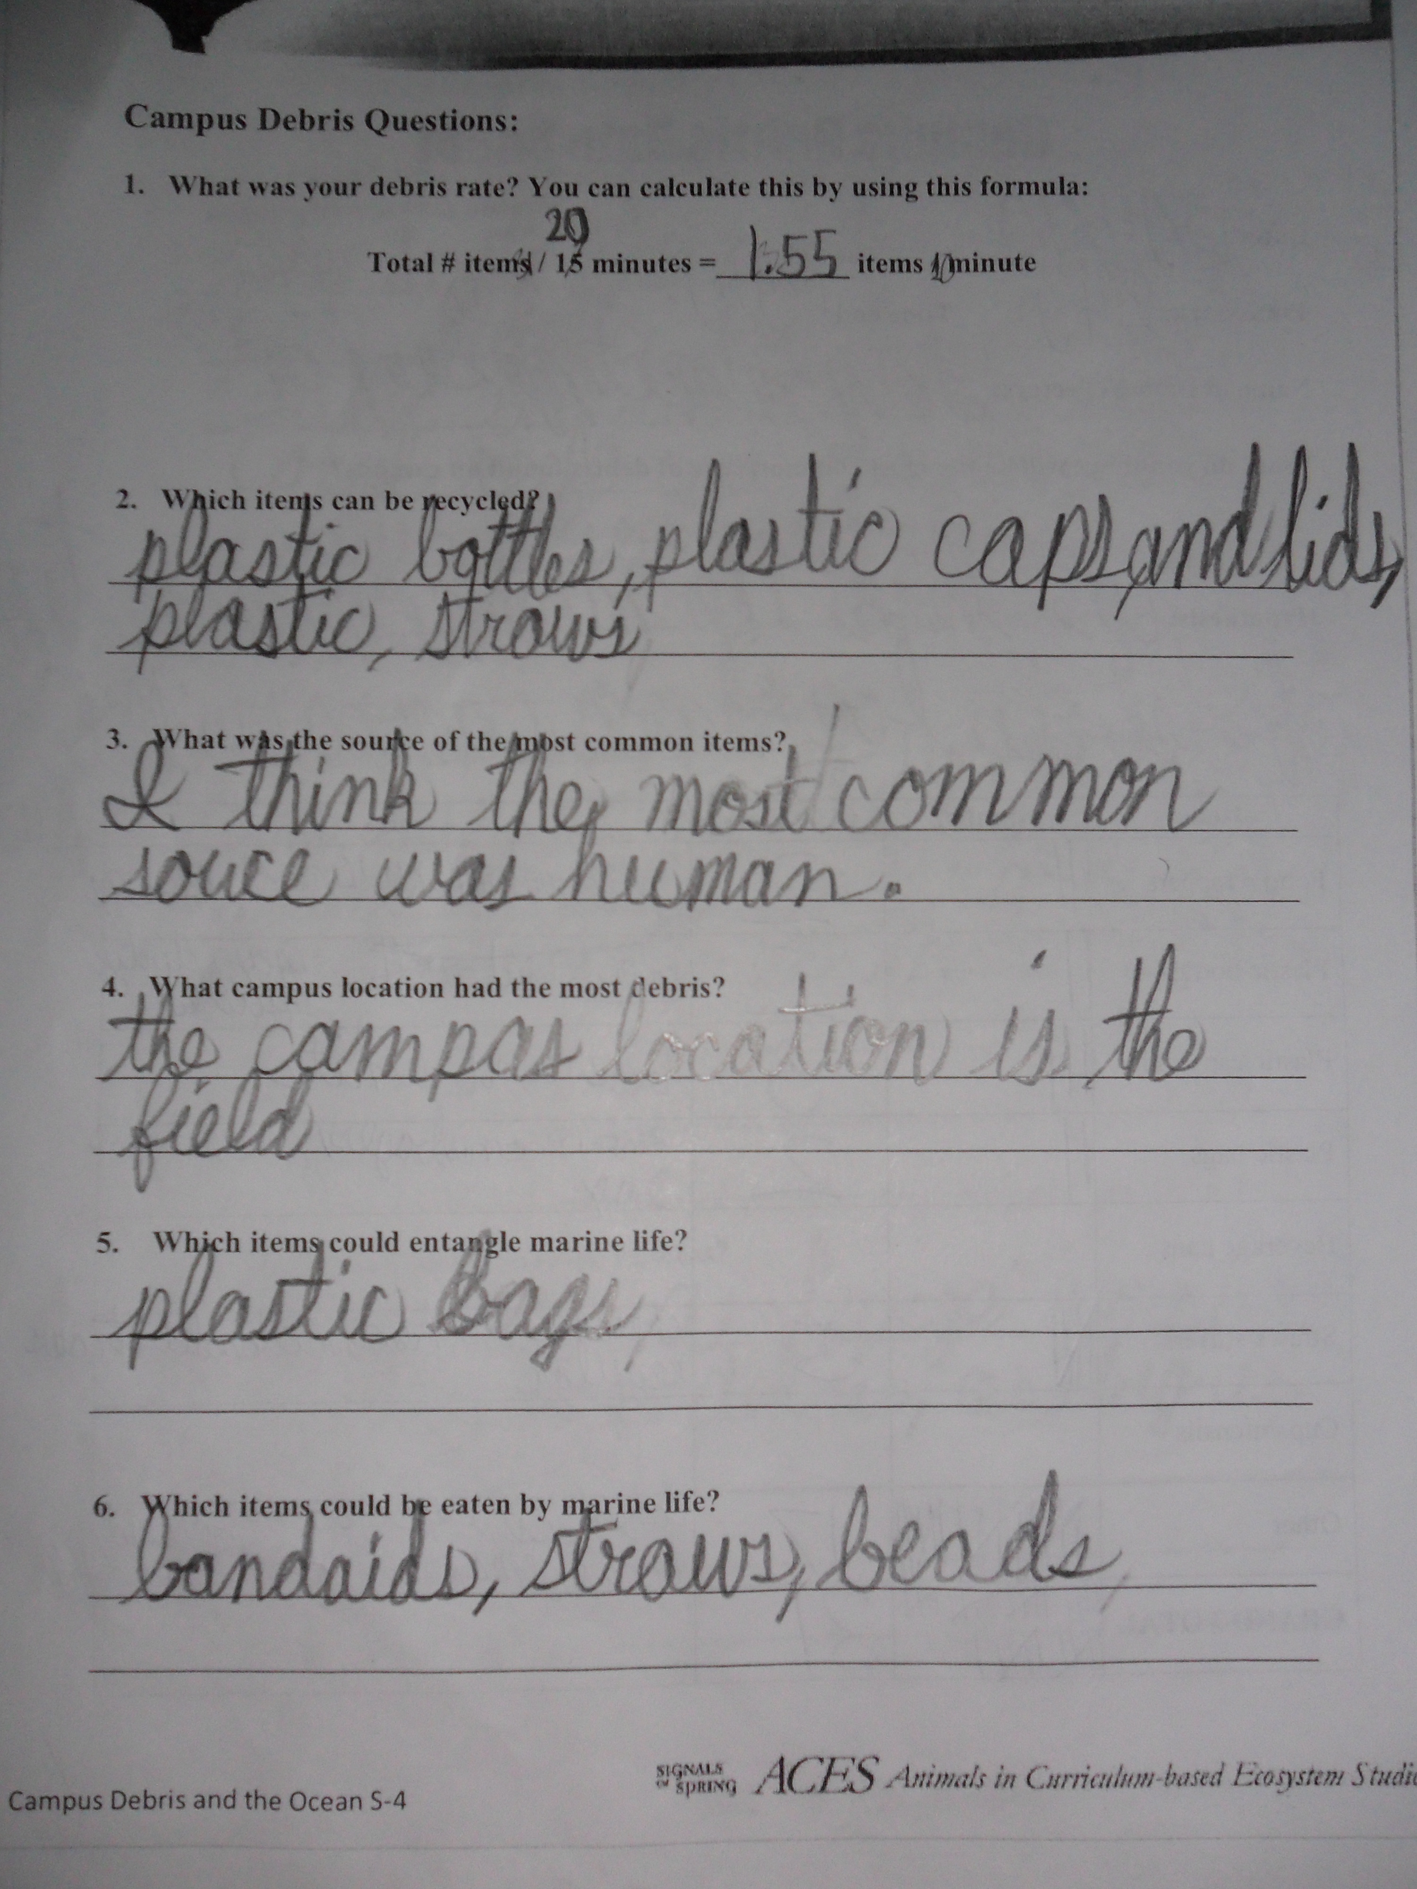
Campus Debris and the Ocean
Data Collections…

Slide 24
Campus Debris and the Ocean
What the students learned…
Debris in the ocean or on their school campus can affect all types of life.
Technology such as plastic bottles, containers, etc. and be a benefit and a downfall.
From afar a school campus can look clean, but after 20 minutes of debris collection, it is dirtier than they thought.

Slide 25
Campus Debris and the Ocean
STEM areas learned…
The biology in the ocean can be diminished by debris.
Satellites can help locate the Pacific Garbage Patch.
The engineering of everyday items can harm the planet.
Data collection and analysis can illustrate problems.

Slide 26
With help from the Endeavor Fellowship
I have gained new tools to assist my teaching in the classroom.
Found ways to step away from Pencil/Paper and Drill technique teaching.
Made my students aware of the world around them.
Excited my students about ALL subjects by integrating STEM into everyday learning.
Planted seeds to help them become life long learners.

