Slide 1
Building Effective Teams in Earth Science Labs by Mr. Barone

Slide 2
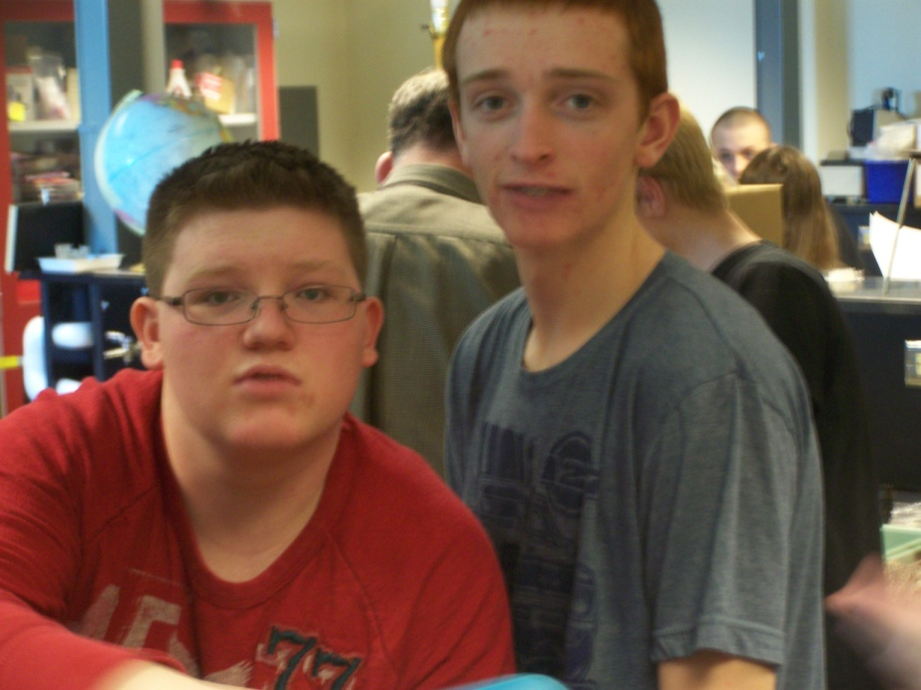
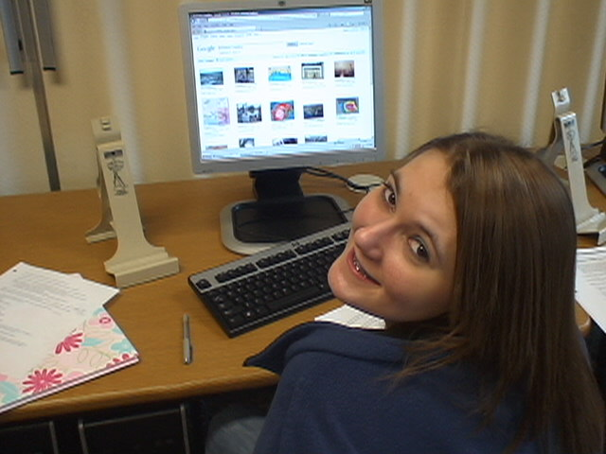
Alternate Earth Science Labs
Monday and Wednesday
Tuesday and Thursday

Slide 3
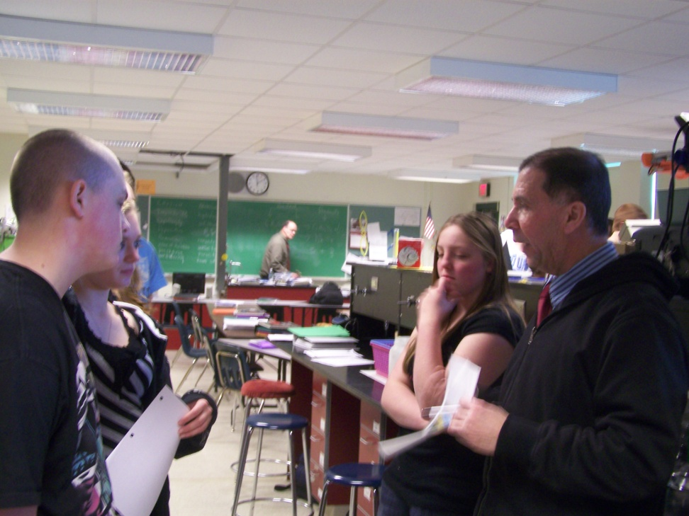
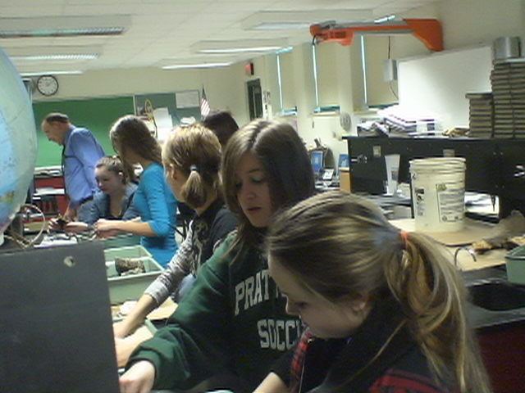
Student Lesson: “Making Seacoast Ecosystem Models” Team collaborations will be used to investigate the following topics: Shoreline Erosion, Shore Locations, Topography, Analysis of Rocks and Soil, Waves, and Currents.

Slide 4
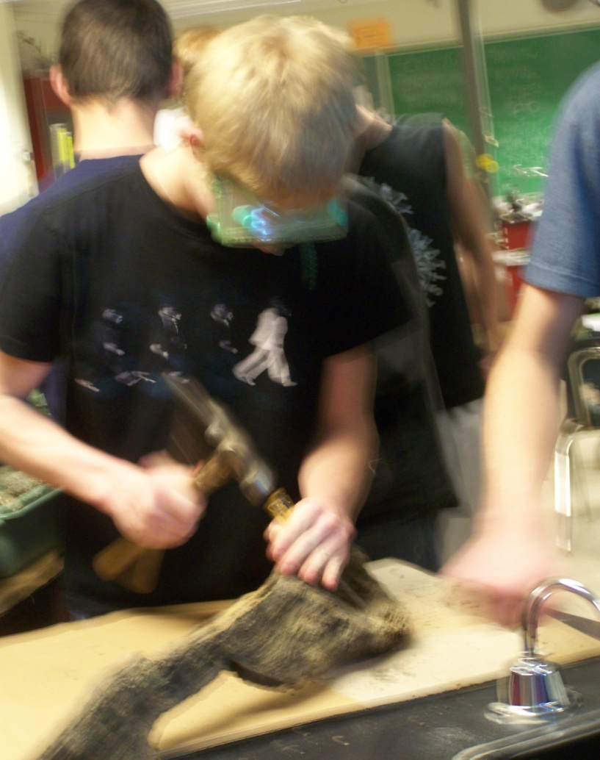
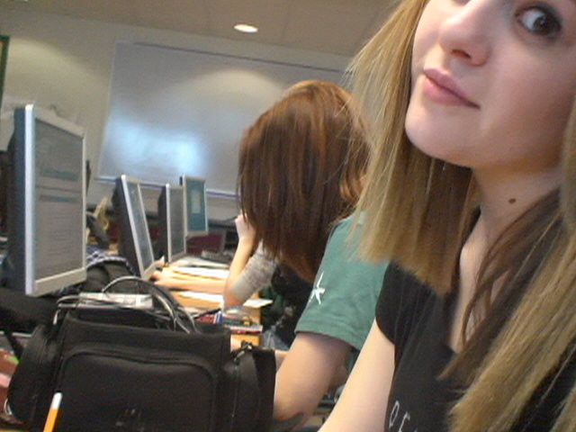
How much is each team willing to contribute to a scientific investigation?

Slide 5
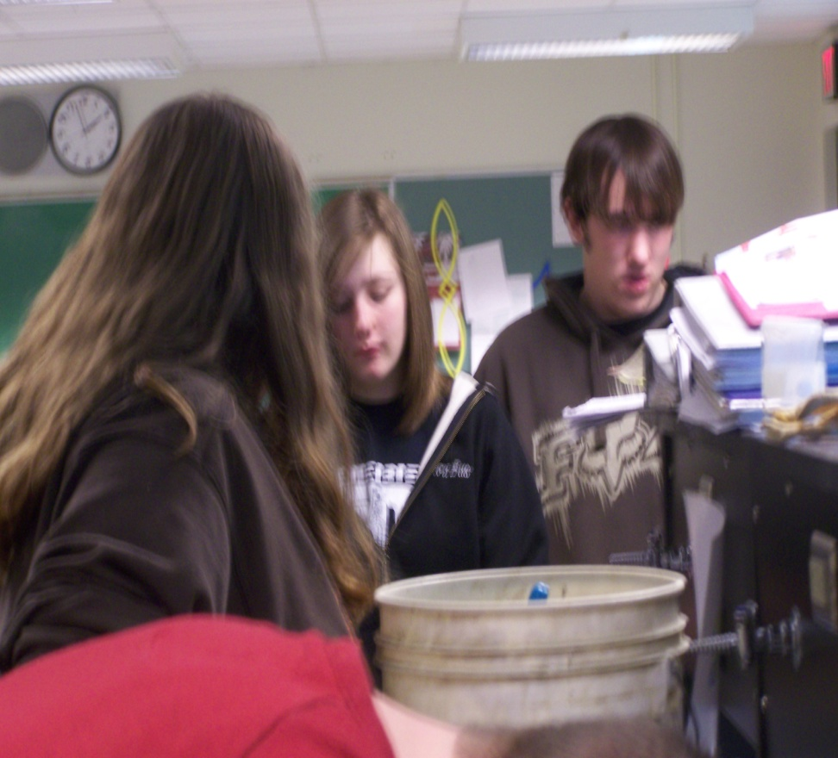
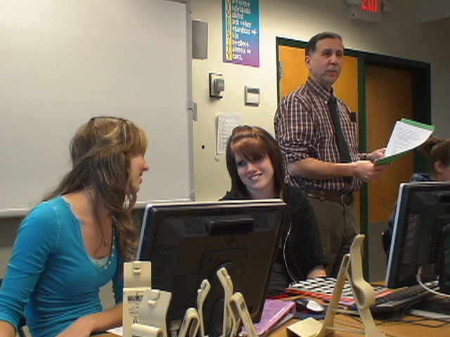
Will the team members remember to share information with each other?

Slide 6
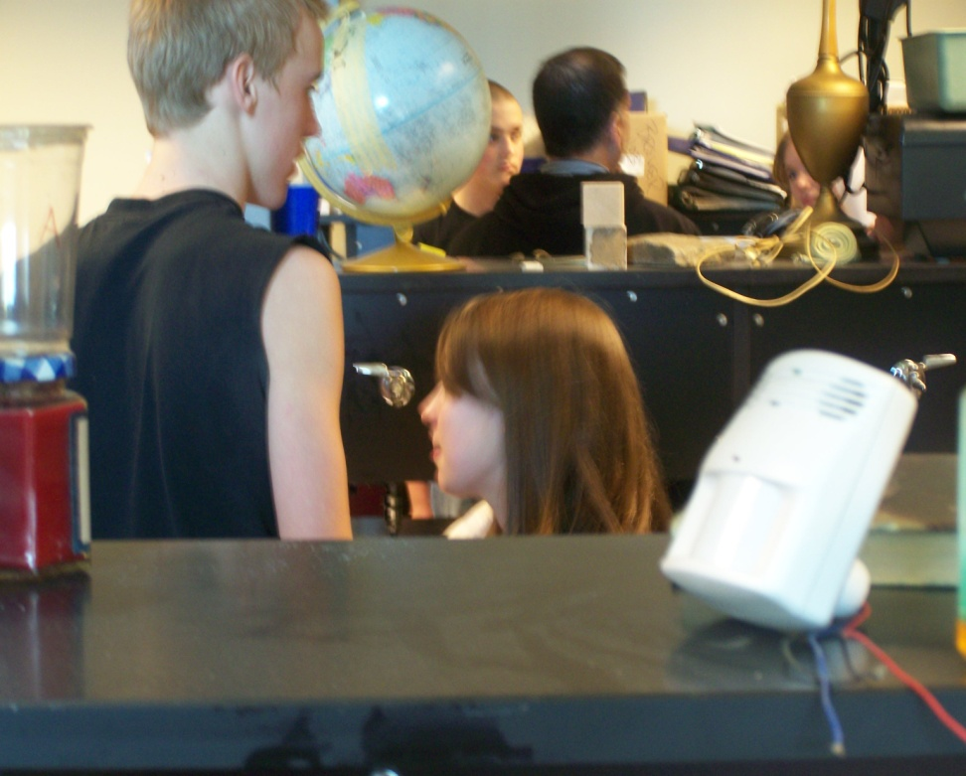
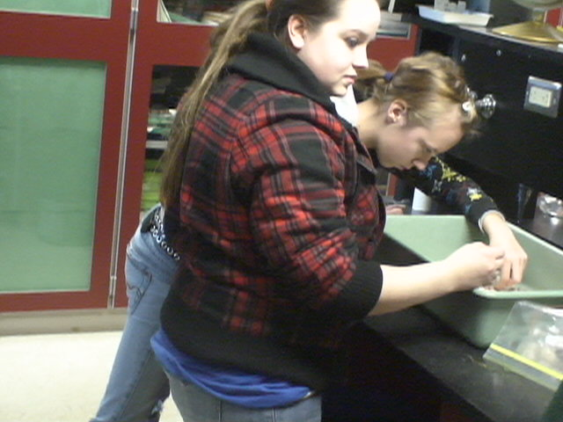
Does each student understand the scientific method of observation? Each person in the team has a specific role. What is it?

Slide 7
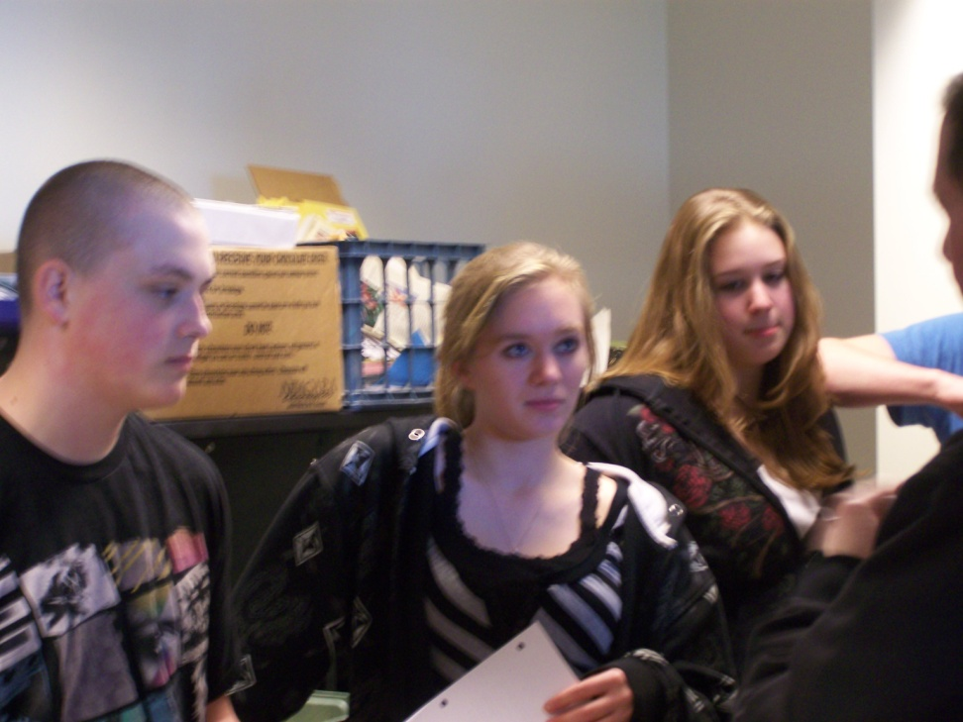
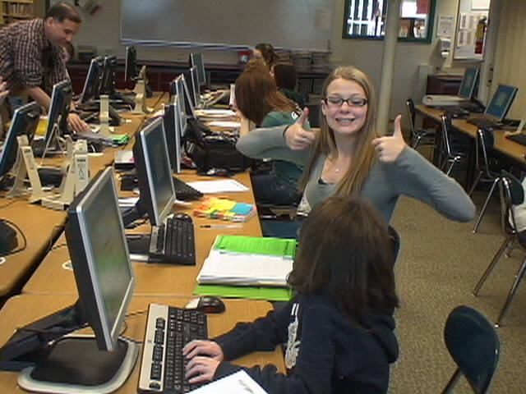
How well does each science team member listen to others?

Slide 8
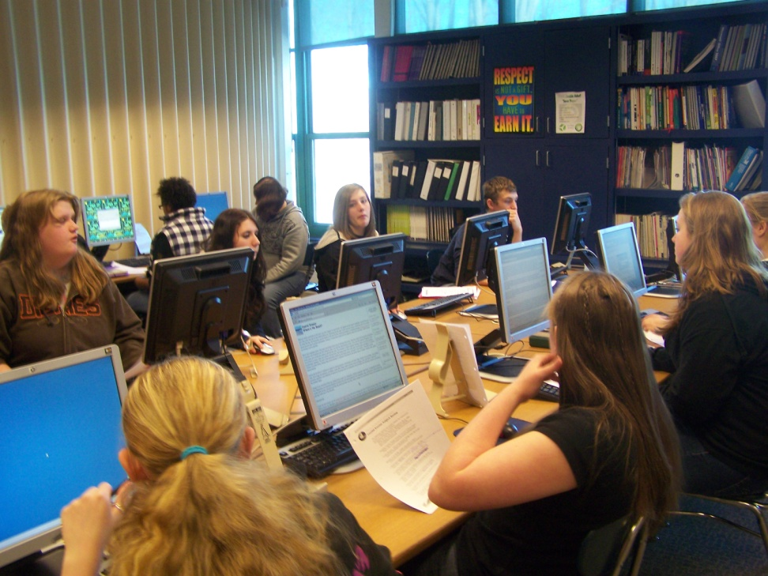
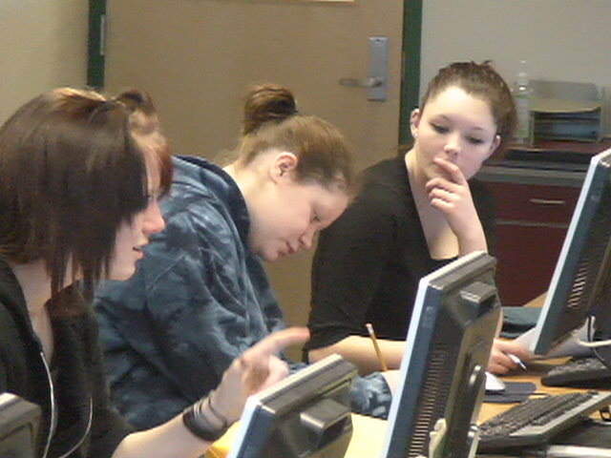
What can team members do to help their group understand the science of shoreline erosion?

