Slide 1
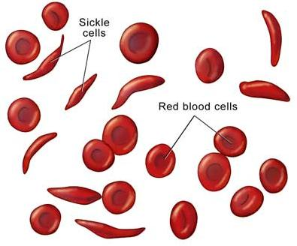
A Unit on Probability and Genetics
(6th Grade)
What? Students will examine factors related to Sickle Cell Disease (SCD) as a
Vehicle for teaching competencies in probability and genetics.
How?
Students will develop data tables from the Centers for Disease Control and South Carolina Department of Health and Environmental Control to cull data on the prevalence of SCD in South Carolina, the United States, and globally. XX
Why?
Concerned with children’s lack of knowledge about how the body works and how to apply knowledge of genetics understanding to personal accountability in health care and quality of life.
What’s New? Discovering and integrating hands-on approaches to facilitating students’ understanding of genetics and integrating science concepts with mathematics.
NASA Assets
http://www.nasa.gov/audience/foreducators/index.html

