Slide 1

Increasing Student Engagement And Learning Through The Use Of Technology In The Science Classroom
Christy Wood
Endeavor STEM Project
November 2009

Slide 2
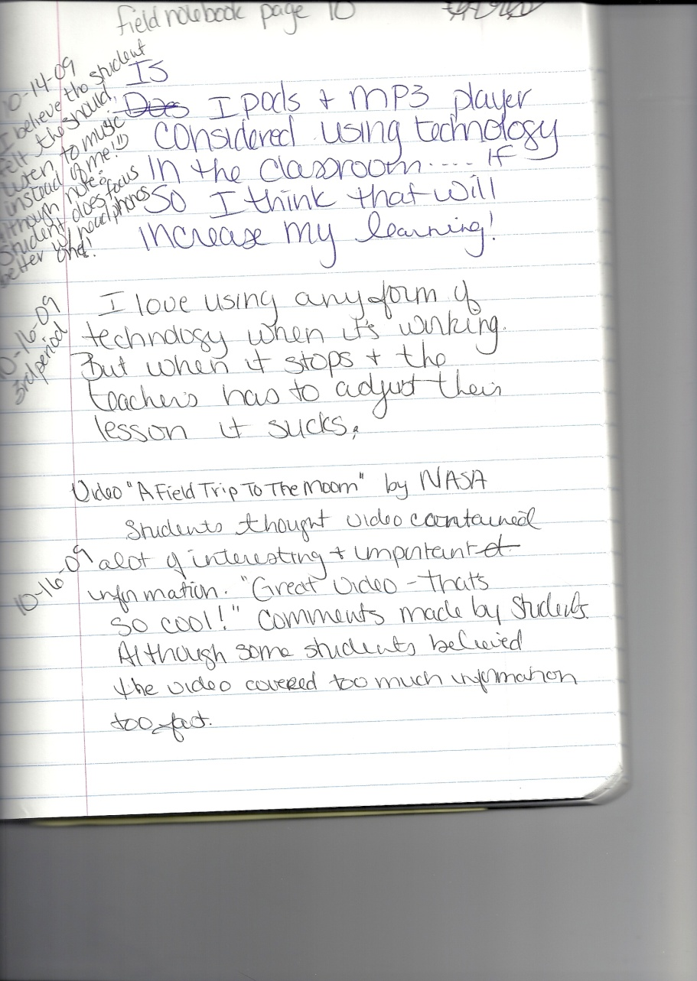
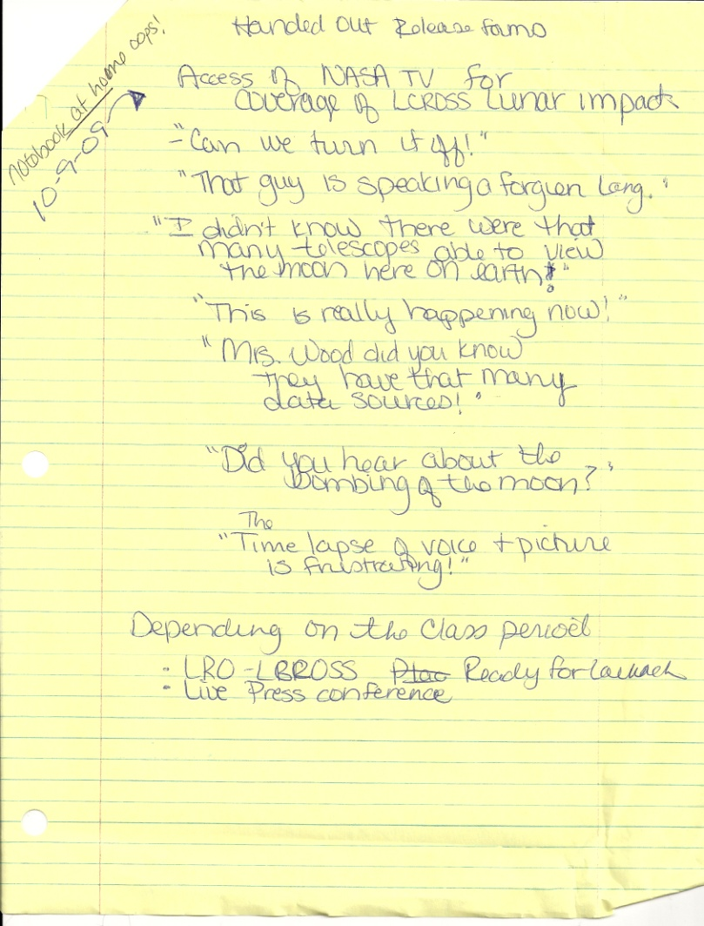
Field Notebook

Slide 3
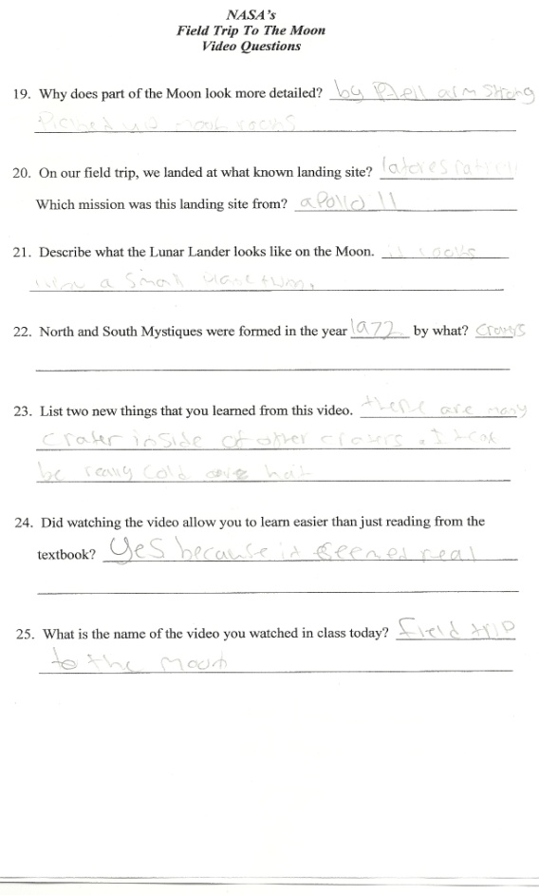
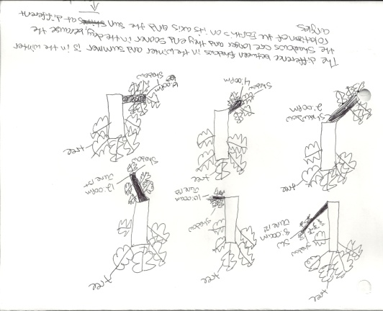
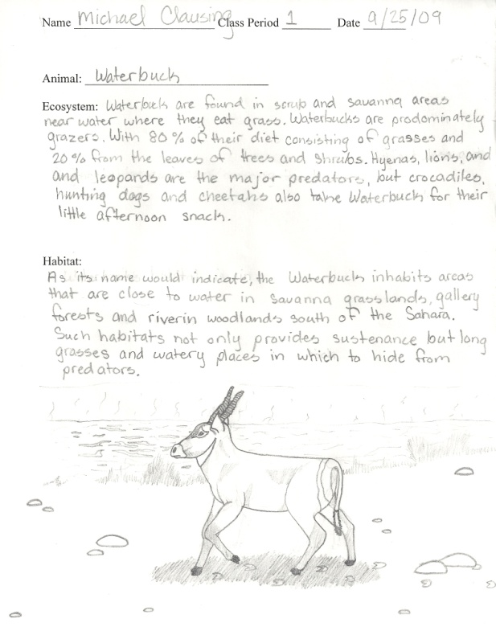
Student Work
Computer Research
Starry Nights Program (STC Kit)
Video Notes
Power Point
Brochures

Slide 4
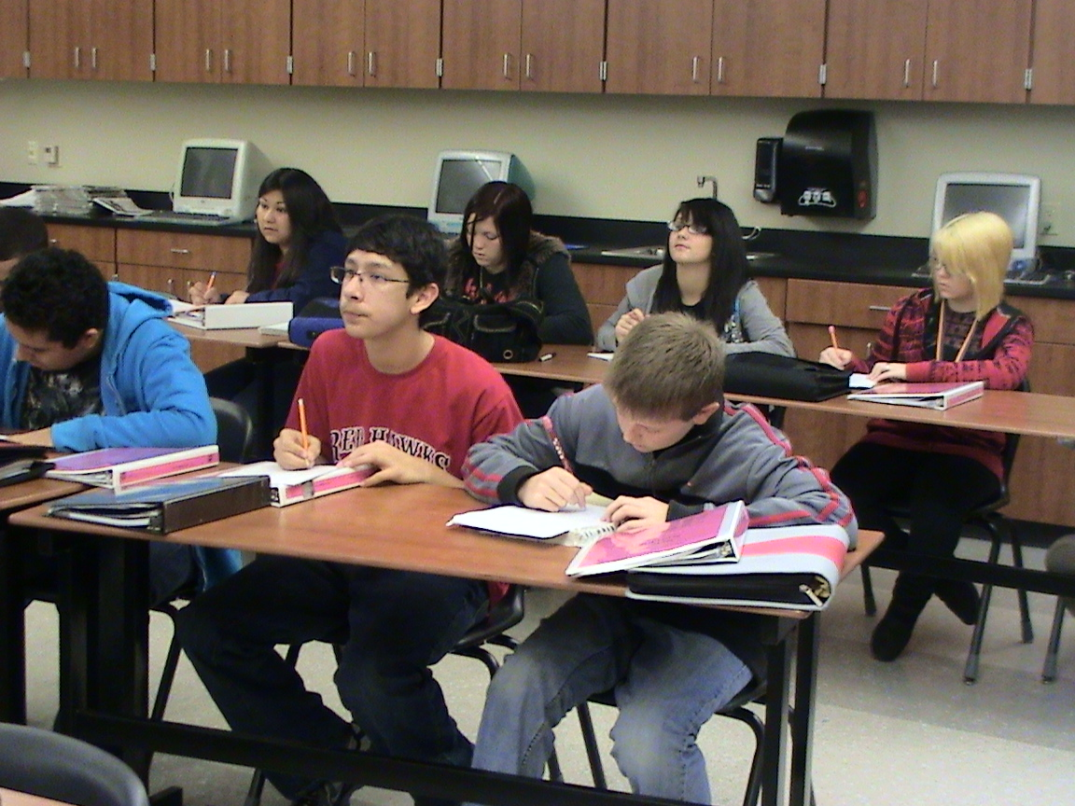
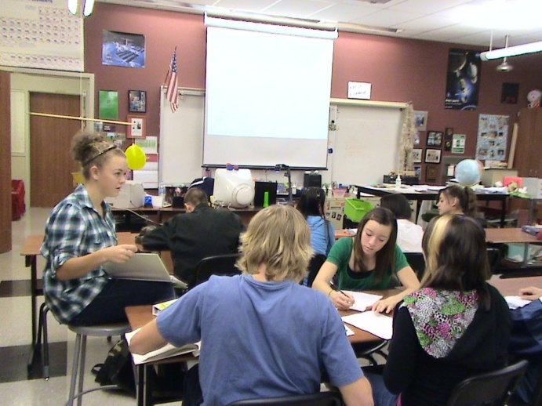
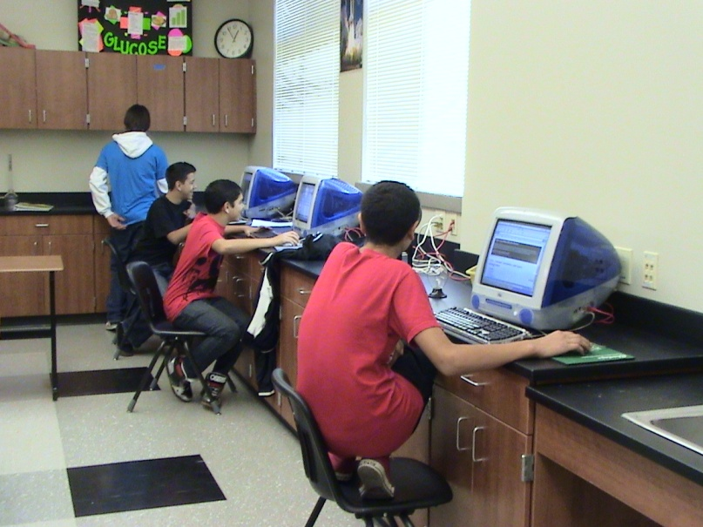
Still Photographs
10
Working Brochure
Using Document Camera
Pictures tell their own
story, it is easy to see if
students are engaged in
the learning or not!
Working on Power Points

Slide 5
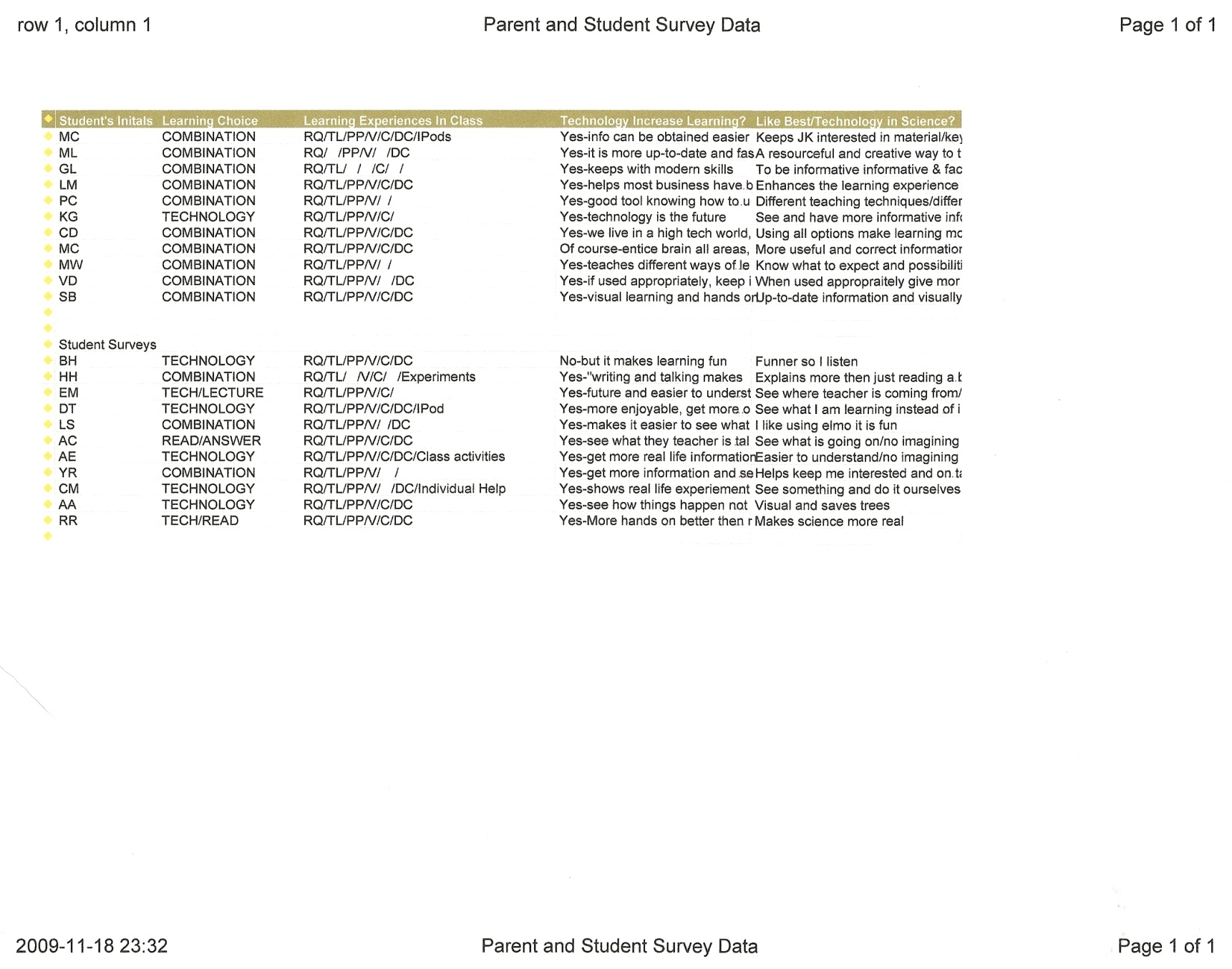
Survey Data
Quotes from parents:
“Technology is a part of Science, when you mix the two I believe it enhances learning!”
“I like that they get to see how technology can be used. That way they know what to expect and the possibilities in the real world.”
“A resourceful and creative way to teach and learn!”
Notes:
Overwhelmingly, student and parent survey were returned quickly and almost in full agreement that technology should be used within the Science classroom.

Slide 6
Quotes from Students
“Using technology gives us a visual of what we are learning or what we are doing so we understand it better. It also gives us more information because we can see what everything looks like.” (EG)
“I can see how things happen and not get confused by the wording of a textbook and not waste paper and then we can save trees!” (AA)
“Technology helps keep me interested and on task. (YR)
“Yes technology will increase my learning because writing and talking makes me tired!” (HH)

Slide 7
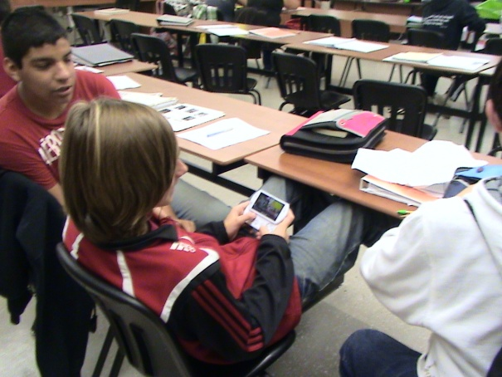
Increasing student engagement and learning…………..
Technology is already
part of our student’s
every day life. If they
can’t afford it, they
just borrow it!
Students in my class
were more
interested in
learning when they
were given the
opportunity to
use technology.
Students using computers for research and for publishing documents such has brochures or Power Points, showed a marked improvement in understanding the concepts studied and the quality of work completed.
“I don’t learn well by reading a book, but give me anything to do on a computer and I am a wiz. If it has a on and off button, I am interested in playing (ok, learning) with it!” (CM)
“Technology is the future, lets roll with it!” (EM)
“You mean I can’t play games in class?”

