Slide 1
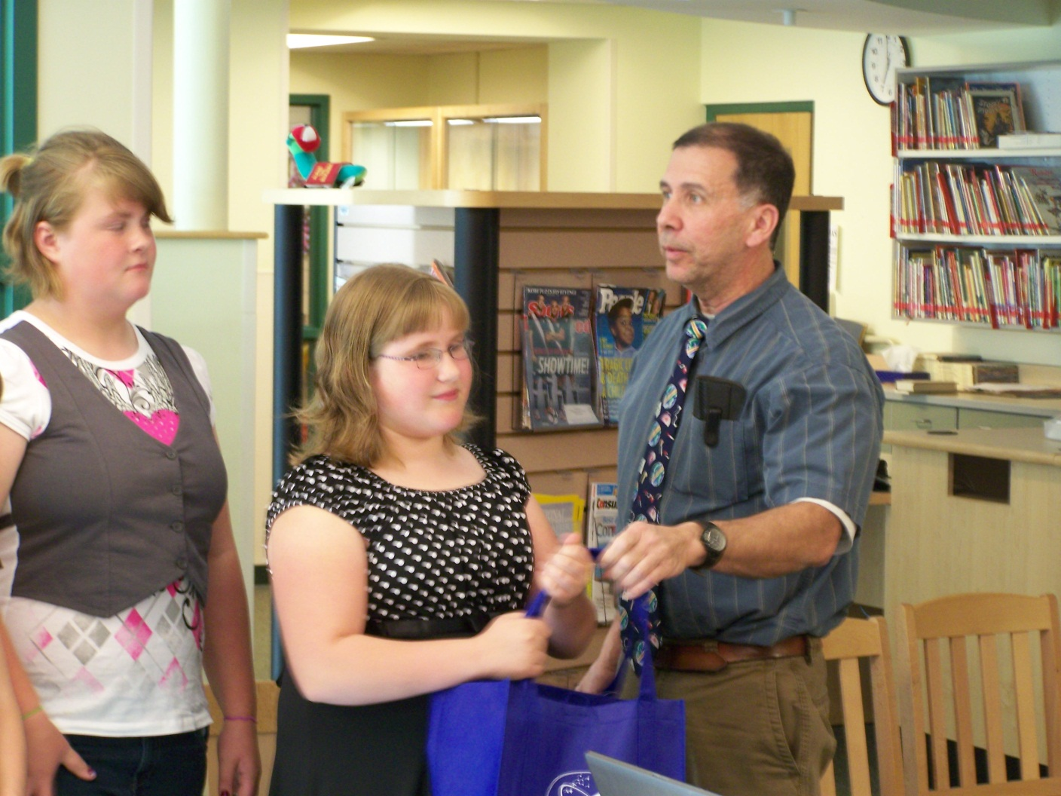
Action Research
Lessons From The Ocean
SPRINT
Earth Science on Mars
Physical Science in Motion
Methods of S.T.E.M.
Education
Endeavor
Cohort 1:
Mark Barone
At
Prattsburgh
Central
School

