Slide 1
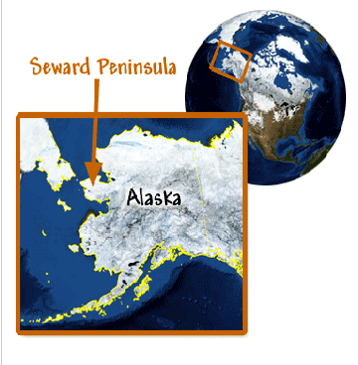

Alaska Native Reindeer Herding by 5th grade students of Leesburg Elementary, Leesburg, FL

Slide 2
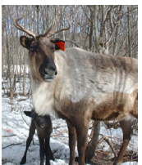
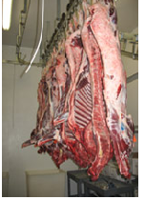
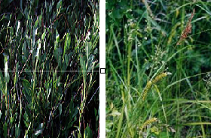

Reindeer herders raise reindeer to sell for their meat. The more weight the reindeer gain, the more meat there is. The more meat to sell, the more money the herders make.
Reindeer eat more during spring and summer than in winter. It is important that they store up a lot of fat during the summer in order to survive the cold, snowy winter when food is harder to find. In the spring, when snow begins to melt, reindeer can begin eating plants like sedge and willow which are high in protein. This helps them to gain weight and produce more milk for their calves.

Slide 3
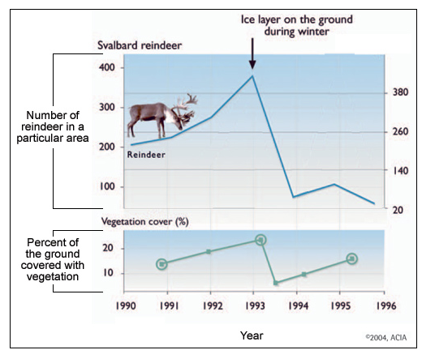

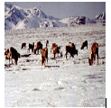
Climate change
Positive impact: Earlier snowmelt would be good for reindeer because it will be easier for them to get to their food earlier in the year.
Negative impact: More winter storms and greater changes in winter temperatures. The freezing and thawing forms a layer of ice over the plants and the reindeer cannot reach the plants below this ice.

