Slide 1
ACES Signals of Spring
Jennifer Sunman

Slide 2
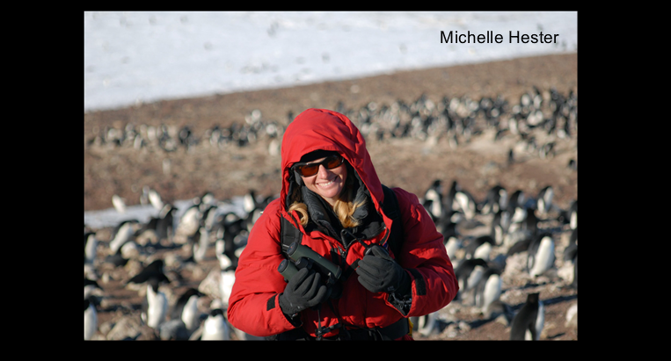
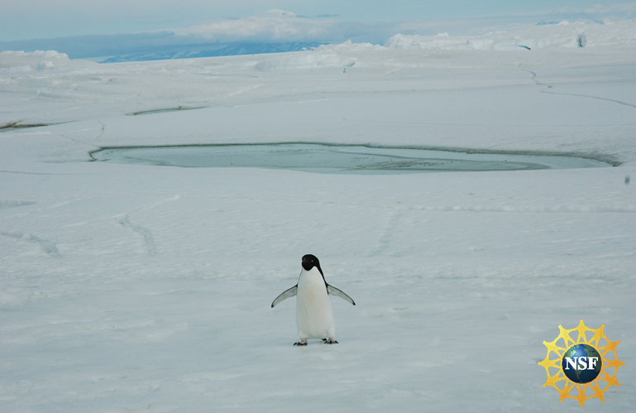
Adelie Penguin
Webcasts

Slide 3
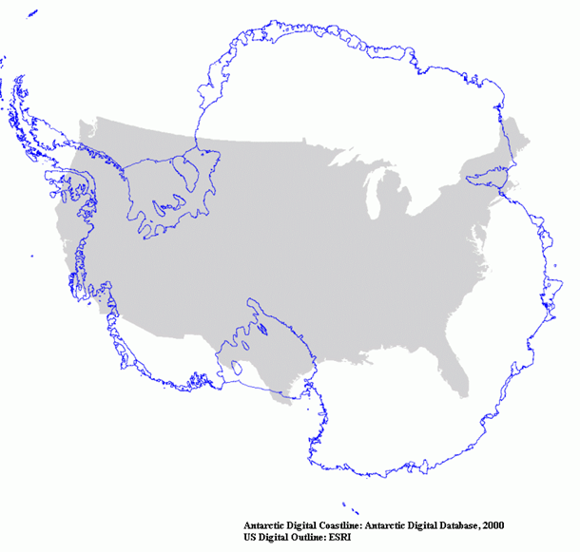

Slide 4
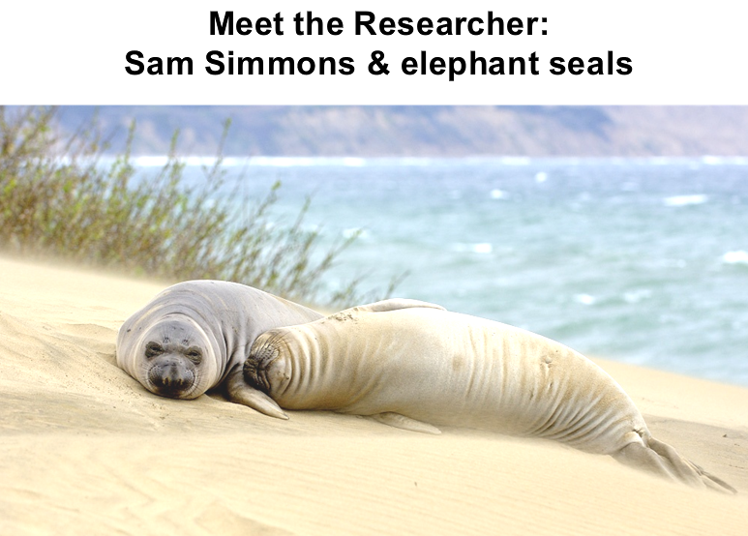
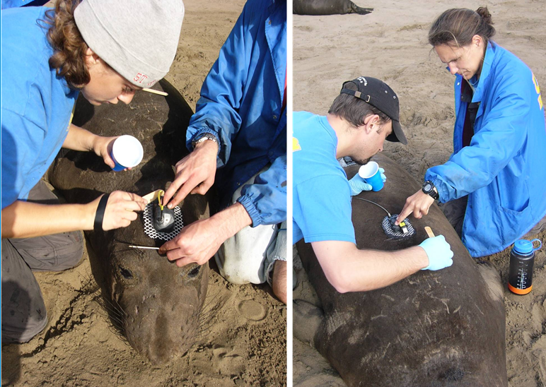
Elephant Seals

Slide 5
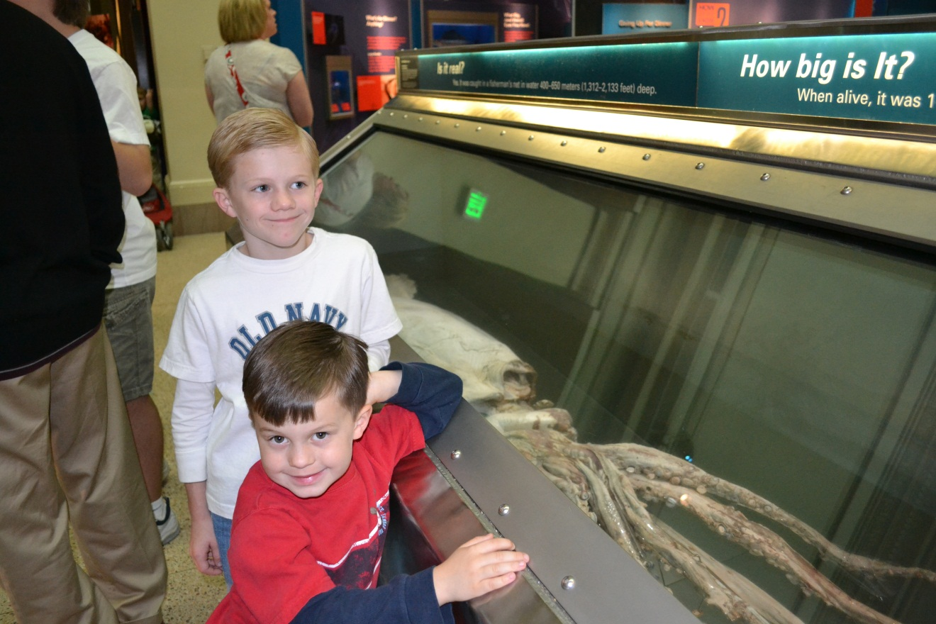
Ocean Hall

Slide 6
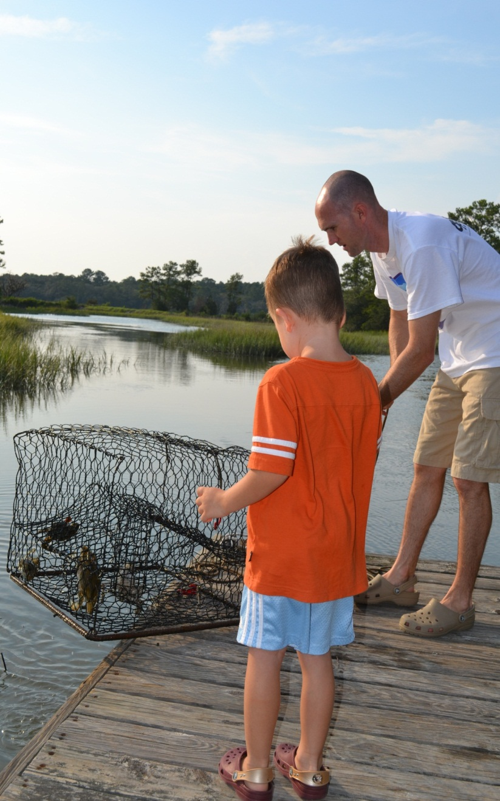
Changes in the Tides
Lesson Plan

