Slide 1


Property Training
Jacksonville Job Corps Center

Slide 2


The references used for Job Corps concerning Property are:
*Policies and Requirements Handbook (PRH)
*Property Handbook 505 and 505A

Slide 3

There are 2 types of property:
*Expendable Property
*Non-expendable Property

Slide 4



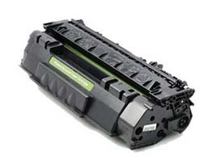


Expendable Property are items that are used
and then thrown away -- or -- have a short life span.
For example:
Copy Paper
Cleaning Supplies
Toner/Ink Cartridges
Pens/Notebook Paper
Napkins/Paper Towels/Tissue
Batteries
Uniforms

Slide 5


Required Information for
Purchasing Supplies (Expendable Property)
An Inventory Supply Purchase Request should include…*
Supervisor’s signature
Account Code
Stock Number
Item Description
Unit of Issue
Quantity
Submit to Finance by Close of Business Monday for Thursday Delivery
*Purchasing procedures and requirements are covered in “Procurement”

Slide 6


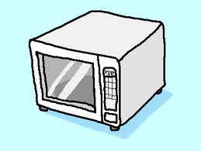
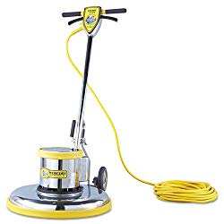

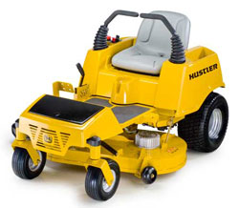
Non-Expendable Property
Examples of non-expendable property include:
Computers
Radios
Tools
Buffers
Microwaves
Lawnmowers
Non-Expendable Property MUST be tracked using a
government approved property management system.

Slide 7


Non-Expendable Property
Staff that are responsible for property are termed:
“Local Property Custodians” (LPC)
The ETA-359 requires 3 quarterly inventories
performed by the LPCs and 1 annual certification
performed by the Property Supervisor.
The purpose is to keep an ongoing account of all Non-Expendable property.
The Property Supervisor and Property Clerk will conduct an unannounced audit
of 10% of the Non-Expendable property every other week.

Slide 8

Non-Expendable Property
~The Department of Labor works with a contractor to perform an
annual property assessment. (inventory, audit)
~The result of this annual audit will determine if the center
is following all of the expected requirements and
that all Non-Expendable Property is accounted for.
You will be held financially responsible
for all damaged or missing property!

Slide 9
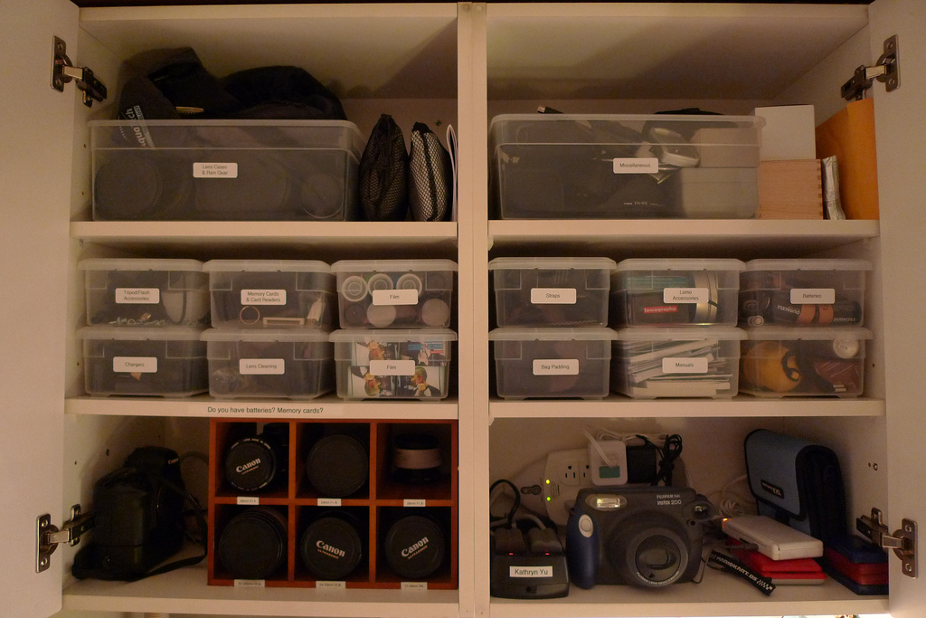
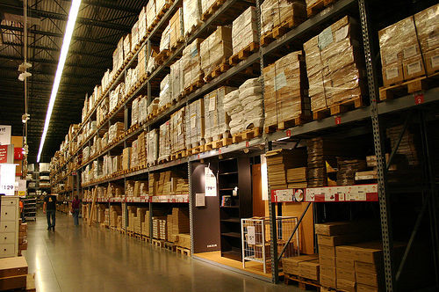
All property is required to be kept in it’s assigned area.
Failure to keep property in the correct area will result in a “write-up.”
More than one offense will result in fines leading to a termination.
All Non-Expendable Property is required to be tagged.

Slide 10

Electronic
Property
Management
System
Master
Itemized
Property
Report
Sample

Slide 11

Instructions for checking your inventory:
Make sure the following is correct:
The manufacturer’s serial number (not the center’s property number)
The description (make/model, etc.)
To make a correction – draw a single line through the mistake, and write out
the accurate information as nearby to the correction as possible.

Slide 12

Instructions for checking your inventory: (continued)
Check off each item, if it is present in your area. If it is not there, mark it: “NH”
If you have something in your area that is not on the inventory sheet (and it’s supposed to be there!) -
add the item to the sheet with all of the appropriate information.
After finishing your inventory, complete the “Custodian Acknowledgement” page
and sign and date it. Then have your supervisor sign it.

Slide 13

Non-Expendable Property
Do NOT move any property until you have approval by the Property Supervisor
If you need to move any Non-Expendable Property, you must fill out a
“Property Transfer” form and have it signed by your Property Supervisor
LPC’s (Local Property Custodians) will be held financially responsible for all missing or damaged property
Please notify your Property Supervisor, if the property tags become lost or damaged.

Slide 14
Procedure for removing damaged, excess,
or no longer needed property:
Complete hand receipt/property transfer
Notify the Supervisor that there is property that needs
to be transferred to the warehouse.
The Supervisor will notify the LPC of the date and time of pick up.
The LPC will check their property run to ensure item has been removed.

Slide 15

Property
Transfer
Form
Equipment
Inventory
Relocation
Notice

