Slide 1

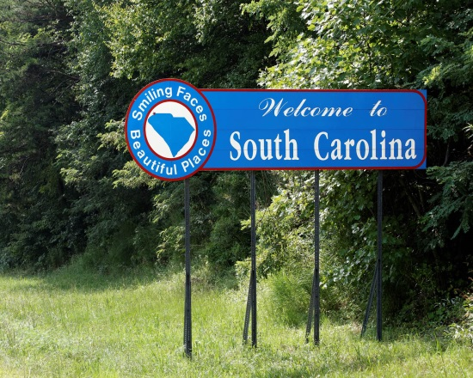





Center for Practice Transformation
Rural Training Series
“Planning Best Chance Network and WISEWOMAN Screening Events: Tips for Success”
Guest Presenter: Denitra Bovian, Data Analyst, Singleton Health Center
Tiffany Simpson-Crumpley, MHA, Education & Training Consultant

Slide 2
Presentation Objectives
By the end of this webinar, participants will learn about:
Steps to plan a successful community screening event
Review of Activating EHR patient screening reminders

Slide 3
Quick Review
The Nuts and Bolts of Implementing an Effective Best Chance Network Program
Got Patient Reminders?: Using Your EHR to Engage Patients in Your BCN/WW Programs
Billing for Success: Effective Strategies for Generating Revenue from the BCN/WW Programs
The Front Desk: The Gateway for Effective Patient Engagement for Best Chance Network and WISEWOMAN Programs
What is WISEWOMAN?: A Program Overview
Making the Case for WISEWOMAN
WISEWOMAN: The Win-Win Solution
Billing for Success: Effective Strategies for Generating Revenue with WISEWOMAN

Slide 4
What is the Best Chance Network?
Since 1991, The Best Chance Network has been South Carolina’s program for National Breast and Cervical Cancer Early Detection Program. It provides comprehensive screening and diagnostic services for low-income, uninsured and underinsured women across the state. It is commonly referred to as the “free mammogram” program the community
Notes:
To see real change and improvements in outcomes – need to redesign how we provide care and subsequently pay for it. Family Medicine recognized this as early as 2000 with the creation of their Future of Family Medicine Task Force and subsequent report issued in 2003.
That report was one of the contributing foundations for the Joint Guidelines of PCMH developed by primary care specialty societies AAFP, AAP, ACP and AOA
Developed in 2007
Endorsed by 15 specialty societies (“neighbors”)

Slide 5
Eligibility Criteria for Best Chance Network Services
A woman who lives in South Carolina
30 to 64-years old
Does not have health insurance or are underinsured (meaning the insurance only covers hospital care)
Has deductibles of $1,000 or higher
Those who have insurance that does not cover diagnostic services
Meet income eligibility guidelines

Slide 6
What is the WISEWOMAN Program?
Since 2008, DHEC has offered The WiseWoman program, to reduce risk factors for heart disease in low-income women from 40-64 years of age. Services focus on cardiovascular disease screening, health coaching and lifestyle changes with a focus on controlling high blood pressure.
Presented along with companion program to BCN to prevent cancer

Slide 7
Building Blocks of the BCN/WISEWOMAN Programs
Practice Champion/
Health Coach
Defined Team Roles and Responsibilities
Patient
Activated EHR Screening Reminders & Telephonic Patient Alerts
Billing & Coding Knowledge for BCN/WW Programs

Slide 8
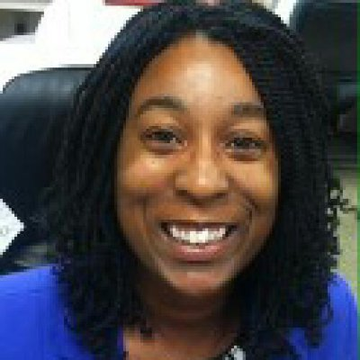
Singleton Family Health Center
Denitra Bovian
Data Analyst and Quality Improvement Coordinator at Singleton Family Health Center
Native of Orangeburg
Proud veteran of the US Marine Corps
Graduate of Claflin University

Slide 9

Inspiration For Singleton Health Center To Have A Community Event
Higher rates of noncompliance for specific preventive screenings like mammograms, annual wellness exams, and colonoscopies
Desire to personalized preventive screenings to increase active patient participation
Acknowledgement that certain diseases such as breast cancer have a more profound adverse impact on rural communities and women of color
Close as many gaps in care as possible in one day
Erase the fear associated with mammograms

Slide 10

Considerations For Your Event
Consider: partnership(s) – what organization/agency do you want to assist with your event & why
Consider: motivation -why are you creating the event and what’s your desired impact
Consider: frequency – how often do you want the event to occur
Consider: date and time – when are patients most likely to come to your event

Slide 11

Event Planning
Choose a date.
Location, location, location.
Research and decide who to partner with.
Get your practice excited about the event.
Allocate time during your day for planning the event.
Promote your event.

Slide 12

Associated Cost & Beneficial Value
Cost: Budget determination by event planner. It will cost as much or as little as YOU prefer!
Beneficial Value: cannot be quantified

Slide 13
Strategy For Identifying Women Internally
Internal care gap report/registry report thru EHR
Verbal and/or electronic notification from healthcare providers

Slide 14
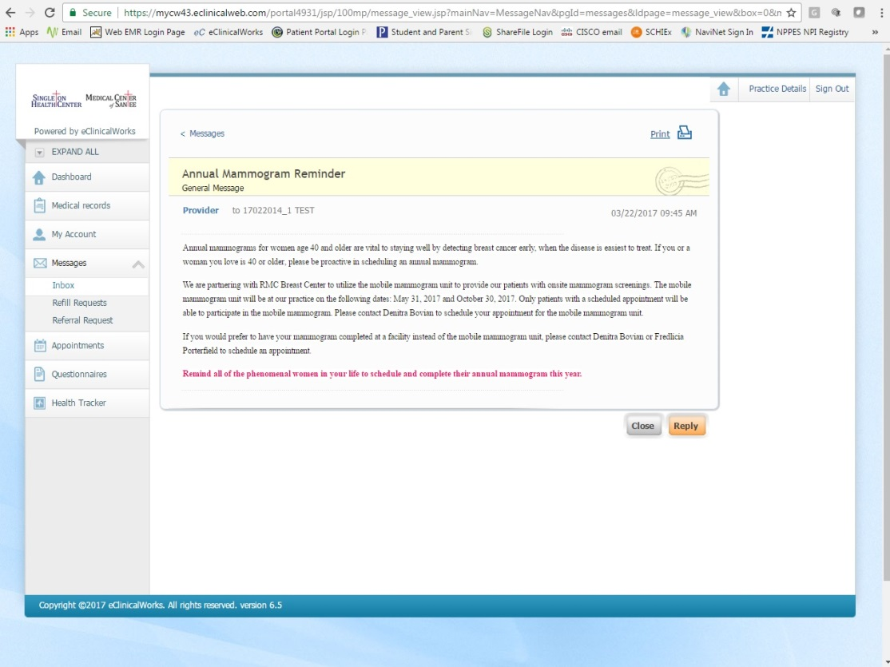
Mammogram Reminder - Patient Portal Inbox

Slide 15
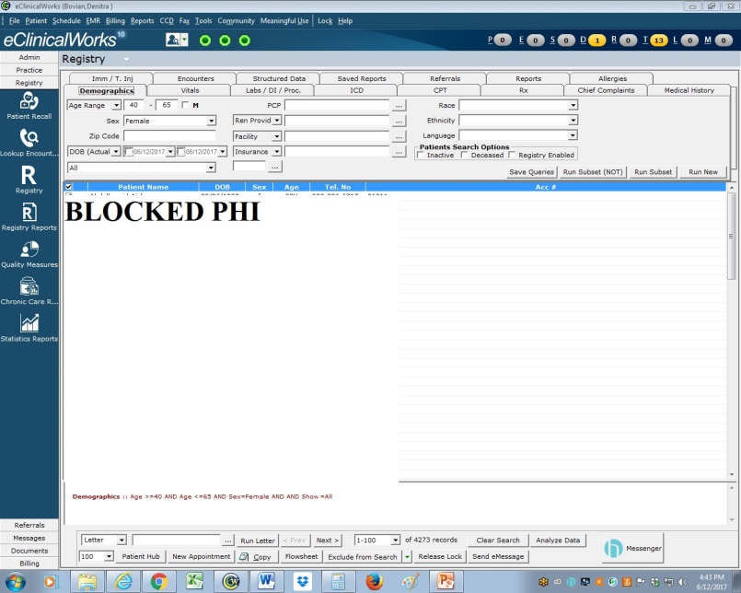
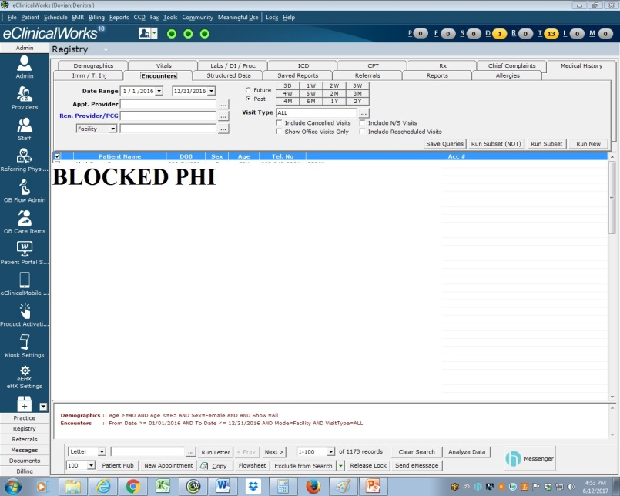
CREATING A PATIENT LIST
Step 1:Select the Registry band on the left side of the screen.
Step 2: On the “Demographics” tap, enter the age parameters and select “female” in the Gender box.”
Step 3:Click on the “Encounters” tab.
Step 4: Enter the date range for your report.

Slide 16
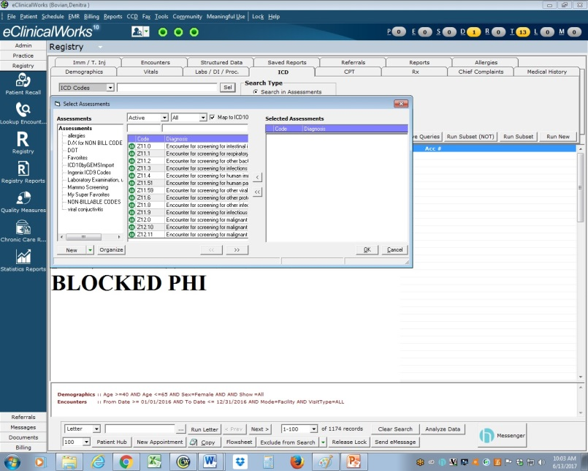

CREATING A PATIENT LIST
**Ensure the date range on this tab is the same as the date range used previously.
Step 5:Click on the “ICD” tab. Click “Sel” to search for the appropriate ICD 10 code.
Step 6:Click on the “Run Subset (NOT)” tab.

Slide 17
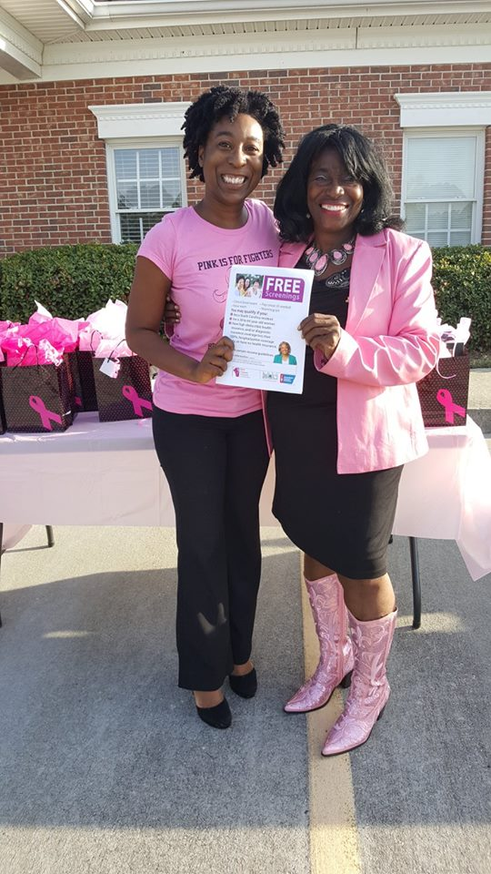
Women Served
3 mobile mammogram events
October 28, 2016
February 15, 2017
May 31, 2017
Last mobile event for 2017
October 30, 2017
Ensures mammogram is scheduled at least 1 year after previous mammogram
Total completion rate
63% for combined mobile mammogram events
Educational materials
Best Chance Network information
Breast Boutique information
Preventive screening information
Community resources list
October 28, 2016 Singleton Health Center’s First Annual Breast Cancer Awareness Day
Pictured: Denitra Bovian, event planner & Joyce Hudson, Best Chance Network consultant
“Swag bags” on the table for patients

Slide 18
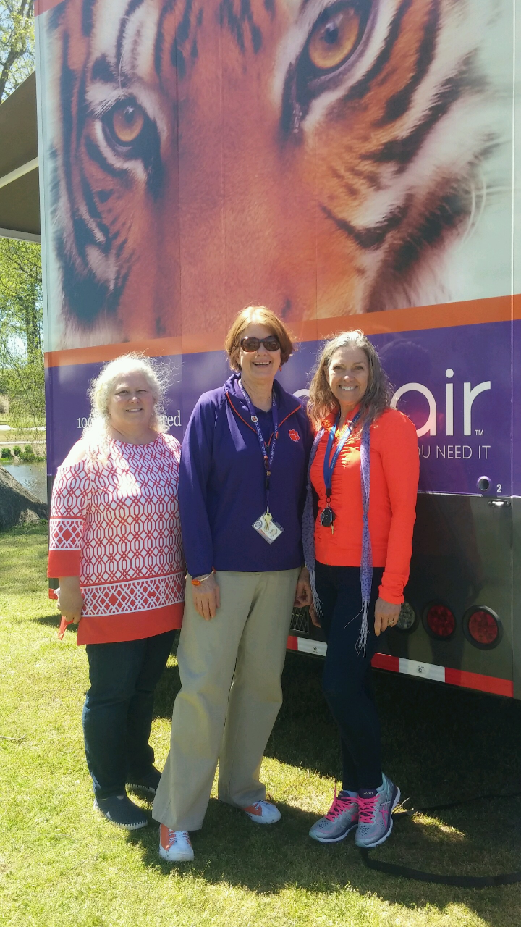
WISEWOMAN Program Interview: Clemson University- Joseph F. Sullivan Center (Mobile Free Clinic Model)
Tips for Success
Pre-qualify patients via phone call prior to mobile screening events/initial appointment
Create 2-3 hour appointment slots to provide all BCN/WW services in one day
Integrate WW forms into EHR system
Consider using nursing and allied health students to support your BCN/WW screening event

Slide 19
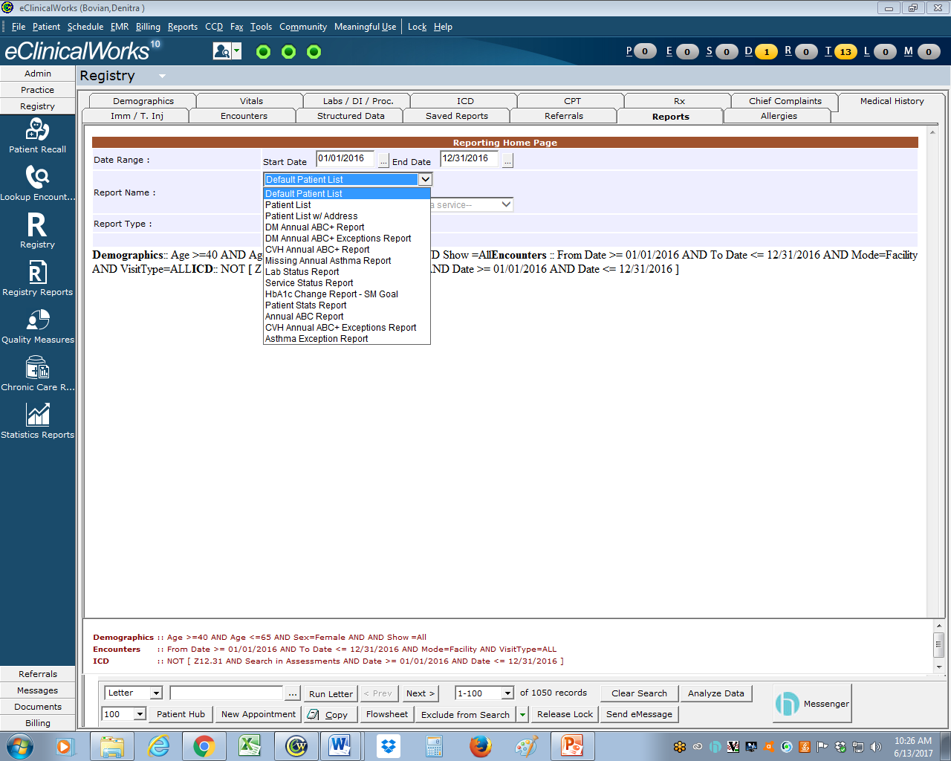
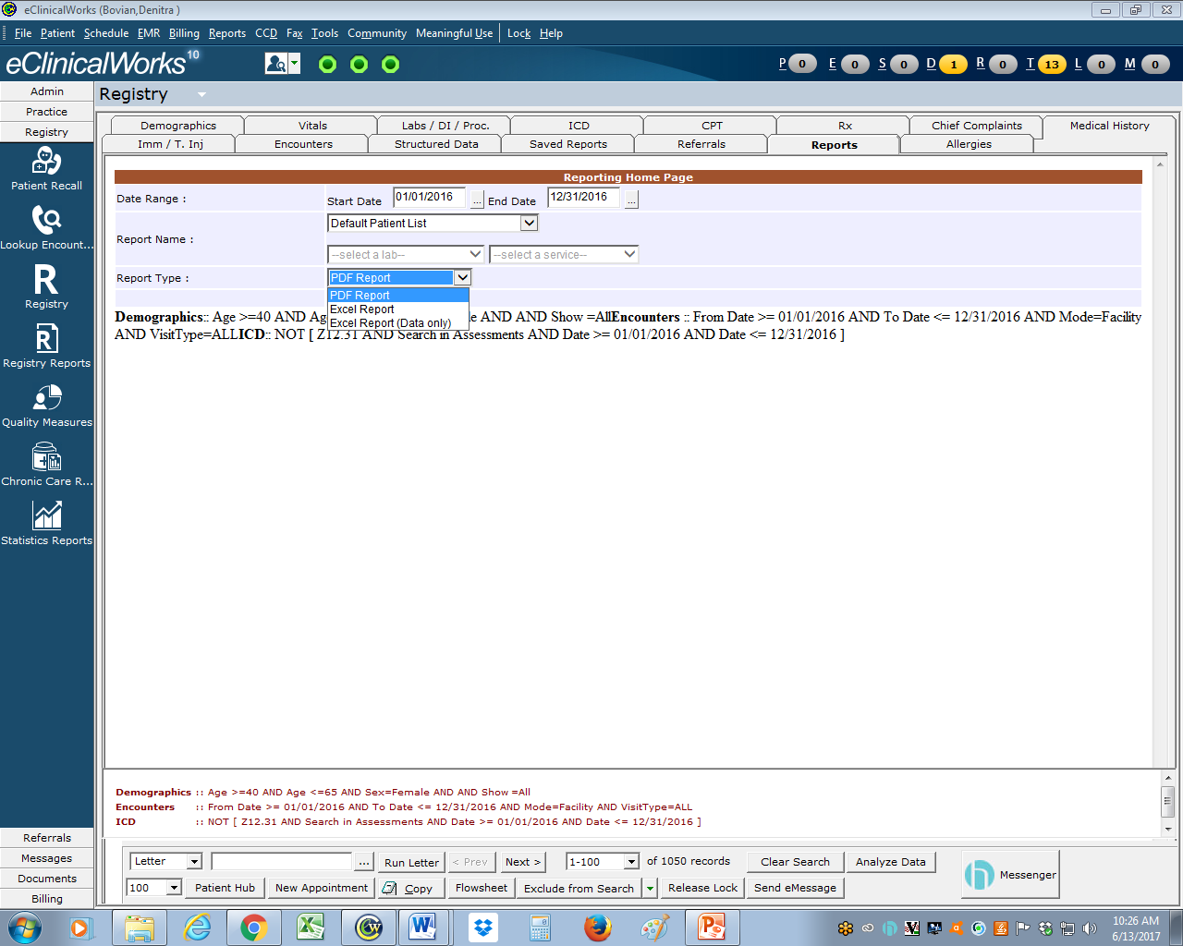
CREATING A PATIENT LIST
**Ensure the date range on this tab is the same as the date range used previously.**
Step 7a:Click on the “Reports” tab. Click the “Report Name” box to determine the information you want included in your report.
Step 7b: Click the “Report Name” box to select the report format.

Slide 20
Benefits of Becoming a Rural WW Provider
Increased revenue from initial screening and follow-up appointments for BCN and WW programs.
For WISEWOMAN, patients can receive free diabetes prevention education and lifestyle coaching to promote healthy eating and physical activity
Screening, intervention and health coaching aligns with other practice improvement measures and PCMH, HEDIS, PQRS and the Medicare Merit-Based Incentive Program (MIPS)

Slide 21
Call to Action: Become a WISEWOMAN Provider
Current contract as Best Chance Network provider
NOTE:WISEWOMAN can be added as an additional service for your contract renewals with SC DHEC.
Not a BCN Provider? Sign up for both BCN and WW!
Designate a member of your staff to become a Health Coach
Attend SCORH Health Coaching Boot Camp - Monday, June 26th from 9am-3pm

Slide 22
QUESTION & ANSWER SESSION

Slide 23
Health Coaching Boot Camp
Monday, June 26th ~ 9am-3pm
Wingate by Wyndham, Lexington
Register at:
https://www.eventbrite.com/e/health-coaching-bootcamp-tickets-34622749576

Slide 24
We are here to help!
The South Carolina Office of Rural Health has staff who are available to provide on-site support for transforming your practice to improve the health of patients you serve and increase your capacity to be reimbursed for providing high quality care. Examples of technical assistance include:
Patient-Centered Medical Home Accreditation
Best Chance Network and WISEWOMAN Program TA
MACRA Technical Assistance
RHC Regulatory Compliance, Coding and Billing Advice

Slide 25
Key Contacts
Trenessa K. Jones, DSL
Best Chance Network Director
Jonestk@dhec.sc.gov
803-898-1613
Linda Pekuri, MPH, RD, LD
WISEWOMAN Program Manager
pekurilm@dhec.sc.gov
Office: (803) 898-1614
Tiffany Simpson-Crumpley
Education & Training Consultant
South Carolina Office of Rural Health
tcrumpley@scorh.net
803-692-1692
LaShandal Pettaway-Brown
Quality Improvement Coach
South Carolina Office of Rural Health
lpbrown@scorh.net
803-454-3850

