Slide 1





Center for Practice Transformation-Best Chance Network Rural Training Series
“Med-IT 101: Tips and Tricks for Using this System for your Best Chance Network and WISEWOMAN Programs”
Moderators: Tiffany Simpson-Crumpley, Education & Training Consultant
Guest Speaker: Beth Williams, BCN and WW Data Manager

Slide 2
Presentation Objectives
By the end of this webinar, participants will:
Learn how to log into Med-IT
Learn how to request a PA code and add a new client
Learn how to avoid creating a duplicate client
Learn how to run a claims status report

Slide 3
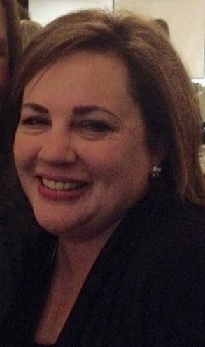
Guest Speaker
Beth Williams, MS
Alabama native and married mother of 2 children
Graduate of Troy University and University of Alabama at Birmingham
Data Manager for South Carolina BCN and WW since 2010

Slide 4


What is Med-IT?
Med-IT stands for Medical Information Tracking. It is a HIPAA compliant online data and billing management system.
OxBow, the company that supplies Med-IT, has been providing information management tools in support of State Health and Human Services Agencies for over 20 years
Today, over a dozen states and tribal communities utilize Med-IT
South Carolina has used Med-IT for our BCN and WW programs since 2009

Slide 5
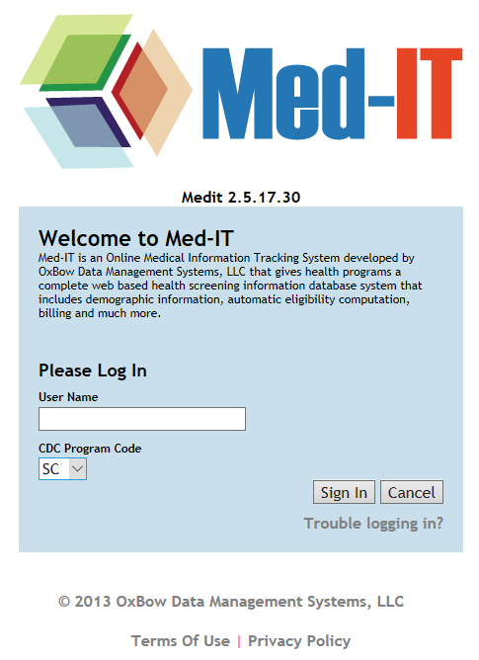
Logging into Med-IT
Each site will determine the individuals who need to have access to Med-IT.
We will then provide you with a user name and initial password.
Once you select to log into the site, enter the user name provided and CDC Program Code “SC.”
Once you log into the system, you will be asked three security questions. You should select three different security questions by using the dropdown box. These questions will only be asked the first time you log into Med-IT.
Your password must be at least 8 characters long, must have at least 1 letter, 1 number, and 1 special character (!@#$%^&*()-+=<>:;'/\",.?][{}`~).
If you forget your password, you can click on the “Trouble logging in?” link.

Slide 6
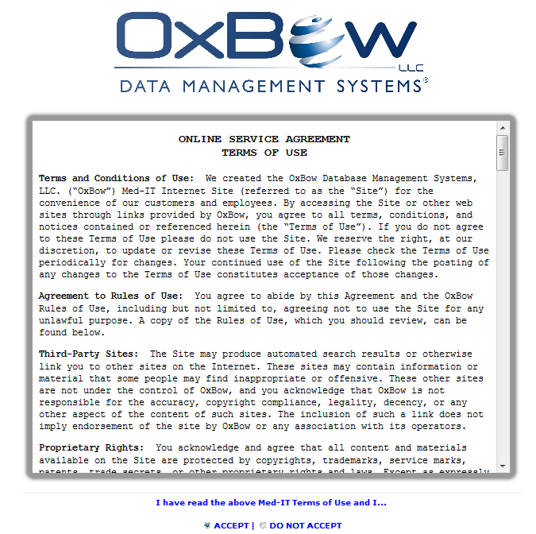
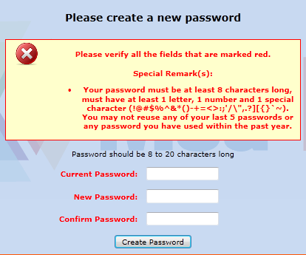
Logging in Hints
The first time you log in, there will be an OxBow Service Agreement that you must accept in order to use Med-IT by clicking on the radio button.
Please remember to log out when not using Med-IT. The system will time out after 20 minutes.
When you do have to reset your password, please note that “current password” refers to the password you just used to log in—it could be your regular password or a temporary password.

Slide 7
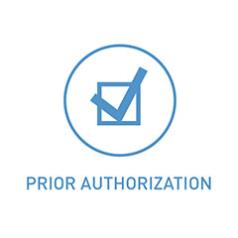
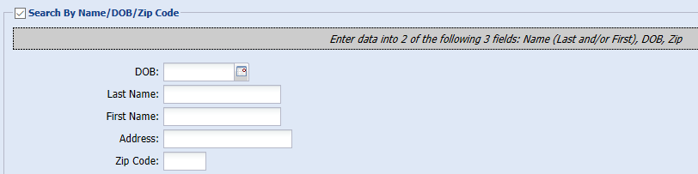
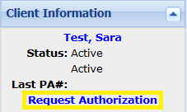
How to Request PA Codes
The Prior Authorization (PA) code system is a way to track how many patients our program will potentially see during the program year so that we can make sure that we have enough money to pay for all the women’s services.
First, search for and select the client for whom you are wanting to request a PA code.
At the left of the client’s enrollment screen, click “Request Authorization.”

Slide 8
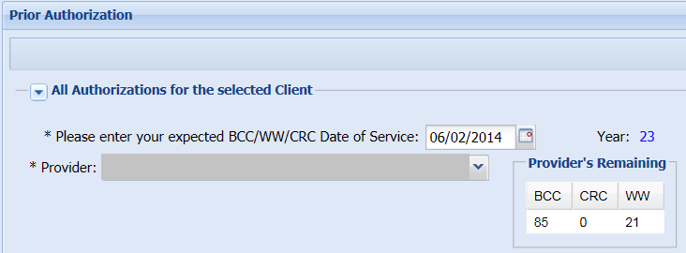
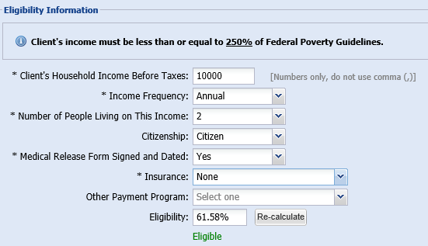
How to Request PA Codes
Select the Correct Provider and complete the Date of Service with the date the client will be coming in for services.
Complete all items on the Eligibility Information section.
The medical release form signed and dated refers to DHEC Form # 1099. This form must be signed by all BCN clients annually and maintained in their file. (Scanned or hard copy). If signing the form is part of your regular protocol you may select yes if requesting the authorization before the client comes in for services.

Slide 9
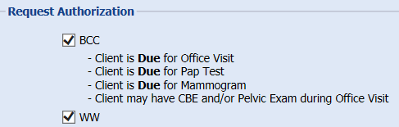

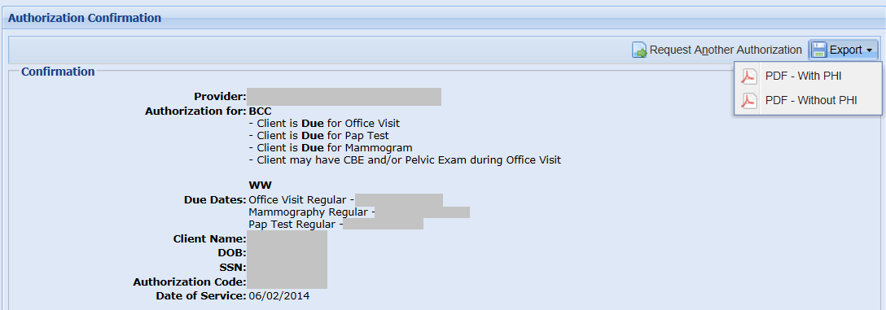
How to Request PA Codes
Check the boxes for the PA codes requested. Med-IT will not allow a user to select services not currently available at their site.
Go to the top right of the page and hit the Request Authorization text.
The following screen will appear. From this screen you may select to Export PDF to be saved or printed for placement in the client’s record. Please note that this is the only time you can export the PDF.

Slide 10
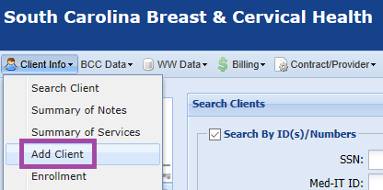
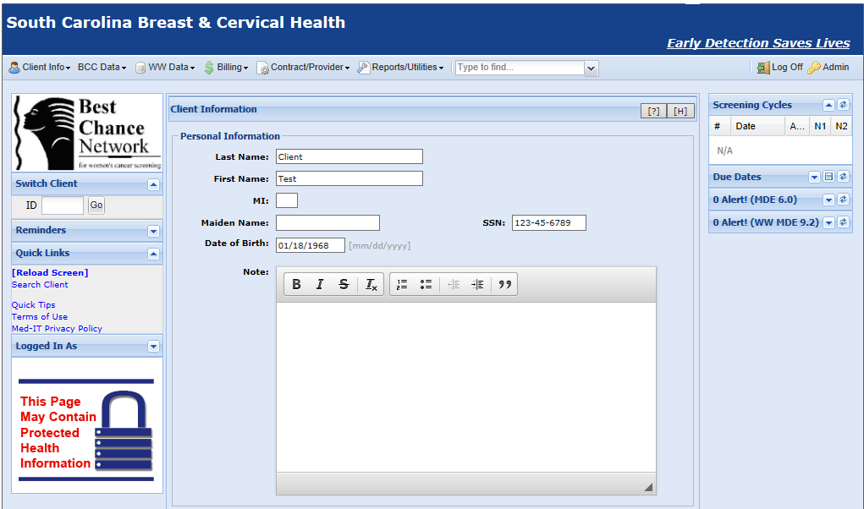

Adding a New Client
If your search for the client does not result in any matches, then you may add a client to Med-IT and then request a PA code.

Slide 11
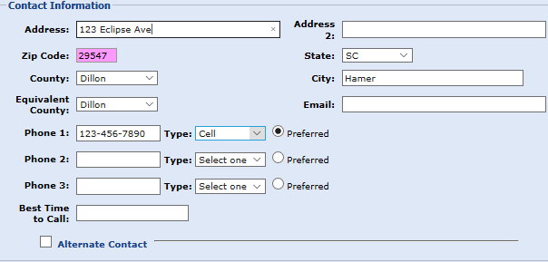
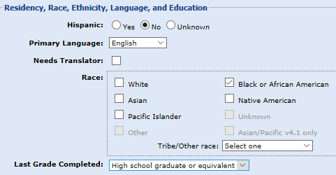
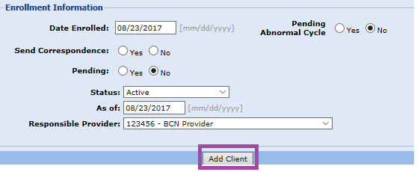
Adding a New Client
You must fill out certain data required by CDC in order to Add the Client.

Slide 12


Data Elements
CDC Requires our program to fill out the data elements for their reporting to Congress
Better Data Quality = More Funding from CDC = More Women Served + More Money for Your Screening Practice!

Slide 13

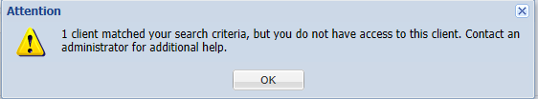
How to Avoid Creating Duplicate Clients
Existing Clients from Previous Providers If the search says that the client exists but you do not have access to her, please call the PA line or fax a PA request form so that the Best Chance Network can then associate this existing client with your provider. Please do not try to add a new client because this will create a duplicate client.
Notes:
Canceling Authorization Codes
Contact the BCN Authorization Line to cancel any authorization codes.
Expired/In-activated Authorization Codes
Authorization codes will be inactivated if there is no indication of services in Med-IT within 30 days of the date of service assigned to the authorization code. Indication of services includes claims for payment or clinical results.

Slide 14
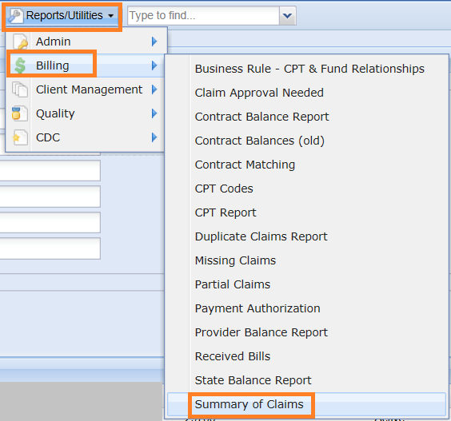

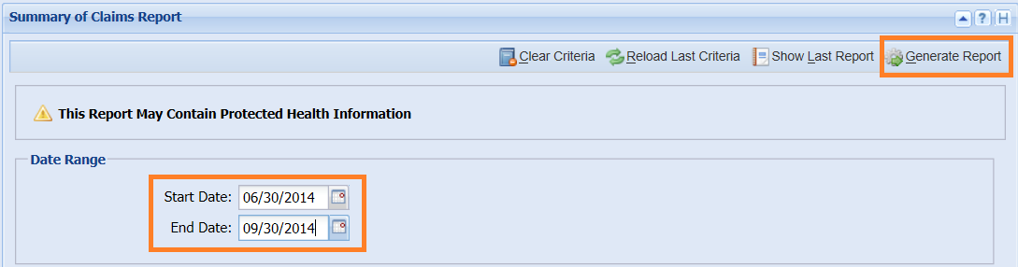
Running a Summary of Claims Report
To research claims from your facility that have been entered by BCN-DHEC, use the Summary of Claims located under Billing under Reports/Utilities at the top of the screen.
Put in the dates of service you are interested in seeing, and click “Generate Report.” The other boxes below these may be left blank.

Slide 15
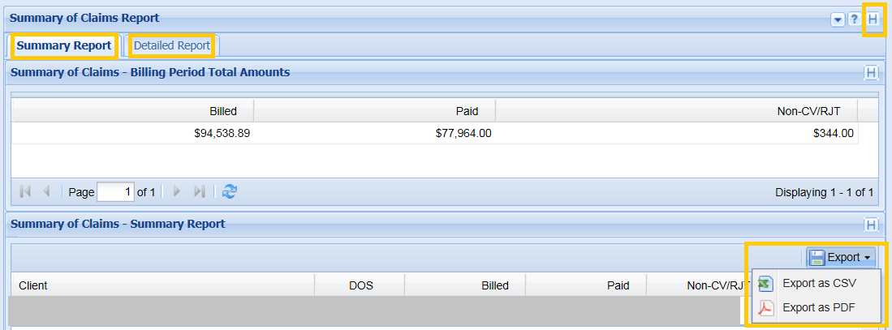
Running a Summary of Claims Report
At any time if you have questions regarding the screen you are on, select the [H] in the upper right hand corner. This is on-line help that provides general information for the screen you are on.
There are two tabs available for viewing: Summary Report and Detailed Report. You may also choose to export the report into a CSV (comma-separated values) or PDF file. A CSV file may be opened in Excel. The CSV file will contain a column called “f_missing” that will contain codes that correspond with the error key for the claims that are pending or not covered or rejected.

Slide 16


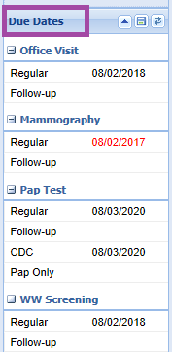
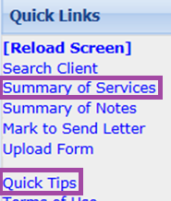
You will find the Billing Error Key and many other helpful guides and forms in the “Blank Forms” section of Med-IT that can be reached at Reports/Utilities→Admin→Blank Forms.
^{Left Sidebar}
^{Summary of Services}
^{Quick Tips}
^{Right Sidebar}
^{Due Dates}

Slide 17
QUESTION & ANSWER SESSION

Slide 18
We are here to help!
The South Carolina Office of Rural Health and the Best Chance Network has staff who are available to provide on-site support for transforming your practice to improve the health of patients you serve and increase your capacity to be reimbursed for providing high quality care. Examples of technical assistance include:
Patient-Centered Medical Home Accreditation
Best Chance Network and WiseWoman Program TA
MACRA Technical Assistance
RHC Regulatory Compliance, Coding and Billing Advice

Slide 19
Key Contacts
Trenessa K. Jones, DSL
Best Chance Network Director
Jonestk@dhec.sc.gov
803-898-1613
Linda Pekuri, MPH, RD, LD
WISEWOMAN Program Manager
pekurilm@dhec.sc.gov
Office: (803) 898-1614
Tiffany Simpson-Crumpley
Education & Training Consultant
South Carolina Office of Rural Health
803-692-1692
tcrumpley@scorh.net
Beth Williams, M.S.
BCN & WISEWOMAN
Data Manager
williame@dhec.sc.gov

