Slide 1
Rise Standards for Writing Contact Notes

Slide 2

Introduction
There is a motto in this field that states “if it’s not written down, it didn’t happen.”
Contact Notes are an important part of documenting the services we provide to the people we support.
This presentation will walk you through the do’s and don'ts of writing Contact Notes.

Slide 3
Activity Tracking

Slide 4
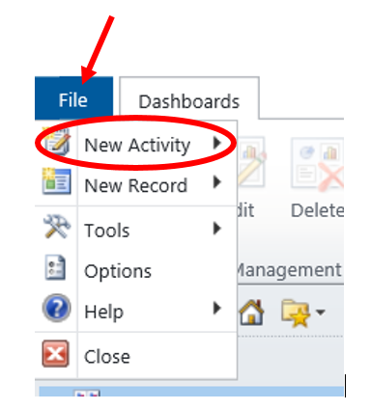
Activity Tracking
This presentation will outline how to write Contact Notes.
Let’s take a few minutes to review other Activities tracked in CareDirector:
Fax
Phone Call
Email
General Information

Slide 5
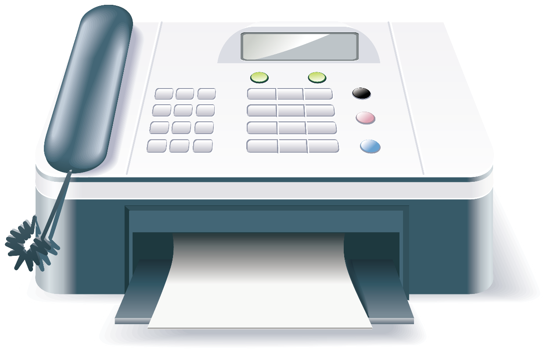
Activity Tracking - Fax
If you receive a fax that directly relates to a person served, enter the receipt of the fax as an Activity.
Fill in the fields on that screen and briefly describe what the fax was in regards to.
Then be sure to scan and attach the document to the Provider Enrollment Record for the person.

Slide 6
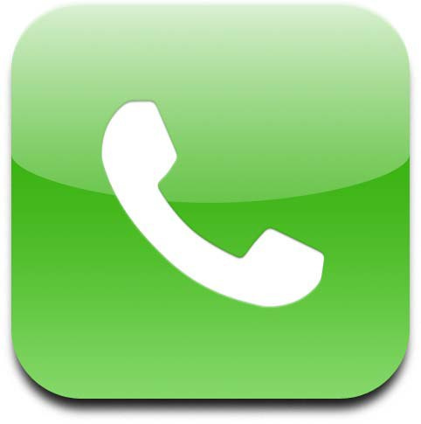
Activity Tracking – Phone Call
Document phone calls you have regarding a specific person.
Briefly describe what that call was about and any next steps, if necessary.

Slide 7

Activity Tracking - Email
You do NOT need to retype the whole email.
Create the activity, then copy and paste the email into the CD activity.
You do NOT need to copy and paste every email.
For example, you would NOT copy and paste an email about choosing a date for a meeting, but you would copy and paste an email that talks about why the meeting is necessary.

Slide 8
Activity Tracking - General
We do NOT need every fax, phone, or email recorded as activities.
If the information is related to our services and important to document for future reference, then an activity should be created.
When in doubt, ask your supervisor. Many times what is important to document in one program, is not necessary to document in another.

Slide 9

Activity
Pause this training and take a few minutes to login to Care Director.
Create a new activity of fax, email, and phone to become familiar with the fields in each.
Jot down any questions you may have so you can ask them at the end of this presentation.
REMEMBER: Don’t click on “Mark Complete” as the Activity will then be saved and can’t ever be altered.

Slide 10
When to Write Contact Notes

Slide 11

When to Write Contact Notes
There has been a face-to-face visit:
This does not have to be completed in 245D programs unless there has been a significant event that happened during the day.
Two face-to-face contact notes are required each month for the SE sub-program of Extended Employment (EE).

Slide 12

When to Write Contact Notes
Service coordination or consultation has happened with another provider:
Document conversations with other providers that pertain to coordinating services for the person served.

Slide 13

When to Write Contact Notes
Team meetings have occurred (annual meetings will be documented elsewhere)
All team meetings should be have a contact note written describing topics discussed during the meeting.

Slide 14

When to Write Contact Notes
You have learned pertinent information that needs to be recorded:
This includes pertinent information from communication books in DTH programs.
Managers will outline program specific documentation needs.

Slide 15
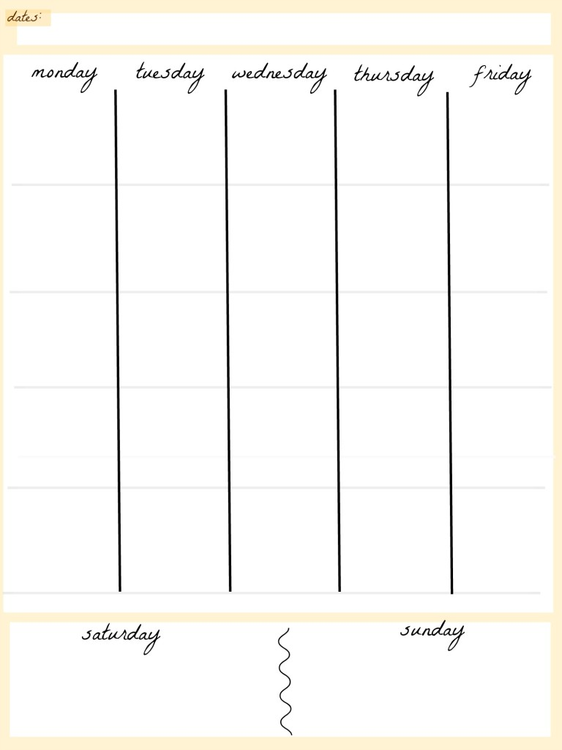
When to Write Contact Notes
Weekly in the Adult Day program:
Once a week a contact note should be written for people served in Adult Day to summarize the services provided for the week.

Slide 16
How to Refer to People

Slide 17

How to Refer to People
Write in the 1st Person
This means using “I” statements.
Don’t say: This writer observed Jane running around the room.
Do say: I observed Jane running around the room.
When writing a direct quote from another person be sure to use quotation marks.
Example: Bob said “I want to find a job in the community.”

Slide 18

How to Refer to People
Don’t put your feelings or observations in quotes
Don’t say: “Sue seems frustrated with her job and may want to quit”
The above statement is an observation, not a direct quote.
If Sue did say this, then follow the example below.
Do say: Sue stated, “I am frustrated with this job and want to quit.”

Slide 19
How to Refer to People
If you are writing a case note for Jane, but part of the documentation involves another person served, simply refer to them as another person served.
Example: Jane was visibly upset after talking with another person served by Rise.
If you are referring to a team member, Rise or otherwise, in the contact note be sure to write out their name and title when first referring to them. After that you can list their first name.
Example: I spoke with LaNay Koralesky, VRS Counselor, to discuss placement efforts for Jane. After providing an update, LaNay had some feedback regarding this.
Example: I was talking with Anne Mornes, Rise Mental Health Coordinator, regarding Jane’s absenteeism. Anne suggested completing a 4 + 1 exercise with Jane to help us determine how best to support her with this new job.

Slide 20
Content of the Contact Note

Slide 21

Content of the Contact Note
The information people include in Contact Notes can vary greatly.
Some people write two sentences after spending an hour with a person served. This is not enough information.
Other people try to capture every moment of the meeting which results in very long notes. This is too much information.
Think of the “goldilocks” approach – just right.
To create consistency across programs we are going to use a formula to write our Contact Notes:
Data – Assessment - Plan

Slide 22

Content of the Contact Note
Data - Assessment – Plan
Data: General overview
Assessment: What was the person’s response to the items being discussed?
Plan: What are you/others going to do moving forward?

Slide 23
Content of the Contact Note
Ask yourself this: If it doesn’t relate to services or supports we are providing, does it need to be included in the Contact Note?
Below is an example of an actual case note written by a former Rise employee (the name of the person served has been changed).
“I asked Jane how her Girls Night Out was 2 weeks ago. She smiled and said it was fun. She wishes they could do this more often than twice a year. I suggested she invite everyone to her apartment. She laughed and said her place is too small. ‘The floor would collapse!’ Things are fine at work.”
This was a case note for follow-up services. The last 5 words state that things are fine at work however there is no documentation about the conversation around work and how we are supporting Jane at work. The contact note should relate to the services we are providing. If it doesn’t relate, leave it out.

Slide 24

Content of the Contact Note
Program Specifics: There are some specific contact note requirements based on funding stream. Below are some examples:
ARMHS: Please follow the GIRPS format (Goal/Objective, Intervention, Response, Plan, and Significant Observations)
EE: Contact notes need to tie back to Outcomes outlined in the person’s plan. There must also be two fact-to-face visits each month in order to bill for that month.

Slide 25
General Information
All contact notes should be entered into CD within one week.
Please remember that these are professional and legal documents. Re-read the contact note for spelling errors and to ensure you have recorded things correctly.
REMEMBER: Don’t click on “Mark Complete” as the Contact Note will then be saved and can’t ever be altered.

Slide 26
CareDirector

Slide 27
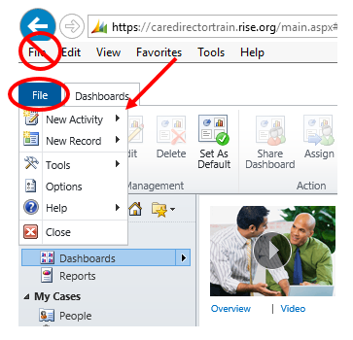
CareDirector
To start a Contact Note in CareDirector click on the blue “File” tab.
Click on “New Activity” and then “Contact Note”.
Make sure NOT to click on “File” in the toolbar ribbon, but rather the blue “File” tab.

Slide 28
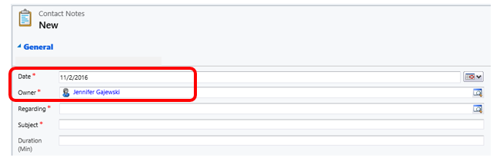
CareDirector
Date: This will automatically fill-in on the date you are typing the contact note. If the contact note is for a different day, please be sure to choose the correct date.
Owner: This will automatically fill-in as you.

Slide 29
CareDirector
Regarding: Choose the name of the person served who is the subject of the Contact Note
Duration (minutes):This is not a required field. You can enter this if helpful or required for your program. If you do use this field, make sure you are entering time in minutes vs. hours.

Slide 30
CareDirector
Subject: The subject line of the Contact Note should contain the principle activity of the service delivery. Do NOT put in the person’s name or a date, as those fields will automatically show in the search feature. Examples of subject lines could include:
Eval
ARMHS
Placement
Team Meeting
Transportation Issue
Hospitalization

Slide 31
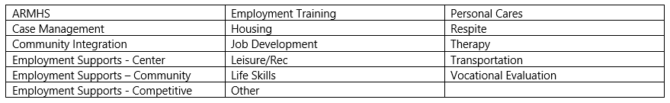
CareDirector
Category: This is a required field. It can be helpful to further categorize the Contact Note and can be used as a sorting tool for reporting purposes.

Slide 32
CareDirector
Sub-Category:
Each category has its own set of sub-categories.
This allows you to further define and categorize the Contact Note.
The Sub-Category is an optional field.

Slide 33
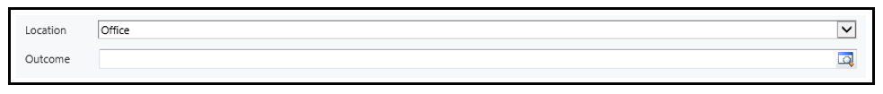
CareDirector
Location: This is an optional field. If helpful to your program, please indicate if whether the contact with the person served occurred in the community, a home, or an office.
Outcome: The Outcome section of CareDirector has not been built yet. At this time, leave this field blank. In the future you will have the ability to tie a Contact Note with a specific outcome.

Slide 34
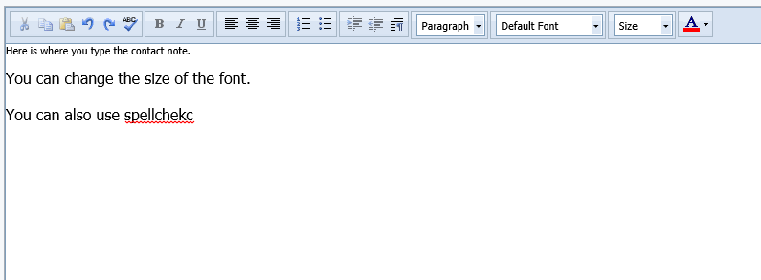
CareDirector
Body of the Contact Note:
As noted below, you can change the font size and use spellcheck.
Please remember that Contact Notes are professional and legal documents. Read through what you typed and look for any spelling or grammatical errors.

Slide 35
CareDirector - Customizations

Slide 36
CareDirector – Customizations
Support Activities:
The items on the remaining slides, in the CD section, are all customizations made to the Contact Note.
We have one contact note template that must meet multiple needs in various programs.
These fields were created for IPS, Placement, and ARMHS. While it is not possible to customize for every specific program need, in the case of these three services it was seen as necessary given their strict reporting requirements.
These fields are not required for all programs.
If they apply to your program or the service you are providing, please choose those that apply.

Slide 37
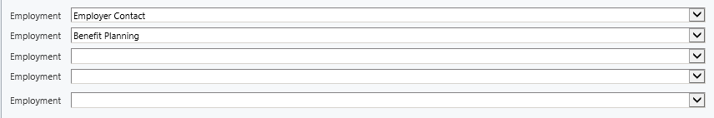
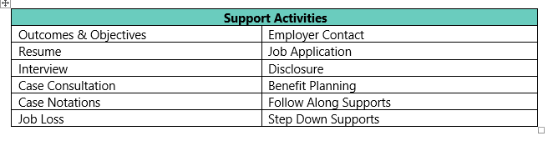
CareDirector – Customizations
Employment: There are 5 pick list fields that allow you to choose a support activity. For each activity that is chosen there must be a narrative paragraph within the contact notes that addresses this. In the example below both employer contact and benefit planning were chosen. This means that both topics must have their own paragraph within the Contact Note.

Slide 38
CareDirector – Customizations
ARMHS Mod: For those who bill under ARMHS there are five modifiers available in this pick list:
Individual
Group
Functional Assessment
Individual Treatment
Community Intervention

Slide 39
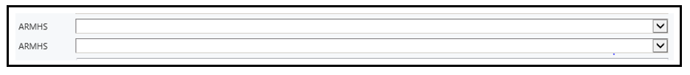
CareDirector – Customizations
ARMHS: There are two pick lists for ARMHS support activities. The activities include:
Care Coordination
Benefit Planning
Not Medically Necessary
Coordinate w/: Use this look-up field to indicate who you need to coordinate services with.

Slide 40
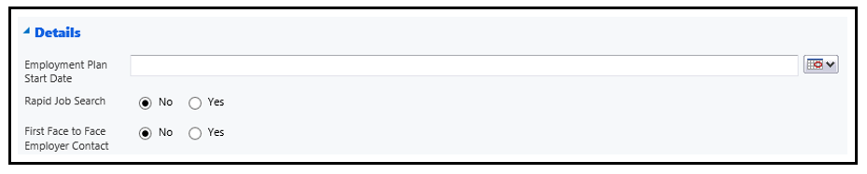
CareDirector – Customizations
Details Section: This is specifically for those who are billing under IPS.
Employment Plan Start Date: Enter in the date the employment plan started.
Rapid Job Search: Within 30 days of program entry an initial employment assessment and first face-to-face contact with an employer has occurred. This must be checked yes and also addressed in the contact note.
First Face to Face Employer Contact: Within 30 days of the employment plan starting, the first face-to-face employer contact must checked yes and also addressed in the contact note.

Slide 41
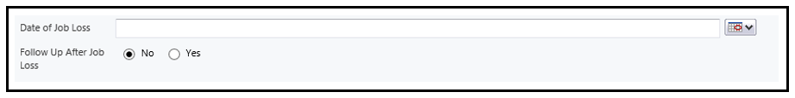
CareDirector – Customizations
Date of Job Loss: Enter the date the job was lost. You must also end the job in the Employment Record.
Follow Up After Job Loss: Within 3 days after a job is lost this must be checked yes and addressed in the contact note.

Slide 42
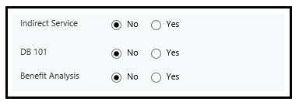
CareDirector – Customizations
If you choose “yes” for any of the items below the topics must also be addressed in the contact note:
Indirect Service
DB101
Benefit Analysis

Slide 43
Conclusion & Next Steps

Slide 44
Conclusion
Thank you for taking the time to review this training.
Writing Contact Notes is an important part of your job and documents the services we are providing to the people we support.
If you have further questions about Contact Notes, please be sure to ask your supervisor.
REMEMBER: Don’t click on “Mark Complete” as the Contact Note will then be locked and can’t ever be altered. Your supervisor may choose to do this after they review the Contact Note for content.

Slide 45

Next Steps
Talk to your supervisor so that you understand any specific requirements or considerations for your program.
If you have any questions about Contact Notes please contact your supervisor or a SuperUser.

