Slide 1
Neonatal & pediatric adrenal and urinary system
Chapter 26

Slide 2
Objectives:
Upon completion of this presentation, students will be able to:
Describe exam preparation and protocols for the neonatal/pediatric urinary system.
Discuss normal anatomy and sonographic findings of neonatal/pediatric kidneys, adrenals, and urinary bladder.
Recognize congenital urinary tract anomalies and distinguish from pathology.
Identify bladder outlet obstructions and their sonographic appearances.
Explain the different malformations of the genitalia.

Slide 3
Indications
Numerous indications for a renal ultrasound in the newborn period:
  Hydronephrosis
  Palpable mass
  Abdominal distention
  Anuria
  Oliguria
  Hematuria
Sepsis
Myelomenigocele
Chromosomal anomalies
Abnormal external genitalia
Prune-belly syndrome

Slide 4
EXAMINATION PREPARATION
Patient should be evaluated with a full bladder
Multiple transducers can be used depending on age and size of the patient:
  10 MHz tightly curved array for neonates and infants
  7.5 MHz tightly curved array for toddler/thin children
  9 – 12 MHz linear array for premature infants
  3 – 5 MHz curved array for adolescents

Slide 5
EXAMINATION PREPARATION (cont’d)
Begin imaging at the level of the bladder first as infant’s urinate spontaneously and young children have difficulty holding their bladder
Obtain images of the pre-void bladder including wall measurement
With the bladder still full, survey the kidneys and perirenal areas to assess for fluid and to document echogenicity compared to liver/spleen
Allow the patient to void and re-examine the bladder post-void
Fully examine the kidneys to include longitudinal and transverse views showing in detail the superior, mid, and inferior poles
  infants and young children- usually start prone
  older children and adolescents- usually decubitus

Slide 6
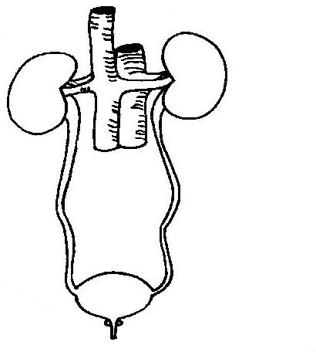
Let’s review!!

Slide 7
kidneys
Fetal lobulation may be visualized
  Remnants of lobes with incomplete fusion
Glomerular filtration rate is low right after term birth; increases rapidly thereafter
Renal pyramids remain large in comparison to surrounding cortex
  Cortex will continue to grow as pyramids regress in size
Less cortical fat in neonates allows for clear distinction of cortical-medullary differentiation

Slide 8
Kidneys (cont’d)
Medullary pyramids large and hypoechoic
Surrounding cortex quite thin; echogenicity essentially similar to or slightly greater than normal liver parenchyma
Renal cortical echogenicity normally decreases to less than liver parenchyma, usually by 4 to 6 months of age
Renal parenchyma consists of peripheral cortex, glomeruli, and several extensions to edge of renal sinus (column of Bertin)
Medulla is more central- adjacent to calices
Normal cortex produces low-level, back-scattered echoes

Slide 9
Kidneys (cont’d)
Medullary pyramids- hypoechoic and arranged around central, echo-producing renal sinus
Arcuate vessels- intense specular echoes at corticomedullary junction
Increased cortical echogenicity results from glomeruli occupying larger proportion of cortical volume and location of 20% of loops of Henle within cortex as opposed to medulla

Slide 10
Kidneys (cont’d)
Normal renal length varies with the age of the neonate or pediatric patient
Left kidney is somewhat longer
  Kidney measurement greater than 1 cm side to side should be monitored closely, and may indicate infection, scarring, or congenital abnormalities, such as hypotrophy or duplicated renal system

Slide 11
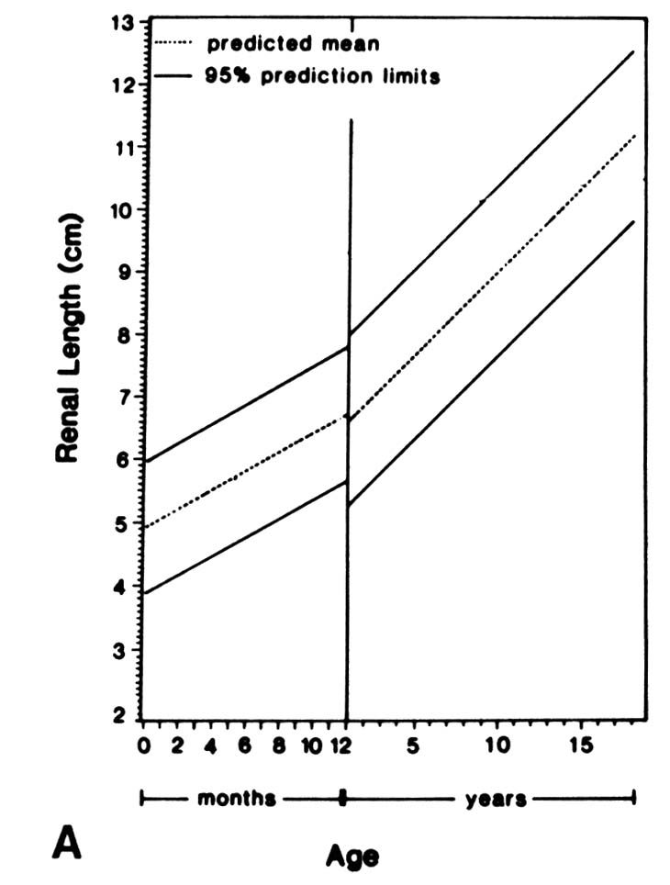
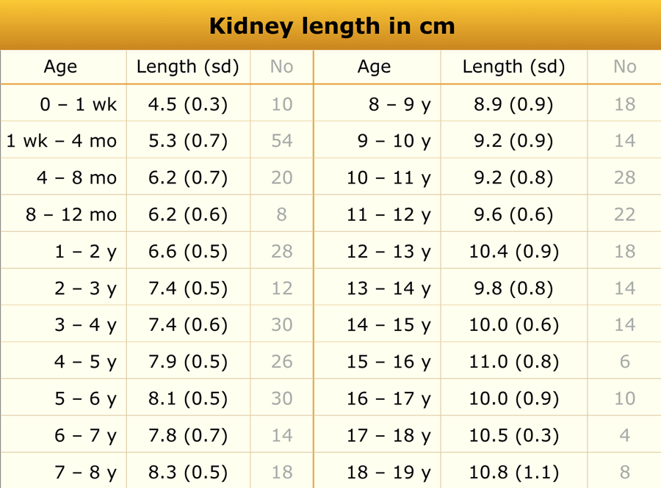
https://radiologyassistant.nl/pediatrics/normal-values/normal-values-ultrasound

Slide 13
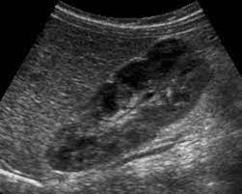
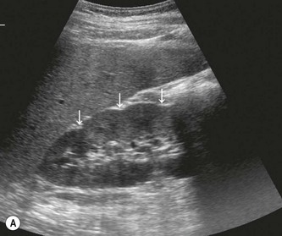
https://quizlet.com/155060220/pediatrics-chap-27-28-flash-cards/
https://radiologykey.com/ultrasound-of-the-renal-tract/

Slide 14
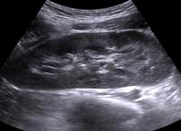
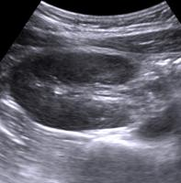

Slide 15
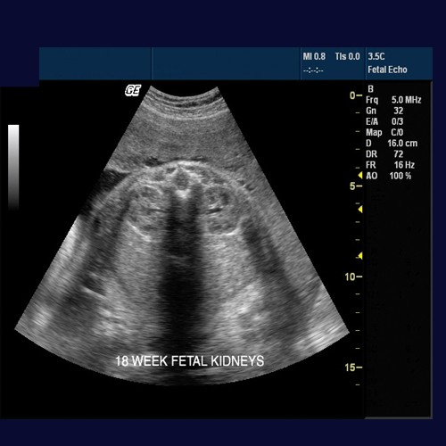
Best plane to document: Presence
Size
Characteristics

Slide 16
Kidneys (cont’d)
Anomalies of position, form, orientation:
  Pelvic kidney
  Horseshoe kidney
  Crossed ectopy
  Renal duplication

Slide 17
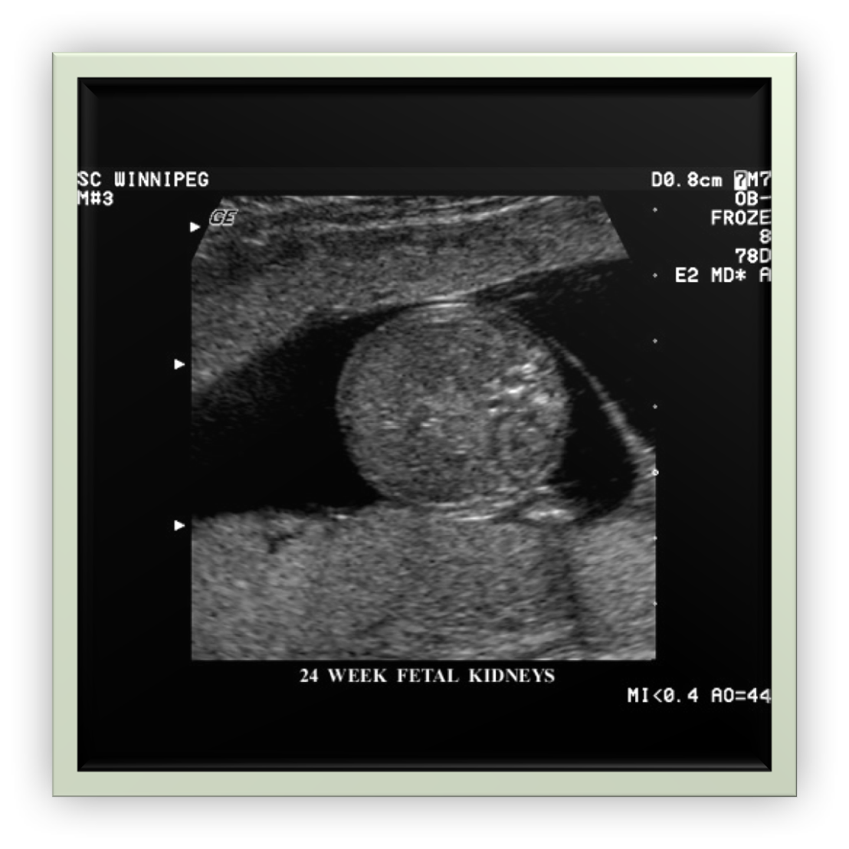
What can you do to improve visibility?

Slide 18
Adrenal glands
Larger and more easily identified in the neonate than in older infant or young child
Left adrenal gland extends slightly more medial than the right
Sonographically, the gland has an inverted “V” or “Y” shape in the longitudinal plane
  Central medulla appears as a thin echogenic stripe surrounded by less echogenic cortex
When the kidney is absent, ipsilateral adrenal gland may have an altered configuration

Slide 19
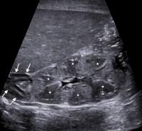
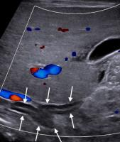

Slide 20
Urinary bladder
The normal urinary bladder is thin-walled in the distended state and should measure less than 3 mm (with a mean of 1.5 mm) in AP
When empty, the wall thickness increases but remains less than 5 mm

Slide 21
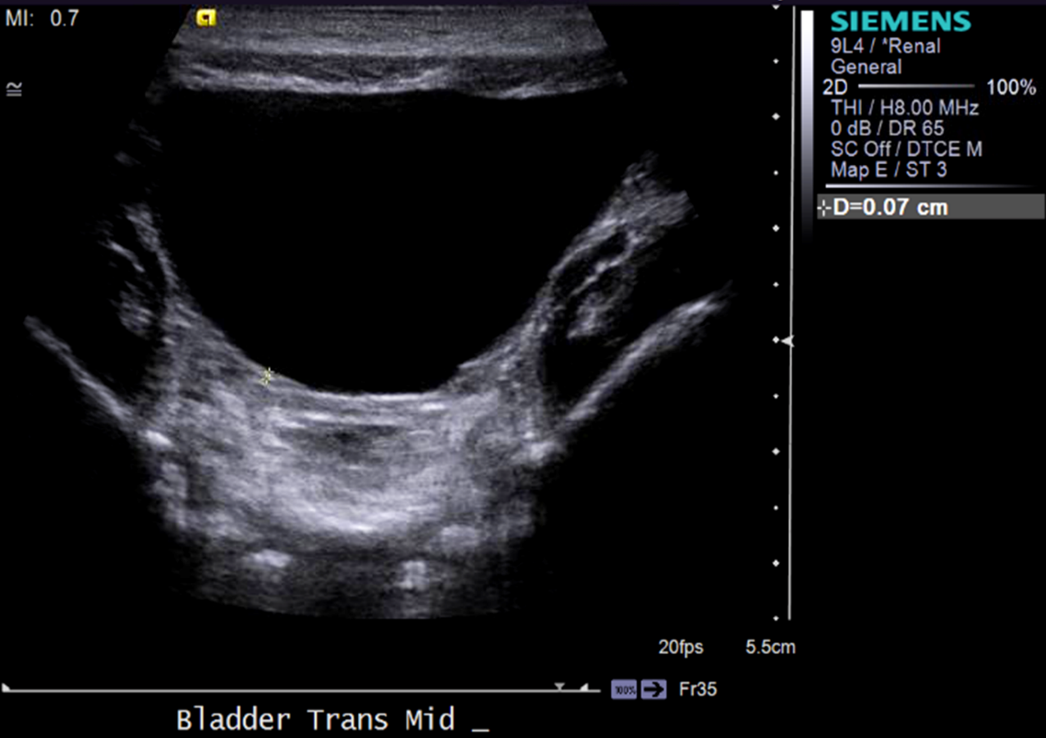
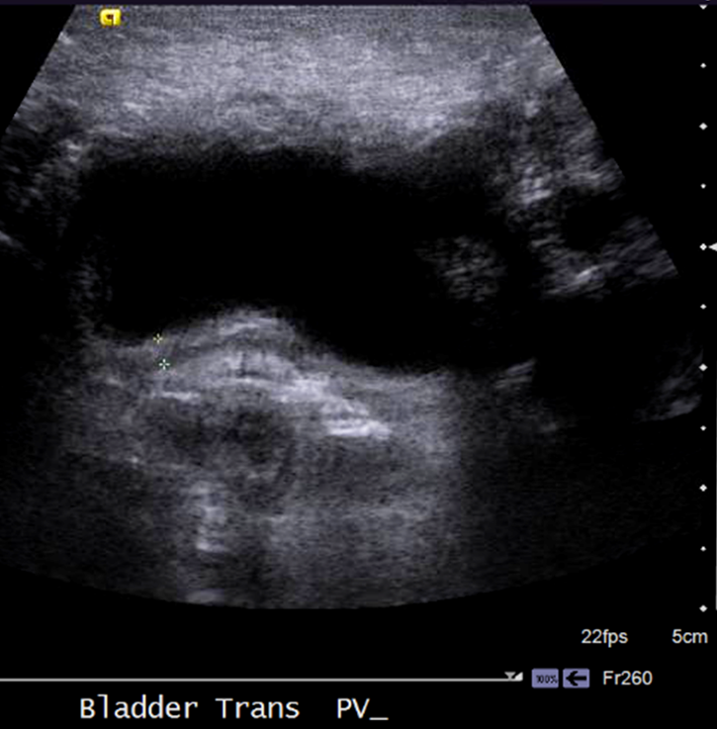
Normal bladder in 1 day old infant

Slide 22
Renal, adrenal, and bladder pathology

Slide 23
Congenital urinary tract anomalies
  Hydronephrosis
  Patent urachus
  Multicystic dysplastic kidney disease (MCDK)

Slide 24
Hydronephrosis
Aka. Urinary tract dilatation (UTD)
Dilation of the urinary collecting system
*Most common urinary tract anomaly in children
* Most common cause of palpable mass in the neonate
Causes of dilation of the collecting system:
  Obstruction
  Reflux
  Abnormal muscle development

Slide 25
Hydronephrosis (cont’d)
Determine the severity of the hydronephrosis, whether the condition is unilateral or bilateral, if the ureters and bladder dilated, and the status of the renal parenchyma
Sonographic features:
  Visible renal parenchyma surrounding central cystic component
  Small peripheral cysts budding off large central cyst
  Dilated ureter

Slide 26
Vesicoureteral reflux (VUR)
Common, nonobstructive cause of hydronephrosis
VUR is abnormal refluxing of urine from the urinary bladder through the ureters and into the kidney
Five different grades: 1- least severe, 5- most severe
Treated conservatively because it is nonobstructive and most resolve within 2 years
Low urine output is normal at birth, typically waiting 7-10 days is preferential

Slide 27
VUR (cont’d)
Sonographic findings:
  Often nonspecific
  May or may not have hydronephrosis
  Pelvic or ureteral wall thickening
  Dilation of collecting system
  Megaureter
  Displaced ureteral jet in bladder

Slide 28
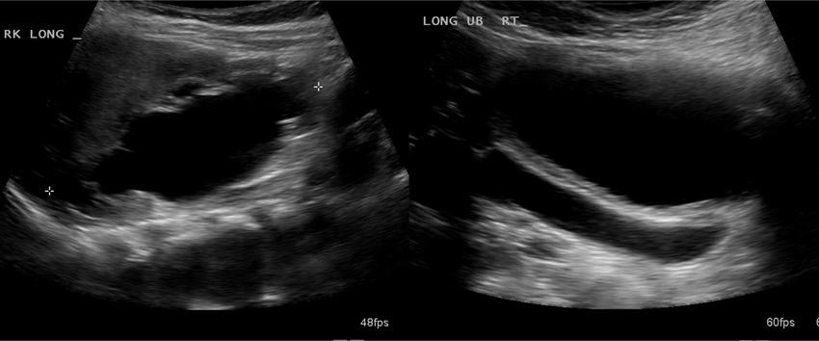

Slide 29
Ureteropelvic junction(UPJ) obstruction
*Most common type of obstruction causing hydronephrosis
3:1 male prevalence
Results from intrinsic narrowing or extrinsic vascular compression at the level of the UPJ
  Obstruction produces proximal dilation of the collecting system
  Ureter is often normal in caliber unless vesicoureteral reflux (VUR) or megaureter is present
Increased incidence of abnormalities in contralateral kidney

Slide 30
UPJ (cont’d)
Sonographic Findings:
Pelvocalyceal dilation without ureteral dilation
When obstruction pronounced, dilated renal pelvis extends inferiorly and medially
If vesicoureteral reflux or primary megaureter is present, ureter may be dilated

Slide 31
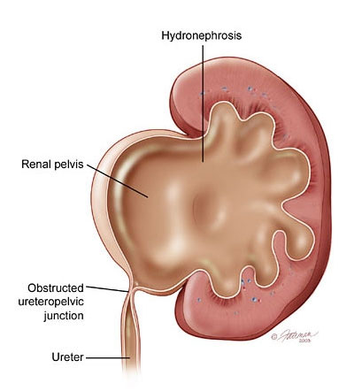
https://www.endourologytraining.in/ureteropelvic-junction-obstruction/

Slide 32
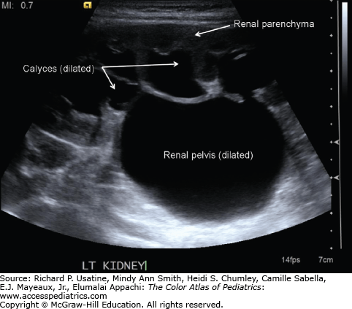

Slide 33
Ureteral obstruction
Ureter may be obstructed anywhere along its course or at ureterovesical junction
Abscess or lymphoma may cause:
  Obstruction to ureter
  Presence of primary megaureter
  Atresia
  Ectopic ureter may be cause of obstruction
Sonographic findings:
  Hydronephrosis and hydroureter with narrow segment of distal ureter behind bladder
  Diminished ureteral jet may be seen in the bladder with color Doppler on the side of the obstruction

Slide 34
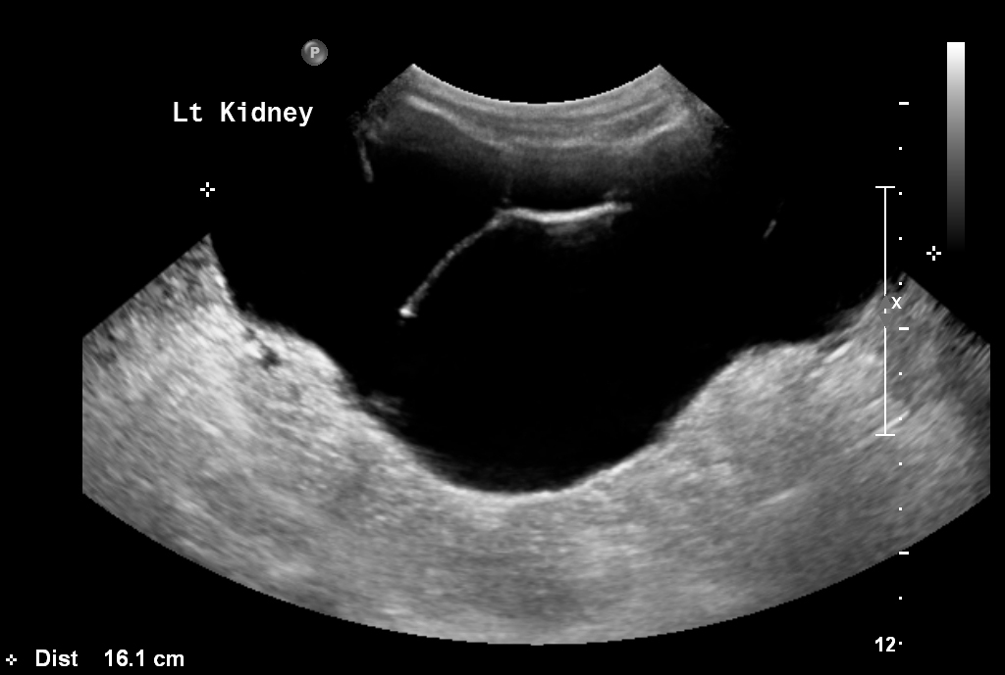
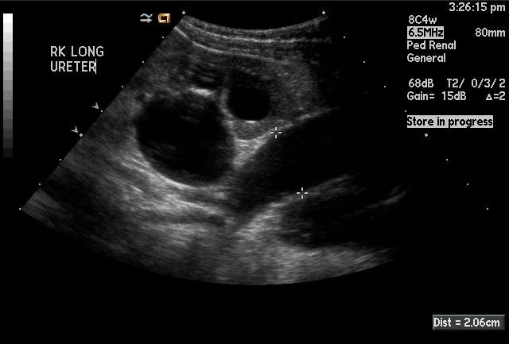

Slide 35
Duplex collecting system & Ectopic ureterocele
Aka. Duplex or double kidney
Results from an ectopic bladder insertion and cystic dilation of the distal ureter of the upper pole from a completely duplicated renal collecting system
More commonly in the female and more often on the lef
Appears as a fluid mass within the urinary bladder
Sonographic findings:
  dilated upper pole and ureter to the bladder

Slide 36
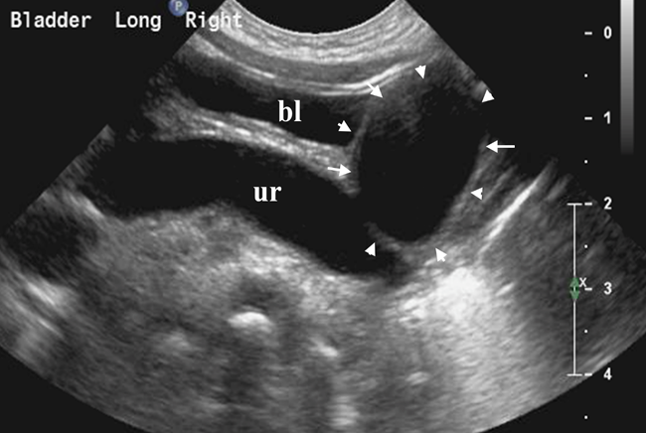
Duplex collecting system & ectopic ureterocele

Slide 37
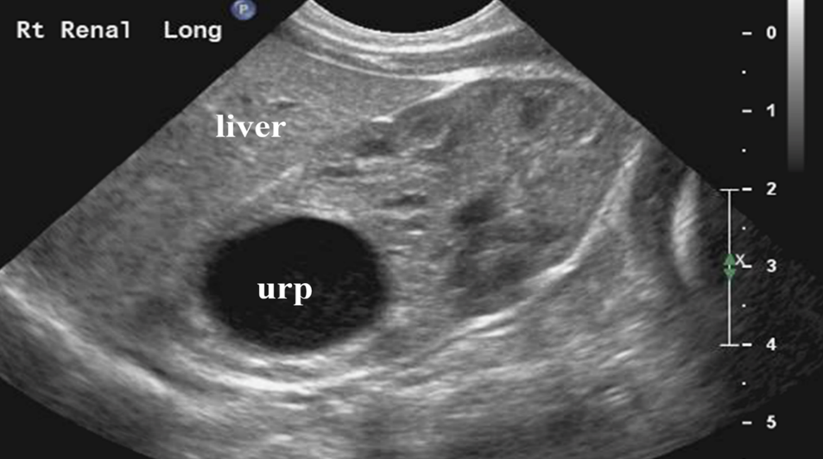

Slide 38
Bladder outlet obstruction
Bilateral hydronephrosis is frequently caused by obstruction at the level of bladder or bladder outlet
Bladder may be obstructed by neurogenic bladder, pelvic mass, or congenital anomaly such as posterior urethral valves

Slide 39
Bladder outlet obstruction (cont’d)
Sonographic findings:
  May identify perirenal urinoma- anechoic structure filled with urine
Other potential causes of perirenal urine extravasation include:
  trauma
  UPJ obstruction
  UVJ obstruction
  pelvic masses that cause obstruction of the bladder or ureter

Slide 40
Posterior Urethral Valve Obstruction (PUV)
*Most common cause of bladder outlet obstruction in male neonate
Caused by excessive flaps of tissue in posterior urethra
Sonographic findings:
  Keyhole appearance of bladder (neonatal)
  Wall of bladder appears thickened and trabeculated
  Midline sagittal imaging with caudal angulation may allow visualization of distended posterior urethra
  Perineal approach may also be helpful to image posterior urethra
  Hydronephrosis and hydroureter are usually bilateral
  May identify perirenal urinoma- anechoic structure filled with urine

Slide 41
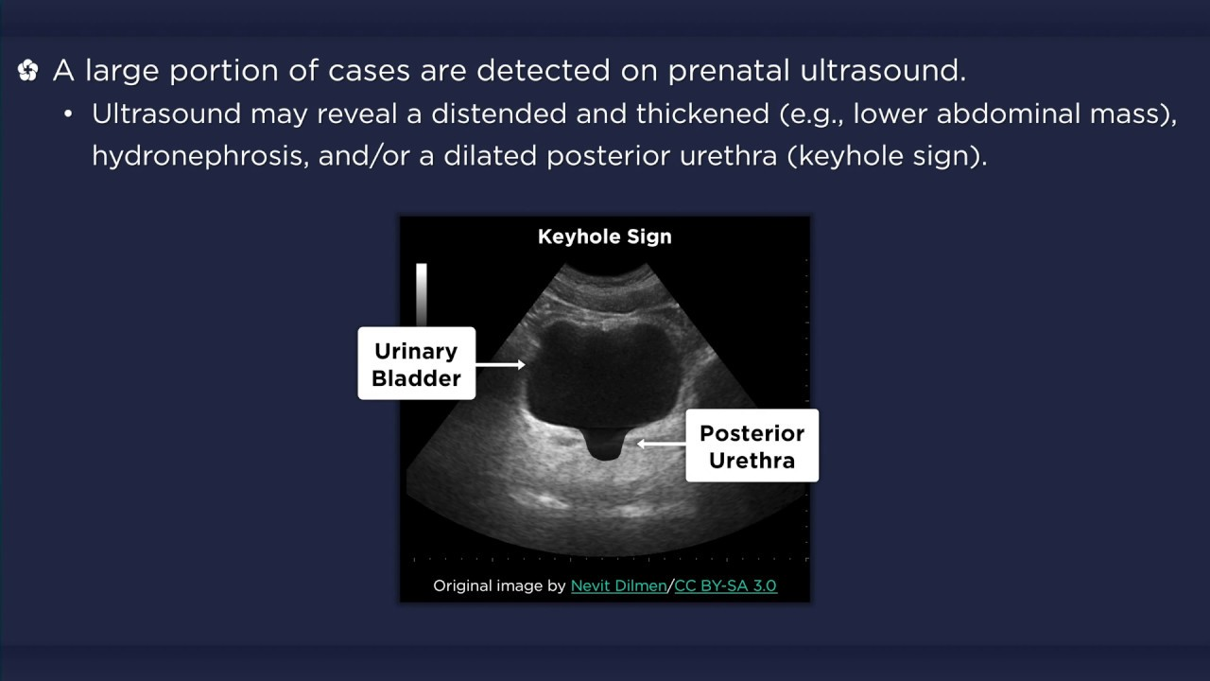
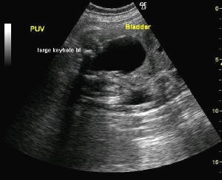
puv

Slide 42
Urethral atresia
Occurs in females
Similar findings as in PUV
Less common
Need to know gender!!!!

Slide 43
Prune-belly syndrome
Abdominal muscle deficiency syndrome- sever distention of abd cavity
Aka. Eagle-Barrett Syndrome
Rare, congenital anomaly of unknown etiology
Males (96% of cases)
  severe cases results in early infant death due to pulmonary hypoplasia
Triad of clinical findings:
  hypoplasia or deficiency of the abdominal musculature
  bilat. cryptorchidism
  urinary tract anomalies- dilated ureters and bladder

Slide 44
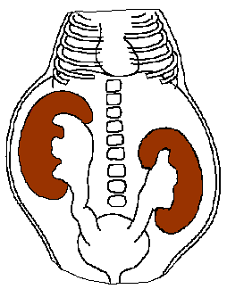

Slide 45
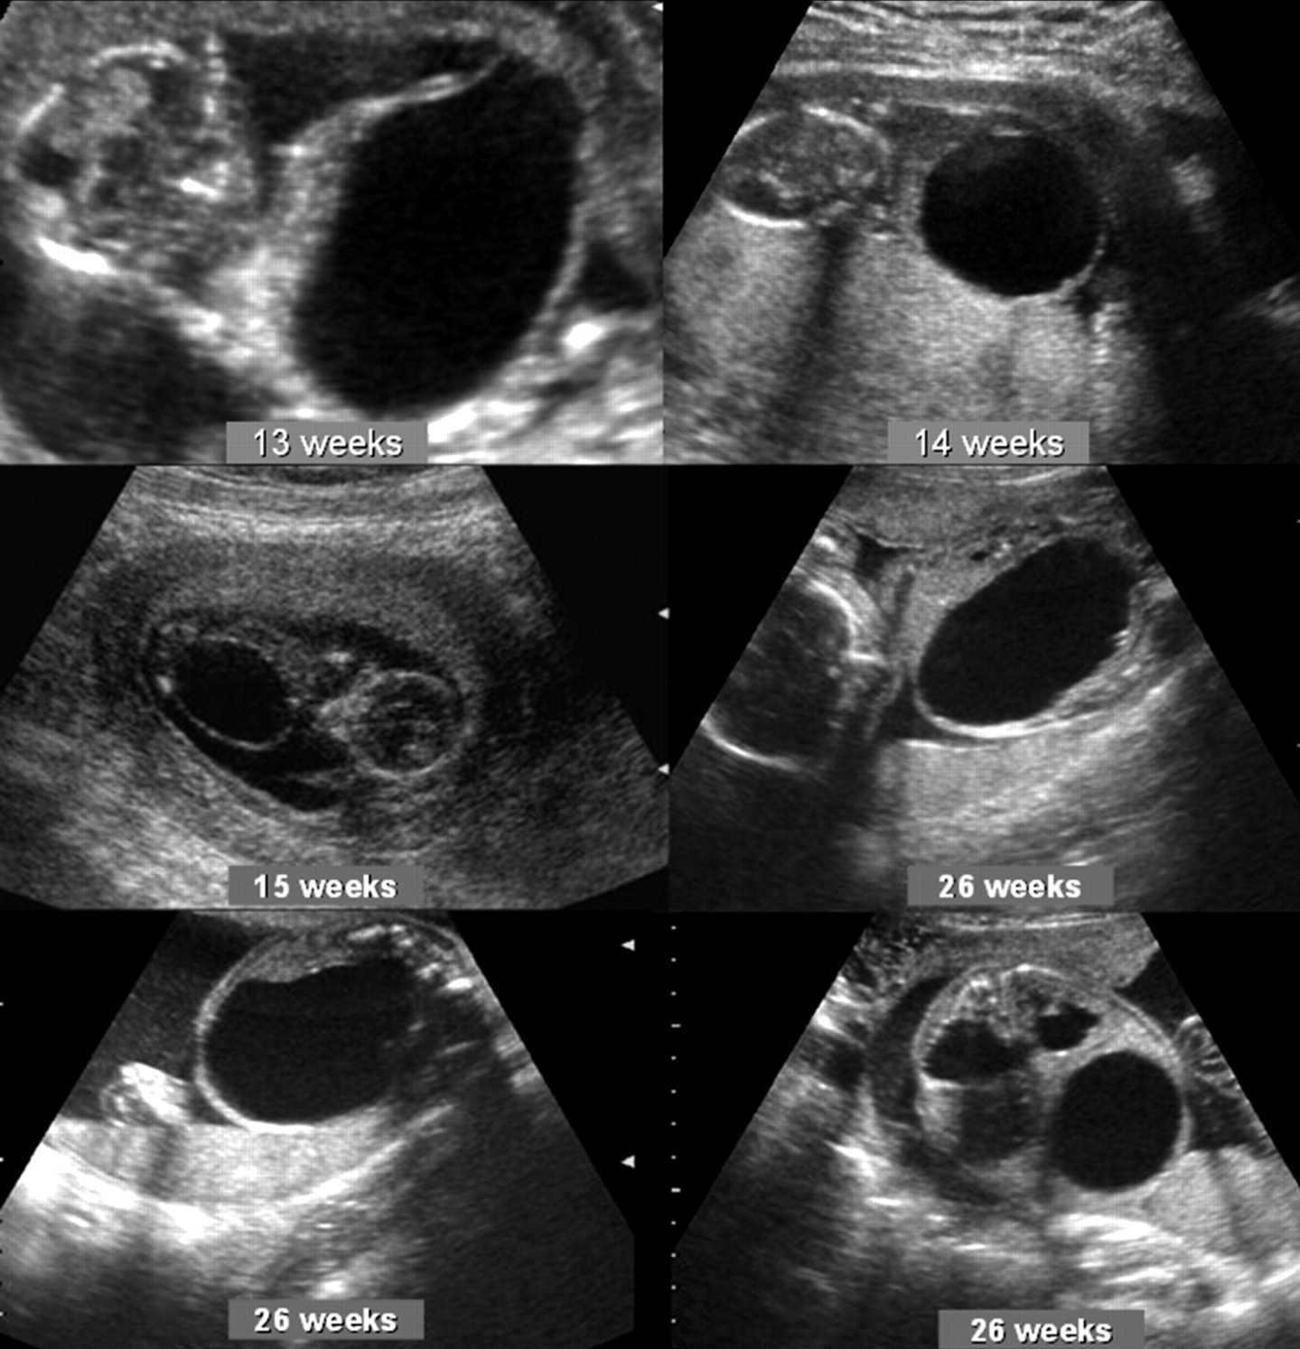

Slide 46
Renal cystic disease

Slide 47
Multicystic dysplastic kidney (MCDK)
*Most common cause of renal cystic disease in neonate when hydronephrosis is
excluded
*Most common cause of abdominal mass in newborn
Congenital, usually sporadic, renal dysplasia
  Secondary to severe, generalized interference with ureteral bud function during first trimester

Slide 48
Mckd (cont’d)
Collecting tubules enlarge, becoming cystic, grossly distorting the shape of the kidney
Remaining renal parenchyma becomes virtually nonfunctioning
Nearly half the cases have contralateral abnormalities
Sonographic findings:
  Classic appearance is unilateral mass resembling “cluster of grapes” that represent multiple discrete noncommunicating cysts
No identifiable renal pelvis

Slide 51
Hereditary Renal Cystic Disease
Hereditary renal cystic disease, which may present in the neonate or pediatric patient include:
  Autosomal recessive polycystic kidney disease (ARPKD)
  Autosomal dominant polycystic kidney disease (ADPKD)
  Tuberous sclerosis
  Von Hippel-Lindau disease
  Medullary cystic disease/nephronophthisis

Slide 52
Autosomal recessive polycystic kidney disease (ARPKD)
Typical pathologic presentation: diffuse enlargement, sacculations, cystic diverticula of medullary portions of kidneys
Most severe form seen in neonatal stage- usually fatal within months
Less severe in infantile to juvenile stage
  Always bilateral
  Always congenital hepatic fibrosis
Mutation of PKHD1 gene on chromosome 6
Kidneys appear hyperechoic, enlarged with hypoechoic rim representing cortex compressed by expanded pyramids (sponge-like)

Slide 53
Autosomal recessive polycystic kidney disease (ARPKD) (cont’d)
Sonographic findings:
  Bilateral renal enlargement
  Diffuse increased echogenicity and loss of definition of renal sinus, medulla, cortex
  Less severe cases: hepatosplenomegaly and portal hypertension, with normal to echogenic renal parenchyma
  Pulmonary hypoplasia and Potter fascies may be associated findings

Slide 54
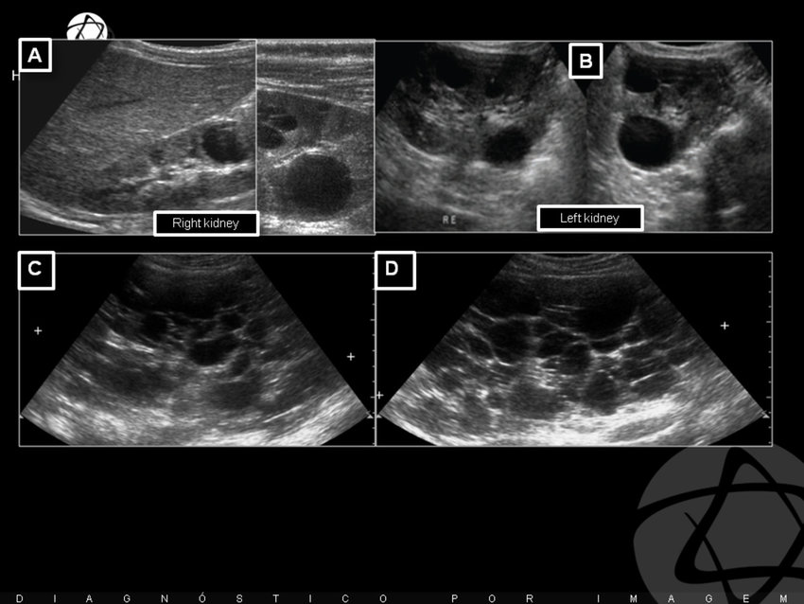
Arpkd (cont’d)

Slide 55
Autosomal dominant polycystic kidney disease (ADPKD)
Adult dominant form of polycystic kidney disease usually appears during middle age (30-50 yrs)
Rarely reported in young infants
90% of cases inherited, 10% are sporadic
Cysts are macroscopic of varying size; can also form in liver, spleen, pancreas
Cerebral berry aneurysms known to occur in 10% to 15% of patients with ADPKD
Increased incidence of RCC

Slide 56
Adpkd (cont’d)
Clinical findings:
  Hypertension
  Microscopic/gross hematuria
  Flank pain- stones in 20-30%
Sonographic findings:
  Enlarged, often echogenic, multicystic kidneys
  Often difficult to distinguish borders
  Cysts in other organs such as liver, spleen, pancreas, ovaries, etc.

Slide 57
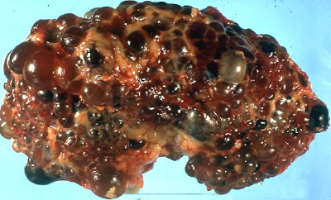
https://www.renalfellow.org/2008/04/23/ultrasound-criteria-for-adpkd/

Slide 58
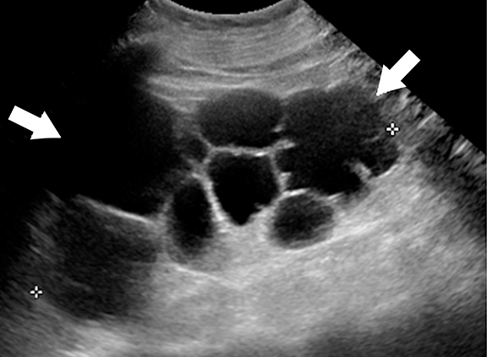
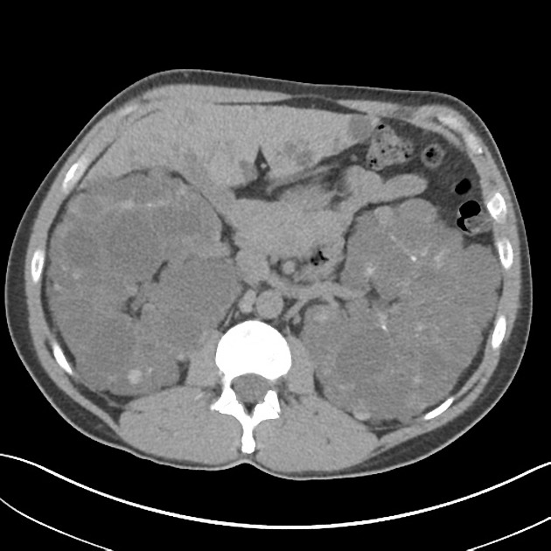

Slide 59
Urinary tract infections (UTI)

Slide 60
Acute pyelonephritis
Clinical symptoms include:
  sudden fever
  flank pain
  tenderness
Infection usually begins in bladder and ascends the ureter into renal pelvis
Sonographic findings:
  renal size may be slightly enlarged with altered renal parenchyma echogenicity secondary to edema
  Color Doppler demonstrates absence of color in affected area of kidney

Slide 61
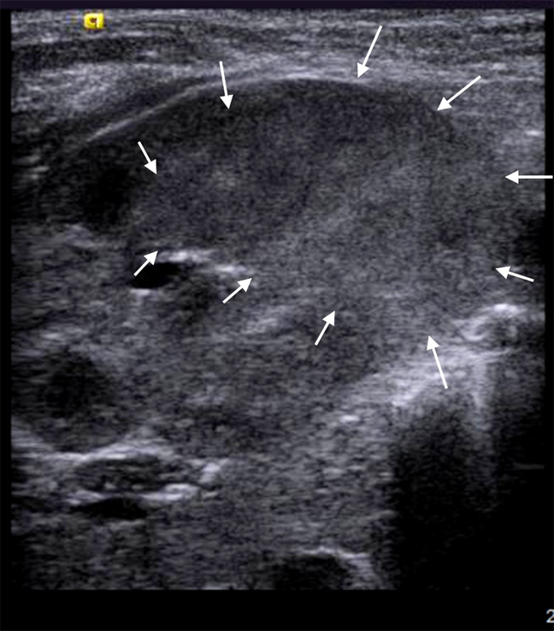
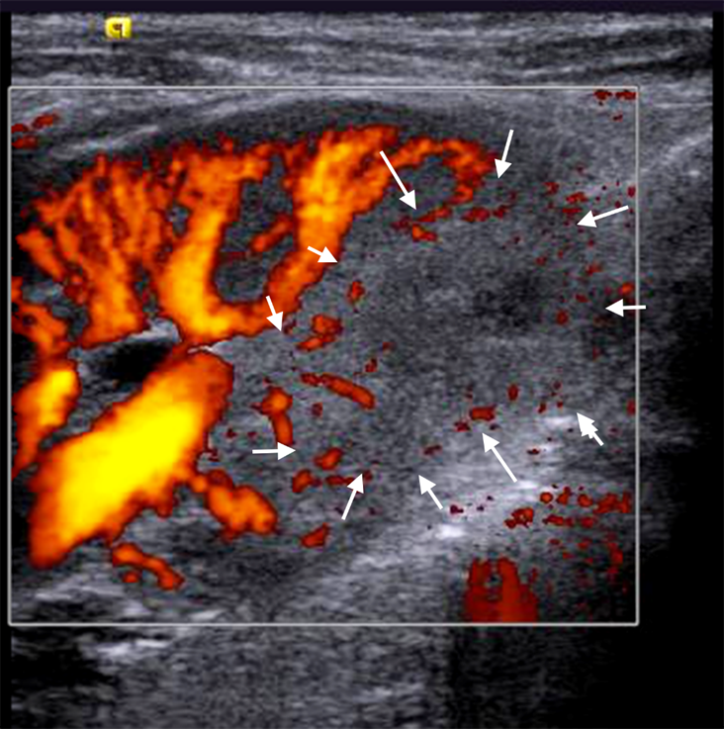
Acute pyelonephritis

Slide 62
Chronic pyelonephritis
Repeated episodes of acute pyelonephritis cause the kidney to become scarred and decrease in size
Outline of the kidney may be irregular from scarring
Renal cortex becomes more echogenic than liver parenchyma
Renal pyramids become difficult to separate from the renal parenchyma

Slide 63
Acquired pathology

Slide 64
nephrocalcinosis
Often in preemies (6-41%)
Calcification of the renal parenchyma, often in the medulla and rare in the cortex
Many underlying causes including:
  Infants receiving long-term treatment for lung or heart disease
  Medullary sponge kidney (Cacchi-Ricci disease)
  Bartter syndrome

Slide 65
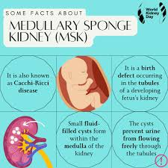
https://encrypted-tbn0.gstatic.com/images?q=tbn:ANd9GcRRxLiCrTP-Ur7ukuOd47u-dSJ40pMMfe4uHU_uN0olmw&s

Slide 66
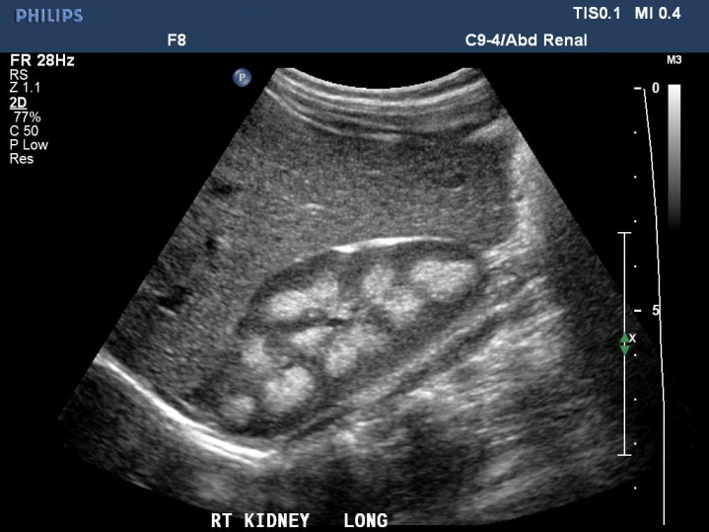
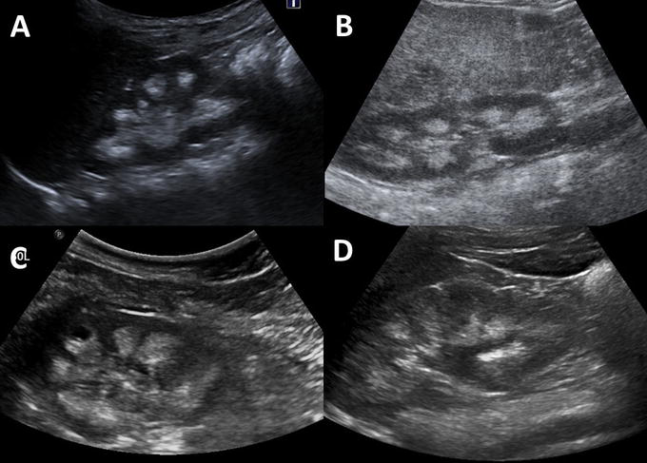
https://www.intechopen.com/chapters/67118

Slide 67
Renal vein thrombosis
Renal vein thrombosis is most likely to occur in dehydrated or septic infants
More prevalent in infants born to diabetic mothers or infants with shock, glomulonephritis ,or nephrotic syndrome
One or both kidneys may be involved
If thrombus reaches renal vein or IVC, it may be directly visualized within the vascular lumen

Slide 68
Renal vein thrombosis (cont’d)
Clinical findings:
  Hematuria
  Low platelet count
Sonographic findings:
  Renal enlargement
  Intrarenal vascular calcifications
  Renal parenchymal echogenicity
  Coexisting adrenal hemorrhage (lt >rt)

Slide 69
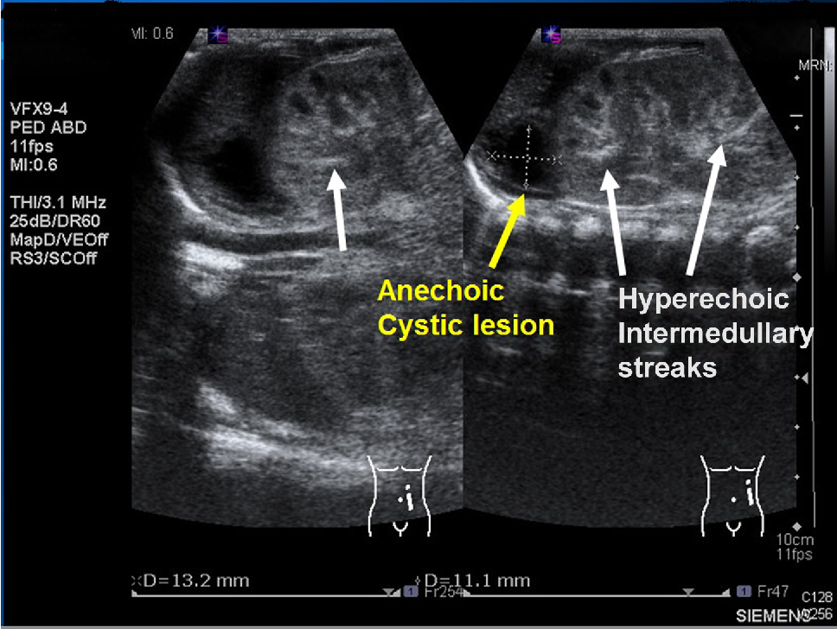
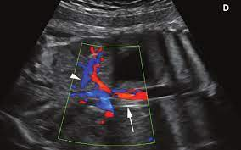
https://www.semanticscholar.org/paper/Unusual-Presentation-of-Renal-Vein-Thrombosis-in-a-Yang-Fu/e08ed0e0b00fa82c78bf6a40a0841711eb169dad
https://onlinelibrary.wiley.com/doi/abs/10.7863/ultra.34.8.1509

Slide 70
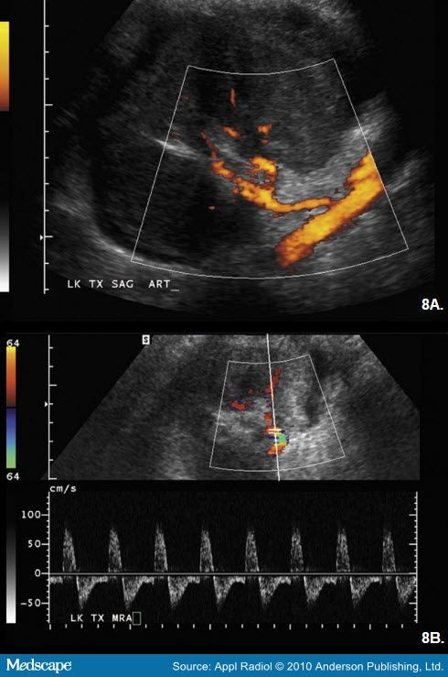

Slide 71
Adrenal hemorrhage
Difficult delivery, large size, infants of diabetic mothers, stress, hypoxia at delivery, septicemia, and shock are all predisposing factors
Sonographic findings:
  Ovoid enlargement of gland or portion of gland
  Appearance can range from anechoic to hyperechoic, or may be a mix of echogenicity depending on age and severity of process

Slide 72
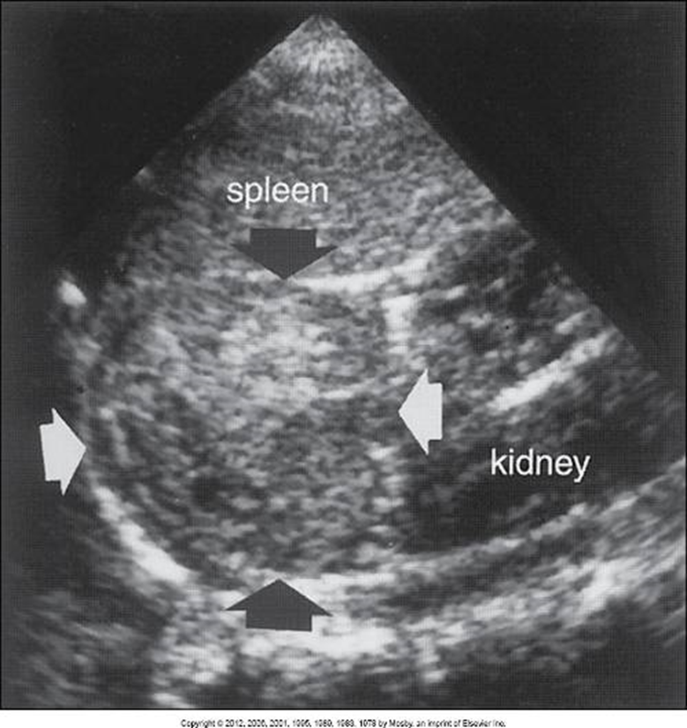
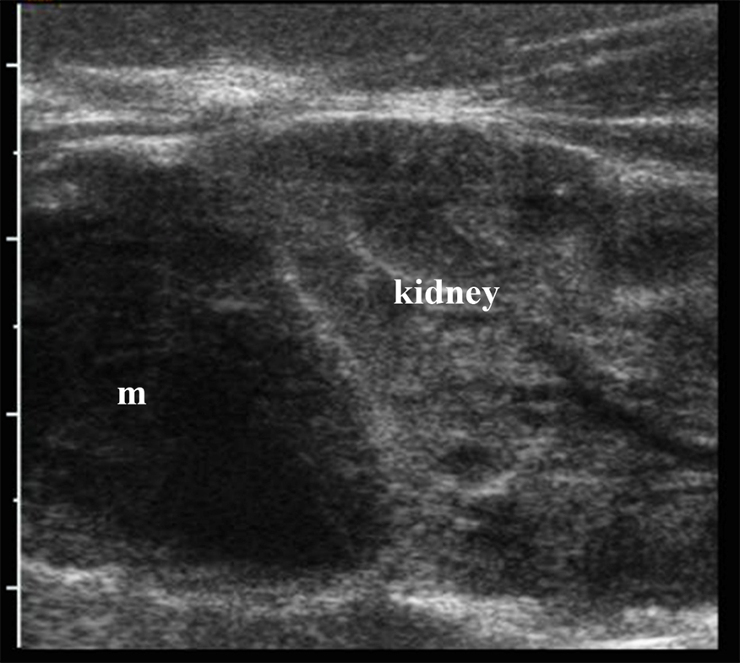

Slide 73
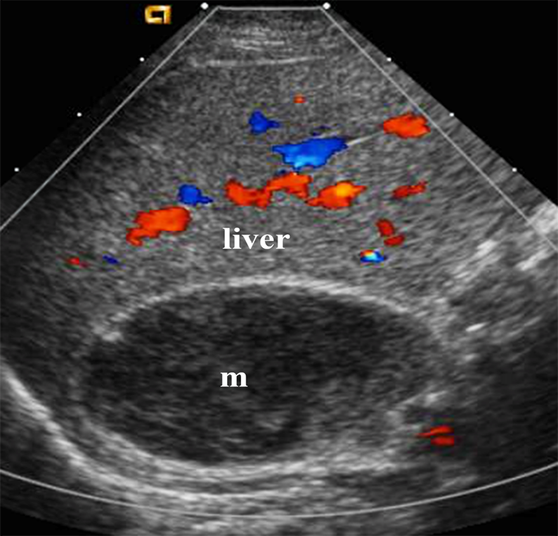
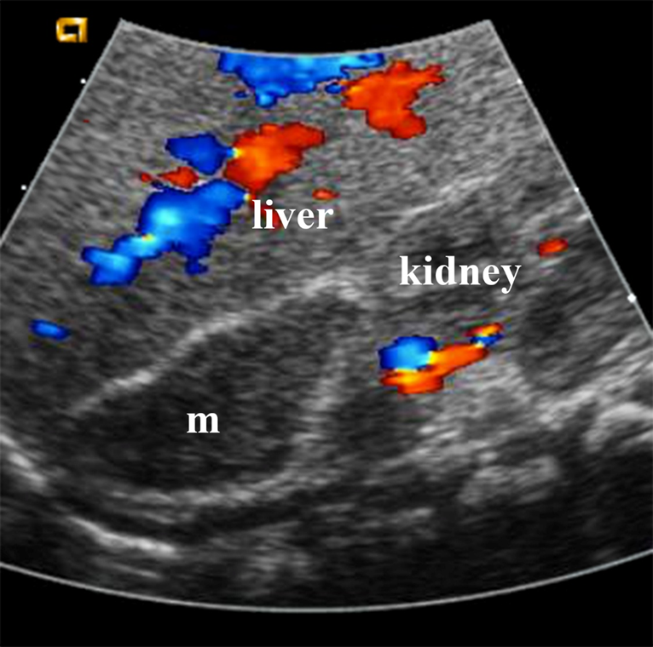

Slide 74
Nephroblastoma (wilms tumor)
*Most common intraabdominal malignant renal tumor in young children
  peaks between 2 and 5 years
Usually unilateral
Sonography can detect tumoral spread into renal vein, IVC, right atrium, and contralateral kidney
Spreads through renal sinus and peripelvic soft tissues, lymph nodes in renal hilum, and paraaortic areas

Slide 75
wilms tumor (cont’d)
Sonographic findings:
  Bulky, solid mass that can will distort renal sinus, pyramids, cortex, contour of kidney
  Hydronephrosis may be present
  Variable echotexture, areas of echogenicity and calcifications within
  May demonstrate liquefaction if necrosis and hemorrhage occur

Slide 76
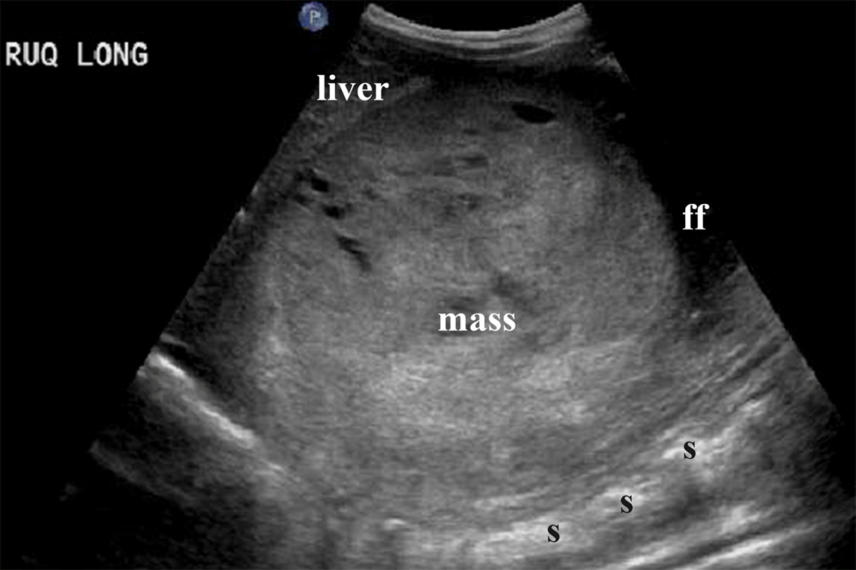
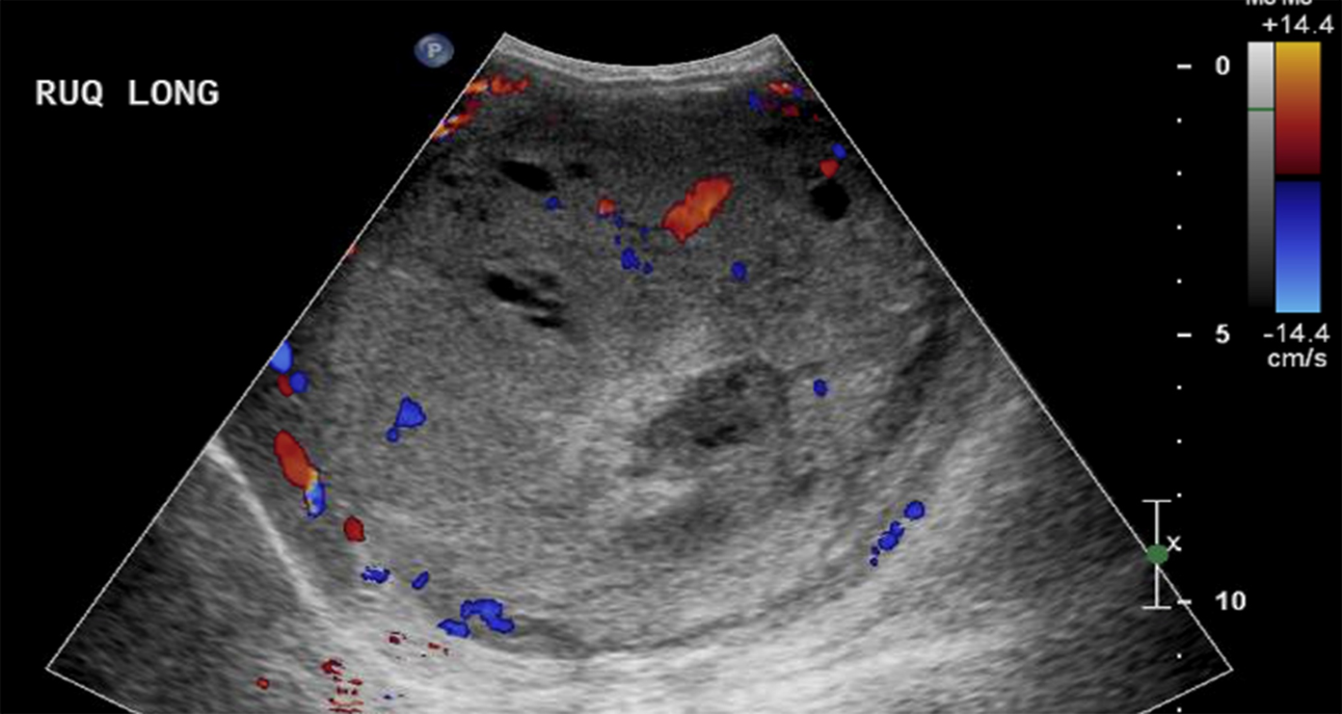
Nephroblastoma (wilms’ tumor)

Slide 77
wilms tumor (cont’d)
Predisposing factors:
  hepatoblastoma
  pancreatoblastoma
  Beckwith-Wiedemann syndrome
Wilms tumor may also occur spontaneously
Differentials include:
  neuroblastoma
  congenital mesoblastic nephroma

Slide 78
Congenital mesoblastic nephroma
Although rare, it’s the most common renal tumor of neonate
Benign, indistinguishable from Wilms
Sonographic findings:
  Solid lesion with mixed echogenicity
  Mass may extend through renal capsule into retroperitoneum
  Found in children <1 year of age (Wilms occurs in children older than one year)

Slide 79
neuroblastoma
*Most common malignancy in children under one year
Malignant tumor arises in adrenal medulla
May be detected on antenatal sonography or at birth
Second most common abdominal tumor of childhood, occurring between 2 months and 2 years

Slide 80
Neuroblastoma (cont’d)
Sonographic findings:
  Highly echogenic
  Calcification may be identified
  Small tumors are homogeneous, large tumors are more complex
  Adjacent kidney is displaced inferiorly
  Use Doppler to distinguish between neuroblastoma and adrenal hemorrhage

Slide 81
Other malignant retroperitoneal tumors
Renal cell carcinoma
Rhabdomyosarcoma
Adrenal malignant tumors
  Pheochromocytoma
  Adrenocortical carcinomas

Slide 82
Genitalia malformations:
Hypospadias
    abnormal opening of the urethra along the ventral aspect of the penis
Cryptoorchidism
    undescended testicle(s)
Hermaphrodites
  ambiguous genitalia
  both ovaries and testicles present
Guevedoces
  born male, look like a female, grow penises at puberty
  lack enzyme that produces dihydrotestosterone
  occurs in a village in DR (also in Turkey and New Guinea)

Slide 83

  https://www.pbs.org/video/9-months-made-you-jonnys-story/
  https://www.bbc.com/news/magazine-34290981

Slide 84
Think questions…..
Discuss the pitfalls a sonographer may encounter in a fetus with renal agenesis.
In a fetus with multicystic dysplastic kidney, what should the sonographer look for in the contralateral kidney?
If hydronephrosis is noted on the obstetric ultrasound examination, what should be examined by the sonographer?
Why is it important to document the fetal gender on an ultrasound examination?

