Slide 1
PROSTATE

Slide 2
Objectives:
Upon completion of this presentation, students will be able to:
Describe the embryology of the prostate and its relational anatomy.
Discuss the function of the prostate and correlating lab values.
Identify the indications for a prostate ultrasound.
Discuss protocol and the sonographic appearance of the prostate.
Distinguish between benign and malignant processes.
Recognize the process of a prostate biopsy.

Slide 3
ANATOMY
LIES BETWEEN THE UROGENITAL DIAPHRAGM AND BLADDER OUTLET
OVAL,CONE, OR CHESTNUT SHAPED
AVERAGE SIZE: 3-4 CM IN LENGTH
2-3 CM IN HEIGHT & WIDTH
PROSTATE VOLUME: GENERALLY INCREASES WITH AGE (<30 CC)
ENLARGING PROSTATE PRODUCES MORE PROSTATE SPECIFIC ANTIGEN (PSA)

Slide 4
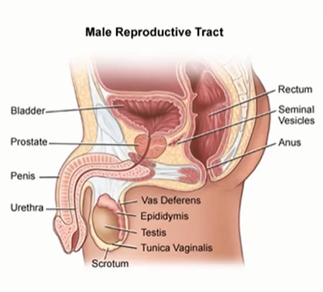
ANATOMY

Slide 5
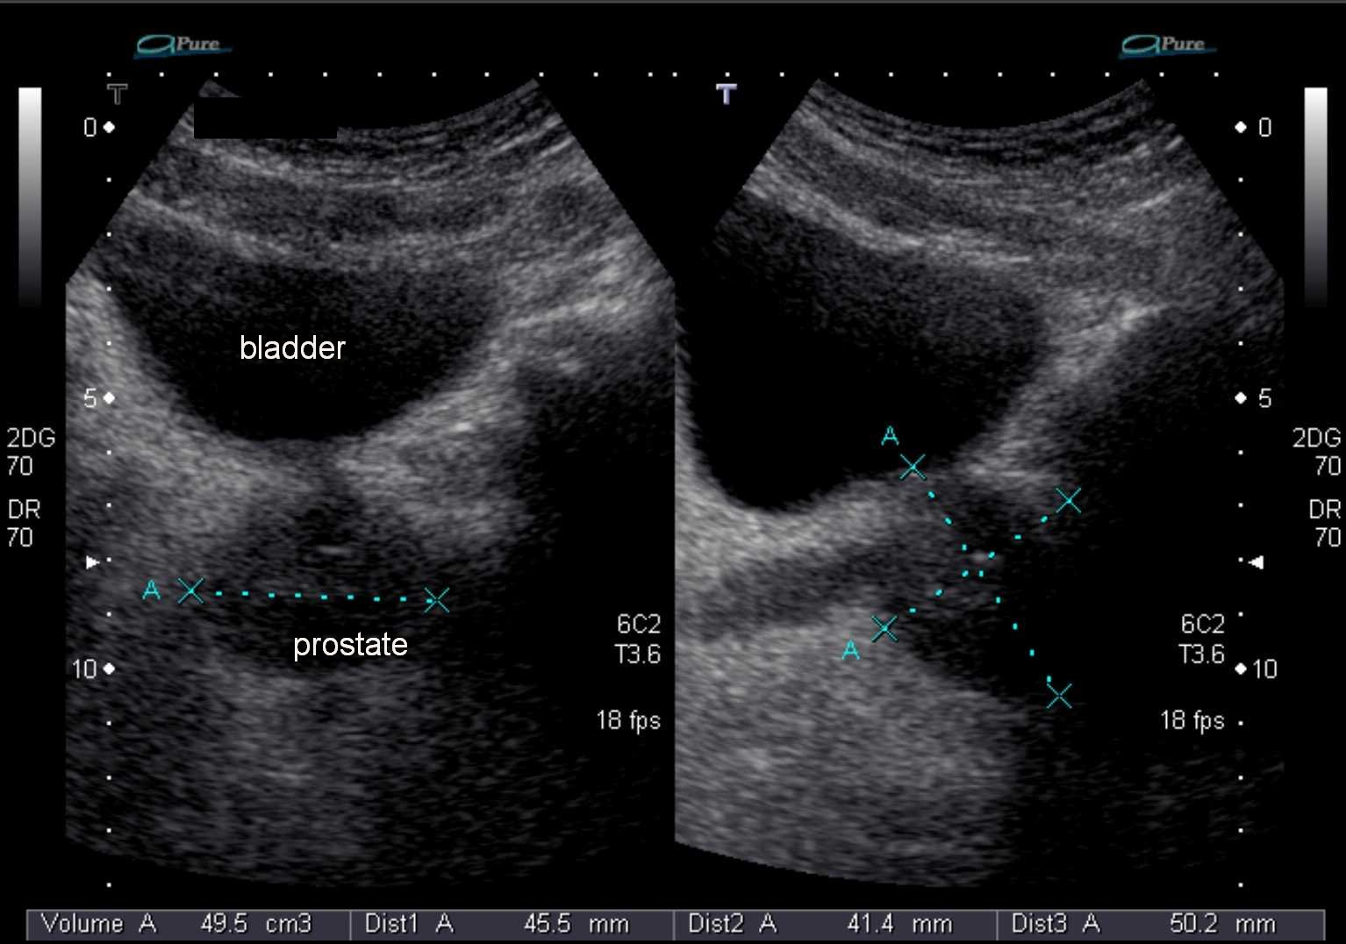

Slide 6
ANATOMY (cont’d)
COMPOSED OF GLANDULAR AND FIBROMUSCULAR TISSUE
ENCAPSULATED WITH COLLAGEN, SMOOTH MUSCLE AND ELASTIN
FIVE LOBES:
ANTERIOR (FIBROMUSCULAR PORTION)
MIDDLE
POSTERIOR
LATERAL (2)

Slide 7
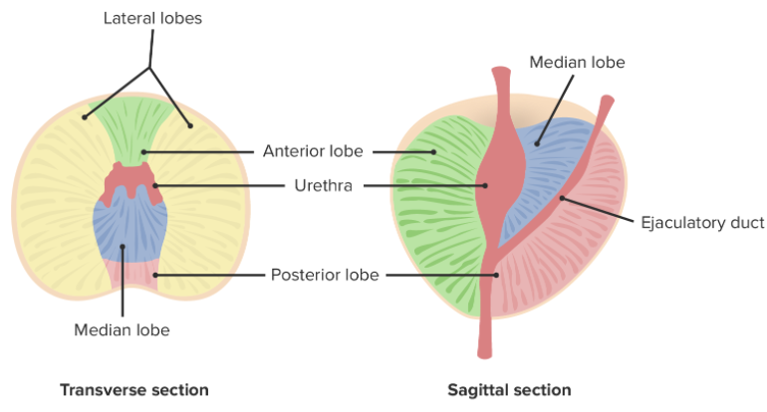
ANATOMY

Slide 8
ANATOMY (cont’d)
FOUR MAIN REGIONS:
CENTRAL ZONE (CZ)
BASE OF PROSTATE
25% GLANDULAR TISSUE
PERIPHERAL ZONE (PZ)
70% GLANDULAR TISSUE
EXTENDS FROM THE BASE TO THE APEX IN THE POSTERIOR GLAND

Slide 9
ANATOMY (cont’d)
TRANSITIONAL ZONE (TZ)
5% OF GLANDULAR TISSUE
ENLARGES WITH BPH
ANTERIOR FIBROMUSCULAR STROMA
DEVOID OF GLANDULAR TISSUE
COMPOSED OF ONLY FIBROUS AND MUSCULAR TISSUE

Slide 10
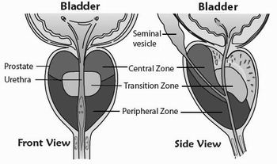

Slide 11
ANATOMY (cont’d)
LOCATION
INFERIOR TO SEMINAL VESICLES AND BLADDER
SURROUNDS PROSTHETIC URETHRA
ANTERIOR TO RECTUM
POSTERIOR TO SPACE OF RETZIUS

Slide 12
FUNCTION
SECRETES A THIN, ALKALINE FLUID INTO THE PROSTATIC URETHRA BY THE PROSTATIC DUCTS
SECRETION CONSTITUTES THE MAJORITY OF THE SEMINAL FLUID AND AIDS IN THE MOTILITY OF THE SPERM
GLANDULAR TISSUE PRODUCES PROSTATE SPECIFIC ANTIGEN (PSA)
TESTOSTERONE AND DIHYDROTESTOSTERONE REGULATES PROSTATE GROWTH AND FUNCTION
MOST ACCURATE METHOD TO CALCULATE PROSTATE FUNCTION IS B Y CALCULATING PROSTATE-SPECIFIC ANTIGEN DENSITY (PSAD)

Slide 13
LAB VALUES
PROSTATE SPECIFIC ANTIGEN (PSA)
PROTEIN PRODUCED BY NORMAL AND MALIGNANT CELLS OF THE PROSTATE GLAND
NORMAL <4.0 ng/mL
ELEVATED LEVELS OF PSA MAY INDICATE PROSTATE CANCER, A NONCANCEROUS CONDITION SUCH AS PROSTATITIS, OR PROSTATE ENLARGEMENT
PSA ASSAYS
MONOCLONAL
POLYCLONAL

Slide 14
VARIANTS OF THE PROSTATE
AGENESIS OF SEMINAL VESICLE
- ASSOC. WITH IPSIALTERAL RENAL AGENESIS
CYSTS
PROSTATIC UTRICLE CYST
-ASSOC. WITH UNILATERAL RENAL AGENESIS
EJACULATORY DUCT CYST
MULLERIAN DUCT CYST
AGENESIS OF VAS DEFERNS

Slide 15
INDICATIONS FOR EXAM
URINARY SYMPTOMS
ABNORMAL PSA/LAB SCREENING
ABNORMAL DIGITAL EXAM
PAIN
HEMATOSPERMIA
OLIGOSPERMIA
INFERTILITY

Slide 16
SONOGRAPHIC EVALUATION
CAN BE PERFORMED BOTH TRANSABDOMINALLY OR TRANSRECTALLY
*TRANSRECTAL PREFERRED FOR SPATIAL RESOLUTION AND IMAGE OPTIMIZATION

Slide 17
SONOGRAPHIC EVALUATION (CONT’D)
TRANSABDOMINAL:
PATIENT SUPINE WITH FULL BLADDER
CURVILINEAR LOW FREQUENCY TRANSDUCER
USE BLADDER AS A WINDOW
SWEEP THROUGH PROSTATE GLAND LONGITUDINALLY AND TRANSVERSE TO OBTAIN NECESSARY IMAGES AND MEASUREMENTS

Slide 18
SONOGRAPHIC EVALUATION (CONT’D)
TRANSRECTAL:
PATIENT DECUBITUS WITH KNEES CLOSE TO CHEST
HIGH FREQUENCY TRANSRECTAL TRANSDUCER
SWEEP THROUGH PROSTATE GLAND LONGITUDINALLY AND TRANSVERSELY TO OBTAIN NECESSARY IMAGES AND MEASUREMENTS
PREPARE PROBE FOR TROPHON DISNINFECTION UPON COMPLETION OF EXAM

Slide 19
PROTOCOL
TRANSVERSE BASE
TRANSVERSE MID WITH AND WITHOUT MEASURE
TRANSVERSE APEX
TRANSVERSE SEMINAL VESICLES
LONGITUDINAL MID WITH AND WITHOUT MEASURE
LONG RIGHT OF MIDLINE
LONG LEFT OF MIDLINE
LONG SEMINAL VESICLES

Slide 20
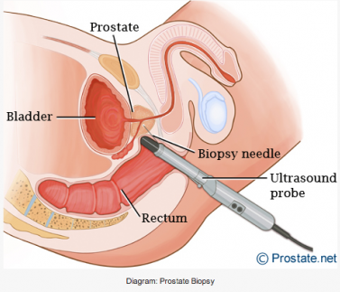
TRANSRECTAL IMAGING

Slide 21
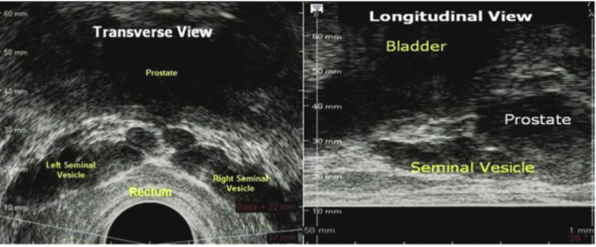
SONOGRAPHIC APPEARANCE SEMINAL VESICLES

Slide 22
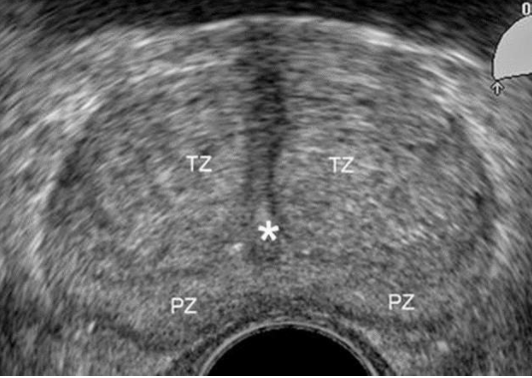
SONOGRAPHIC APPEARANCE TRANS PROSTATE
Anterior
Right
Left
Posterior

Slide 23
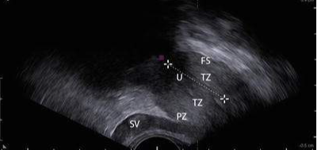
SONOGRAPHIC APPEARANCE LONG PROSTATE
Anterior
Superior-
Base
Inferior-Apex
Posterior

Slide 24
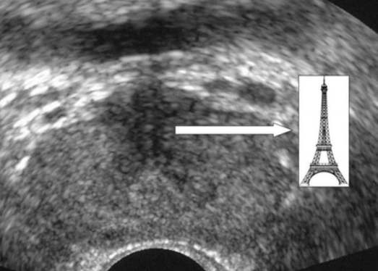
SONOGRAPHIC APPEARANCE VERUMONTANUM
VERUMONTANUM- AREA WHERE SEMINAL VESICLES AND DUCTUS DEFERENS EMPTY INTO THE URETHRA

Slide 25
BENIGN
DISEASES

Slide 26
BENIGN PROSTATIC HYPERTROPHY (BPH)
OVER 70 YRS. OLD
FREQUENTLY ENLARGED MEDIAN LOBE (TRANSITIONAL ZONE) BULGING UPWARD TO BLADDER
SMOOTH ENLARGED GLAND
(SOFT AND SYMMETRIC)

Slide 27
BPH (CONT’D)
SONOGRAPHIC APPEARANCE:
ENLARGEMENT OF GLAND
POSSIBLE ENLARGEMENT WITH OR WITHOUT DISTINCT NODULES
HYPOECHOIC INNER REGION COMPARED TO PERIPHERAL
CENTRAL AND PERIPHERAL ZONES MAY BE COMPRESSED
MINUTE CALCULI (1-2mm) OFTEN CO-EXIST WITH BPH
MAY HAVE THICKENED BLADDER WALL AND TRABECULATIONS
POSSIBLE HYDRONEPHROSIS AND HYDROURETERS
ASYMMETRIC ENLARGEMENT SHOULD BE EVALUATED FOR MALIGNANT CHANGE

Slide 28
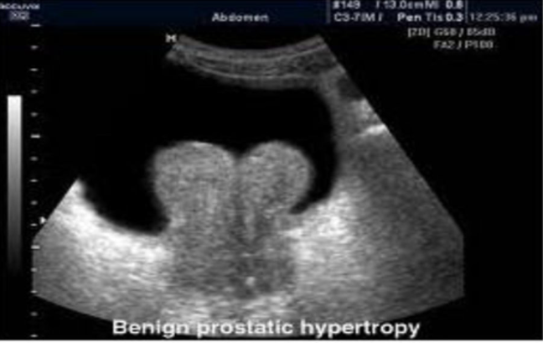
BENIGN PROSTATIC HYPERTROPHY
SONOGRAPHIC APPEARANCE:

Slide 29
BPH (CONT’D)
TREATMENT:
MEDICATION
SURGICAL THERAPIES:
TURP- TRANSURETHRAL RESECTION OF THE PROSTATE
PROSTATECTOMY

Slide 30
PROSTATITIS
ACUTE INFLAMMATION
USUALLY OCCURS IN PERIPHERAL ZONE
COMPLICATION OF ABSCESS FORMATION
SWELLING AND TENDERNESS ON EXAM
DECREASED ECHOGENICITY
UNIFORMLY HOMOGENEOUS
INCREASED VASCULARITY
SONOGRAPHIC FINDINGS:
USUALLY NORMAL APPEARANCE
MAY HAVE DIFFUSE HYPERECHOIC APPEARANCE OF PZ
HYPERVASCULARITY
HYPOECHOIC MASS
ABSCESS

Slide 31
PROSTATITIS (cont’d)
CHRONIC INFLAMMATION
RECURRENT EPISODES OF ACUTE
CLINICAL PRESENTATION VARIES, MAY HAVE MODERATE SWELLING
MAY BE ASYMMETRICAL
SONOGRAPHIC FINDINGS:
INHOMOGENEOUS TEXTURE WITH FOCAL HYPOECHOGENIC AREAS
COMMONLY CALCULI ARE PRESENT
CAPSULAR THICKENING AND/OR IRREGULARITY

Slide 32
PROSTATIC CALCULI
SMALL
2-3 mm
SHADOWING, COULD CAUSE REVERBERATION COMET TAIL ARTIFACT
IN BPH, TYPICALLY ARRANGED IN CHAIN NEAR NODULE
LARGE
DENSE ECHOGENIC FOCI WITH SHADOWING

Slide 33
PROSTATIC CYSTS
USUALLY ASYMPTOMATIC
ACQUIRED
RETENTION CYSTS
SMOOTH WALL
ANECHOIC WITH POSTERIOR ENHANCEMENT
CONGENITAL
SEMINAL VESICLE

Slide 34
MALIGNANT
DISEASES

Slide 35
CARCINOMAS
SMALLER- GENERALLY LESS ECHOGENIC THAN SURROUNDING TISSUE
LARGER- BECOME ISOECHOIC TO SURROUNDING TISSUE AND EVENTUALLY BECOME MORE ECHOGENIC
*ULTRASOUND NOT ABLE TO DIFFERENTIATE MALIGNANT VS BENIGN LESIONS WITH CERTAINTY

Slide 36
SONOGRAPHIC APPEARANCE
IRREGULAR MARGINATED PERIPHERALLY HYPOECHOIC LESION
CAPSULAR DISTORTION
CAPSULAR DISRUPTION
ECHOGENIC ASYMMETRY
DISTENDED, THICK BLADDER WITH TRABECULATIONS
BILATERAL HYRONEPHROSIS AND HYDROURETERS
LOSS OF SMOOTH CONTOUR INAREA OF LESION INDICATING EXTRACAPSULAR SPREAD
INCREASED VASCULARITY
25% OF CARCINOMAS MAY NOT BE SEEN SONOGRAPHICALLY WITH THE ENDORECTAL PROBE
-LOCATED WITHIN CENTRAL GLAND OR ANTERIOR LOBE
-MAJORITY FOUND IN PERIPHERAL ZONE

Slide 37
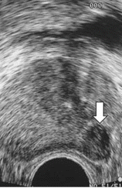
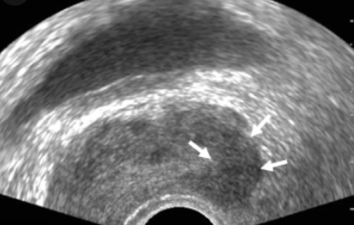
SONOGRAPHIC APPEARANCE

Slide 38
PROSTATE BIOPSY
INDICATED IN PATIENTS WITH QUESTIONABLE LAB WORK OR PRIOR IMAGING STUDIES/ ABNORMAL DIGITIAL EXAM
TRANSRECTAL
TRANSPERINEAL (IF ABSENT RECTUM)
MAY ALSO BE USED FOR ABSCESS DRAINAGE

Slide 39
PROSTATE BIOPSY (CONT’D)
LESION DIRECTED: BASED ON SONOGRAPHIC LESION (RARE)
SYSTEMIC SEXTANT: SYSTEMATIC BX TO PERIPHERAL ZONE ONLY (ex-3 ON THE RT, 3 LT)
PARASAGITTAL SEXTANT: SYSTEMTIC SEXTANT BX + ADDITONAL CORES IN LATERAL ASPECTS OF PERIPHERAL ZONE

Slide 40

Any Questions??

