Slide 1
Penis

Slide 2
Objectives:
Upon completion of this presentation, students will be able to:
Identify the anatomy and blood supply of the penis.
Describe the function of the penis.
Recognize the normal sonographic appearance.
Distinguish the different pathologies of the penis.

Slide 3
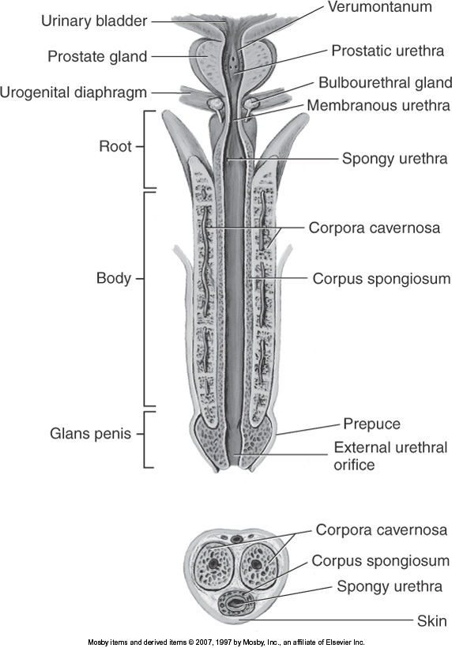
ANATOMY
Root
Body
  Corpora cavernosa x2
  Corpus spongiosum x1
    Contains the urethra
  Tunica albuginea
    Fibrous tissue bounds and separates 3 corpora
Glans penis
Buck’s fascia
  Thick covering of skin enveloping the penis

Slide 4
ARTERIES
Internal Iliac Arteries
Internal Pudendal Arteries
Dorsal Artery
Cavernous Artery
  supplies corpora cavernosa
Bulbourethral Artery
  supplies corpus spongiosum, glans penis, and urethra

Slide 5
VEINS
Superficial Dorsal Vein
  Located outside of Buck’s fascia
Deep Dorsal Vein
  Beneath Buck’s fascia
Pudendal Venous Plexus
Internal Pudendal Vein

Slide 6
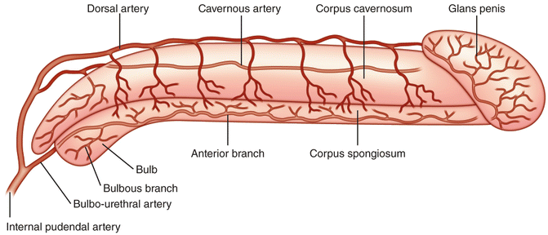
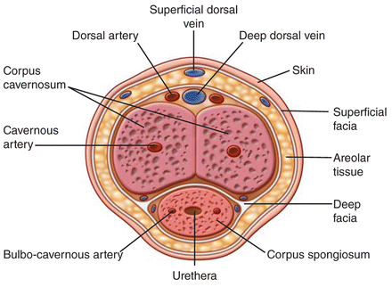
BLOOD SUPPLY

Slide 7
FUNCTION
Eject semen
  Stimulation increases blood supply
  Expansion of arteries, cause compression of veins
  Built up pressure causes bladder sphincter to close during ejaculation

Slide 8
SONOGRAPHIC APPEARANCE
Corpora Cavernosa
  Paired
  Symmetrically round or oval
  Homogenous
  Medium-level echoes
Corpus spongiosum
  Homogenous
  Medium-level echoes
Tunica albuginea (septum penis)
  Echogenic

Slide 9
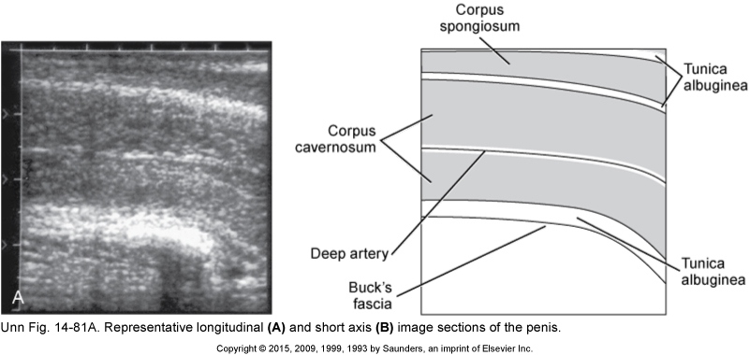
SONOGRAPHIC APPEARANCE

Slide 10
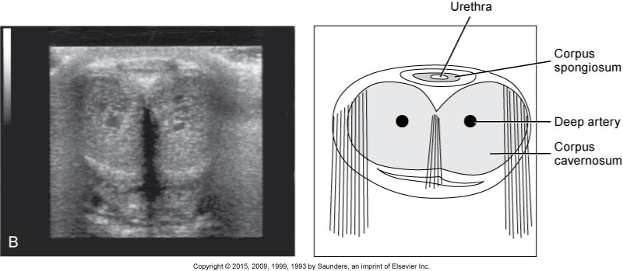
SONOGRAPHIC APPEARANCE

Slide 11
PATHOLOGY

Slide 12
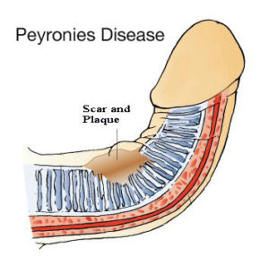
PEYRONIE’S DISEASE
Calcified or fibrous tissue deposited in the dorsal penis
Can cause the penis to bend
Becomes painful when erect
Extent defined by ultrasound

Slide 13
PEYRONIE’S DISEASE
EVALUATION:
  High frequency linear array
  The patient or another sonographer hold the penis
  May scan ventral or dorsal side

Slide 14
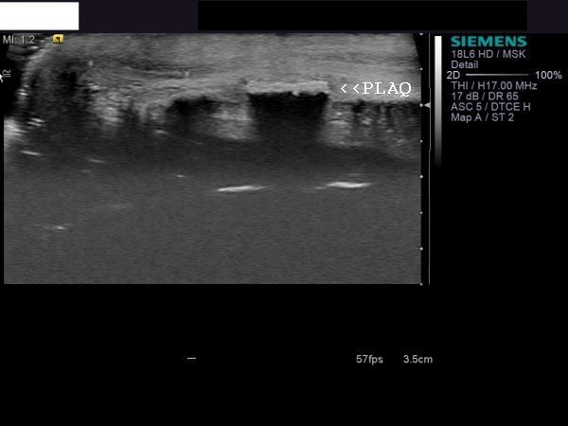
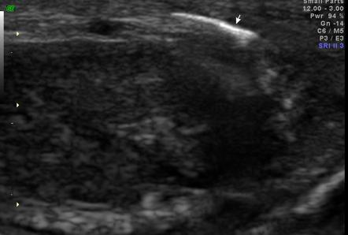
PEYRONIE’S DISEASE
Hyperechoic areas in peripheral margin, may shadow

Slide 15
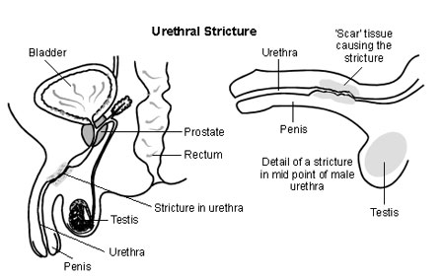
STRICTURE
Urethra becomes narrowed
Develops due to trauma or infection
Sonography determines the length and width of stricture
Seen when urethra distended with fluid

Slide 16
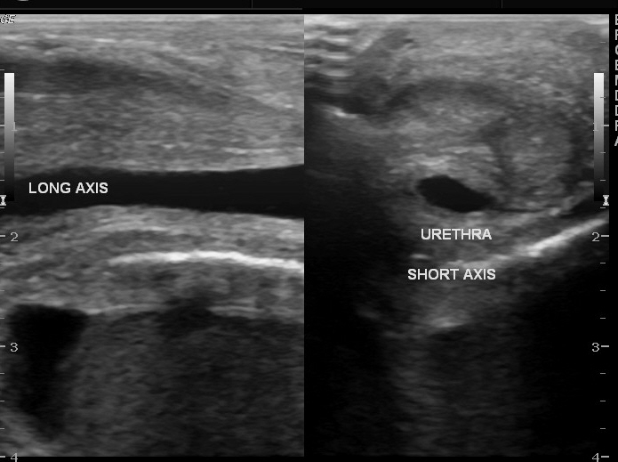
STRICTURE
Sonourethrography
EVALUATION:
  High frequency linear array
  Patient needs distended urethra
    Urine
    Sterile Saline
    Lidocaine gel
  Long and transverse views obtained
  Measure length and width of stricture

Slide 17
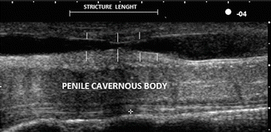
SONOGRAPHIC APPEARANCE
Thickened urethral wall
Decreased lumen

Slide 18
IMPOTENCE
Inability to achieve or maintain erection
Causes:
  Poor arterial flow
    Inadequate systolic flow indicates arterial insufficiency
  Venous leak
    Venous blood leaks out during erection

Slide 19
IMPOTENCE (cont’d)
EVALUATION:
  Scan from ventral side
  First scan with penis flaccid
    Measure diameter and flow of cavernosal arteries
    Doppler angle less than 60 degrees and matching direction of flow
    Measure peak systolic and end-diastolic velocities
  Vasodilator injected into cavernosum
  Measure diameter and velocities every 5 minutes until erection stops

Slide 20
IMPOTENCE (cont’d)
Cavernosal peak systolic arterial velocity >30 cm/sec is normal
Cavernosal systolic arterial velocity<25 cm/sec after injection = poor arterial flow
Cavernosal end-diastolic flow at 15-20 min after injection > or = 5 cm/sec, indicates venous incompetence
  Surgically corrected

Slide 21
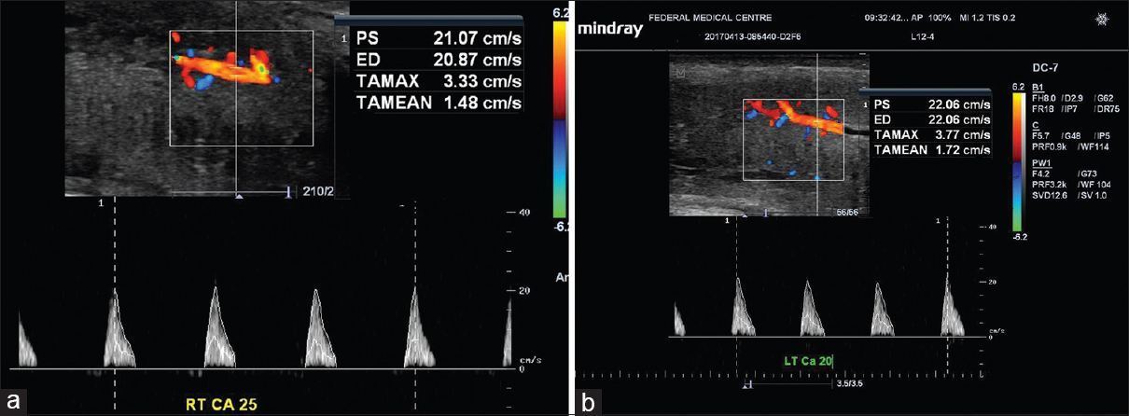
IMPOTENCE

Slide 22
https://youtu.be/X2tubB7Sxlk

