Slide 1
The THYROID GLAND
Chapter 22

Slide 2
Objectives:
Upon completion of this presentation, students will be able to:
Identify the embryology of the thyroid gland.
Describe the normal anatomy and physiology of the thyroid gland, as well as relational anatomy.
Discuss laboratory values and clinical findings .
Describe the indications and sonographic examination of the thyroid.
Identify lymph node levels and the significance of lymph node mapping.
Recognize thyroid pathologic conditions and their sonographic appearances.

Slide 3
Embryology
First endocrine gland to develop
Develops at the floor of the primitive larynx at the same location as the base of the tongue and migrates inferiorly along the anterior neck to the lower neck anterior to the trachea.
Migration may leave behind embryonic remnants or ectopic thyroid tissue that should atrophy but can form developmental cysts

Slide 4
Anatomy of the Thyroid Gland
Located in anteroinferior neck at level of thyroid cartilage (Adam’s apple area)
“H” or “U” shape
Right and left lobe
Connected by isthmus-straddles trachea anteriorly
Rt and lt lobes bounded laterally by carotid arteries and jugular veins
Notes:
The gland consists of a right and left lobe located along either side of the trachea and connected across the midline by the thin bridge of thyroid tissue called the isthmus.

Slide 5
Anatomic Variations
Pyramidal lobe- arises from caudal portion of thyroglossal tract, small and usually cephalic extension of isthmus
arising from lt >rt lobe
seen in 15-30% of patients
most commonly seen in peds patients and atrophies with age
Absence of thyroid
Absence of an isthmus
Absence of 1 lobe
Continuation from 1 lobe to the other, obliterating the isthmus

Slide 6
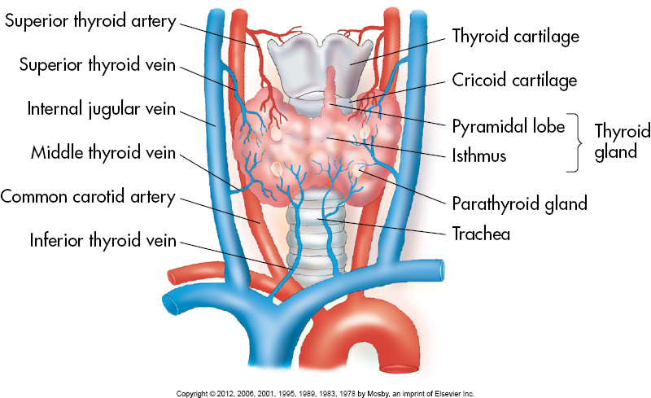
Anatomy of the Thyroid Gland

Slide 7
Size
*Largest endocrine gland
Females have slightly larger gland than males
Lobes normally equal in size
Children- 20-30mm (SAG) x 12-15mm (AP) x 10-15mm (TRV)
Adults- 40-60mm (SAG) x 20-30mm (AP) x 15- 20mm (TRV)
Isthmus- 4-6mm (AP)
Notes:
In the newborn, the gland measures 18 to 20 mm long, with an anteroposterior (AP) diameter of 8 to 9 mm.
The normal adult thyroid measures 40 to 60 mm in length, 20 mm in AP diameter, and 13 to 18 mm in width.
The isthmus is the smallest part of the gland with a 4 to 6 mm AP diameter.

Slide 8
Volume
Common method to calculate the thyroid volume is based on the ellipsoid formula with a correction factor (length x width x thickness x 0.52 for each lobe)
Normal mean thyroid volume is 18.6 ± 4.5 ml
Volume in males is slightly larger than in females

Slide 9
Relational Anatomy
Anterior
Anterior surface: Strap muscles, including sternothyroid, omohyoid, sternohyoid, and sternocleidomastoid muscles
Sternohyoid and omohyoid muscles: Thin, hypoechoic bands anterior to gland
Sternocleidomastoid muscle: Larger oval band that lies anterior and lateral to gland

Slide 10
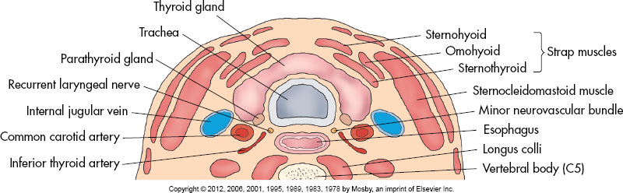
Relatial

Slide 11
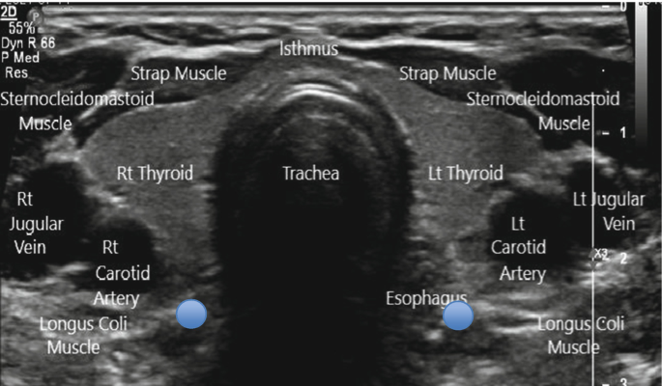
Relational Anatomy
https://link.springer.com/chapter/10.1007/978-3-031-18448-2_1

Slide 12
Relational Anatomy (cont’d)
Posterior
Posterolateral anatomy: Common carotid artery, internal jugular vein, vagus nerve
Longus colli muscle: Posterior and lateral to lobes, hypoechoic triangular structure adjacent to cervical vertebrae

Slide 13
Relational Anatomy (cont’d)
Medial
Medial anatomy: larynx, trachea, inferior constrictor of pharynx, esophagus
Esophagus found to left of trachea-identified by target appearance in transverse plane and by its peristaltic movements when patient swallows.
Posterior border of each lobe related to superior and inferior parathyroid glands and anastomosis between superior and inferior thyroid arteries

Slide 14
Blood Supply
Two superior thyroid arteries (rt and lt) arise from external carotids and descend to upper poles
Two inferior thyroid arteries (rt and lt) arise from thyrocervical trunk of subclavian artery and ascend to lower poles
Doppler peak systolic velocities reach 20 to 40 cm/sec in major thyroid arteries and 15 to 30 cm/sec in intraparenchymal arteries
Corresponding superior thyroid veins drain into internal jugular veins
Inferior thyroid veins drain into innominate vein

Slide 15
Physiology and Labs
Maintains normal body metabolism, growth, and development by synthesis, storage, and secretion of thyroid hormones
Mechanism for producing thyroid hormones is iodine metabolism
Notes:
Role of the thyroid is to maintain normal body metabolism, growth, and development by the synthesis, storage, and secretion of thyroid hormones.
The mechanism for producing thyroid hormones is iodine metabolism.

Slide 16
Physiology and Labs (cont’d)
Thyroid traps iodine from blood and through series of chemical reactions; thyroidglobulin is a protein made by the thyroid that produces thyroid hormones triiodothyronine (T₃) and thyroxine (T₄)
Thyroid hormone released into bloodstream by action of thyrotropin, or thyroid-stimulating hormone (TSH), produced by pituitary gland
Secretion of TSH regulated by thyrotropin-releasing hormone (TRH), produced by the hypothalamus

Slide 17
Physiology and Labs (cont’d)
Calcitonin decreases concentration of calcium in blood by first acting on bone to inhibit its breakdown
Calcitonin helps to maintain homeostasis of blood calcium
When thyroid is producing correct amount of thyroid hormone, considered to be normal, or euthyroid

Slide 18
Hypothyroidism
Undersecretion of thyroid hormones
May be caused by:
low intake of iodine (goiter) in body
inability of thyroid to produce proper amount of thyroid hormone
problem in pituitary gland that doesn’t control thyroid production
Hashimoto’s thyroiditis (75%)
medications
radiation exposure to head or neck
Signs and symptoms of hypothyroidism include:
- myxedema
- weight gain
- hair loss
- increased subcutaneous tissue around eyes
- lethargy
- intellectual and motor slowing
- cold intolerance
- constipation
- deep, husky voice

Slide 19
Hyperthyroidism
Caused by:
over secretion of thyroid hormones
when entire gland is out of control or if localized neoplasm (such as adenoma) causes overproduction of thyroid hormone
Grave’s disease
Clinical signs include:
- increased metabolic rate
- weight loss
- increased appetite
- nervous energy
- irritability
- tremors
- excessive sweating
- heat intolerance
- palpitations
- exophthalmos (protruding eyes)

Slide 20
Thyroid Function Tests
Nuclear medicine used to determine function of thyroid: iodine uptake scan and thyroid scan
Laboratory tests for thyroid measure amount of:
-T₃ or T₄
-TSH

Slide 21
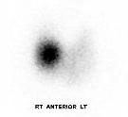
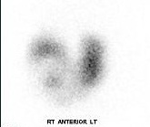
Thyroid Function tests
Nuclear medicine used to determine function of thyroid: iodine uptake scan and thyroid scan

Slide 22
Indications for A thyroid ultrasound
Palpable enlargement
Abnormal labs (T3, T4, TSH)
Palpable mass in neck/thyroid
Swelling/asymmetry in neck
Redness or tenderness in neck
Hypercalcemia
Post-thyroidectomy

Slide 23
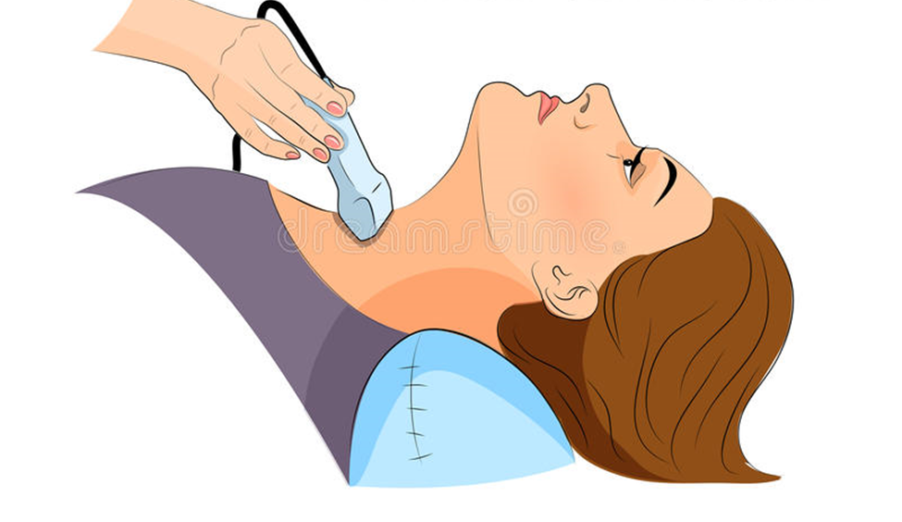
Sonographic Evaluation of the Thyroid gland
Patient placed in supine position with pillow under both shoulders to provide moderate hyperextension of neck.
High-frequency (7.5- to 15-MHz) linear-array transducer should be used.

Slide 24
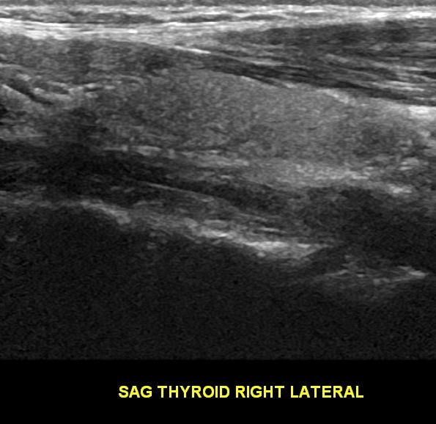
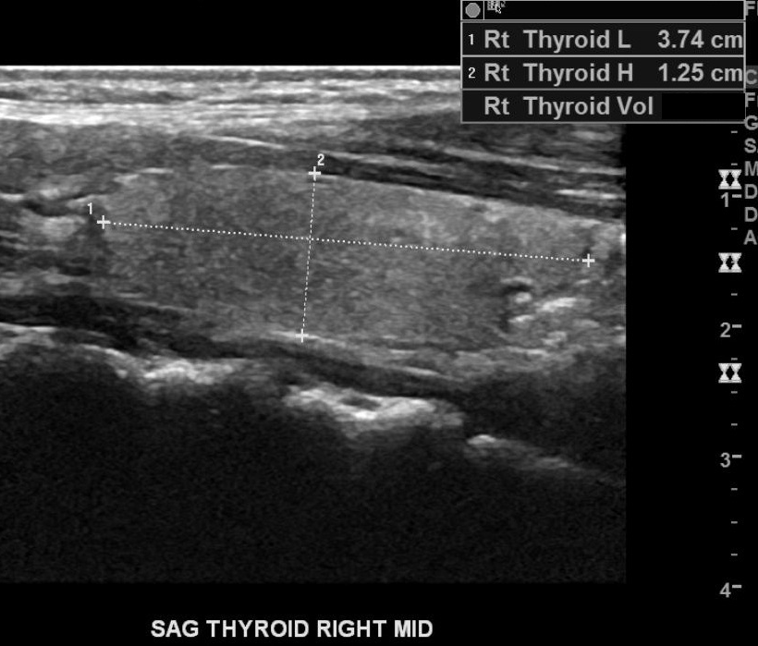
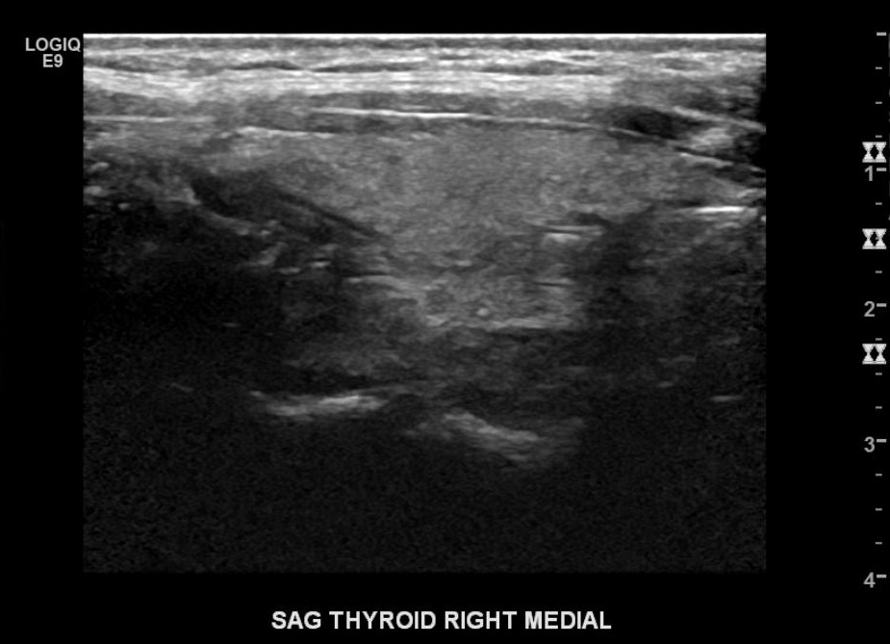
Sonographic Evaluation of the Thyroid: Sagittal
Notes:
Normal thyroid. C, Carotid; T, thyroid.

Slide 25
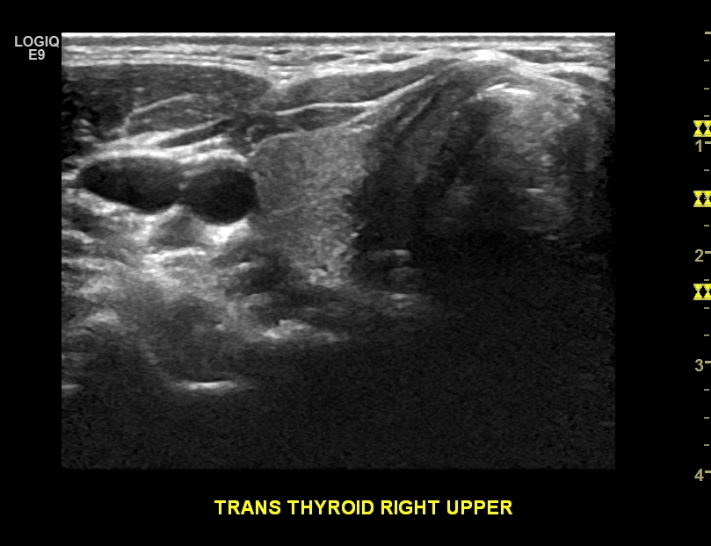
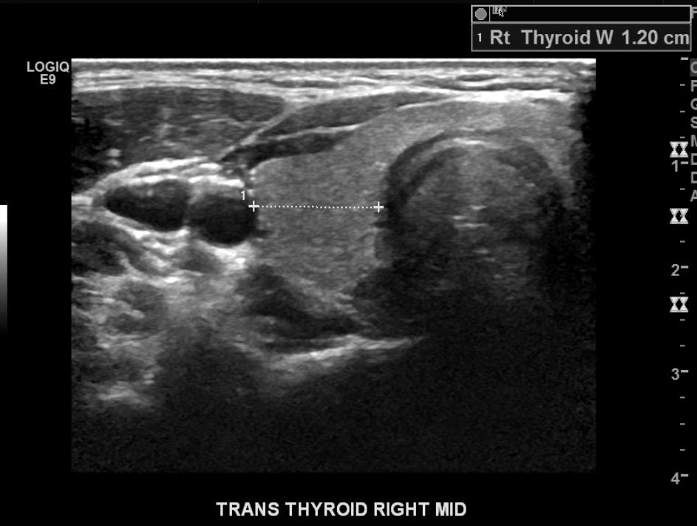
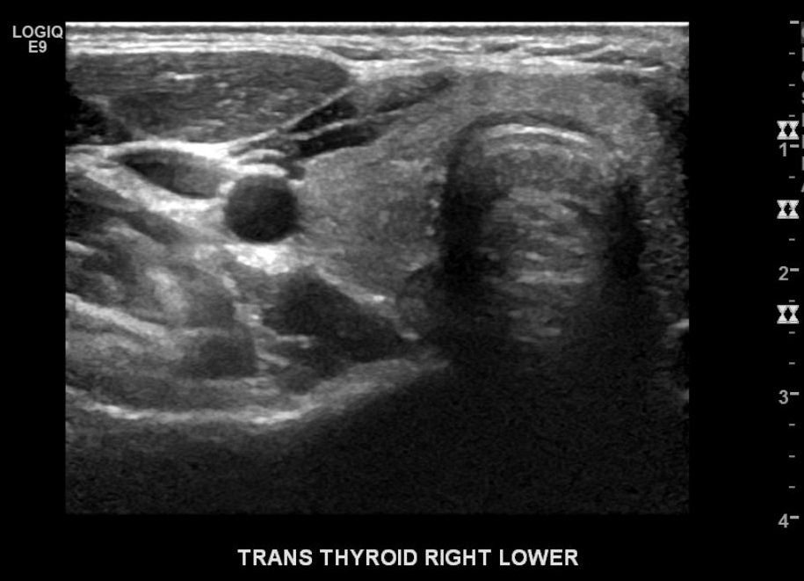
Sonographic Evaluation of the Thyroid: Transverse
Notes:
Normal thyroid. C, Carotid; T, thyroid.

Slide 26
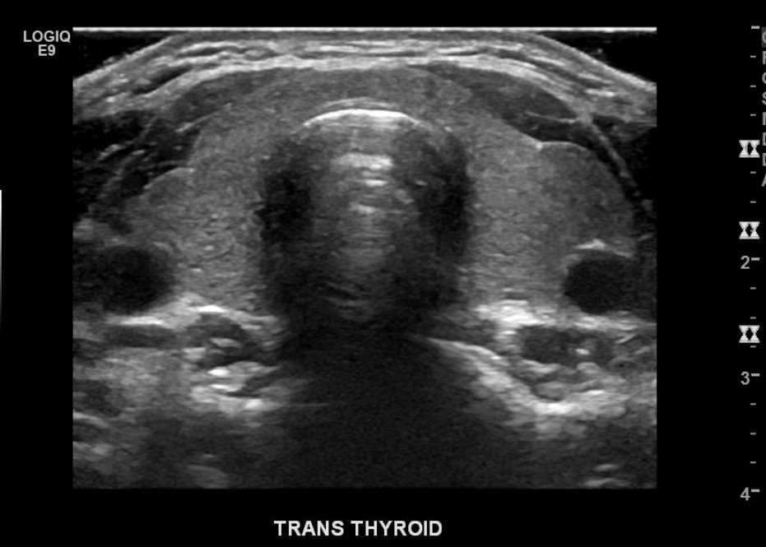
Sonographic Evaluation of the Thyroid
Notes:
Normal thyroid. C, Carotid; T, thyroid.

Slide 27
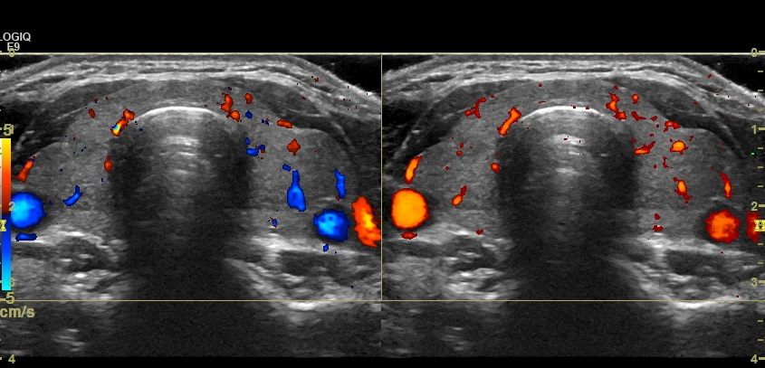
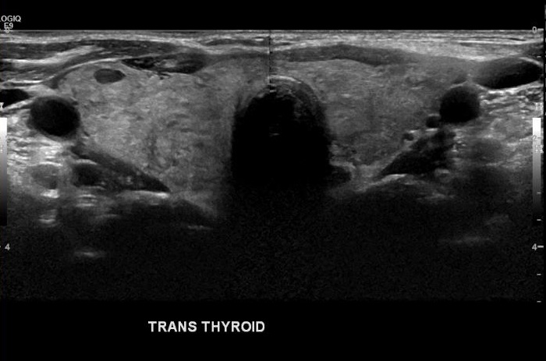
Sonographic Evaluation of the Thyroid
Notes:
O, Omohyoid muscle; S, sternohyoid muscle; SC, sternocleidomastoid.

Slide 28
Sonographic Evaluation of the Thyroid
Notes:
O, Omohyoid muscle; S, sternohyoid muscle; SC, sternocleidomastoid.

Slide 29
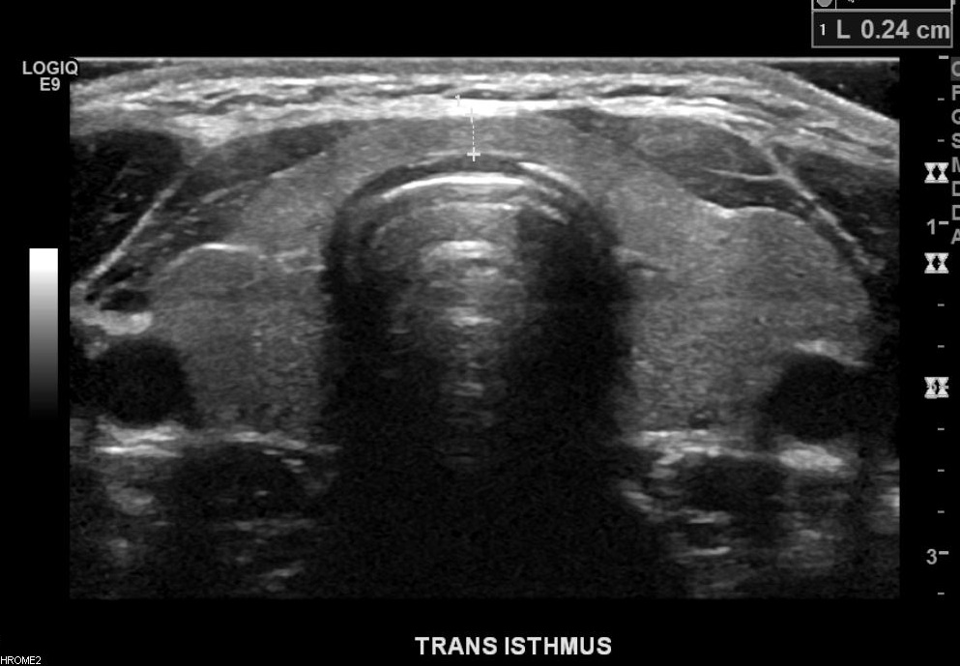
Sonographic Evaluation of the
Isthmus
Notes:
O, Omohyoid muscle; S, sternohyoid muscle; SC, sternocleidomastoid.

Slide 30
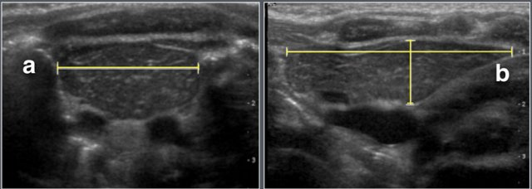
Thyroid Measurements
https://radiologyassistant.nl/pediatrics/normal-values/normal-values-ultrasound

Slide 31
Thyroid protocol
https://youtu.be/53lyqKhIu_Q?si=0XxJl3VT_SSnkIBf

Slide 32
Thyroid pathology

Slide 33
Role of Ultrasound
Detect presence of nodules
Characterize nodules
-cystic, solid, mixed
-size
-location
Aspiration or biopsy guidance

Slide 34
Thyroid nodules
Variable gland enlargement
Causes:
Thyroiditis (ill-defined nodular areas)
Nodular hyperplasia
Multinodular goiter
Adenomatous hyperplasia
Neoplasm (benign or malignant)
Hashimoto’s thyroiditis (micronodules)

Slide 35
Sonographic findings
Diffuse enlargement
Hypoechoic, heterogeneous, without palpable nodules
Markedly increased vascularity
-increased PSV in inferior thyroidal artery

Slide 36
Hyperplasia and Goiter
Nodular hyperplasia, multinodular goiter, and adenomatous hyperplasia are terms used to describe goiter
*Most common thyroid abnormality
Caused by iodine deficiency

Slide 37
Multinodular Goiter (MNG)
Enlargement of thyroid gland
Due to compensatory hypertrophy and hyperplasia of follicular epithelium caused by derangement that hampers hormone secretion
May become very large, compressing esophagus and interfering with swallowing, or cause pressure on trachea
Other causes of goiter:
- Graves’ disease
- thyroiditis
- neoplasm
- cyst
Notes:
Goiter is an enlargement of the thyroid gland, which is often visible as an anterior protrusion on the neck.

Slide 38
MNG (cont’d)
Toxic goiter:
-Hyperthyroid condition resulting from hyperactivity of
thyroid gland
Nontoxic (simple) goiter occurs as diffuse thyroid enlargement not resulting from neoplasm or inflammation
- not initially associated with hypothyroidism or
hyperthyroidism
Notes:
Toxic goiter is a hyperthyroid condition resulting from hyperactivity of the thyroid gland, perhaps caused by excessive stimulation from TSH, which produces a large nodular gland.

Slide 39
MNG (cont’d)
Clinical signs:
- hypermetabolism
- diffuse toxic goiter
- exophthalmos
- cutaneous formations
Periorbital
Dorsum of feet
Cause:
- autoimmune

Slide 40
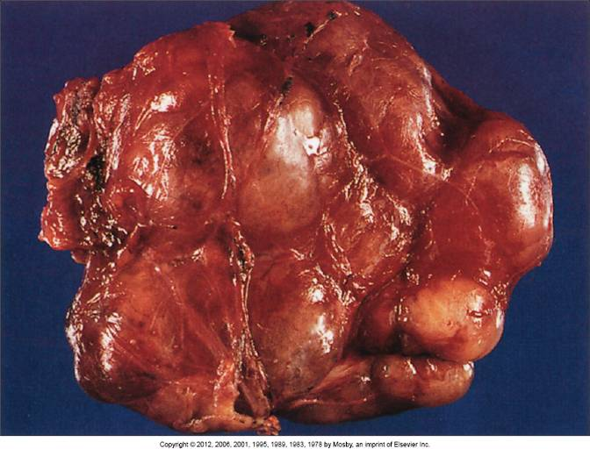
Multinodular Goiter

Slide 41
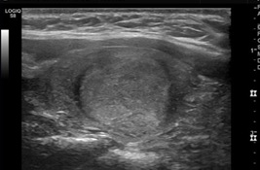
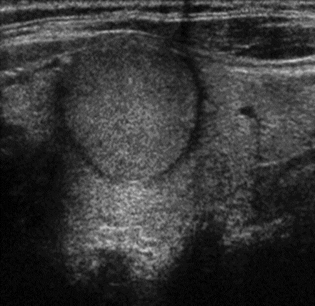
MNG
Nodules may present as poorly circumscribed or well defined and encapsulated by a thin, peripheral hypoechoic halo due to surrounding compressed tissue and should be documented.

Slide 42
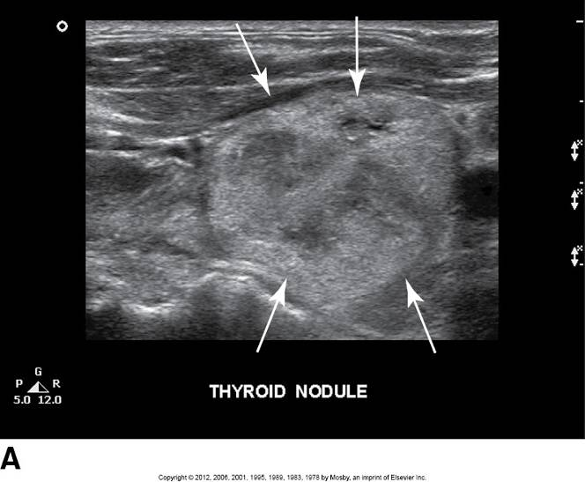
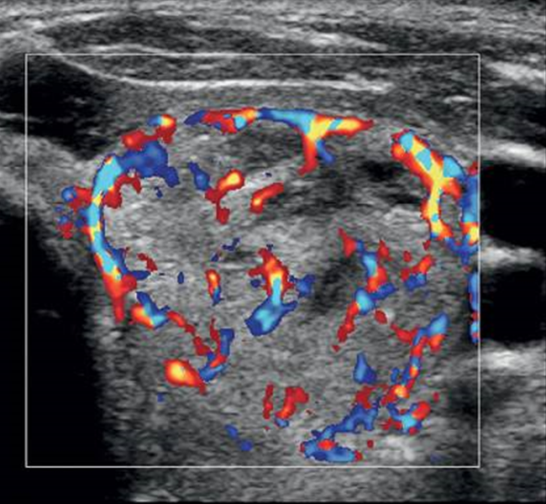
MNG

Slide 43
MNG (cont’d)
Sonographic Findings:
Diffuse enlargement
Most hyperplastic or adenomatous nodules isoechoic compared to normal thyroid tissue
As gland enlarges, may become hyperechoic
Focal scarring and ischemia, as well as necrosis and cyst formation
Fibrosis or calcifications
Increased vascularity- “thyroid inferno”
- increased PSV in inferior thyroid artery

Slide 44
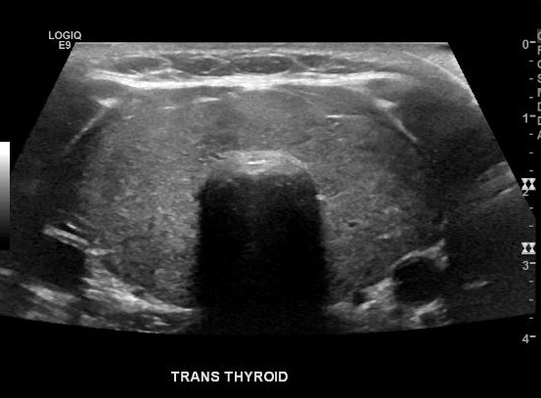
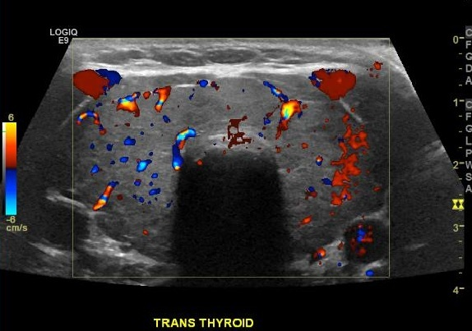
Multinodular Goiter

Slide 45
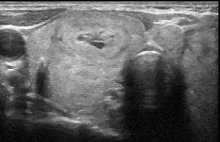
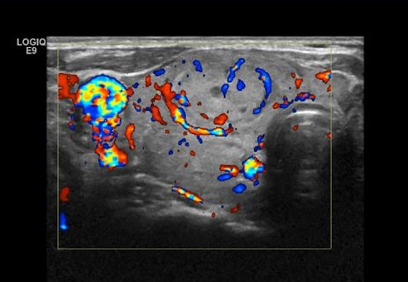
MNG
Multinodular goiter is seen as an inhomogeneous enlarged tissue mass within the thyroid gland. Increased vascularity is also seen.

Slide 46
Thyroid Cyst
Cystic degeneration of follicular adenoma
Sonographic Findings:
Degenerative changes of nodules correspond to their sonographic appearance
Purely anechoic areas - from serous or colloid fluid, echogenic fluid, or moving fluid, with posterior enhancement
-if see fluid levels, corresponds to hemorrhage
Approx. 20% of solitary nodules are cystic

Slide 47
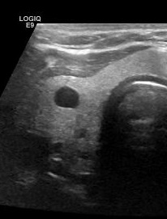
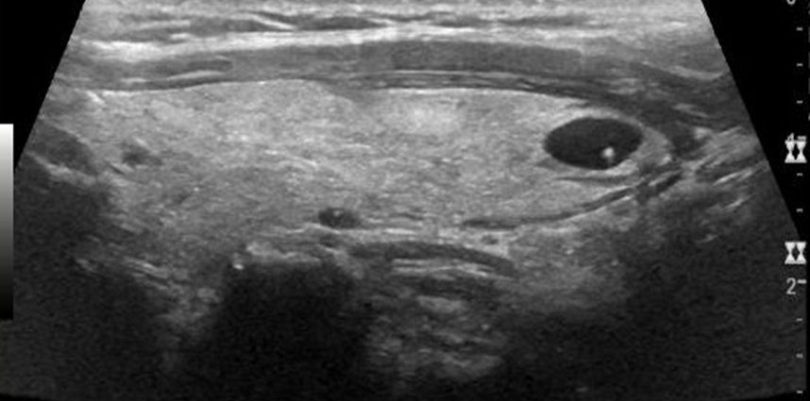
Thyroid Cyst
Left: Anechoic cyst within the thyroid gland. Right: Colloid cyst with echogenic focus.

Slide 48
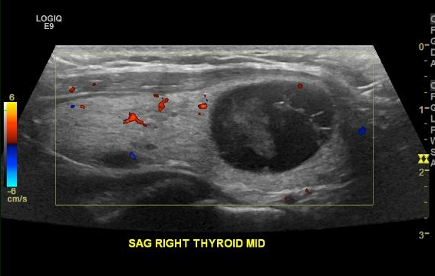

Slide 49
Adenoma
Benign thyroid neoplasm characterized by complete fibrous encapsulation
*70% of solitary nodules
More common in females (7:1)
Characterized by compression of adjacent tissue and fibrous encapsulation
Homogeneous with variable size
Usually lesion solitary with areas of hemorrhage or necrosis

Slide 50
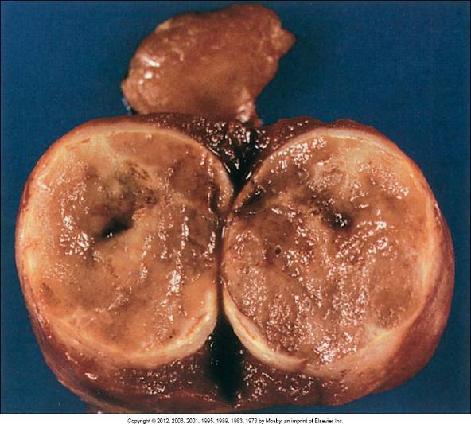
Adenoma

Slide 51
Adenoma (cont’d)
Sonographic Findings:
Anechoic to completely hyperechoic; commonly have peripheral halo
Halo, or thin echolucent rim surrounding lesion, is edema of compressed normal thyroid tissue or capsule of adenoma
Hyperfunction of adenoma can exhibit increased blood flow patterns as seen on Doppler along peripheral borders or within lesion

Slide 52
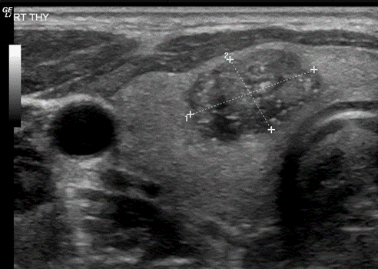
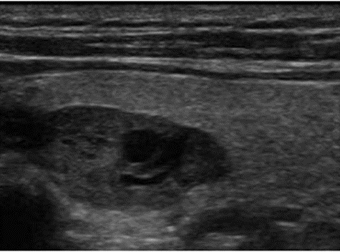
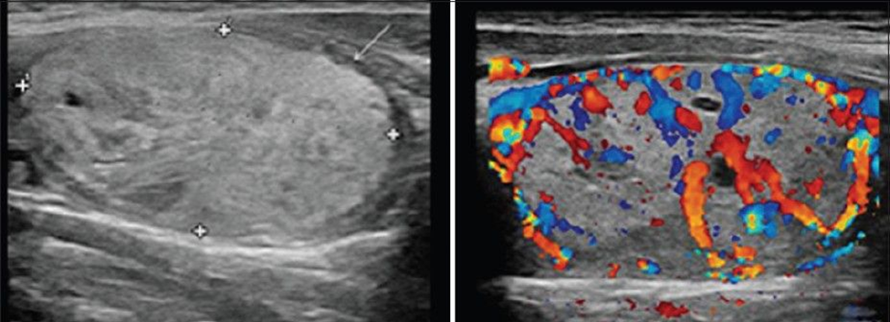
Adenoma
Adenomas have a broad spectrum of sonographic appearances. They are most often solitary, homogeneous, and variable in size and range in echogenicity from anechoic, hypoechoic, isoechoic, to hyperechoic with the presence of a thin hypoechoic rim or halo.
Notes:
See textbook Figure 22-14 for more sonographic variations of adenomas.

Slide 53
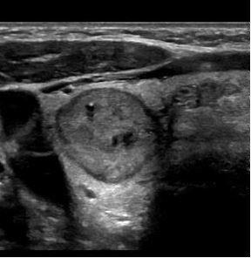
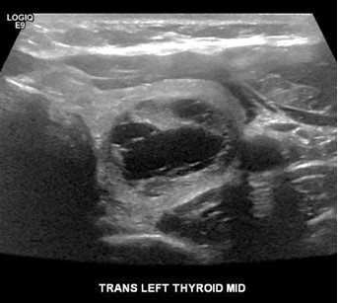
Adenoma

Slide 54
Thyroid Imaging Reporting & Data system (TI-RADS)
standardized reporting and description system of thyroid nodules created by American College of Radiology (ACR)
Prevents:
Unnecessary follow-up
Further imaging
Biopsies
Nodules are placed within 5 levels (TR1- TR5) based on 5 ultrasound features:
- composition
- echogenicity
- shape
- margin
- punctate echogenic foci

Slide 55
TI- RADS (cont’d)
Each feature is assigned a point, the more points assigned, the higher the risk of malignancy
Sum of all points results in TI-RADS of 0-7 or more
Highest level is TR5- considered highly suspicious for malignancy
Most worrisome nodules contain punctate echogenic foci, are hypoechoic, taller than wide, irregular margins that may extend beyond normal thyroid margins

Slide 56
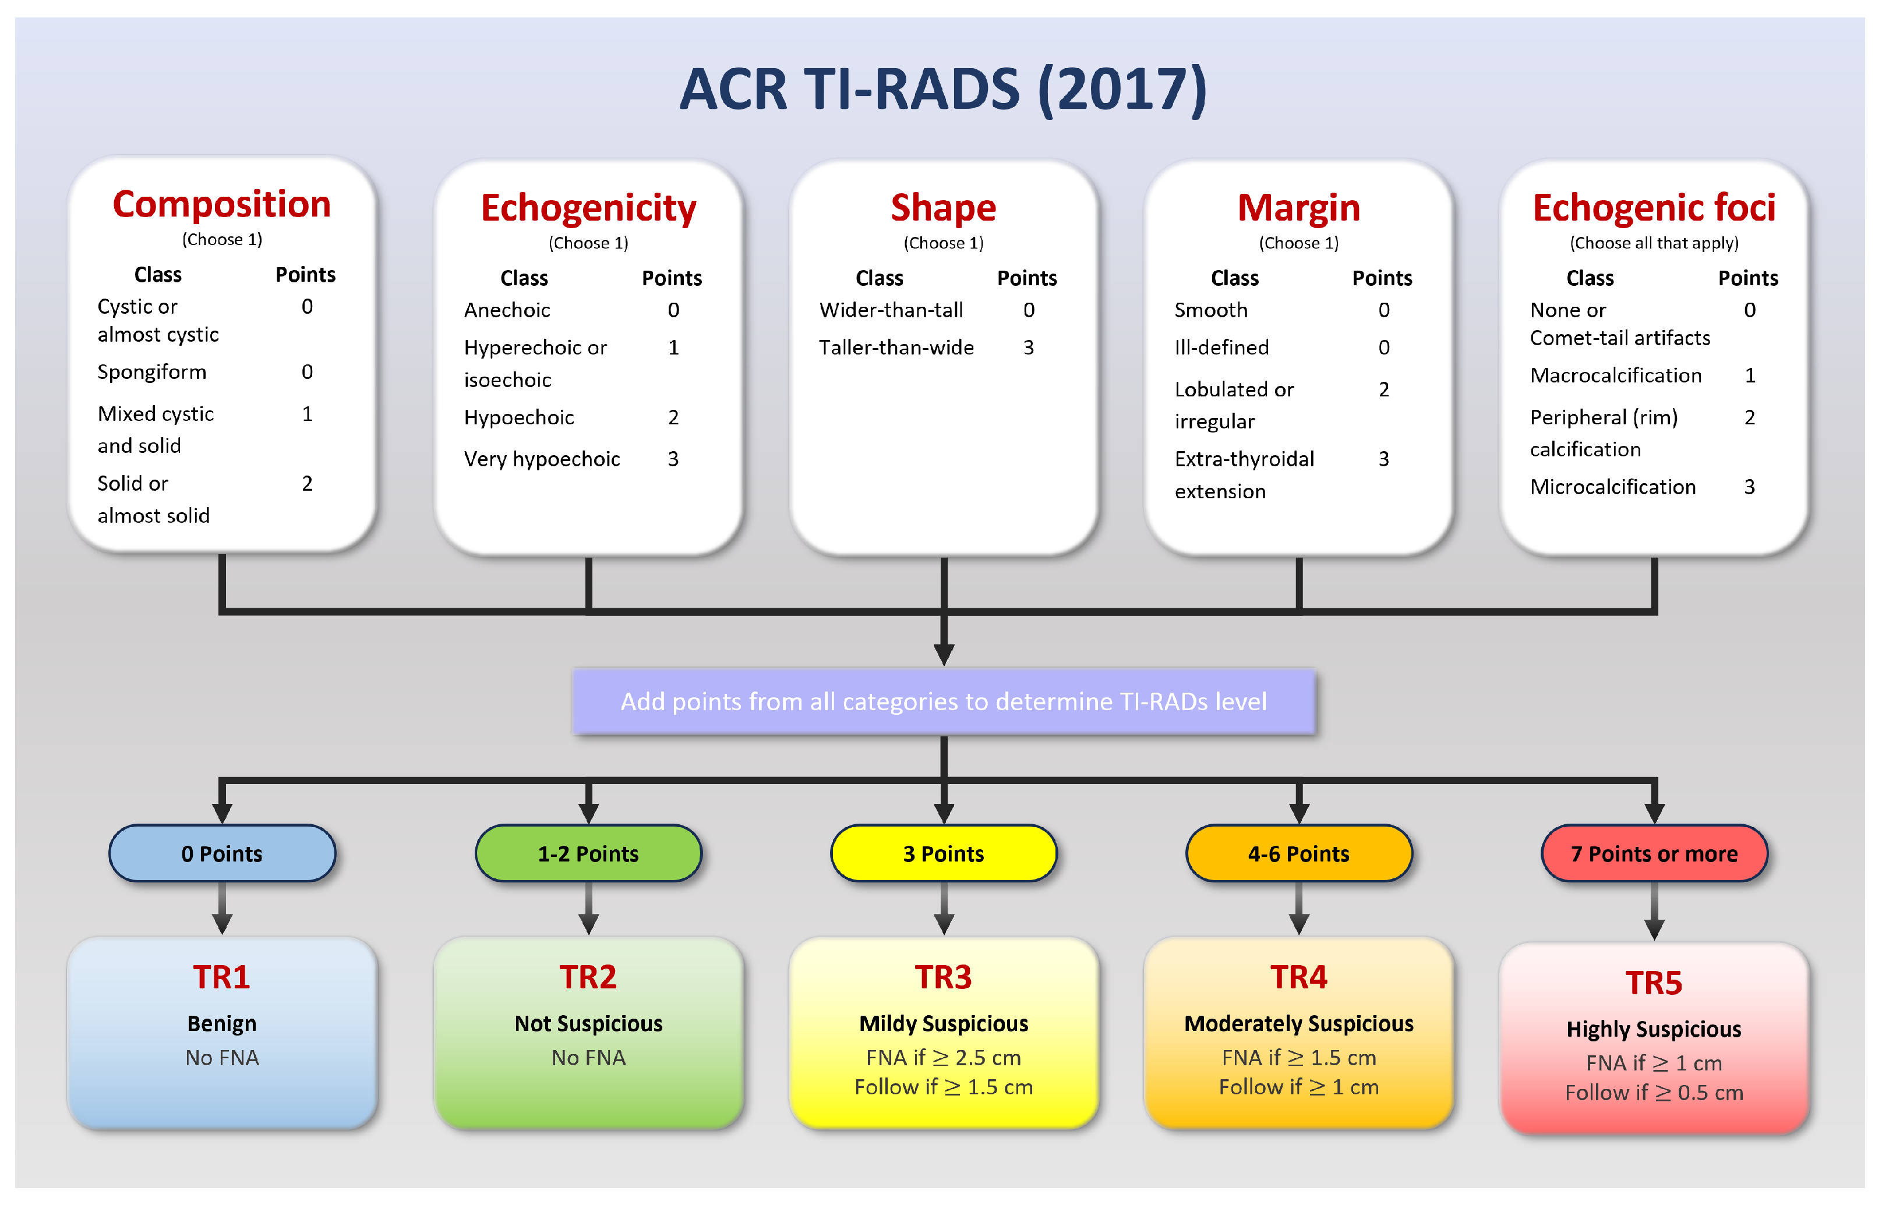
https://www.mdpi.com/1424-8220/23/16/7289

Slide 57
Malignant lesions

Slide 58
Malignant Lesions
Carcinoma of thyroid is rare
Slow-growing, not a frequent cause of death
Female to male ratio is 2:1
Solitary nodule may be malignant in small percentage of cases, but risk of malignancy decreases with presence of multiple nodules
*Solitary thyroid nodule in presence of cervical adenopathy on same side suggests malignancy

Slide 59
Malignant Lesions (cont’d)
Clinical findings:
Painless, palpable, hard, firm, solitary nodule
If more advanced- compression of adjacent structures may cause hoarseness, cough, dysphagia, or dyspnea

Slide 60
Malignant Lesions (cont’d)
Sonographic Findings:
Neoplasm can be of any size, single or multiple
Usually solid, but may be partially cystic, or largely cystic mass
Usually hypoechoic relative to normal thyroid
Irregular or microlobulated margins, taller than wide, may have shadowing
* Microcalcifications are present in 50% to 80% of all types of thyroid carcinoma
Increased vascularity may be present

Slide 61
Papillary Carcinoma
*Most common thyroid malignancy
Females more than males
Round, laminated, tiny calcifications seen in 25% of cases, called psammoma bodies
May have macrocalcifications
Major route of spread of papillary carcinoma is through lymphatics to nearby cervical lymph nodes
Approx. 20% of patients with papillary thyroid cancer have metastatic cervical adenopathy

Slide 62
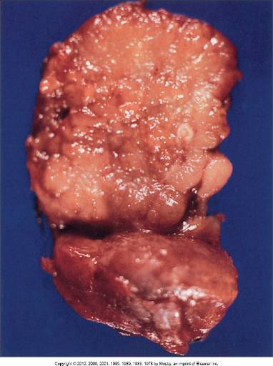
Papillary Carcinoma

Slide 63
Papillary Carcinoma (cont’d)
Sonographic Findings:
Hypoechoic (90% of cases), predominantly soild
Microcalcifications that appear as tiny, punctate hyperechoic foci (with or without acoustic shadowing)
Taller than wide
Hypervascularity (90% of cases)
Cervical lymph node metastasis ( approx. 20% of cases)

Slide 64
Papillary carcinoma (cont’d)
Clinical signs:
- Asymptomatic
- Painless lump in neck
- Rapidly growing lump in neck
- Hashimoto’s thyroiditis (more than 90% of cases)

Slide 65
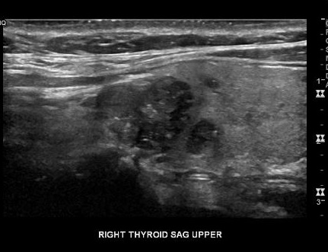
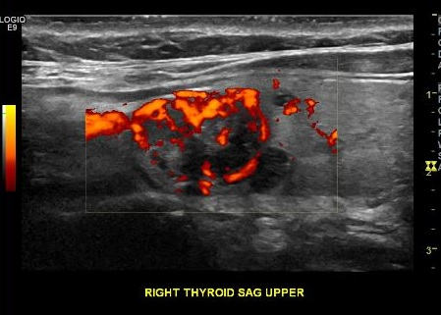
Papillary Carcinoma

Slide 66
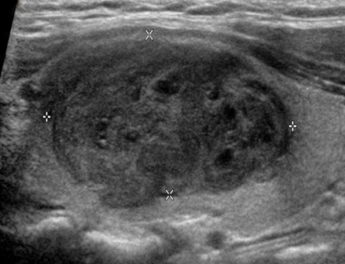
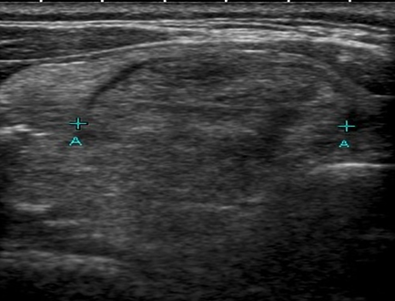
Papillary Carcinoma
.
Sonographic characteristics of papillary carcinoma include solid texture with marked hypoechogenicity when compared with strap muscles

Slide 67
Follicular Carcinoma
Second most common type of thyroid cancer (10-20%)
2 types:
Minimally invasive- well encapsulated, demonstration of focal invasion of capsular blood vessels of fibrous capsule permits differentiation from follicular adenoma
Widely invasive type (not encapsulated)- will demonstrate
invasion of tumor blood vessels into adjacent thyroid tissue
Spreads through the bloodstream rather than lymphatic system to bone, lung, brain, and liver
Lymph node involvement less common (10%)

Slide 68
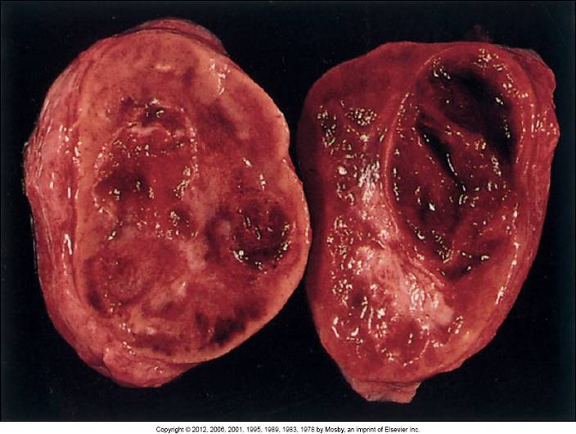
Follicular Carcinoma

Slide 69
Follicular Carcinoma (cont’d)
Sonographic Findings:
Irregular margins with thick irregular halo
Nodular enlargement and tortuous internal blood vessels characteristic, but not specific for follicular carcinoma

Slide 70
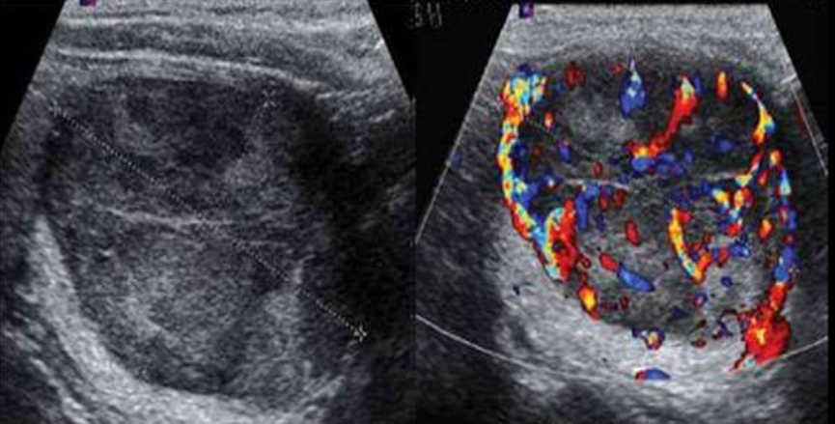
Follicular Carcinoma
Sonographic features are similar to benign follicular adenoma, but malignancy should be suspected with presence of thick irregular halo and tortuous internal blood vessels with increased vascularity with color or power Doppler.

Slide 71
Medullary Carcinoma
Accounts for 5% of thyroid cancers
Often familial (20%) and essential component of multiple endocrine neoplasia (MEN) type II syndromes
Multicenter and/or bilateral in familial cases
High incidence of metastatic involvement of lymph nodes has been reported (80%) and liver metastasis- worse prognosis
Female to male ratio is 3:2

Slide 72
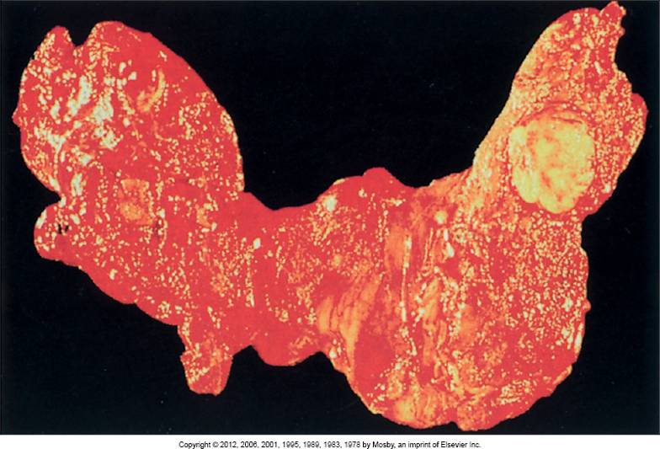
Medullary Carcinoma

Slide 73
Medullary Carcinoma (cont’d)
Sonographic Findings:
Lesions appear similar to that of papillary carcinoma as hypoechoic mass
Often calcium deposits
Sonography highly sensitive in detecting metastatic lymphadenopathy in these patients
Notes:
Sonography is highly sensitive in detecting metastatic lymphadenopathy in these patients; thus careful evaluation of the entire neck area and liver is important to rule out metastases.

Slide 74
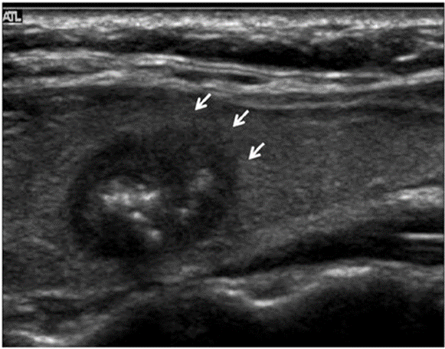
Medullary Carcinoma

Slide 75
Anaplastic Carcinoma
Means undifferentiated; rare—accounts for less than 2% of thyroid cancers
Most deadly form of thyroid cancer
Usually occurs after age 6o
Presents as hard, fixed mass with rapid growth
Growth locally invasive in surrounding neck structures
Sonographic Findings:
Hypoechoic mass, with invasion of surrounding muscles and vessels of neck
Notes:
Its growth is locally invasive in surrounding neck structures, and it usually causes death by compression and asphyxiation because of invasion of the trachea.
The sonographic appearance of this type of thyroid cancer is as a hypoechoic mass, with invasion of the surrounding muscles and vessels of the neck.

Slide 76
Anaplastic carcinoma (cont’d)
Clinical findings:
Many years of radiation exposure to neck or upper chest
Rapidly enlarging, hard, fixed mass in neck
Dyspnea
Dysphagia
Hoarseness
Cough

Slide 77
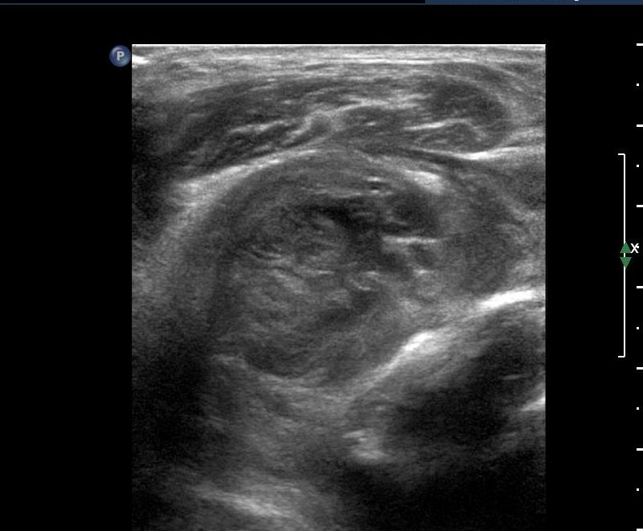
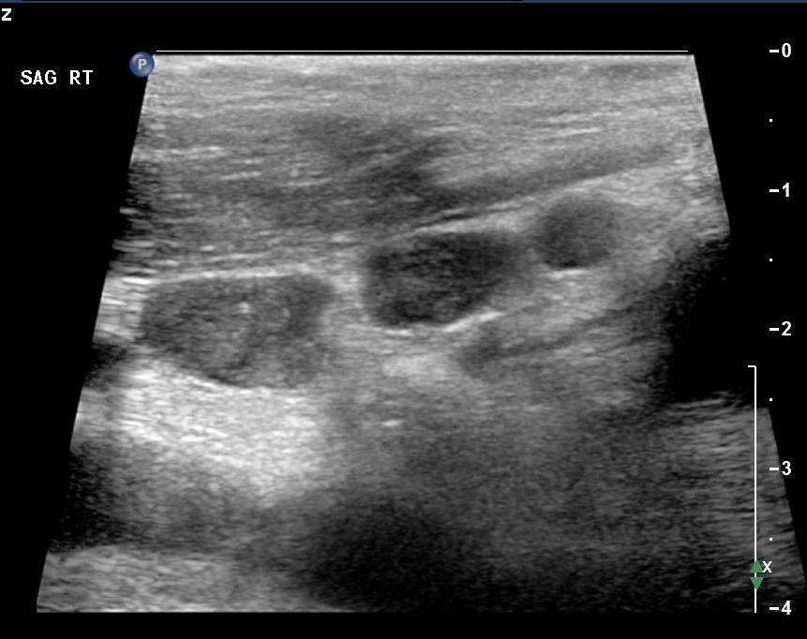
Anaplastic Carcinoma

Slide 78
Lymphoma
Lymphoma in thyroid primarily non-Hodgkin’s type
Older females (4X more than males)
Accounts for 4% of all thyroid malignancies
Clinically patient has rapidly growing mass in neck area
Patient may have pre-existing chronic lymphocytic thyroiditis (Hashimoto’s disease) with subclinical or overt hypothyroidism

Slide 79
Lymphoma (cont’d)
Sonographic Findings:
Nonvascular hypoechoic and lobulated mass
May be large areas of cystic necrosis within tumor or encasement of adjacent neck vessels
Adjacent thyroid parenchyma may be heterogeneous secondary to associated chronic thyroiditis

Slide 80
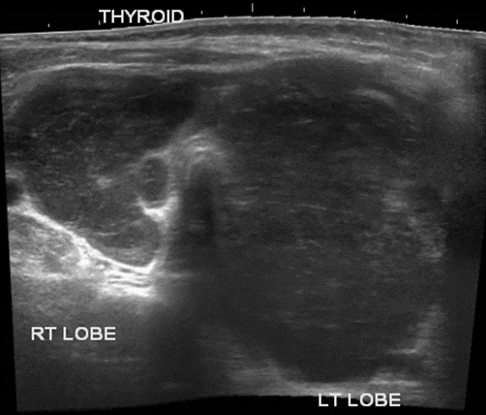
Lymphoma
Lymphoma is characterized by a large, nonvascular, hypoechoic, and lobulated solid mass.

Slide 81
Metastatic
Most common from breast CA
Other primary sites:
melanoma
kidney

Slide 82
Lymph node mapping
Normal lymph nodes (LN) appear hypoechoic with an echogenic hilum
Measure less than 1 cm
Abnormal LN’s are more rounded in shaped, lose their hilar feature, may contain calcifications, and may have abnormal vascular patterns
Post surgical (thyroidectomy) because of thyroid ca requires an analysis of LN levels to check for lymphadenopathy (metastatic disease to the nodes)

Slide 83
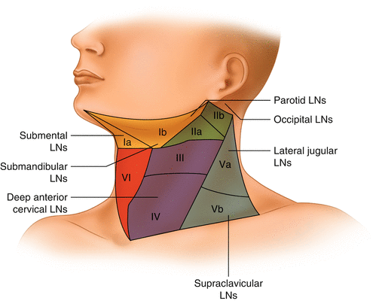

Slide 84
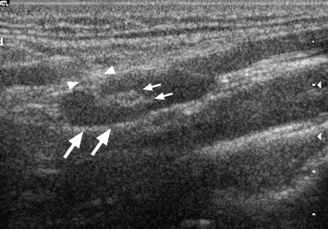

Lymph nodes
NORMAL
ABNORMAL
https://www.sciencedirect.com/science/article/abs/pii/S1078817405000593
https://radiologykey.com/sonographic-appearance-of-abnormal-cervical-lymph-nodes-in-the-preoperative-and-reoperativeempty-neck-a-surgeons-perspective/

Slide 85
Additional Imaging
Nuclear Medicine
Radioisotope scan- determines if nodules are benign or malignant
Hot nodules- increased thyroid activity (more concentration),
almost always benign
Cold nodules- decreased thyroid activity (less concentration),
-20% malignant
- 20% cystic
-remainder usually benign adenomas

Slide 86

Elastography
Elastography images demonstrate soft areas as blue and hard areas as red within the thyroid gland.

Slide 87
Diffuse thyroid disease

Slide 88
Graves’ Disease
Occurs more frequently in women over 30 years of age
Autoimmune disorder
Characterized by thyrotoxicosis
* Most common cause of hyperthyroidism (85%)

Slide 89
Graves’ Disease (cont’d)
Characterized by the following findings:
Hypermetabolism
Diffuse toxic goiter
Exophthalmos
Cutaneous manifestations
Elevated T3 and T4 but low TSH
Notes:
Exophthalmos (inflammatory infiltration of the orbital tissue resulting in proptosis, or bulging of the eyes)
Cutaneous manifestations (thickening of the dermis of the pretibial areas and the dorsum of the feet)

Slide 90

Graves’ Disease

Slide 91
Graves’ Disease (cont’d)
Hyperthyroidism associated with diffuse hyperplastic goiter present
Gland diffusely homogeneous and enlarged
Sonographic Findings:
Heterogeneous, diffuse goiter
Younger patients may be hypoechoic
Overactivity of Graves’ disease manifested sonographically by increased vascularity on color Doppler imaging- “thyroid inferno”
Spectral Doppler- velocities over 70 cm/sec

Slide 92

Graves’ Disease

Slide 93

Graves’ Disease

Slide 94
Thyroiditis
Inflammation of thyroid causing swelling and tenderness
Types:
Acute suppurative thyroiditis
Subacute granulomatous thyroiditis (de Quervain’s disease)
Chronic lymphocytic thyroiditis (Hashimoto’s disease)

Slide 95
Subacute Thyroiditis (de Quervain’s)
Caused by viral infection of thyroid
Gradual or fairly abrupt onset, pain may be severe
May cause transient hyperthyroidism, but in period of weeks or months swelling and pain subside and gland functions normally
Gland may appear enlarged and hypoechoic with normal or decreased vascularity
Notes:
Caused by a viral infection of the thyroid, which results in diffuse inflammation of the thyroid with enlargement and tenderness.

Slide 96
Subacute thyroiditis (De quervain’s) (cont’d)
Clinical findings:
Dysphagia
Fever
Neck pain (may be sudden and severe)
Tenderness
Enlargement
Malaise/fatigue
Increased sedimentation rate

Slide 97

Subacute Thyroiditis (de Quervain’s)
Subacute thyroiditis may demonstrate an enlarged and hypoechoic thyroid with normal or decreased vascularity secondary to diffuse edema of the gland. The process could also present as focal hypoechoic regions within the thyroid gland.
Notes:
Caused by a viral infection of the thyroid, which results in diffuse inflammation of the thyroid with enlargement and tenderness.

Slide 98
Hashimoto’s Thyroiditis
*Most common form of thyroiditis
Characterized by destructive autoimmune disorder, which leads to chronic inflammation of thyroid
Entire gland involved with inflammatory reaction; enlargement not necessarily symmetric

Slide 99
Hashimoto’s thyroiditis (cont’d):
Clinical findings:
Usually painless (may develop pain over time)
Diffusely enlarged gland in young or middle-aged female
Labs show low T3 and T4, but elevated TSH

Slide 100

Hashimoto’s Thyroiditis

Slide 101
Hashimoto’s Thyroiditis
Sonographic Findings:
Diffuse coarsened parenchymal texture slightly more hypoechoic than normal thyroid
Homogeneous enlargement initially occurs with nodularity; as disease progresses, gland shows inhomogeneous enlargement (microlobulation)
Thick, fibrous strands or echogenic septae
Color Doppler shows normal to increased flow (acute phase) “thyroid inferno” when hypothyroidism develops, decreased flow velocity (chronic phase)
May have adjacent cervical lymphadenopathy

Slide 102

Hashimoto’s Thyroiditis

Slide 103

Hashimoto’s Thyroiditis

Slide 104

Hashimoto’s Thyroiditis

Slide 105
Miscellaneous Neck Masses

Slide 106
Neck Masses
https://radiologyassistant.nl/head-neck/neck-masses/neck-masses-in-children

Slide 107
Thyroglossal duct cyst
Benign congenital abnormality located midline near trachea
Usually pediatric population (90% before age 10)
Remnant of tubular development of thyroid gland may persist between base of tongue and hyoid bone
Narrow, hollow tract, which connects thyroid lobes to floor of pharynx, normally atrophies in the adult
Failure to atrophy creates potential for cystic masses to form anywhere along it
Clinical signs:
Palpable, midline mass
Pain, associated with hemorrhage or infection

Slide 108
Thyroglossal duct cyst(cont’d)
Sonographic findings:
Cystic midline mass anterior to trachea
May have internal echoes caused by hemorrhage or infection

Slide 109


Thyroglossal duct cyst
https://radiologyassistant.nl/head-neck/neck-masses/neck-masses-in-children

Slide 110
Thyroglossal duct cyst
https://radiologyassistant.nl/assets/neck-masses-in-children/a57c91eaad60e0_1%20thyroglossal%20duct%20cyst.m4v

Slide 111
Branchial cleft cyst
During embryonic development, branchial cleft is slender tract extending from pharyngeal cavity to opening near auricle or into neck
Diverticulum extends either laterally from pharynx or medially from neck
Most often found near angle of the mandible (submandibular) or lateral to the thyroid
Sonographic findings:
Primarily cystic with posterior enhancement
May have some low-level echoes or solid components

Slide 112


Branchial cleft cyst
https://radiologyassistant.nl/head-neck/neck-masses/neck-masses-in-children

Slide 113
Cystic hygroma
Congenital lymphatic malformation found on posterior neck
Aka. lymphangioma
Usually seen in utero (OB ultrasound)
Associated with syndromes and chromosomal abnormalities such as Turner’s syndrome, trisomy 13, 18, and 21, and fetal hydrops
Webbed neck

Slide 114
Cystic hygroma (cont’d)
Sonographic Findings:
Thin-walled, fluid-filled sac posterior to fetal neck
Varies in size
May have septations or internal echoes

Slide 115



Cystic hygroma (cont’d)
https://www.mdpi.com/2227-9059/10/11/2997

Slide 116


Slide 117
Fibromatosis colli
Rare, pediatric fibrous tumor of the inferior sternocleidomastoid muscle
Results in twisting of the chin towards nonaffected side (torticollis)

Slide 118


Fibromatosis colli
https://journals.sagepub.com/doi/pdf/10.1177/8756479306294249
https://districtspeech.com/infant-torticollis/

Slide 119
Abscess
Can arise in any location in the neck
Sonographic Findings:
Primarily fluid-filled to completely echogenic
Most commonly low-level echogenicity with irregular walls
Chronic abscesses may be difficult to distinguish because blends in with surrounding tissue
Localization for percutaneous needle aspiration and follow-up examination during and after treatment

Slide 120


Abscess
An abscess can range in its sonographic appearance from primarily fluid filled to completely echogenic. Most commonly, an abscess will appear as a complex cystic mass with low-level echogenicity and irregular walls.

Slide 121
lymphadenopathy
Normal lymph node oval in shape with homogeneous texture with central core echo complex
More rounded the node, the more likely node is malignant
Sonographic appearance:
Low-level, well-circumscribed masses is classic appearance
Inflammatory process may appear more cystic
Differentiation of inflammation from neoplastic processes
Fine-needle biopsy

Slide 122


lymphadenopathy
Normal
Lymphadenopathy
https://www.researchgate.net/figure/Ultrasound-image-shows-bilateral-cervical-lymphadenopathy-right-more-extensive-than-left_fig1_325475855

Slide 123
Correlative imaging
Nuclear Medicine
CT
MRI
X-ray
Extracranial duplex Doppler

Slide 124

Review TIME!!!
https://www.bmj.com/content/347/bmj.f6182
Notes:
A: Isthmus
B: Left thyroid lobe
C: Strap muscle
D: Right carotid artery
E: Right internal jugular vein
F: Trachea

