Slide 1
Parathyroid Gland
Chapter 22

Slide 2
Objectives:
Upon completion of this presentation, students will be able to:
Identify the embryology of the parathyroid gland.
Describe the normal anatomy and physiology of the parathyroid gland, as well as relational anatomy.
Discuss laboratory values and clinical findings .
Describe the indications and sonographic examination of the parathyroid.
Recognize parathyroid pathologic conditions and their sonographic appearances.

Slide 3
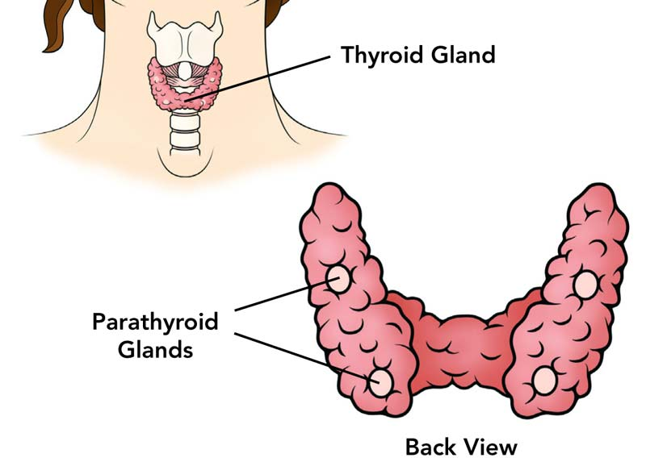
PARATHYROID GLANDS

Slide 4
Anatomy of the Parathyroid Gland
Normally located on posterior medial surface of thyroid gland
Four parathyroid glands (some may have three or five)
-paired, two lie posterior to each superior pole of thyroid and two lie posterior
to each inferior pole
Have been found in ectopic places, such as in neck and mediastinum

Slide 5
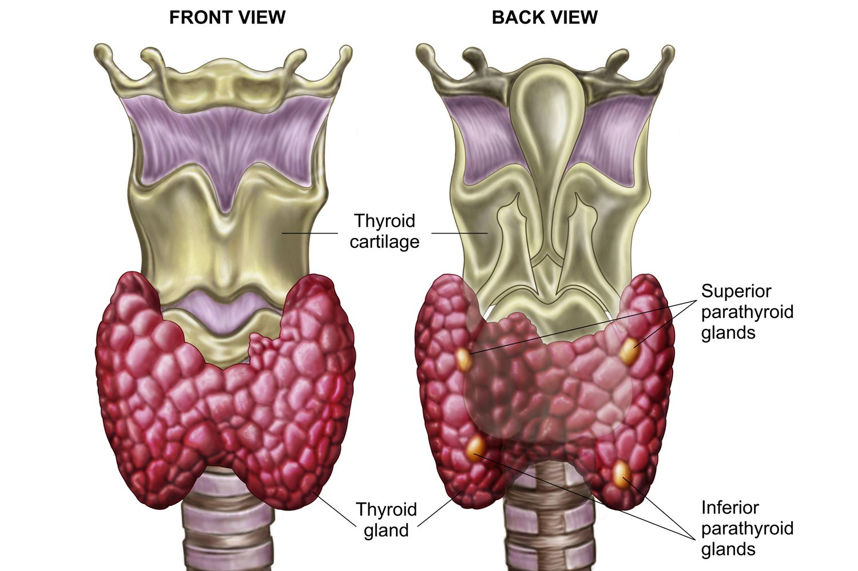
Anatomy of the Parathyroid Gland

Slide 6
Anatomy of the Parathyroid Gland (cont’d)
Each gland flat and disc-shaped
Echotexture similar to that of overlying thyroid gland
Normal-size glands (<4 mm) usually not seen with sonography
Enlarged glands (>5 mm) have decreased echotexture and appear as elongated masses between posterior longus colli and anterior thyroid lobe
Notes:
Normal-size glands (< 4 mm) usually not seen with sonography; occasionally a single gland may be imaged as a flat hypoechoic structure posterior and adjacent to the thyroid.
Enlarged glands (> 5mm) have a decreased echo texture and appear sonographically as elongated masses between the posterior longus coli and the anterior thyroid lobe.

Slide 7
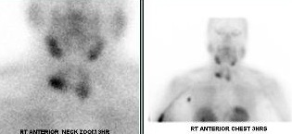
Anatomy of the Parathyroid Gland

Slide 8
Parathyroid Physiology and Labs
Regulate serum calcium in the blood
Produces parathyroid hormone (PTH) that monitors serum calcium feedback mechanism
Stimulus to PTH secretion is decrease in level of blood calcium.
When serum calcium level decreases, parathyroid glands are stimulated to release PTH

Slide 9
Parathyroid Physiology and Labs (cont’d)
Serum calcium level increases; parathyroid activity decreases.
PTH acts on bone, kidney, and intestine to enhance calcium absorption
*Unexplained hypercalcemia detected on routine blood chemistry screening is most common referrals for parathyroid sonography.
Symptomatic renal stones, ulcers, and bone pain are other indications

Slide 10
Hypocalcemia
Low serum calcium levels
Symptoms may include:
-hyperirritability
-fatigue
-anxiety
Mild decrease in calcium, symptoms include:
-numbness around mouth
-tingling or numbness in the extremities
-muscle cramps
Severe calcium decrease, symptoms include:
-dementia
-depression
-psychosis
-seizures

Slide 11
Hypercalcemia
Excessive calcium affects renal, skeletal, and GI systems
Symptoms include:
-weight loss
-anorexia
-dyspepsia
-peptic ulcer
-pancreatitis
-nausea

Slide 12
Sonographic Evaluation of the Parathyroid Gland
High-resolution (7.5- to 15-MHz) linear transducer.
Patient placed supine with neck slightly hyperextended.
Upper neck (jaw to sternal notch), transverse and longitudinal planes of thyroid/parathyroid area.
Patient asked to swallow to elevate thyroid gland during real-time scanning.
Under usual circumstances, not common to be able to visualize normal parathyroid glands.
Size: 5 mm x 3 mm x 1 mm.
Oval or bean-shaped. Also reported as spherical, elongated, or lobulated.

Slide 13
Sonographic Evaluation of the Parathyroid Gland
Longus colli muscle: appears as discrete area posterior to thyroid
Longitudinal sections: Linear appearance of muscle evident in this plane
Minor neurovascular bundle may also be source of confusion
Longitudinal scans can often eliminate confusion by identifying bundle’s tubular appearance
Notes:
In some cases, a prominent longus colli muscle appears as a discrete area posterior to the thyroid; it is important not to confuse this normal anatomy with a mass.
Longitudinal sections can usually solve the problem, and the linear appearance of the muscle is evident in this plane.
The minor neurovascular bundle, consisting of the inferior thyroid artery and recurrent laryngeal nerve, may also be a source of confusion.
Longitudinal scans can often eliminate this confusion by identifying the bundle’s tubular appearance.

Slide 14
Pathology of the Parathyroid Gland

Slide 15
Primary Hyperparathyroidism
Occurs when increased amounts of PTH produced by adenoma, primary hyperplasia, or (rarely) carcinoma
State of increased function of parathyroid glands
Women have primary hyperparathyroidism 2 - 3 times more frequently than men; particularly common after menopause
Characterized by hypercalcemia, hypercalciuria, and low serum levels of phosphate (hypophosphatasia)

Slide 16
Hyperplasia
Of patients with hyperparathyroidism, approximately 10% have parathyroid hyperplasia
Primary hyperplasia defined as hyperfunction of all parathyroid glands with no apparent cause
Only one gland may significantly enlarge, with remaining glands only mildly affected, or all glands may be enlarged (>1 cm)

Slide 17
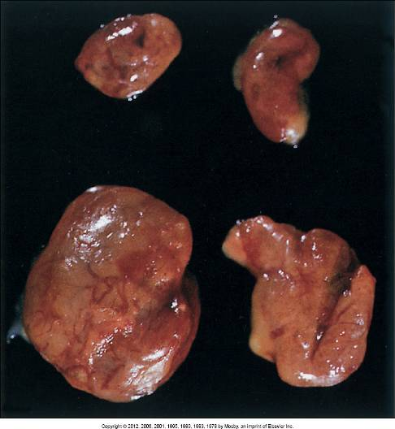
Hyperplasia

Slide 18
Hyperplasia (cont’d)
Usually involves all glands.
Multiple adenomas may involve two or three of the glands.
As glands become inconsistently enlarged, it becomes more difficult to separate lesions with sonography
Correct diagnosis of parathyroid enlargement requires recognition of normal cervical structures (veins, arteries, esophagus, muscles), which can simulate adenomas and produce false-positive results.

Slide 19
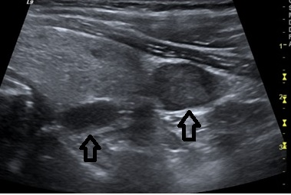
Hyperplasia

Slide 20
Adenoma
Most common cause of primary hyperparathyroidism (80% of cases)
Solitary adenoma may involve any one of four glands with equal frequency
Most common shape is oval
80% are single lesions
Assoc. with radiation exposure

Slide 21
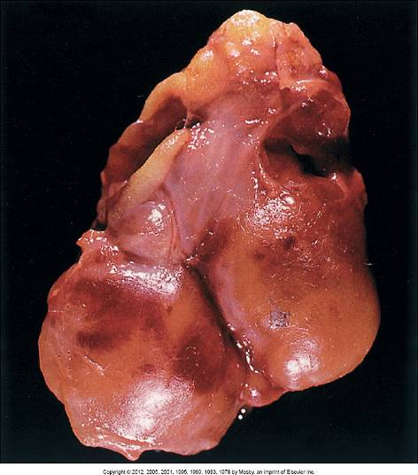
Adenoma

Slide 22
Adenoma (cont’d)
Sonographic findings:
Hypoechoic; vast majority solid.
Usually <3 cm in size, with larger adenomas >5 cm in length.
Superior parathyroid adenomas located adjacent to posterior aspect of mid portion of thyroid
Location of inferior thyroid adenomas more variable, but may be found close to caudal tip of lower pole of thyroid
Encapsulated with discrete border

Slide 23
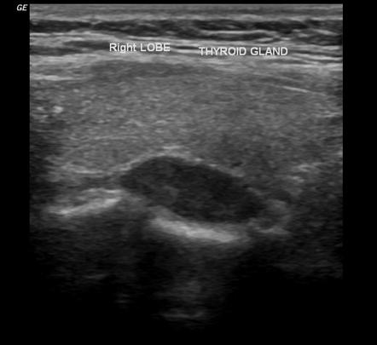
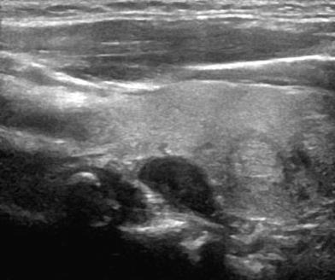
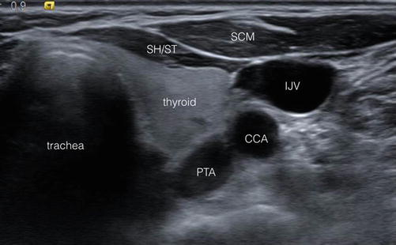
Adenomas

Slide 24
Parathyroid Carcinoma
Histologic differentiation of adenoma and carcinoma very difficult
Metastases to regional nodes or distant organs, capsular invasion, or local recurrence must be present for cancer to be diagnosed
Most cancers of parathyroid glands small, irregular, firm masses
Mass may adhere to surrounding structures
On sonography, carcinoma usually larger than adenoma
Malignant tumor has lobular contour, heterogeneous internal architecture, and internal cystic components

Slide 25
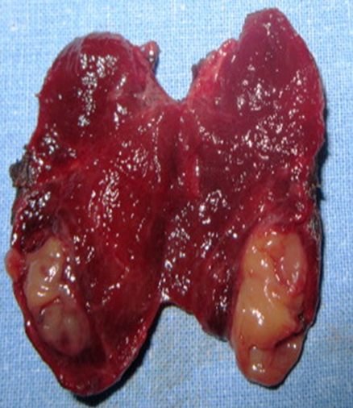
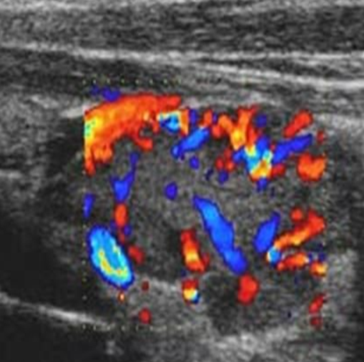
Parathyroid Carcinoma
The sonographic appearance of parathyroid cancer is usually larger, more irregular in shape, or with a lobulated contour. Note the prominent internal vascularity of the carcinoma.

Slide 26
Secondary Hyperparathyroidism
Chronic hypocalcemia caused by renal failure, vitamin D deficiency (rickets), or malabsorption syndromes
Abnormalities induce PTH secretion, which leads to secondary hyperparathyroidism

Slide 27
Secondary Hyperparathyroidism (cont’d)
Hyperfunction of parathyroids apparently compensatory reaction
Renal insufficiency and intestinal malabsorption cause hypocalcemia
-leads to stimulation of PTH
All four glands usually enlarged

Slide 28

Review
https://entnova.com/ent/head-neck/thyroid-parathyroid/

