Slide 1
Abdominal Cavity
Chapter 7

Slide 2
Peritoneum
Thin serous membrane that lines the walls of the abdominal cavity
2 layers:
  Parietal – lines abdominal wall
  Visceral – covers the organs
Layers are separated by a film of serous fluid for lubrication

Slide 3
Peritoneum
Forms a cavity that encloses:
  Liver (except for the bare area)
  Gallbladder
  Spleen
  Stomach
  Ovaries
  Majority of intestines

Slide 4
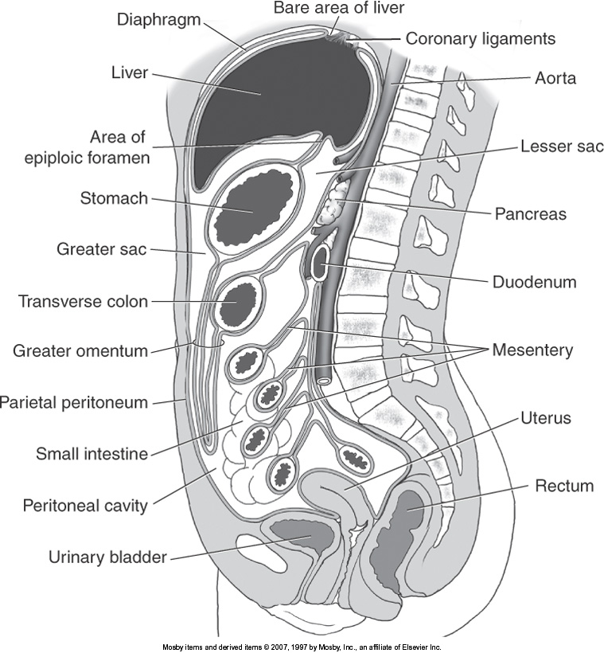
Bare Area

Slide 5
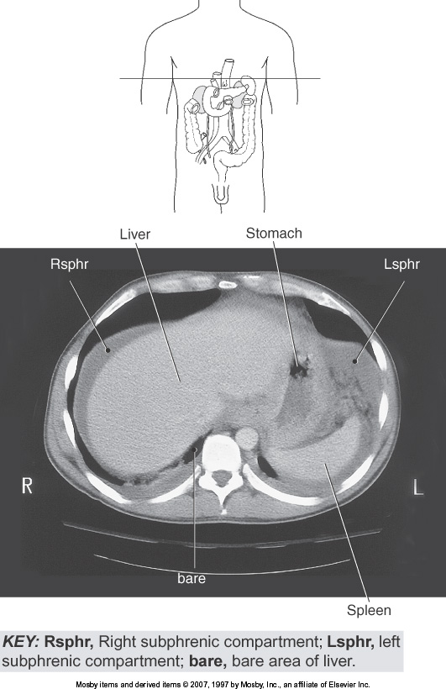

Slide 6
Peritoneal Cavity
Males
  Closed cavity
Females
  Communicates with the exterior through the:
      Vagina
      Cervix
      Uterus
      Ovaries
      Fallopian Tubes

Slide 7
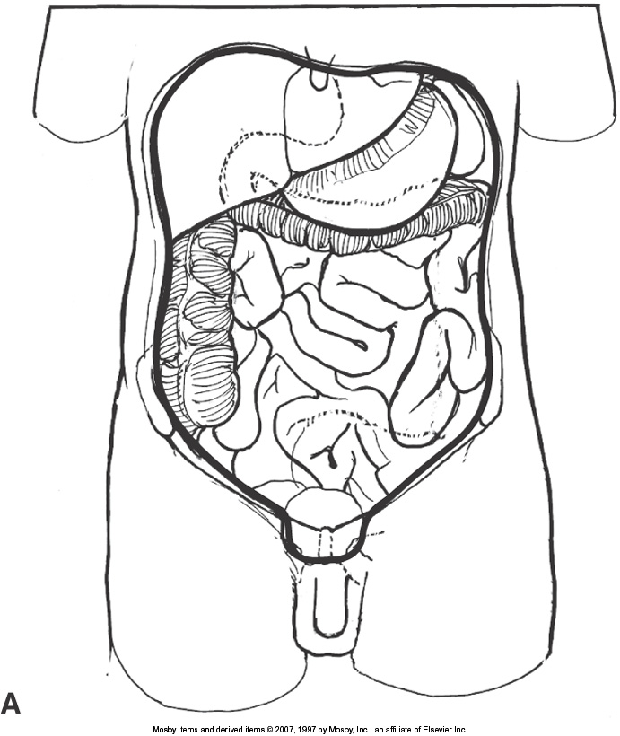
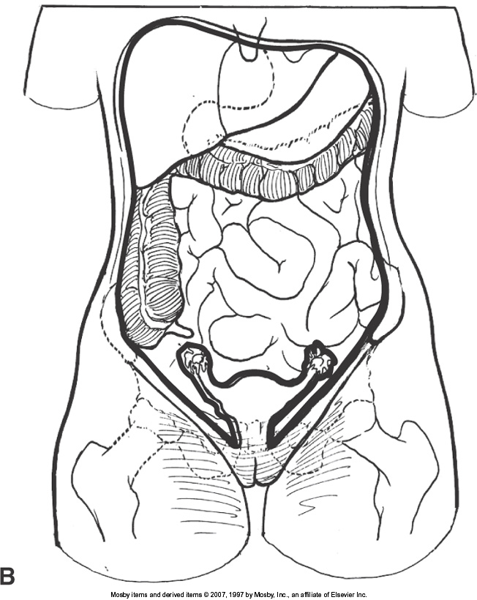
Peritoneal Cavity
Male
Female

Slide 8
Peritoneal Cavity
Greater Sac
  Located between:
    Inner surface of the anterior wall
    Outer surface of the abdominal viscera
Lesser Sac (omental bursae)
  Located between:
    Posterior surface of the stomach
    Posterior abdominal wall

Slide 9
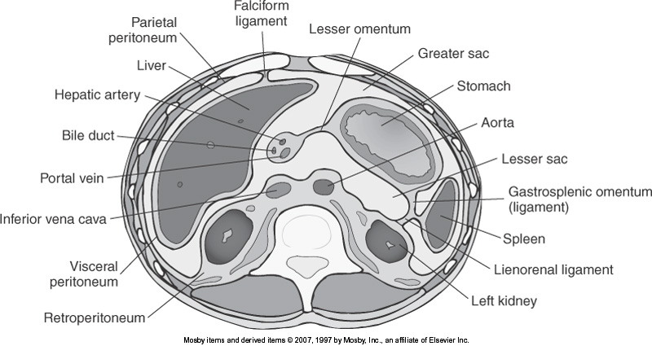

Slide 11
Epiploic Foramen
Epiploic foramen of Winslow
  Area where the following communicates
    Greater Sac
    Lesser Sac
  Located:
    Superiorly & posteriorly
    Inferior to liver

Slide 12
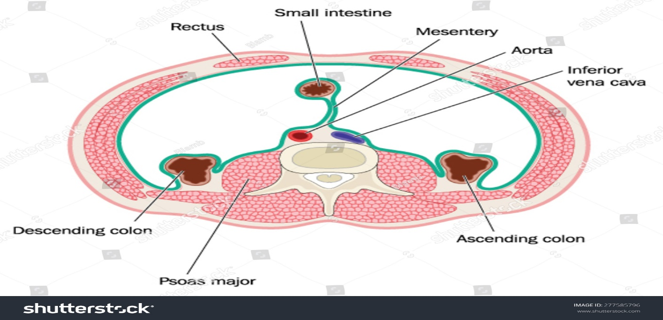
Mesentery
Double layer of peritoneum
Encloses the intestine & attaches it to the abdominal wall

Slide 13
Omentum
A mesentery (double layer of peritoneum)
Attached to the stomach
Visible only when fluid is present

Slide 14
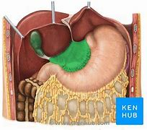
Greater Omentum
Fatty fold of peritoneum
Drapes down from the greater curvature of the stomach
Connects the stomach with
  Spleen
  Transverse colon

Slide 15
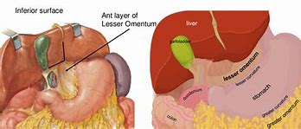
Lesser Omentum
Attaches the duodenum and lesser curve of the stomach to
  Liver

Slide 16
Falciform Ligament
Extends from umbilicus to the diaphragm in a parasagittal plane
Contains the ligamentum teres
Divides the liver into
  Left lobe
  Right lobe

Slide 17
Ligamentum Teres
Also know as the Round ligament
  Within the Falciform ligament
The obliterated umbilical vein
Attaches the internal surface of the umbilicus
Lying within the falciform ligament

Slide 18
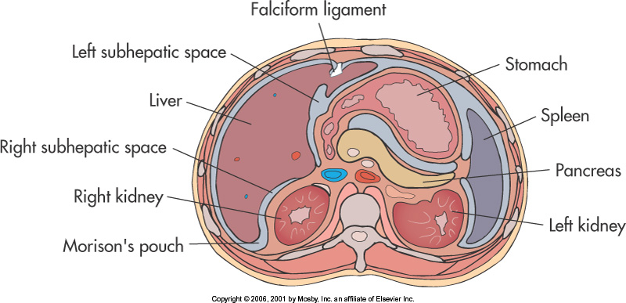

Slide 19
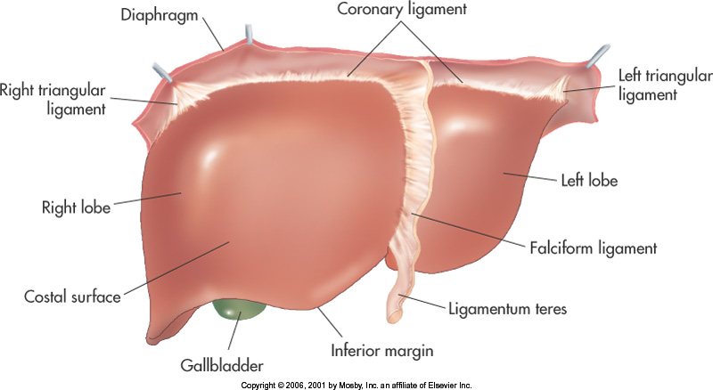

Slide 20
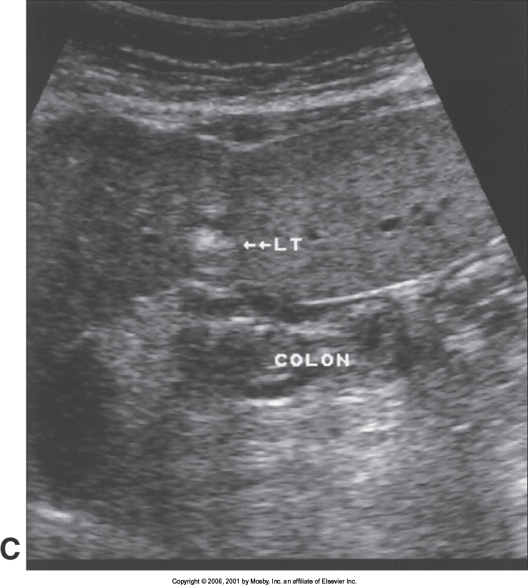
Ligamentum Teres

Slide 21
Ligamentum Venosum
Separates the left lobe of liver from the caudate lobe
Seen:
  Anterior to caudate lobe

Slide 22
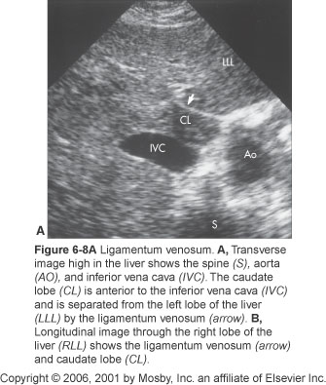

Slide 23
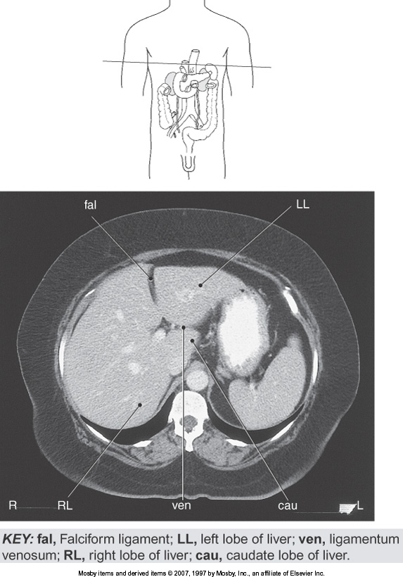

Slide 24
Subphrenic Spaces
Located between
  Diaphragm
  Anterior portion of liver
Divided by the falciform ligament into:
  Right compartment
  Left compartment

Slide 25
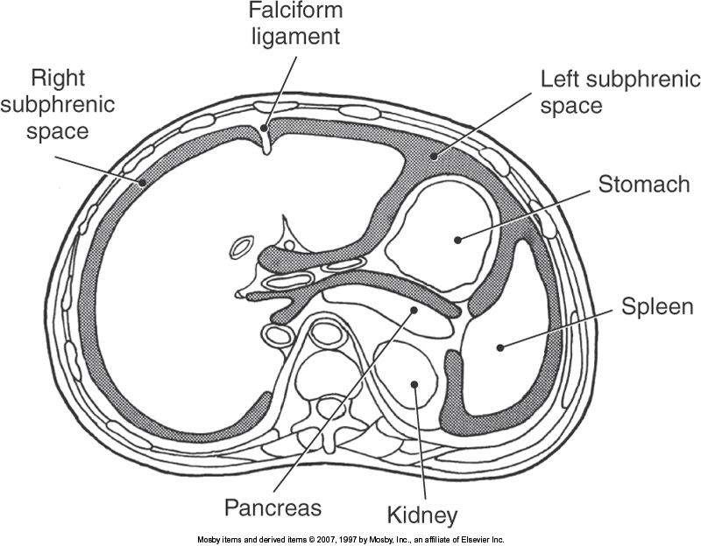

Slide 26
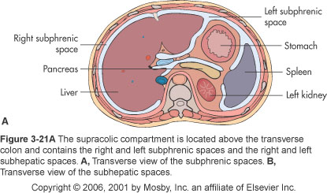

Slide 27
Subhepatic Spaces
Located posterior and inferior between the liver and abdominal viscera
Right Subhepatic Space
  Located between liver and kidney
    Contains Morison’s Pouch
  Deepest part of abdominal cavity
  Common site for fluid collection

Slide 28
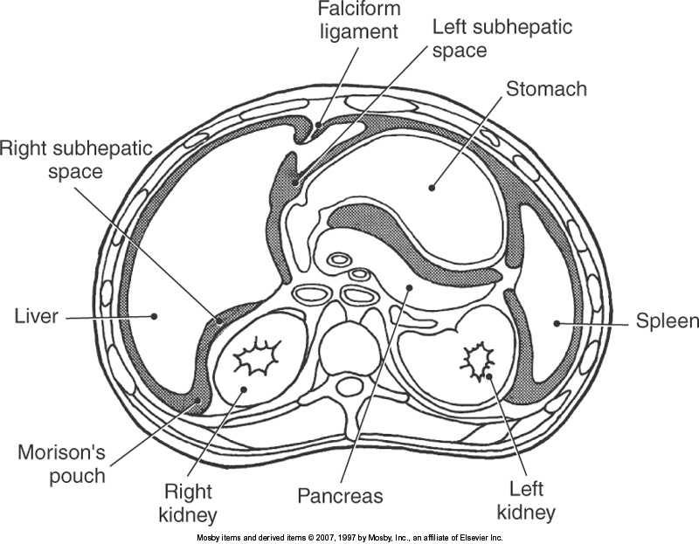

Slide 29
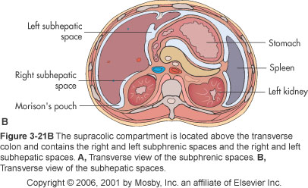

Slide 30
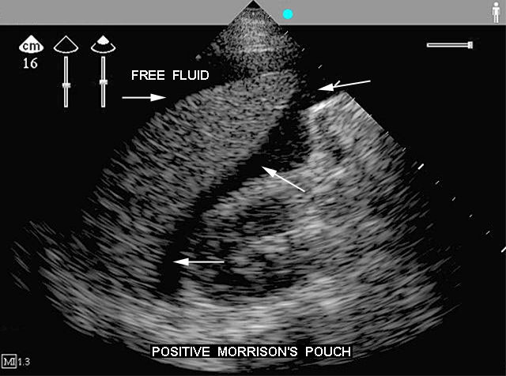

Slide 31
Paracolic Gutters
Trough-like spaces located lateral to the:
  Ascending colon - Right
  Descending colon - Left
Right paracolic gutter
  Deeper of the two
  Common site for fluid collections

Slide 32
Retroperitoneum
Posterior to the peritoneum
Structures
  Kidneys
  Ureters
  Adrenal glands
  Pancreas
  Aorta
  Ascending and Descending colon
IVC
Bladder
Uterus
Prostate
Duodenum

Slide 33
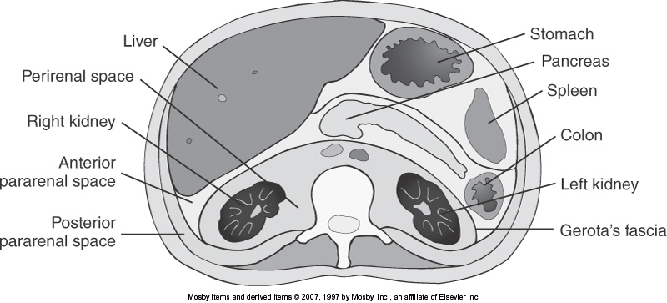

Slide 34
Anterior Pararenal Space
Located between
  Anterior surface of renal fascia (Gerota’s)
  Posterior area of peritoneum
Structures
  Pancreas
  Duodenum
  Ascending and Descending colon

Slide 35
Posterior Pararenal Space
Located between
  Posterior renal fascia
  Muscles of the posterior abdominal wall
Structures
  Fat
  Vessels

Slide 36
Perirenal Spaces
Located
  Directly around kidneys
Enclosed by renal fascia
Structures
  kidneys
  Adrenal gland
  Lymph nodes
  Blood vessels
  Perirenal fat

Slide 37
