Slide 1
Lower Extremity
Chapter 10

Slide 2
New Terminology
Combining Form | Meaning | Example | Meaning of New Term
Acr/o | Extremities | Acroanesthesia | Absence of sensation in the extremities
Ankyl/o | Stiff joint | Ankylosis | Abnormal condition of a stiff joint
Arthr/o Articul/o | Joint | Arthrocentesis Articular | Surgical puncture of a joint Pertaining to a joint
Burs/o | Bursa, sac | Bursitis | Inflammation of a bursa

Slide 3
New Terminology
Combining Form | Meaning | Example | Meaning of New Term
Chondr/o | Cartilage | Chondrodysplasia | Bad, painful, or difficult formation or growth of cartilage
Fasci/o | Fascia | Fasciodesis | Binding or surgical fixation of a fascia
Femor/o | Femur | Femorotibial | Pertaining to the femur and tibia
Ili/o | Ilium | Iliolumbar | Pertaining to the ilium and lower back
Kinesi/o | Movement | Kinesiology | Study of movement

Slide 4
New Terminology
Combining Form | Meaning | Example | Meaning of New Term
Menisc/o | Meniscus | Meniscectomy | Excision or surgical removal of a meniscus
Metatars/o | Metatarsals, ankle | Metatarsophalangeal | Pertaining to the ankle, metatarsals, and phalanges
Muscul/o My/o | Muscle | Musculoskeletal Myocardial | Pertaining to the muscles and skeleton Pertaining to heart muscle

Slide 5
New Terminology
Combining Form | Meaning | Example | Meaning of New Term
Oste/o | Bone | Osteolytic | Pertaining to the destruction of bone
Patell/a Patell/o | Patella | Patellapexy Patelloptosis | Surgical fixation of the patella Prolapse of the patella
Pelv/i | Pelvis | Pelvimeter | Measuring instrument for the pelvis
Phalang/o | Phalanges | Phalangitis | Inflammation of the phalanges
Pub/o | Pubis | Pubofemoral | Pertaining to the pubis and femur

Slide 6
New Terminology
Combining Form | Meaning | Example | Meaning of New Term
Sacr/o | Sacrum | Sacrodynia | Pain of the sacrum
Sthen/o | Strength | Myasthenia | Condition of absence of muscle strength
Synov/o Synovi/o | Synovial membrane | Synovectomy Synovioma | Surgical removal of a synovial membrane Tumor of a synovial membrane
Tars/o | Ankle (tarsal bones) | Tarsometatarsal | Pertaining to the ankle

Slide 7
New Terminology
Combining Form | Meaning | Example | Meaning of New Term
Ten/o Tend/o Tendin/o | Tendon | Tenodynia Tendotome Tendinous | Pain of a tendon Cutting instrument for a tendon Pertaining to a tendon
Tibi/o | Tibia | Tibiofibular | Pertaining to the tibula and fibula

Slide 8
Bony Anatomy
Hip
  Acetabulum
    Cup-like cavity created by
      Ilium
      Ischium
      Pubis

Slide 9
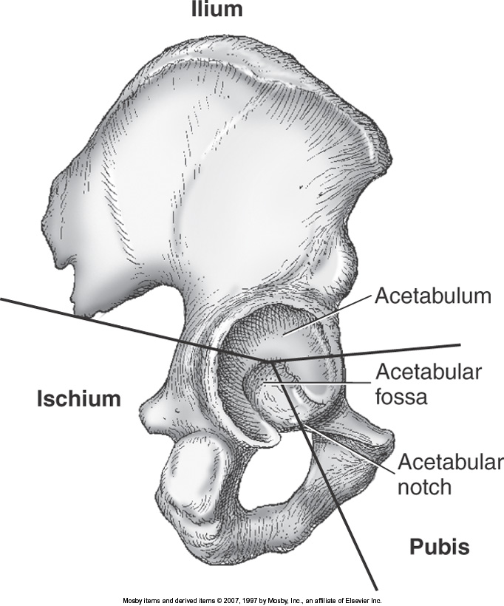

Slide 10
Femur
Longest
  Heaviest Bone in the body
Strongest
Femoral head
  Fits into acetabulum

Slide 11
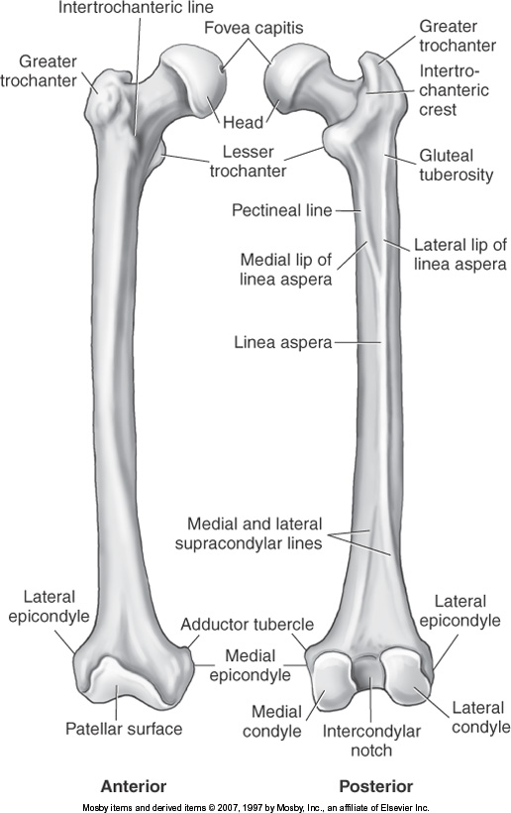
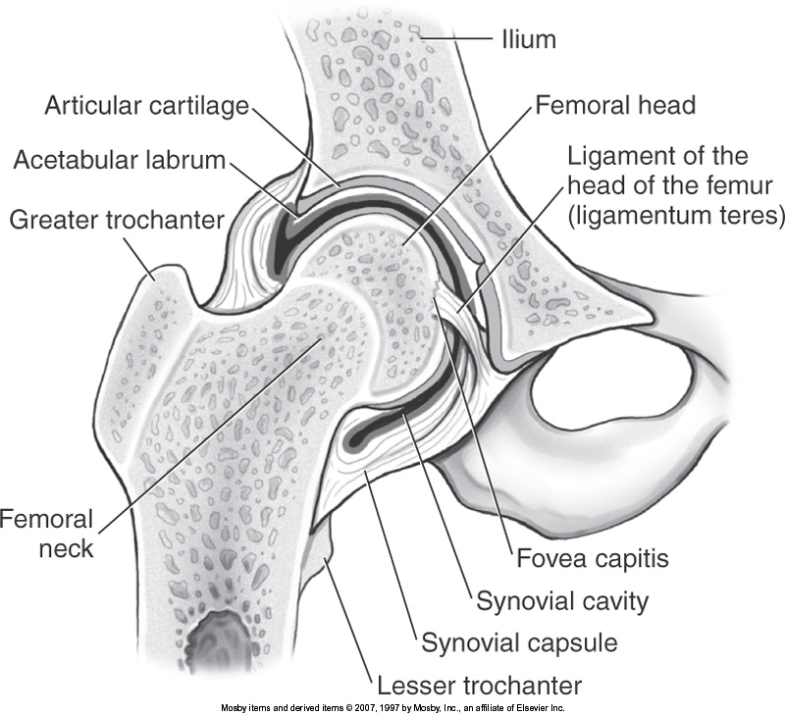

Slide 12
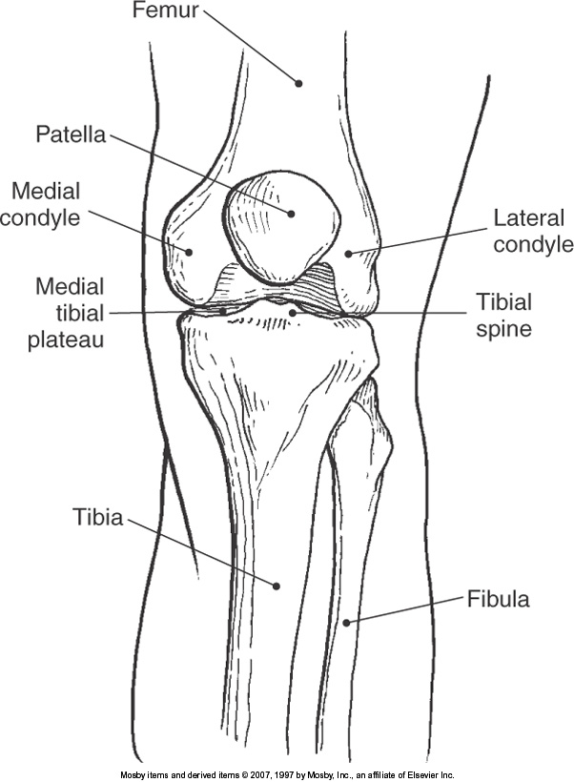
Knee
Bones that contribute to knee joint
  Femur
  Tibia
  Patella
  Fibula

Slide 13
Popliteal Fossa
Posterior aspect of knee

Slide 14
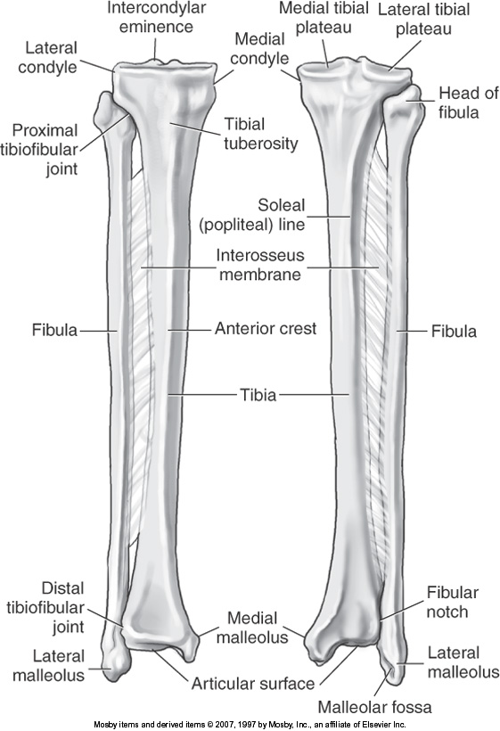
Lower Leg
Tibia
  “shin bone”
  Medial
  Thicker
Fibula
  Lateral
  Thinner

Slide 15
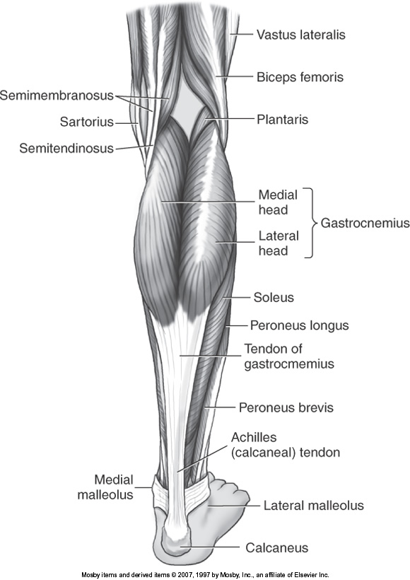
Gastrocnemius Muscle
Superficial muscle located
  Distal popliteal area
  Proximal lower leg

Slide 16
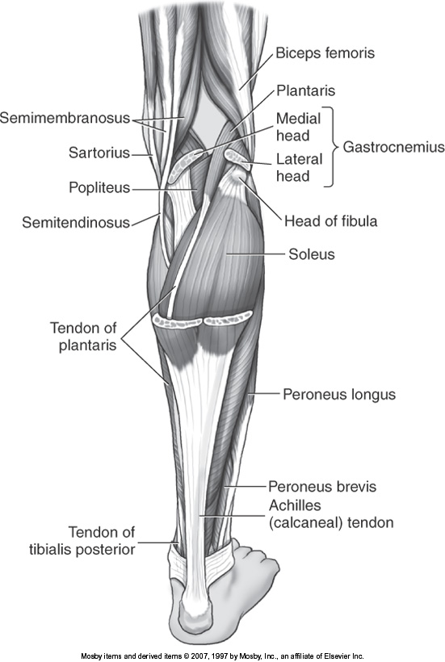
Soleus Muscle
Located beneath gastrocnemius
  Deeper than gastrocnemius

Slide 17
Lower Extremity Arteries

Slide 18
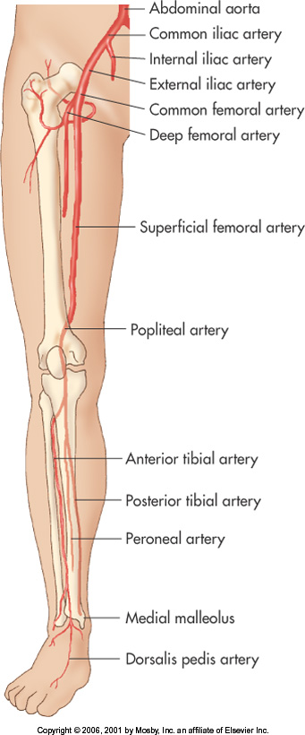

Slide 19
Common Iliac
Terminal branches of the Aorta
Right Common Iliac
  Approximately 5 cm’s in length
Left Common Iliac
  Approximately 4 cm’s in length
Common Iliac arteries divide into:
  Internal Iliac
  External Iliac

Slide 20
Internal Iliac
Also known as hypogastric artery
Descend into the pelvis dividing into:
  Anterior
  Posterior
Supplies the:
  Pelvis viscera and wall
  Buttocks
  Genital organs
  Medial thigh
  Perineum

Slide 21
External Iliac
Larger than the Internal Iliac Artery
Branches into:
  Inferior Epigastric Artery
    Arises anteriorly just proximal to the inguinal ligament
    Supplies the abdominal muscles and peritoneum
    Used in TRAM or CABG procedures
  Deep Circumflex Iliac Artery
    Arises laterally near the inguinal ligament
    Supplies the abdominal muscles

Slide 22
Common Femoral
Is a continuation of the External Iliac Artery
Divides into:
  Superficial Femoral
  Deep Femoral or also known as Profunda Femoris

Slide 23
Femoral Artery
Descends along the anteromedial part of the thigh in the femoral triangle
Courses the length of the thigh
Passes through an opening in the adductor magnus (Also known as Adductor Canal or Hunter’s Canal)
  Tunnel in the middle third of the thigh through which the femoral vessels reach the popliteal fossa
Enters the popliteal fossa

Slide 24
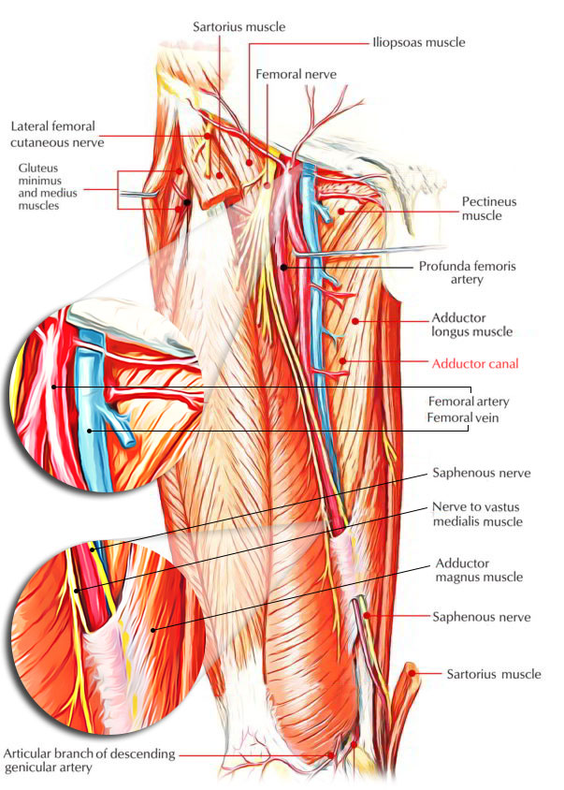

Slide 25
Profunda Femoris
Also know as Deep Femoral Artery
Large lateral branch arising approximately 3.5 cm distal to the inguinal ligament
Main blood supply to:
  Adductor muscle
  Extensor muscle
  Flexor muscle

Slide 26
Popliteal
Continuation of the Superficial Femoral Artery
As the SFA enters the popliteal fossa it becomes the popliteal artery
Popliteal divides into:
  Anterior Tibial
  Posterior Tibial

Slide 27
Anterior Tibial
First branch off of the distal Popliteal Artery
Terminal branch of the popliteal artery
Passes superficial to the interosseous membrane and courses anteriorly along the interosseous membrane
Distally – courses along the anterior aspect of the tibia
Becomes the Dorsalis Pedis Artery

Slide 28
Dorsalis Pedis
Continuation of the Anterior Tibial Artery
ATA becomes more superficial as it passes anteriorly to the lateral malleolus and becomes the DPA distal to the ankle
Transverses the dorsal aspect of the foot towards the base of the great toe
Branches:
  Tarsal
  Arcuate
  First dorsal metatarsal arteries

Slide 29
Tibioperoneal Trunk
Second branch of the distal Popliteal Artery
Sometimes referred to as the proximal segment of the Posterior Tibial Artery
Branches into:
  Posterior Tibial Artery
  Peroneal Arteries

Slide 30
Posterior Tibial
One of the two branches of the Tibioperoneal Trunk
Begins between the tibia and fibula, extending downward and medially to the midpoint between the medial malleolus and the heel
Distal to medial malleolus divides into:
  Medial Arteries
  Plantar Arteries
  * Feeds the sole of the foot *

Slide 31
Peroneal
Originates at the distal portion of the Tibioperoneal trunk
Passes obliquely to the fibula
Courses along the medial aspect of the fibula
Supplies blood to:
  Lateral lower leg
  Calcaneus (Heel)

Slide 32
Plantar Arch
Comprised of:
  Digital arteries
    Terminal branches of Dorsalis Pedis and Posterior Tibial
Deeply situated
Extends from the 5th metatarsal base to the proximal end of the 1st intermetatarsal space
Supply blood to: (In the sole of the foot)
  Skin
  Fasciae
  Muscles

Slide 33
Plantar Arch
Deep Plantar Artery
  Branch of the Dorsalis Pedis Artery
Lateral Plantar Artery
  Branch of the Posterior Tibial Artery
*Deep Plantar Artery unites with the Lateral Plantar Artery to complete the plantar arch *

Slide 34
Digital
Plantar and Dorsal metatarsals distribute blood to the digits

Slide 35
Lower Extremity
Venous system divided into 3 systems:
  Deep system
  Superficial System
  Communicating or Perforating veins
  We will begin with the foot and work up the leg
  (Blood travels cephalad in the legs)

Slide 36
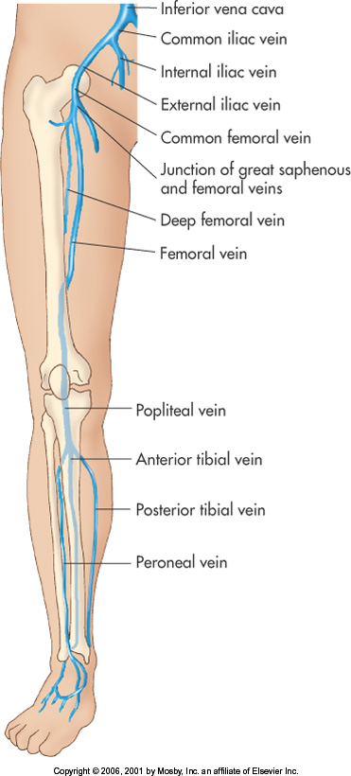
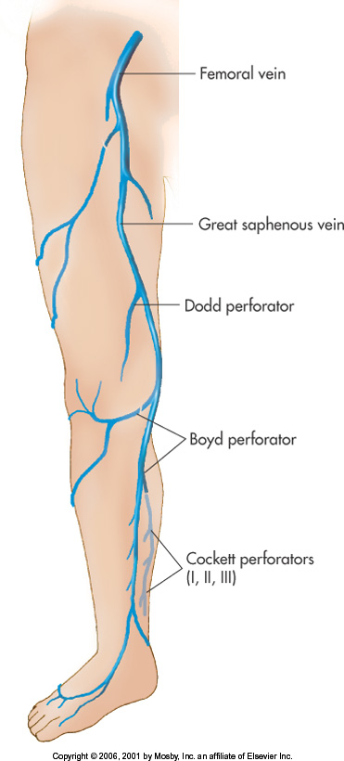
DEEP SYSTEM
SUPERFICIAL SYSTEM

Slide 37
Deep Veins
Deep Digital Veins
  Plantar digital and Dorsal digital veins join to form 4 Metatarsal veins
Metatarsal Veins
  Connected by perforators to the Dorsal Veins to form the Deep Plantar Venous Arch
Peroneal Veins
  Paired veins that course along the lateral aspect of the leg near the fibula
  Carries blood cephalad to the tibioperoneal trunk
  Forms the common peroneal trunk

Slide 38
Posterior Tibial Veins
Paired veins formed by plantar veins
Course posterior to the tibia
Carries blood cephalad to the tibioperoneal trunk
Drains blood from the posterior aspect of the leg
Tibioperoneal Trunk
  Where the Common Tibial Trunk and the Common Peroneal Trunk converges

Slide 39
Anterior Tibial Veins
Paired veins formed by the Dorsal Pedis veins
Lies lateral to the tibia (medial to fibula)
Drains blood from the front of the leg
Along with the tibioperoneal trunk veins join to form the popliteal vein just below the level of the knee

Slide 40
Popliteal Vein
Formed by the anterior tibial and the tibioperoneal trunk just bed just below the knee
  Gastrocnemius Muscular Vein
    Paired veins that drain the “muscle mass” of the calf
    Drains in to the popliteal vein
    Resemble a “dumb bell” shape

Slide 41
Soleal Sinusoids
Thin walled “reservoirs” that lie within the soleal muscle
Drains into the Posterior Tibial and Peroneal Veins
“Spindle Shaped” veins important for the “muscle pump” in the calf
** Frequent site of thrombus**

Slide 42
Femoral Vein
This vein is part of the “DEEP” system
A continuation of the popliteal vein
Becomes the Femoral Vein (FV) when it passes through the adductor hiatus
  Also know as adductor canal

Slide 43
Common Femoral
A continuation of the femoral vein
Formed by the FV and Deep Femoral Vein (Profunda Femoris)
Becomes the External Iliac Vein (EIV) when it approaches the inguinal ligament
Lies in the femoral triangle (Scarpa’s triangle) medial to the Common Femoral Artery

Slide 44
External Iliac
A continuation of the CFV
Becomes the External Iliac Vein when it passes through the inguinal ligament
Joins with the Internal Iliac Vein to form the Common Iliac Vein
  Internal Iliac Vein
    Drains the pelvis

Slide 45
Common Iliac
Formed by the External Iliac and Internal Iliac veins
Left Common Iliac Vein courses behind the Right Iliac Artery
Pressure on the Left Common Iliac vein may account for a higher incidence of Deep Vein Thrombosis (DVT) and swelling of the left leg

Slide 46
Inferior Vena Cava
Formed by the:
  Right Common Iliac
  Left Common Iliac
    Commonly at the level of the 5th Lumbar Vertebra
Carries blood to the right atrium of the heart

Slide 47
DEEP SYSTEM
SUPERFICIAL SYSTEM

Slide 48
Superficial Veins
Lesser Saphenous Vein
  Begins posterior to lateral malleolus
  Courses midline along the back of the calf
  Normally joins the Popliteal Vein
    May continue up the posterior aspect of the thigh and unite with the Greater Saphenous

Slide 49
Greater Saphenous
Formed from digital veins that become larger venous channels of the foot
Originates on the dorsum of the foot traveling medially to the Saphenofemoral Junction ending in the Common Femoral Vein
Often duplicated (can have 2 GSV’s)
Longest vein in the body

Slide 50
Communicating Veins
Also known as Perforating Veins or Perforators
Forms the communication between the superficial and deep venous systems
Carries blood from the superficial veins into the deep system via the Perforators
Contains valves that prevent bidirectional flow
  As long as they are functioning properly

Slide 51
DEEP SYSTEM
SUPERFICIAL SYSTEM

