Slide 1
Spleen
Chapter 7

Slide 2
New Terminology
Combining Form | Meaning | Example | Meaning of New Term
Aden/o | Gland | Adenoma | Tumor of a gland
Adenoid/o | Adenoid | Adenoidectomy | Excision or surgical removal of an adenoid
Angi/o Vas/o | Vessel | Angiasthenia Vasorrhaphy | Absence of vessel strength Suturing of a vessel
Bacteri/o | Bacteria | Bacteriemia | Condition of bacteria in the blood
Immun/o | Immune | Immunopathology | Study of immune disease

Slide 3
New Terminology
Combining Form | Meaning | Example | Meaning of New Term
Lymph/o | Lymph | Lymphoma | Lymph tumor
Lymphaden/o | Lymph gland | Lymphadenocele | Hernia of a lymphatic vessel
Lymphangi/o | Lymphatic vessel | Lymphangiectasis | Dilation of a lymphatic vessel
Lymphocyt/o | Lymph cell | Lymphocytosis | Abnormal condition of lymph cells
Myel/o | Bone marrow, spinal cord | Myeloma | Tumor of the bone marrow
Path/o | Disease | Pathophobia | Fear of disease

Slide 4
New Terminology
Combining Form | Meaning | Example | Meaning of New Term
Ser/o | Serum | Serous | Pertaining to serum
Splen/o | Spleen | Splenomegaly | Enlargement of the spleen
Thym/o | Thymus | Thymocyte | Thymus cell
Tonsill/o | Tonsil | Tonsillitis | Inflammation of the tonsil
Tox/o Toxic/o | Poison, toxin | Toxoid Toxicogenic | Resembling poison Creating poison

Slide 5
Spleen
Largest lymph organ
Highly vascular
Spongy parenchyma
Intraperitoneal organ
Covered entirely with peritoneum
Except for its small bare area
Splenic hilum

Slide 6
Spleen
Posterior to stomach
In LUQ
Medial border
Left kidney
Splenic flexure
Pancreatic tail
Posterior border
Diaphragm
Pleura
Left lung
Ribs

Slide 7
Splenic Vasculature
Splenic Artery (1)
Splenic Vein (1)
Hilum
Where artery enters
Where vein exits

Slide 8
Spleen
Functions to produce WBC
Filters abnormal blood cells from blood
Stores iron from RBC
Initiate immune response

Slide 9
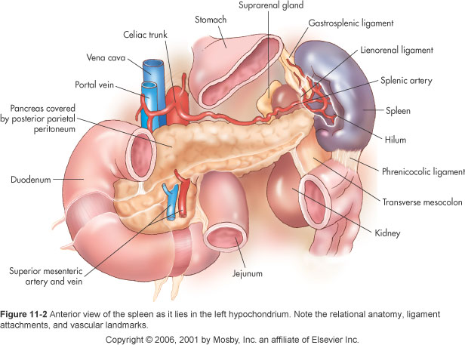

Slide 10
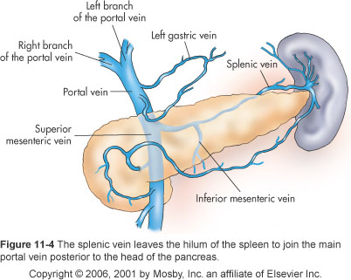

Slide 11
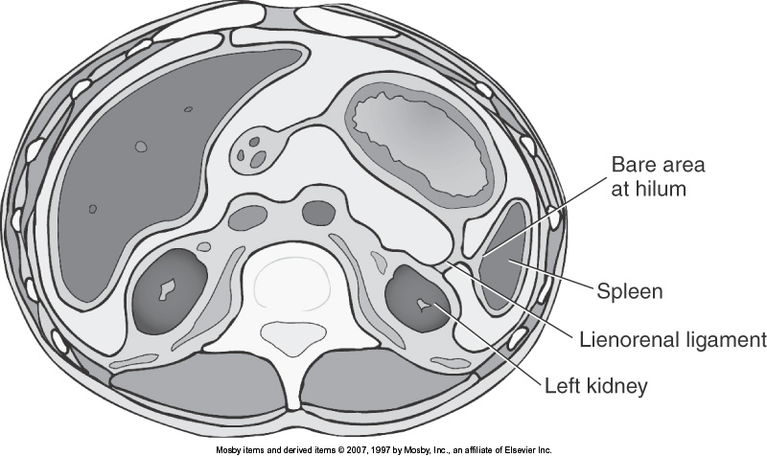

Slide 12
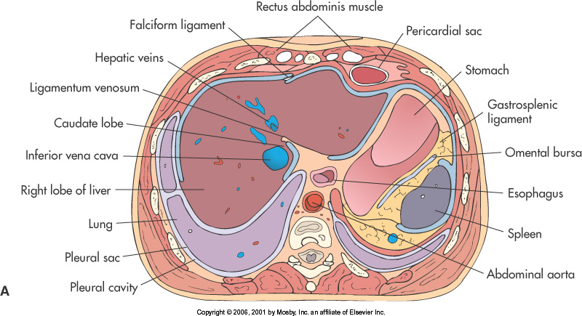

Slide 13
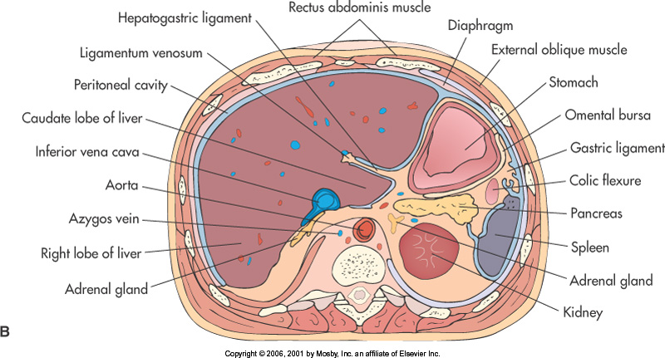

Slide 14
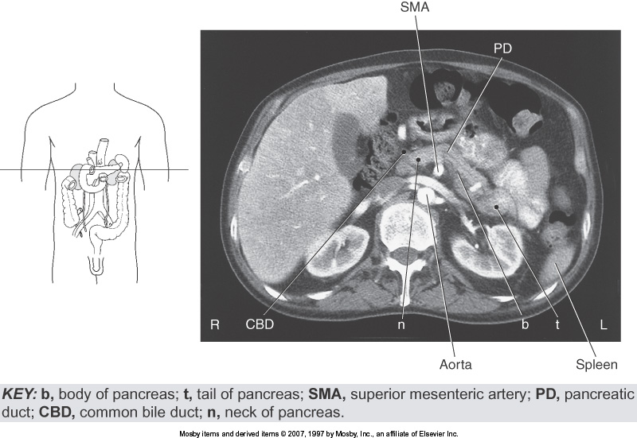

Slide 15
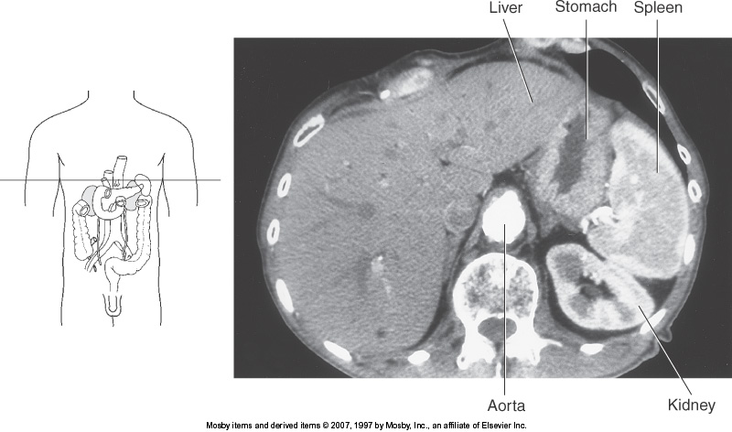

Slide 16
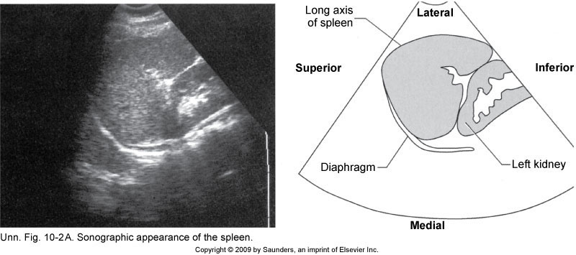
Spleen Coronal Long Axis

Slide 17
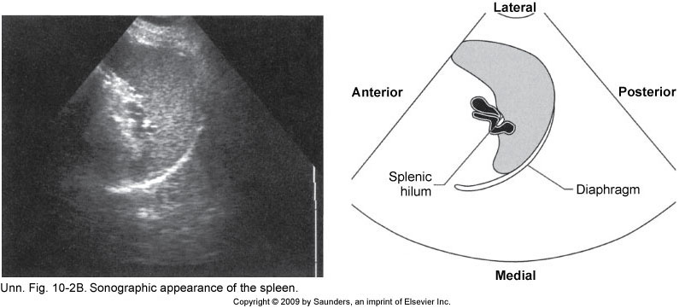
Spleen Transverse Axis

Slide 18
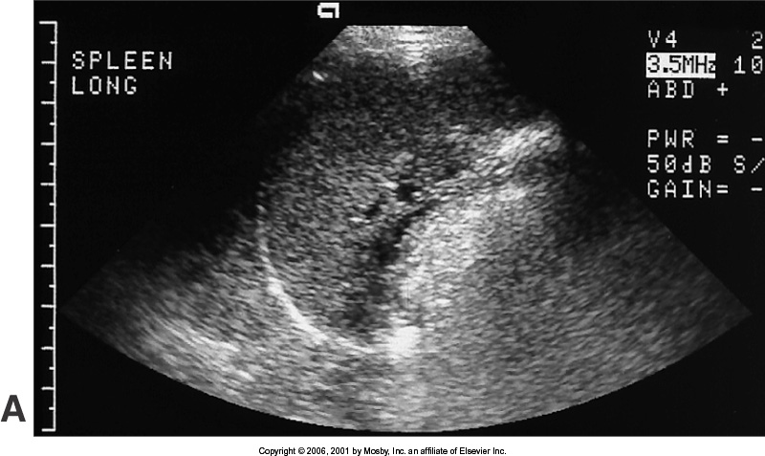

Slide 19
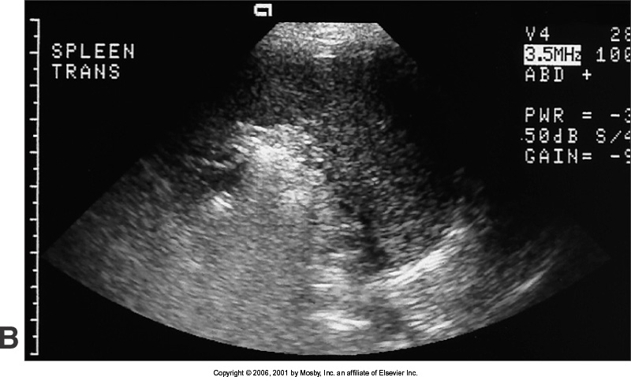

Slide 20
Lymph Nodes
Filtration:
Filters and traps germs
Makes antibodies to know what needs to be disposed of
Immune response:
Destroys germs
Keeps track of immune cells for the body to know when to make more of a certain kind

Slide 21
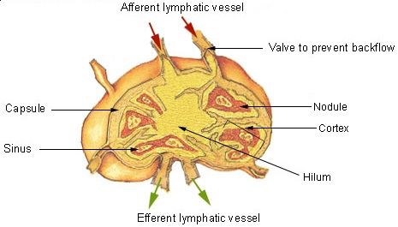
Anatomy of a Lymph Node

Slide 22
Lymph Nodes Sonographic Appearance
bean or oval shape
low echogenicity
Homogenous echotexture
smooth border
hyperechoic hilum with internal blood flow
<2cm

Slide 23
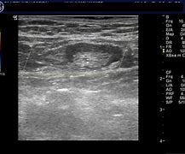
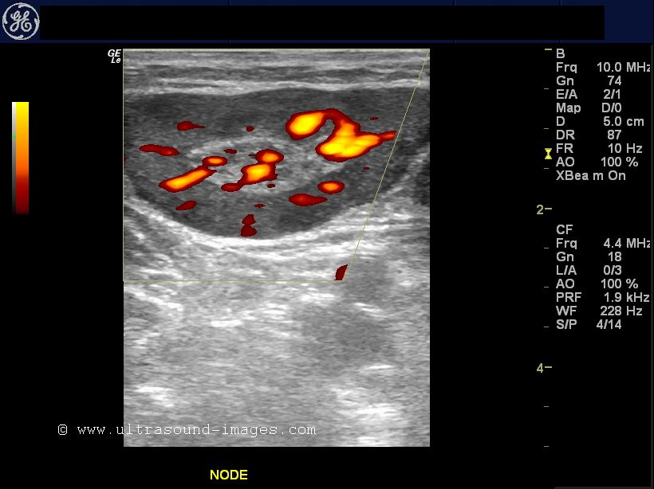
Lymph Nodes

