Slide 1
Liver
Chapter 7

Slide 2
New Terminology
Combining Form | Meaning | Example | Meaning of New Term
Bil/i | Bile | Biliary | Pertaining to bile
Chol/e | Bile/gall | Cholecystitis | Inflammation of the gallbladder
Cholangi/o | Bile duct | Cholangiography | Process of recording a bile duct
Choledoch/o | Common bile duct | Choledocholith | Stone of the common bile duct
Duoden/o | Duodenum | Duodenoscopy | Visual exam of the duodenum
Enter/o | Small intestine | Enteritis | Inflammation of the small intestine

Slide 3
New Terminology
Combining Form | Meaning | Example | Meaning of New Term
Espohag/o | Esophagus | Esophagostenosis | Narrowing or stricture of the esophagus
Gastr/o | Stomach | Gastralgia | Pain of the stomach
Hepat/o | Liver | Hepatitis | Inflammation of the liver
Ile/o | Ileum | Ileotomy | Cutting or incision of the ileum
Jejun/o | Jejunum | Jejunostomy | Mouth-like opening into the jejunum
Lapar/o | Abdomen, abdominal wall | Laparoscope | Instrument used to view inside the abdominal cavity

Slide 4
New Terminology
Combining Form | Meaning | Example | Meaning of New Term
Pancreat/o | Pancreas | Pancreatitis | Inflammation of the pancreas
Phag/o | Eating, swallowing | Phagocyte | Eating cell (type of WBC)
Pylor/o | Pylorus | Pylorostenosis | Narrowing or stricture of the pylorus
Sigmoid/o | Sigmoid colon | Sigmoidoscope | Viewing instrument for the sigmoid colon
Steat/o | Fat | Steatorrhea | Flow or discharge of fat

Slide 5
LIVER
Largest organ of the abdomen
Bordered by the Right hemidiaphragm
  Superiorly
  Laterally
  Anteriorly
Medial surface is bordered by
  Stomach
  Duodenum
  Transverse Colon

Slide 6
LIVER
Inferior surface is bordered by
  Hepatic Flexure
Posterior surface is bordered by
  Right Kidney

Slide 7
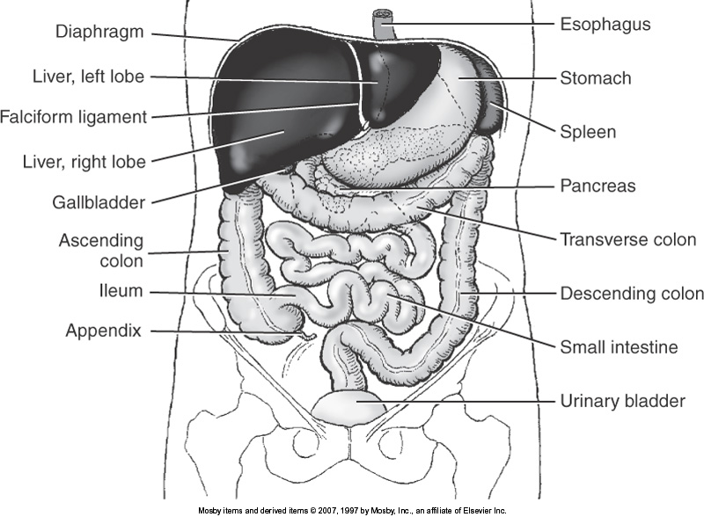

Slide 8
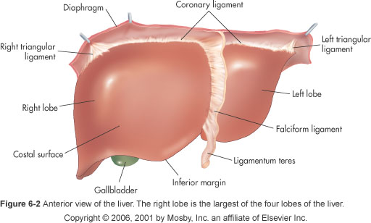

Slide 9
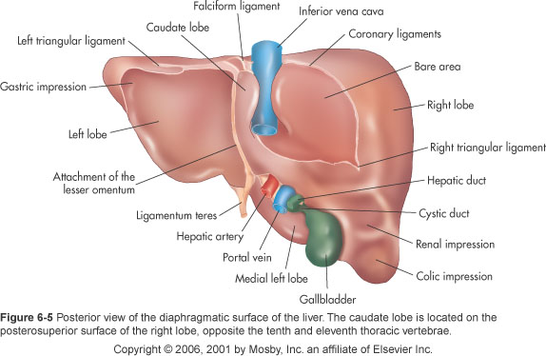

Slide 10
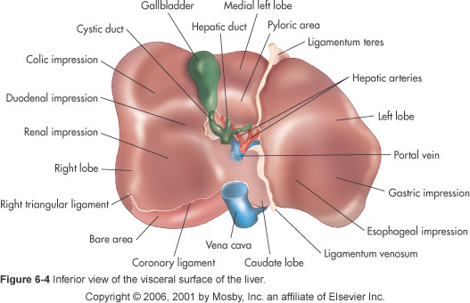

Slide 11
Glisson’s Capsule
Surrounds the liver
Strong connective tissue capsule
Gives shape and stability to soft hepatic tissue

Slide 12
LIVER
Entirely covered by peritoneum
  Except
    Gallbladder fossa
    Surface in proximity to IVC
    Bare Area

Slide 13
FISSURES
Umbilical Fissure (Fissure for Ligamentum Teres)
  Divides the left lobe into
    Medial Segment
    Lateral Segment
Fissure for the Ligamentum Venosum
  Separates the caudate from the left lobe

Slide 14
FISSURES
Transverse Fissure (Portal)
  Contains portions of Right & Left Portal Veins
Interlobar Fissure (Main Lobar Fissure)
  Fissure for the gallbladder
    Divides the right & left lobe
  Imaginary line drawn through the GB fossa and the middle hepatic vein (MHV) to the IVC

Slide 15
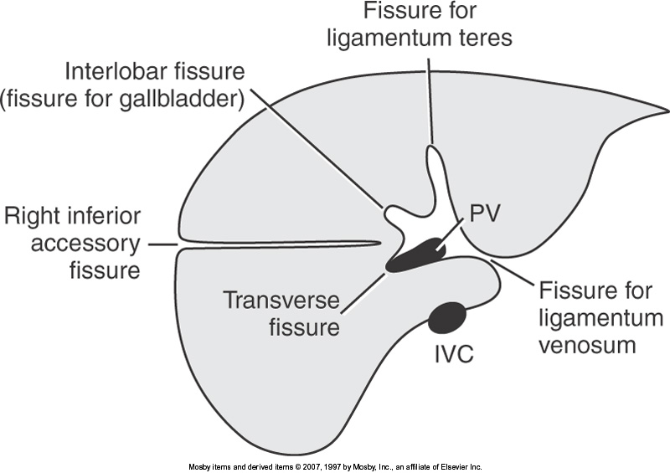

Slide 16
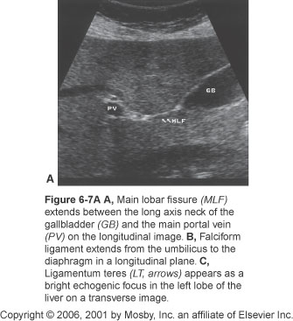

Slide 17
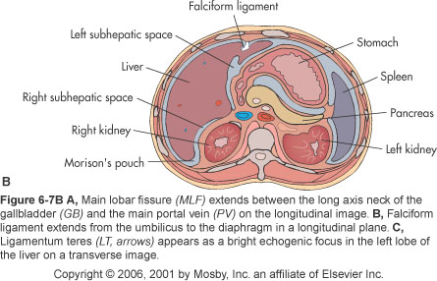

Slide 18
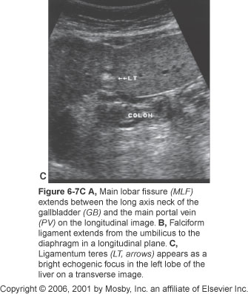

Slide 19
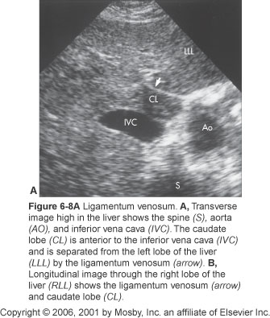

Slide 20
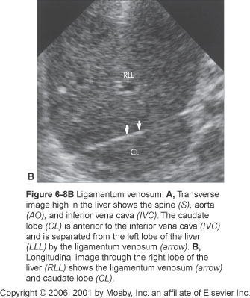
Lig of Venosum
Separates
LLL/Caudate
Don’t let this
Image confuse
You!
Angling through RLL

Slide 21
Lobes
Right Lobe
  Largest
  Most Lateral
Left Lobe
  Most anterior
  Extends across the midline

Slide 22
Lobes
Caudate
  Smallest lobe
  On the superior (book says inferior) and posterior liver surface
  Lies between IVC & Ligamentum Venosum
Quadrate
  Anteroinferior surface of the Left Lobe
  Lies between GB and Ligamentum Teres

Slide 23
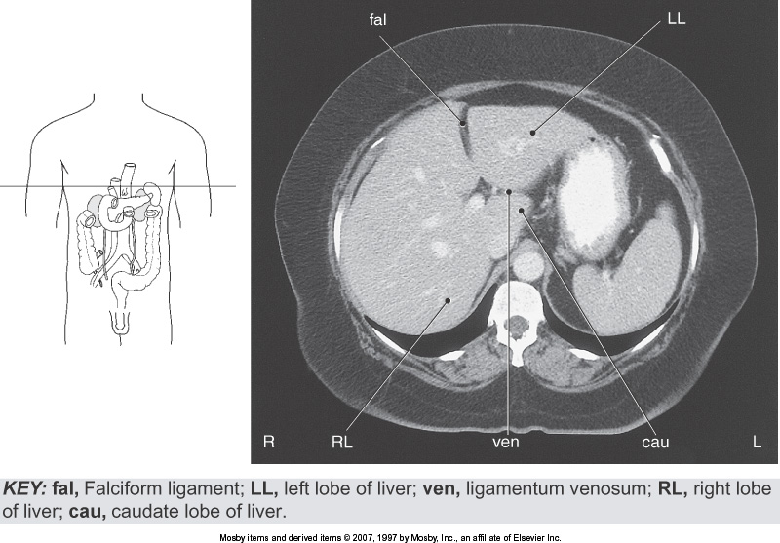

Slide 24
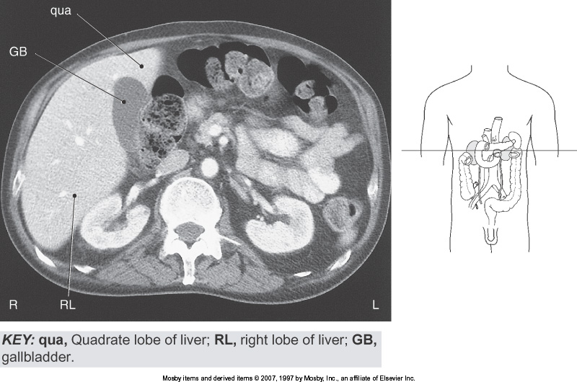

Slide 25
Segmental Anatomy
Current practice
  Divides liver into 8 segments
Based on the branching
  Portal veins (supplies blood)
  Hepatic veins (drains blood)
Each segment can function independently

Slide 26
Segmental Anatomy
Main Hepatic Veins divide
  Liver longitudinally into 4 sections
MHV divides liver into Right/Left
RHV divides RLL into Anterior/Posterior
LHV divides LLL into Medial/Lateral
Portal Veins divide transversely
  Right and Left Portal Veins

Slide 27
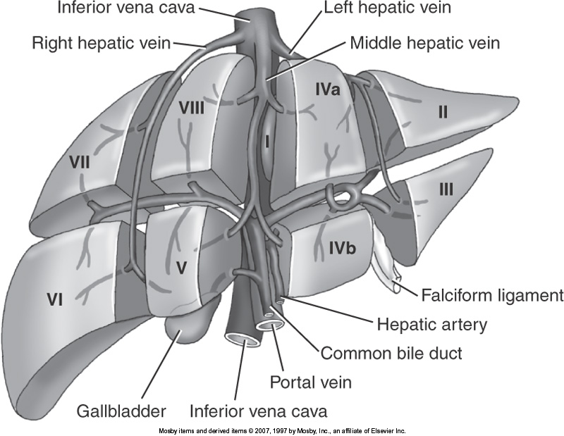

Slide 28
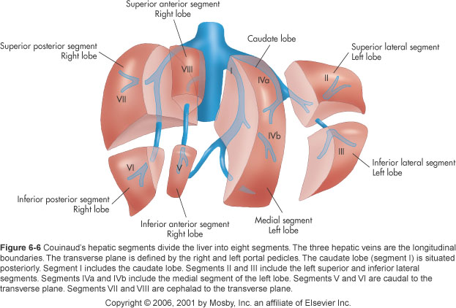

Slide 29
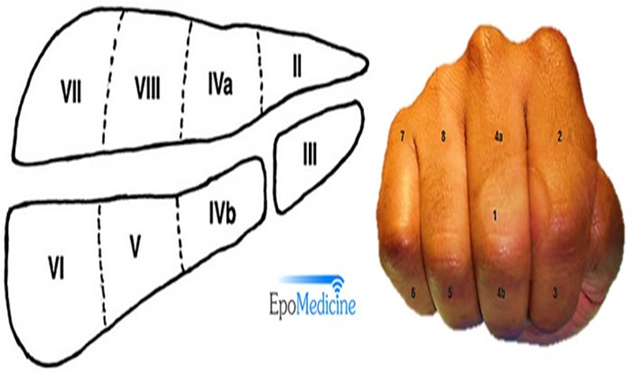
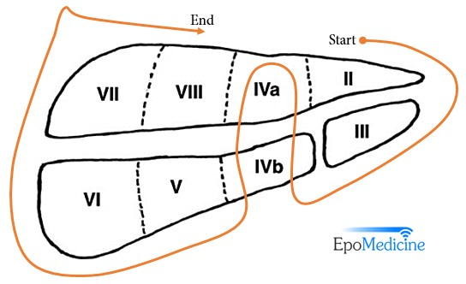
Segmental Anatomy
Tucked in thumb = Segment I (Caudate Lobe)
Line of Proximal Interphalangeal (PIP) joints = Plane of portal vein, separating liver into upper and lower segments.
Interdigitary spaces = Intersegmental planes (hepatic fissures – left, middle and right) in which corresponding hepatic veins run and divide liver sagitally
2nd finger = Left medial segment = Segment IV
Proximal phalanx = Segment Iva
Distal phalanx = Segment IVb
Distal phalanx of 3rd finger = Right inferior anterior segment = Segment V
Distal phalanx of 4th finger = Right inferior posterior segment = Segment VI
Proximal phalanx of 4th finger = Right superior posterior segment = Segment VII
Proximal phalanx of 3rd finger = Right superior anterior segment = Segment VIII

Slide 30
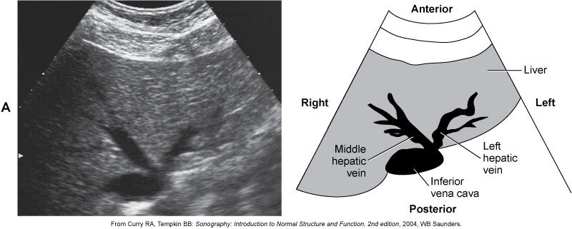

Slide 31
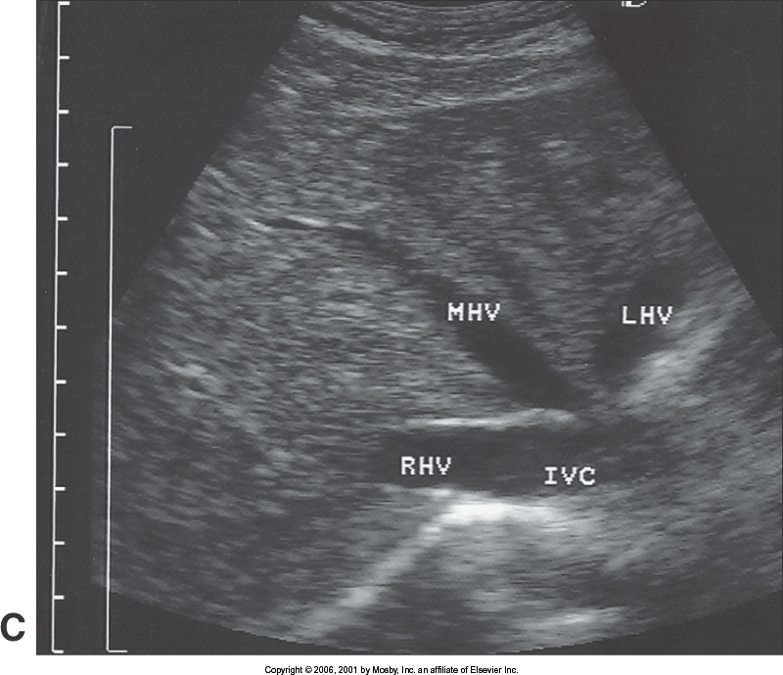

Slide 32
Portal Veins
Supplies liver with nutrient-rich blood
Main Portal Vein (MPV)
  Formed by:
    Superior Mesenteric Vein (SMV)
    Splenic Vein (SV)
  Enters Liver at Porta Hepatis
    Branches into Right & Left Portal Veins

Slide 33
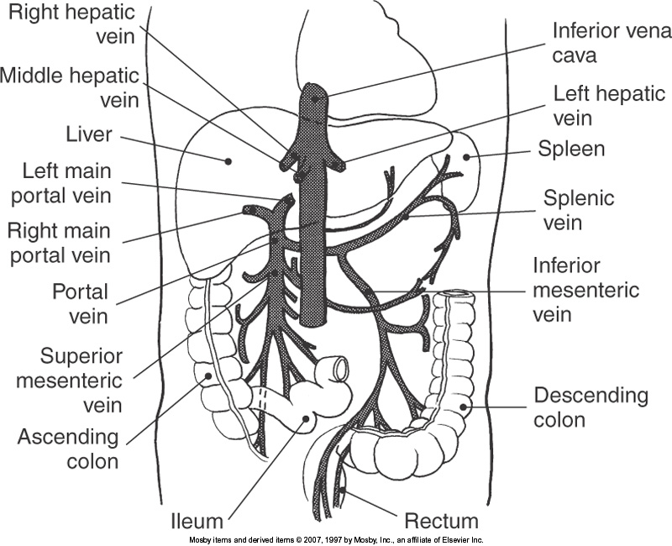

Slide 34
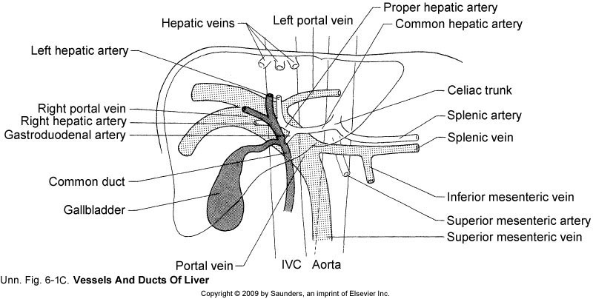

Slide 35
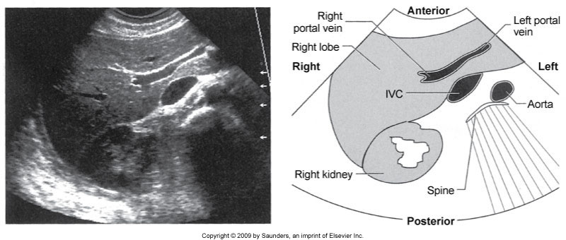

Slide 36
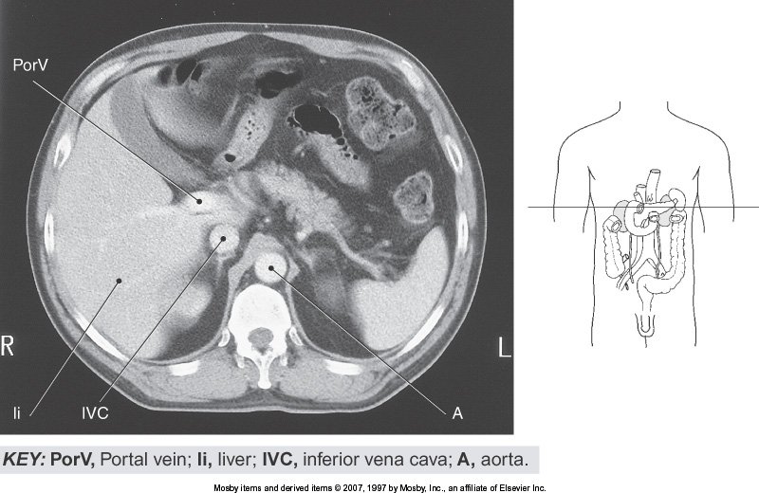

Slide 37
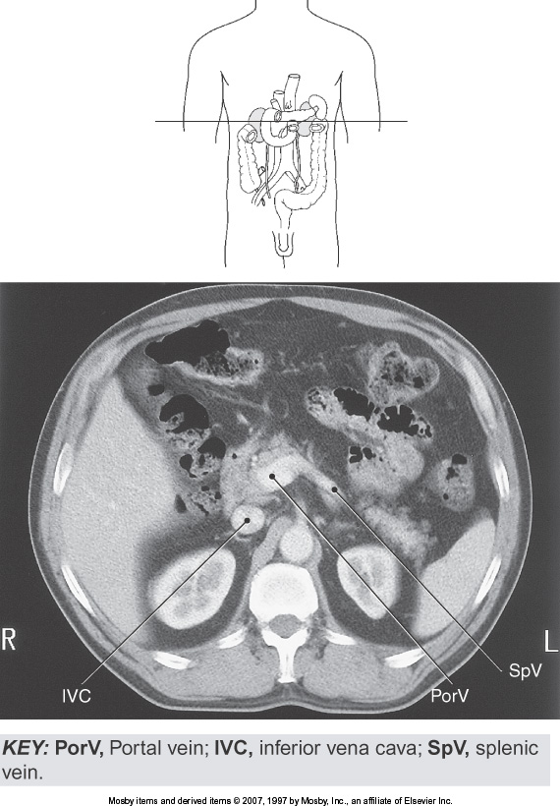

Slide 38
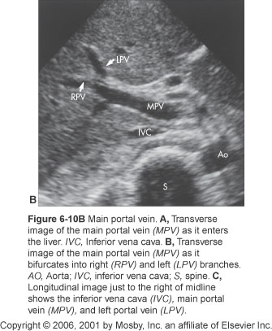

Slide 39
Vasculature
Dual blood supply
  Common Hepatic Artery
    Arterial blood
    20-25%
  Portal Vein
    Nutrient-rich venous blood
    75-80%

Slide 40
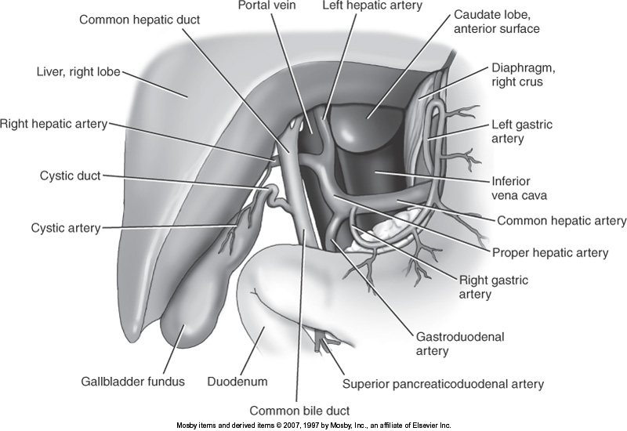

Slide 41
Hepatic Artery
Common Hepatic Artery
  Branch off the Celiac Artery
  Continues to form the Proper Hepatic Artery
  Branches into
    Right Hepatic Artery
      Larger, supplies majority of right lobe
    Left Hepatic Artery
      Smaller, supplies caudate, quadrate, medial & lateral segments of left lobe

Slide 42
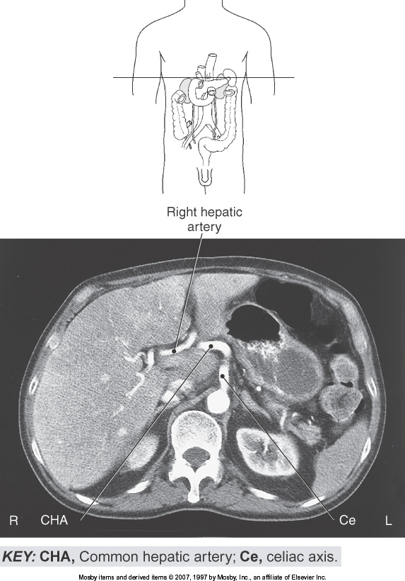

Slide 43
Hepatic Veins
3 major Hepatic Veins
  Right (largest)
  Middle
  Left (smallest)
Frequently the middle and left converge to form a common trunk before emptying into the IVC

Slide 44
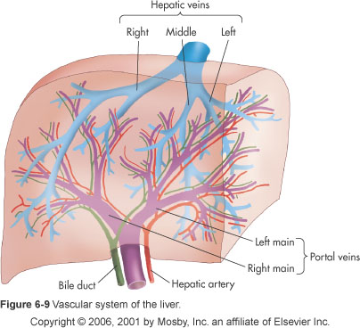

Slide 45
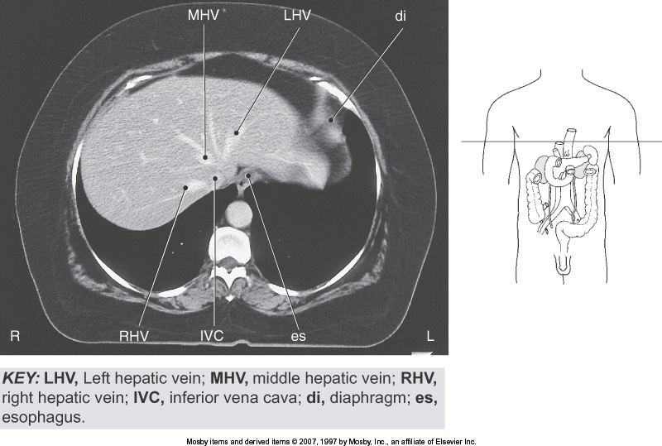

Slide 46
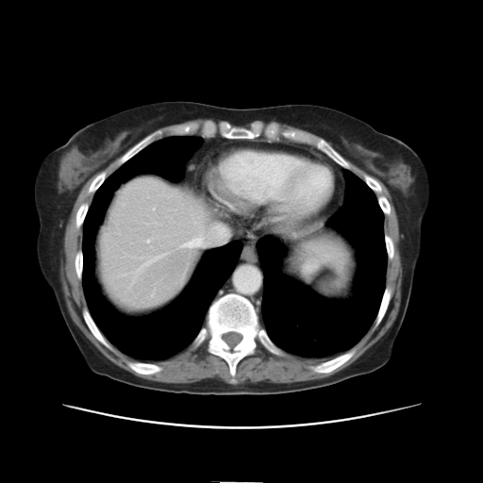

Slide 47
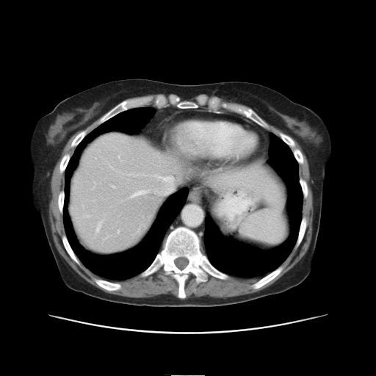

Slide 48
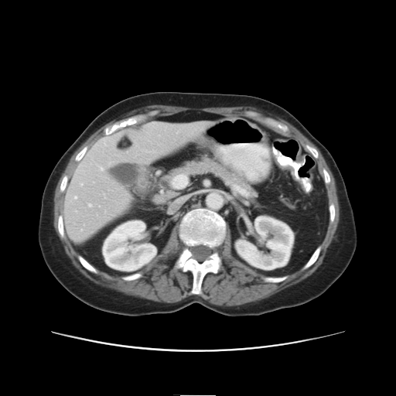

Slide 49
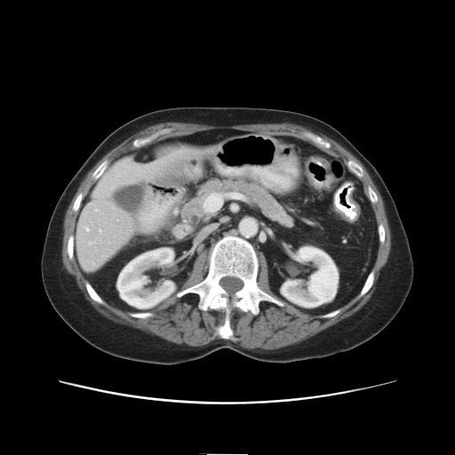

Slide 50
