Slide 1
Abdominal Aorta & IVC (Branches)
Chapter 7

Slide 2
New Terminology
Combining Form | Meaning | Example | Meaning of New Term
Angi/o | Vessel | Angioedema | Swelling of a vessel
Vas/o | Vessel | Vasorrhaphy | Suturing of a vessel
Aort/o | Aorta | Aortostenosis | Narrowing or stricture of the aorta
Arteri/o | Artery | Arteriorsclerosis | Abnormal condition of hardening of an artery
Ather/o | Thick, fatty | Atheroma | Thick, fatty tumor

Slide 3
New Terminology
Combining Form | Meaning | Example | Meaning of New Term
Hem/o | Blood | Hemolytic | Pertaining to the destruction of blood
Hemat/o | Blood | Hematemesis | Vomiting of blood
Phleb/o | Vein | Phleborrhexis | Rupture of a vein
Ven/o | Vein | Venostasis | Stopping of a vein
Vascul/o | Blood vessel | Vasculogenesis | Creation of a blood vessel

Slide 4
Abdominal Aorta
Retroperitoneal
Begins at the diaphragm
Tapers as it travels distal
Left of midline
Bifurcates approx at L4
Right Common Iliac
Left Common Iliac

Slide 5
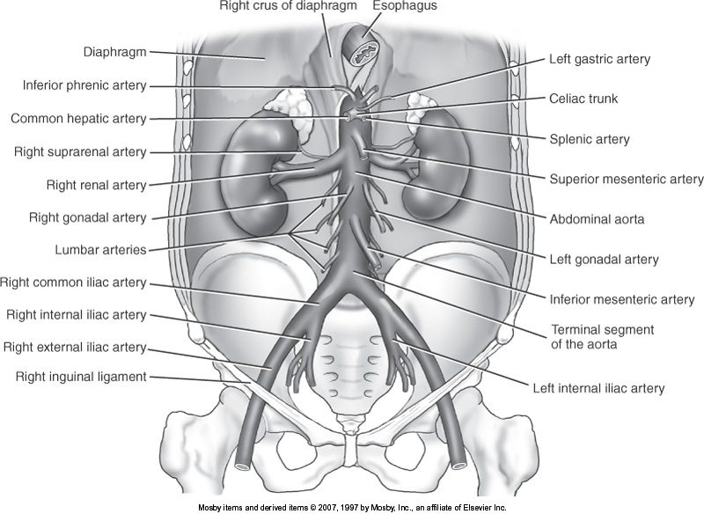

Slide 6
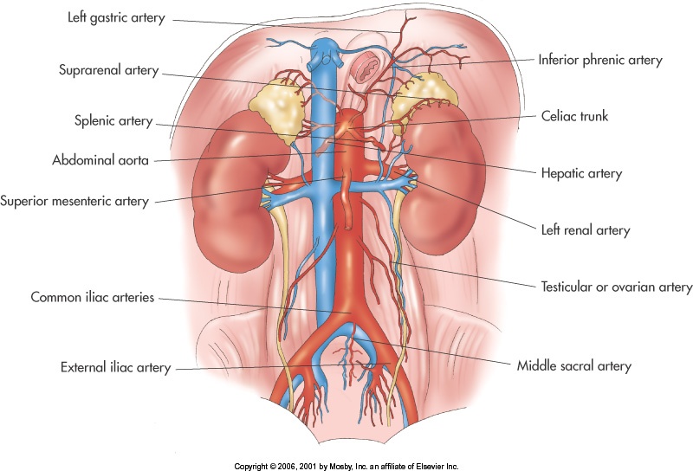

Slide 7
Ventral Branches
Celiac trunk
Left gastric
Common hepatic
Splenic artery
SMA
IMA

Slide 8
Lateral Branches
Renal Artery
Inferior Phrenic Artery
Middle Suprarenal Artery
Testicular or Ovarian Artery

Slide 9
Dorsal Branches
Lumbar (4 pairs)
Median Sacral
Gives off 5th pair of lumbar arteries

Slide 10
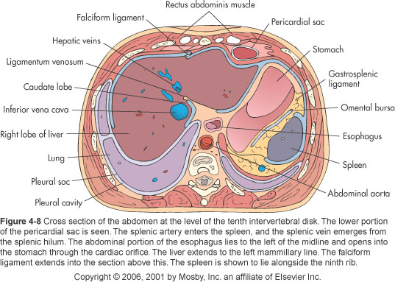

Slide 11
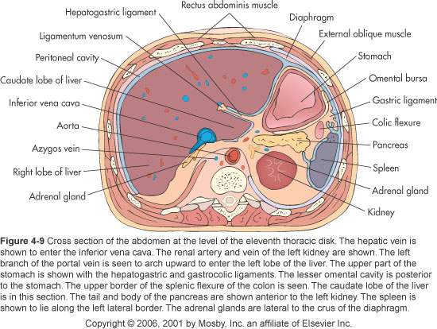

Slide 12
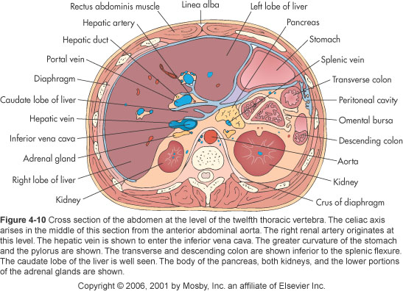

Slide 13
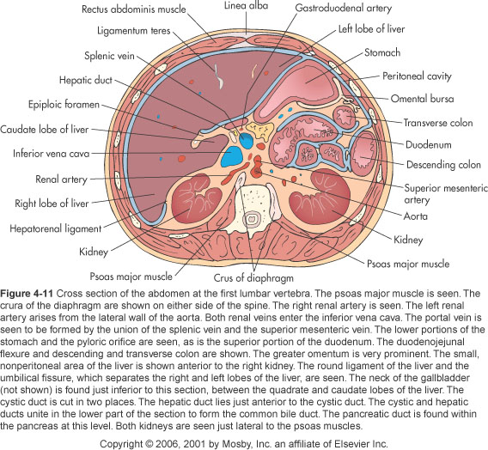

Slide 14
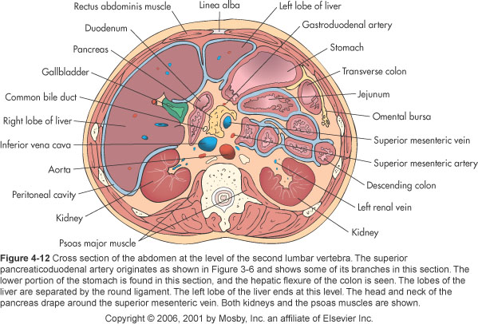

Slide 15
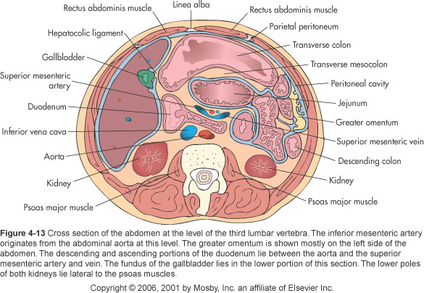

Slide 16
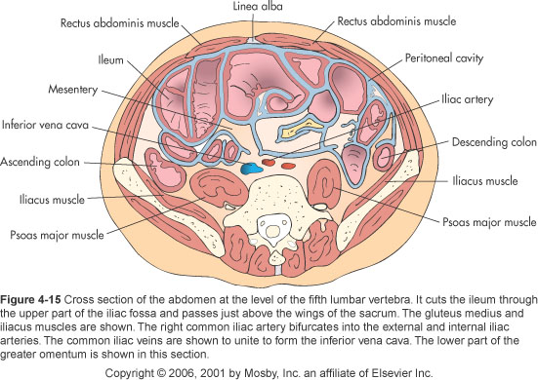

Slide 17
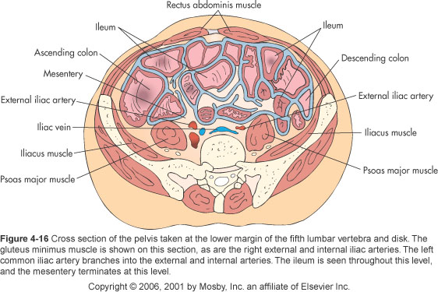

Slide 18
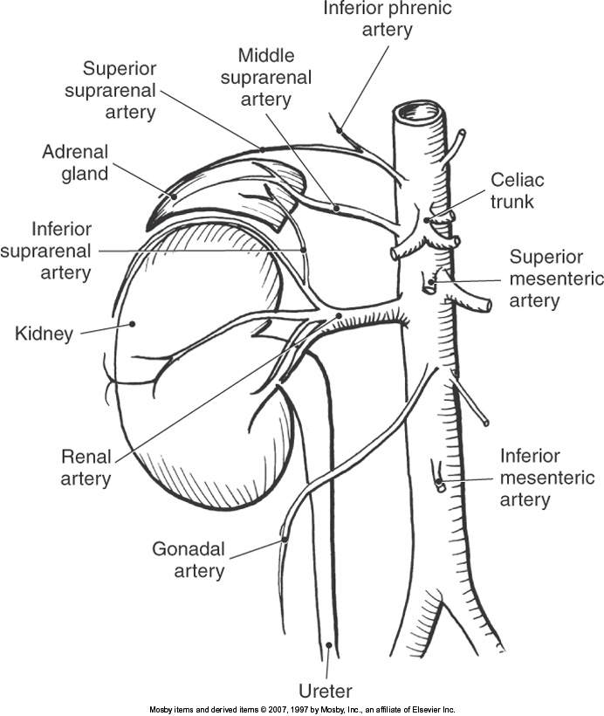

Slide 19
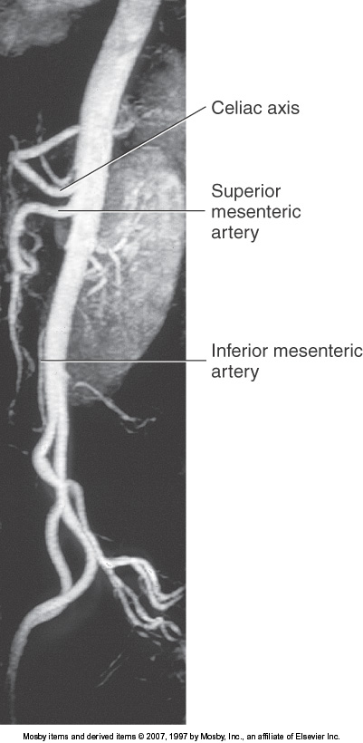

Slide 20
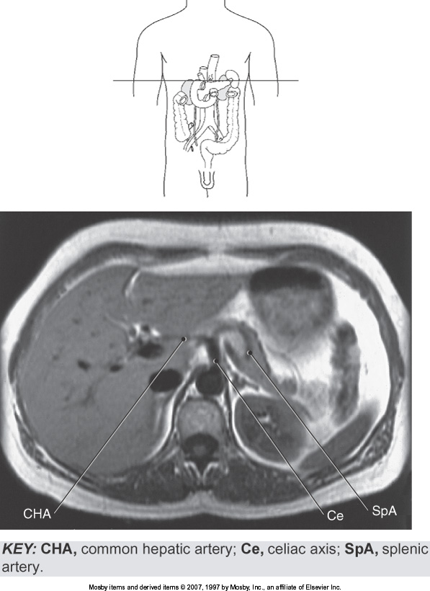

Slide 21
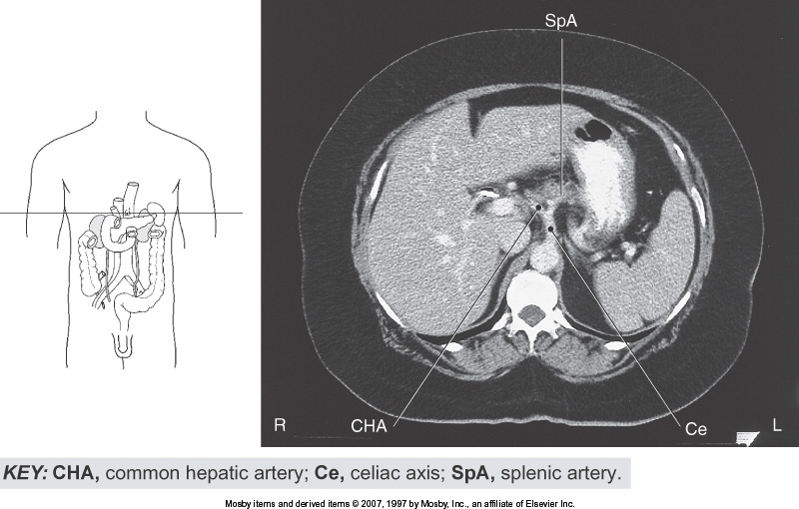

Slide 22
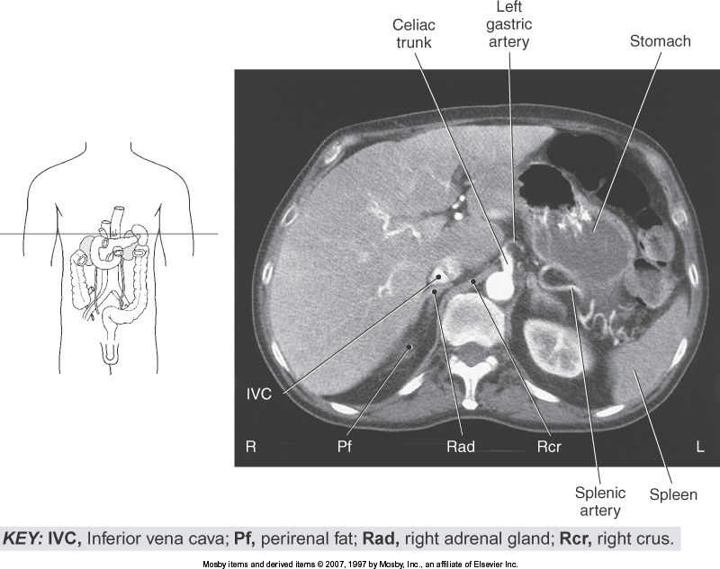

Slide 23
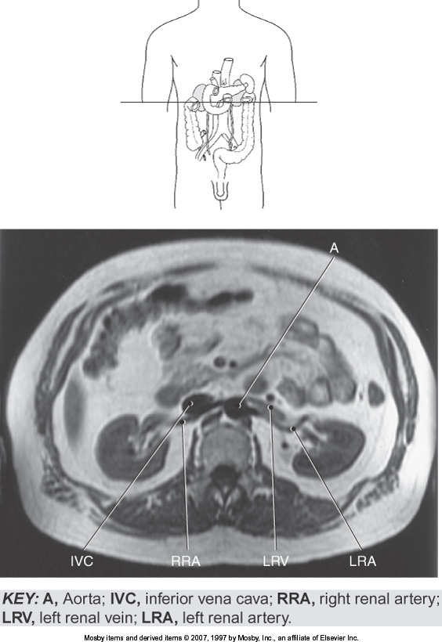

Slide 24
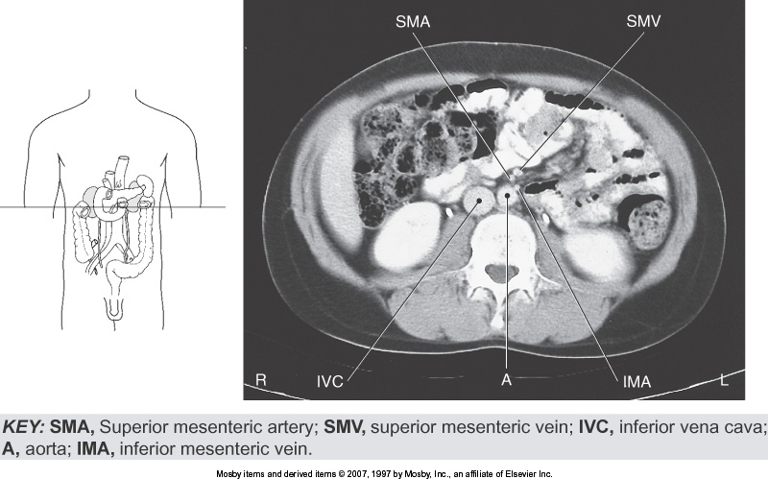

Slide 25
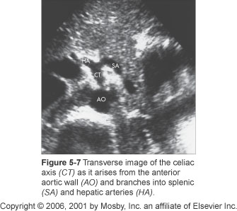

Slide 26
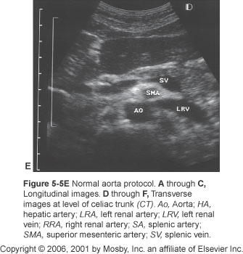

Slide 27
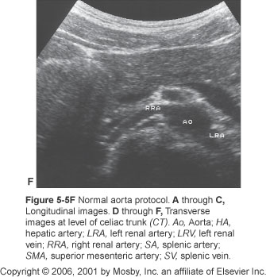

Slide 28
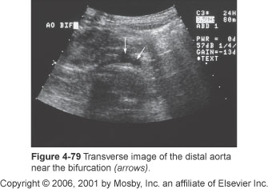

Slide 29
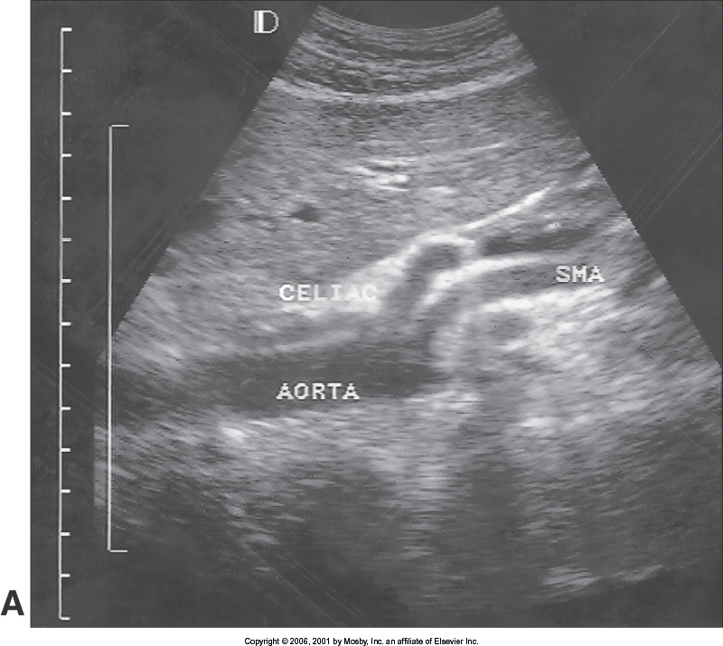

Slide 30
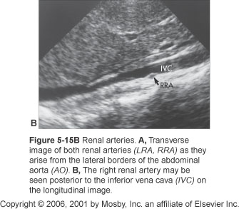

Slide 31
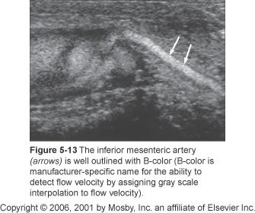

Slide 32
IVC
Largest vein of body
Formed at level of L5 at union of:
Right common iliac vein
Left common iliac vein
Enters right atrium
Distal aspect

Slide 33
Tributaries
Lumbar
Inferior phrenic
Left – often doubled and drains into either
Left suprarenal
Left renal
Right drains directly into IVC
Gonadal
Right drains directly into IVC
Left empties into left renal vein

Slide 34
Tributaries
Renal
Pass anterior to renal arteries
Left renal vein passes posterior to SMA and anterior to AO
Suprarenal
Right drains directly into IVC
Left empties into left renal vein or left inferior phrenic vein
Hepatic
Enters just below diaphragm

Slide 35
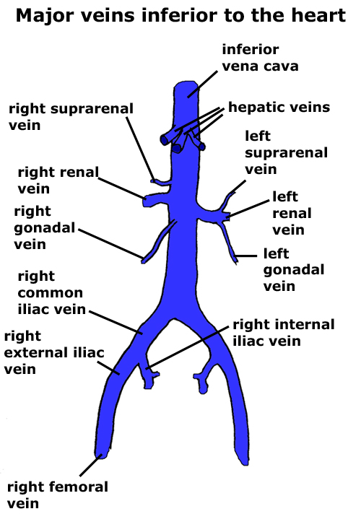

Slide 37
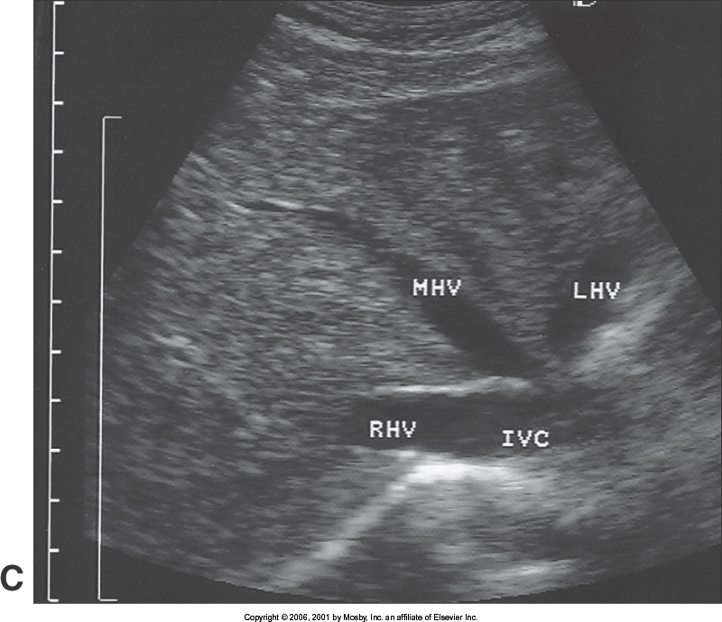
Transverse
Hepatic Veins

Slide 38
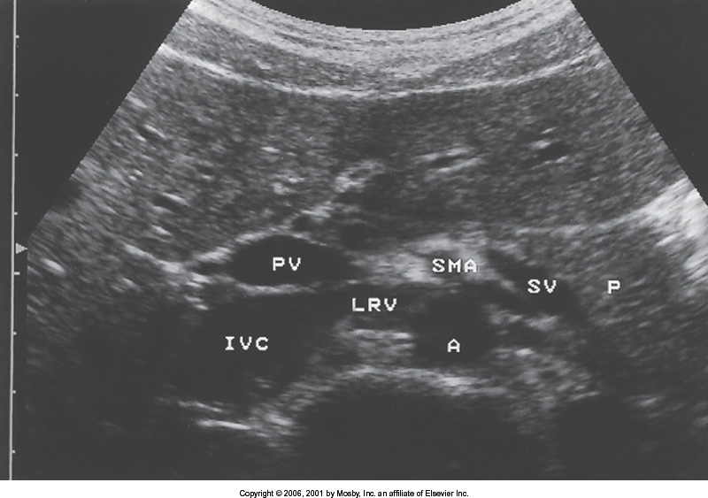
Transverse
Renal Vein

Slide 39
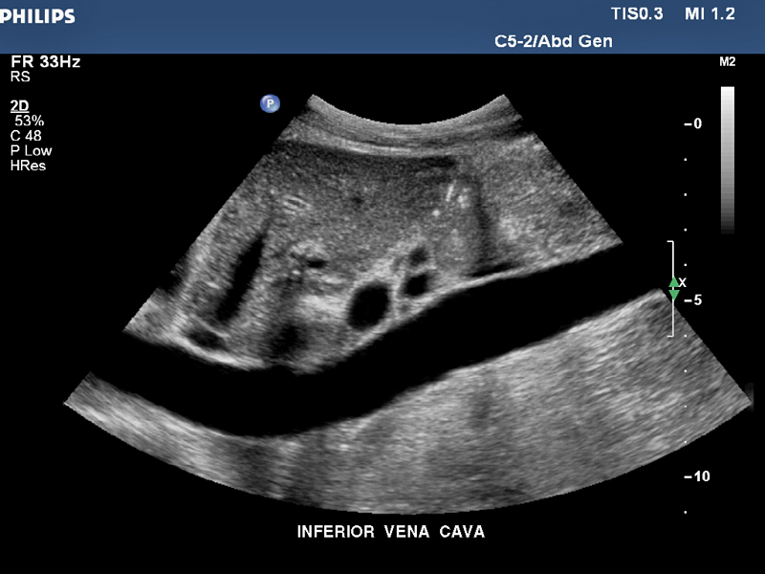
Sagittal
Distal IVC

