Slide 1

Gross Anatomy of the central and peripheral arterial systems
CHAPTER 1

Slide 2
Upper extremity arteries

Slide 3
Aortic Arch
1st – Innominate/Brachiocephalic Artery
Bifurcates into Right Subclavian and Right CCA
Right Subclavian Artery
Arises from the innominate artery laterally after traveling cephalad for 4-5 cm
Right Common Carotid Artery
Arises from the innominate artery coursing proximally towards the brain
2nd – Left Common Carotid Artery
Arises directly from the transverse Aortic Arch
3rd – Left Subclavian Artery
Arises directly from the transverse Aortic Arch

Slide 4
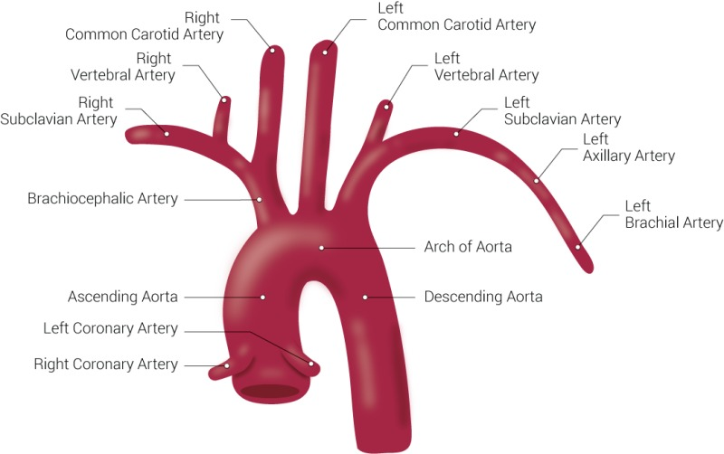

Slide 5
subclavian
Arches above clavicle
Travels laterally and downward to the outer border of the first rib
Important branches:
Vertebral
Thyrocervical
Internal thoracic
Costocervical
Internal Mammary (commonly used for coronary artery bypass)

Slide 6
axillary
A continuation of the subclavian artery
Becomes the brachial artery after giving off the following branches:
Superior artery
Thoracic artery
Thoracoacromial artery
Lateral thoracic artery
Subscapular artery
Anterior and Posterior humeral artery
Thoracodorsal artery

Slide 7
brachial
Continuation of the Axillary artery
Courses down the upper arm to 1 cm below the bend of the elbow
Divides into the Radial and Ulnar arteries

Slide 8
radial
Smaller of the terminal branches of the brachial artery
Descends along the lateral aspect of the forearm
Helps form the Superficial Palmar Arch with one branch
Crosses medially to form the Deep Palmar Arch with the deep branch of the ulnar artery (level of the hand)
Terminates in the Deep Palmar Arch

Slide 9
ulnar
Larger of the terminal branches of the brachial artery
Descends along the medial aspect of the forearm
Gives off a branch to form the Deep Palmar Arch
Terminates at the Superficial Palmar Arch (level of the hand)

Slide 10
Palmar arch
Superficial – anastomosis formed primarily by the ulnar artery “USA”
Deep – formed by the anastomosis of the distal segment of the radial artery with the deep palmer branch of the ulnar artery “RAD”
Approximately 1/3 of the Superficial Palmar Arches are formed by the ulnar artery alone
1/3 are completed by a branch of the radial
1/3 are completed by other branches
Primarily the medial artery distal segment of the ulnar artery
Radial artery branch

Slide 11
digital
Arise from the palmar arches
Each palmar digital artery had two dorsal branches anastomosing with the dorsal digital arteries
Lateral branch
Medial branch

Slide 12
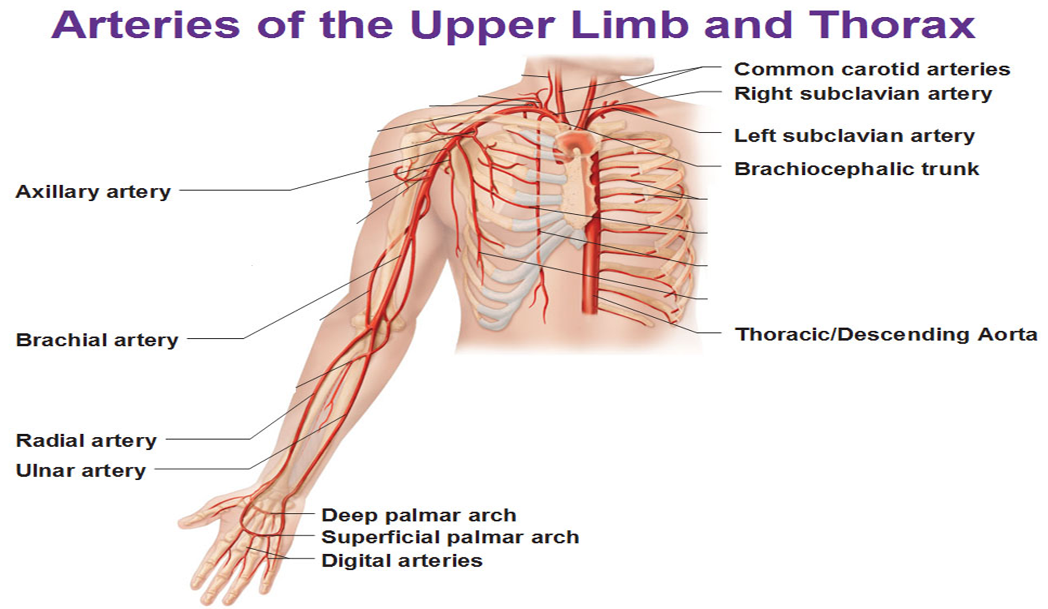

Slide 13
Thoracic and abdominal arteries

Slide 14
Ascending aorta
Arises from the left ventricle
Has two branches:
Right coronary artery
Left coronary artery

Slide 15
Aortic arch
Formed by the ascending aorta
Gives off three branches:
Innominate
Left common carotid artery
Left subclavian artery

Slide 16
Descending thoracic aorta
Extends from the aortic arch inferiorly to the diaphragm
Once it passes through the diaphragm, it becomes the abdominal aorta

Slide 17
Abdominal aorta
Major visceral branches of the abdominal aorta include:
Celiac axis
Superior mesenteric artery
Renal arteries
Inferior mesenteric artery

Slide 18
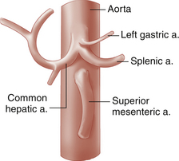
Celiac axis
Also called the celiac trunk or celiac artery
Feeds the stomach, liver, pancreas, duodenum, and spleen
Branches into the left gastric, splenic, and common hepatic arteries

Slide 19
Superior mesenteric artery
Feeds the small intestine, cecum, ascending colon, and part of the transverse colon
Located approximately 1 cm distal to the celiac artery
Can occasionally share a common trunk with the celiac artery

Slide 20
Renal arteries
Supply blood to the kidneys, suprarenal glands, and ureters
Multiple renal arteries are not uncommon bilaterally
Right renal artery is the only vessel seen posterior to the IVC
Left renal artery is found posterior to the left renal vein

Slide 21
Inferior mesenteric artery
Arises from the distal abdominal aorta approximately 3-4 cm above the bifurcation
Supplies the left half of the transverse colon, the descending, iliac, and sigmoid colon, and part of the rectum

Slide 22
Other major branches
Parietal branches include:
Inferior phrenic artery
Lumbar arteries
Middle sacral arteries
Terminal branches of the abdominal aorta include the right and left common iliac arteries
Carries blood to the pelvis, abdominal wall, and lower limbs

Slide 23
lower extremity arteries

Slide 24
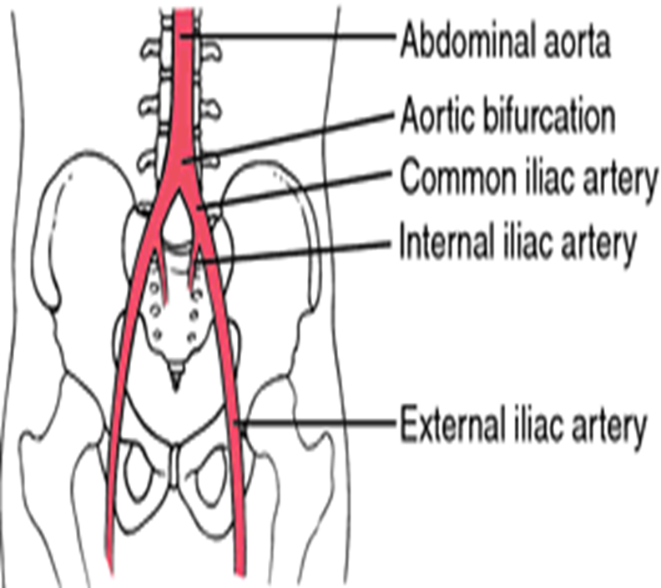
Common iliac
Terminal branches of the Aorta
Right Common Iliac
Approximately 5 cm in length
Left Common Iliac
Approximately 4 cm in length
Common Iliac arteries divide into:
Internal Iliac
External Iliac

Slide 25
Internal iliac
Also know as hypogastric artery
Descend into the pelvis, dividing into:
Anterior
Posterior
Supplies the:
Pelvic viscera and wall
Buttocks
Genital organs
Medial thigh
Perineum

Slide 26
External iliac
Larger than the Internal Iliac Artery
Branches into:
Inferior Epigastric Artery
Arises anteriorly just proximal to the inguinal ligament
Supplies the abdominal muscles and peritoneum
Used in TRAM or CABG procedures
Deep Circumflex Iliac Artery
Arises laterally near the inguinal ligament
Supplies the abdominal muscles

Slide 27
Common femoral
Is a continuation of the External Iliac Artery (becomes the Common Femoral Artery at the inguinal ligament)
Divides into:
Superficial Femoral
Deep Femoral
Also known as “Profunda Femoris”

Slide 28
Superficial femoral
Descends along the anteromedial part of the thigh in the femoral triangle
Courses the length of the thigh
Passes through a hiatus in the adductor magnus muscle (Also known as Adductor Canal or Hunter’s Canal) to enter the popliteal fossa
Tunnel in the middle third of the thigh through which the femoral vessels reach the popliteal fossa

Slide 29
Femoral triangle
Also known as Scarpa’s Triangle
Depressed are of the thigh lying distal to the inguinal fold
Its borders are:
Medial margin of the sartorius
Medial margin of the adductor longus
Inguinal ligament superiorly
Also contains nerves, fat and lymphatics

Slide 30
Profunda femoris
Also known as Deep Femoral Artery
Large lateral branch arising approximately 5 cm distal to the inguinal ligament
Responsible for perfusion to:
Adductor muscle
Extensor muscle
Flexor muscle

Slide 31


popliteal
Continuation of the Superficial Femoral Artery
As the SFA passes through Hunter’s Canal it becomes the popliteal artery
Has several branches that include:
Genicular arteries
Gastrocnemius arteries
Popliteal divides into:
Anterior Tibial Artery
Tibioperoneal Trunk

Slide 32
Anterior tibial
First branch of the distal Popliteal Artery
Passes superficial to the interosseous membrane and courses anteriorly along the interosseous membrane
Distally the ATA courses to the anterior aspect of the tibia
Becomes Dorsalis Pedis Artery

Slide 33
Dorsalis pedis artery
Continuation of the Anterior Tibial Artery
ATA becomes more superficial as it passes anteriorly to the lateral malleolus and becomes the DPA distal to the ankle
Traverses the dorsal aspect of the foot towards the base of the great toe
Branches:
Tarsal
Arcuate
First dorsal metatarsal arteries

Slide 34
Tibioperoneal trunk
Second branch of the distal Popliteal Artery
Sometimes referred to as the “proximal segment of the Posterior Tibial Artery”
Branches into:
Posterior Tibial Artery
Peroneal Artery

Slide 35
Posterior tibial
One of the two branches of the Tibioperoneal Trunk
Begins between the tibia and fibula, extending downward and medially to the midpoint between the medial malleolus and the heel
Distal to the medial malleolus divides into:
Medial plantar artery
Lateral plantar artery
** Feeds the sole of the foot **

Slide 36
peroneal
Originates at the distal portion of the Tibioperoneal Trunk
Passes obliquely to the fibula
Courses along the medial aspect of the fibula
Supplies blood to:
Lateral lower leg
Calcaneus (heel)

Slide 37
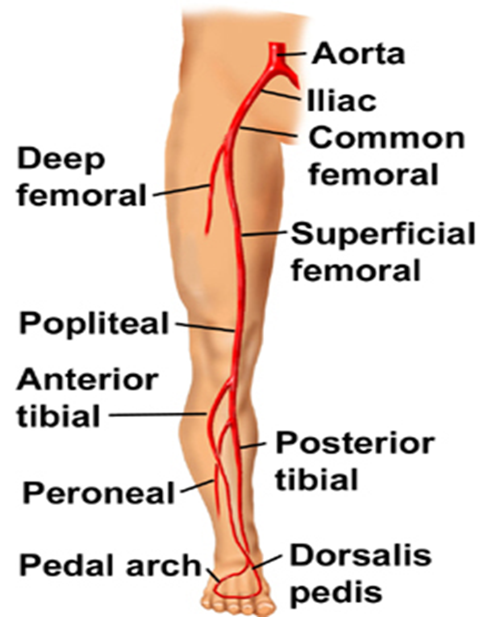
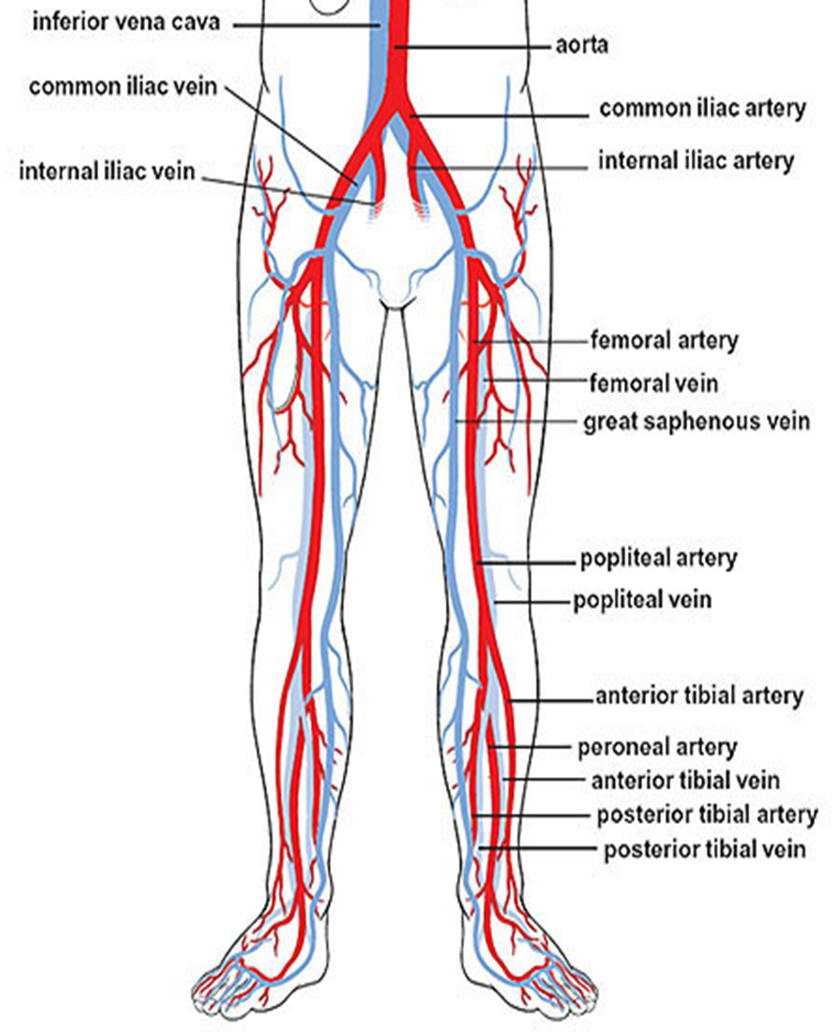

Slide 38

Plantar arch
Comprised of:
Digital arteries
Terminal branches of Dorsalis Pedis and Posterior Tibial
Deeply situated
Extends from the 5th metatarsal base to the proximal end of the 1st intermetatarsal space
Supplies blood to:
Skin
Fasciae
Muscles
In the sole of the foot

Slide 39
Plantar arch
Deep Plantar Artery
Branch of the Dorsalis Pedis Artery
Lateral Plantar Artery
Branch of the Posterior Tibial Artery
*Deep Plantar Artery anastomoses with the Lateral Plantar Artery to complete the plantar arch*

Slide 40
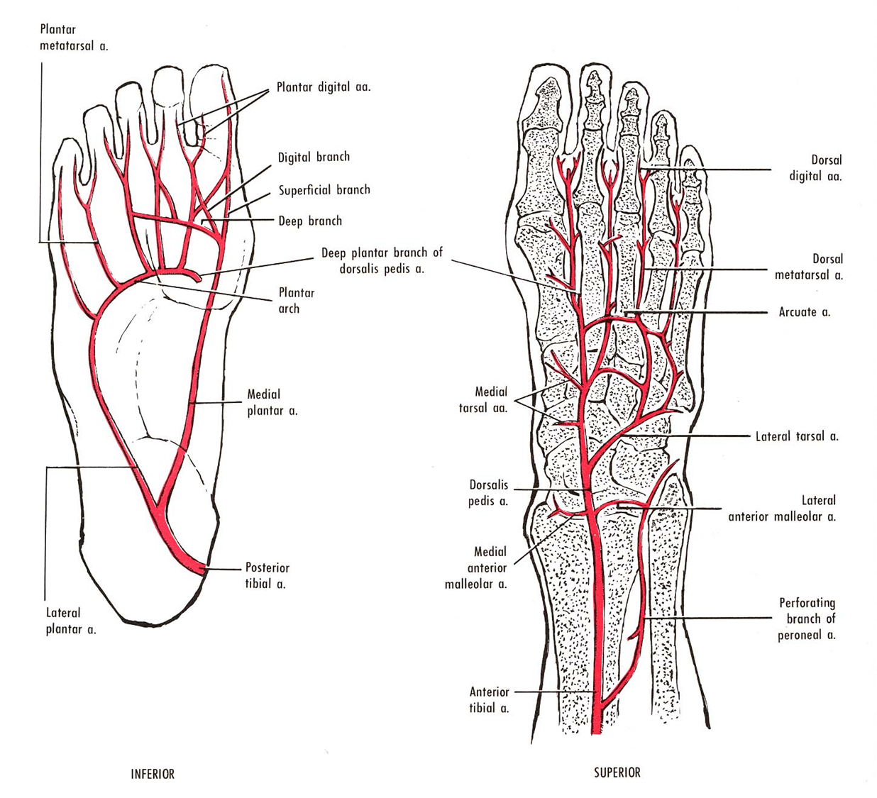
digital
Plantar and Dorsal Metatarsal arteries distribute blood to the toes

Slide 41
capillaries
Extremely thin-walled vessel of the microcirculation
Single layer of epithelium
Capillaries are only 1 mm long and 8-10 microns in diameter (same as RBC)
Supplied by arterioles that transport gases, nutrients, and other essential substances to the capillary beds
Capillaries are a vital part of the circulatory system

Slide 42
arterioles
Diameter < 1.5mm
Play a major role in regulating the flow of blood into the capillaries by:
Vasoconstriction
Vasodilation
Principle point of resistance in arterial blood flow

Slide 43
Microscopic anatomy of the arterial wall

Slide 44
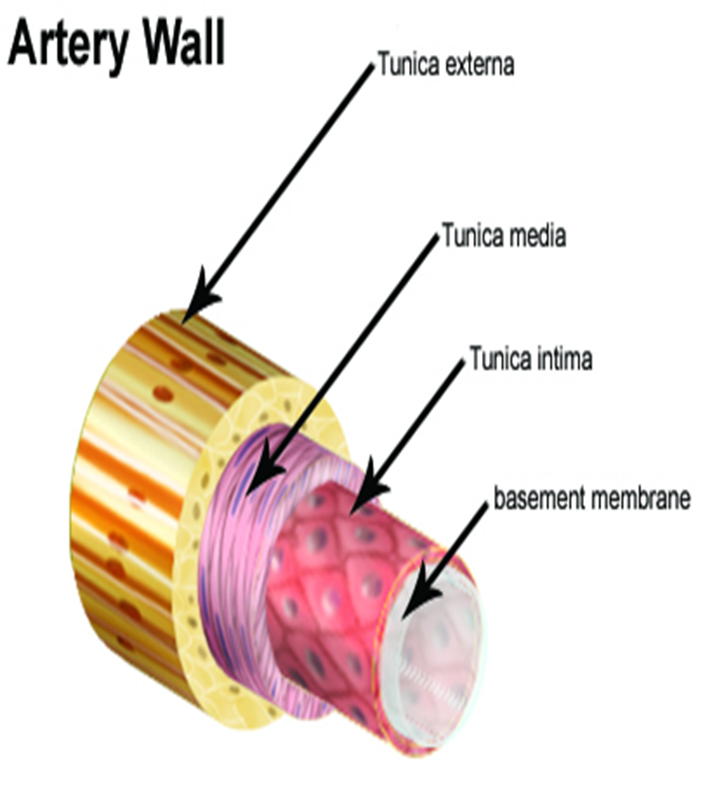
arteries
Function:
Transports blood (gases, nutrients, and essential substances) away from the heart to the tissues
Composed of 3 layers or tunics:
Tunica Adventitia – outermost layer
Tunica Media – middle layer
Tunica Intima – innermost layer

Slide 45
Tunica adventitia (externa)
Outermost layer
Made up of elastic lamina enclosed by fibrous tissue
Fibers that make up the elastic lamina run longitudinally
Provides great elasticity to the arteries

Slide 46
Tunica media
Middle layer
Composed of smooth muscle layer surrounded by fibrous tissue
Muscular layer varies in thickness depending on the artery’s function
Muscle fibers are arranged in a circular pattern
Allows the muscle fibers to have better control over diameter changes
Regulates flow of blood through the artery

Slide 47
Tunica intima
Innermost layer
Composed of elastic lamina lined by a layer of endothelial cells one cell thick on the inner surface
Endothelial cells provide a smooth lining with no obstruction to blood flow
Fibers course in a longitudinal pattern
Lumen – hollow center of the artery where blood courses

Slide 48
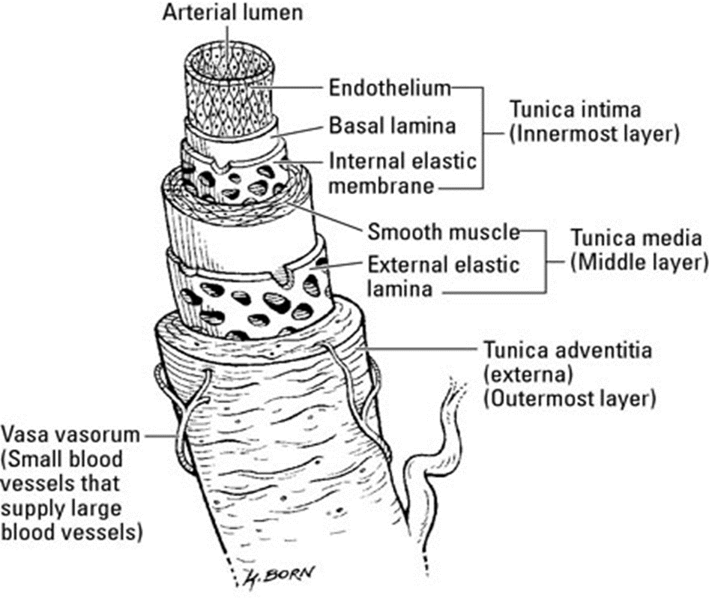
Vasa vasorum
“Vessels of Vessels”
Tiny vessels on the outside of the tunica adventitia of both arteries and veins
Provides the blood vessels with a source of nutrients as well as a conduit for waste products

