Slide 1

Atypical Vascular Disorders
Chapter 22

Slide 2
Subclavian Steal
Blood that is destined for the brain is shunted away from cerebral circulation due to a high-grade stenosis or occlusion in the subclavian or innominate artery
Vertebral artery demonstrates retrograde flow on the ipsilateral side
Provides blood flow to the arm

Slide 3
Subclavian Steal
Patients are usually asymptomatic
Normally detected when taking both brachial blood pressures
Pressure difference of 15-20 mmHg between right and left arm will indicate an issue
Steal is found on the side with the lower arm pressure

Slide 4
Subclavian Steal
When imaging with ultrasound, vertebral flow will be demonstrated as retrograde and flow resistance will be increased
90% of cases occur on the left side
Contralateral vertebral artery may have an increase in size and flow velocity

Slide 5
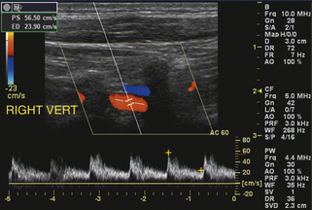
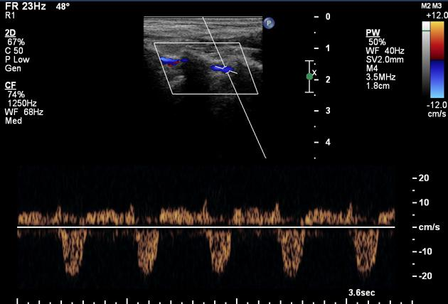
Subclavian Steal

Slide 6
Takayasu’s Arteritis
Rare, systemic, inflammatory large-vessel vasculitis
? autoimmune disorder
Leads to thickening of the arterial walls, causing narrowing
“Pulseless disease”

Slide 7
Takayasu’s Arteritis
Commonly affects women of childbearing age
Symptoms include:
Dizziness
Headache
Fainting
Weakness and fatigue
Chest pain
HTN
Heart attack
Stroke

Slide 8
Takayasu’s Arteritis
Angiogram is the best diagnostic tool
Treatment is aimed to reduce inflammation
Corticosteroids or immunosuppressants
Surgery in severe cases

Slide 9
Temporal Arteritis
Form of vasculitis where inflammation of the distal segment of the superficial temporal artery is visualized
Blood vessels near the temples are inflamed and constricted
“Giant Cell Arteritis” or “Horton’s Arteritis”

Slide 10
Temporal Arteritis
Patients complain of:
Headaches
Temporal tenderness
Ipsilateral visual changes, possibly blindness
B-mode may demonstrate an anechoic halo surrounding the vessel due to edema in the vessel walls

Slide 11
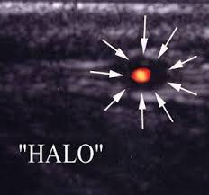
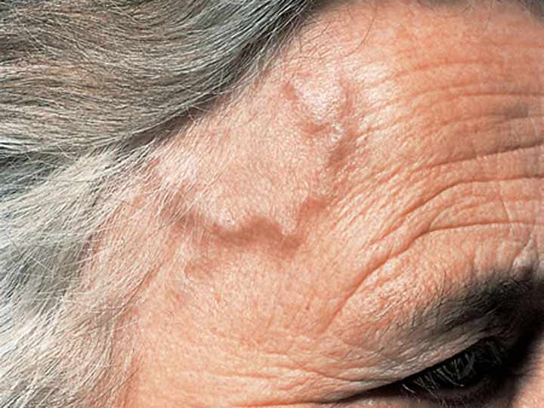
Temporal Arteritis
Spectral analysis will show elevated velocities in the narrowed vessel
Treatment consists of reducing the inflammation with corticosteroids

