Slide 1

Fetal Echocardiography: Beyond the Four Chambers
Chapter 35

Slide 2
Embryology of the Cardiovascular System
Most sensitive period for cardiac development in first trimester is between 3.5 and 6.5 weeks.
Cardiovascular system is first organ system to reach functional state.
By end of third week, circulation of blood has begun.
In fifth week, heart begins to beat.

Slide 3
Embryology of the Cardiovascular System
Human teratogens produce or raise incidence of congenital malformations.
7% caused by environmental agents or teratogens
Spontaneous abortion usually occurs if genetic malformation severe.

Slide 4
Development of Blood Vessels
Circulation of blood starts by end of third week as tubular heart begins to beat.
Embryo obtains sufficient nourishment during second week of development by diffusion of nutrients from maternal blood flow.
Vascular system begins during third week in wall of yolk sac, connecting stalk, and chorion.

Slide 5
Development of Blood Vessels
Blood vessels form two days later.
Blood islands form; cavities develop in islands to form primitive blood cells and vessels.
Primitive vessels form vascular network in wall of yolk sac.
Umbilical veins return oxygenated blood from placenta; only one umbilical vein persists.
Blood formation in embryo begins at fifth week.

Slide 6
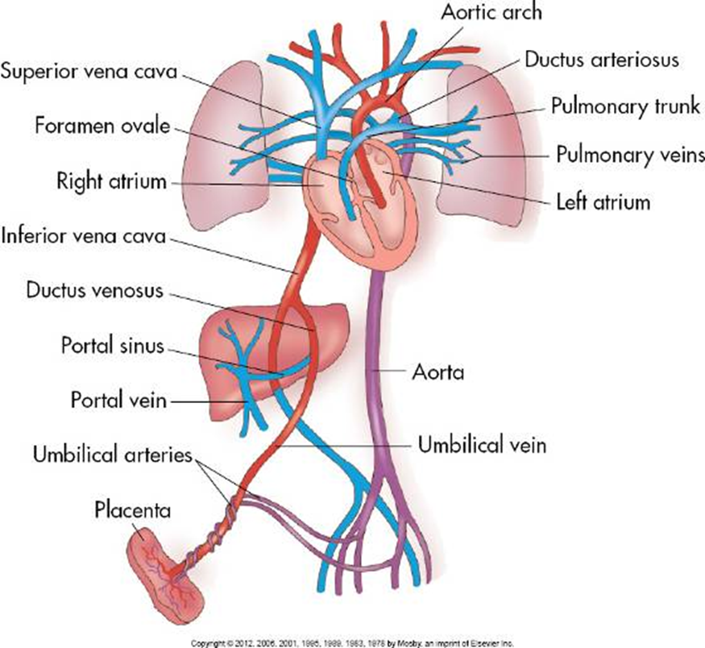
Fetal Circulation

Slide 7
Fetal Circulation
Communication is open between right and left sides of heart through fossa ovale, and between the aorta and pulmonary artery via the ductus arteriosus.
Before birth fetus receives oxygenated blood by way of umbilical vein from placenta to heart.
Approximately half of the blood passes through hepatic sinusoids; the rest bypasses the liver to go through ductus venosus into the inferior vena cava.
Blood flows from the IVC and SVC and enters the right atrium.

Slide 8
Fetal Circulation
Blood in RA flows through the tricuspid valve into the right ventricle and leaves the RV through main pulmonary artery.
Bifurcates into right and left pulmonary artery branches that lead to their respective lungs.
Most of this blood passes through the connection of ductus arteriosus into the descending aorta; only a very small amount goes to the lungs.

Slide 9
Fetal Circulation
Blood mixes with small amount of deoxygenated blood as it returns from lungs via the four pulmonary veins into LA.
Blood then flows from LA into LV through bicuspid mitral valve and leaves heart through ascending aorta.
Rest of mixed blood in descending aorta passes into umbilical arteries and is returned to placenta for reoxygenation.

Slide 10
Fetal Circulation
Circulation of fetal blood through placenta ceases after birth when the neonatal lungs begin to function.
Fetal cardiac structures that are no longer necessary: foramen ovale, ductus arteriosus, ductus venosus, and umbilical vessels.

Slide 11
Heart Rate
Normal fetal heart rate (HR) is between 120 and 160 beats per minute (bpm).
First trimester of pregnancy: HR begins around 90 bpm and increases to 170 bpm before returning to normal rate and sinus rhythm.
HR <100 bpm is bradycardia.
HR >200 bpm is tachycardia.

Slide 12
Heart Rate
Heart rate <100 bpm places fetus at high risk of associated heart disease.
Association of complete heart block with structural cardiac defects has poor prognosis, perhaps because of their adverse interaction and the AV regurgitation that commonly complicates the condition.
Connective tissue disorders like systemic lupus erythematosus are associated with heart block and pericardial effusion.

Slide 13
Indications for Fetal Echocardiography
Fetal Indications:
Polyhydramnios (1.5%)
Nonimmune hydrops (7.5%)
Arrhythmias (23%)
Suspected cardiac abnormality on routine ultrasound

Slide 14
Indications for Fetal Echocardiography
Fetal Abnormalities and Dysmaturity (11%)
Extracardiac abnormalities
Chromosome abnormalities
Intrauterine growth restriction

Slide 15
Fetal Risk Factors
IUGR
Cardiac arrhythmias
Abnormal amniocentesis
Abnormal amniotic fluid collections
Abnormal HR
Hydrops fetalis
Presence of extracardiac abnormalities in fetus is frequently associated with congenital heart disease

Slide 16
Maternal Risk Factors
Maternal Disease Affecting the Fetus (7%)
Diabetes
Lupus erythematosus
Infections during pregnancy
Maternal Ingestion of Drugs or Teratogens (4.5%)
Alcoholism
Drug exposure during pregnancy

Slide 17
Familial Indications
Familial history of congenital heart disease (44%)
Recurrence risk cited given a sibling with one of most common cardiovascular abnormalities varies from 2.5% to 3%.
If one parent has congenital heart defect, recurrence risk ranges from 2.5% to 4%.

Slide 18
Beyond the Four-Chamber View
Transducer selection
Instrumentation
M-Mode
Doppler (color and PW Doppler)
3D and 4D

Slide 19
Transducer Selection
Ideal transducer for fetal echocardiography is multifrequency transducer: can be quickly and easily changed from low to a high frequency.
Early second trimester fetus may be adequately imaged with curved array transducer or small-sector, high-frequency probe.

Slide 20
Instrumentation
Cine-loop
High-power resolution (write zoom) capability
Simultaneous M-mode with range expansion (for cardiac arrhythmias)
Simultaneous Doppler capability with pulsed and continuous wave (to record high-velocity flow)
Color Doppler

Slide 21
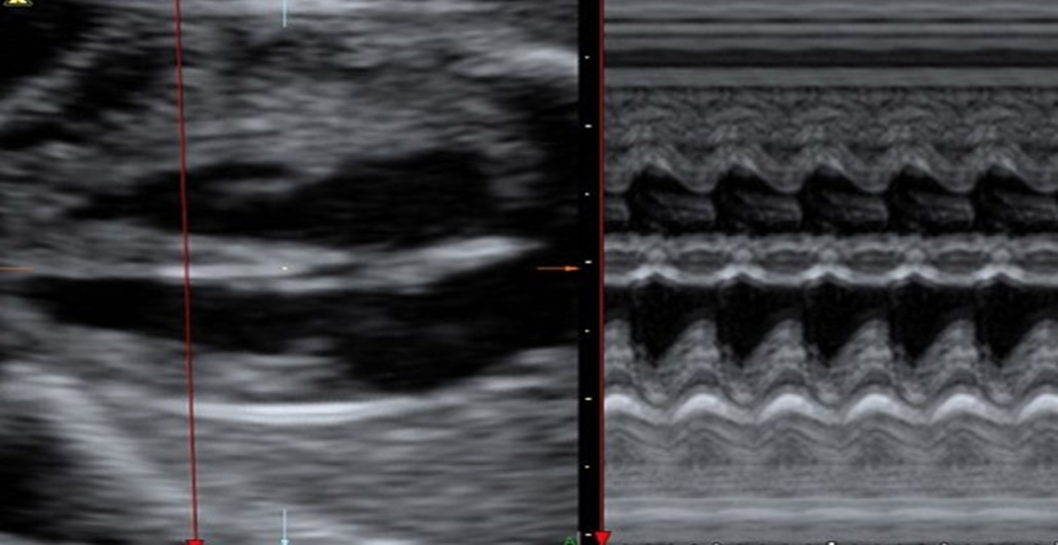
M-Mode Evaluation
Once the two-dimension image is made, a single vertical line of information can be obtained from the face of the transducer through the fetal cardiac structures

Slide 22
Pulsed Doppler Imaging
Pulsed Doppler demonstrates the direction and characteristics of blood flow within the fetal heart and great vessels and allows the qualitative and quantitative definition of flow disturbances, such as those that occur with valvular stenotic or regurgitant lesions.

Slide 23
Color Flow Doppler Imaging
Color Doppler may help detect flow disturbances and flow direction (to check whether vessels or chambers are patent) and should be integrated into the fetal echocardiogram.
Color displays are usually oriented so that flow toward the transducer is projected in shades of red and orange, and flow away is projected in cool blue colors.
Disturbed flow is seen as a mixture of red, orange, and yellow or blues and greens.
The color gain should be adjusted to each image to eliminate color “blooming.”

Slide 24
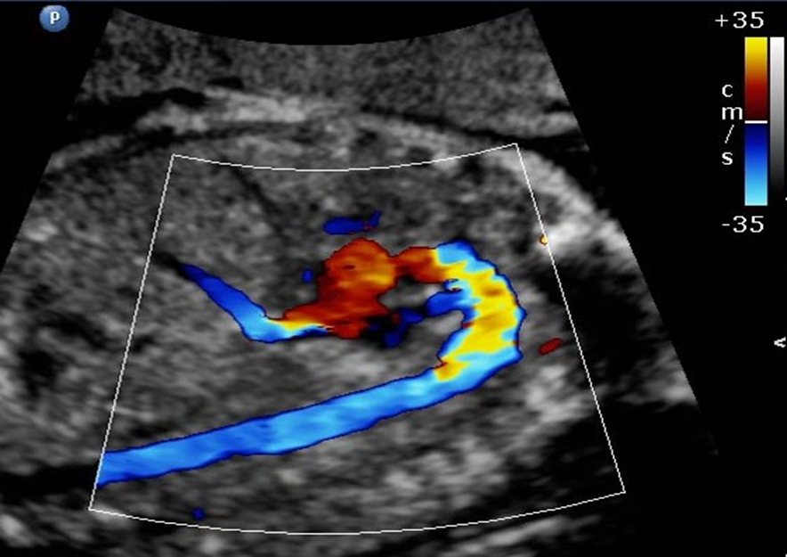

Slide 25
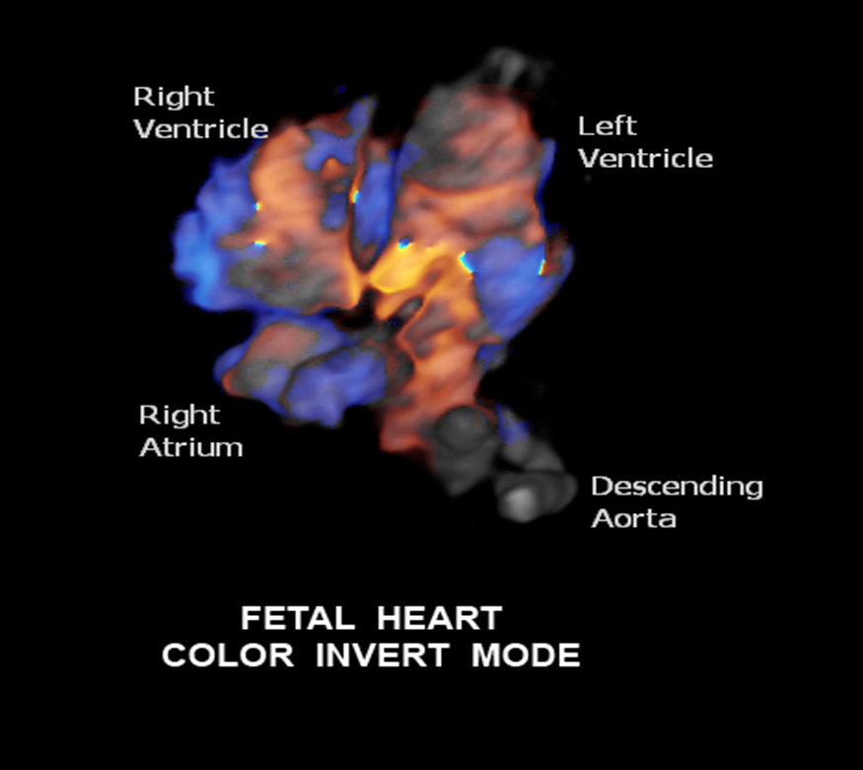
3D Imaging
Clinical investigation of three-dimensional echocardiography has been performed both with and without cardiac gating.
Clarity of images is still the primary problem in this technique: The fetal heart is beating so quickly and the volume is too small to acquire enough data points to display an image better than the current real-time two-dimensional images.

Slide 26
Fetal Ultrasound Landmarks
Fetal position
Fetal thorax
Fetal stomach
Apex of heart
Location of fetal aorta and IVC
Position of placenta
Biparietal diameter/femur length

Slide 27
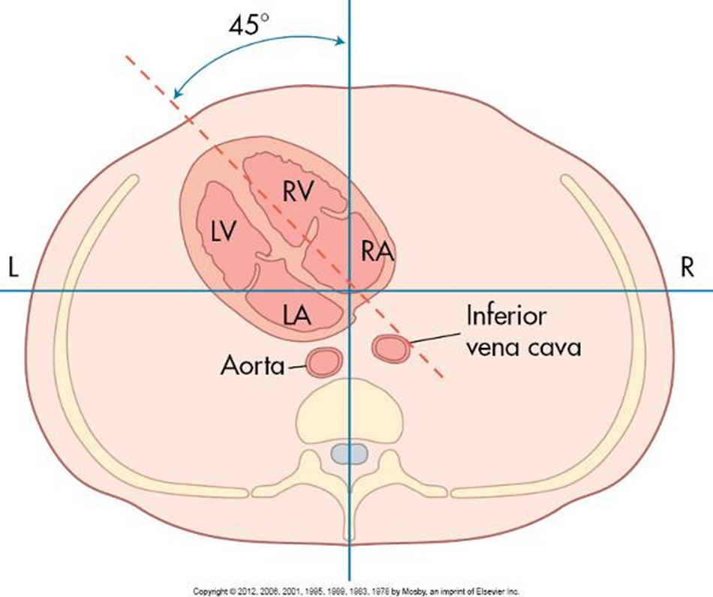
Fetal Ultrasound Landmarks

Slide 28
Echocardiographic Evaluation of the Fetus
Normal cardiac study should include the following views:
Four-chamber
Outflow tracts
Oblique long-axis view for aortic arch and ductus arteriosus

Slide 29
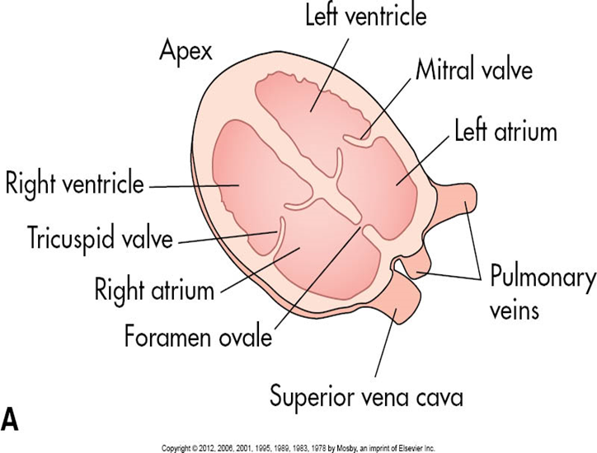
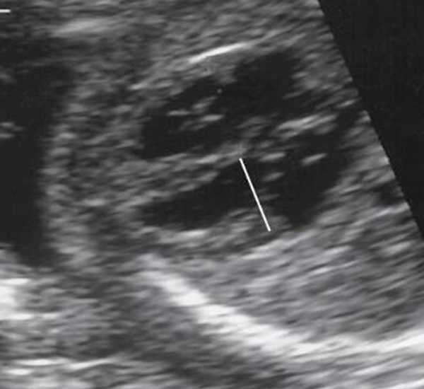
Four Chamber View

Slide 30
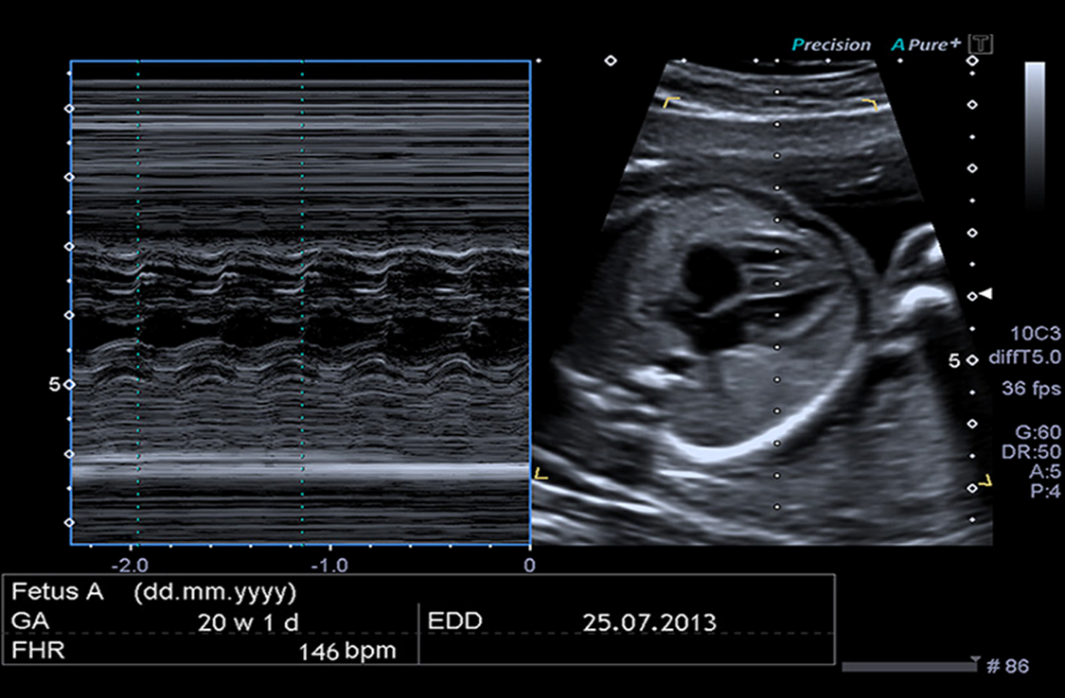
Four Chamber View

Slide 31
Four-Chamber View
Right atrium and ventricle (with moderator band)
Tricuspid valve
Left atrium and ventricle
Mitral valve
Interventricular septum
Interatrial septum
Foramen ovale
Pulmonary veins as they enter left atrium

Slide 32
Left and Right Ventricular Outflow Tracts
Considered a “Criss-Cross View” to visualize each outflow tract
Begin by angling slightly anterior from the four-chamber view to find the left ventricle and the aortic outflow tract
Called the LVOT – left ventricular outflow tract
To obtain the right ventricle and pulmonary artery outflow, angle the transducer slightly medial and anterior from the LVOT view
Called the RVOT – right ventricular outflow tract (also referred to as the 3VV)

Slide 33
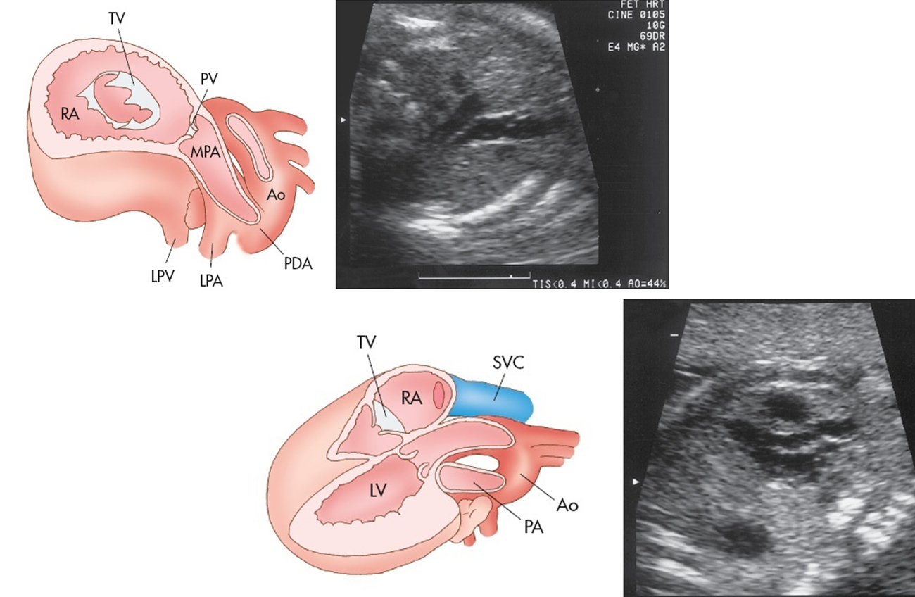

Slide 34
Ductal and Aortic Arch Views
Find fetal spine in sagittal plane and angle slightly inward toward left chest to search for descending aorta and arch.
Tubular dimension of vessel should be somewhat uniform as one follows aorta from its base into thorax and abdomen.
Three head and neck branch arteries (innominate, carotid, and left subclavian) arise from perfect curve of aortic arch as they ascend into fetal head.
“Candy cane” appearance of ascending aorta, arch, and descending aorta.

Slide 35
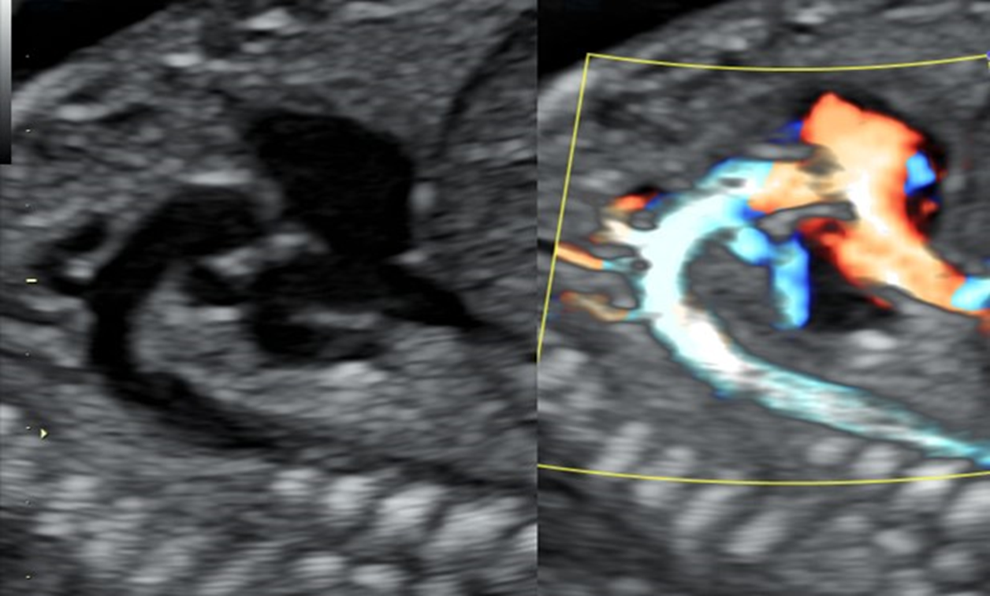

Slide 36
Ductal and Aortic Arch Views
Angulation inferior to the aortic arch will show another “arch-type” structure
Represents patent ductus arteriosus
Ductus slightly larger than aortic arch and has sharper angle (“hockey stick”) as it drains into descending aorta
Does not have arterial structures arising from its wall as the aorta does

Slide 37



Slide 38
Ductal and Aortic Arch Views
Can obtain an image of both the aortic and ductal arches
Appears as a V-shaped confluence
Should always be found left of the trachea
Thymus may also appear in the image
Called the 3VT view

Slide 39
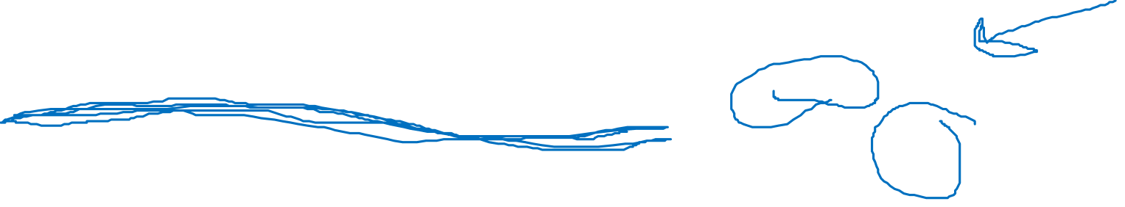

Slide 40
