Slide 1
Footnoting – Turabian Style
Just the basics

Slide 2
Footnoting – Turabian Style
Footnotes are an important detail for any research or theme paper.
They provide acknowledgement of the source for ideas, which is ethically necessary.
They provide a useful tool for readers of your paper to do more of their own research.
Using them correctly shows your maturity as a scholastic writer.
Using them incorrectly will lower your research paper grade.

Slide 3
Footnoting – Turabian Style
We will examine a basic example for the Turabian style for footnoting.

Slide 4
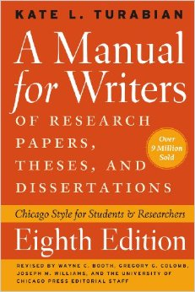
Turabian Style Manual
8th Edition

Slide 5
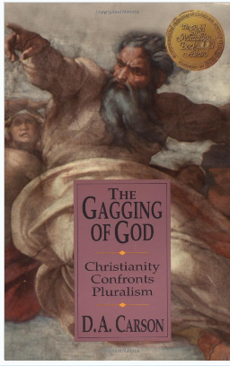
Footnoting – Turabian Style
Let’s look at an example.
Suppose you found the following quote for your paper from the book, The Gagging of God, by Don Carson.

Slide 6
Footnoting – Turabian Style
“It is not surprising, then, that toward the end of the nineteenth century and well into the twentieth, science was often associated with positivism in epistemology. Indeed, scientific knowledge became the model for all knowledge: data had to be obtained empirically, or they were suspect. Meanwhile religion, relegated to the category of mere opinion, was necessarily based on “faith.” Such “faith” was assumed to be making a bogus claim if it pretended to knowledge, which of course had to be empirically based.”

Slide 7
Footnoting – Turabian Style
How would you create a footnote for it?
First, you will need the author’s name, full title, and copyright date from the copyright page in the front of the book.
You will also need to note the page number of the quote (page 62).

Slide 8
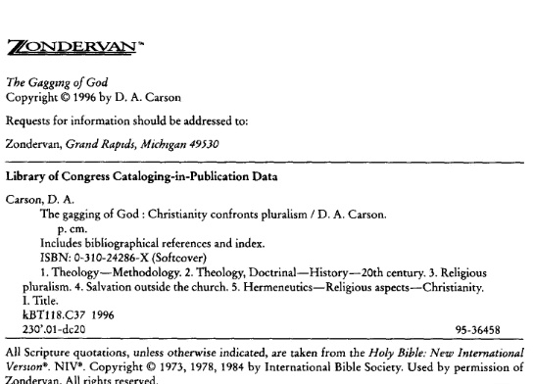
Copyright and Author’s Name
Full Title

Slide 9
Footnoting – Turabian Style
We will also need to note the publisher and probable place of publication.

Slide 10

Publisher and
Place of Publication

Slide 11
Footnoting – Turabian Style
Now that we have the pieces, let’s put it all together.
Note that the title is italicized, there is a colon after the place of publication, and no comma is needed after the parenthesis before the page number.
And that’s the basics!
Don Carson, The Gagging of God: Christianity Confronts Pluralism
(Grand Rapids: Zondervan, 1996) 62.

