Slide 1
Welcome to
Clinical Immunology/Serology
Dr. Christina A Nevel-McGarvey

Slide 2
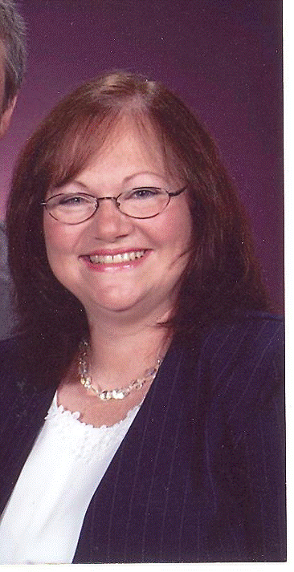
Meet and greet!

Slide 3
Course Expectations
Weekly Lessons-Independent Study Online
  Textbook Reading
  Narrated Powerpoint Presentations
Weekly Assignments
  Discussions
  Quiz
  Seminars
  (Midterm & Final)
Scientific Writing/References

Slide 4
How will I tackle this???
What should you do first to get ready for this session?
  Obtain and organize a notebook for yourself! Be sure to take notes on class materials and journal your challenges as well as the things that you find easy to accomplish! Be sure to compile this information to help you study for your midterm, final, and boards!
  Obtain notecards and a zip pocket for your notebook! Organizing your course material on flashcards is a great organizational tool as well as a way to solidify information as you flip through the material repeatedly. Color coding or flagging them can be done in many ways to help you throughout the course and for your boards.
  Get started on your work early in the week

Slide 5
What should you do every time you enter the classroom?
  Check classroom announcements!
  Check your messages!
  Check to see if anyone has responded to your discussion post and reply to them!

Slide 6
How should you attack your coursework every week?
  First, attack your reading assignment listed in lesson area of classroom! (Week One=Ch 1 & 29)
  Go to the lessons area of the classroom to listen to the lecture and view any available Power-Point presentations created to support your reading material.
  Post to your discussion early in the week! (Week One= Introductions + Main Discussion)
    2 topics per week
    Both topics may be addressed in the same main post each week
    150-300 words per topic for the main post
    One Credible reference to support your work
    Minimum of 2 substantive comments to classmates per topic per week
    No late posts will be accepted for any reason
    Be sure to load your photo into the classroom so that discussions are not impersonal
  Benchmark quiz can be accessed from the lesson area as well as the quiz/test area
    One submission
  All work is due by 11:59pm ET Sunday ending the unit week

Slide 7
PROFESSOR CONTACT
  Primary Contact is via the Message area in the classroom. This is your class email system. Be sure to stay in close contact with any questions/problems.
    Be sure to enter your email address into your personal profile so that messages from the classroom are forwarded to your email account.
  VIRTUAL OFFICE HOURS
    Mondays and Wednesdays 6-8 PM ET
    and other times by arrangement.
    http://nymahe.adobeconnect.com/virtualofficemeetingroomcng
      If you need to meet at another time, we will try to arrange a mutually agreeable time. This may be difficult due to other responsibilities and schedules. Usually we can work through any problems in writing via email.

Slide 8
Seminars
Hematology Seminars: Wednesdays at Noon ET
Immunology Seminars: Thursdays at Noon ET
It is mandatory that you attend 5 out of 10 seminars live.
  Seminars are held during weeks 1, 2, 3, 4, 5, 7, 8, 9, 10, & 11. Weeks 6 & 12 are exam weeks with no seminar.
If you know that your schedule will not permit you to attend seminar at the above times, you must email me explaining why you will not be able to attend seminar and you must carbon copy Lynn Jones (ljones@nymahe.org) and Lori Burkard (lburkard@nymahe.org). They will determine if each individual case qualifies for an exception for live attendance. If an exception is granted, then you will be notified to let you know how to procede to make up for the seminar attendance.

Slide 9
Questions?
-Expectations
-Course Content?
-Let’s take a quick look at the classroom!

Slide 10
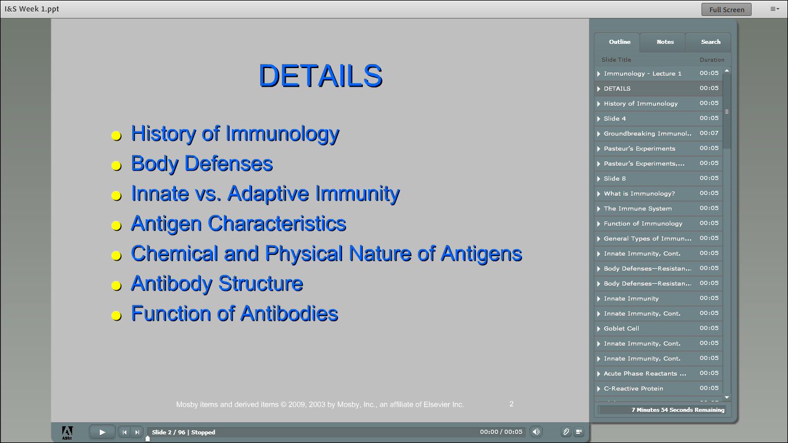

Slide 11
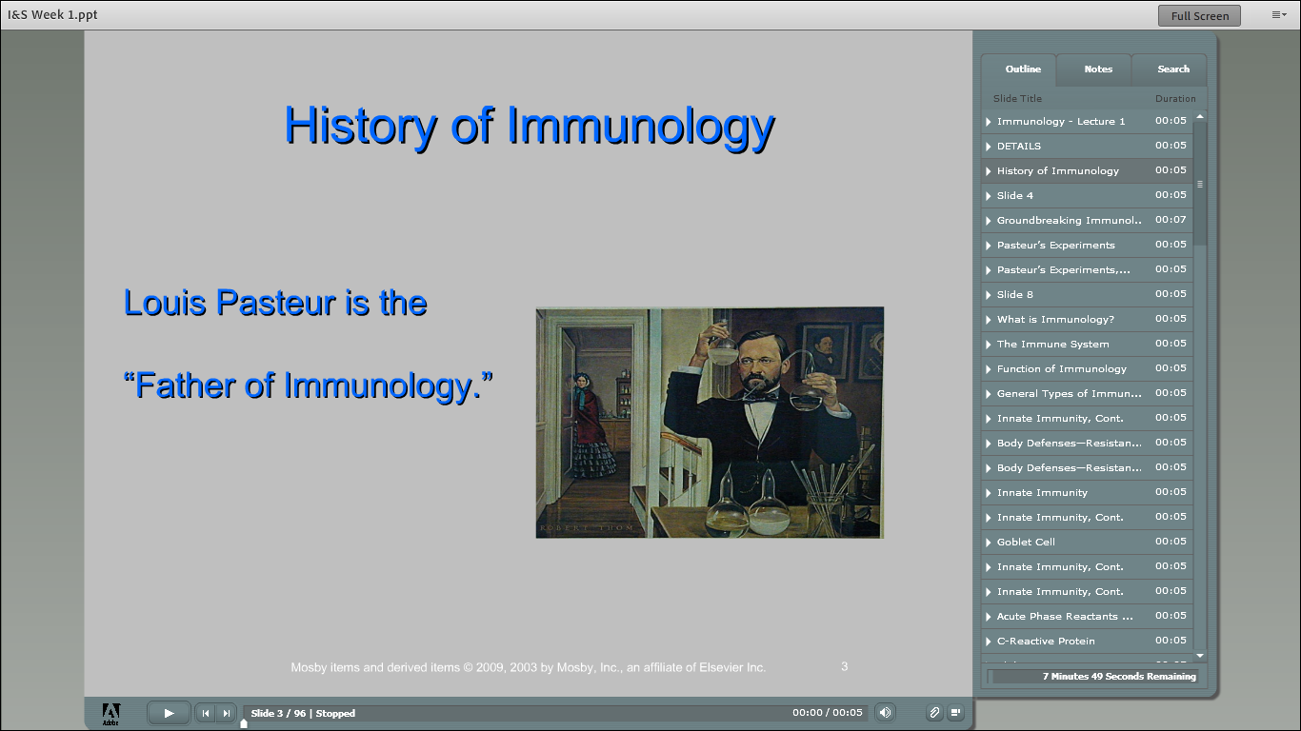

Slide 12
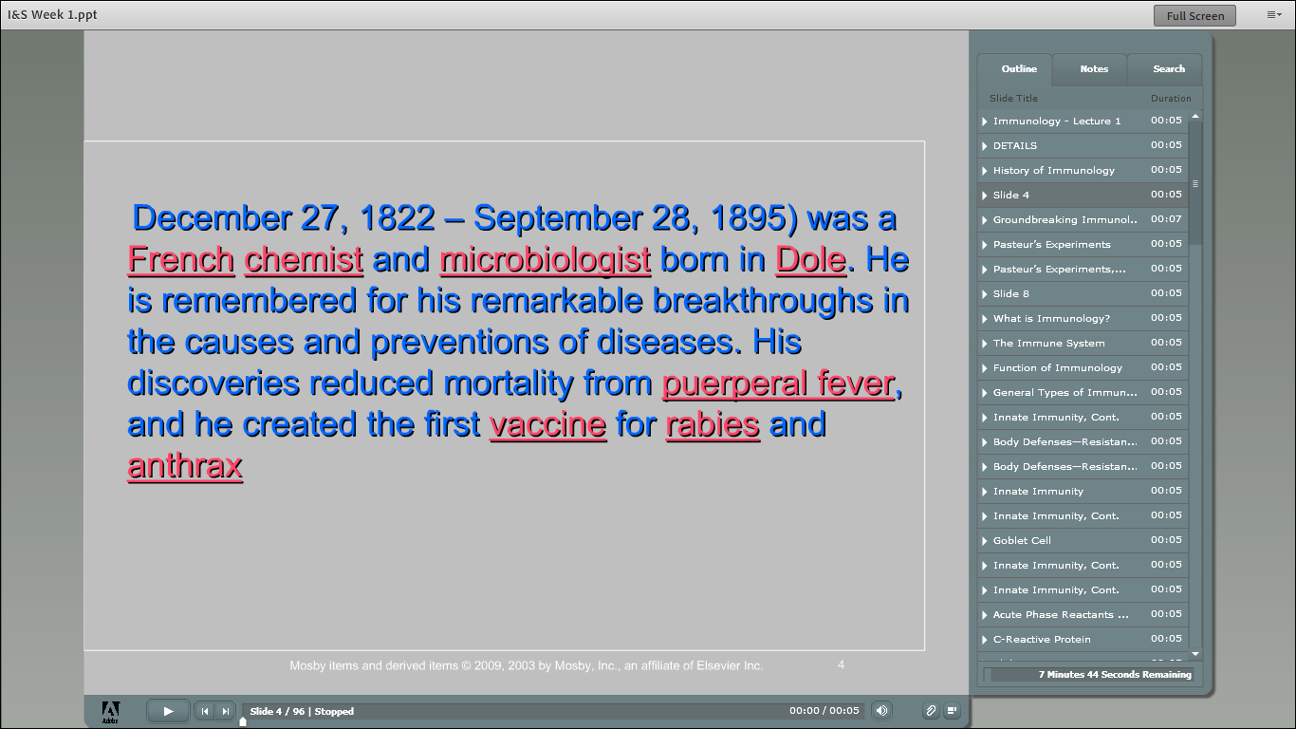

Slide 13
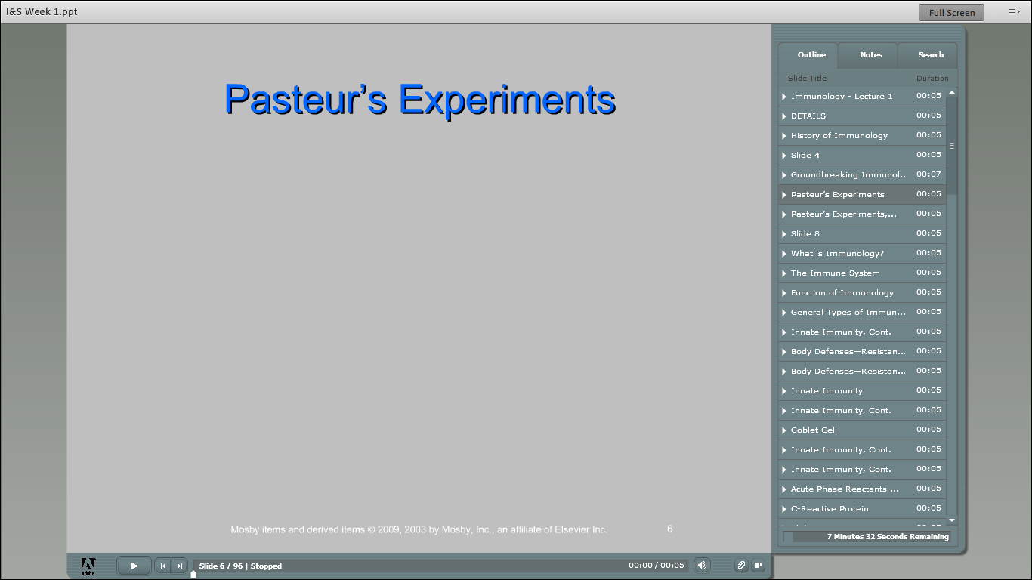

Slide 14
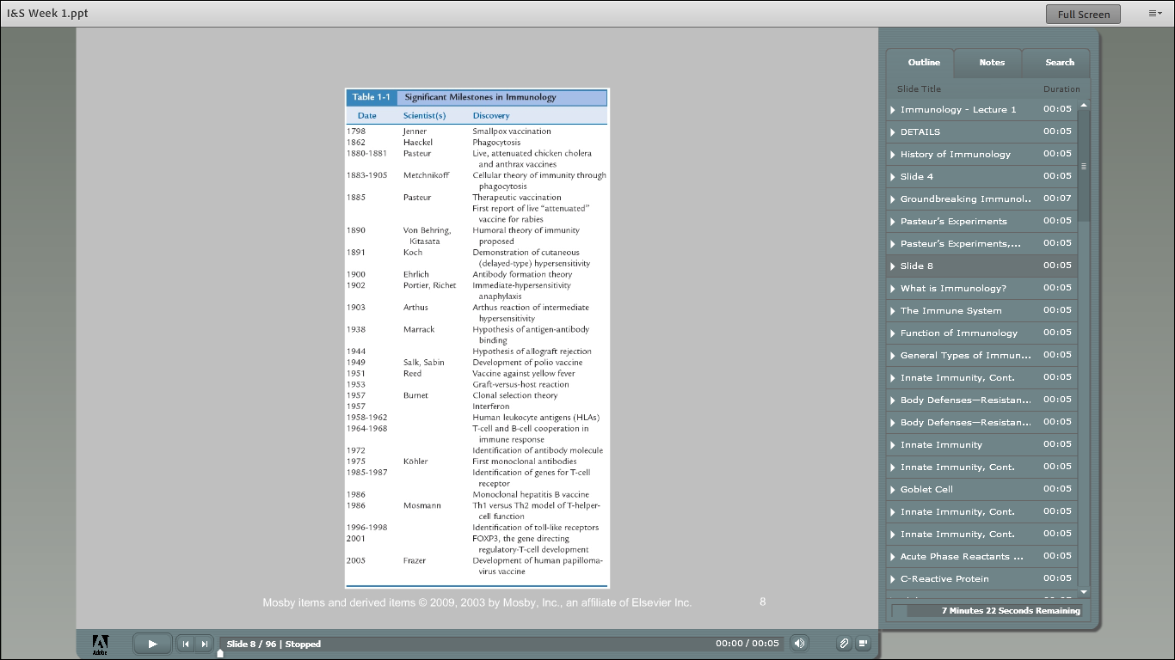

Slide 15
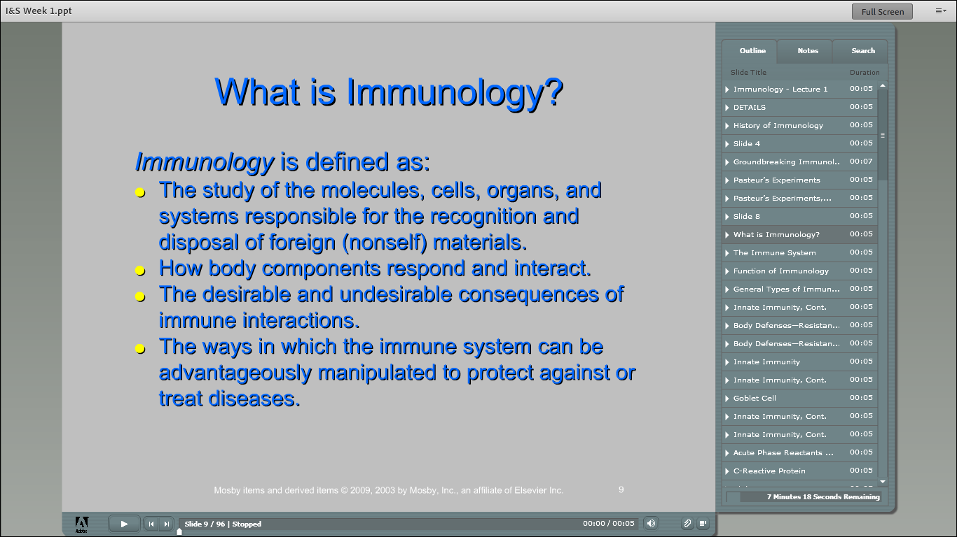

Slide 16
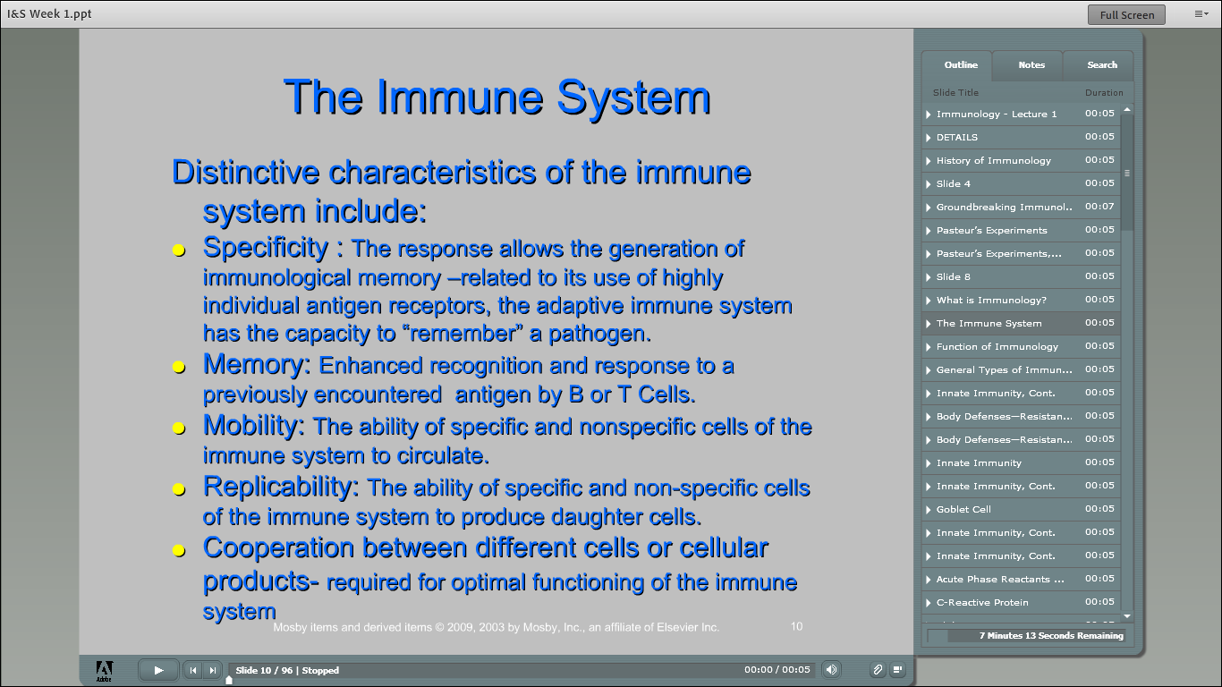

Slide 17
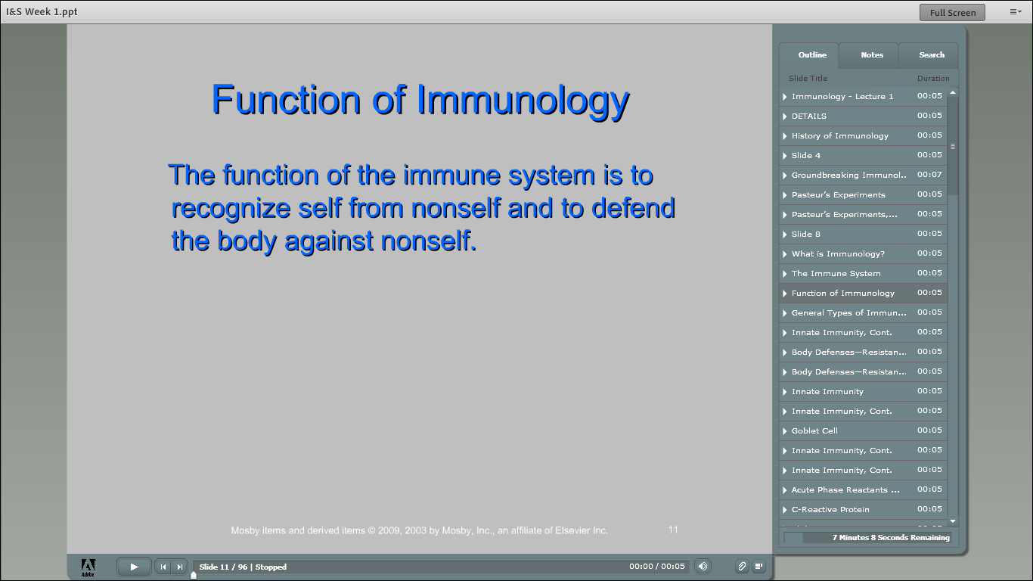

Slide 18
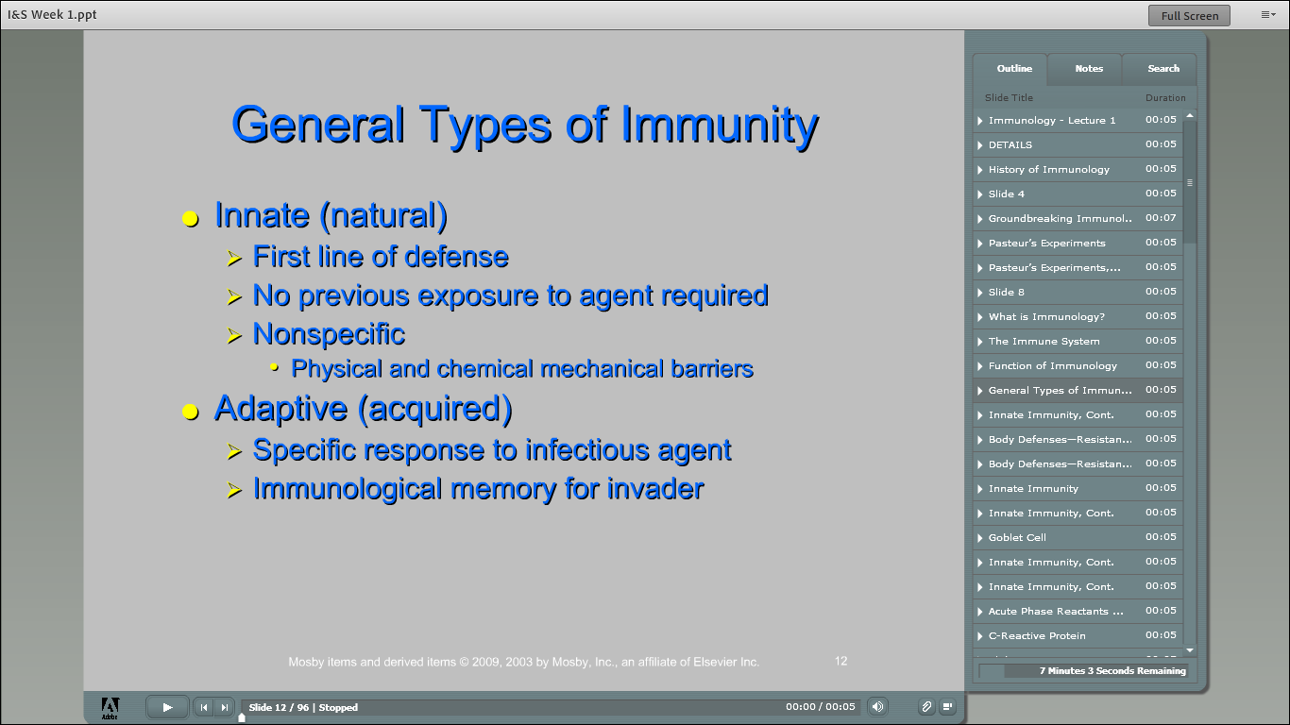

Slide 19
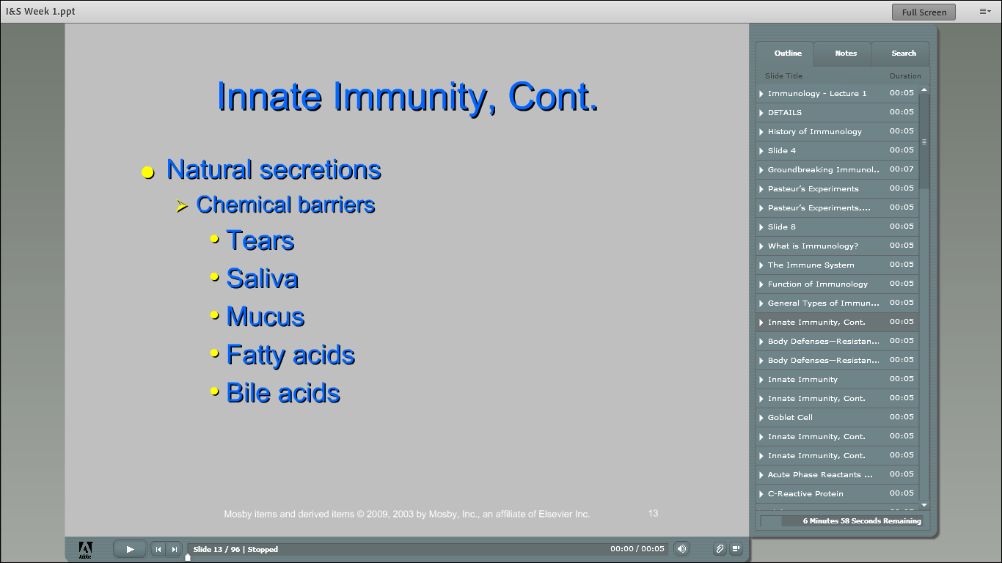

Slide 20
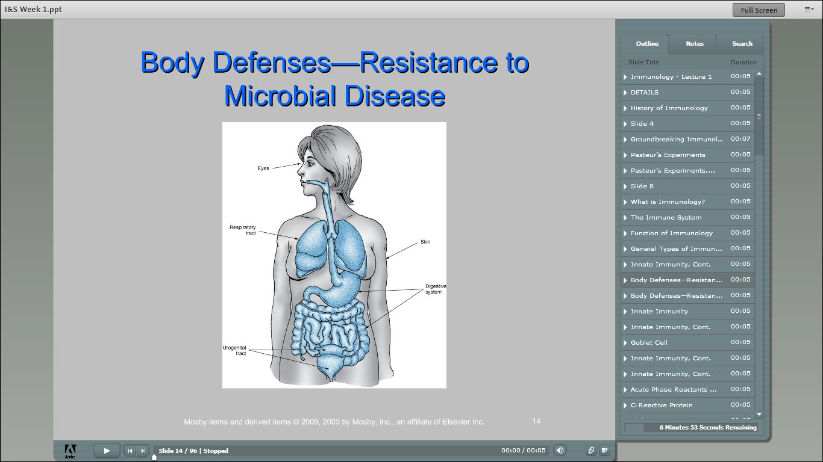

Slide 21
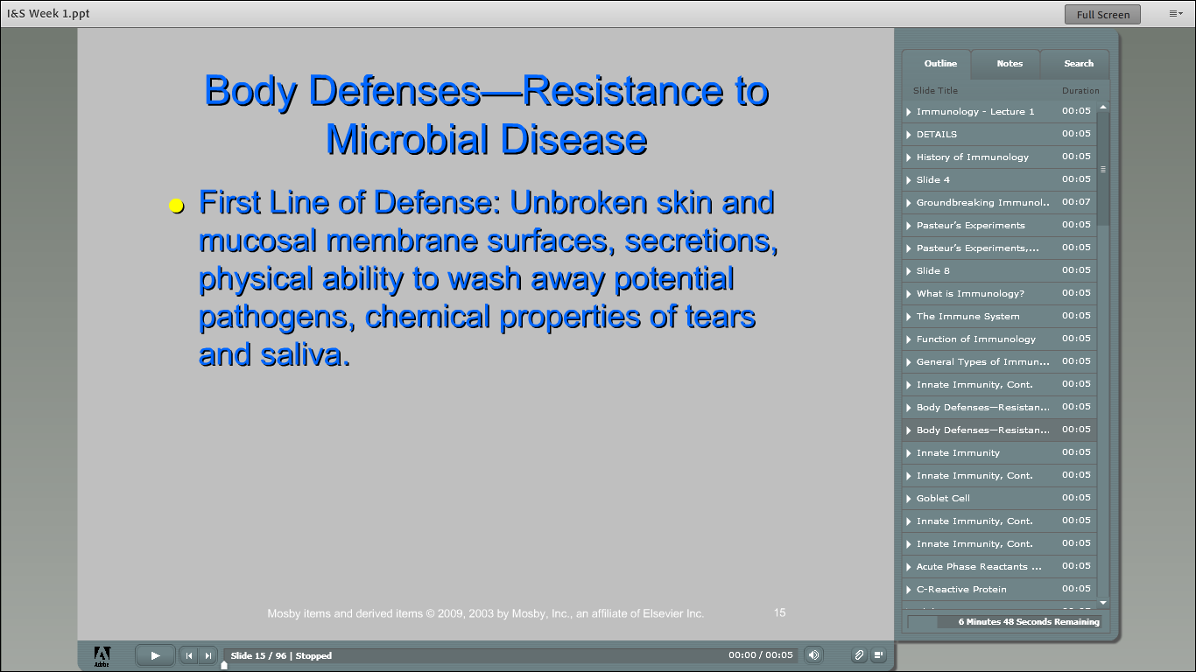

Slide 22
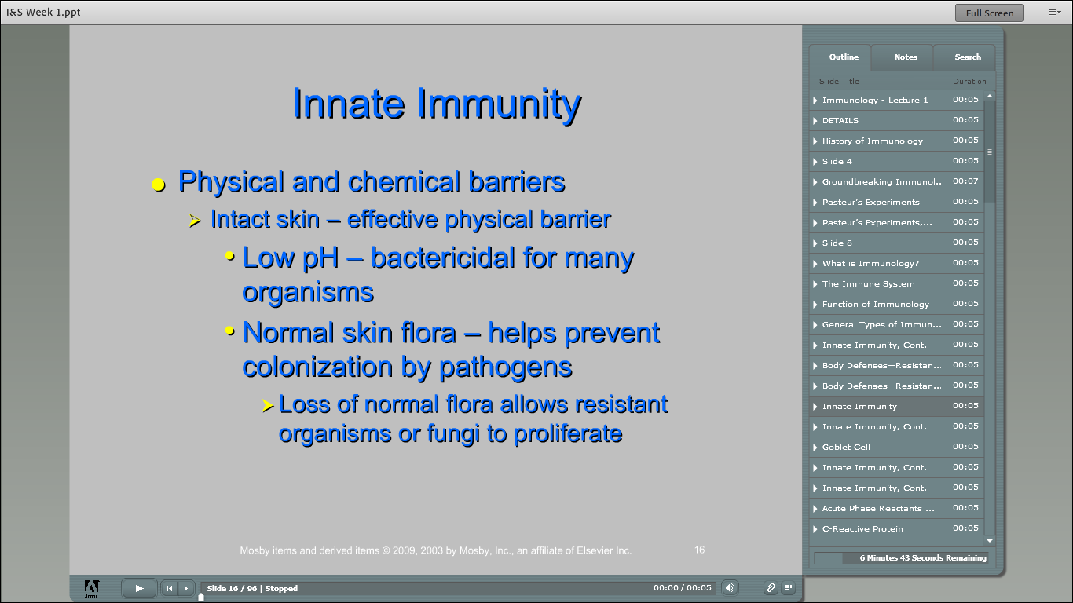

Slide 24
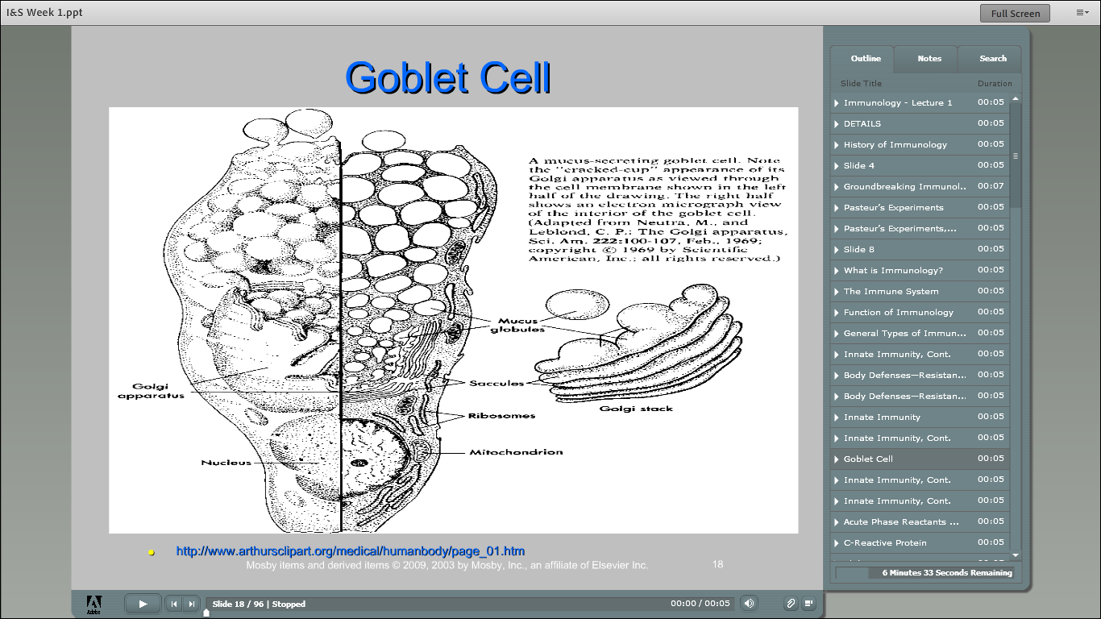

Slide 25
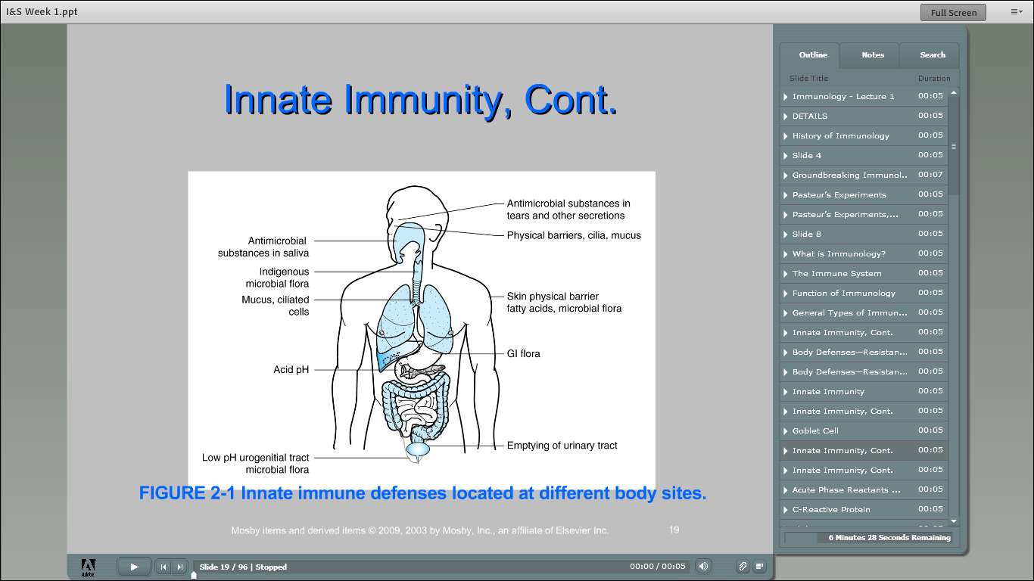

Slide 26
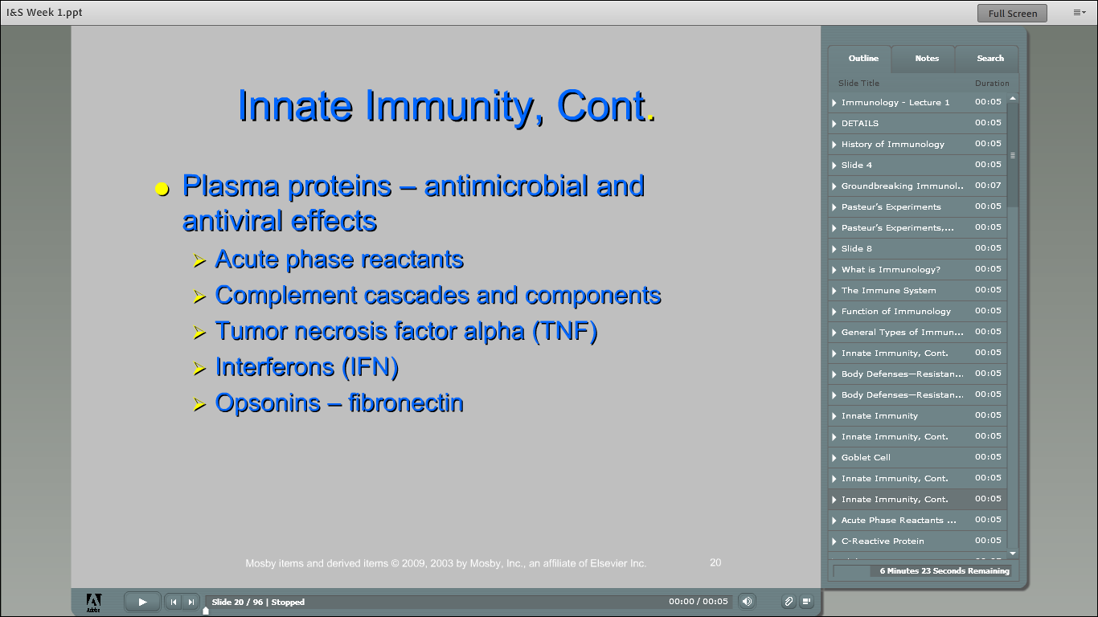

Slide 27
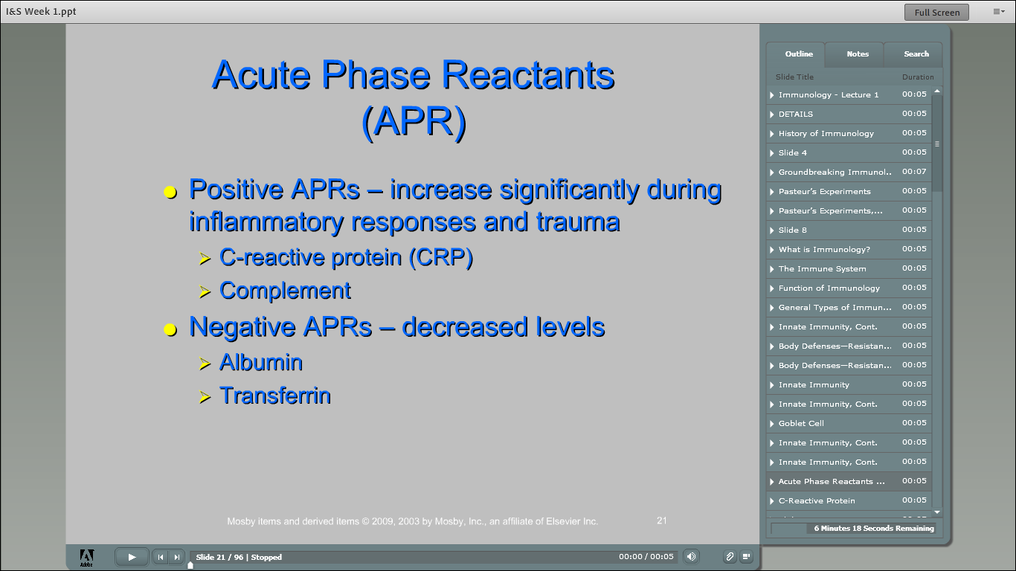

Slide 28
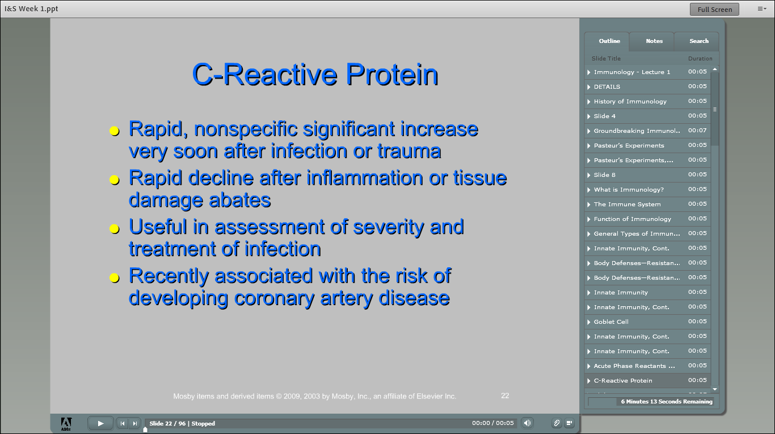

Slide 29
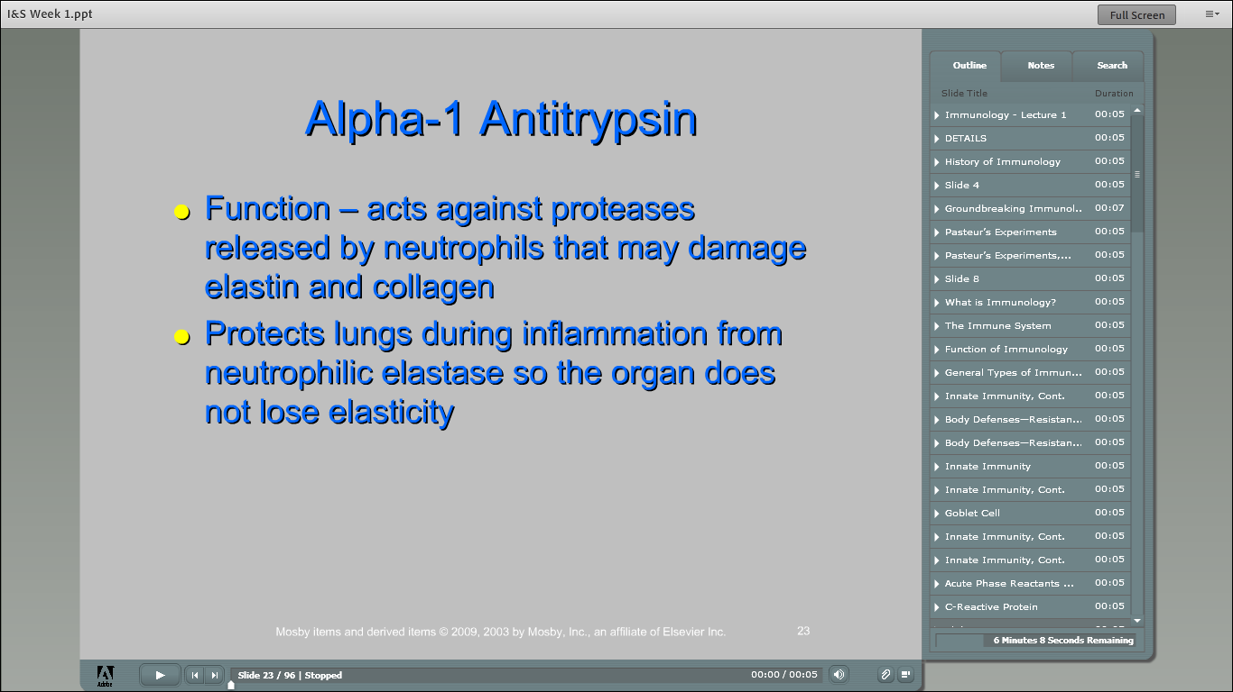

Slide 30
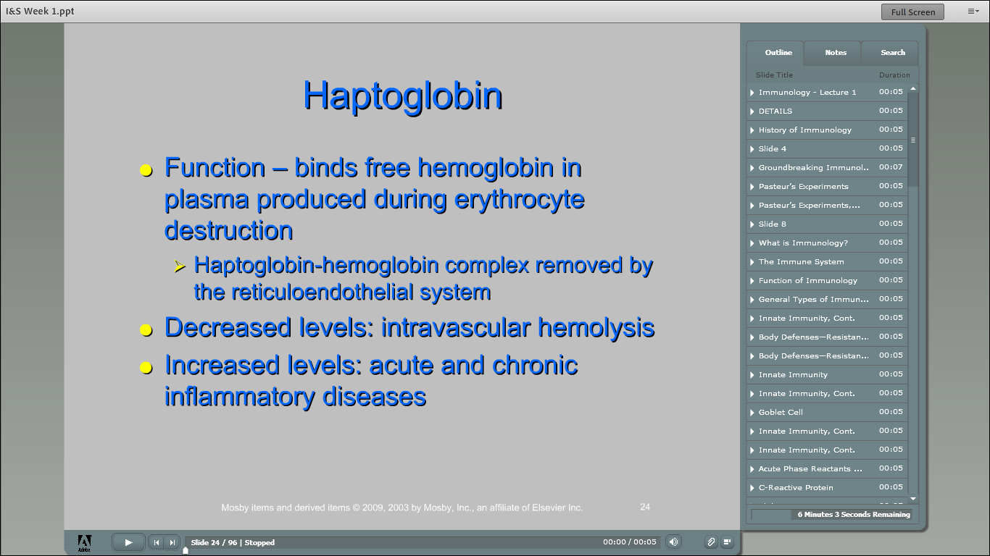

Slide 31
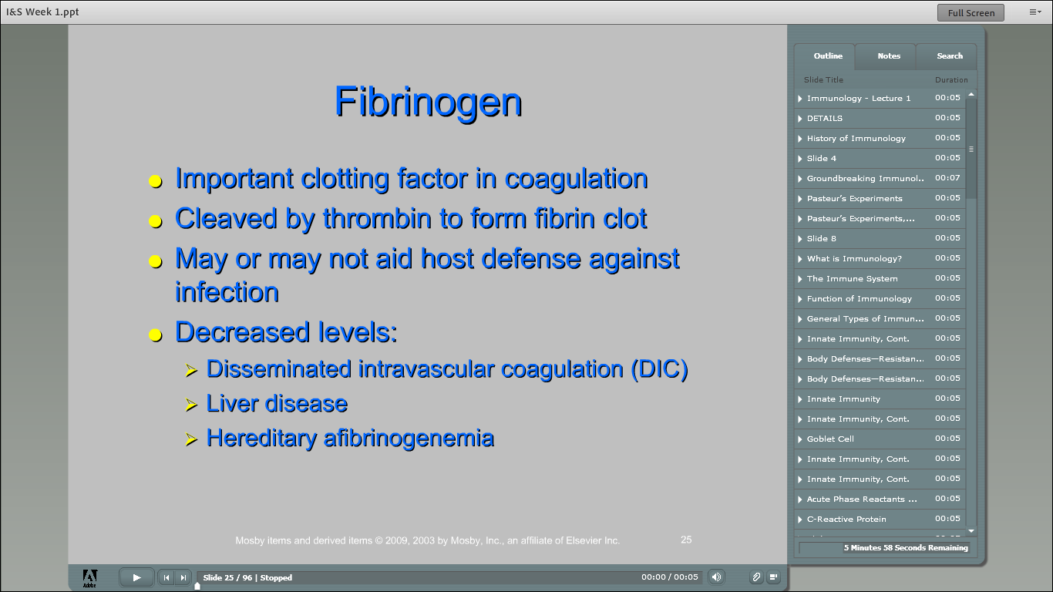

Slide 32
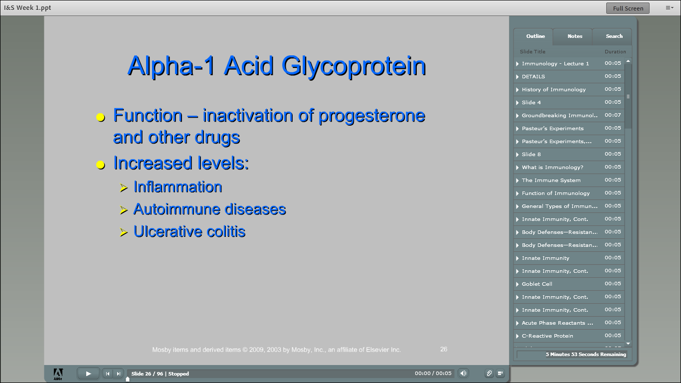

Slide 33
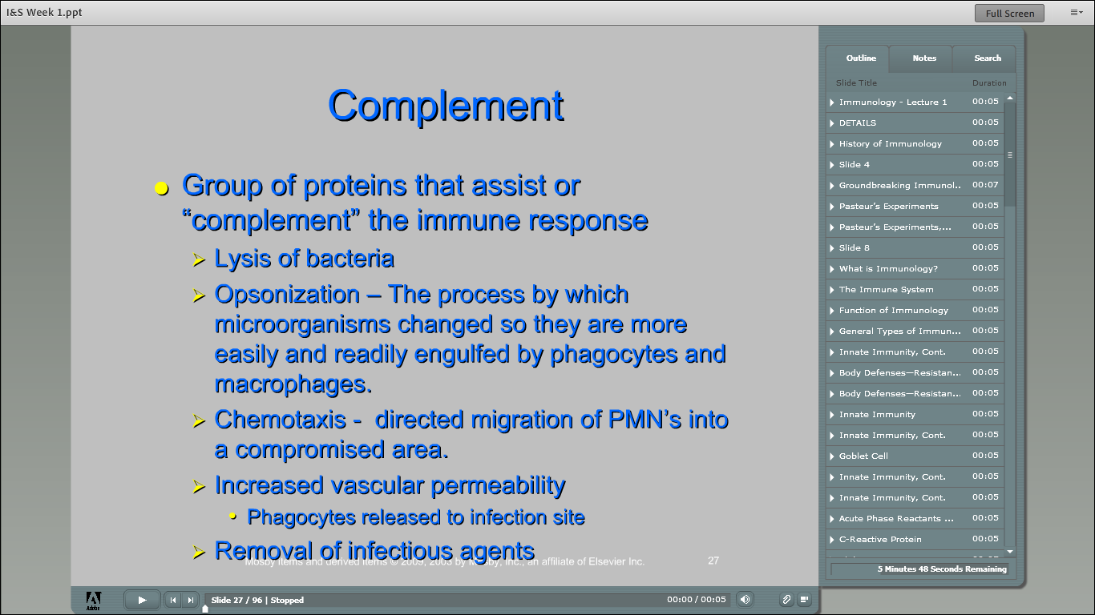

Slide 34
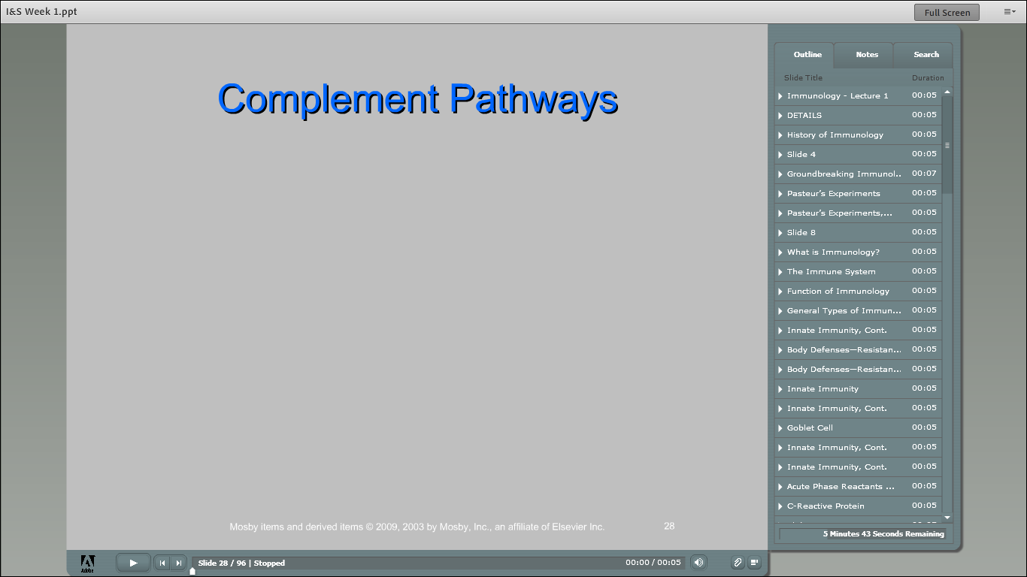

Slide 35
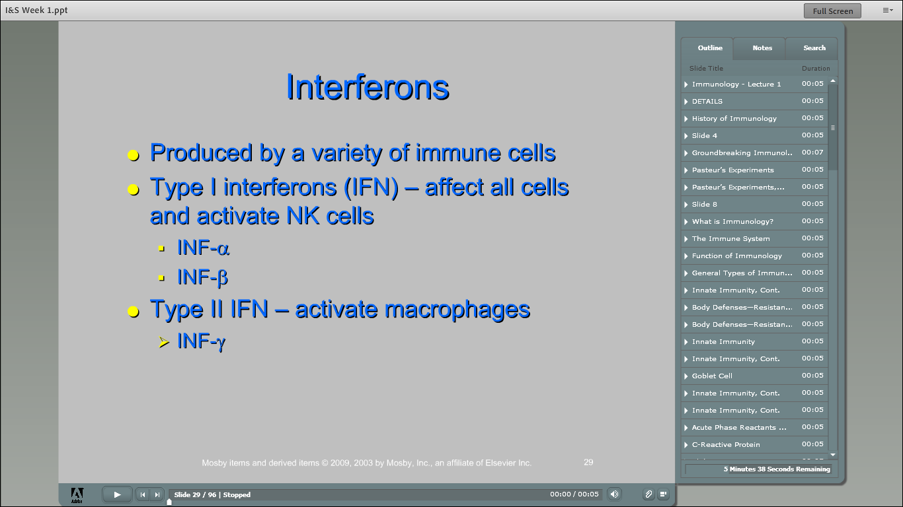

Slide 36
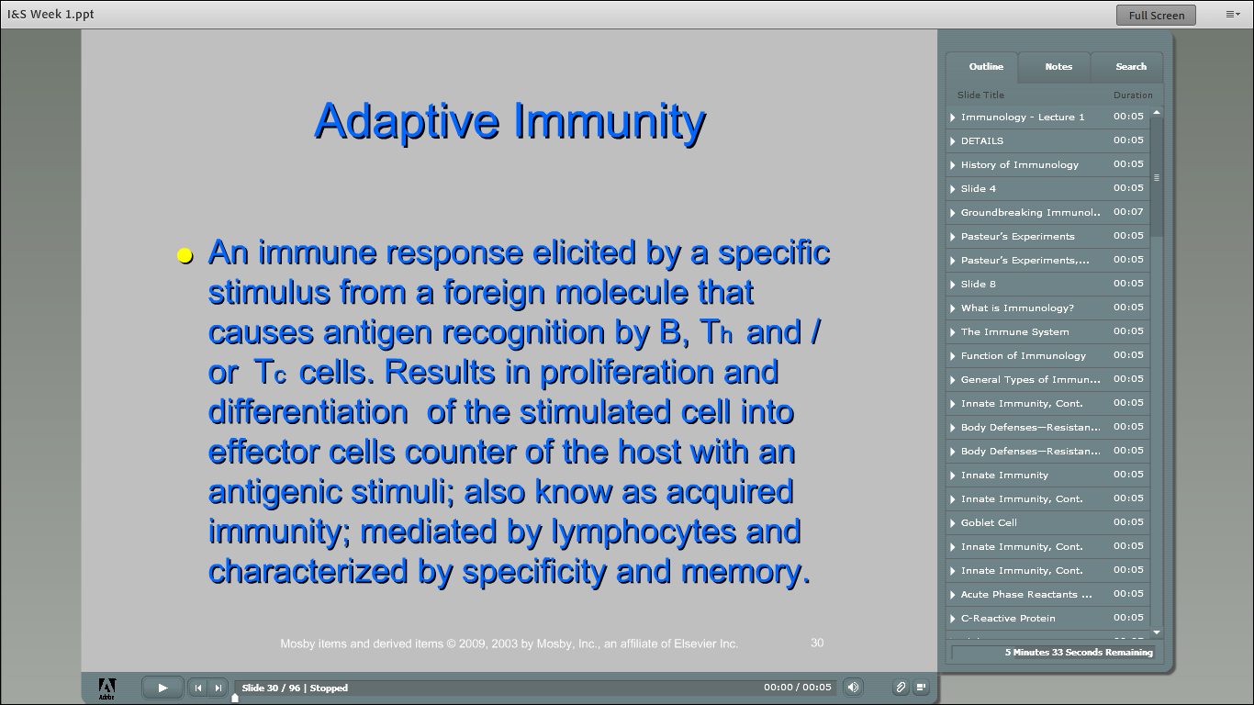

Slide 37
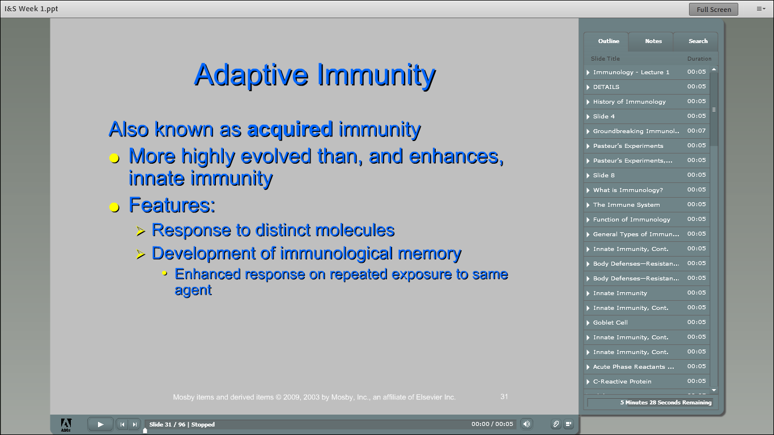

Slide 38
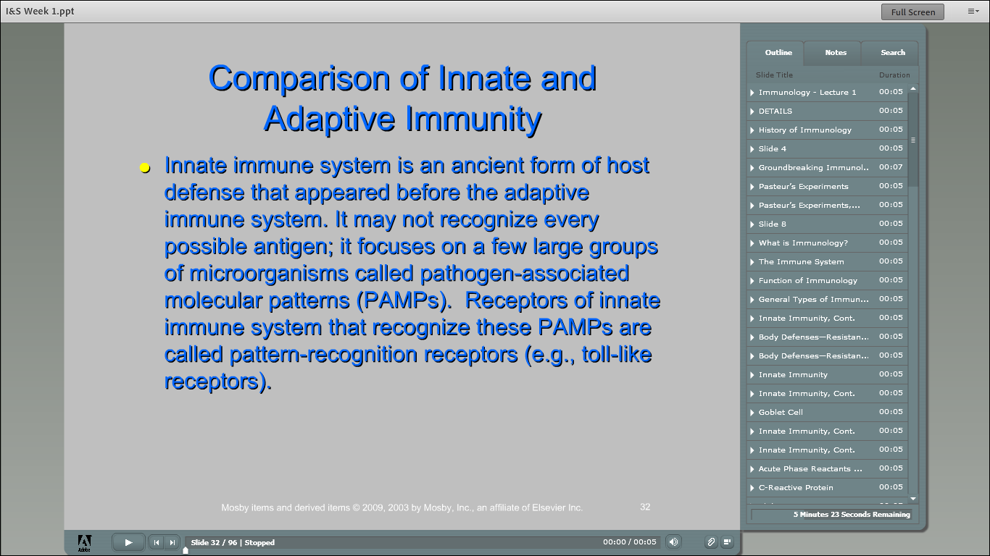

Slide 39
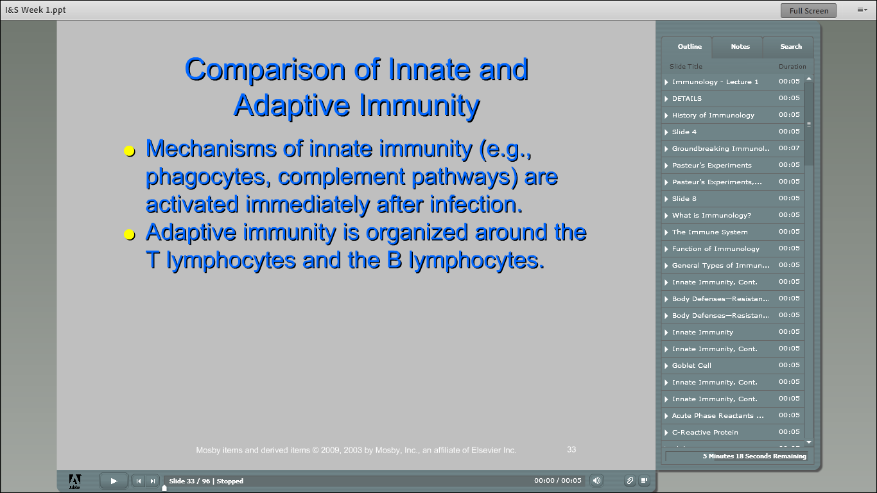

Slide 40
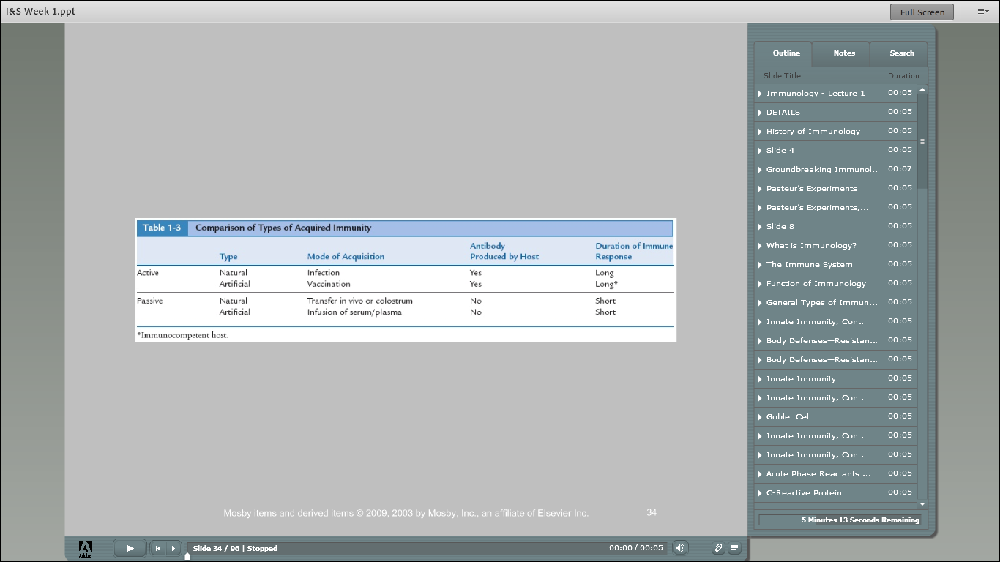

Slide 41
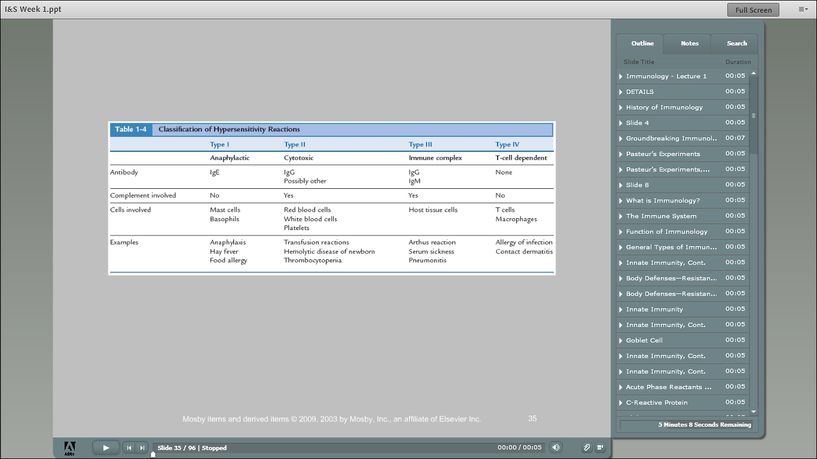

Slide 42
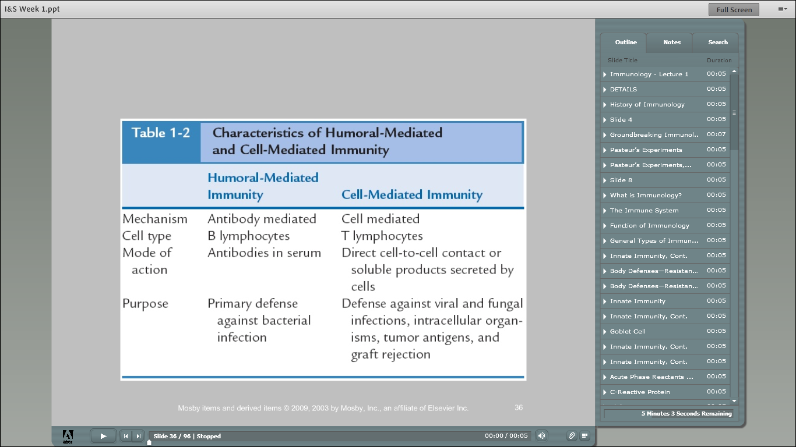

Slide 43
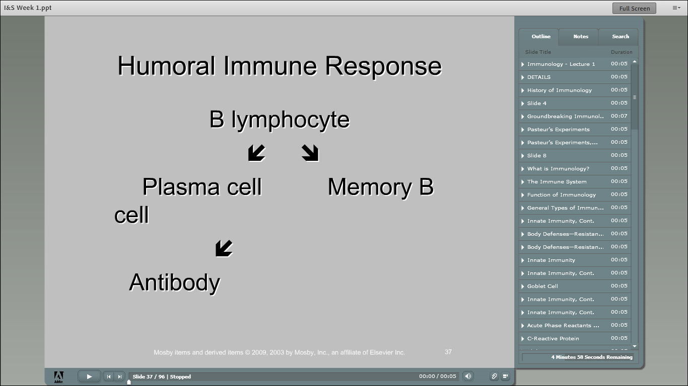

Slide 44
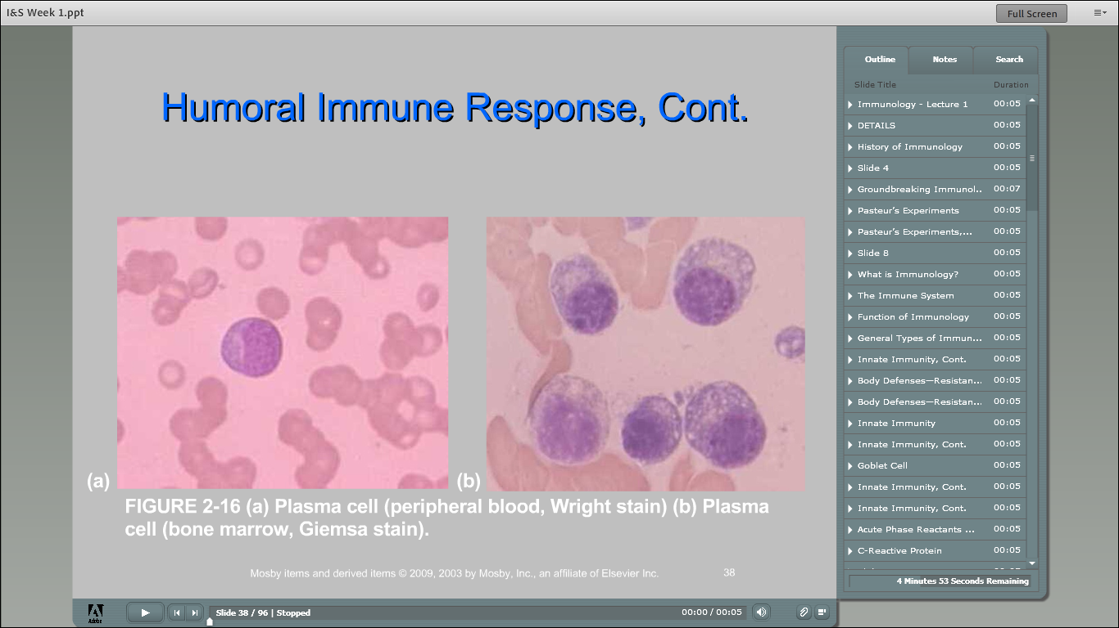

Slide 45
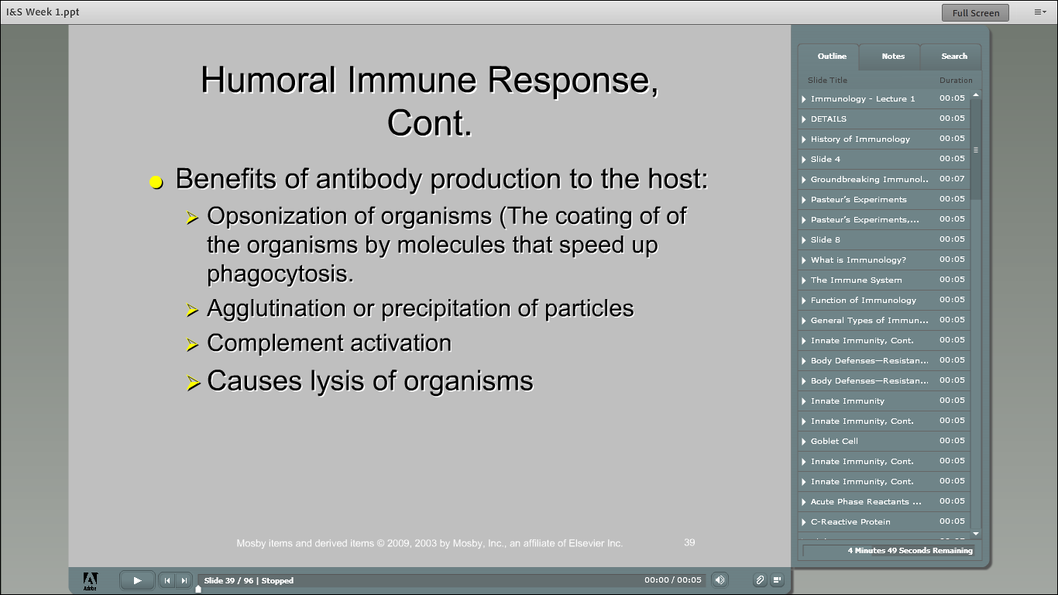

Slide 46
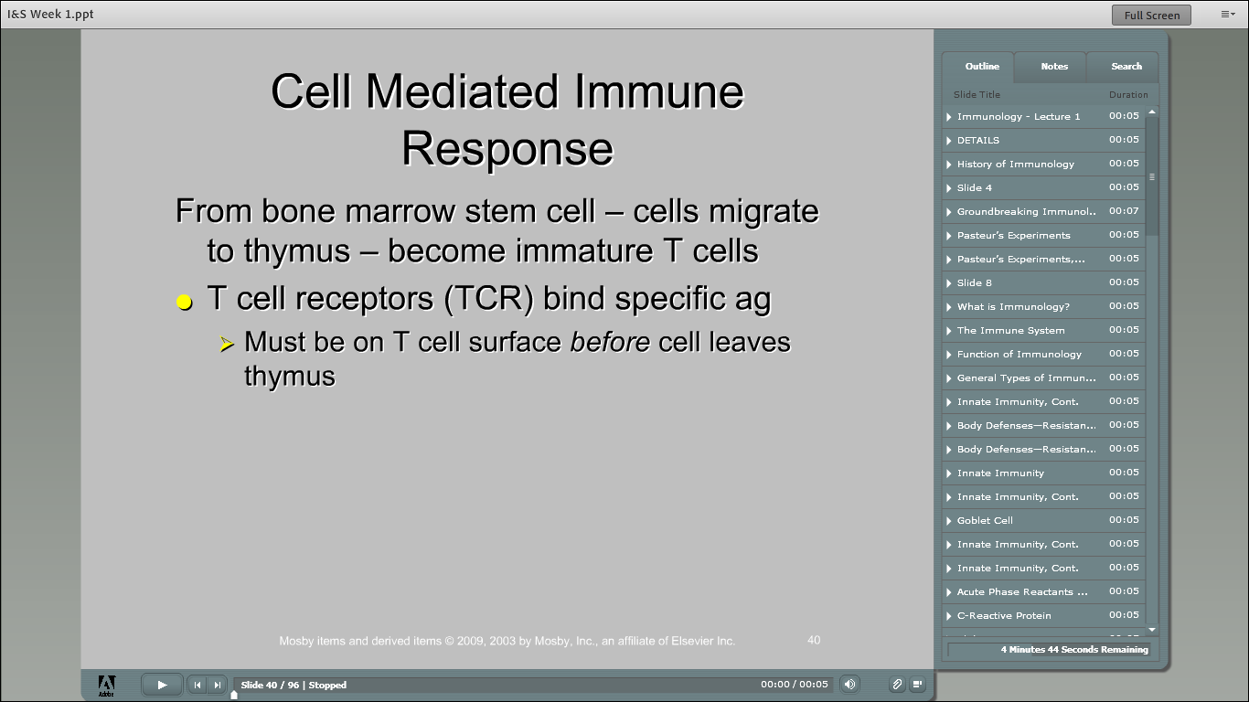

Slide 47
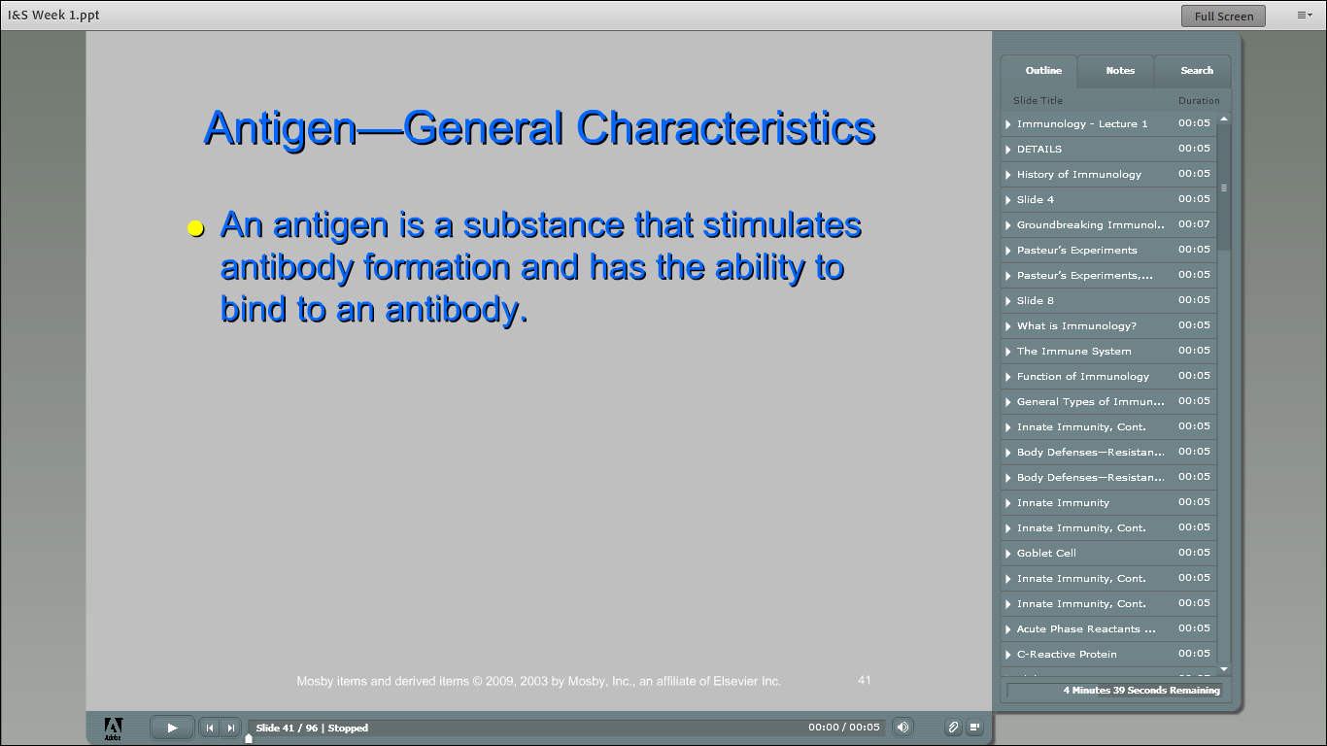

Slide 48
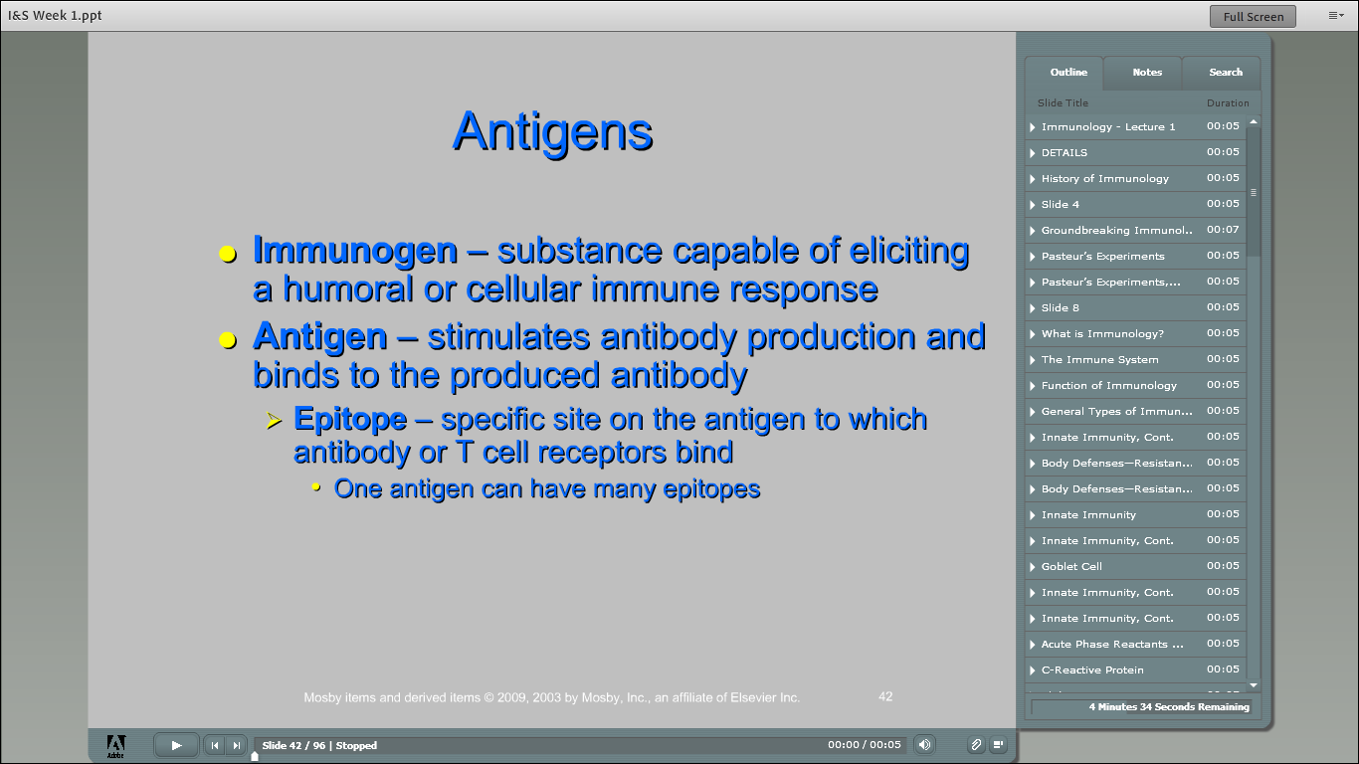

Slide 49
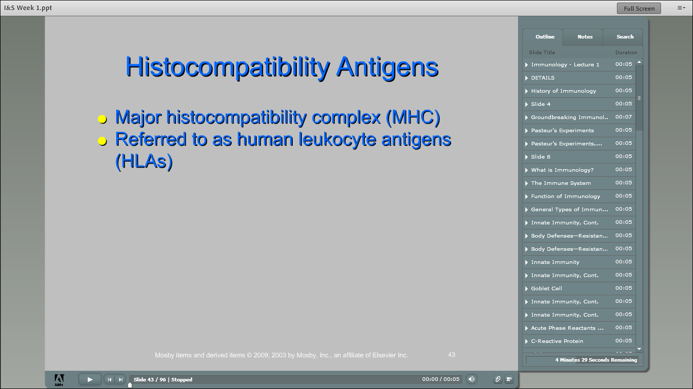

Slide 50
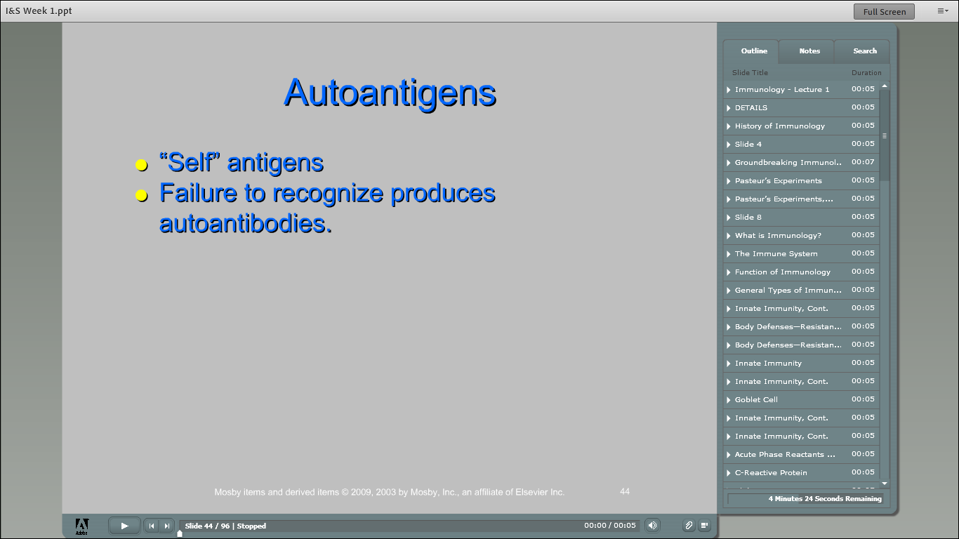

Slide 51
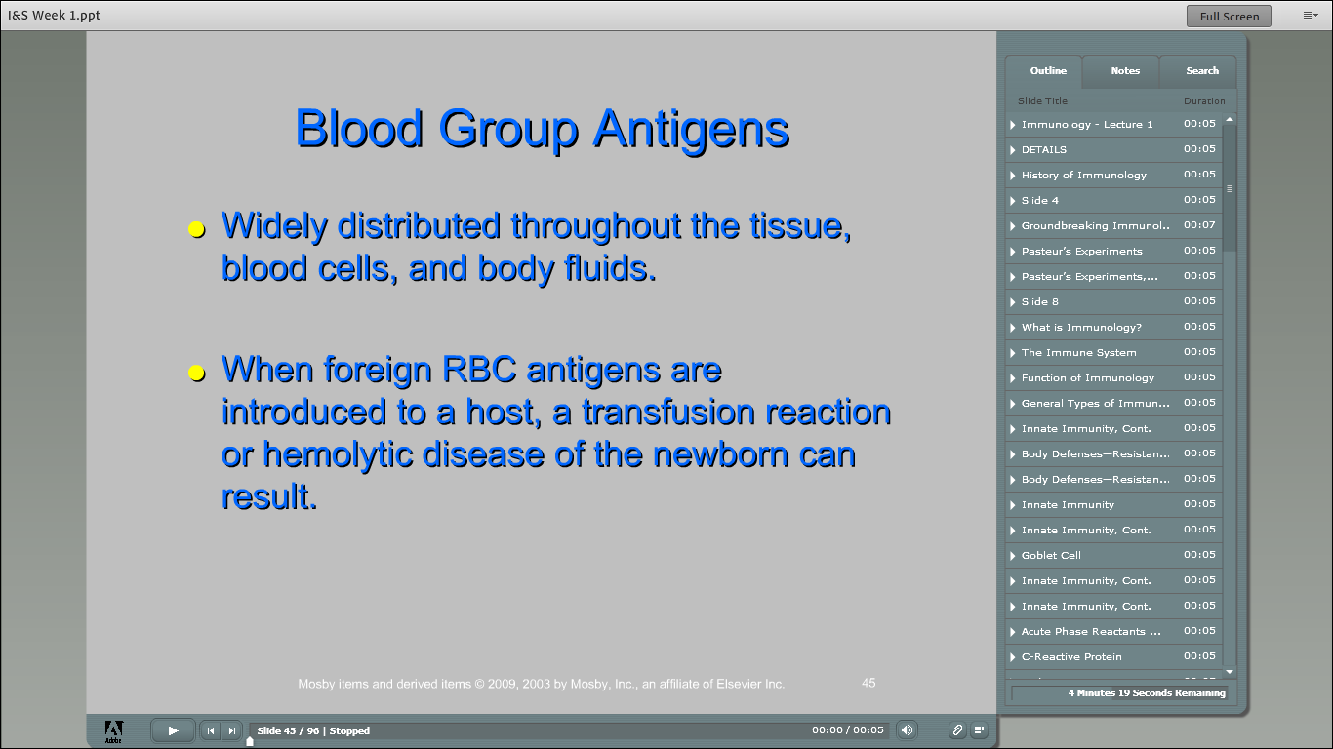

Slide 52
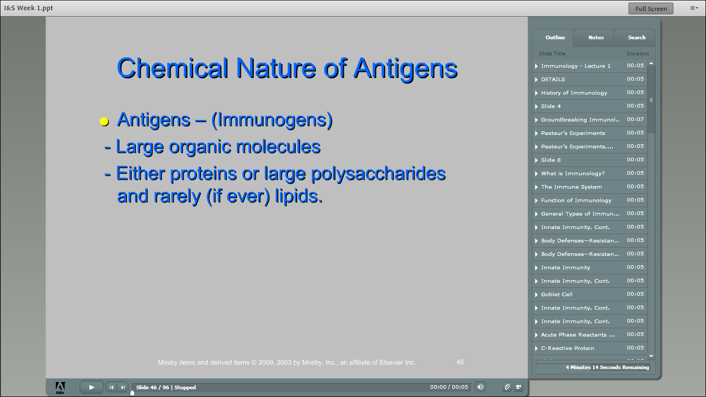

Slide 53
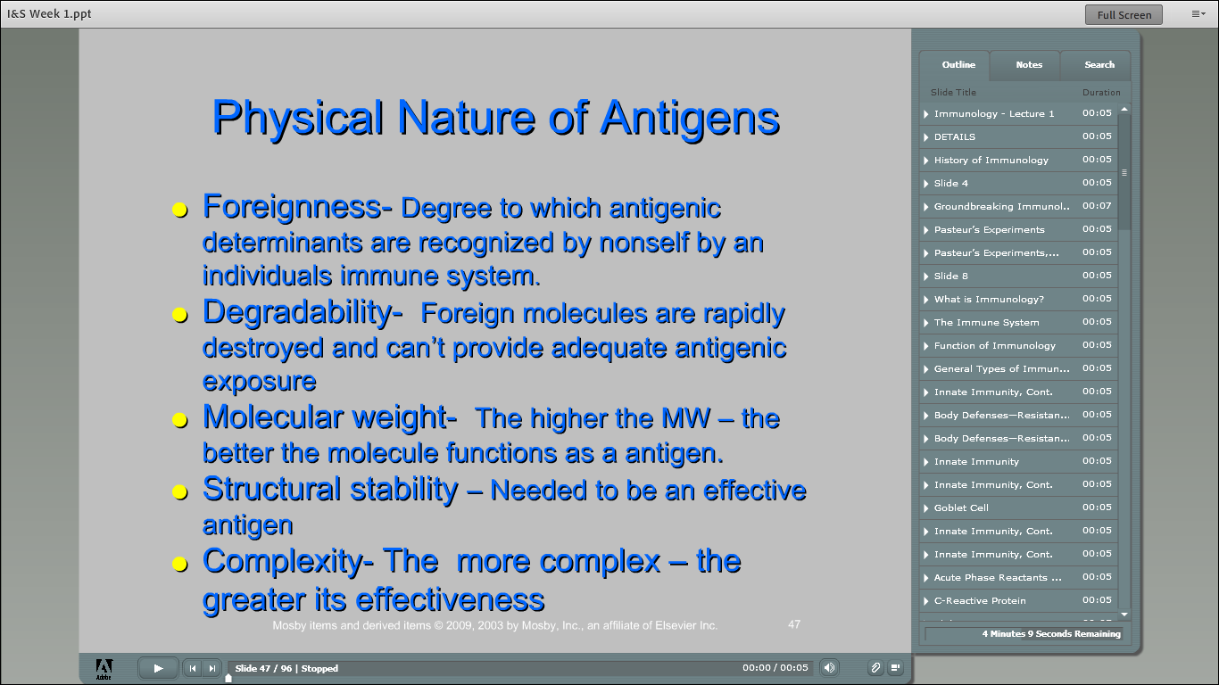

Slide 54
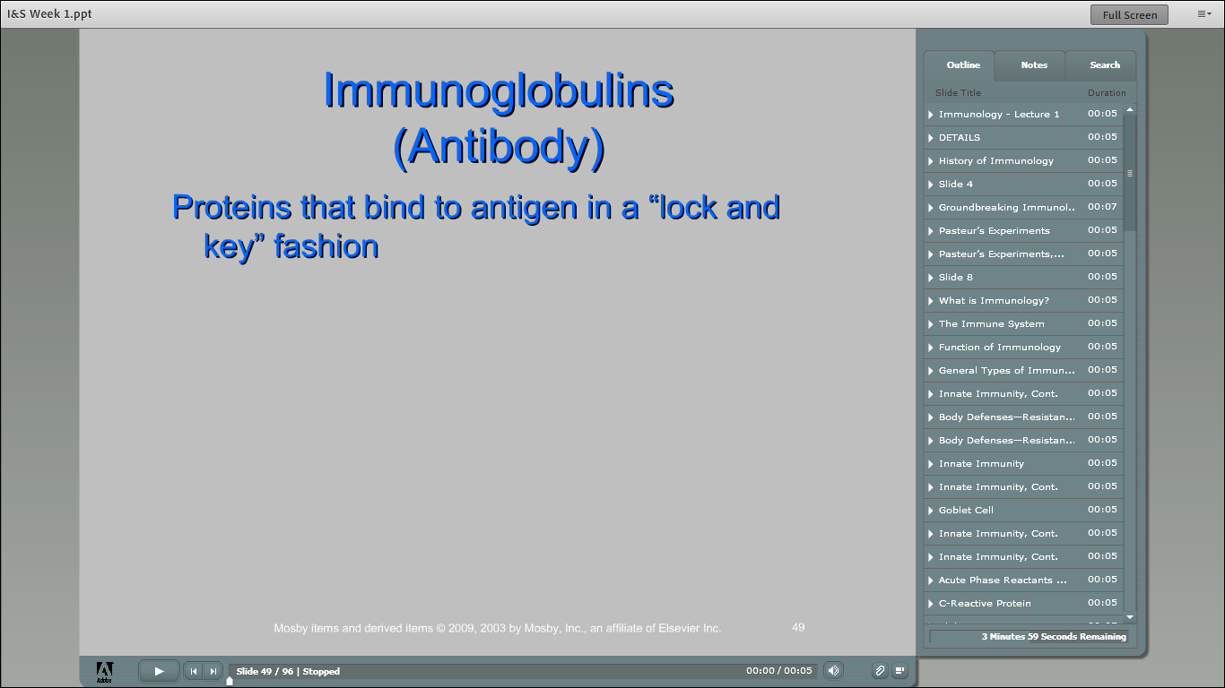

Slide 55
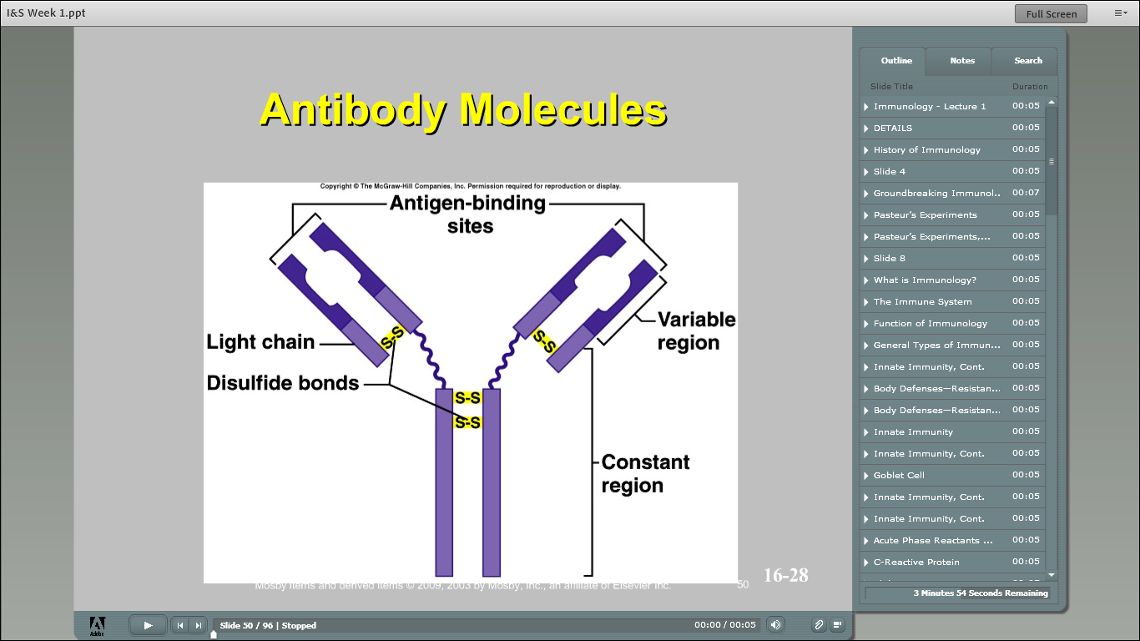

Slide 56
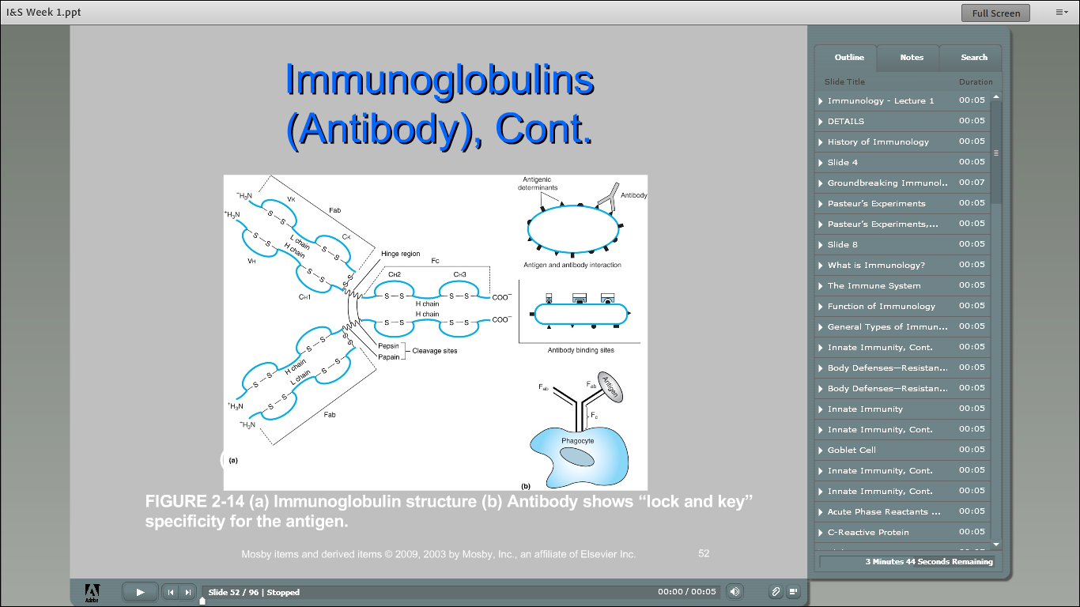

Slide 57
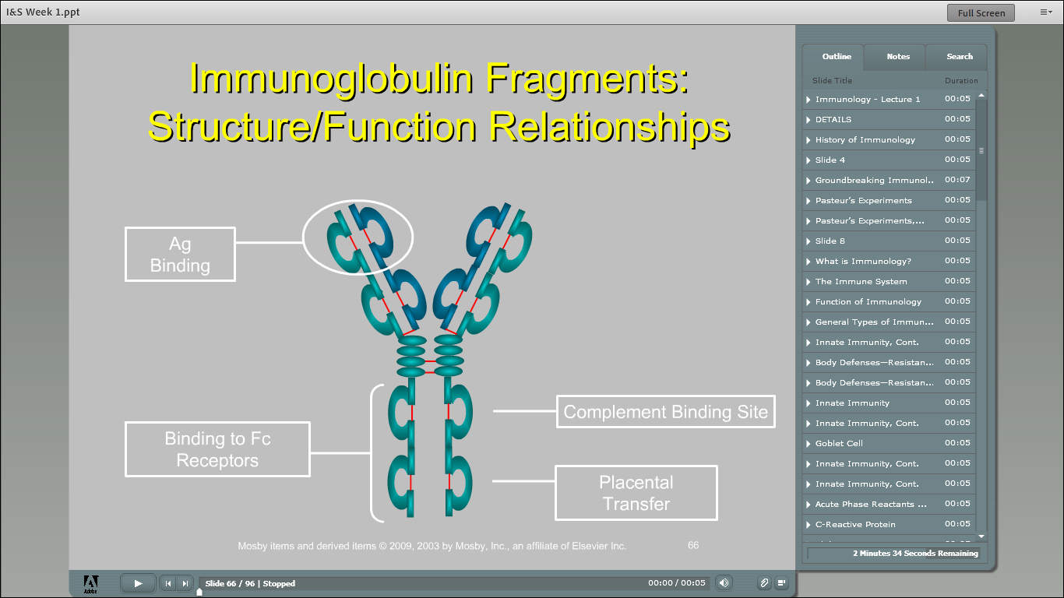

Slide 58
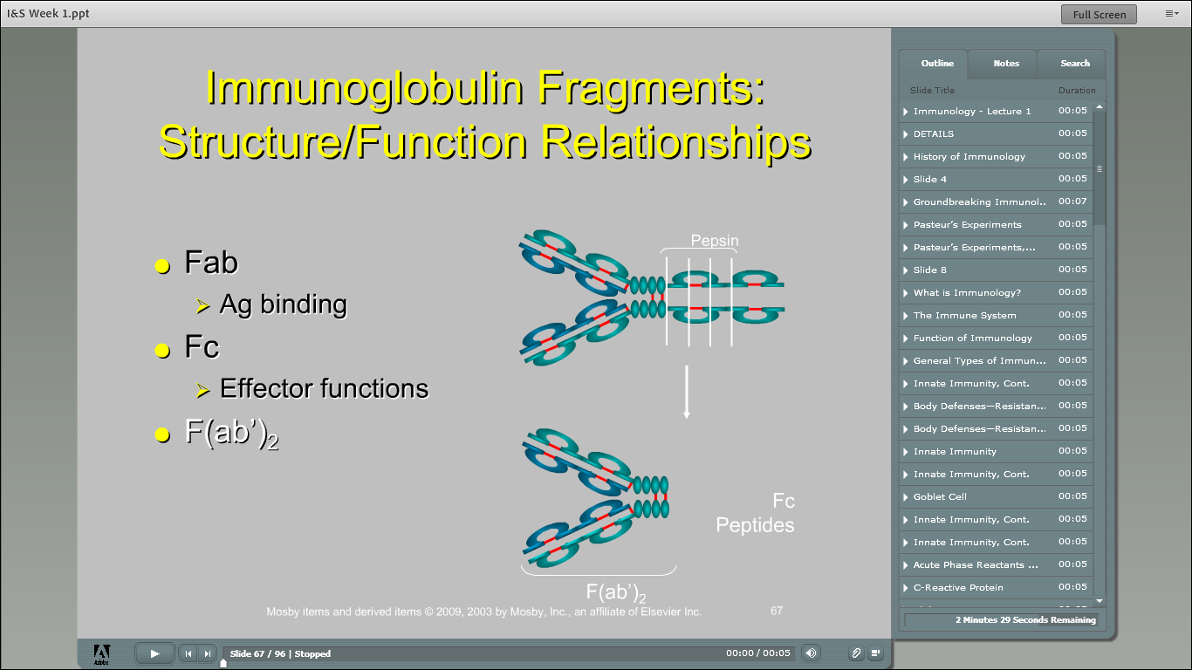

Slide 59
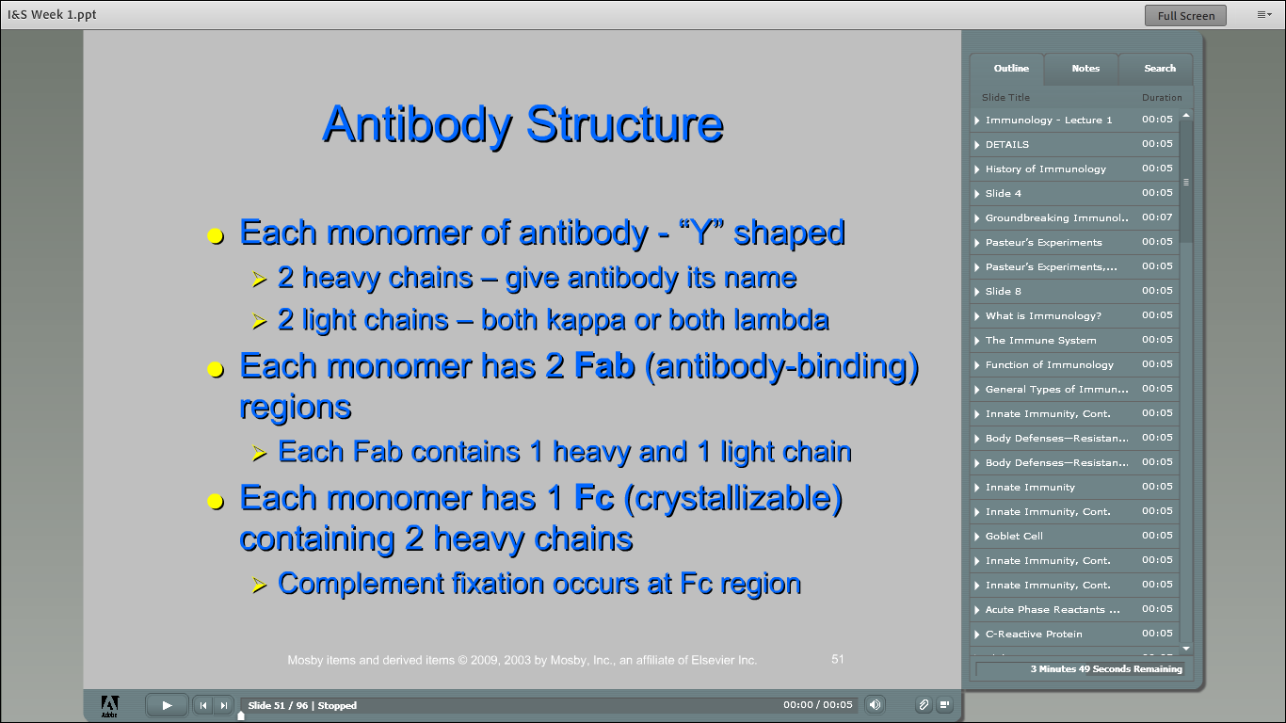

Slide 60


Slide 61


Slide 62


Slide 63


Slide 64


Slide 65


Slide 66


Slide 67


Slide 68


Slide 69


Slide 70


Slide 71


Slide 72


Slide 73


Slide 74


Slide 75


Slide 76


Slide 77


Slide 78


Slide 79


Slide 80


Slide 81


Slide 82


Slide 83


Slide 84
QUIZ BOWL!!!

Slide 85
The first line of defense in protecting the body from infection include all of the following except:
Unbroken skin
Normal microbiota
Phagocytic leukocytes
Secretions such as mucus and tears

Slide 86
The first line of defense in protecting the body from infection include all of the following except:
Unbroken skin
Normal microbiota
Phagocytic leukocytes
Secretions such as mucus and tears

Slide 87
Another term for adaptive immunity is
Antigenic immunity
Acquired immunity
Lymphocyte reactive immunity
Phagocytosis

Slide 88
Another term for adaptive immunity is
Antigenic immunity
Acquired immunity
Lymphocyte reactive immunity
Phagocytosis

