Slide 1
Welcome to Clinical Hematology
Dr. Christina A Nevel-McGarvey

Slide 2
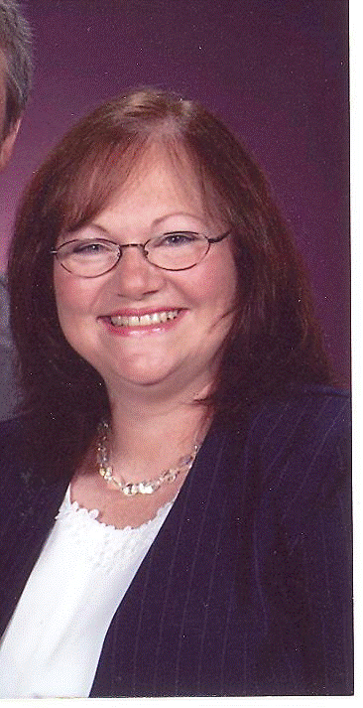
Meet and greet!

Slide 3
Course Expectations
Weekly Lessons-Independent Study Online
Textbook Reading
Narrated Powerpoint Presentations
Static Powerpoint Slides
Weekly Assignments
Discussions
Quiz
Seminars (must attend 5/10)
(Midterm week 6 & Final week 12)
Scientific Writing/References

Slide 4
How will I tackle this???
What should you do first to get ready for this session?
Obtain and organize a notebook for yourself! Be sure to take notes on class materials and journal your challenges as well as the things that you find easy to accomplish! Be sure to compile this information to help you study for your midterm, final, and boards!
Obtain notecards and a zip pocket for your notebook! Organizing your course material on flashcards is a great organizational tool as well as a way to solidify information as you flip through the material repeatedly. Color coding or flagging them can be done in many ways to help you throughout the course and for your boards.
Get started on your work early in the week

Slide 5
What should you do every time you enter the classroom?
Check classroom announcements!
Check your messages!
Check to see if anyone has responded to your discussion post and reply to them!

Slide 6
How should you attack your coursework every week?
First, attack your reading assignment listed in lesson area of classroom! (Week One=Ch 1 & 29)
Go to the lessons area of the classroom to listen to the lecture and view any available Power-Point presentations created to support your reading material.
Post to your discussion early in the week! (Week One= Introductions + Main Discussion)
2 topics per week
Both topics may be addressed in the same main post each week
150-300 words per topic for the main post
One Credible reference to support your work
Minimum of 2 substantive comments to classmates per topic per week
No late posts will be accepted for any reason
Be sure to load your photo into the classroom so that discussions are not impersonal
Benchmark quiz can be accessed from the lesson area as well as the quiz/test area
One submission
All work is due by 11:59pm ET Sunday ending the unit week

Slide 7
PROFESSOR CONTACT
Primary Contact is via the Message area in the classroom. This is your class email system. Be sure to stay in close contact with any questions/problems.
Be sure to enter your email address into your personal profile so that messages from the classroom are forwarded to your email account.
VIRTUAL OFFICE HOURS
Mondays and Wednesdays 6-8 PM ET
and other times by arrangement.
http://nymahe.adobeconnect.com/virtualofficemeetingroomcng
If you need to meet at another time, we will try to arrange a mutually agreeable time. This may be difficult due to other responsibilities and schedules. Usually we can work through any problems in writing via email.

Slide 8
Seminars
Hematology Seminars: Wednesdays at Noon ET
Immunology Seminars: Thursdays at Noon ET
It is mandatory that you attend 5 out of 10 seminars live.
Seminars are held during weeks 1, 2, 3, 4, 5, 7, 8, 9, 10, & 11. Weeks 6 & 12 are exam weeks with no seminar.
If you know that your schedule will not permit you to attend seminar at the above times, you must email me explaining why you will not be able to attend seminar and you must carbon copy Lynn Jones (ljones@nymahe.org) and Lori Burkard (lburkard@nymahe.org). They will determine if each individual case qualifies for an exception for live attendance. If an exception is granted, then you will be notified to let you know how to procede to make up for the seminar attendance.

Slide 9
Questions? -Expectations -Course Content?

Slide 10
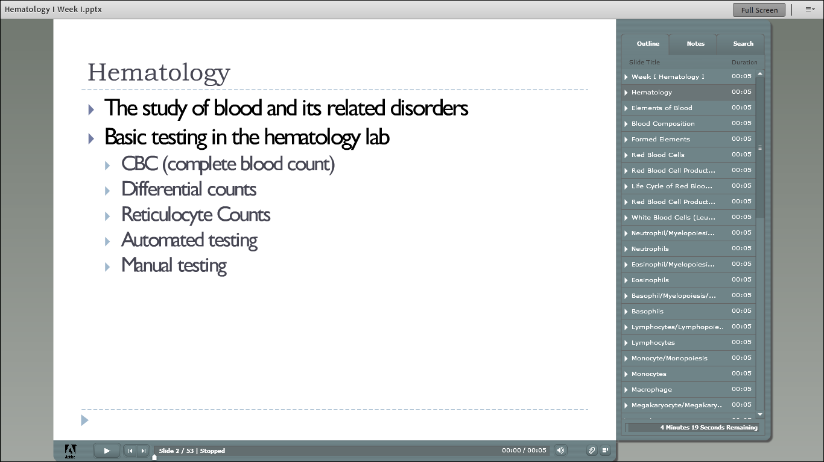

Slide 11
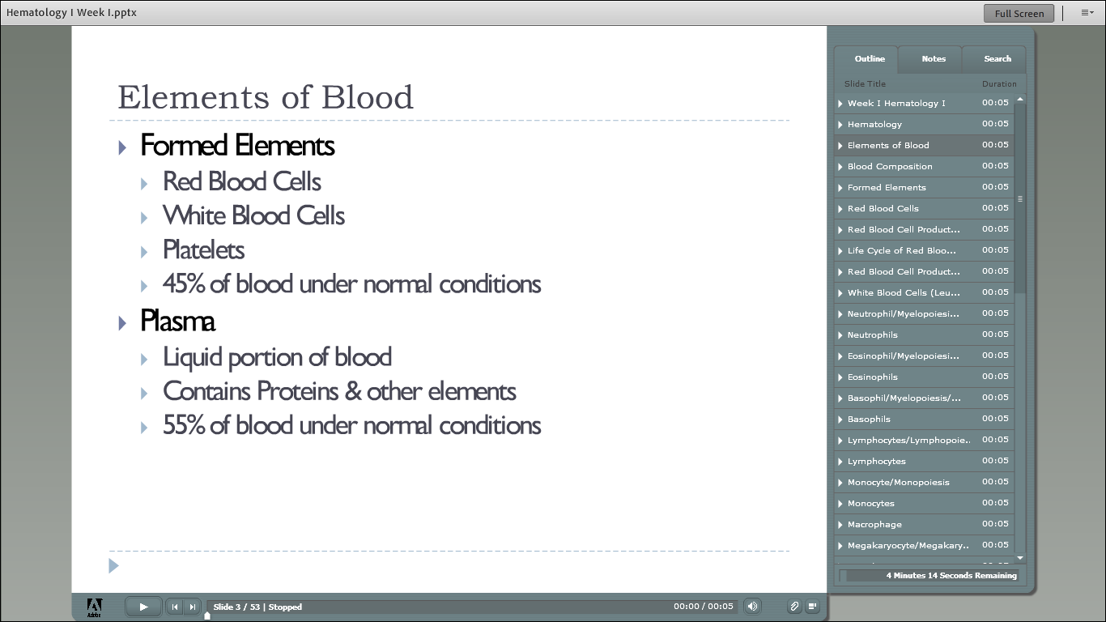

Slide 12
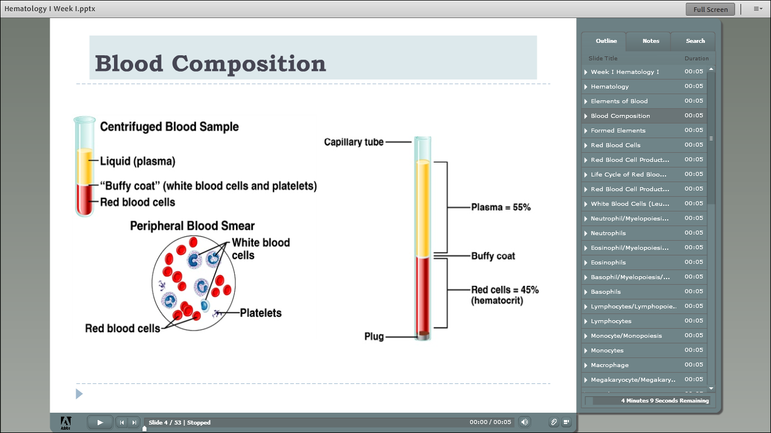

Slide 13
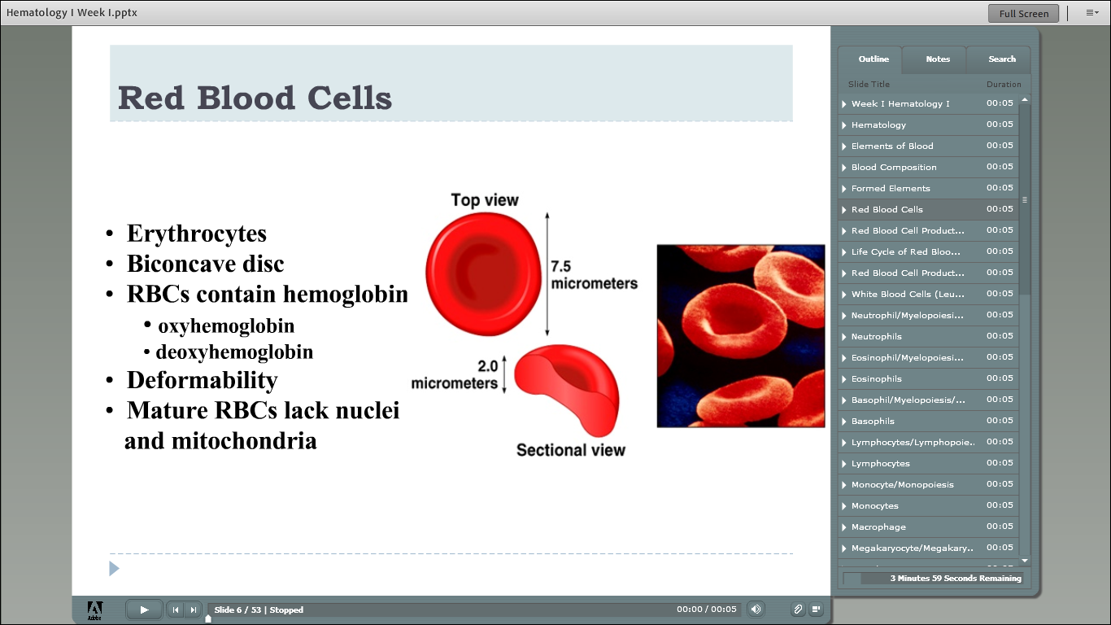

Slide 14
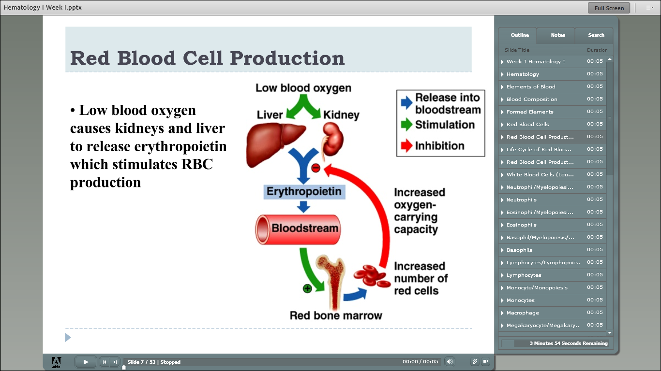

Slide 16
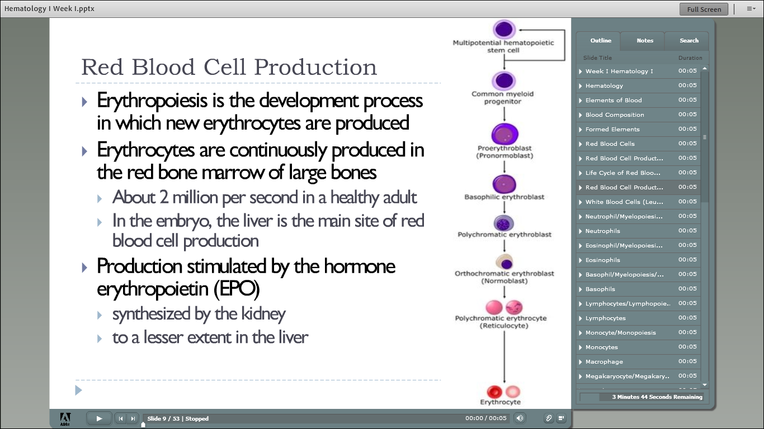

Slide 17
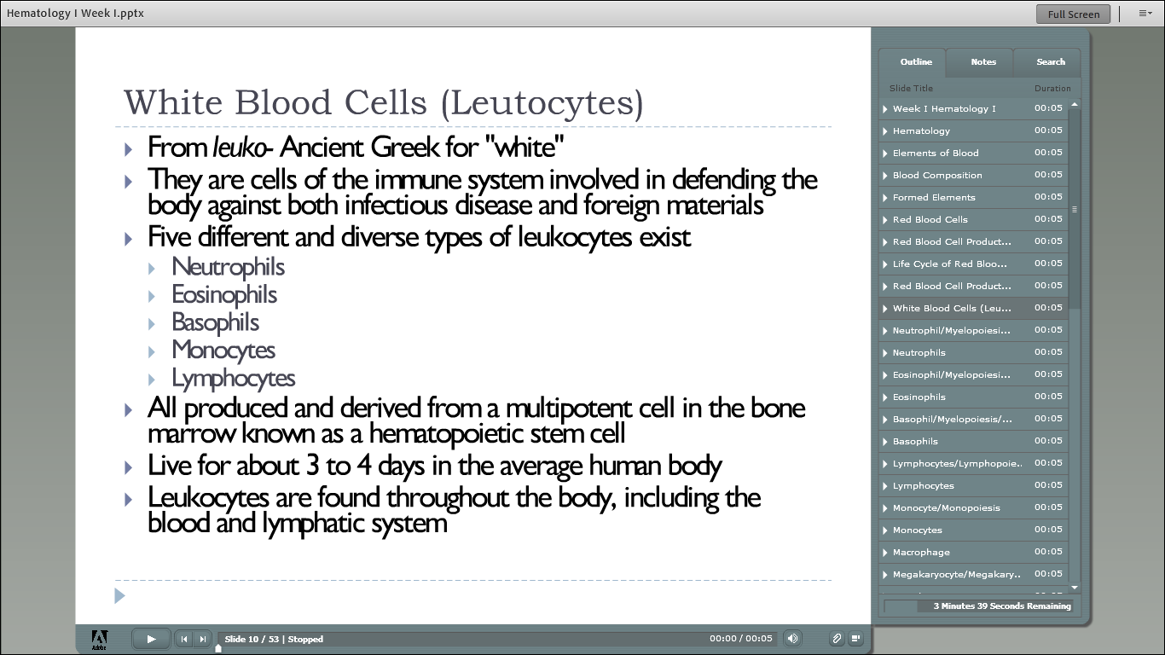

Slide 18
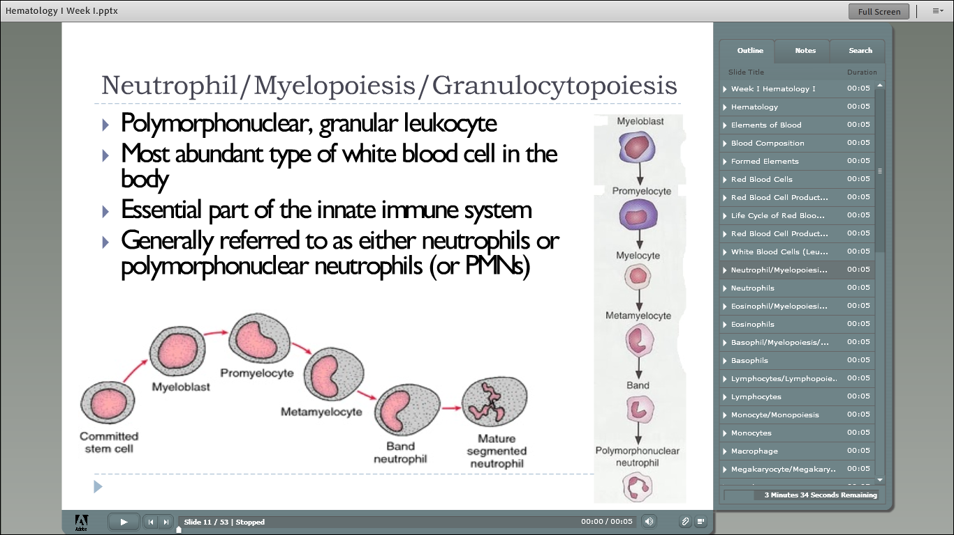

Slide 20
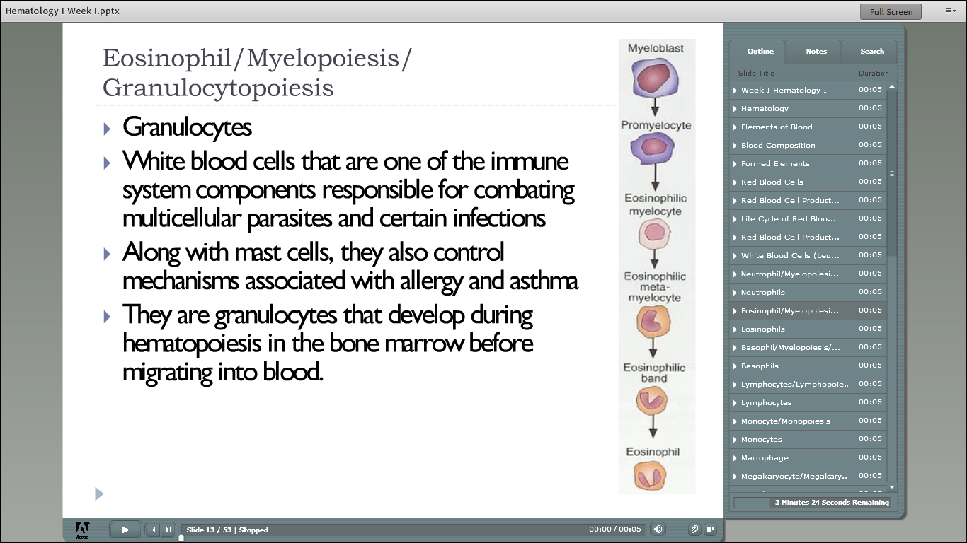

Slide 21
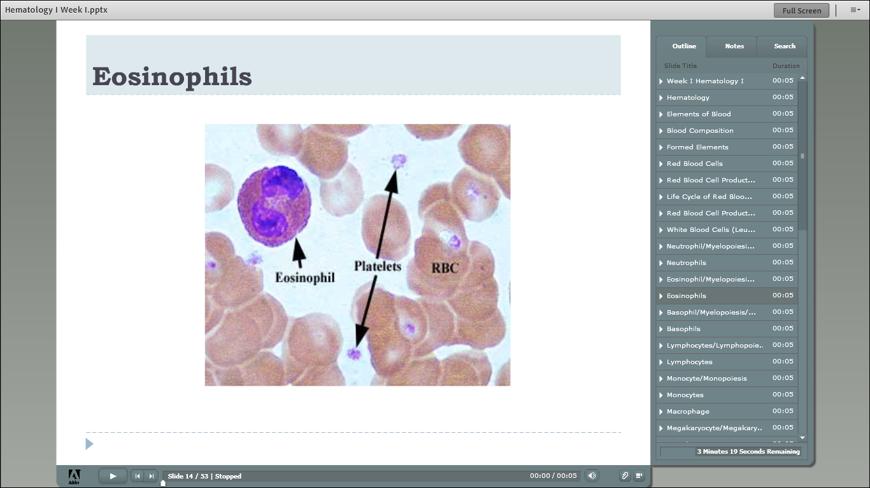

Slide 22
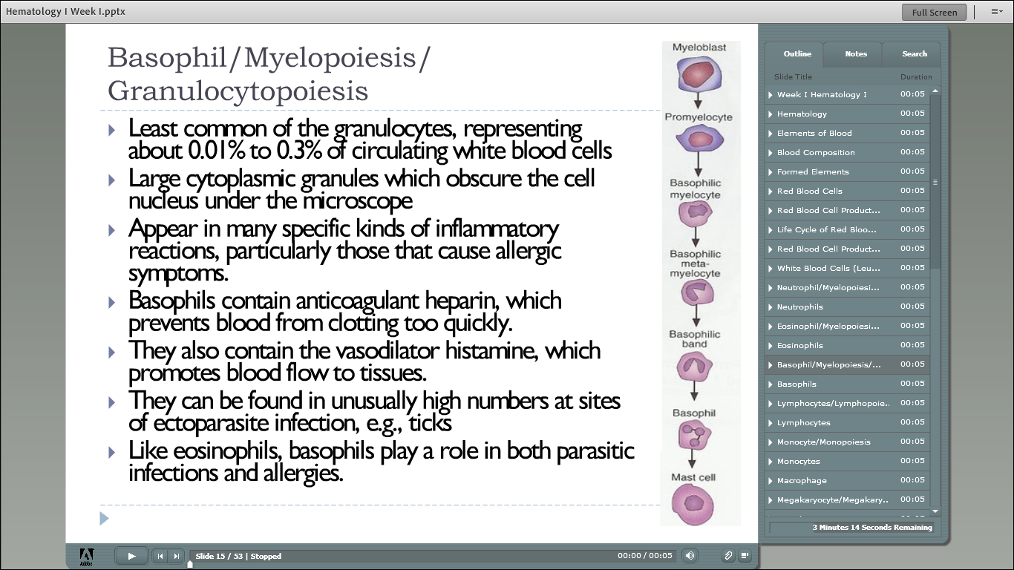

Slide 23
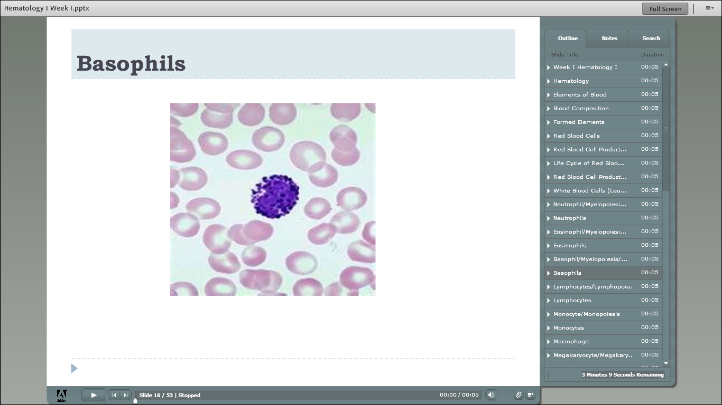

Slide 24
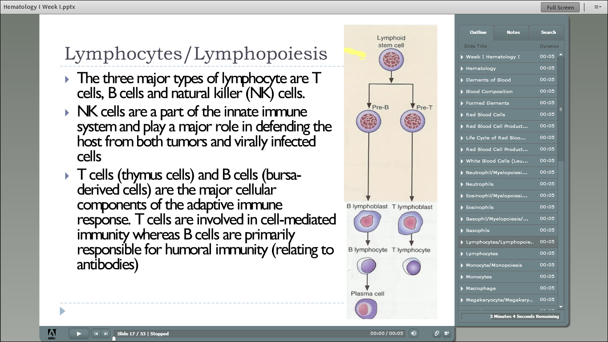

Slide 25
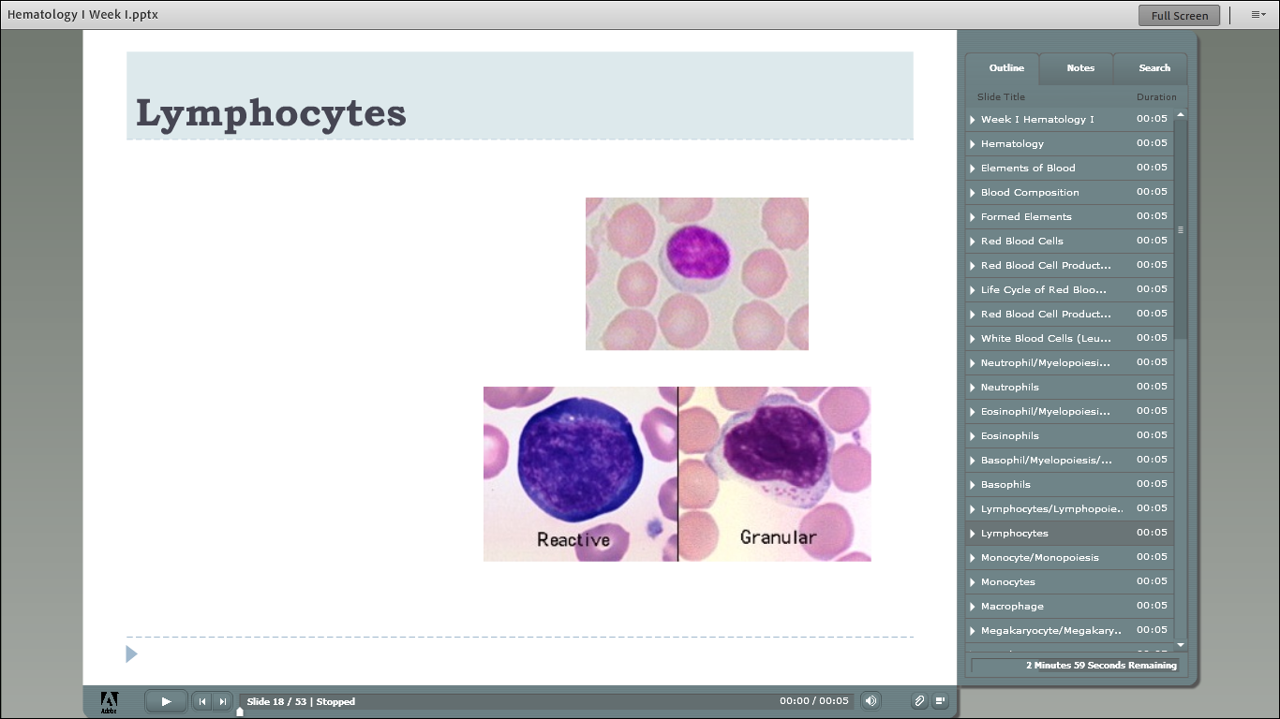

Slide 26
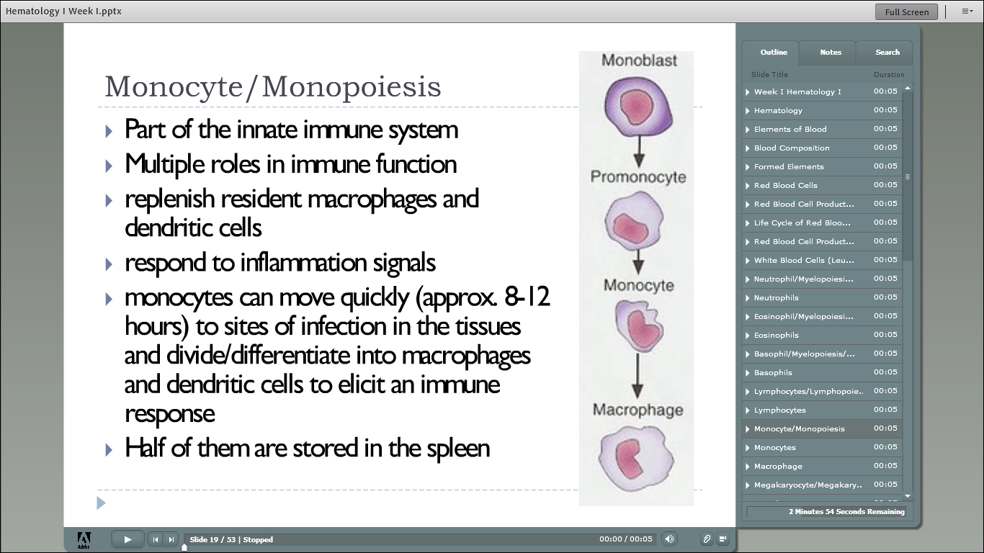

Slide 27
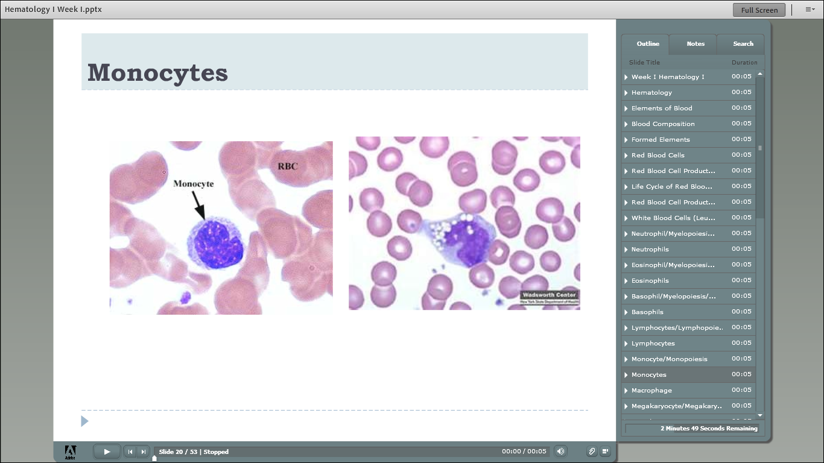

Slide 28
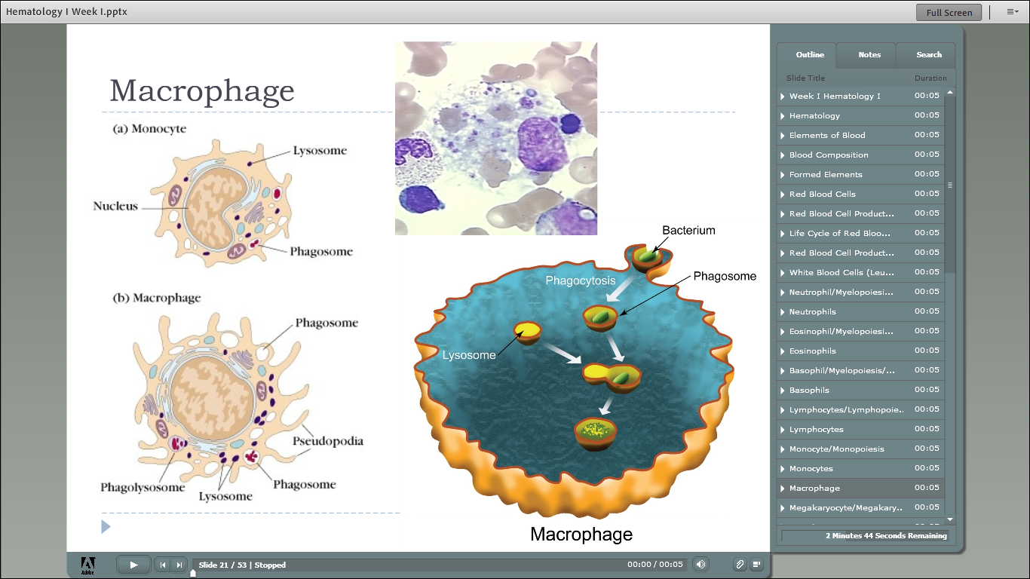

Slide 29
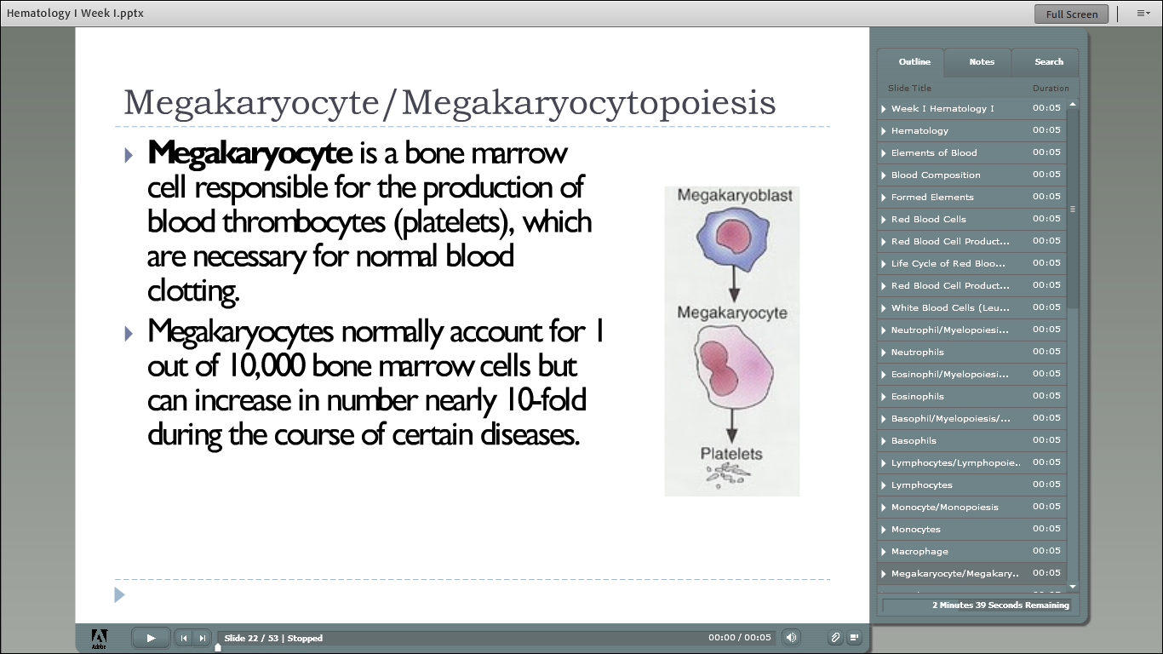

Slide 30
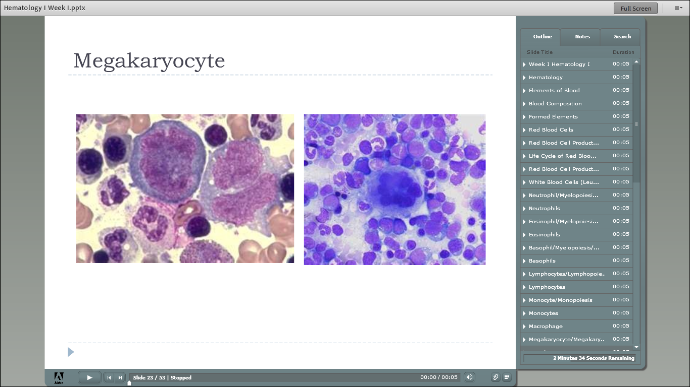

Slide 31
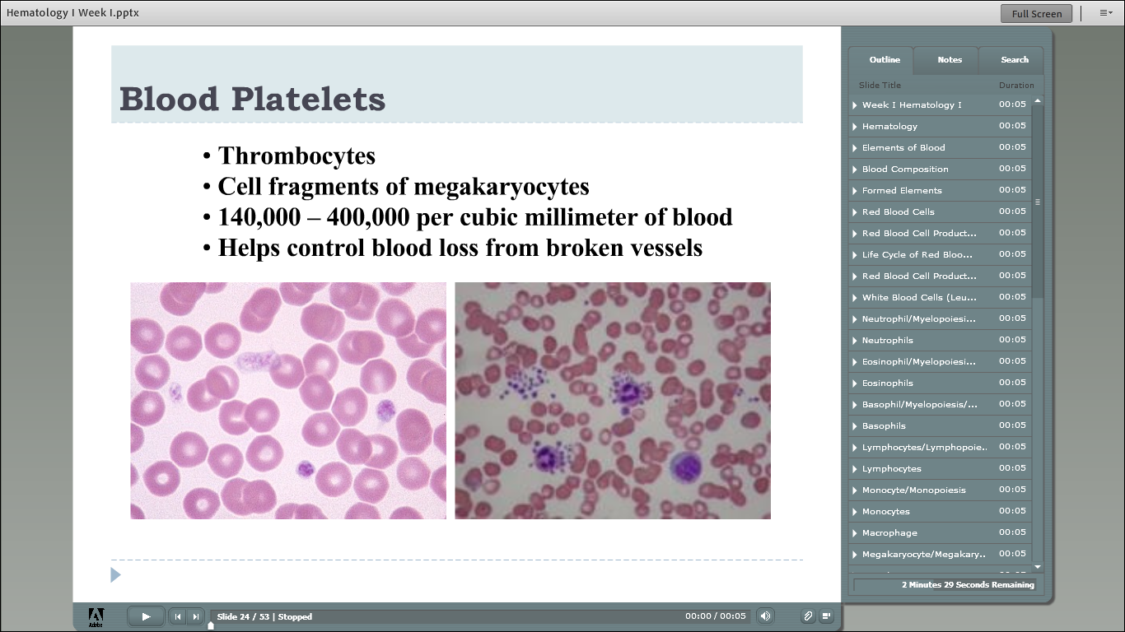

Slide 32
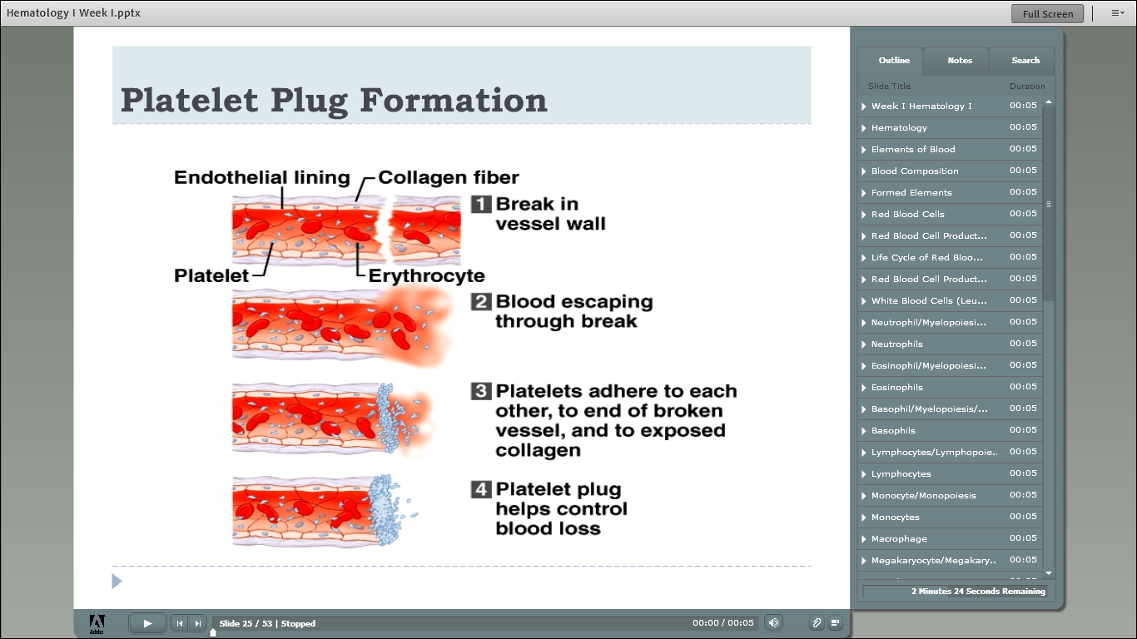

Slide 33
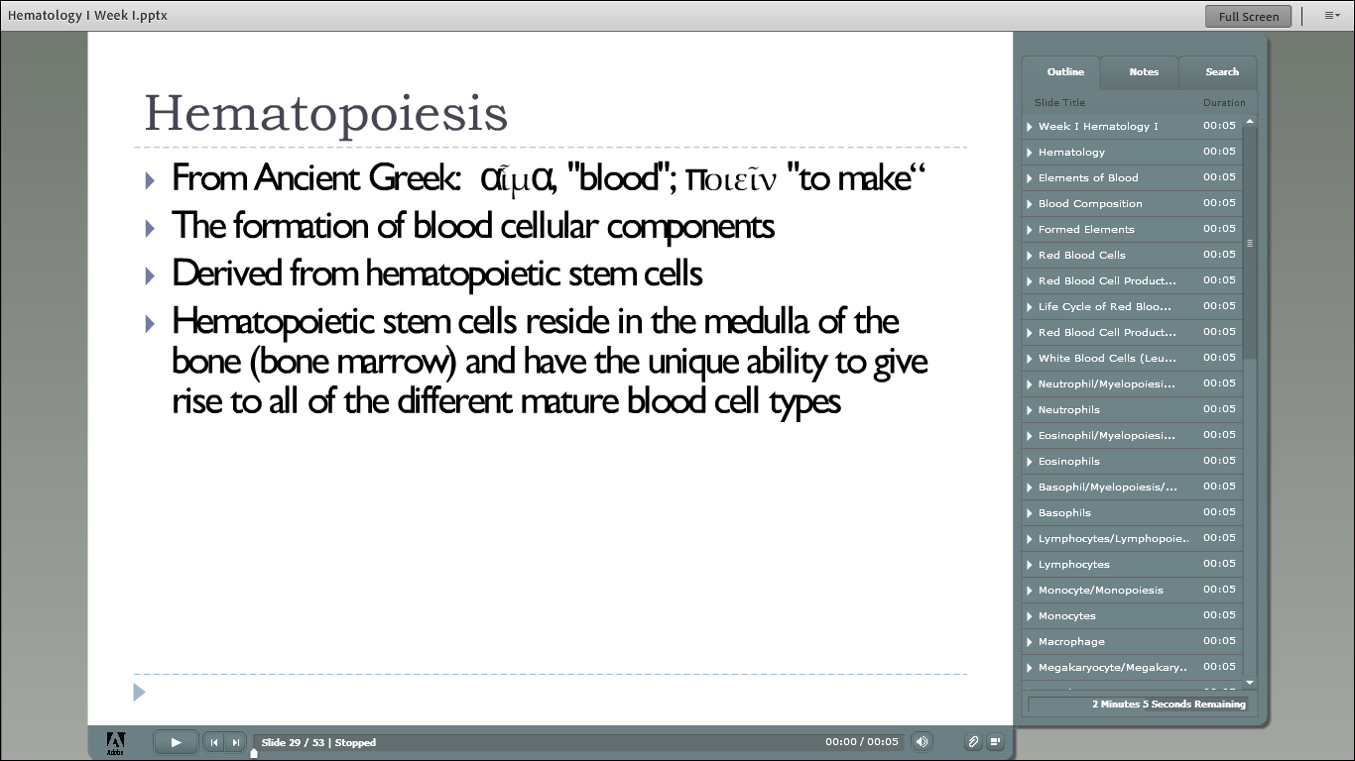

Slide 34
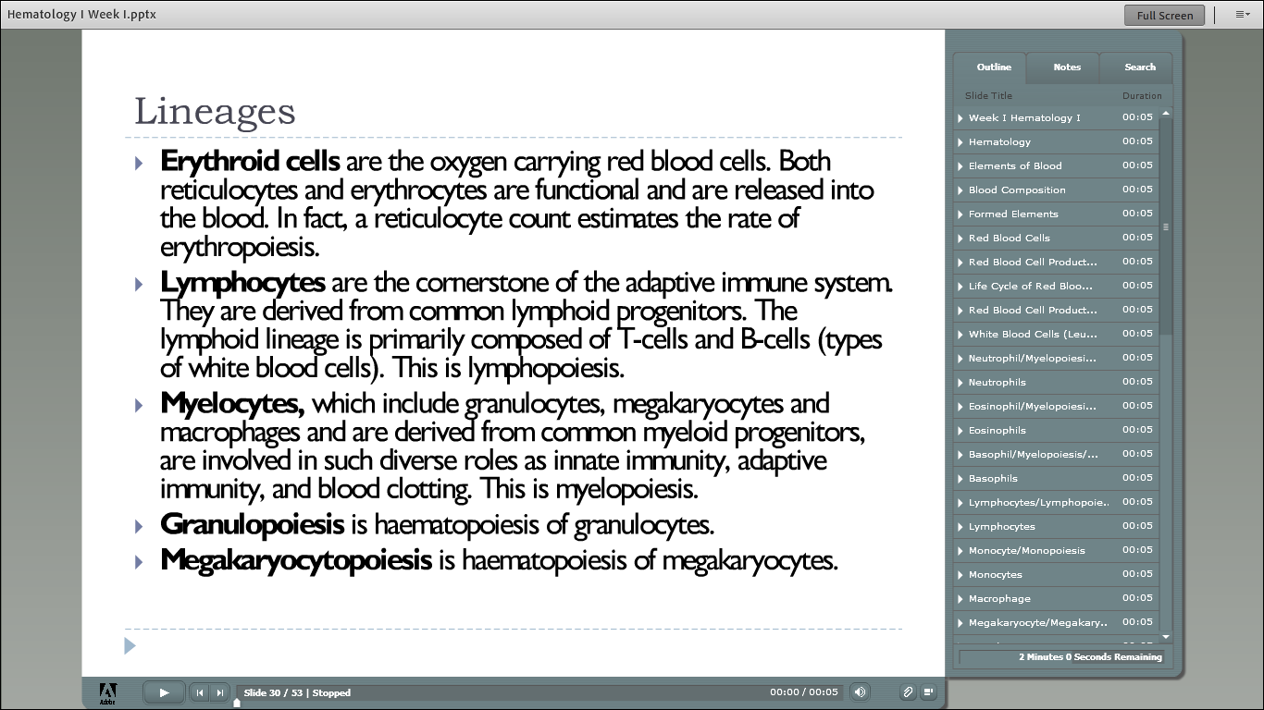

Slide 35
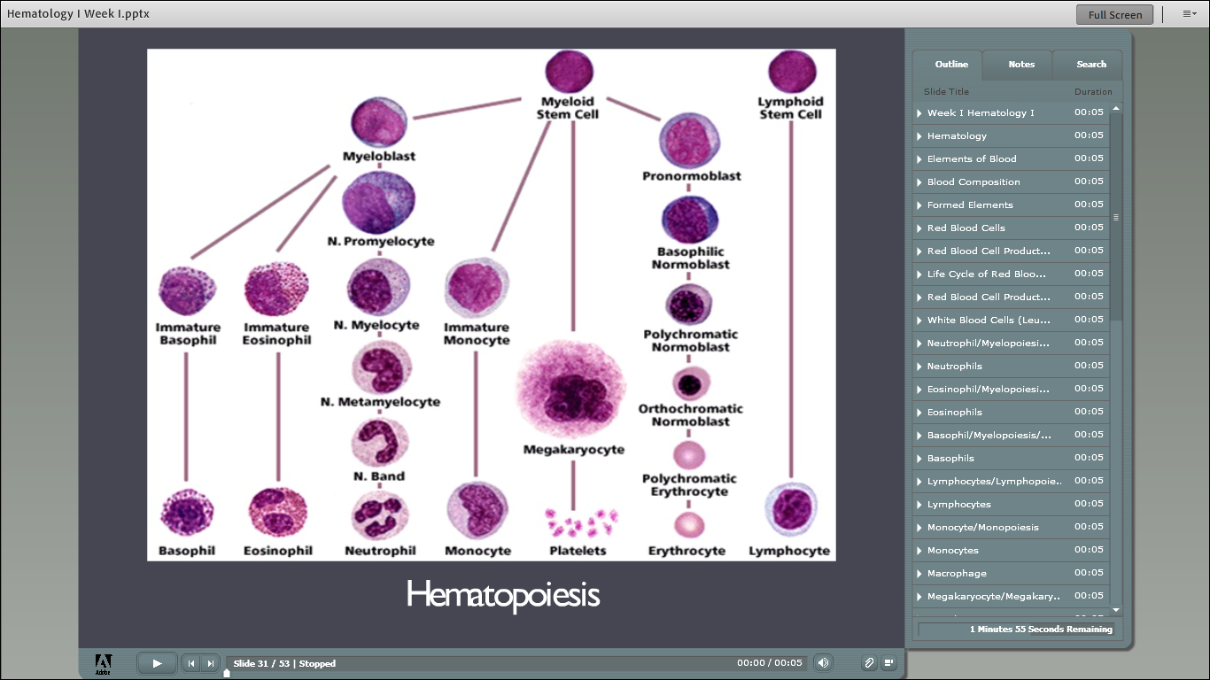

Slide 36
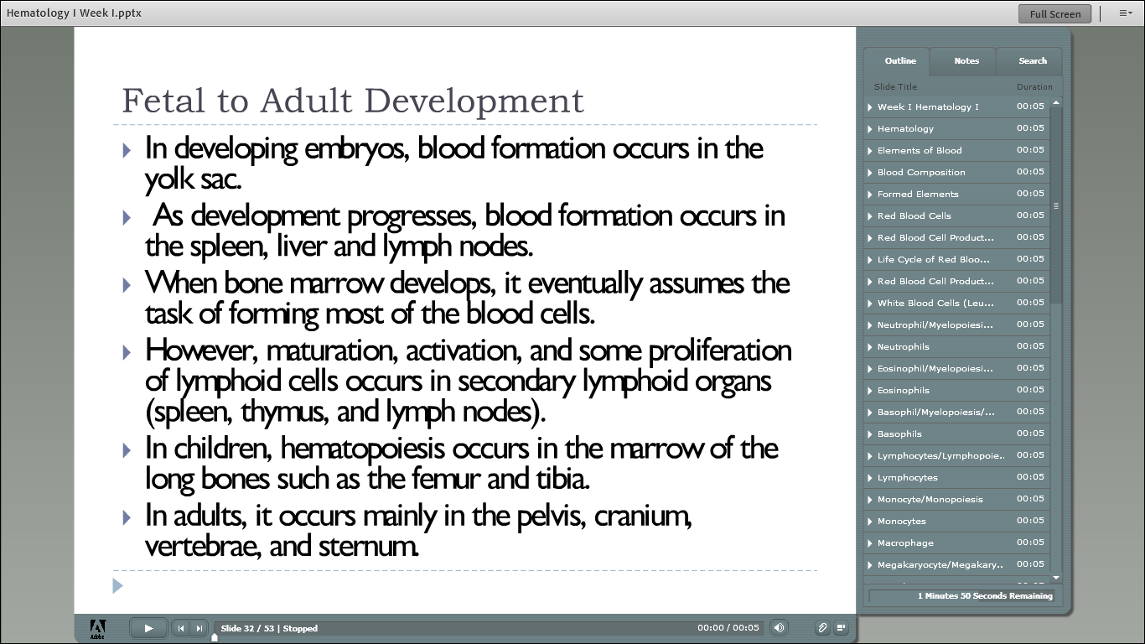

Slide 37
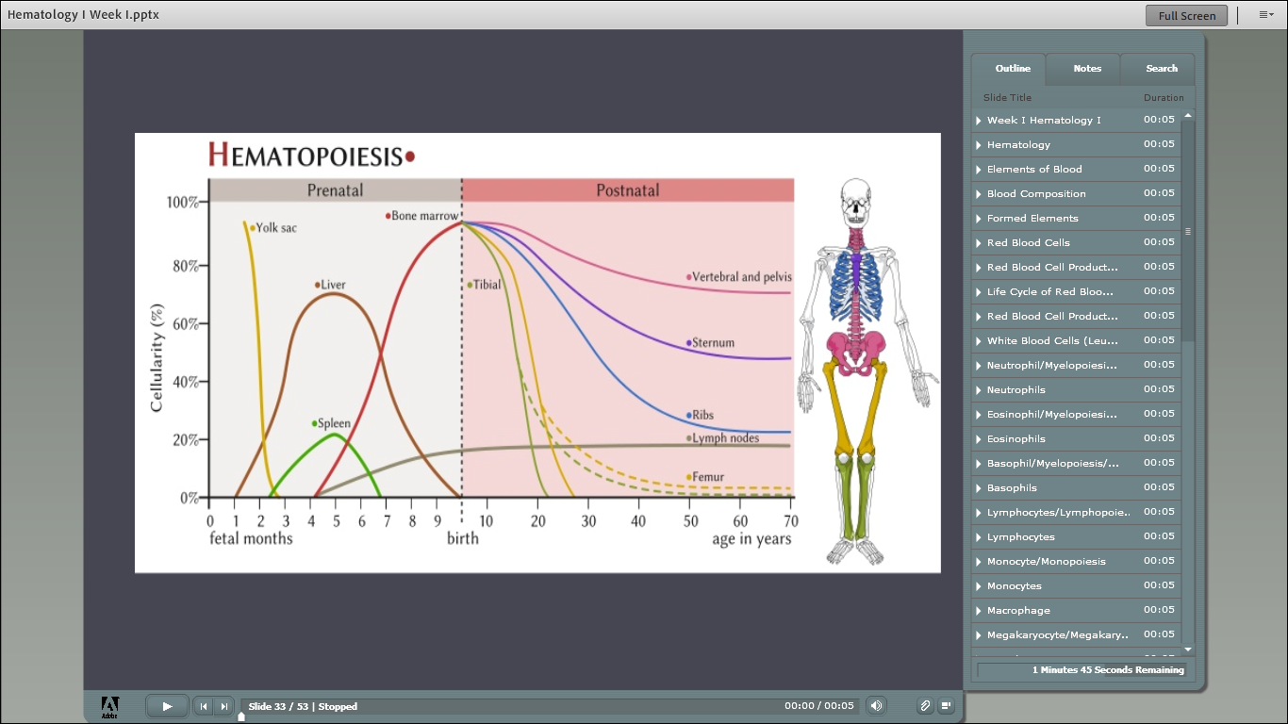

Slide 38
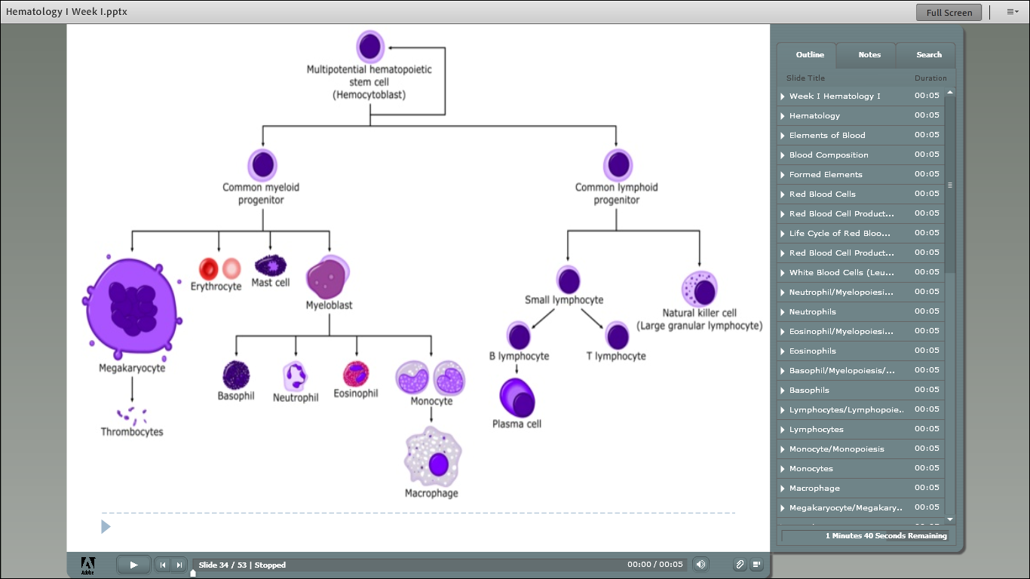

Slide 39
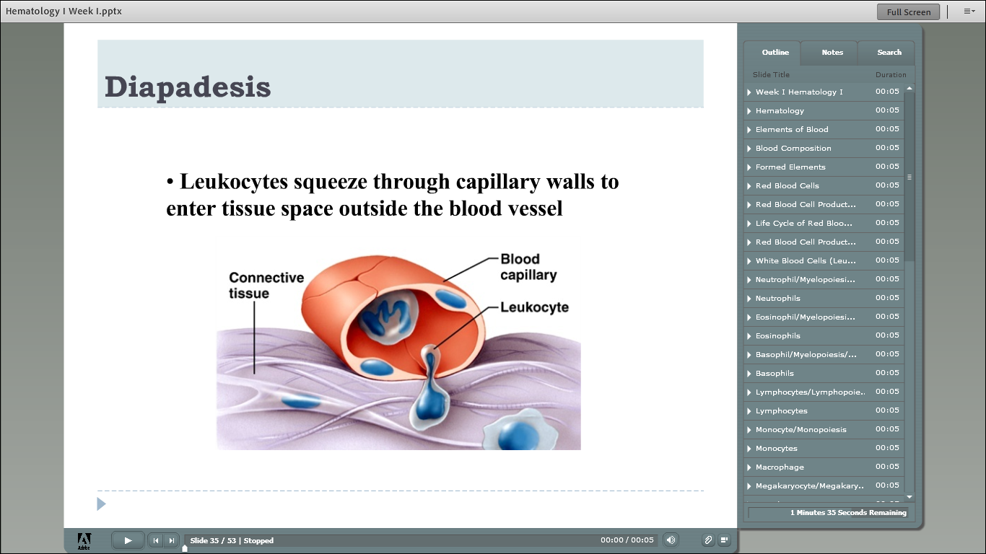

Slide 40
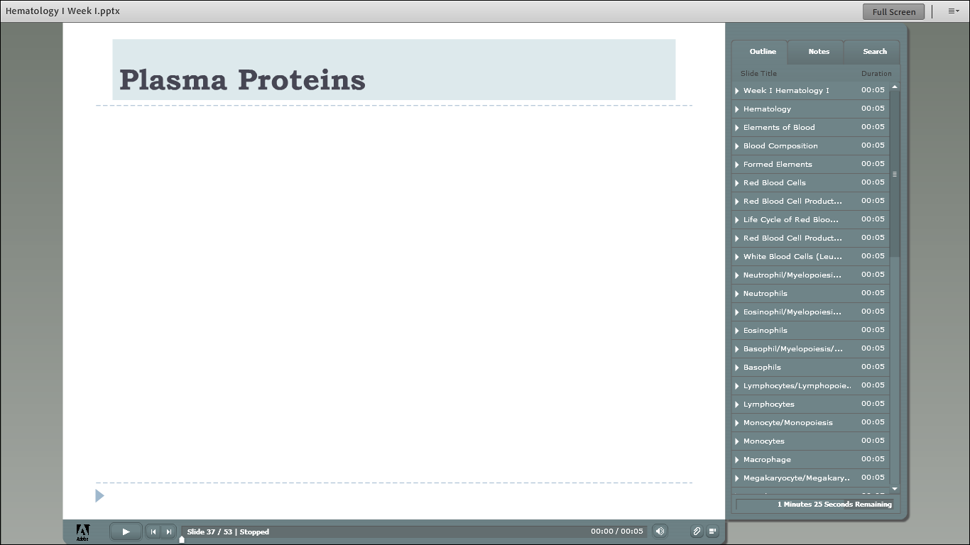

Slide 41
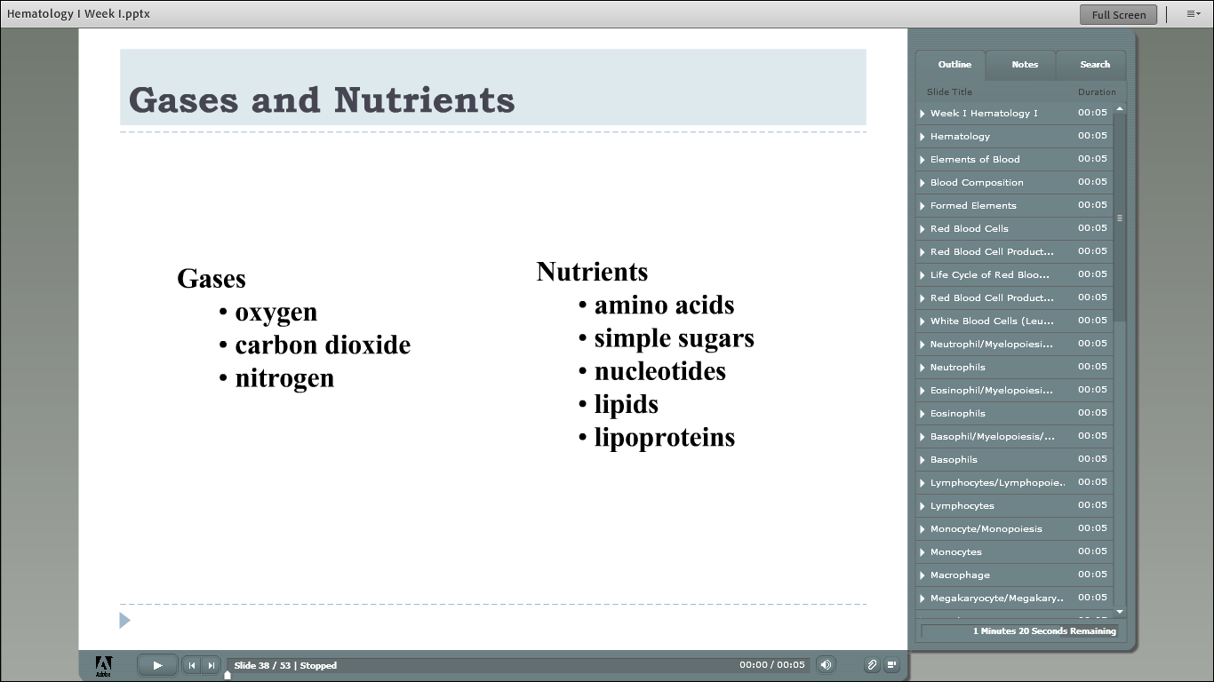

Slide 42


Slide 43
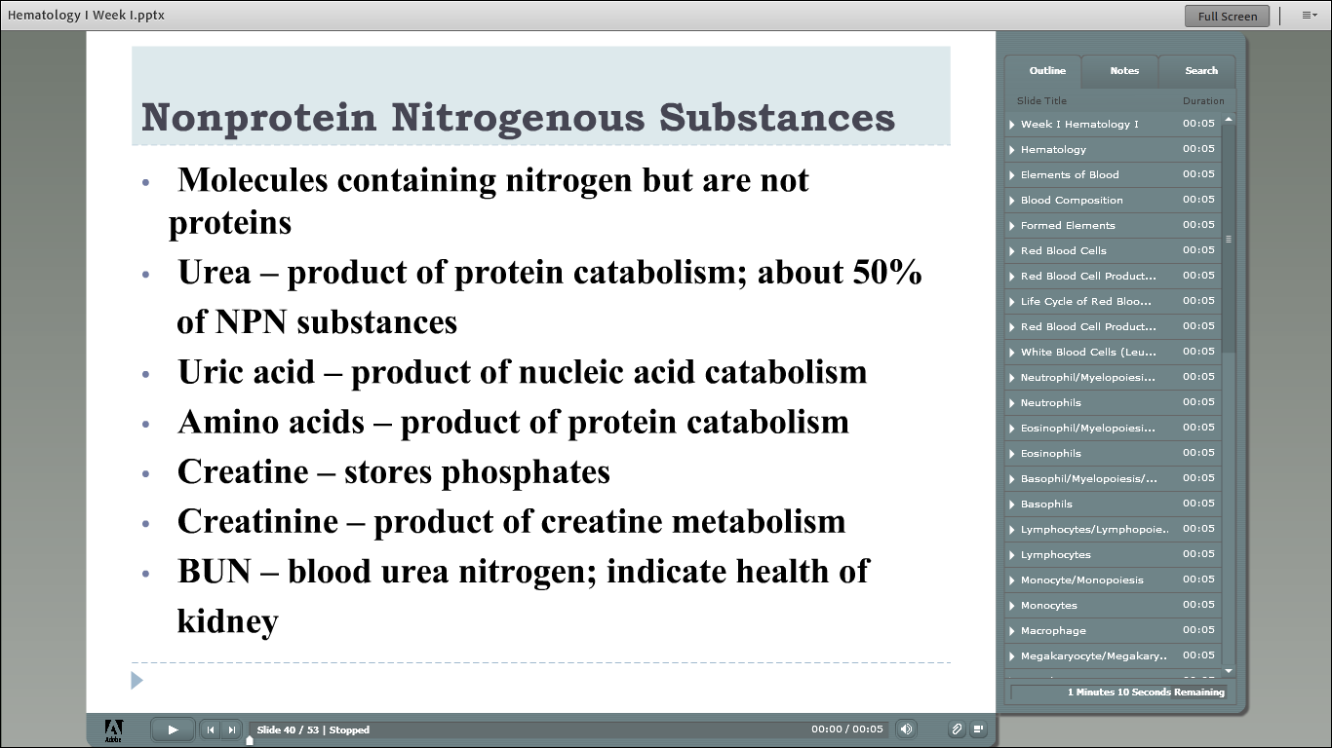

Slide 44
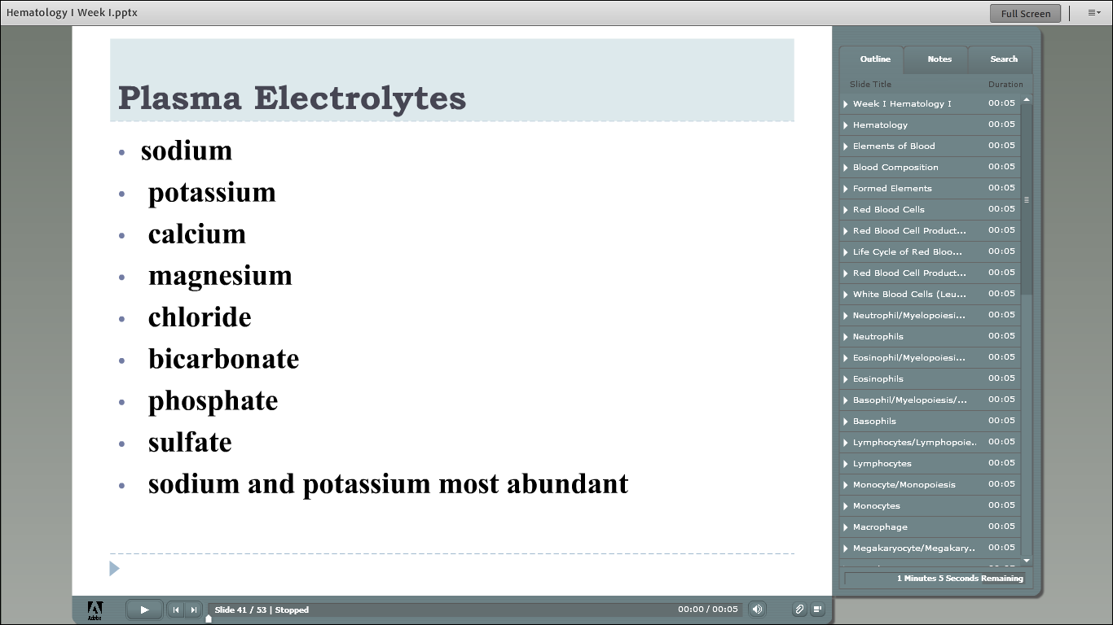

Slide 45
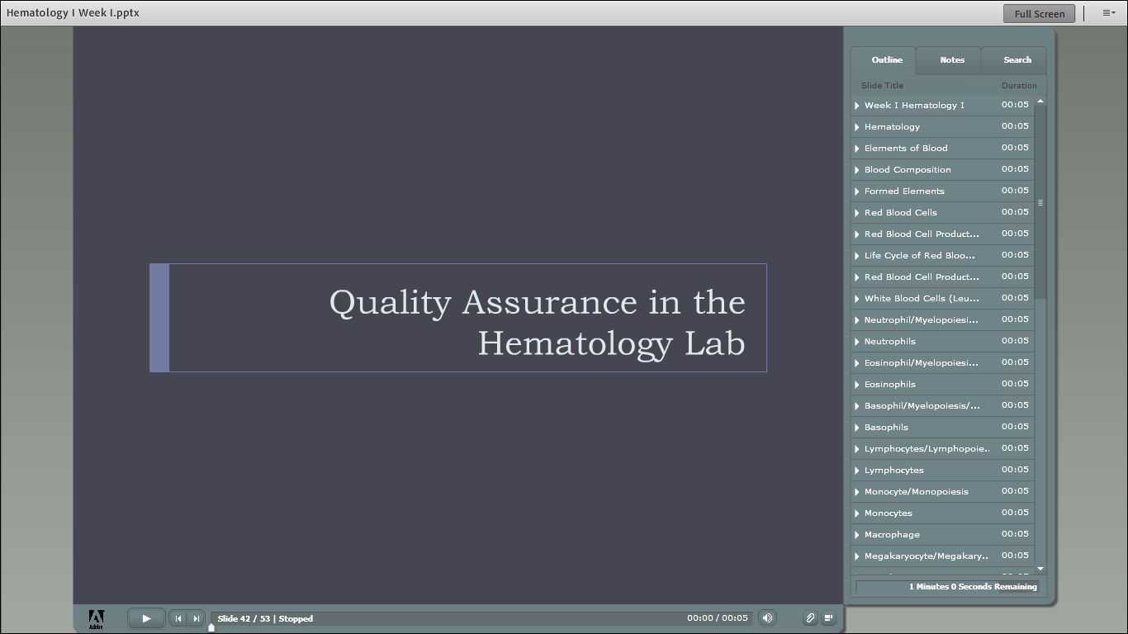

Slide 46
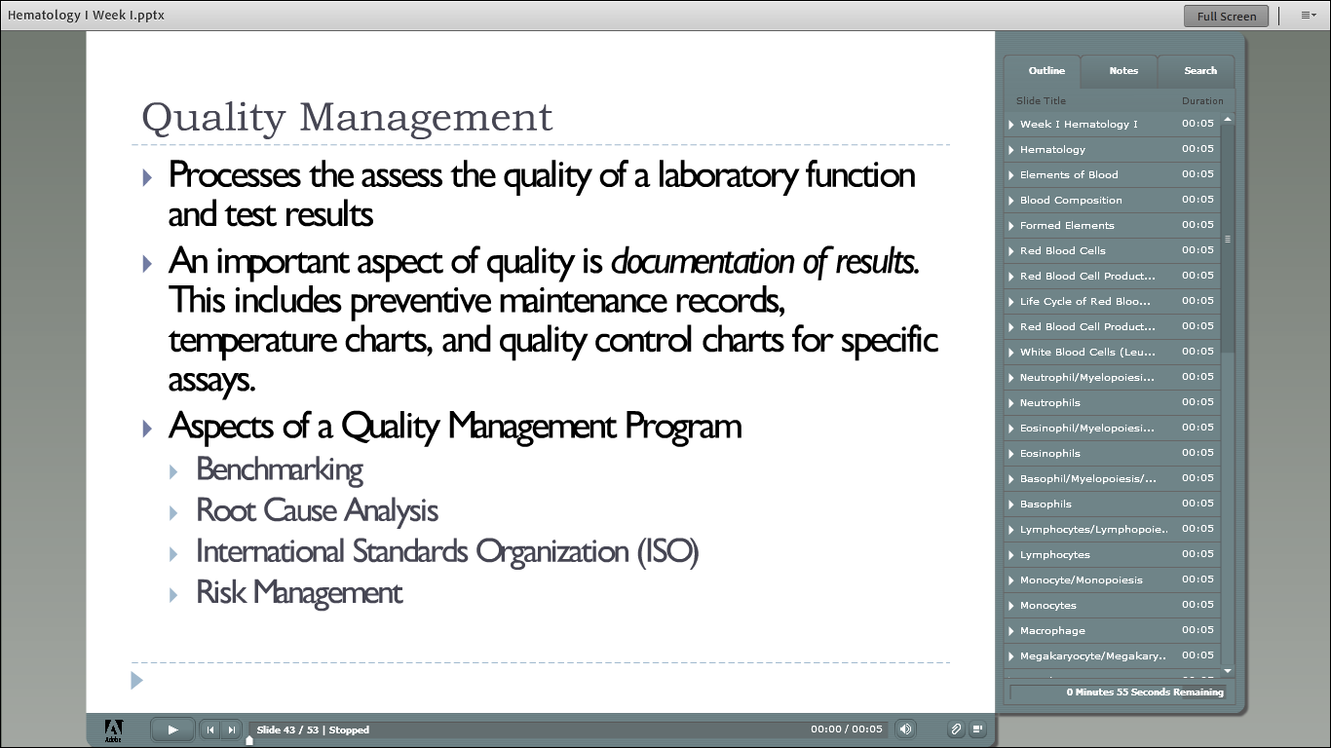

Slide 47
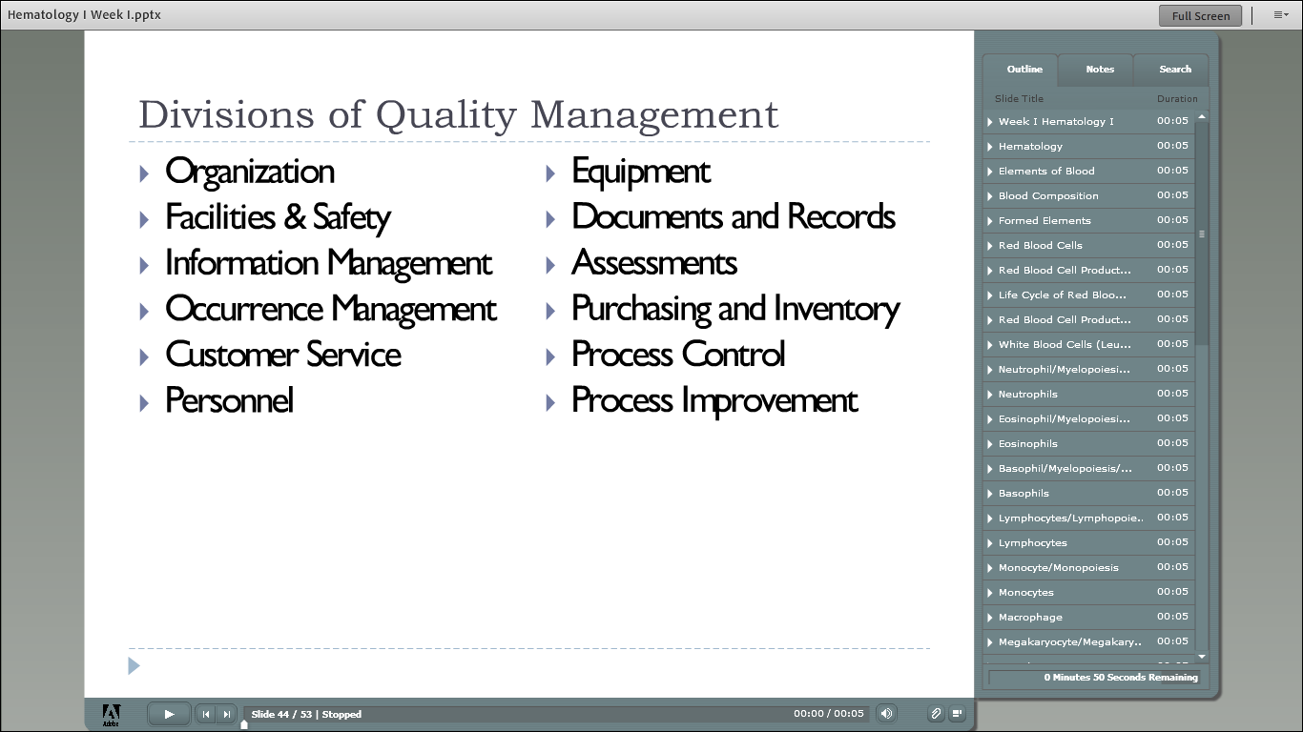

Slide 48
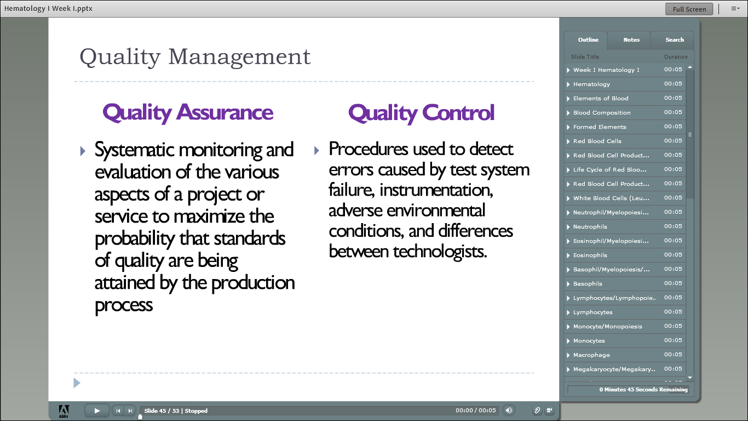

Slide 49
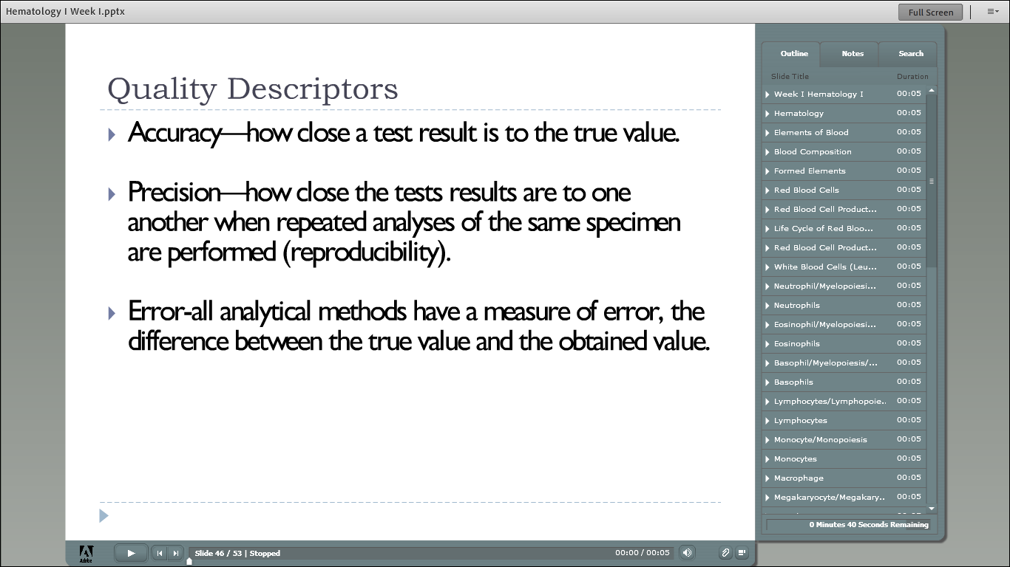

Slide 50
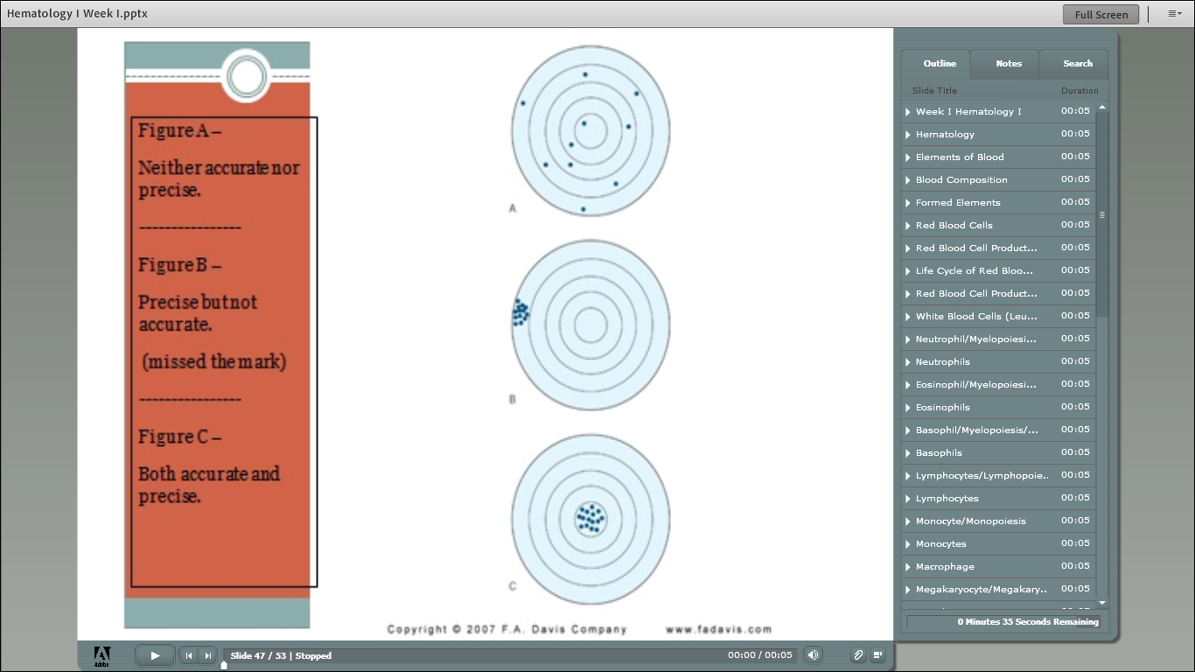

Slide 51
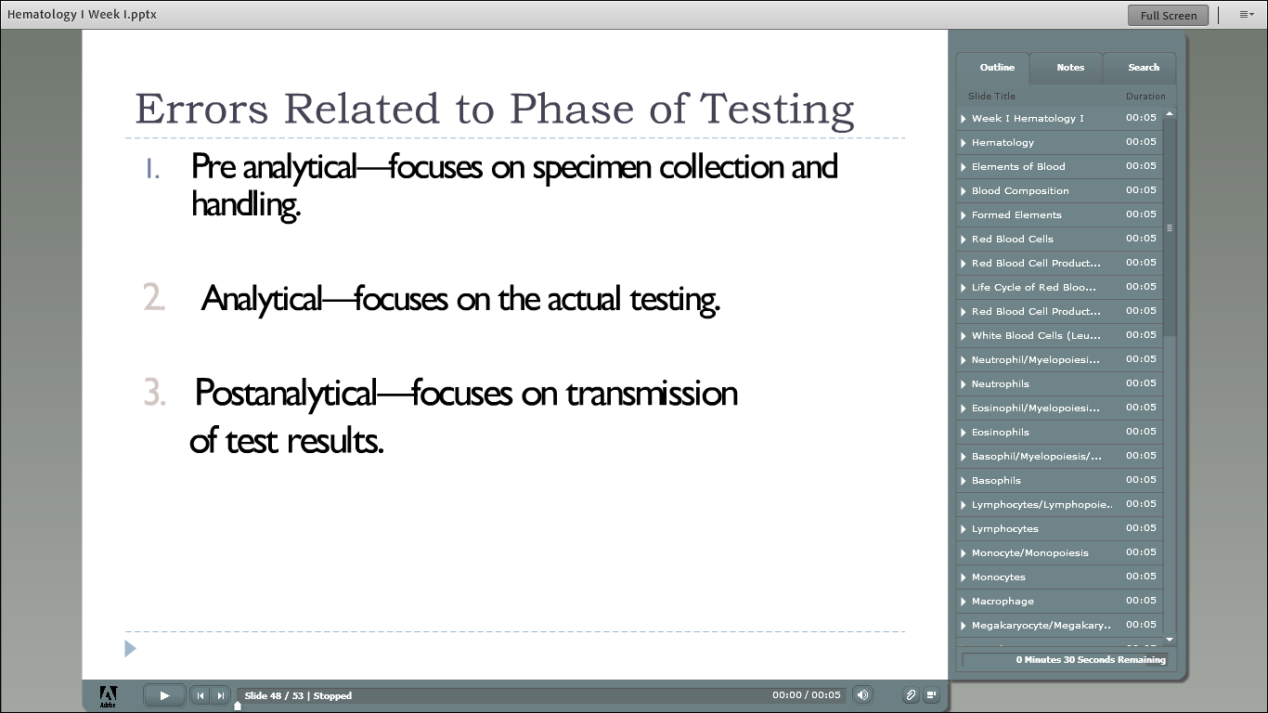

Slide 52
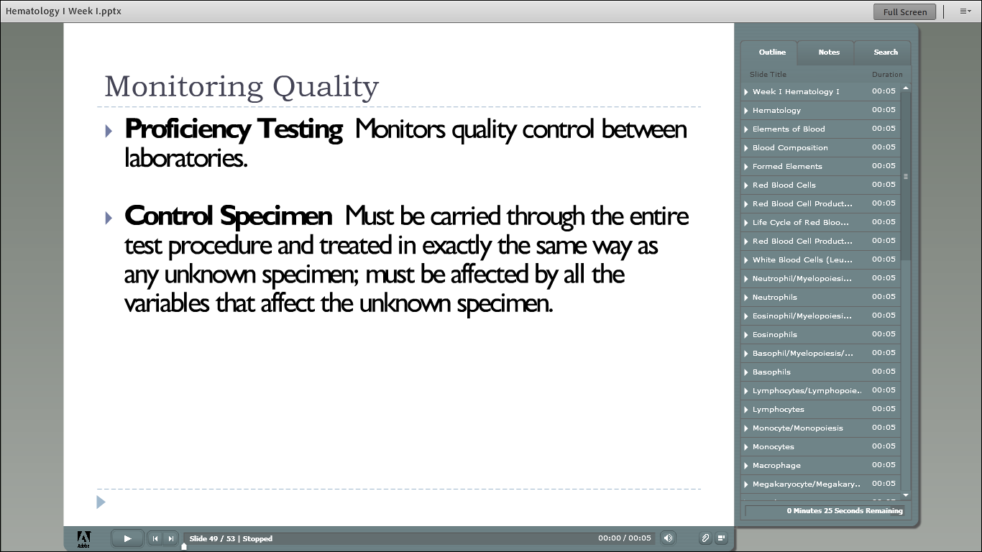

Slide 53
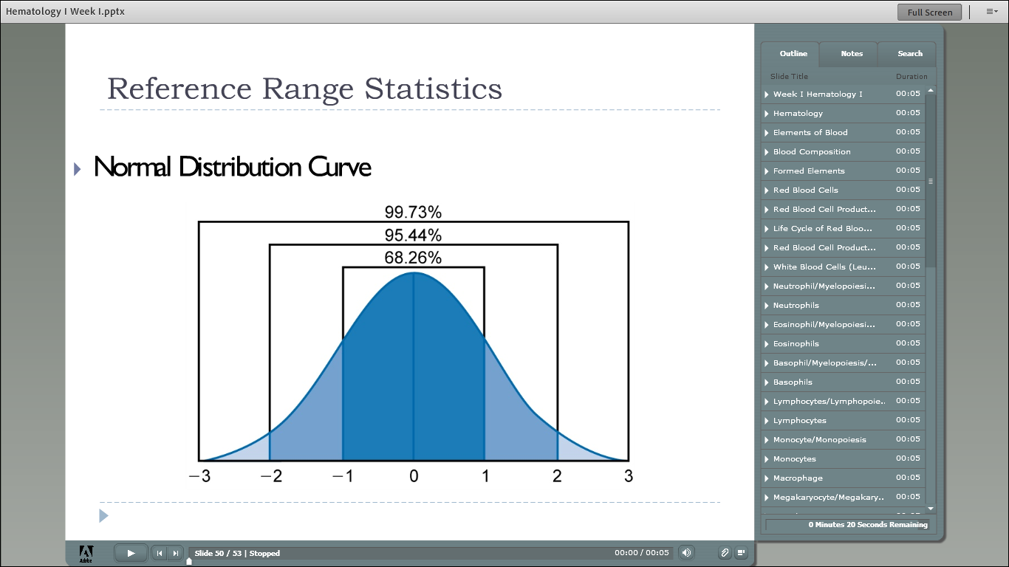

Slide 54
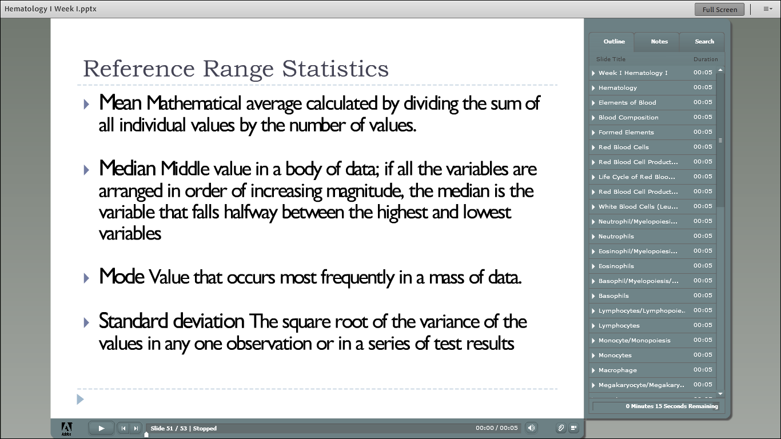

Slide 55
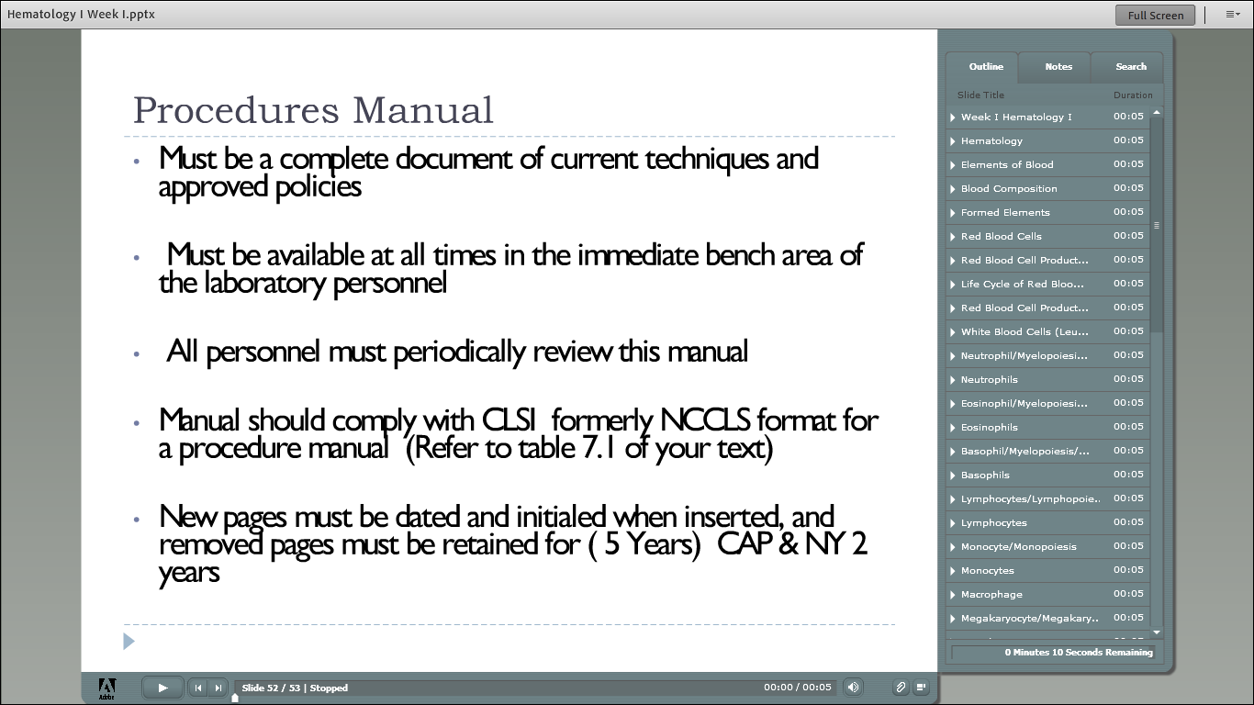

Slide 56
QUIZ BOWL!!!

Slide 57
Wht percent of the bood volume represents the formed elements?
55%
50%
60%
45%

Slide 58
Wht percent of the bood volume represents the formed elements?
55%
50%
60%
45%

Slide 59
Which of the following is a plasma protein?
Fibrinogen
Globulin
Albumin
All of the above

Slide 60
Which of the following is a plasma protein?
Fibrinogen
Globulin
Albumin
All of the above

Slide 61
What is the average blood volume?
5-6 L
4-6 L
6-7 L
3-5 L

Slide 62
What is the average blood volume?
5-6 L
4-6 L
6-7 L
3-5 L

Slide 63
Which cell is the second most numerous cell in the blood?
Monocyte
Lymphocyte
Null Cell
Plasmacyte
Erythrocyte

Slide 64
Which cell is the second most numerous cell in the blood?
Monocyte
Lymphocyte
Null Cell
Plasmacyte
Erythrocyte

Slide 65
What is the proper sequence for the monocyte-macrophage phagocytic system?
Monoblast, macrophage, promonocyte, monocyte
Monoblast, monocyte, promonocyte, macrophage
Monoblast, promonocyte, monocyte, macrophage
Monoblast, promonocyte, macrophate, monocyte

Slide 66
What is the proper sequence for the monocyte-macrophage phagocytic system?
Monoblast, macrophage, promonocyte, monocyte
Monoblast, monocyte, promonocyte, macrophage
Monoblast, promonocyte, monocyte, macrophage
Monoblast, promonocyte, macrophate, monocyte

Slide 67
Which WBC is small & round, with intensely blue cytoplasm, and nucleus with clumped dark purple chromatin?
Monocyte
Basophil
Eosinophil
Lymphocyte

Slide 68
Which WBC is small & round, with intensely blue cytoplasm, and nucleus with clumped dark purple chromatin?
Monocyte
Basophil
Eosinophil
Lymphocyte

Slide 69
Which granulocyte has large violet blue or purple-black granules?
Eosinophil
Basophil
Neutrophil
Monocyte

Slide 70
Which granulocyte has large violet blue or purple-black granules?
Eosinophil
Basophil
Neutrophil
Monocyte

