Slide 1
Welcome to Clinical Immunohematology!
Dr. Christina A Nevel-McGarvey

Slide 2
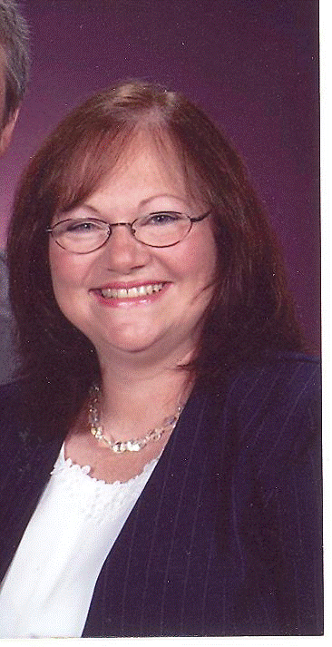
Meet and greet!

Slide 3
Course Expectations
Weekly Lessons-Independent Study Online
Textbook Reading
Narrated Powerpoint Presentations
Weekly Assignments
Discussions
Quiz
Seminars
(Midterm & Final)
Scientific Writing/References

Slide 4
How will I tackle this???
What should you do first to get ready for this session?
Obtain and organize a notebook for yourself! Be sure to take notes on class materials and journal your challenges as well as the things that you find easy to accomplish! Be sure to compile this information to help you study for your midterm, final, and boards!
Obtain notecards and a zip pocket for your notebook! Organizing your course material on flashcards is a great organizational tool as well as a way to solidify information as you flip through the material repeatedly. Color coding or flagging them can be done in many ways to help you throughout the course and for your boards.
Get started on your work early in the week

Slide 5
What should you do every time you enter the classroom?
Check classroom announcements!
Check your messages!
Check to see if anyone has responded to your discussion post and reply to them!

Slide 6
How should you attack your coursework every week?
First, attack your reading assignment listed in lesson area of classroom! (Week One=Chapters 15 & 16 )
Go to the lessons area of the classroom to view any available Power-Point presentations created to support your reading material.
Post to your discussion early in the week! (Week One= Introductions + Main Discussion)
2 topics per week
Both topics may be addressed in the same main post each week
150-300 words per topic for the main post
One Credible reference to support your work
Minimum of 2 substantive comments to classmates per topic per week
No late posts will be accepted for any reason
Benchmark quiz can be accessed from the lesson area as well as the quiz/test area
One submission
All work is due by 11:59pm ET Sunday ending the unit week

Slide 7
PROFESSOR CONTACT
Primary Contact is via the Message area in the classroom. This is your class email system. Be sure to stay in close contact with any questions/problems.
Be sure to enter your email address into your personal profile so that messages from the classroom are forwarded to your email account.
VIRTUAL OFFICE HOURS
Mondays and Wednesdays 6-8 PM ET
and other times by arrangement.
http://nymahe.adobeconnect.com/virtualofficemeetingroomcng
If you need to meet at another time, we will try to arrange a mutually agreeable time. This may be difficult due to other responsibilities and schedules. Usually we can work through any problems in writing via email.

Slide 8
Immunohematology Seminars
Fridays: 2PM Eastern (1PM Central)
It is mandatory that you attend 5 out of 10 seminars live.
Seminars are held during weeks 1, 2, 3, 4, 5, 7, 8, 9, 10, & 11. Weeks 6 & 12 are exam weeks with no seminar.
If you know that your schedule will not permit you to attend seminar at the above times, you must email me explaining why you will not be able to attend seminar and you must carbon copy Lynn Jones (ljones@nymahe.org) and Lori Burkard (lburkard@nymahe.org). They will determine if each individual case qualifies for an exception for live attendance. If an exception is granted, then you will be notified to let you know how to procede to make up for the seminar attendance.

Slide 9
Questions? -Expectations -Course Content?

Slide 10
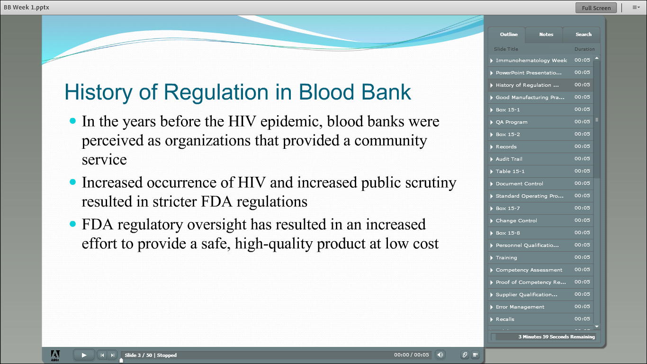

Slide 11
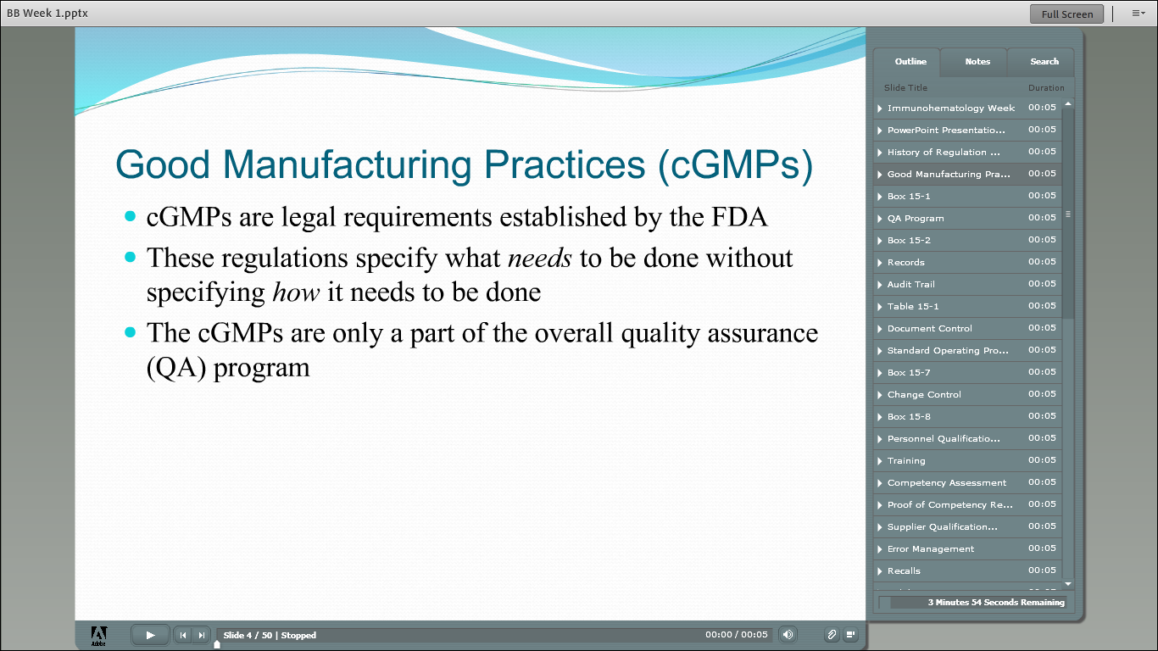

Slide 12
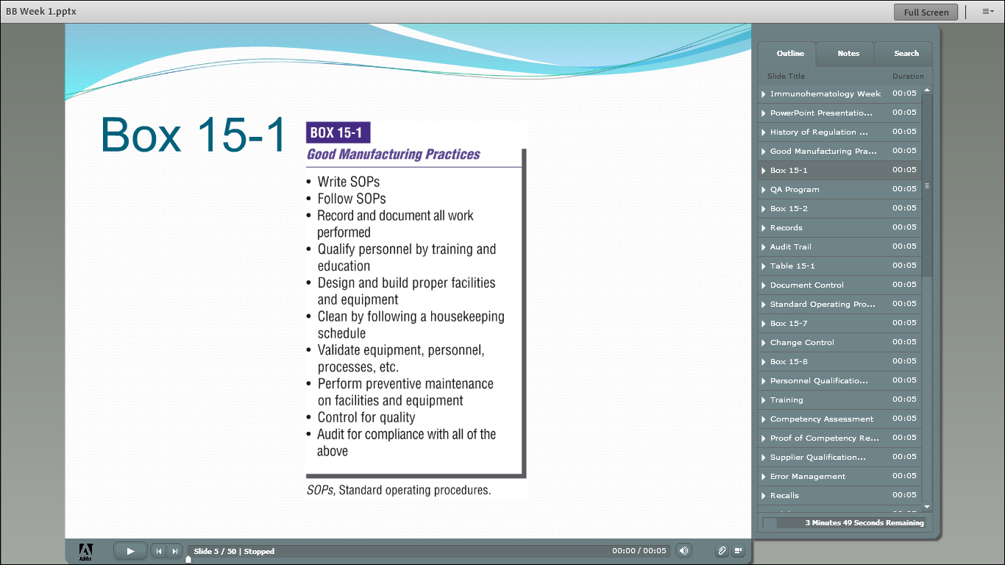

Slide 13
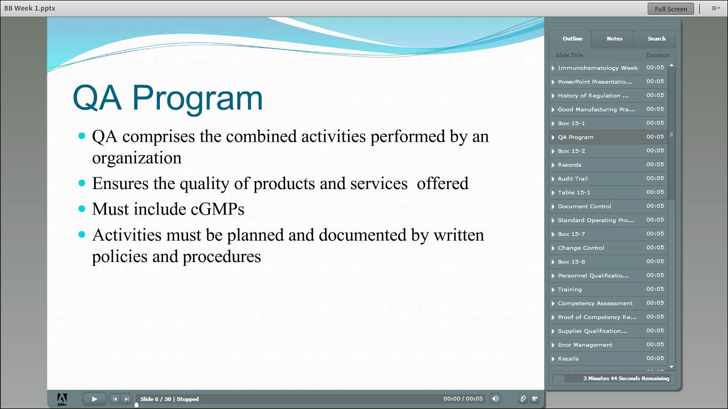

Slide 14
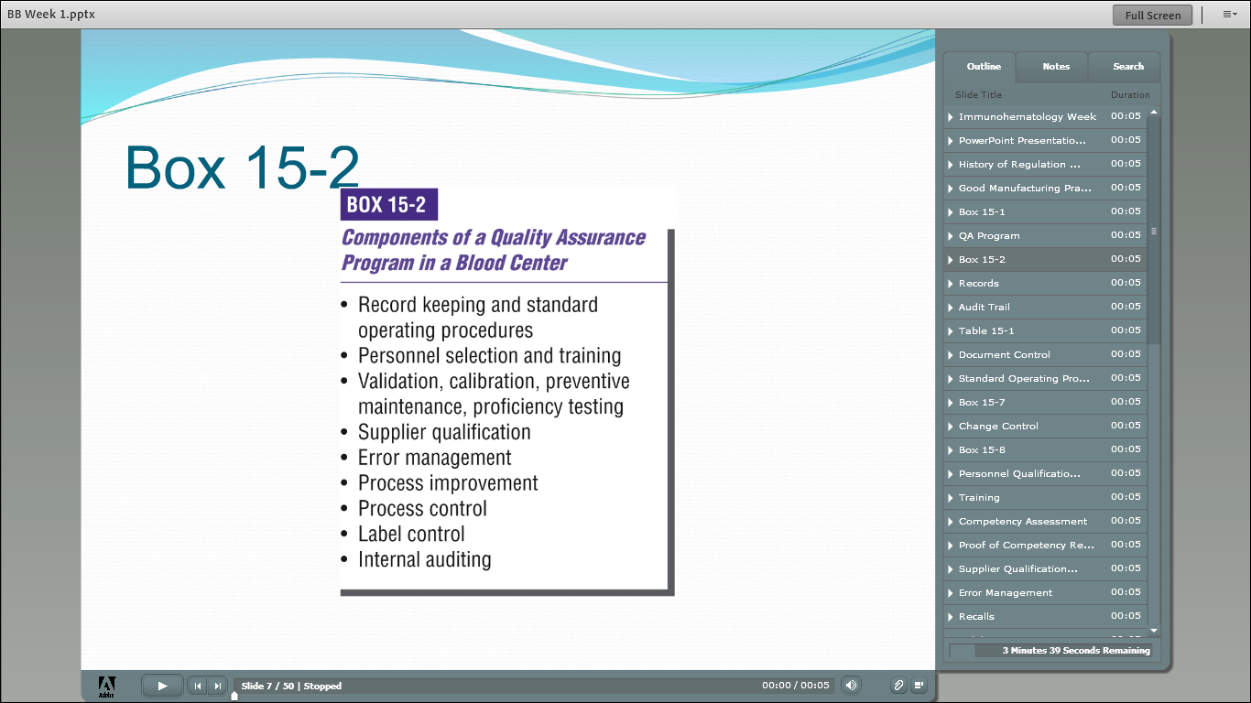

Slide 15
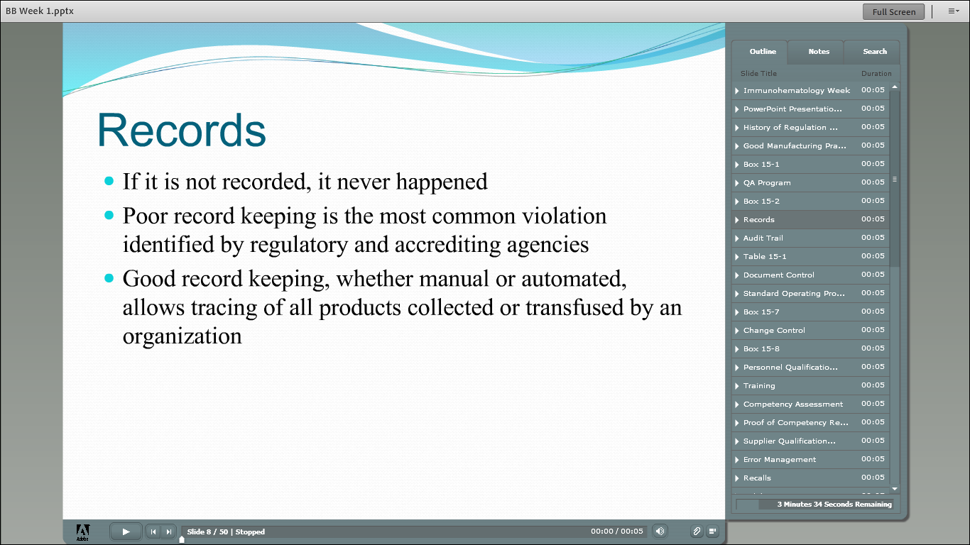

Slide 16
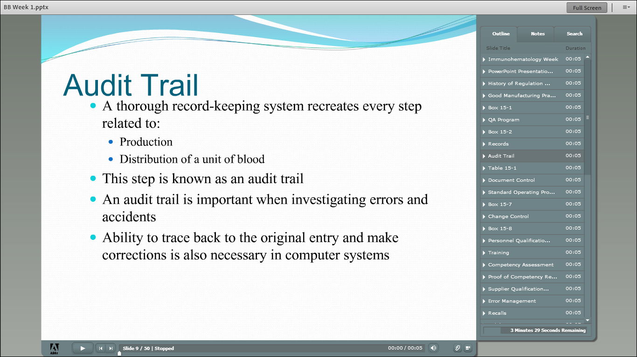

Slide 17
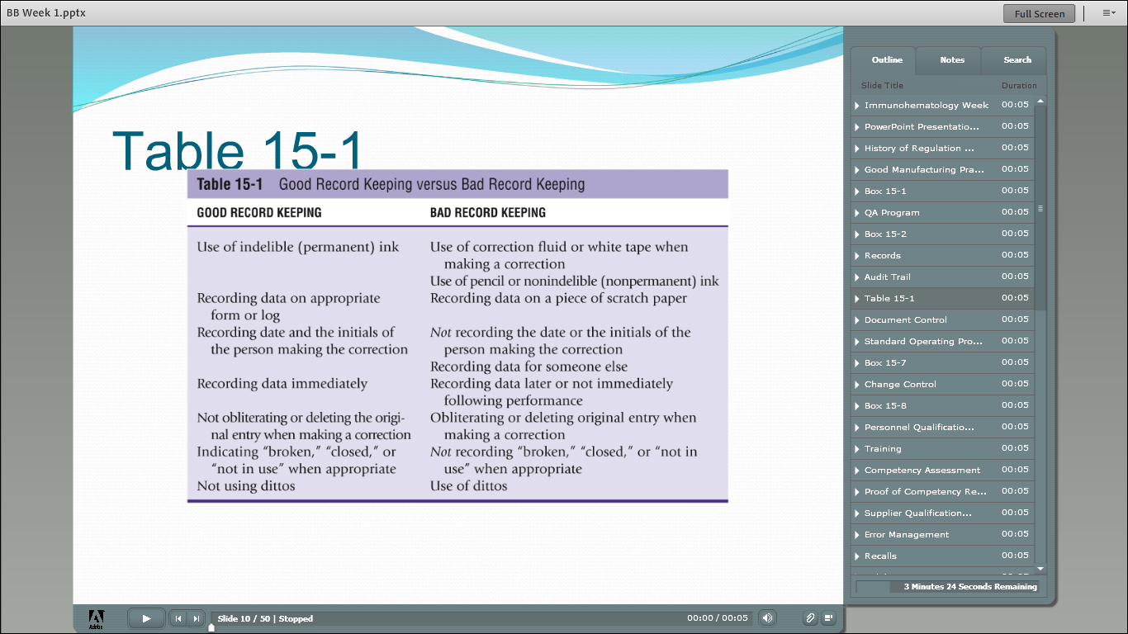

Slide 18
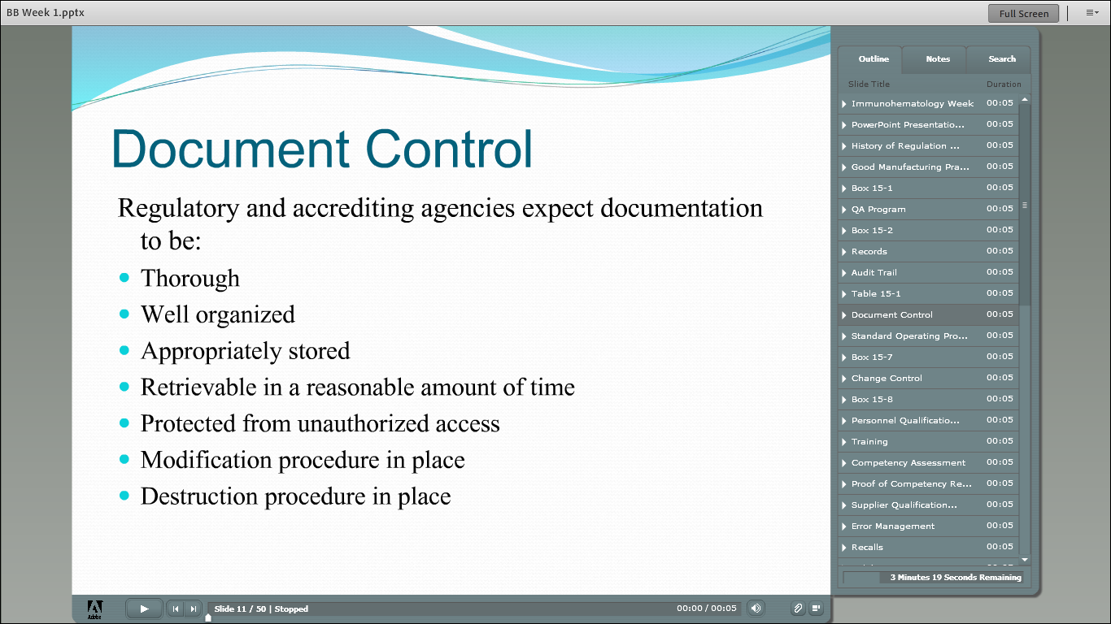

Slide 19
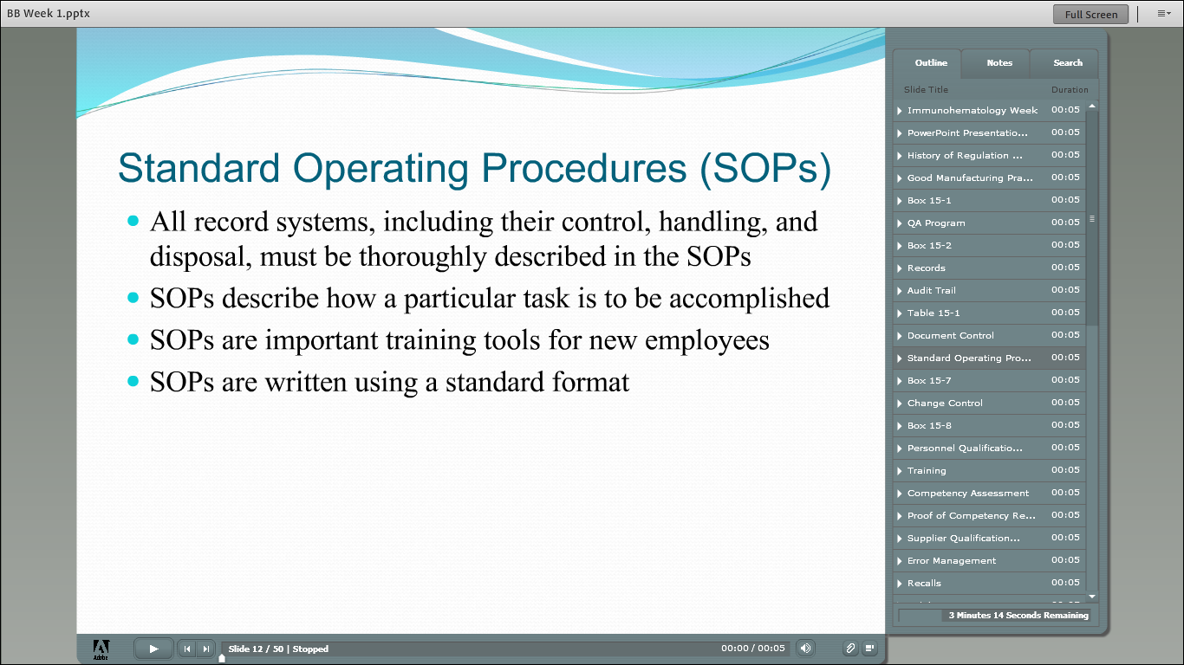

Slide 20
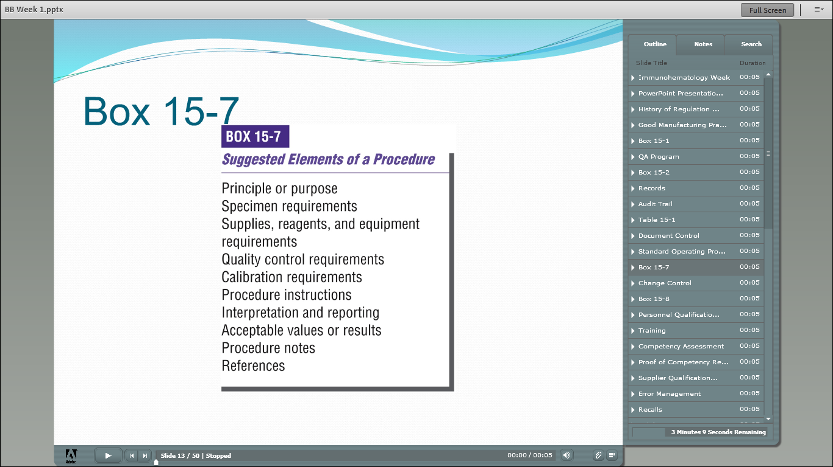

Slide 21
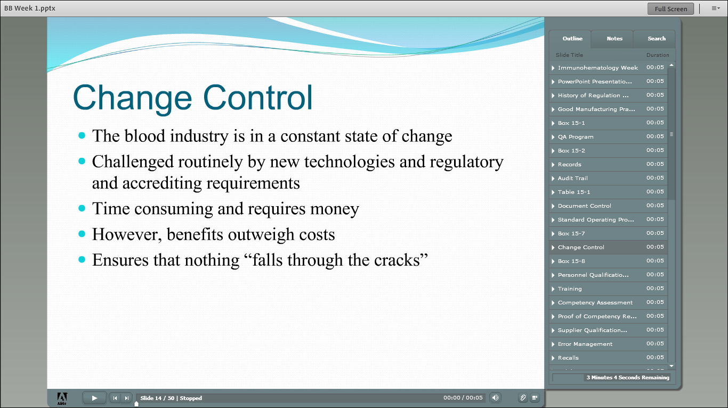

Slide 22
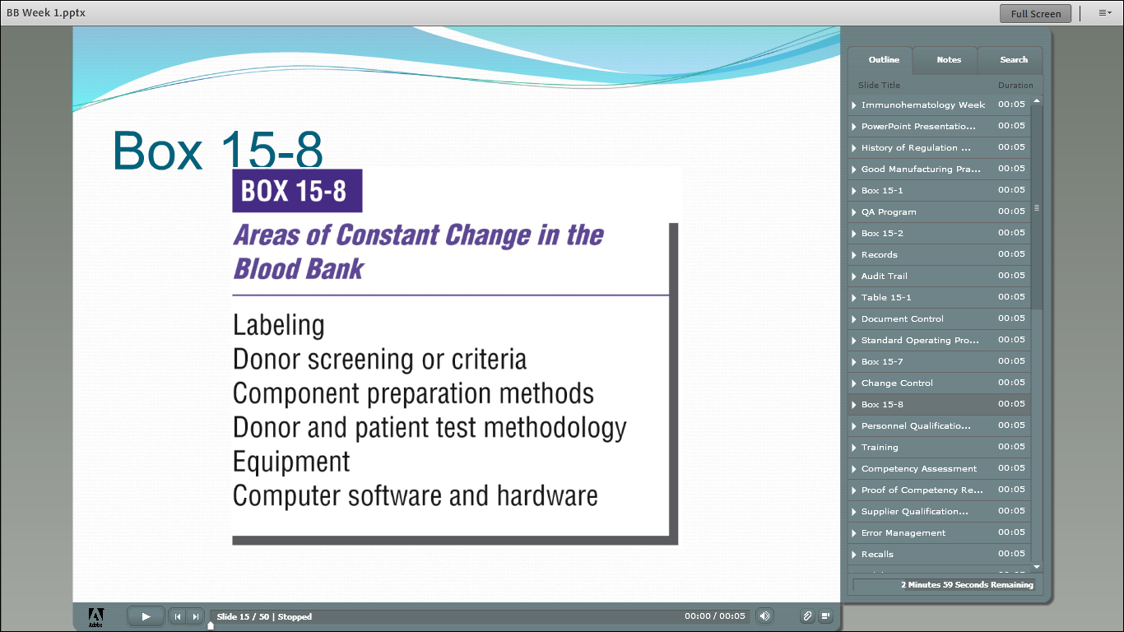

Slide 23
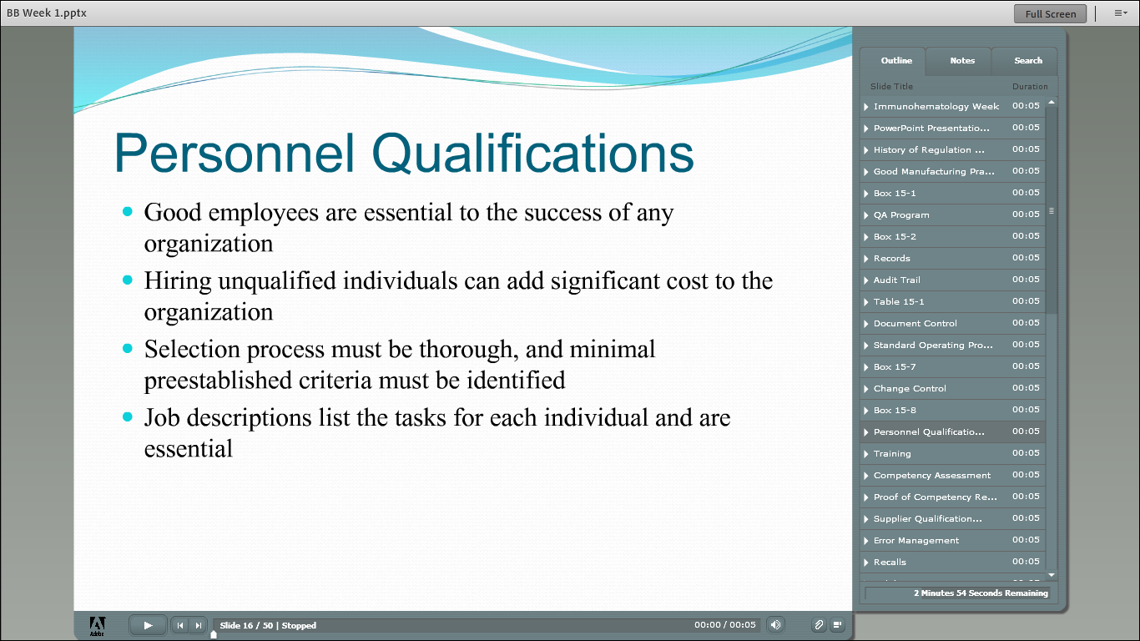

Slide 24


Slide 25
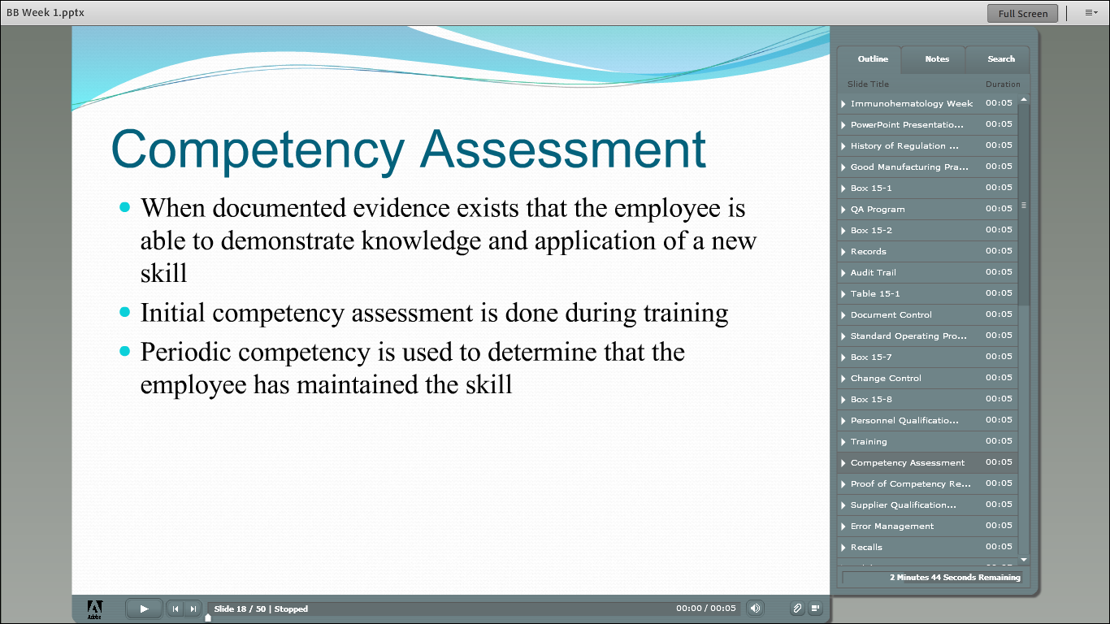

Slide 26
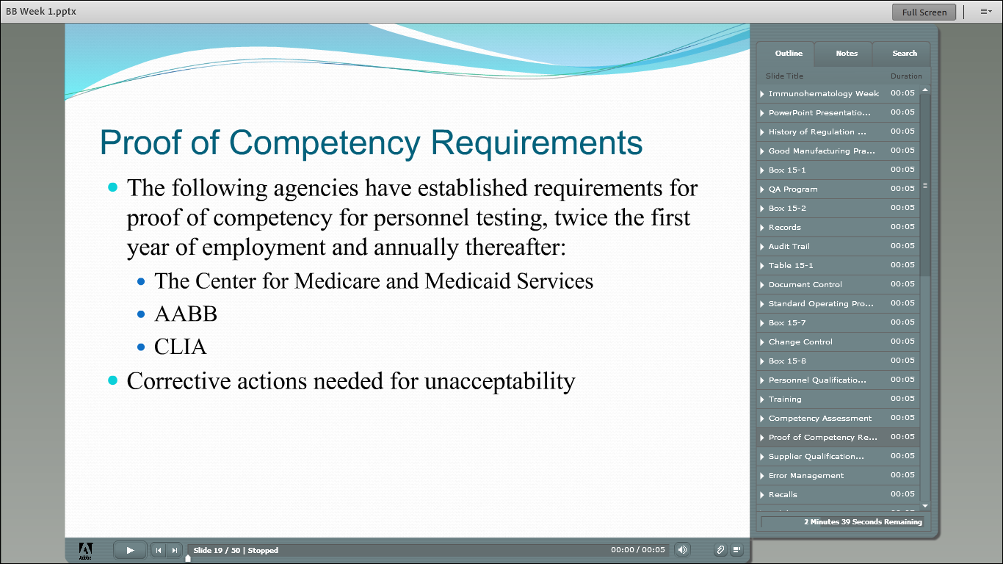

Slide 27
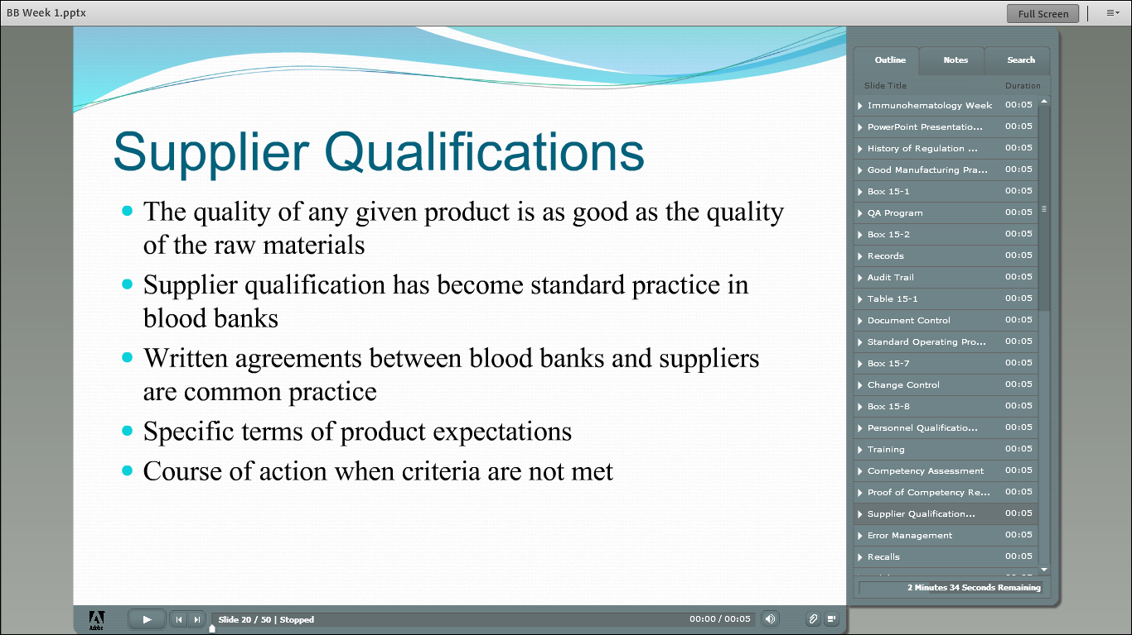

Slide 28
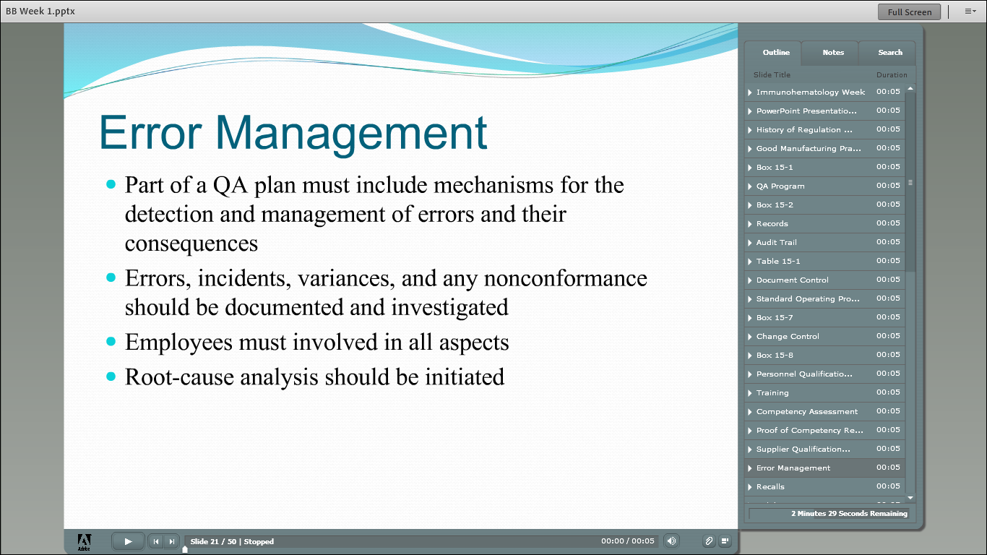

Slide 29


Slide 30
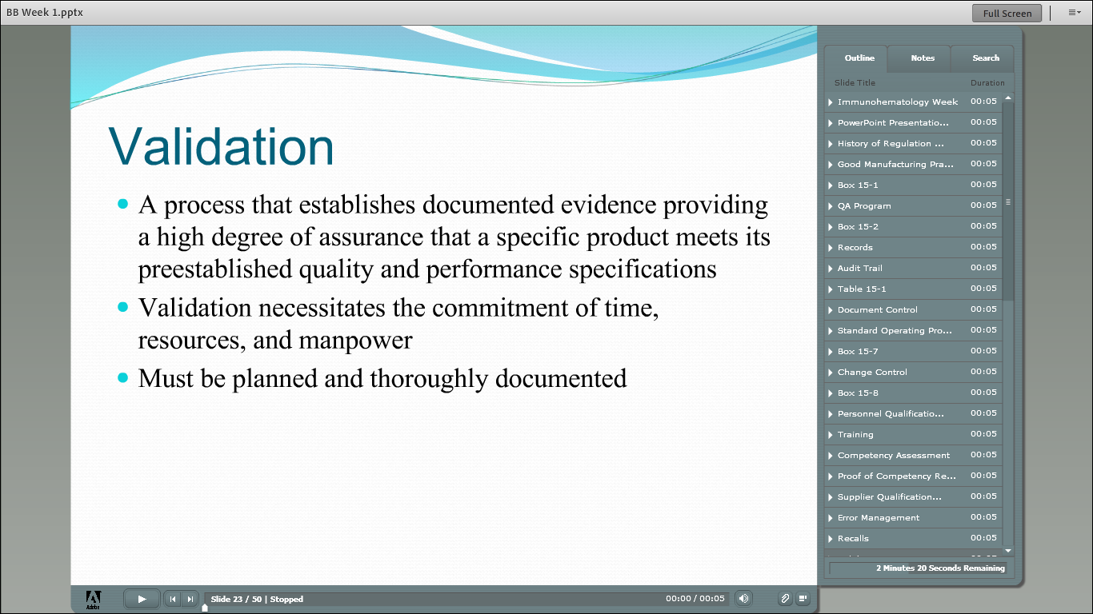

Slide 31
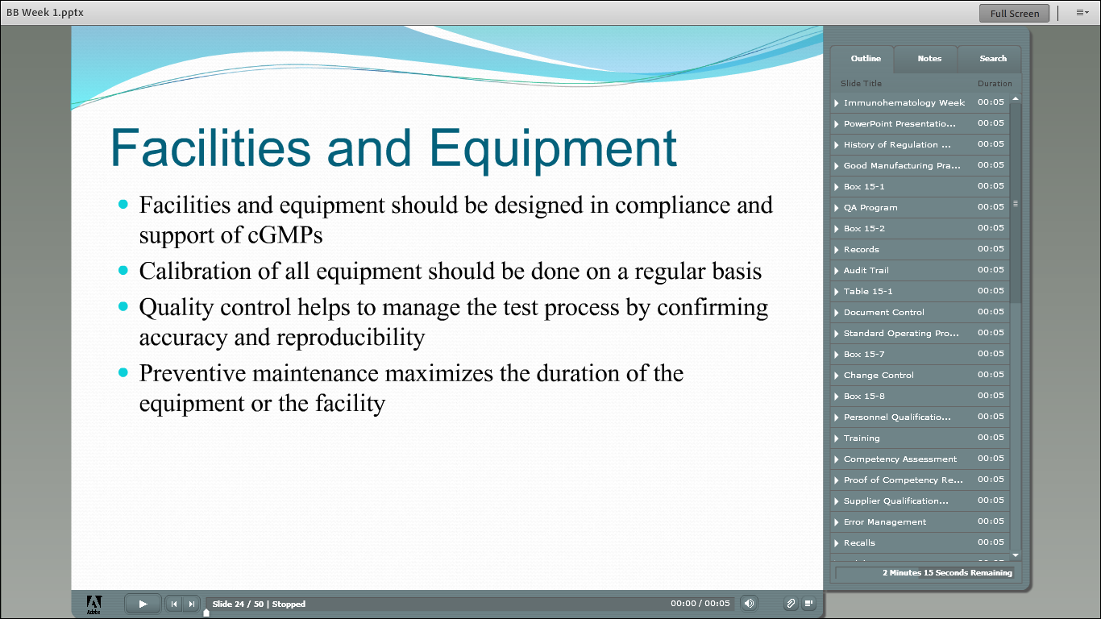

Slide 32
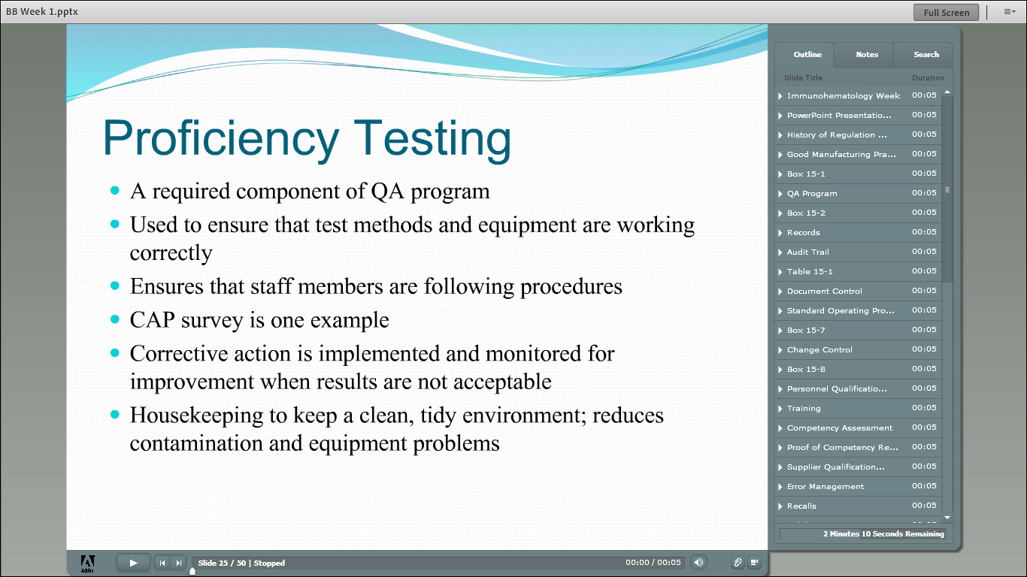

Slide 33
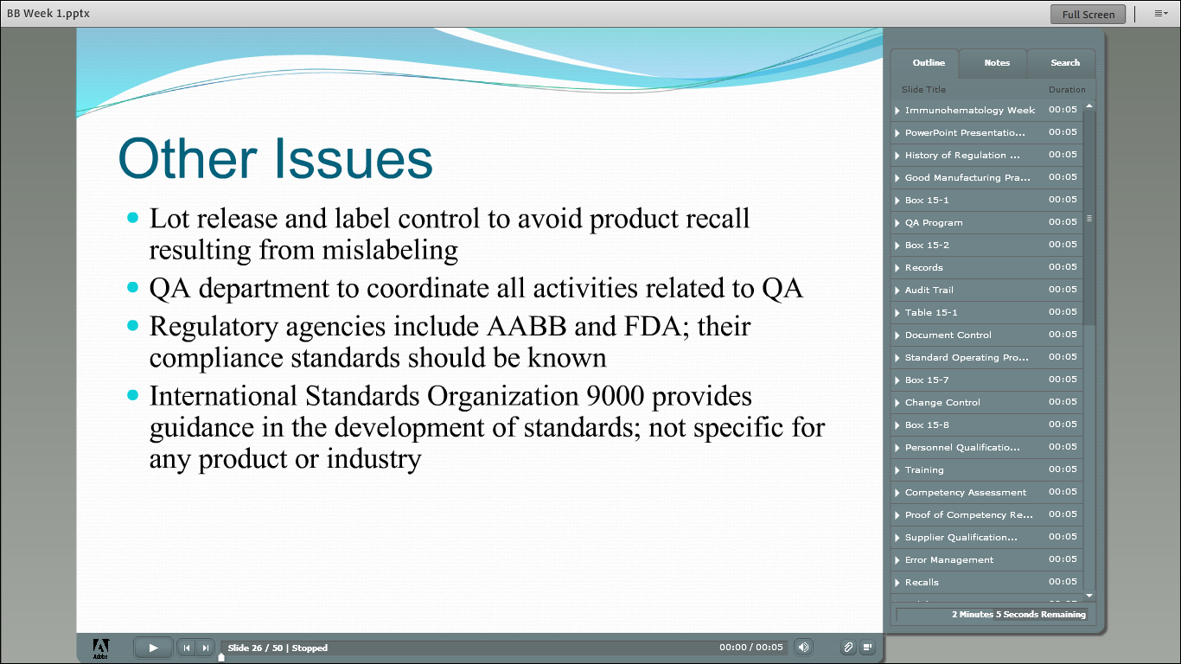

Slide 34
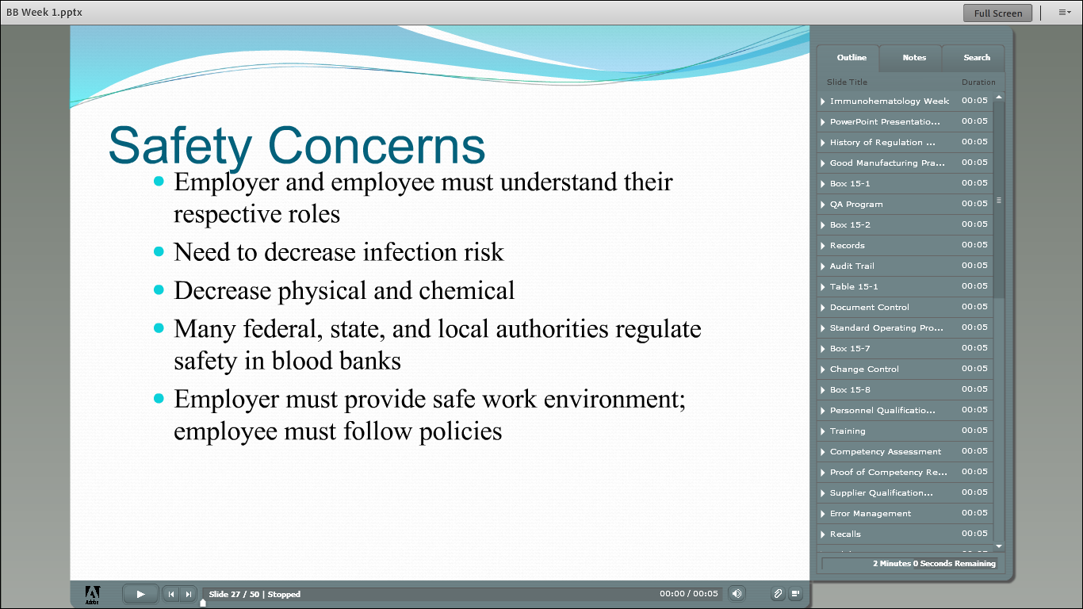

Slide 35
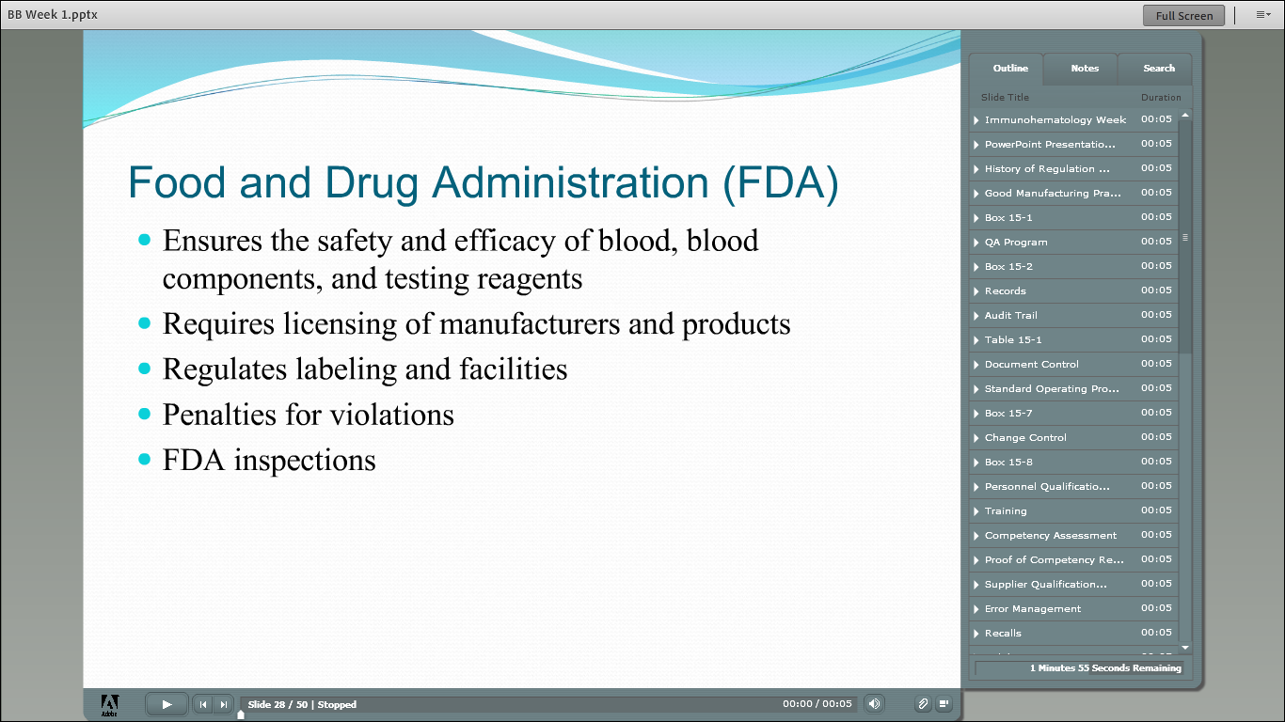

Slide 36
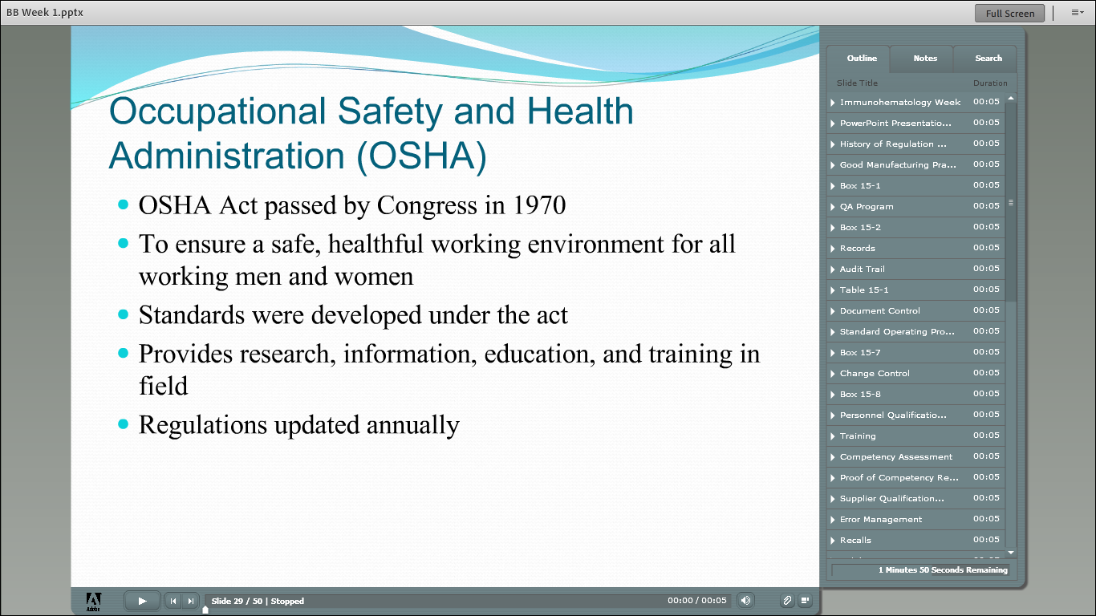

Slide 37
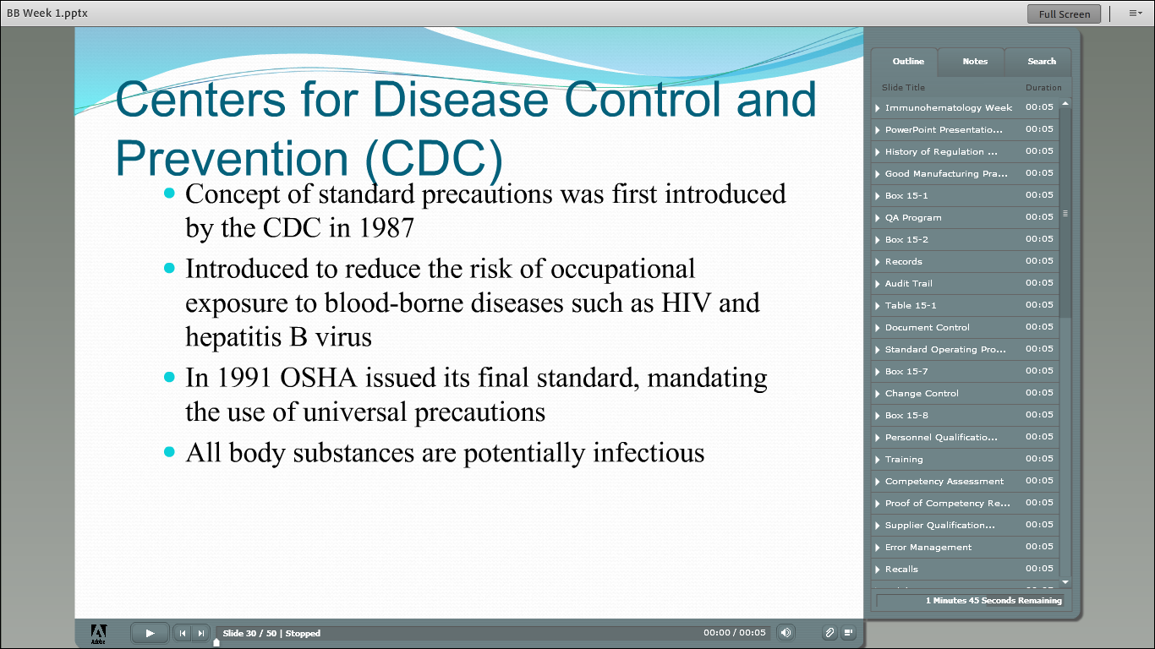

Slide 38
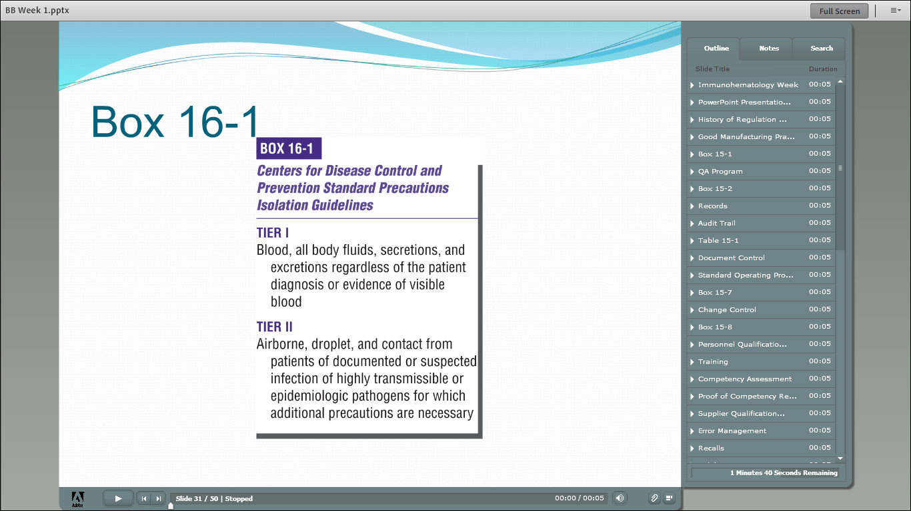

Slide 39
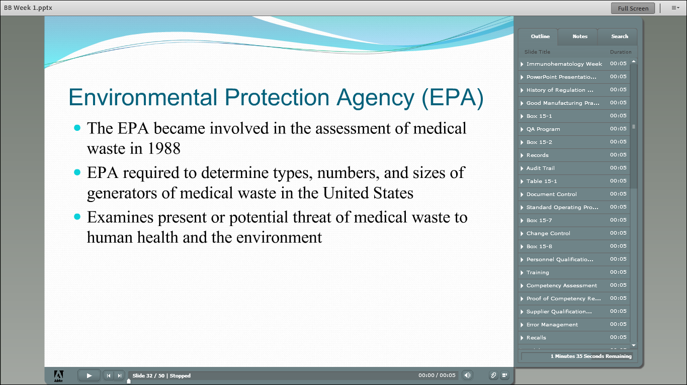

Slide 40
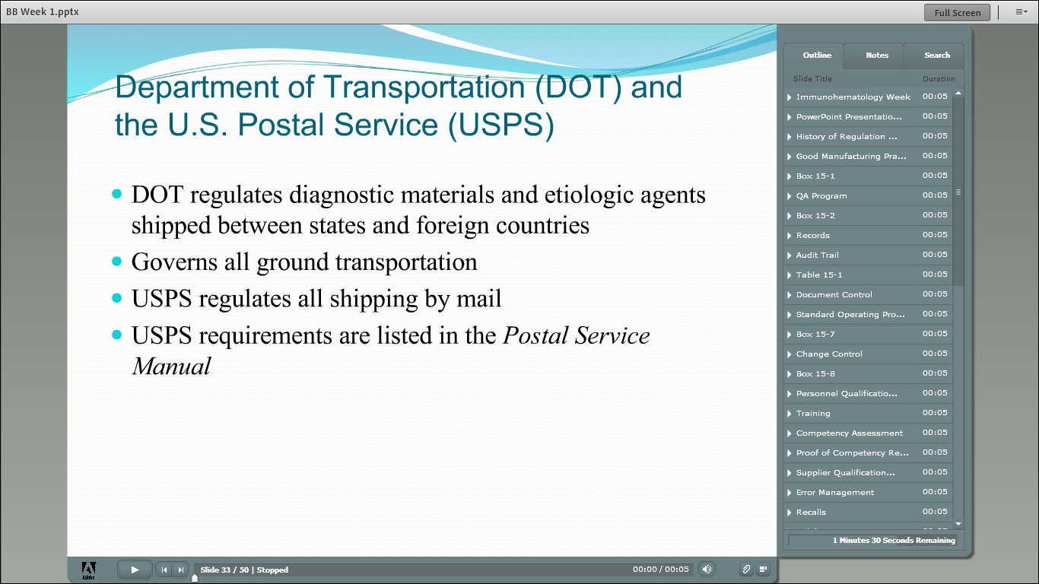

Slide 41
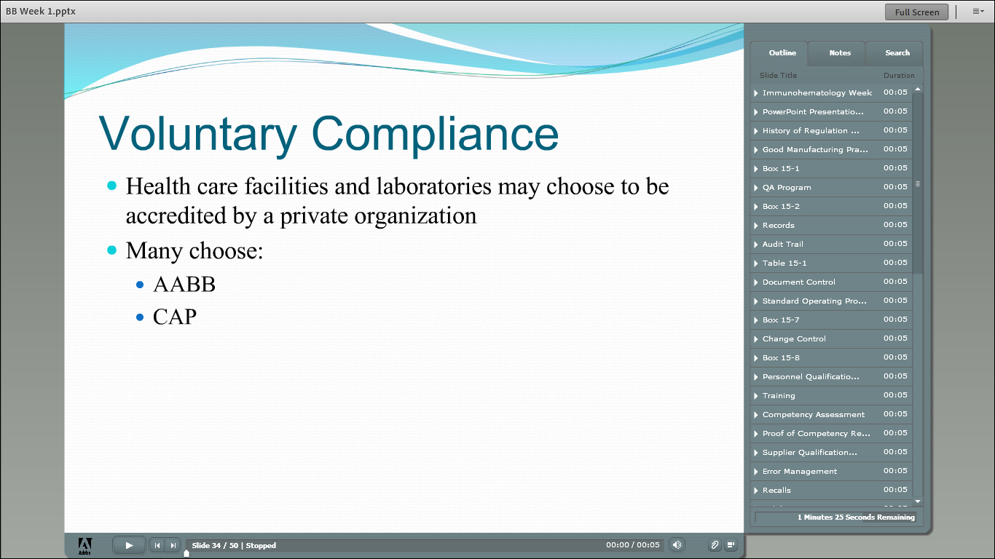

Slide 42
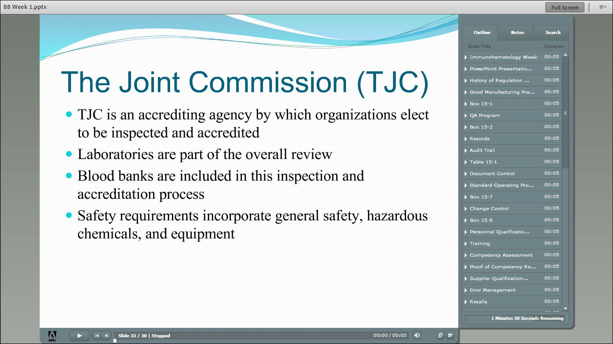

Slide 43
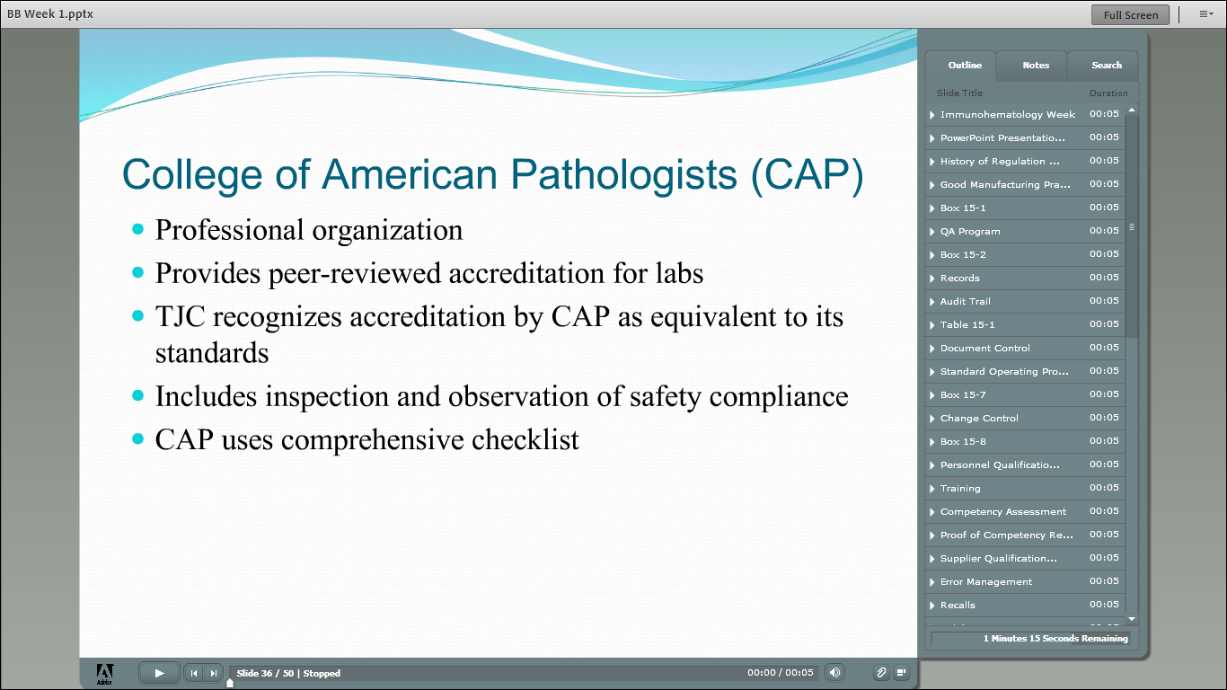

Slide 44
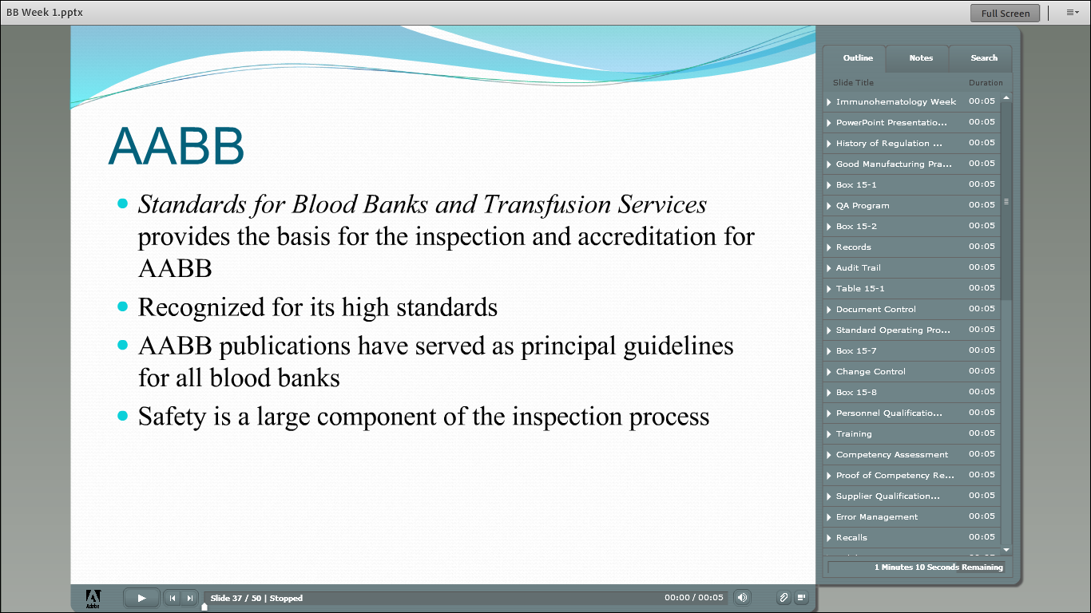

Slide 45
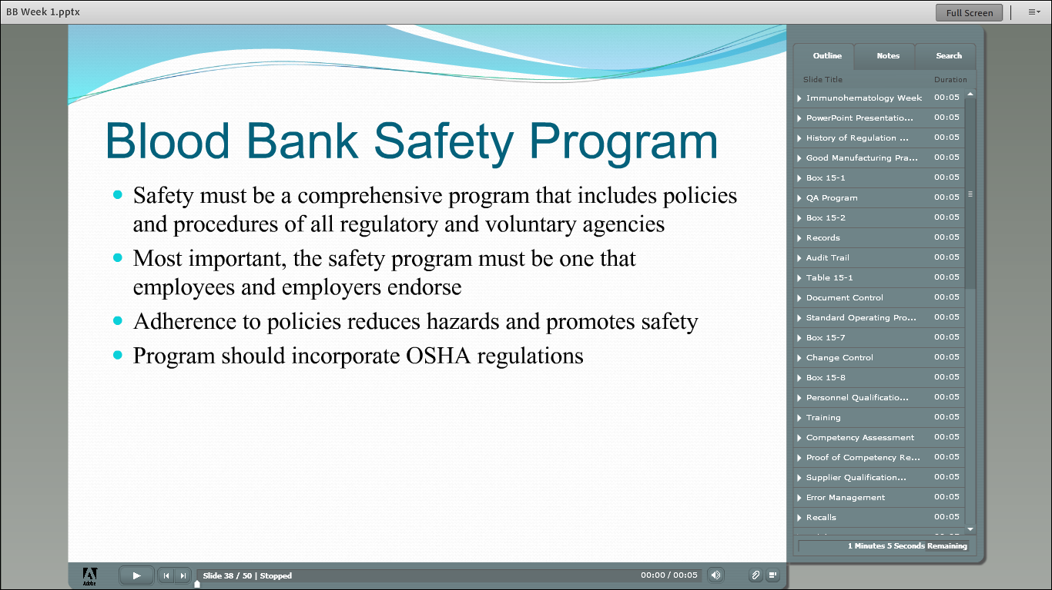

Slide 46
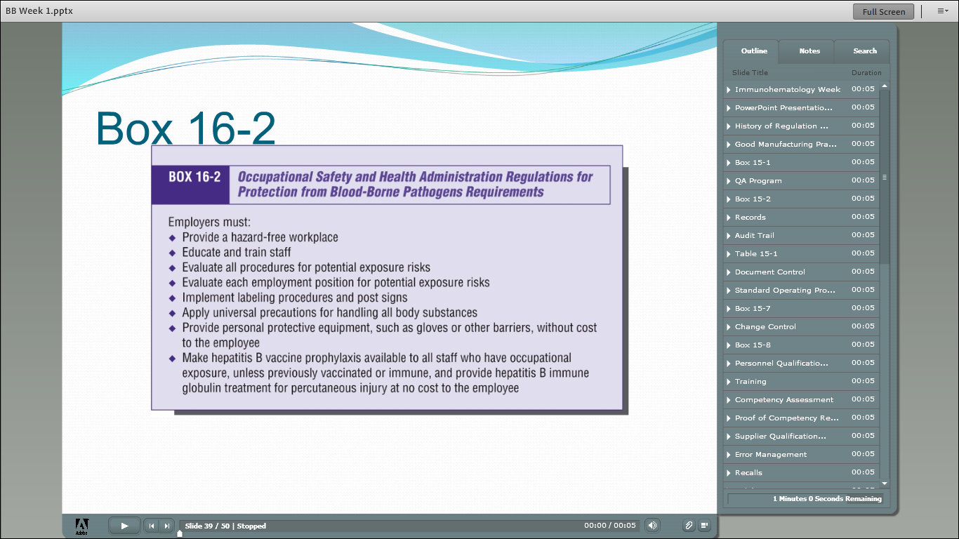

Slide 47
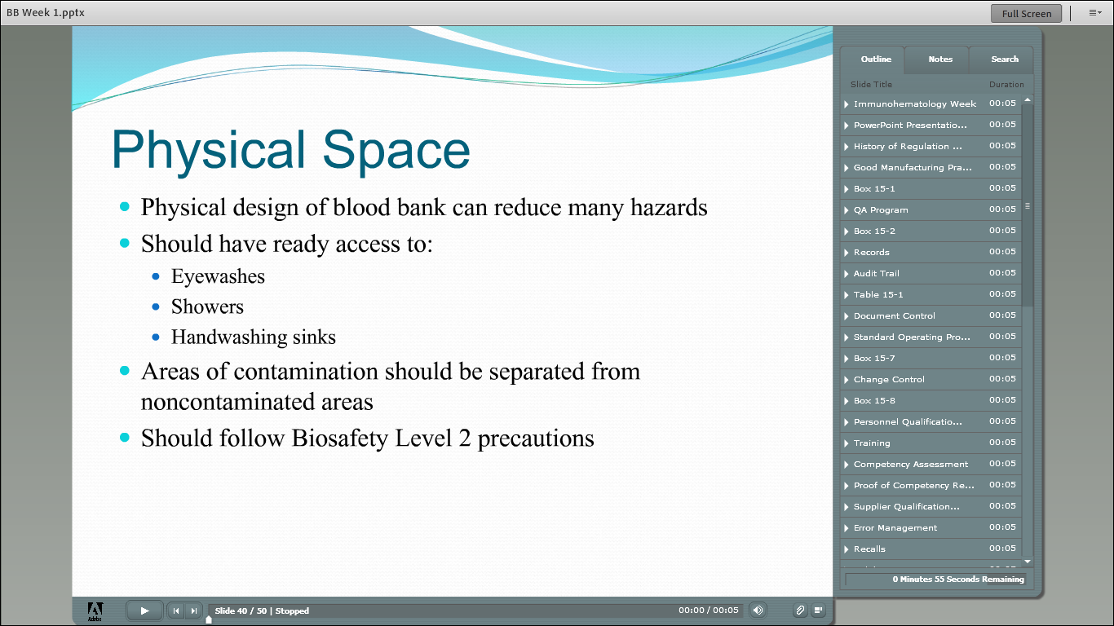

Slide 48
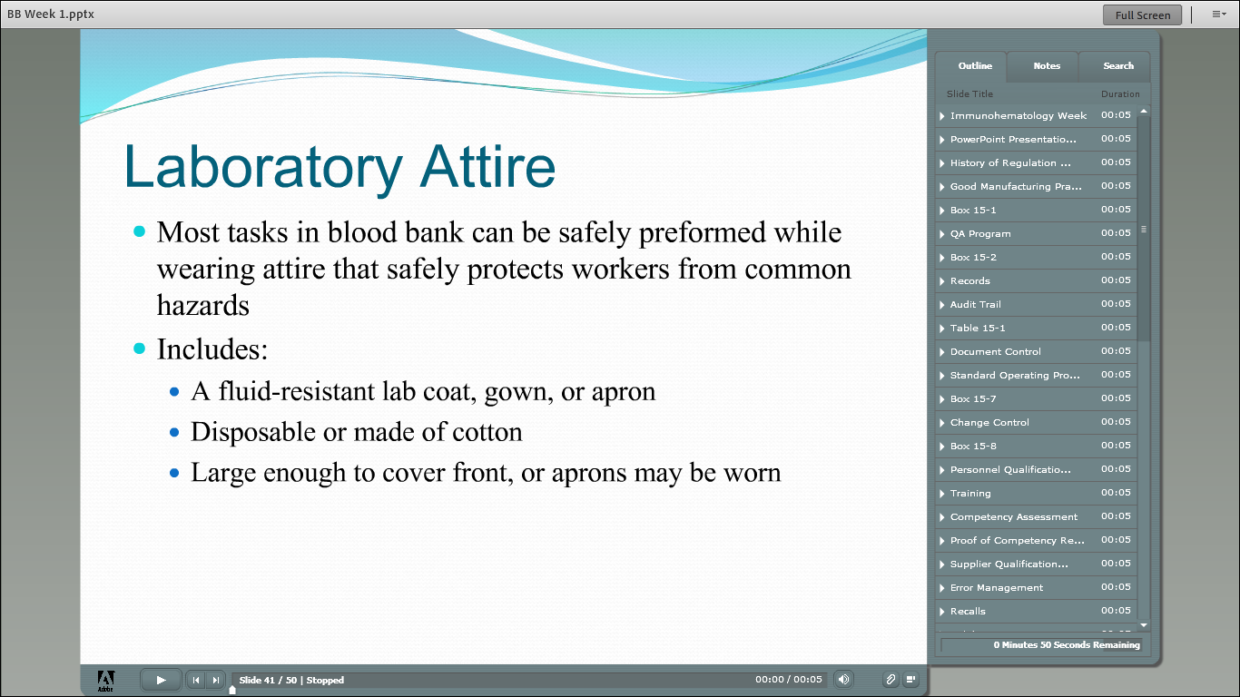

Slide 49
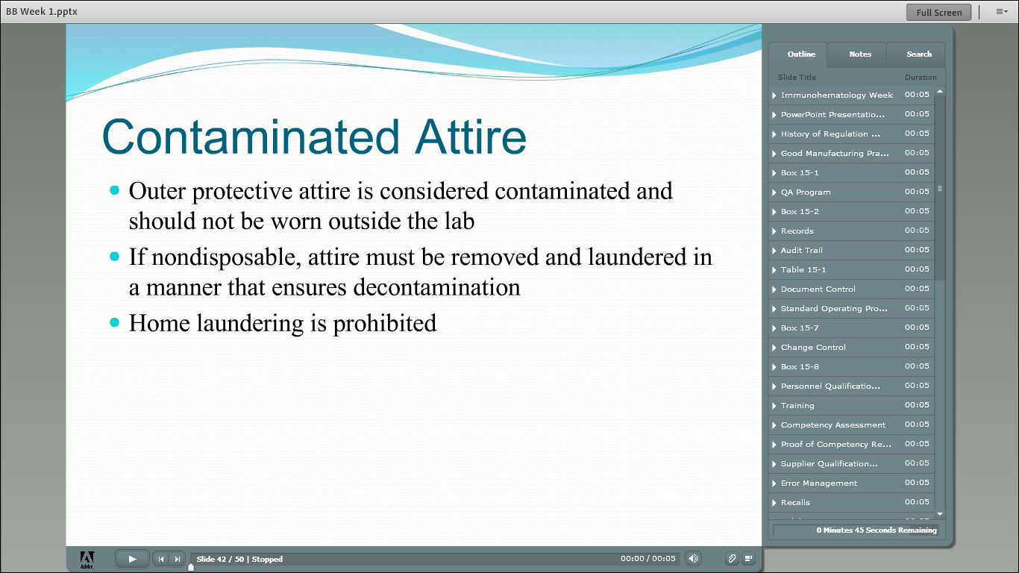

Slide 50
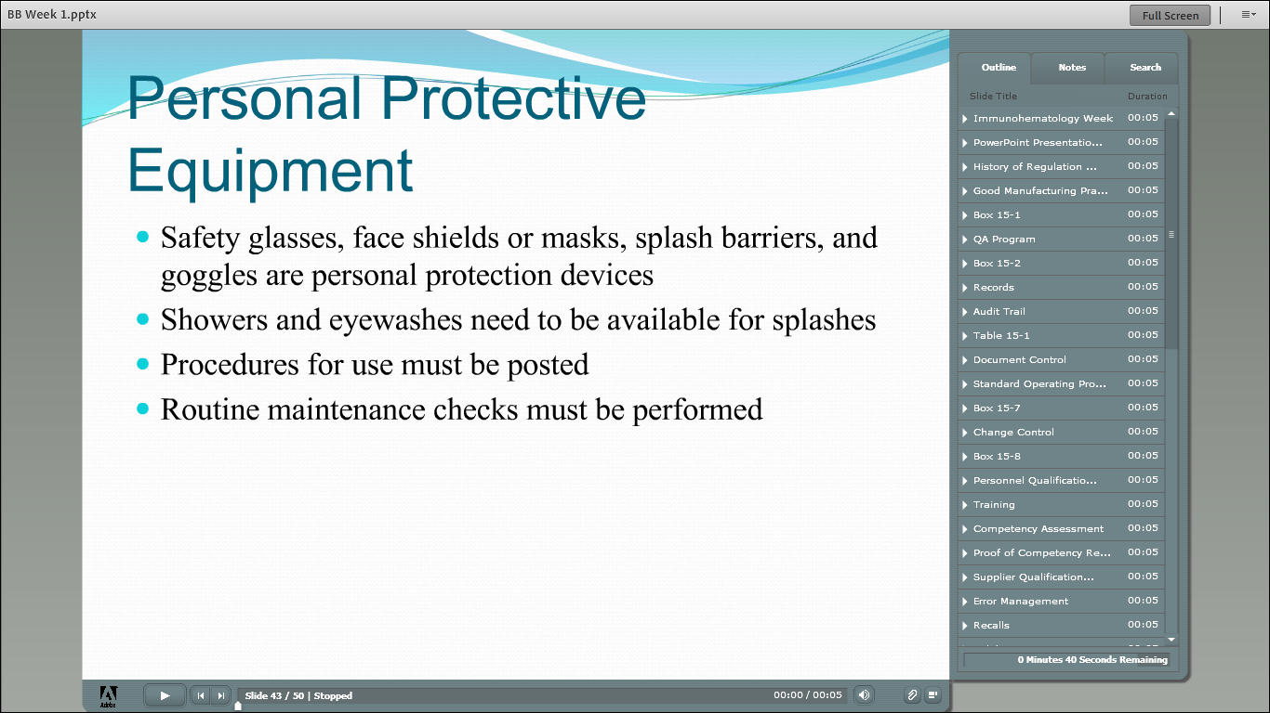

Slide 51
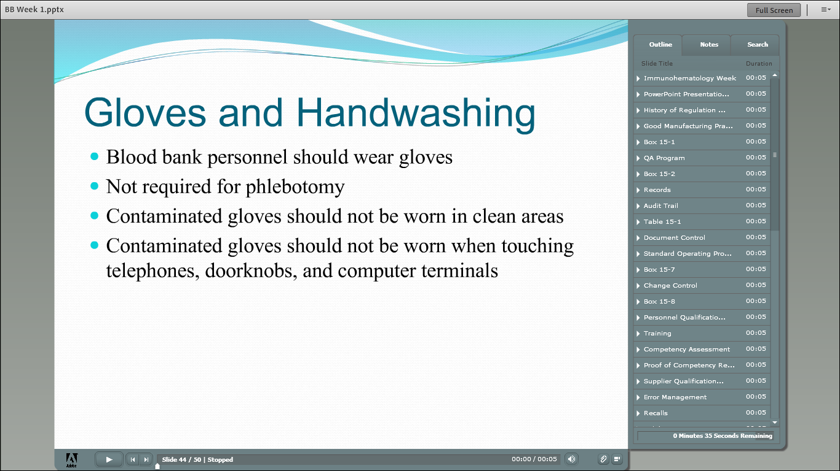

Slide 52
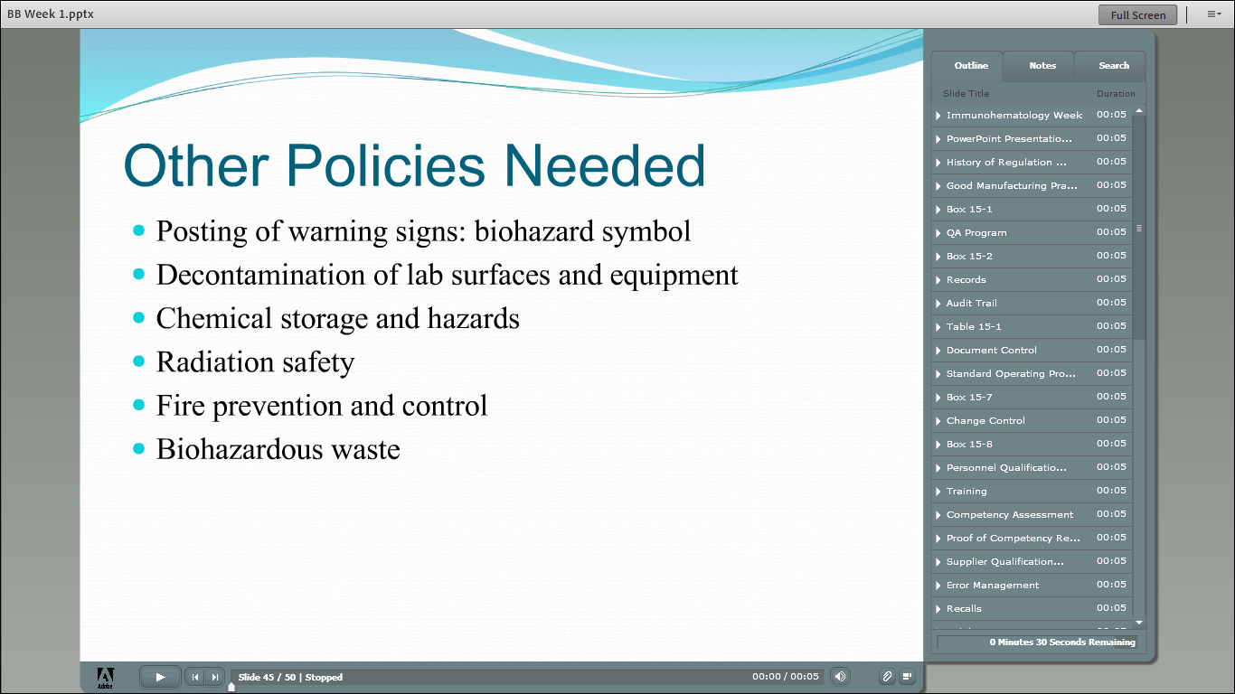

Slide 53
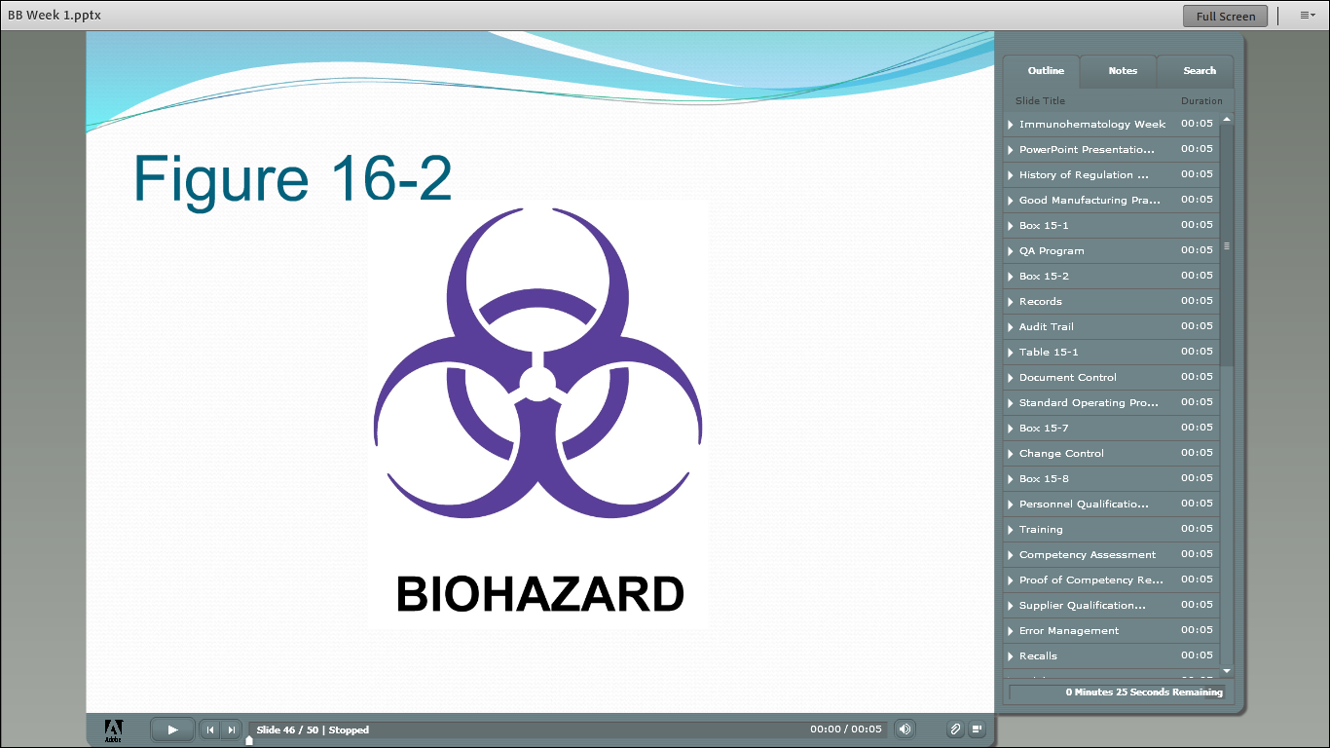

Slide 54


Slide 55


Slide 56
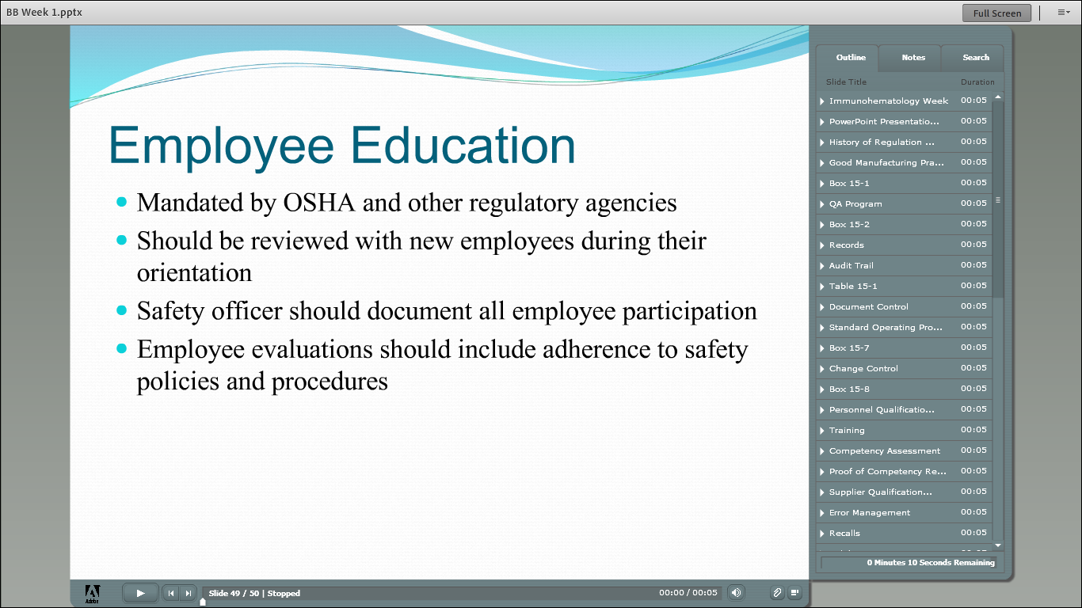

Slide 57
QUIZ BOWL!!!

Slide 58
Employees are the core of a laboratory, and therefore they:
Must be trained
Must report errors without fear of reprisal
Can deviate from SOP’s only after obtaining supervisor’ approval
Are a key part of problem solving
All of the above

Slide 59
Employees are the core of a laboratory, and therefore they:
Must be trained
Must report errors without fear of reprisal
Can deviate from SOP’s only after obtaining supervisor’ approval
Are a key part of problem solving
All of the above

Slide 60
cGMPs applicable to the blood industry can be found in the
AABB Standards
SOP Manual
FDA’s Code of Federal Regulations
QA Manual

Slide 61
cGMPs applicable to the blood industry can be found in the
AABB Standards
SOP Manual
FDA’s Code of Federal Regulations
QA Manual

Slide 62
Early identification of problems by evaluating the compliance with established SOP is the purpose of
Internal audits
Accident reports
Root-cause analysis
FDA inspection

Slide 63
Early identification of problems by evaluating the compliance with established SOP is the purpose of
Internal audits
Accident reports
Root-cause analysis
FDA inspection

Slide 64
All of the following are true regarding internal audits except they
Help identify problems early
Ensure continuous quality improvement efforts
Are used for the purpose of identifying “troublemakers”
Are one of the many responsibilities of the QA unit

Slide 65
All of the following are true regarding internal audits except they
Help identify problems early
Ensure continuous quality improvement efforts
Are used for the purpose of identifying “troublemakers”
Are one of the many responsibilities of the QA unit

Slide 66
What is the purpose of competency assessment?
Identify employees in need of retraining
Evaluate an individual’s level of knowledge during a job interview
Identify employees who need to be let go
All of the above

Slide 67
What is the purpose of competency assessment?
Identify employees in need of retraining
Evaluate an individual’s level of knowledge during a job interview
Identify employees who need to be let go
All of the above

Slide 68
All of the following statements are true about SOPs except that they are
Step by step instructions
Used to monitor accuracy and precision
Written in compliance with cGMPs
Written in compliance with manufacturer’s recommendations

Slide 69
All of the following statements are true about SOPs except that they are
Step by step instructions
Used to monitor accuracy and precision
Written in compliance with cGMPs
Written in compliance with manufacturer’s recommendations

Slide 70
Manual records can be corrected as long as
The original entry is neither obliterated nor deleted
The person making the correction dates and initials the change
The item to be corrected is crossed off with a single line
All of the above

Slide 71
Manual records can be corrected as long as
The original entry is neither obliterated nor deleted
The person making the correction dates and initials the change
The item to be corrected is crossed off with a single line
All of the above

Slide 72
Which of the following iss not a basic component of a QA program?
Calibration
Preventive maintenance
Viral marker testing
Record keeping

Slide 73
Ultimately the responsibility for safety in the lab belongs to
CDC
OSHA
Employer/Lab Director
Employee

Slide 74
Ultimately the responsibility for safety in the lab belongs to
CDC
OSHA
Employer/Lab Director
Employee

