Slide 1
Research Methods II
Christina A Nevel-McGarvey, PhD, MS, MT(ASCP)

Slide 2
want to isolate a protein?
Introduction to Research Methods

Slide 3
Protein Purification
Why?
Preparative
Large quantity of purified protein for subsequent use
Commercial products, biopharmaceuticals
Analytical
Small amount of protein for research or analytical purposes
Identification, quantification
Protein structure
Post translational modification
Function

Slide 4
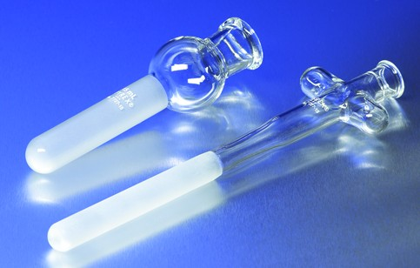
Protein Solubilization/Extraction
Work quickly and keep cold!
Put the protein into solution by breaking the tissues or cells containing it, or isolating an excreted protein from culture media
Filtration
Freeze/thaw, Grinding
Homogenization, Sonication
Organic solvent extraction
Isolate protein from nucleus or mitochondria?
Lyse cells in buffer isotonic to the organelle
Disrupt with mild detergents
Integral membrane proteins can only be removed with detergents

Slide 5
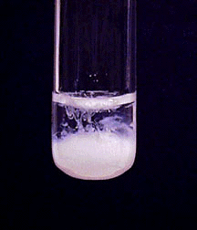
Precipitation & Differential Solubilization
Ammonium sulfate precipitation
Used for bulk protein purification
Add increasing amounts (NH₄)₂SO₄
Collect fractions
The first proteins that precipitate are most hydrophilic
Remove (NH₄)₂SO₄ by dialysis

Slide 6
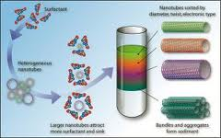
Ultracentrifugation of Proteins
Centrifugal force separates mixtures of particles suspended in liquid
Equilibrium Centrifugation
Particles reach equilibrium at a point in the tube where buoyant density is balanced with centrifugal force
Gradient Centrifugation
Highest % at bottom to lowest on top
Sucrose
Glycerol
Percol
Layer Sample on top
Heaviest molecules settle closer to bottom

Slide 7
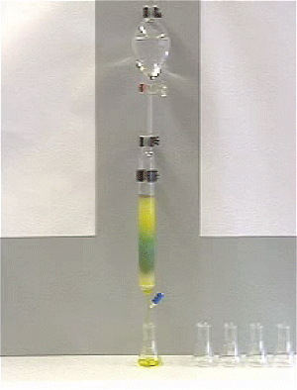
Chromatography
Size Exclusion Chromatography
Molecules excluded or retained by pore size of resin
Collect fractions of eluent
Hydrophobic Interaction Chromatography
Hydrophobic region of protein is attracted to hydrophobic region on gel and retained longer
Ion Exchange Chromatography
Proteins exchange with ions in buffer to bind to resin
Most weakly charged molecules elute first
Affinity Chromatography
Lock and key fit with ligand on resin, ex: lectins
Immunoaffinity Chromatography
Proteins bind to specific antibody bound to resin
Elute by changing pH or salinity

Slide 8
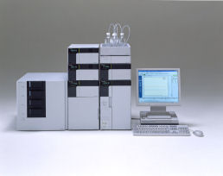
Chromatography
High Performance Liquid Chromatography (HPLC)
High pressure drives solutes through column
Elute with gradient of organic solvent
Improved resolution
Reverse phase HPLC

Slide 9
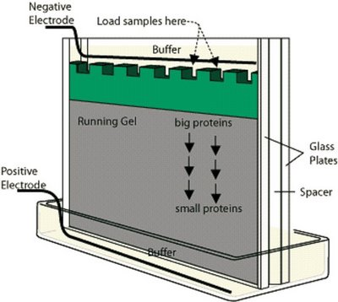
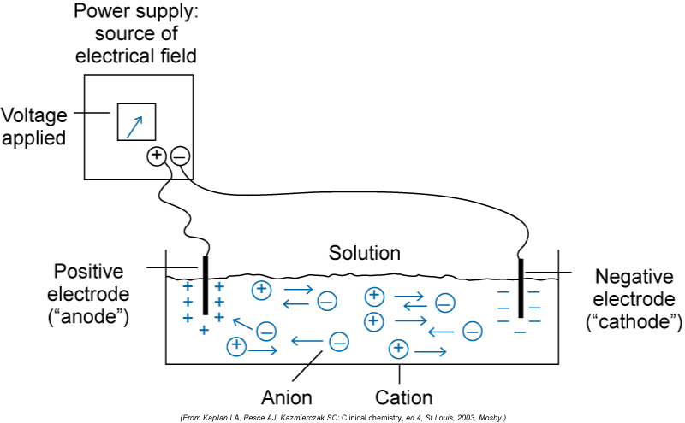
Electrophoresis

Slide 10
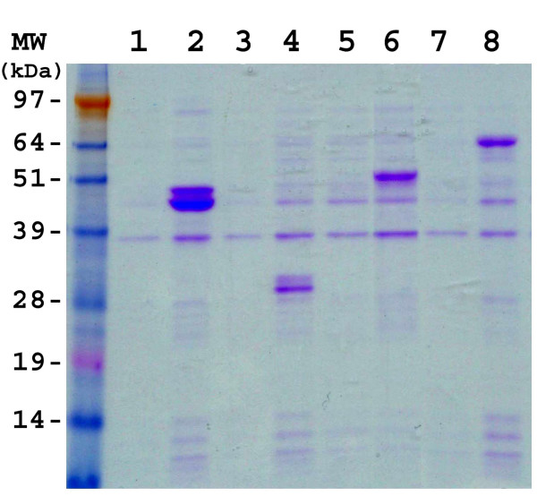
Electrophoresis
Polyacrylamide Gel Electrophoresis
Preparative & Analytical
SDS PAGE-Denaturing Conditions
Protein unfolded & covered with negative charged SDS
Separates according to molecular weight
Gradient SDS PAGE
Highest percentage acrylamide at bottom
High resolution separation
Non Denaturing PAGE
Buffer maintains native protein conformation
Enzymatic activity retained

Slide 11
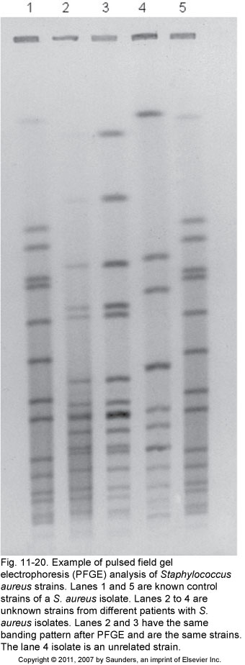
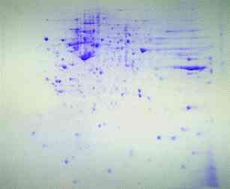
Protein Characterization Electrophoresis
Two Dimensional Electrophoresis & Mass Spectometry
Pulse Field Electrophoresis
Isoelectric Focusing
Isotachophoresis
Capillary Electrophoresis
Western Blotting
….and others….

Slide 12
The power of antibodies!
Introduction to Research Methods

Slide 13
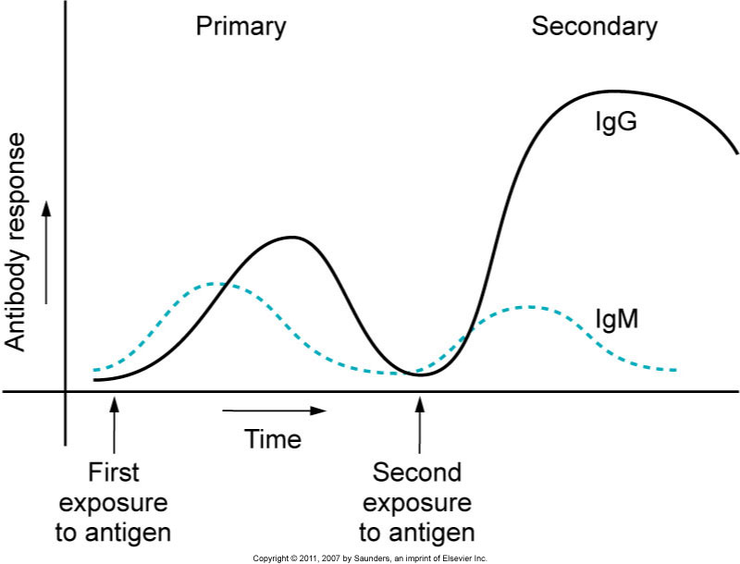
Why Antibodies?
Why raise antibodies?
Powerful tool for isolation & characterization of biomolecules and identification of pathogens!

Slide 14
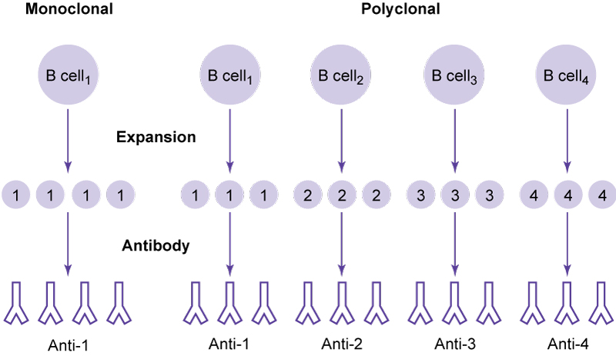
Polyclonal or Monoclonal?
Polyclonal
Rabbit, mouse, rat, goat, horse
Immunoaffinity
Immunoprecipitation
Hemagglutination
Identification Tests
Monoclonal
Mouse
Identify specific unique epitope
Hemagglutination

Slide 15
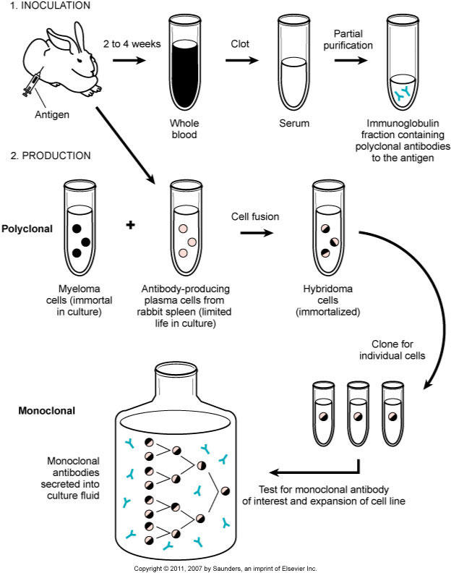
Hybridoma Production
Inoculate & Boost
Isolate WBC
Splenocytes from mouse
Fuse with myeloma cells
Limiting dilution
Screen for antibody production
Characterize
Expand cells!
Monoclonal Antibodies!

Slide 16
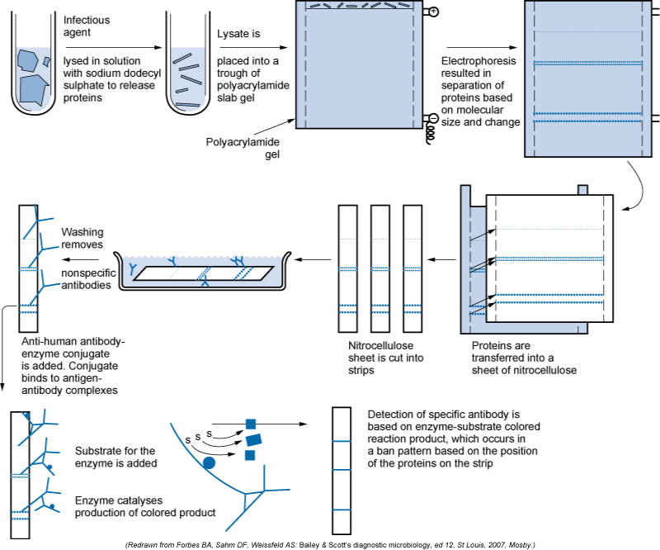
Western Blot Protocol

Slide 17
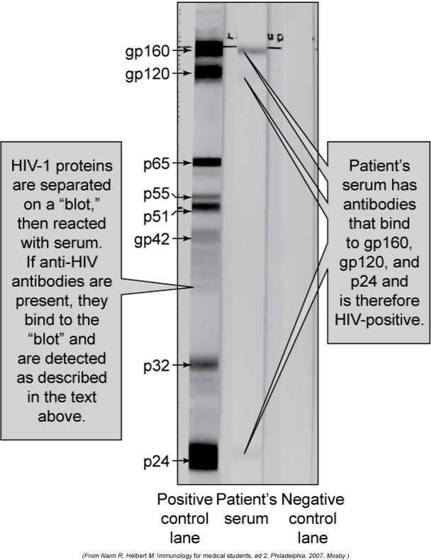
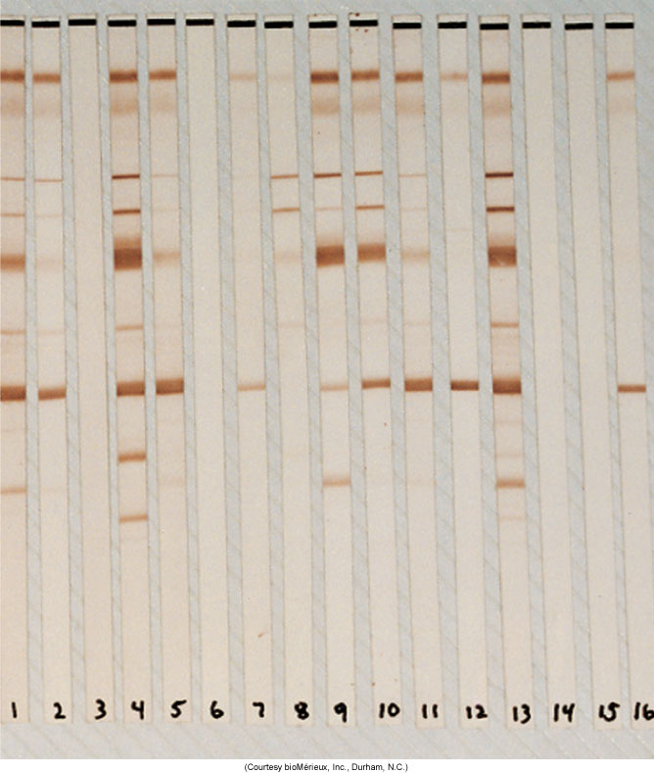
Western Blot Results

Slide 18
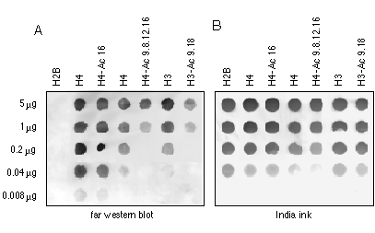
Western Dot Blot Far Western Blot
Western
Antigen Dilutions
(cell lysates etc)
Antibody Detection
Enzyme Linked Conjugate
Far Western
Detects Protein to Protein Interaction
Antigen
Add cell lysate with target protein
Antibody Detection
Enzyme Linked Conjugate

Slide 19
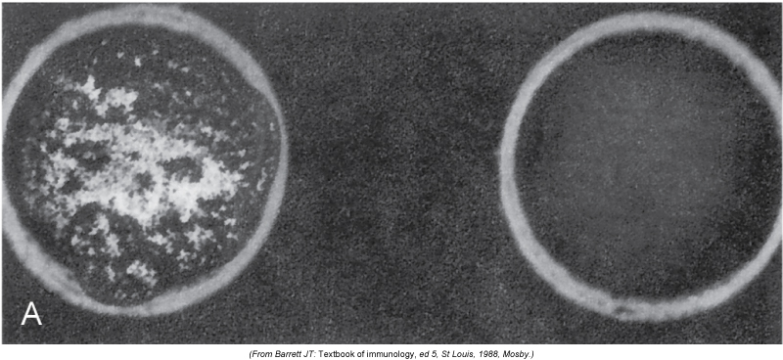
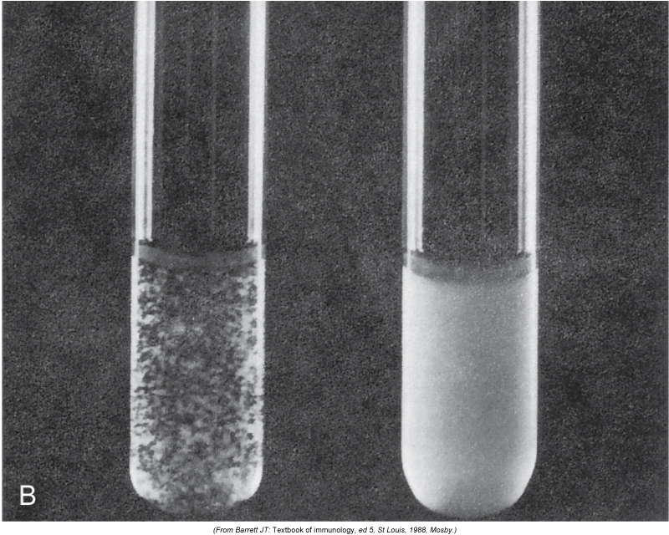
Agglutination Tests
Slide Agglutination
Tube Agglutination
Agglutination Inhibition

Slide 20
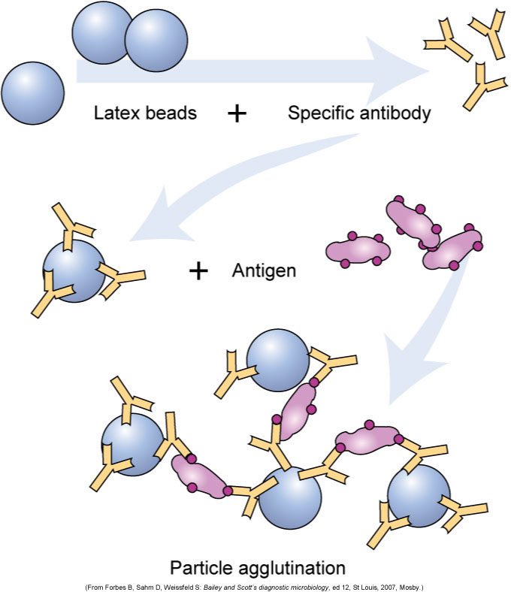
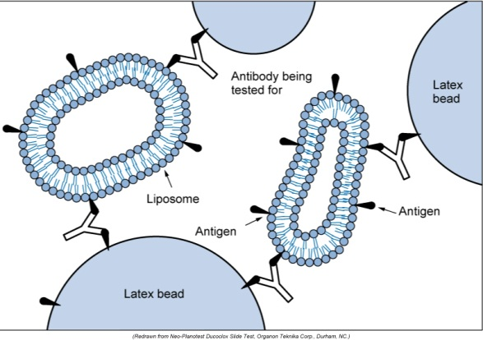
Latex Agglutination
Antibody adheres to latex microbeads
Antigen detection = Visual agglutination
Can be enhanced with liposomes

Slide 21
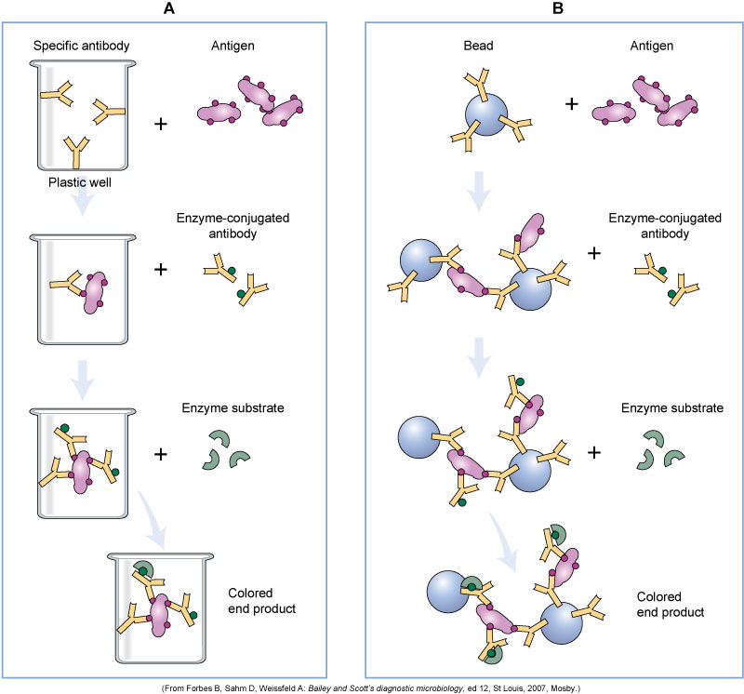
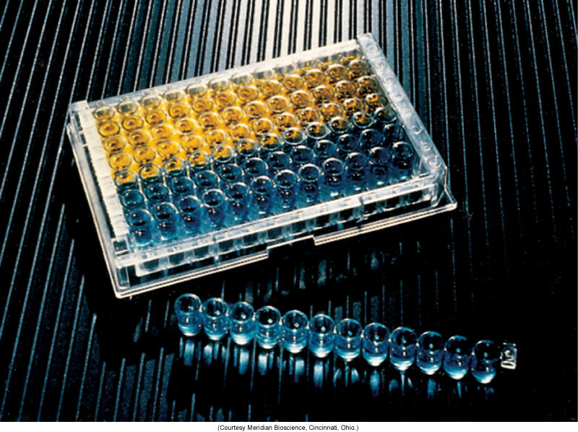
ELISA
Antibody on solid surface of well or bead
Antigen Binds
Add enzyme conjugated antibody
Add enzyme substrate
Color change

Slide 22
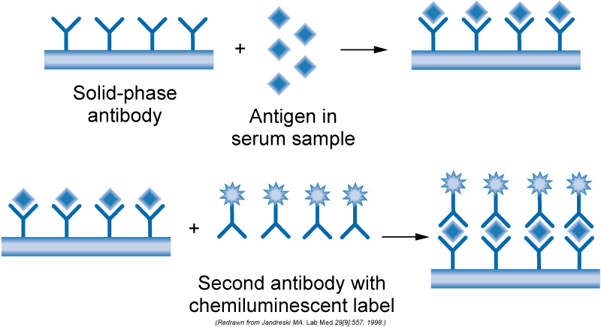
Chemiluminescent Label Adds Sensitivity

Slide 23
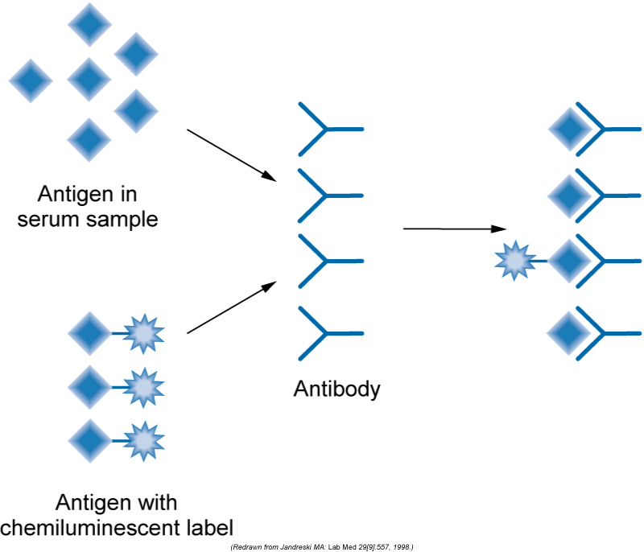
Competetive Immunoassay Adds Sensitivity

Slide 24
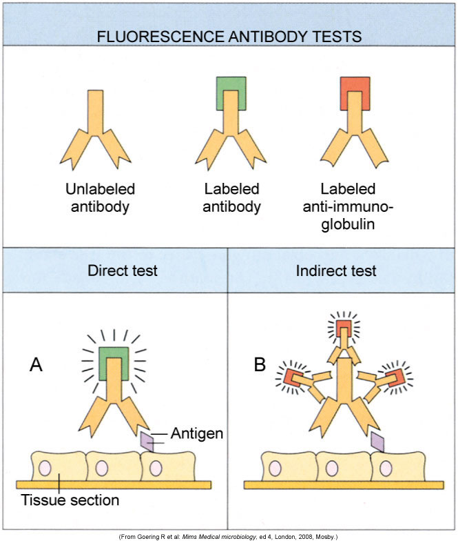
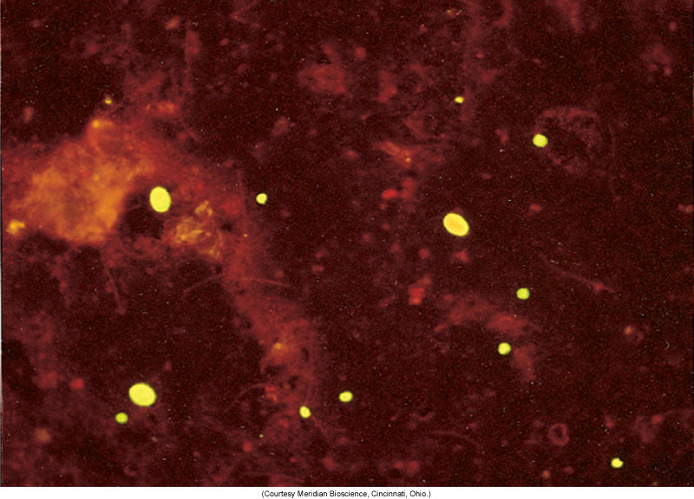
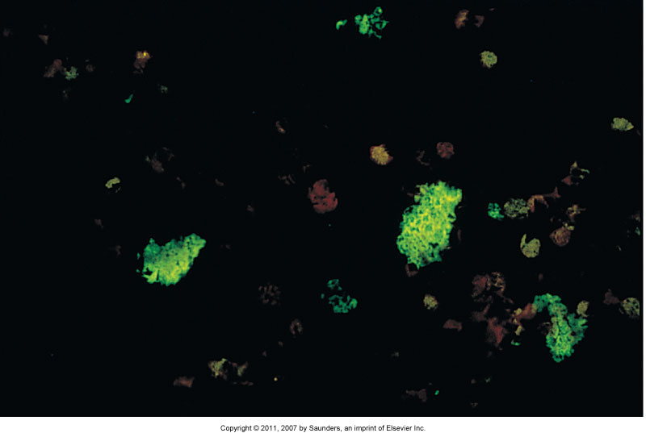
Fluorescent Staining

Slide 25
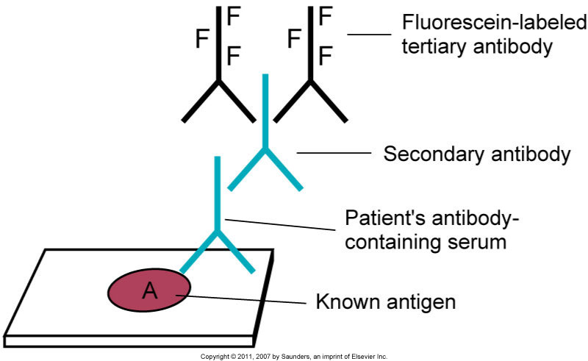
Double Indirect Staining Detects Patient Antibody

Slide 26
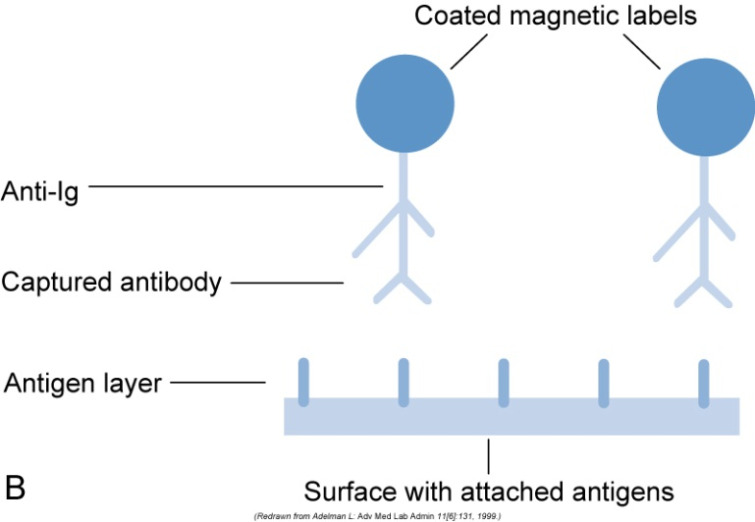
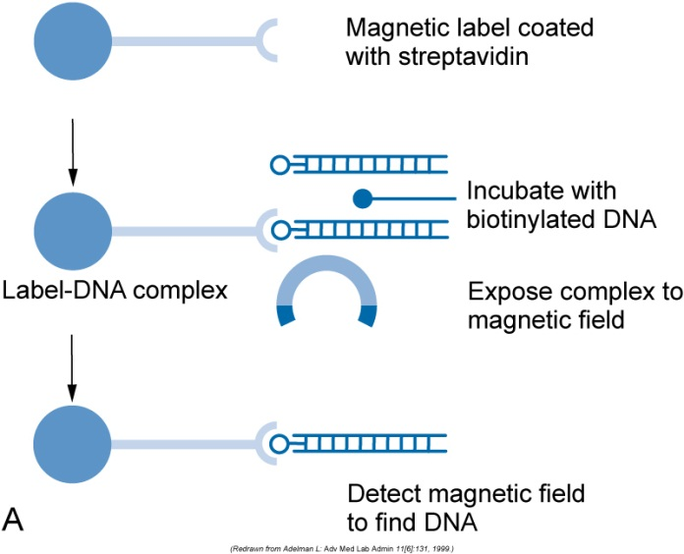
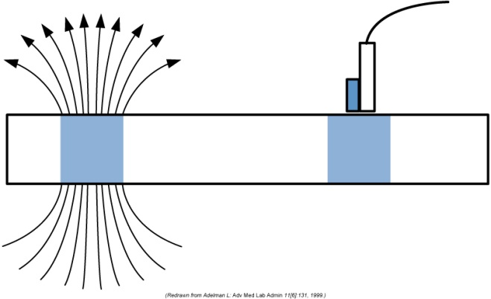
Always Moving Forward with New Technology: Magnetic Labeling

Slide 27
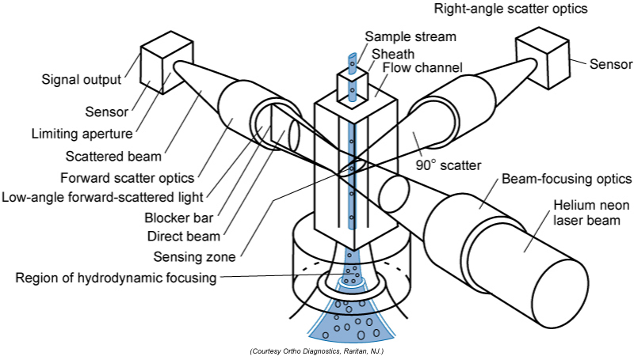
Flow cytometry

Slide 28
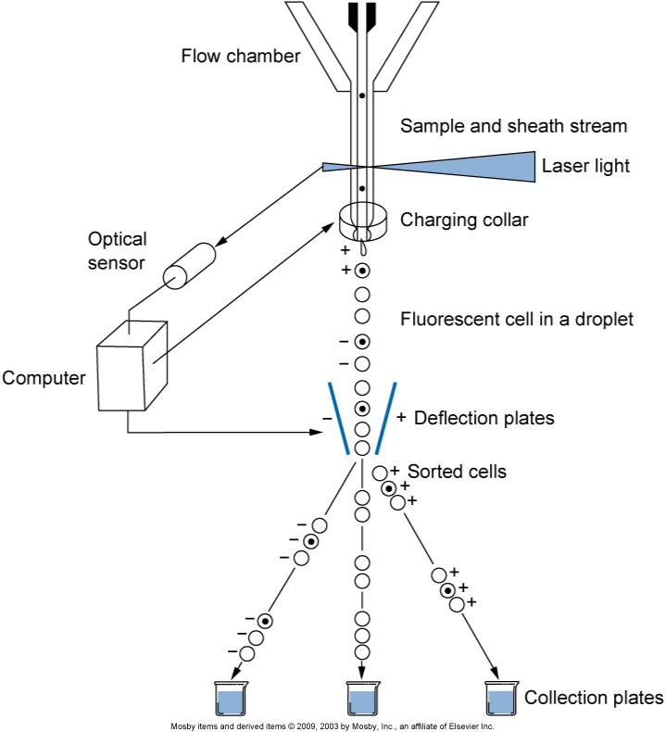
Cell Sorting of Fluorescent Ab Labeled Cells

Slide 29
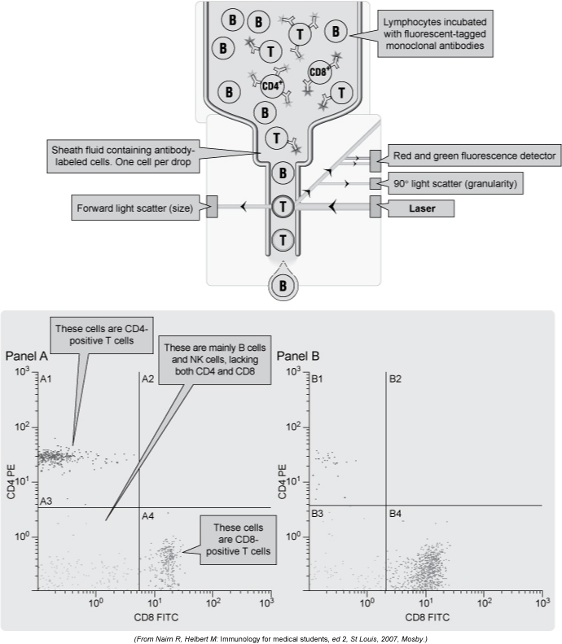
Dot Plot of Flow Cytometry /Sorting

Slide 30
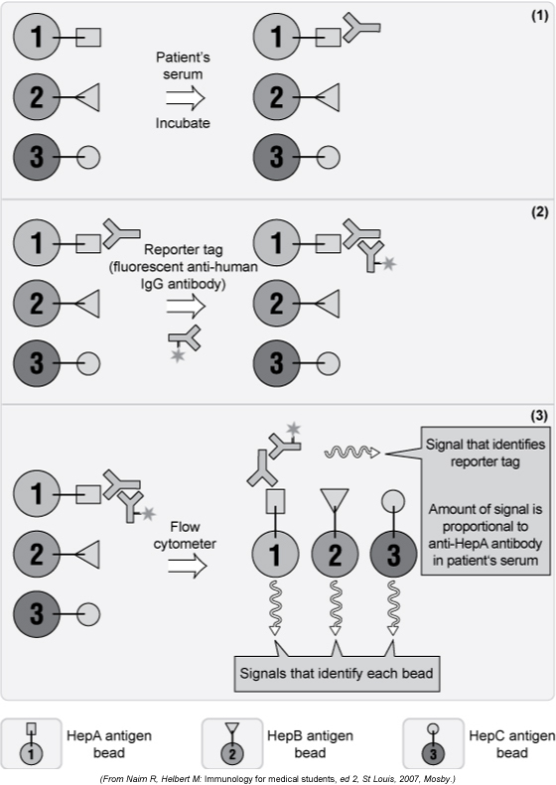
Fluorescent Microsphere Based Assay ELISA + Flow Cytometry

Slide 31
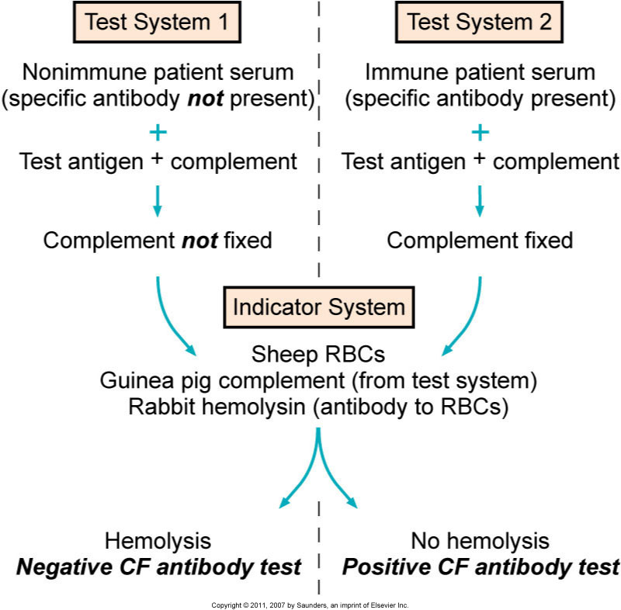
Complement Fixation

Slide 32
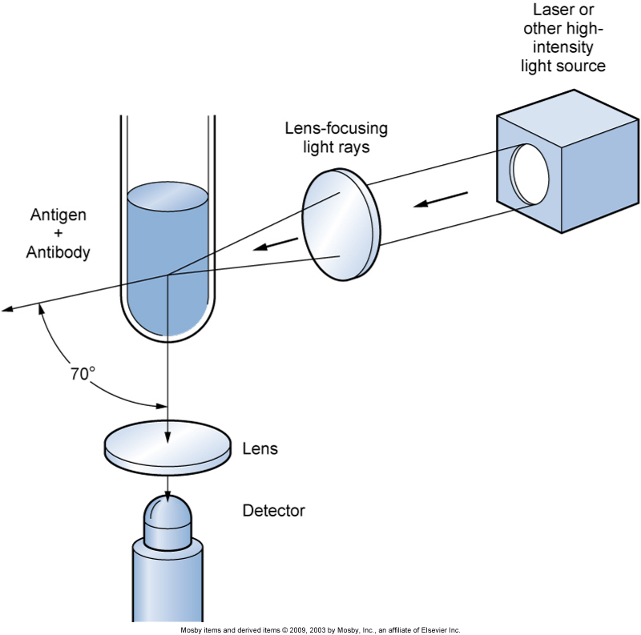
Nephelometry Ag-Ab Detection via scattering

Slide 33


Slide 34
Molecular genetics!
Introduction to Research Methods

Slide 35
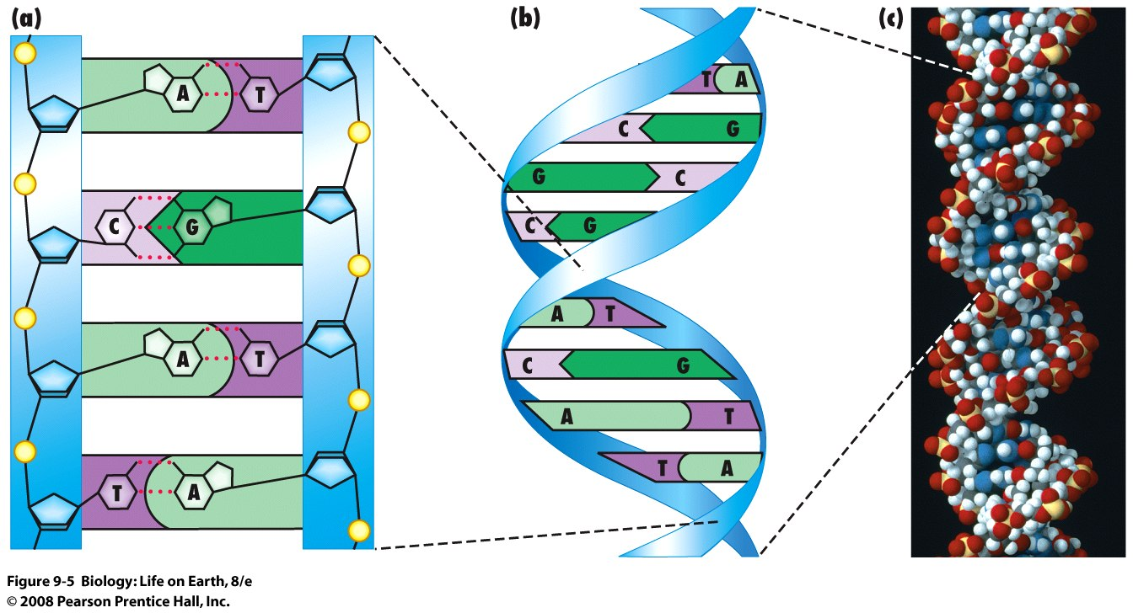
DNA Molecule
Double Helix
Double Stranded
Antiparallel
Sugar Phosphate Backbone
Complimentary Base Pairing
A-T, G-C

Slide 36
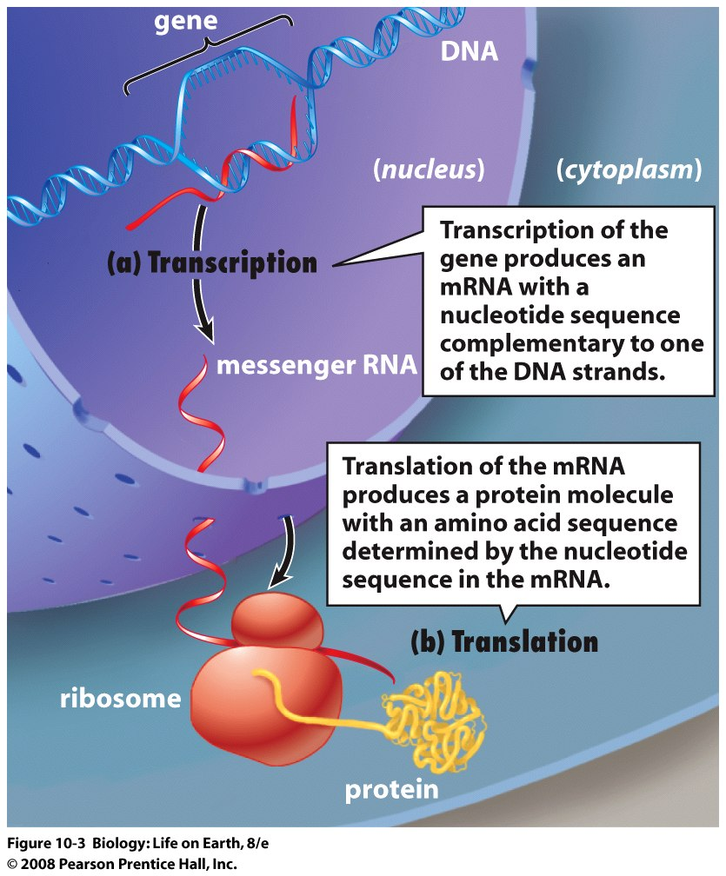
Central Dogma: DNA→mRNA→Protein

Slide 37
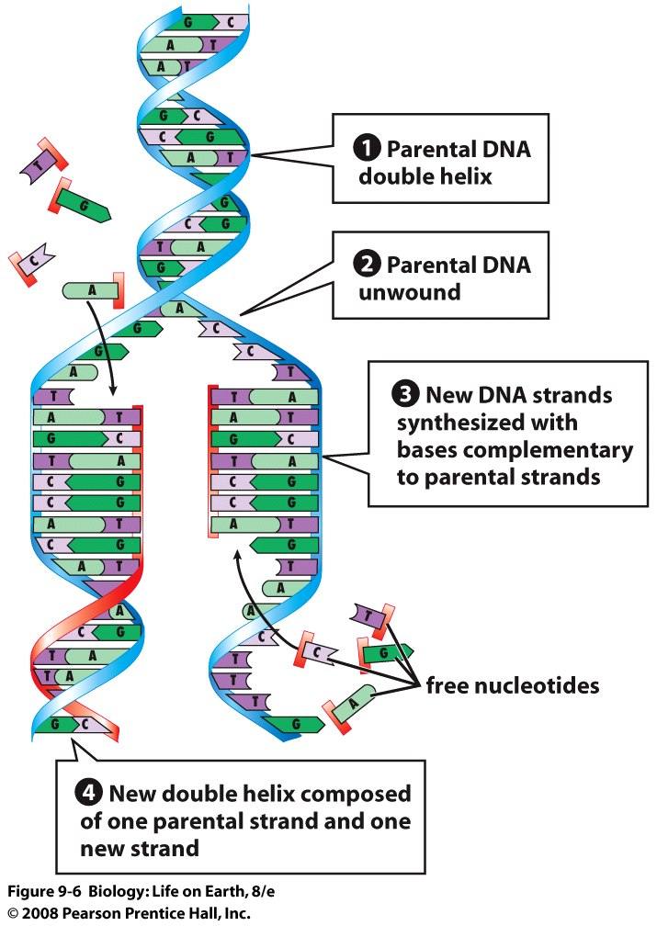
DNA Replication
Semiconservative
Mom + Daughter
Helicases
DNA polymerase
Melting
Synthesis
Proof reading
Leading or Continuous
Lagging or Discontinuous
Okazaki fragments
DNA ligase

Slide 38
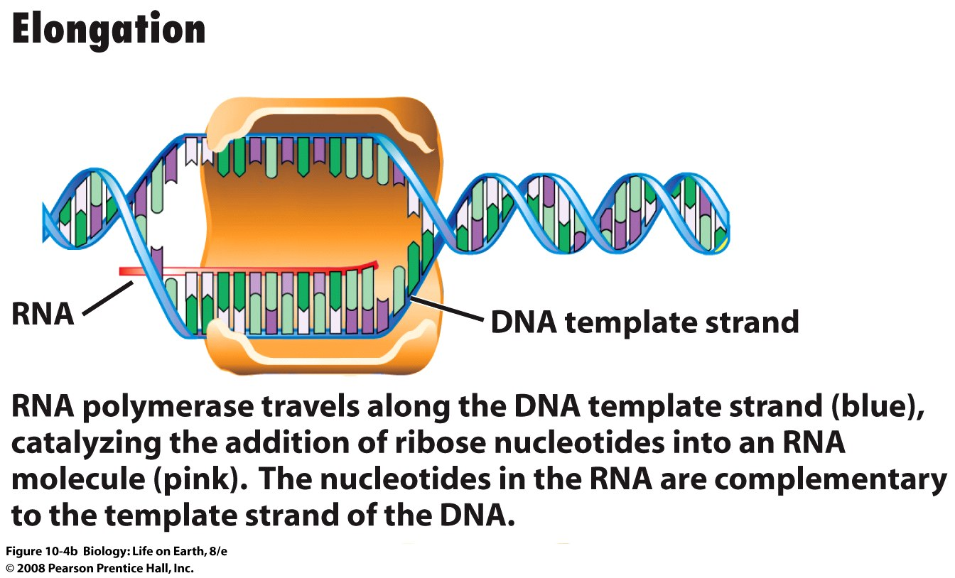
Transcription
Complimentary RNA Bases
G-C, A-U
Enzyme: RNA Polymerase
(Initiation, Elongation, Termination)
DNA sequences:
Promoter
Terminator
Other Proteins
Enhancers
Repressors
RNA splicing & poly A capping
rids noncoding /ready to go to cytoplasm

Slide 39
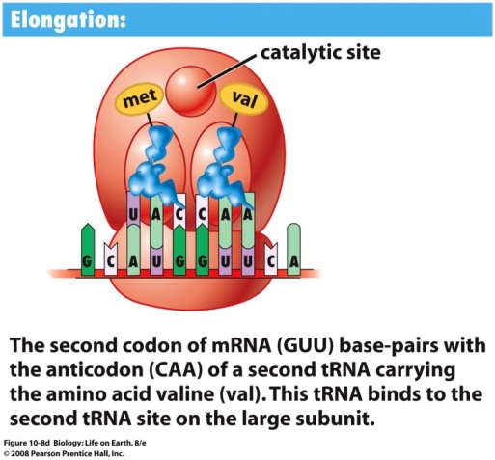
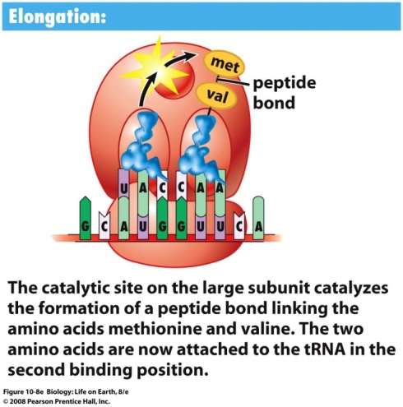
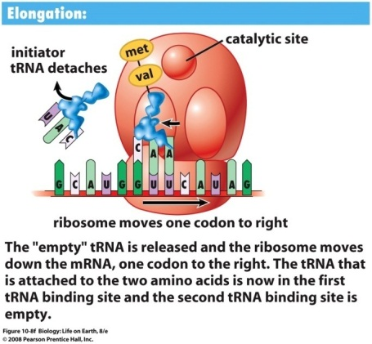
Translation
3 Base Codon = 1 Amino Acid
Anti Codon on tRNA matches the Codon on mRNA and puts in correct Amino Acid
Initiation
Start Codon on mRNA
Always AUG Methionine
Ribosomal subunit
Elongation
Continued reading of message, incorporating AA. In growing polypeptide chain
Termination
Stop Codon
complex falls apart

Slide 40
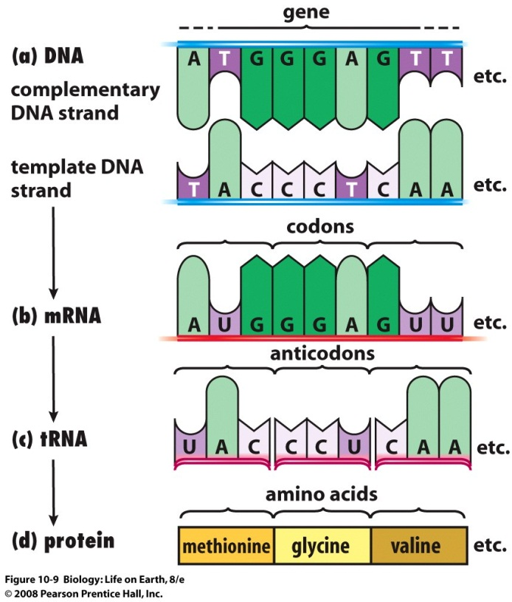
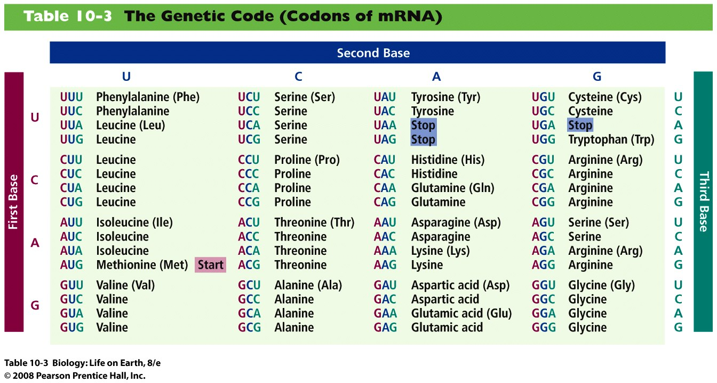
Central Dogma DNA→mRNA→Protein (cDNA←mRNA via Reverse Transcriptase experimentally)

Slide 41
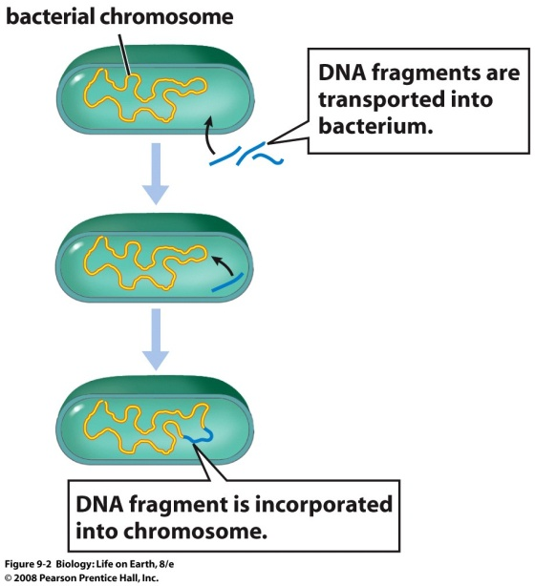
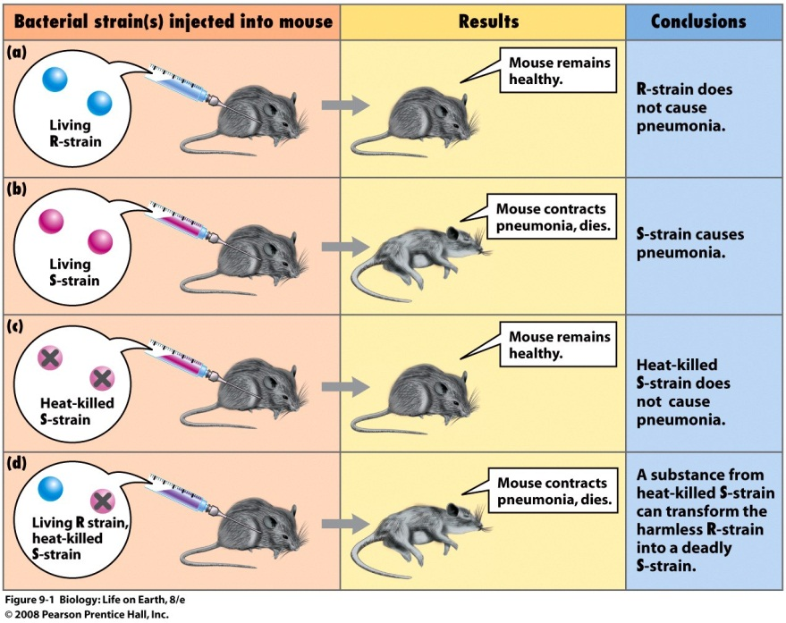
Transformation
Griffith’s Transformation Experiment
Bacterial Transformation in Nature

Slide 42
The World of Modern Biotechnology
Traditional Applications of Biotechnology
Biotechnology is Applied Biology
Modern focus on genetic engineering, recombinant DNA technology, and analysis of biomolecules
Most modern biotechnology includes manipulation of DNA
Genetic Engineering
The modification of genetic material to achieve specific goals
Learn more about cellular processes, including inheritance and gene expression
Provide better understanding, detection and treatment of diseases, particularly genetic disorders
Generate economic and social benefits through production of valuable biomolecules and improved plants and animals for agriculture
Recombinant DNA (technology)
Splicing together of genes or portions of genes from different organisms
Recombinant DNA can be transferred to plants and animals
Transgenic or genetically modified organisms (GMOs)

Slide 43
Research Fields/Applications
Forensics
Identify victims and criminals from trace biological samples
Genetic sequences of any human individual are unique
DNA analysis reveals patterns that identify people with a high degree of accuracy (DNA Fingerprinting)
Agriculture
Genetically Modified (GM) Plants may be engineered to produce
Vitamins & Medicines
Resistance to Insect Pests & Herbicides
Transgenic Animals May Be Useful in Agriculture & Medicine
Healthy Transgenic animals are difficult to engineer
Growth hormone genes have been inserted into pigs and fish species but some abnormalities have been observed
Animals like sheep might be engineered to produce medically important proteins in their milk
Human Genome Project
Has determined the nucleotide sequence of all the DNA in our entire set of genes, called the human genome
Human genome contains ~25,000 genes
New genes, including many disease-associated genes have been discovered
Applications
Improved diagnosis, treatment and cures of genetic disorders or predispositions
Comparison of our genome to those of other species will clarify the genetic differences that help to make us human
Medicine
Diagnosis and treatment of disease
Biotechnology and Ethics: With great power comes great responsibility!

Slide 44
Biotechnology in Medicine
Diagnostic Research
Treatment
Proteomics
Study of proteins on a cellular level
Can determine protein expression in certain disease conditions
Cancer
Genetic diseases
Infection
Pharmacogenetics
Study the individual patient genes to determine efficacy of drug treatment
Individualized treatment Ex: Coumadin
Nanotechnology
Uses atomic/molecular properties to build structures
Nanomolecular diagnostics & treatments
Metagenomics
Developed as a means to identify nonculturable microorganisms
Identification of microbial genomes from mixed populations using molecular techniques
May find organisms underlying disease not yet identified
Administration of recombinant proteins
Treat but not cure disorder
Ex: Humalin-recombinant human insulin
Prevent infectious disease
Ex: Recombivax-Hepatitis B Vaccine
Gene Therapy
Replacing defective genes to possibly cure a disorder
Possibilities
Cystic Fibrosis
Type I Diabetes
Severe Combined Immunodeficiency (SCID)
Parkinson’s Disease
Includes Stem Cell Research
Adult, umbilical, embryonic stem cells

Slide 45
Biotechnology Tools
Restriction Enzymes
Other Enzymes: Polymerases, Ligases, Klenow fragment, etc
DNA Probes
Bacterial Plasmids
Bacterial Transformation
Viral Transformation
Plant or Animal Cell Transduction
DNA Microinjection into Embryo
Agarose Gel Electrophoresis
Southern Blot (DNA)
Northern Blot (RNA)
Western Blot (Protein)
Polymerase Chain Reaction
Restriction Fragment Length Polymorphism

Slide 46
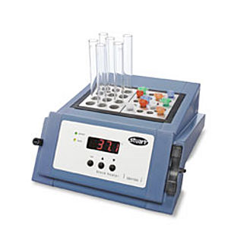

Restriction Digestion
Restriction Endonucleases
Naturally occurring enzymes in bacteria
Ex: Ecor1 from E. coli
Restrict at specific base pair sequences
Ex: Ecor1at GAATTC
Incubate DNA in buffer with enzyme at 37 degrees, 60 min

Slide 47



Agarose Gel Electrophoresis
Separate DNA (or RNA) fragments using agarose gel and electric current
Stain with Ethidium bromide
Visualize over UV lightbox

Slide 48


Cloning
Cut DNA fragment from gel and elute
Cut plasmid
Ligate plasmid + fragment
Transform competent E. coli
Select for transformants on appropriate media
Antibiotics
Lactose utilization

Slide 49

Nucleic Acid Hybridization Techniques
Nucleic acid hybridization
The formation of hydrogen bonds between single strands of RNA or DNA that are complementary
Also called duplex formation
Target (template)
Sequence that will be identified
Immobilized or suspended in solution
Probe
Single-stranded RNA or DNA oligonucleotide labeled with a reporter chemical

Slide 50

Probe Selection & Labeling
Very important step!
Determine the sequence of the probe!
Determines recognition of the target sequence
Cloned? Synthesized?
Labeled with radioactivity, biotin, digoxigenin (DIG), or fluorescein
End labeled
Attached to 5’ or 3’ end
Continuously labeled
Incorporated at intervals along the length of the nucleic acid
Random Primer Synthesis

Slide 51
Hybridization Formats
Solid support hybridization
Blotting
Nucleic acid is immobilized to a membrane
Southern Blot
Restriction enzyme digest of DNA fragments
DNA separated by agarose gel electrophoresis
Then blotted with high salt from gel to membrane
Probes can bind to target
Northern Blot
Detect RNA transcripts
Detect size of RNA run on agarose
Can be used to semiquantitate the amount of transcript
Similar to Southern blot except no restriction enzymes are used
In situ hybridization
Detection of RNA in cells or tissue

Slide 52

Southern Blot Analysis

Slide 53
Hybridization Reaction Variables
Temperature
Melting temperature (Tm)
50% of hybrids have formed, 50% are still dissociated
Based on G + C concentration
Length of Probe
Hybridization occurs more rapidly in shorter probes
Probe Concentration
Higher concentrations of probe will lower reaction time
Also increase the probability of binding to nontarget sequences
Complementarity
Exact matches between probe and target occur first
Microbes vary in sequence influencing the hybridization
Salt concentration
Ionic strength
Affects the stringency of the reaction
pH
Affects the stability of double stranded nucleic acid molecules in solution
Neutral pH is preferred for most reactions

Slide 54

Southern vs Northern

Slide 55

In Situ Hybridization

Slide 56
In-Solution Hybridization
Detect target in solution
Tubes or microtiter wells
Usually using chemiluminescent probes

Slide 57

Polymerase Chain Reaction (PCR)
Template DNA
Target/Sample
Thermostable DNA Polymerase
Enzyme that amplifies DNA
Magnesium buffer
Required by polymerase
Primers
To amplify target sequence
Deoxynucleotide triphosphates (DNTPs)
All four DNA bases
Thermal Cycler
Adjust temperatures as needed

Slide 58

Basic Steps of PCR

Slide 59

PCR Mechanism

Slide 60

Nested Primer PCR
Consists of two consecutive PCR assays
Standard PCR amplifies a target region
Tube 1
Nested PCR amplifies a portion of the target region
Tube 2
Ex: Herpesvirus Detection
First set might amplify if herpes is present
Second set amplifies a region that distinguishes HSV-1 from HSV-2

Slide 61
Multiplex PCR
Simultaneous detection of two or more targets from the same tube
Can be adapted to real-time PCR
Reaction conditions
Must be similar for all targets
Primers must have similar Tm’s

Slide 62

Real-Time PCR
PCR amplicons are assessed as they are accumulated after each cycle
Reactions occur in closed tubes that do not have to be opened
Reduces likelihood of contamination
Analyze fluorescence
Fluorescence per cycle
SYBR green binds to dsDNA
Thus fluorescence increases with each dsDNA product
During denaturation, fluorescence decreases
Due to high temperature and ssDNA
Analyze melting curve (Tm)

Slide 63

Molecular Beacon
Separation of Fluorophore and Quencher causes light emission

Slide 64

Scorpion Primer
Similar to Beacon
Quencher binds primer and fluorophore bends over the top and binds via base pairing
Looks a bit like a scorpion

Slide 65

5’ Nuclease Assay
Primer and probe anneal to target
Polymerase extends to primer
Pol cleaves fluorescent dye from quencher
Fluorescence observed

Slide 66

Dual Probe FRET
FRET
Fluorescence Resonance Energy Transfer
Upon binding, the donor transfers energy to the Fluorophore
Emits light

Slide 67
Reverse Transcriptase PCR (RT-PCR)
Detect mRNA transcripts
RNA transcripts from a single cell are possible to detect
Must extract mRNA
Reverse transcriptase
RNA dependant DNA polymerase
Generates complementary DNA (cDNA)
Can be used to detect RNA viruses
One step (tube) or two step (tube) process

Slide 68
Nucleic Acid Sequence−Based Amplification (NASBA)
Sometimes called Self-Sustained Sequence Replications (3SR)
Requires three enzymes
AMV Reverse Transcriptase
Ribonuclease H (RNase H)
Digests DNA-RNA hybrids
T7 RNA polymerase

Slide 69

Nucleic Acid Sequence−Based Amplification (NASBA) (Cont’d)
Steps
Create DNA strand from RNA target using primer 1
Digest RNA with RNase H
Amplify single DNA strand using primer 2
Thus generating dsDNA
dsDNA is transcribed to ssRNA by T7 RNA polymerase
ssRNA is used to repeat step 1
Amplifying DNA produced

Slide 70
DNA Microarrays and Nanoarrays
Microscopic DNA molecules attached to a solid support (silicone computer chip)
Advantages
Can detect single base mutations in genes
Assay thousands of DNA sequences
Thus thousands of pathogens
Monitor activation of genes by mRNA hybridizing to DNA on chip
Can capture RNA or DNA
Nanoarrays
Can work in even smaller spaces and be more sensitive

Slide 71



Gene Chip Probe Microarray

Slide 72

Hybrid Capture Assay
Release target nucleic acid from samples using an alkaline agent
Denature DNA and destroys RNA
RNA probe added to sample binds target DNA if present
RNA-DNA hybrid captured by antibodies linked to a solid support (microtiter well)
Antibodies conjugated to AP bind to hybrids
Substrate added and light emission is recorded via luminometer

Slide 73
Nonamplified Organism Typing Methods
Southern blotting
Detecting rRNA Restriction Fragment length polymorphisms (RFLPs)
Ribotyping
Restriction Enzyme Analysis of chromosomal DNA
Similar to ribotyping only using chromosomal DNA
Plasmid profile analysis
Determines plasmids present
Pulsed field gel electrophoresis (PFGE)
Enzymes cut chromosomal DNA into large fragments
Run on a low-percentage, low-melt agarose gel
Pulsed electric field that periodically changes direction
Multilocus enzyme electrophoresis (MLEE)
Uses proteins to compare strains
Separate proteins using electrophoresis

Slide 74
Amplified Organism Typing Methods
Random amplified polymorphic DNA (RAPD)
Uses small random primers to amplify random DNA
If strains are the same that should show the same pattern
Repetitive palindromic extragenic elements PCR
Amplify DNA between palindromic repeats
If similar in size than likely the same strain
Multilocus sequence typing (MLST)
Target DNA sequence of housekeeping genes

Slide 75
Sequencing
Determining the order of nucleotides in DNA
Sanger method
Chain termination
16SrRNA gene sequencing
Identify isolates
Determine relatedness
Chain termination method
Uses nucleotides that terminate the string with a fluorescent color
Fragments can be aligned by size and last fluorescent nucleotide
Dentograms
A rough prediction of similarity based on the comparison of sequence structure
Relatedness or likely organism

Slide 76
THE COMBINATIONS & POSSIBILITIES ARE ENDLESS! GO FOR IT!

Slide 77


Slide 78
Bibliography
Audesirk, Audesirk and Byers, (2010), Biology: Life on Earth with Physiology 9th Ed.
Blaney, Kathy D and Howard, Paula R, (2009), Basic & Applied Concepts of Immunohematology, 2nd Ed..
Kaplan, Lawrence A and Pesce, Amadeo J, (2010), Clinical Chemistry, 5th Ed
Turgeon, Mary Louise, (2009), Immunology and Serology in Laboratory Medicine, 4th Ed.
Mahon, Lehman and Manuselis, (2009),Textbook of Diagnostic Microbiology, 4th Ed
Ammonium sulfate precipitate image retrieved January 2012 from http://www.public.asu.edu/~jpbirk/qual/qualanal/barium.html
Clip Art retrieved January 2012 from world wide web
Cloning protocol image retrieved January 2012 from http://www.epibio.com/newsletter/f1_2/f1_2ps.asp
Column Chromatography image retrieved January 2012 from
http://www.demochem.de/D-CC-e.htm
Density gradient centrifugation image retrieved January 2012 from http://www.nsf.gov/news/newsletter/oct_06/index.jsp
DNA elution image retrieved January 2012 from http://www.ubi.ca/cart/index.php/cPath/27_45_49_98
Far Western Dot Blot image retrieved January 2012 from http://www.currentprotocols.com/protocol/ps1907
Fireworks image retrieved January 2012 from http://www.whoguides.com/who-invented-fireworks
HPLC image retrieved January 2012 from http://www.shimadzu.eu/products/chromato/hplc/
In situ hybridization image retrieved January 2012 from http://www.biocompare.com/Articles/ApplicationNote/845/The-DIG-System-%E2%80%93-Nonradioactive-Automated-High-Throughput-In-Situ-Hybridization-A-Powerful-Tool-For-Functional-Genomics-Research.html
Microarray image retrieved January 2012 from http://dnadestiny.yolasite.com/microarrays.php
Microarray protocol image retrieved January 2012 from http://www.accessexcellence.org/RC/VL/GG/microArray.php
Northern & Southern Blot images from Fidalgo et al., Adaptive evolution by mutations in the FLO11 gene. PNAS 10:1073.
PAGE setup image retrieved January 2012 from http://biotech.matcmadison.edu/resources/proteins/labManual/chapter_5/procedure5_2.htm
PCR Thermocycler image retrieved January 2012 from http://www.unk.edu/academics/chemistry/equipment/Eppendorf_PCR_Thermocycler/
SDS-PAGE image retrieved January 2012 from http://www.personal.psu.edu/jms5704/blogs/simmons/technical-definition.html
Tissue grinder image retrieved January 2012 from http://www.cardinal.com/us/en/distributedproducts/ASP/T4018-2.asp?cat=laboratory
Two dimensional electrophoresis image retrieved January 2012 from http://cellbiosignal.jp/biochem/kamo/index.html

