Slide 1
Research Methods I
Christina A Nevel-McGarvey, PhD, MS, MT(ASCP)

Slide 2
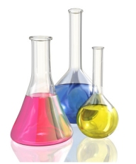

What is Scientific Research?
An investigative process that, in toto, creates a body of knowledge on a particular subject
Science is not just a subject in school, but a systematic way of conducting investigation!

Slide 3
What can we Examine SCIENTIFICALLY?
Anything Measurable in a concrete way
  See it
  Touch it
  Smell it
  Measure it in some way
    Weight
    Height
    Speed
    Electrical
    Observe activity
    ETC.
Supernatural
Matters of Faith
Matters of Morals
Matters of Opinion
Science CAN Examine
Science CANNOT Examine

Slide 4
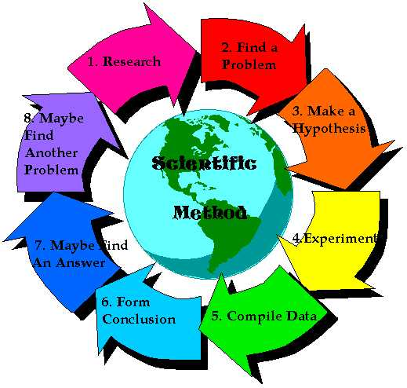
The process of science=
The Scientific Method
Observation
Hypothesis
Controlled Experiment
Results
Conclusions
Publish Findings

Slide 5
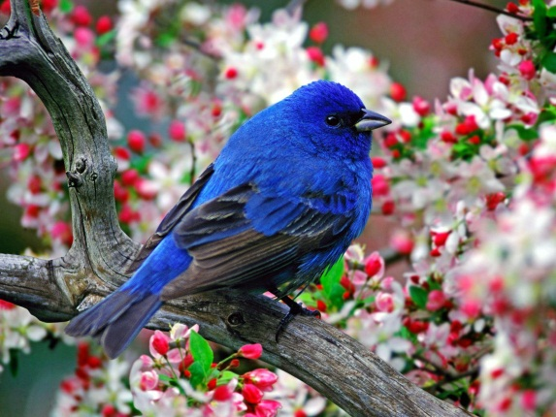
The Scientific Method
Step One
Observation
  Your observations lead you to inquire on how something works or how something came to be
    Bluebirds in my back yard seem to eat more of a new food that I just purchased. I wonder if they prefer this new food to the old food I used to buy?
  Preliminary Information Gathering
    Review published literature
    Talk to experts in the field
  If……then Statement……
    If the bluebirds prefer the new food then I would expect to see more of them eating it during the day than the old food in the same kind of feeder.

Slide 6
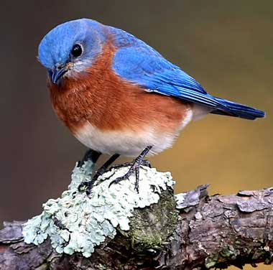
The Scientific Method
Step Two
Hypothesis
  Statement of Educated Guess of what you believe to be true that you can test with a controlled experiment
    Blue birds in my back yard prefer to eat blue bird feed mix compared to song bird seed mix.

Slide 7
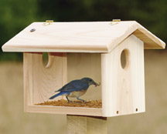
The Scientific Method
Step Three
Experiment to Test the Hypothesis
  Variables
    Independent Variable
      The variable that you change in your experiment
      For example, the types of food I will place in my bird feeders
    Dependent Variable
      The observed result of the Independent Variable being manipulated
      For example, the number of blue birds eating at each feeder
  Controls
    All other possible variables must be held in common, the same
    Without the proper controls it is impossible to determine the effect of the independent variable, impossible to interpret the results
      For example, two feeders exactly the same, location of feeders same area, exposure of feeders to light, darkness, wind all the same, location of water same distance away from both feeders
      We want to make sure we only measure the bird’s food preference, not something else by mistake

Slide 8
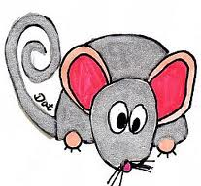
The Scientific Method: Step3-Experiment
STEPS in an EXPERIMENT
Write an outline of the steps in experiment and things to consider! For example…
  Which animal? Mouse? Human?
  Preliminary isolation: homogenize or grind tissue? Isolate sub-cellular fractions?
  Steps in purification: DEAS? Sephadex?
  Monitoring of enzyme activity.
  Monitoring enzyme purity.
  Stability of purified enzyme.

Slide 9
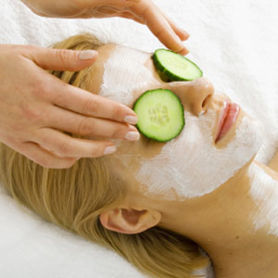
The Scientific Method: Step3-Experiment
STEPS in an EXPERIMENT
Estimate time needed to accomplish each step, designate places for a halt.
  - assume you will underestimate
Accumulate all resources needed for all steps.
For those experiments that require it, set up test and control or placebo groups.
Placebo-test substance with all constituents except the active ingredient in the new “drug.”
Example: Eye cream with and without cucumber extract

Slide 10
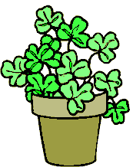

The Scientific Method: Step 3-Experiment
CONTROL vs TEST GROUPS
Do plants grow better or worse in the presence of music?
Hypothesis: Music helps plants grow.
  Focus the hypothesis!
    Which kinds of plants?
    Which kinds of music?
Do children learn better or worse in the presence of music?
  What kind of music? Classical? Rock? Soft? None?
Hypothesis: LOUD music adversely affects learning by reading.
  Which is test group and which is control group?

Slide 11

The Scientific Method: Step 3-Experiment
Experimental Design
FOCUS your hypothesis:
  Three groups: Loud classical, loud rock, and NO music.
NEED TO MIMIIZE BIAS in the experiment.
  An “N” of 75 must be randomly assigned to each group.
  Approximately 45-55% must be male
Exclusion criteria are set up
30 minutes are given for subjects to read
Each must answer 30 questions about material (which is removed)
The score (% correct) is calculated for each

Slide 12

The Scientific Method: Step 3-Experiment
THE EFFECT OF CHANCE
You have to design the experiment to ensure that a conclusion is not:
  Biased by HOW it was set up
  Just the result of chance
  The effect of a confounding affect (M vs F)
“N” has to sufficiently large
  Statisticians can determine the appropriate “N”
As “N” increases, the likelihood of chance adversely affecting conclusion deceases

Slide 13
The Scientific Method: Step 3-Experiment
THE EFFECT OF CHANCE
Let’s say that in the MUSIC question, some students learn poorly by reading; they need to listen or talk to learn.
Is it possible that when you assign students to your test and control groups that one of the groups might have an excess of these poor reading learners? How can you minimize such an effect?
Increase “N”

Slide 14

The Scientific Method: Step 3-Experiment
Exclusion Criteria
Remove potential subjects who have KNOWN confounding issues.
  Person is caught cheating during exam
  Person becomes sick during exam
  Person with known dyslexia
Set up the exclusion criteria as part of your experimental design, before beginning the experiment, to minimize bias.

Slide 15
The Scientific Method: Step 3-Experiment
THE EFFECT OF CHANCE
Have an infinitely large number of students to assign, to spread bias among all groups.
Assign the students to the groups by:
  Alternating assignment (ABC, ABC,….)
  By preference (“I like rock”)
  By random draw
WHICH IS BEST?
LARGE “N” and randomization of subjects decreases affect of chance.

Slide 16
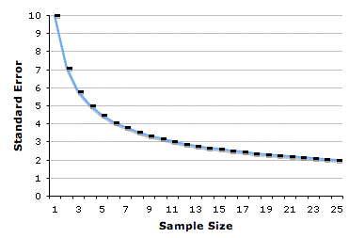
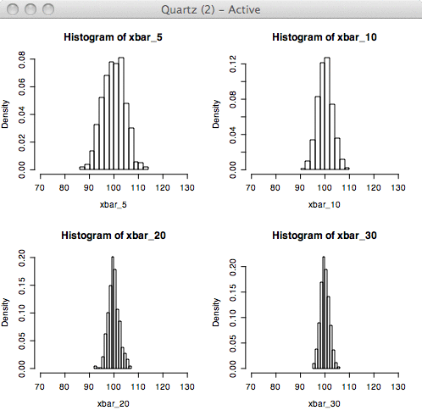
The Scientific Method: Step 3-Experiment
EFFECT OF “N” Replicates
Increasing “N”
increases confidence
of the mean and narrows
the distribution.

Slide 17
The Scientific Method
Step Four
Results
  We MUST see your numerical measurements!
    You can present them in a table, graph, any way you prefer, as long as we see those numbers!
  You must also describe how you took your measurements
  For example,
    I will count the number of bluebirds feeding at each feeder at 9am, noon and 3pm each day for thirty consecutive days.
    I will measure the emergence of new shoots and measure the length of all leaves in the music affects plant growth experiment every week for 8 weeks
    I will measure the results of an exam given to each test group while listening to the music assigned to the group.
      We have much more to look at here!!!!

Slide 18
The Scientific Method: Step 4-Results
Crunching the Data
Calculate basic parameters of population data:
  Mean, median
  Standard deviation, range
Plot and visually inspect the data.
Do the distributions
look the same?
Anything strange?

Slide 19
The Scientific Method: Step 4-Results
Basic Statistical tests
Comparison of central tendencies:
  Medians and Means.
    Are they equal or different ?
      ANOVA: compares many means together
      Student t-test for mean
      Comparison of medians
      Comparison of Standard Deviation of the Mean (SD)s:
        F-test for significant differences
  Screen for outliers

Slide 20
The Scientific Method
Step Five
Conclusions
  You explain what your numerical data means!
  You ultimately explain whether the Results Support or Reject the Hypothesis
  Hypothesis can NEVER be PROVEN true
  Form a New Hypothesis if the experiment rejects the original hypothesis
    This is what keeps science going! New ideas on how to solve the problem! Start experimenting again!

Slide 21
The Scientific Method: Step 5-Conlclusions
Children Learning/Music Experiment statistics
Let’s say that you analyzed your data and test and removed all outliers.
You Now have three sets of data:
  No music, N=74, mean correct=83%, SD=10
  Loud rock, N=75, mean correct=79%, SD=11
  Loud classical, N=72, mean correct=78%, SD=9
    Are these means different?
    How different?
    How do you know?

Slide 22
The Scientific Method: Step 5-Conclusions
Children Learning/Music Experiment statistics
  No music, N=74, mean correct=83%, SD=10
  Loud rock, N=75, mean correct=79%, SD=11
  Loud classical, N=72, mean correct=78%, SD=9
Perform a t-test
  each test group vs the NO music control group.
You will get a t-statistic 0.578 and the probability of a significant difference, p- value, at which this is significant.
Example, p=0.56 at this statistic.
  NO STATISTICAL SIGNIFICANCE

Slide 23
The Scientific Method: Step 5-Conclusions
Statistical vs Clinical Significance
A comparison of methods
  NEW vs OLD.
There is a statistical difference between the two creatinine methods.
  Mean 1 = 1.25; Mean 2 = 1.18
But the Lab Director believes that there is NO clinical significance and accepts the new methods for other good reasons.

Slide 24
The Scientific Method: Step 5-Conclusions
Crunching the Data: Outliers
Outliers are data that you gathered but you suspect might not be part of the true population.
  Visually inspect the data
  Compare S.D.s: if one is very large, the outlier(s) might be causing the spread.
There are statistical test for outliers
  >4 SD? Remove
  Recalculate mean and SD and re-test

Slide 25
The Scientific Method: Step 5-Conclusions
Regression Analysis
Commonly used to determine the relationship between two groups: X and Y
The ‘independent variable” is on the horizontal, X axis. Dependent on Y axis.
Y = mX + a
  m is the slope of the line
  a is the intercept, or bias
Regression is used in comparison of methods study.
Higher the “r,” the better the relationship.

Slide 26
The Scientific Method: Step 5-Conclusions Regression Analysis Interpretation
Decreased linearity of relationship gives a DECREASED “r.”
LOOK at (plot) the data.

Slide 27
The Scientific Method: Step 5-Conclusions Regression Analysis Interpretation
Are these 2 methods measuring the same analyte?
A very high value for “r” only means a linear
relationship between x vs y, NOT equality.
LOOK at data. High “m” = incr. equality.

Slide 28
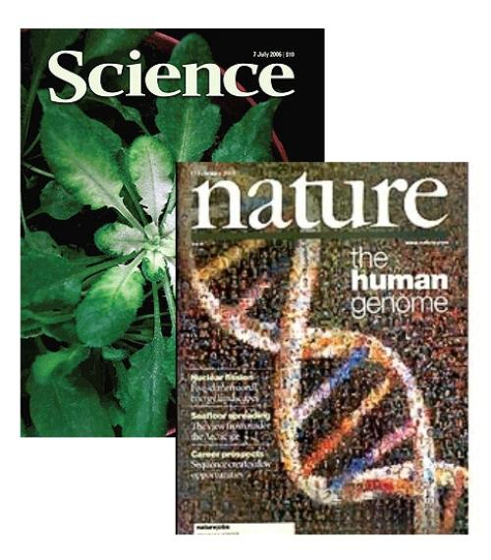
The Scientific Method
Step Six
Publish Findings
  Scientific Paper
    Abstract, Introduction, Materials & Methods, Results, Conclusions, Discussion
    Written in third person
    Paraphrase reference sources
  Results read and accepted by scientific peers
  Repeatability
    Experiment presented in detail so that it can be repeated by others
  Self Correcting
    If results cannot be duplicated or someone has a different hypothesis to solve the problem, then it will be presented and previous data will be corrected in time

Slide 29
What about Animal Studies?
Basic research and testing in animals
  Invertebrates to Non-human Primates
    Fruit fly, nematodes, zebrafish
    Mice, rats, guinea pigs, rabbits, cats, dogs, primates
In US, Animal Welfare Act & Guide for the Care and Use of Laboratory Animals, published by National Academy of Sciences
  Animal Tests should only be performed where necessary, meaning scientifically justified
  Animal Testing should cause as little suffering to animals as possible
Institutional Animal Care and Use Committee (IACUC)
  Including a licensed veterinarian
Institutional Review Board (IRB)
  Includes people from the community
Alternatives
  Replacement, Reduction, Refinement

Slide 30
What about Human Studies?
Regulated by FDA Law
  Drugs and Medical Devices
Internally regulated by IRB
Paid volunteers monitored under controlled conditions
Phase I Clinical studies
  Assesses Safety of Drug or Device
  Healthy volunteers (20-100)
  Measure absorption, metabolism, excretion, side effects
  Can take several months to conduct
  70% of experimental drugs pass this phase
Phase II
  Assesses efficacy in diseased patients
  Randomized double blind studies
    One group receives drug, one group receives standard treatment or placebo
    Neither patients or researchers know who received the experimental drug
  Measure relative safety and effectiveness
  Lasts several months to 2 years
  About 33% of experimental drugs pass both Phase I and Phase II

Slide 31
Human Studies? (continued)
Phase III
  More thorough understanding of effectiveness, benefits &
  range of adverse reactions
  Can last several years
  Randomized and blind testing
  70-90% that enter this phase complete successfully
  Pharmaceutical company can then request FDA approval for marketing
  the drug/device
Phase IV
  Post Marketing Surveillance Trials
  After approval for consumer sale
  Compare with other drugs/devices on the market
  Monitor long term effectiveness and impact on patient’s quality of life
  Determine cost effectiveness compared to traditional/other therapies
  Restrictions of use could be placed on the product pending results
  Drug or device could be taken off the market pending results

Slide 32
Ethics in Science
Standards of conduct in Science
Ethical conduct assures the reliability of research results and safety of research subjects
  Standards of methods/process that address
    Research Design/Procedures
    Data Analysis/Interpretation
    Reporting
Replication, collaboration & peer review all help to minimize ethical breaches and identify them when they do occur
National Science Foundation (NSF)
  Online ethics center for Engineering & Science
It is only with ethically performed experiments that data can
lead to progress and knowledge in science!

Slide 33
Have questionable scientific ethics tainted our past?
YES!
This will be the focus of your discussions this week!
Good news is that we have learned from our past and now move forward ethically!

Slide 34
Research Technologist?
Learn many techniques well, as they are your currency for a better job.
Never, never rush to the point of sloppiness.
  Remember, most research methods are manual, NOT automated.
Be sure to monitor precision, accuracy quality control and clinical quality as these may not be the basic scientist’s expertise.
Talk to the principal investigator, as a good technician can have good ideas, and a good scientist will listen!

Slide 35
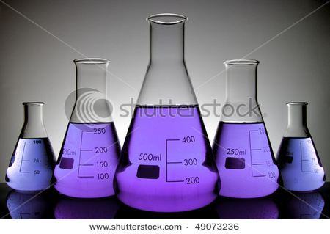


Slide 36
Bibliography
Carbone, Larry, (2004), What Animal Want: Expertise and Advocacy in Laboratory Animal Welfare Policy. Oxford University Press, pp. 68–69
Carpi, Anthony, Scientific Ethics, retrieved on Jan 22, 2012 from http://www.visionlearning.com/library/module_viewer.php?mid=161
Flecknell, P., (2002),Replacement, reduction and refinement. ALTEX 19 (2): 73–8
Online Ethics Center for Engineering and Research, retrieved Jan 22, 2012 from http://onlineethics.org/
Overview of Clinical Trials, CenterWatch, retrieved Jan 22,2012 from http://www.centerwatch.com/clinical-trials/overview.aspx
Research, presentation, copyrighted by Pesce Kaplan Pulbishers, provided by New York Methodist School of Clinical Laboratory Sciences December 2011
Bluebird image retrieved January 2012 from http://www.animalsw.com/wallpaper/Very-Blue-Bird-in-Morning/
Bluebird image retrieved January 2012 from http://www.statesymbolsusa.org/New_York/bird_E_bluebird.html
Bluebird feeder image retrieved January 2012 from http://www.drsfostersmith.com/pic/article.cfm?aid=1890
Clip Art retrieved January 2012 from world wide web
Cucumber image retrieved January 2012 from http://health.howstuffworks.com/skin-care/moisturizing/products/cucumbers-for-eyes.htm
Glassware image retrieved January 2012 from http://www.shutterstock.com/pic-49073236/stock-photo-five-vials-of-purple-liquid-conical-laboratory-on-a-white-background.html
Journal image retrieved January 2012 from http://www.sciencemediacentre.co.nz/2009/03/25/mits-opejn-access-push-for-scientific-research/
Scientific Method Image retrieved January 2012 from http://www.yale.edu/ynhti/curriculum/units/2008/6/08.06.09.x.html

