Slide 1
Healthcare delivery systems
Christina A Nevel-McGarvey, PhD, MS, MT(ASCP)

Slide 2
Policy and reform

Slide 3
Reform Occurs When and Where Problem, Policy, and Politics Meet
Kingdon’s Model of Agenda Setting says:
Problem Stream
Cost Crisis, Economy,
Rising Unemployment
Political Stream
Policy Stream
Grassroots mobilization
Window of Opportunity

Slide 4
The Health Care System is Broken:
Costs are out-of-control:
$2.4 trillion spent on health care in 2008
  Represents 16.6% of Gross Domestic Product
  By 2015, it is projected be 20% of GDP
Health Insurance Coverage is in Crisis:
47 million people are uninsured (15.5%)
  52 million people are considered medically disenfranchised (i.e. they do not have a usual source of care, even if they are insured)
  13.2 million (28%) of the uninsured are aged 19-29
The Delivery System is Strained:
Disparities in quality and access
  Medical errors, birth weight outcomes, hospital readmit rates, and waiting times for ER visits and specialty care indicate that we do not have the best health care system in the world.

Slide 5
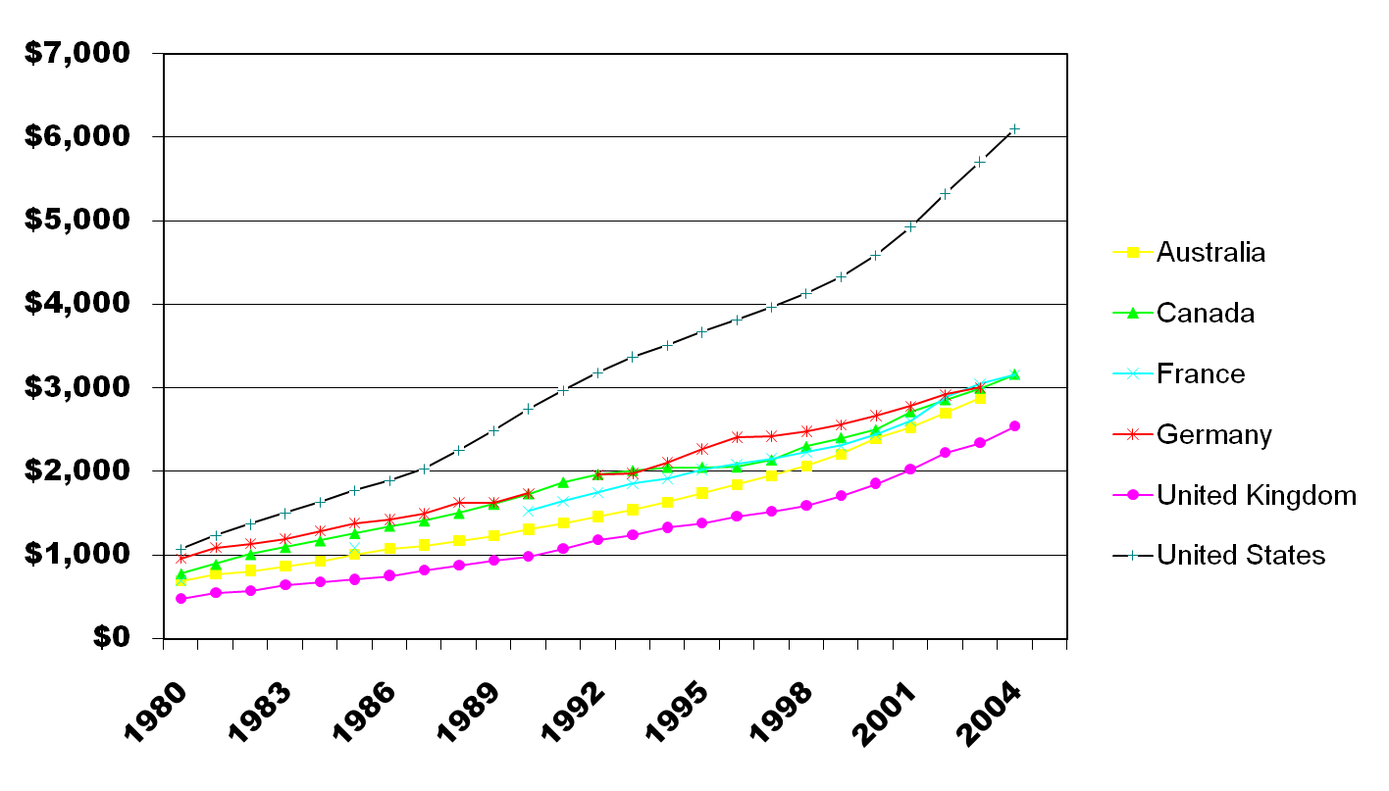
Health Care Spending per Capita,1980-2004
- adjusted for cost of living differences -
U.S.: $12,357 per person, 20% of GDP by 2015
Source: The Commonwealth Fund, calculated from OECD Health Data 2006.

Slide 6
Health Care Spending
The U.S. spends more than any other country in the world, on a per person basis, for health care.
It represents over 16% of GDP now, and should surpass 20% by 2015.
Our rate of increase has gone up drastically since the late 80s.
The rate of increase was slightly better from 1995 to 2000 when managed care was seen as the “cost savior”, but has ticked up sharply at an unprecedented rate since them.
We see these cost increases in both cost of services and the premiums paid by employers and individuals for health insurance premiums.

Slide 7
Health Spending in the U.S.
Compared to Other Industrialized Countries, 2003
Per capita spending data shows that we almost double other countries in terms of spending per person.
We spend much more on both inpatient, outpatient, pharmacy, and nursing home care.
Despite data that shows the U.S. has lower rates of hospitalization, we spend more on inpatient stays than any other country.
Our reliance on outpatient procedures does not appear to help in terms of cost savings.
Even though the U.S. is not a “government-run” health system, we spend more than Japan, Germany, and France in direct government spending.
In Japan, Germany, and France the residents put money into a “social security” type of pool that supports their health care system and regulates the delivery of health care.
In Canada, tax dollars into provincial governments result in the higher government spending for health care.
However, all 4 countries spend much less on health care than we do, which these percentages do not show. It is probable that the 32% of government spending in the U.S. exceeds the government/social security spending in most of the other 4 comparison countries.

Slide 8
Half of the Population Uses Very Little Health Care:
97% of all health spending is concentrated in half of the population!
Spending on health care is concentrated among select members of the population.
The elderly and chronically ill represent a large portion of health care spending.
The top 1% of the U.S. population is responsible for using health services (22% of all costs in 2002), while the bottom 50% of the population resulted in only 3% of all health care spending.
In California, the top 20% of the Medicaid population (aged, disabled, and chronically ill) represent almost 80% of the health spending in Medicaid.
Many U.S. residents do not use health care at all, which is also not appropriate.

Slide 9
The elderly and low-income spend much more of their income on health care than other age and income groups.
It appears to confirm that the elderly and medically needy spend more out of pocket than their younger, insured, and higher income counterparts as a percentage of their annual income.
The burden of our health care problems often falls on the poor and the elderly, regardless of insurance status.

Slide 10
What is our “System?”
Financing and Structure of the System are Intertwined
Different Components of the Health Care System are financed and regulated in different ways
  Public Health Activities
  Care for the Uninsured
  Government Programs
  Hospitals
  Community Health Centers
  Free Clinics
  Private Physician Offices
  Medical Groups
  TriCare/CHAMPUS/Military
  Employer-based Insurance
  Individually-Purchased Insurance
  Indian Health Services
  HIV/AIDS-related care
  Insurance Companies
  Veterans’ Affairs (VA) Health Care
  Workers’ Compensation
  Children’s Health Care

Slide 11
Does our System make sense?
It appears to be based on a combination of incremental and comprehensive changes that began near the beginning of the 20th century:
Workers’ Comp, growth of almshouses and pest houses that became hospitals, self-pay health care, employer-based insurance during and after World War Two, disease monitoring and epidemiology since the days of cholera, Medicare and Medicaid, responses to specific diseases like HIV/AIDS, SCHIP, etc…
We truly have a “system” patched together by various payers and interest groups that do not embody a well-planned system. However, this web of intertwined systems have many gaps, especially for the uninsured, other vulnerable populations (like the chronically ill or people with limited English proficiency), the homeless, some young people (aged 19-29), and people who do not have generous health care benefits.
Two-tiered system results in rationing care, even if we do not usually hear it framed that way. Opponents of health care reform often say that universal health care will bring about rationing – in actuality, we are rationing care in the U.S. right now along social class, employee type, health status, and racial/ethnic lines.

Slide 12
The Challenges of Basing a System on Employer Provided Insurance
As health care costs increase, employers are faced with difficult choices:
  Reducing benefits or not offering
  Reducing choice of potential plans
  Offering high deductible, catastrophic plans
  Establishing different requirements for health benefit participation
    Minimum hours, waiting periods, workers must higher percentage of employer-negotiated premium
Employers negotiate directly with insurers for benefits and premiums
  Smaller employers have less leverage due to smaller risk pool
  Can represent a significant cost when workforce and retirees age, get sicker, and ultimately use more health care

Slide 13
Sources of Commercial Insurance
Group (Employer-Based)
  In the past, commercial insurance was known as “Major Medical” – Benefits similar to Medicare Part A
  Currently, employer-based insurance benefits are more comprehensive
Individually Purchased (Non-Group Market)
  Premium and Benefits based on risk profile of the individual policyholder
  Tends to be more expensive for the individual
  Limitations due to pre-existing conditions
  Medical Bankruptcy and foreclosures:
    A Harvard Study (Himmelstein, 2005) found that medical bills were cited in half on all personal bankruptcies, many of which were experienced by families WITH health insurance coverage.

Slide 14
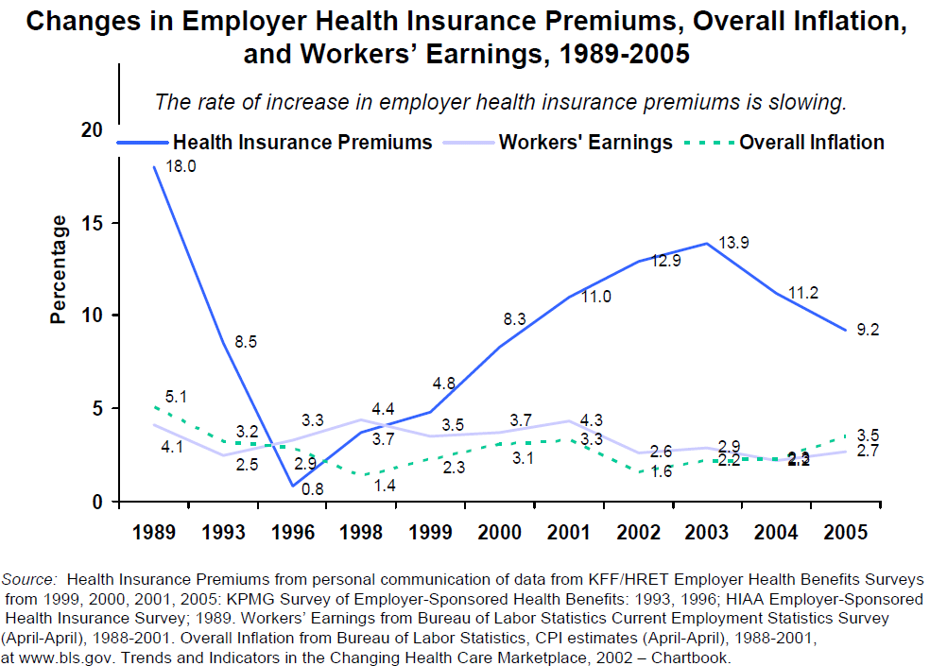
We haven’t had a drop in the rate of premiums in over 20 years.
Also, small employers face larger % changes due to lower levels of negotiating power.
The annual premium that a health insurer charges an employer for a health plan covering a family of four averaged $12,700 in 2008. Workers contributed nearly $3,400, or 12 percent more than they did in 2007.2 The annual premiums for family coverage significantly eclipsed the gross earnings for a full-time, minimum-wage worker ($10,712).
Percentage of premium increases (10%+) over the last few years is much higher than Medical Services Inflation (3-4% per year)

Slide 15
Main Governmental Sources of
Health Insurance Coverage
Two programs were voted into law in June of 1965 and implemented in July of 1966.
  Title XVIII (Medicare) and XIX (Medicaid) of the Social Security Act
  Medicare is “social insurance”
    Designed for people with disabilities or the elderly who meet specific requirements, lifetime benefit
  Medicaid is a “welfare program”
    Designed for needy people who are categorically eligible (not a guaranteed benefit)
State Children’s Health Insurance Program (SCHIP)
  Created in 1997 as part of the Balanced Budget Act
Notes:
Medicare, Medicaid, and SCHIP are all aimed at insuring people who cannot afford coverage or would otherwise be unable to get insurance due to disability, age, medical needs, and overall cost.
They represent almost half of the health care expenditures for the population.

Slide 16
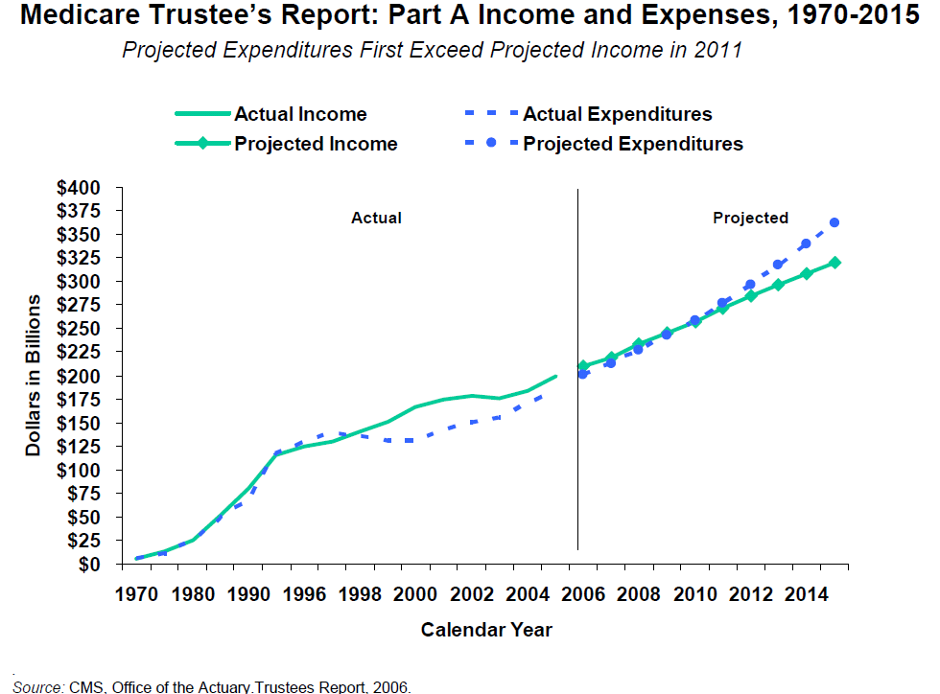
There is concern, much like Social Security, that Medicare will not be able to handle all of the aging baby boomers and rising health care costs.

Slide 18
The Uninsured: At Serious Risk
The uninsured in the U.S. face huge obstacles when attempting to access health care:
  Many private providers will not accept them
    The burden is placed on community health centers, public hospitals, and emergency rooms
  Some are considered uninsurable due to pre-existing conditions, but cannot qualify for Medicaid
  Cannot afford full cost of visits
    This can lead to medical bankruptcies and foreclosures
    There is some evidence that cost-shifting has resulted in the uninsured being billed for full charge, even higher than commercially insured patients

Slide 19
The U.S. also faces problems related to:
Health Care Disparities
  Racial/Ethnic, Language, and Gender differences in outcomes and access
  These differences persist even with insurance coverage
Medical Errors
  44,000 to 98,000 preventable deaths
Emergency Room overcrowding
  Waiting Times
  Throughput, Discharge Planning, Staffed Bed Supply
Some areas do not have appropriate numbers of primary care and specialty physicians (i.e. physician maldistribution)
Hospital Re-Admission Rates

Slide 20
The Flow of the Dollar
Costs, Payment, Delivery, and Insurance Coverage are completely intertwined in our system!
Insurance Company
Physicians
Government
Employer
Individually Insured
Uninsured
Publicly Insured
Insured Employees
Payment made to this entity
Service provided by this entity to individuals
Source: Roby DH. 2009 (forthcoming). Impacts of Being Uninsured in Handbook of Health Psychology (edited by Suls, Kaplan, Davidson), Guilford Publications: New York, NY.

Slide 21
Controlling Costs
Government has been a major proponent of cost controls
  Prospective Payment
    Use of Diagnosis Related Groups
  Managed Care
    Capitation (HMO and POS)
    Discounted Fee-for-Service (PPO and POS)
How do differential cost controls impact hospitals, clinics, and physician providers?
  Lower payments for Medicaid and Medicare
  Insurance companies have increased leverage to negotiate prices due to managed care contracting
  Cost Shifting impacts delivery and coverage

Slide 22
Impacts of Medicare Prospective Payment System
The use of PPS and lower Medicaid fee schedules has resulted in providers needing to subsidize their government-funded care with commercial insurance billing (aka COST SHIFTING).
When negotiating contracted rates, private physicians and hospitals must negotiate a high enough rate from commercial sources to compensate for the relatively lower rates from Medicaid and Medicare.
Now, with managed care, it is growing harder to negotiate high enough rates to compensate.
In the hospital, Medicare and Medicaid often result in financial losses, especially if a hospital is not in a state with high enough inpatient Medicaid rates.
  California is notorious for paying about 80% of cost, while Medicare pays 90%, and private insurers (negotiated rates) tend to be 100-110% of cost. Not a lot of room for a hospital to stay financially solvent. This puts hospitals with a high Medicare, Medicaid, and Uninsured caseload in a predicament.

Slide 23
Why Does the U.S. Spend So Much More on Health Care?
Compared to other Industrialized countries, the U.S. has:
  Fewer physician office visits per capita
  Fewer hospital inpatient admissions per capita
  Lower Average Length of Stay (ALOS) per admission
  Fewer hospital inpatient days per capita
  Higher (but not the highest) use per capita of selected high-tech procedures (MRI, CT, angioplasty, dialysis)
If expenditures = prices x quantity, and quantities are not higher in the U.S., then prices must be higher!
Notes:
23

Slide 24
Profits for Health Insurers
Profits for health insurance companies and pharmaceutical companies continue to increase
  In 2006, the top 18 health insurers made $15 billion in profits
  In 2006, pharmaceutical industry profits were 19.6%
    2nd most profitable industry, behind the oil industry
Insurers profit from privatized government programs
  The Medicare Advantage (Part C) program results in $18 billion in overpayment to insurance companies when compared to traditional Medicare Fee-for-Service (FFS)
    Outcomes are not better for Medicare HMO enrollees
    Rates paid to private insurers are much higher than cost of Medicare FFS claims

Slide 25
Possible Reforms and
Future Financing
Restructure our Current System
  Indirect Subsidies and Consolidation could be used to insure Uninsured
  There is enough money in the system to care for everyone, but it is not being used efficiently and effectively! (Obama and Baucus)
Market-Based Approach
  Consumer Choice – high deductible plans, health savings accounts, provider fee transparency (McCain)
Complete Dismantling of Current System
  Can universal health care survive in a for-profit system? (Conyers)
Is Universal Insurance required, or Universal Access?
  President G.W. Bush’s health care reform efforts were based upon expanding the safety net (Community Health Centers), rather than insuring the uninsured.

Slide 26
Current Reform Models
Policy Choices are numerous, if there is political will and priority given to health care:
  Individual Mandate
  Employer Mandate
  Pay-or-Play Provision
  Tax Credits for Health Insurance
  Expansion of Safety Net Providers
  Health IT (EMR) and Comparative Effectiveness
    Designed to create efficiencies and save money on services, avoid duplication
  Introduction of Public Health Insurance Plans
    Benchmark Plan
    Based on community rating, risk adjustment/reinsurance
    Will insure those who cannot get other coverage
      Pre-Existing Conditions
Notes:
Discuss issues around ADVERSE SELECTION and CROWD OUT

Slide 27
Where is Reform Occurring?
Since Clinton’s failed attempt at universal health care in 1994, most efforts have been at the state-level
  Massachusetts’ recently passed a universal health care reform
    Individual Mandate – requires all residents to have insurance coverage, while providing subsidies to those who cannot afford to buy on the private market
    Health Insurance Connector
    Expansion of state Medicaid and SCHIP eligibility plans
Other states have tried and failed
  California was close to a compromise to allow for an individual mandate, similar to Massachusetts
  Budget problems derailed the reform effort
  Hawaii was able to enact an employer mandate in 1974
  States are considered “laboratories of democracy”

Slide 28
Problems with State-Level Reform
Complications due to:
  State Budgets
    Current economic situation can derail efforts
  ERISA
    Employee Retirement and Income Security Act
    Federal Law that preempts state laws mandating employer provision of specific benefits
  Centers for Medicare and Medicaid Services (CMS)
    Changes to Medicaid or SCHIP state plan require approval of waiver or change in federal regulations
    G.W. Bush was not supportive of changes in eligibility requirements
    Obama administration is supportive and actively pursuing expansions

Slide 29
Obstacles to Reform
Frequently, universal reform efforts have been led by elites
  Clinton’s health care plan was written in a “vacuum”, rather than seeking consensus from political figures
    Even proponents of universal health care opposed Clinton’s plan
Interest groups, especially business, are powerful
    Campaign financing is loosely regulated
    Political Parties are weak and de-centralized
    Pharmaceutical companies, the American Medical Association, and other special interest groups have interest in maintaining status quo → Health Care = $$$$
Major Stakeholders and Politicians cannot agree on the best solution
  Universal coverage can have many different forms
  Grassroots mobilization could turn the tide
    This economic downturn, with its rising unemployment, could create class of uninsured and underserved that is vocal, motivated, and in serious need of reform

Slide 30
Patient Protection and Affordable Health Care Act signed into Law by President Obama on March 23, 2010
Employer Mandate – Large employers would be required to pay portion of payroll tax into fund (Pay-or-Play) – 5% or more
  Lower costs for businesses by covering a portion of the catastrophic health costs they pay in return for lower premiums for employees.
Require insurance companies to cover pre-existing conditions so all Americans regardless of their health status or history can get comprehensive benefits at fair and stable premiums.
Create a new Small Business Health Tax Credit
Establish a National Health Insurance Exchange to allow individuals and small businesses to buy affordable health coverage.
Subsidy through personal tax credits based on income
Additional steps to create efficiencies and reduce costs:
  Health Information Technology (HIT) investment
  Disease Management for chronic illness
  Limits on overhead; greater transparency
  Allow safe pharmaceuticals from other countries
  Prevent insurers from overcharging doctors for their malpractice insurance
  Reduce preventable medical errors.

Slide 31
Opponents of “Obamacare”
Unconstitutional Individual Mandate
New Tax Increases
New Entitlement Expansion
Unworkable and Costly Insurance Provisions
Fails to Control Cost
Law Concentrates enormous power in the US Dept Health & Human Service
Creates Giant Federal Network of Micromanagement of Health Plans

Slide 32
Alternatives
Provide individual tax relief to all persons purchasing private health insurance
Eliminate barriers to individuals purchasing health insurance across state lines
Allow employers to convert health care from a defined package to a defined contribution system
Promote new group purchasing arrangements
Improve consumer directed health options such as health savings accounts
Extend rational preexisting condition protections
Encourage the states to set up pools, like high risk pools
Combat fraud and abuse of Medicare

Slide 33
What is next?
It appears that the window of opportunity may be open
  Economy is in crisis
  Unemployment and loss of insurance are big problems
  Reformers need to take advantage of these opportunities

Slide 34
As laboratory employees, what can we improve on a daily basis?

Slide 35
Quality, Safety & reliability in healthcare delivery!

Slide 36
Paradox of Plenty
  Most advanced healthcare system in the world
  High Cost, Low Quality
  For the money the United States spends on healthcare, about $2.5 trillion a year – the quality of care is unacceptably low
  Each year as many as 15 million patients harmed in some manner by America’s healthcare system

Slide 37
Life Expectancy at Age 65
Source: The Commonwealth Fund, calculated from OECD Health Data, 2005.

Slide 38
Infant Mortality Rate per 1000 Live Births
Source: Commonwealth Fund National Scorecard on U.S. Health System Performance, 2006. Data: 2002 rates International estimates—OECD Health Data 2005; State estimates—National Vital Statistics System, Linked Birth and Infant Death Data (AHRQ 2005a).

Slide 39
Deaths due to Surgical or Medical Mishaps per 100,000 Population
Source: The Commonwealth Fund, 2004 data calculated from OECD Health Data 2006.

Slide 40
Quality in Healthcare…
What is it?
  It depends!

Slide 41



Quality Efforts in Healthcare
Quality pioneers have different opinions:
  Dr Joseph Juran – “fitness for use”
  Philip Crosby – “zero defects”
  Dr Edwards Deming – “never-ending
  cycle of continuous improvement”

Slide 42
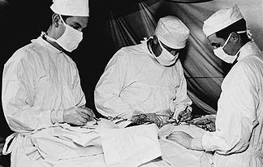
Quality Efforts in Healthcare
Quality in healthcare originally defined by those who provided it
    American Medical Association circa 1850
    Abraham Flexner Report, 1910 – Carnegie Foundation
    Ernest Codman, 1910 - Mass General
    American College of Surgeons, 1917 – Hospital Standardization Program

Slide 43

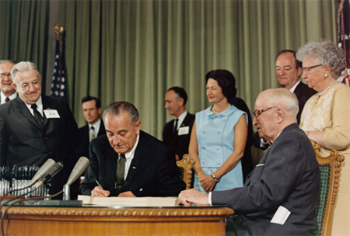
Quality Efforts in Healthcare
Joint Commission formed - 1952
    Followed ACS “minimum standards”
        American Medical Association
        American College of Physicians
        American Hospital Association
    1966 - “Optimal achievable standards”
Federal Government - 1965
    Medicare signed into law
    Conditions of Participation

Slide 44

Quality Efforts in Healthcare
Federal Medicare and Quality
    Initially “quality” efforts were punitive in nature
    Length of stay variation and “bad apples”
    1995 – CMS began movement of education and collaboration on QI and PS initiatives via state-based Medicare Quality Improvement Organizations (QIOs)
State Governments
    Initial focus on physician and other practitioner licensure
    More recent focus on hospitals and “incidents”

Slide 45
Movement to data-based quality assessment
“In God we trust
All others bring data”
W. Edwards Deming

Slide 46
Those who pay for care are now writing the “Quality Agenda” using data
  Federal Government
      QIOs
      Medicare Compare
      Joint Commission “deemed status”
  State Governments
      Increased licensing requirements
      State review boards
      Public report cards
  Corporations
      Leapfrog
      Business health coalitions
  Private Insurers
      Pay for performance
      Patient Centered Medical Homes
  Consumer Groups
      Rankings and advisory groups
      HealthGrades.com
      Angie’s List

Slide 47
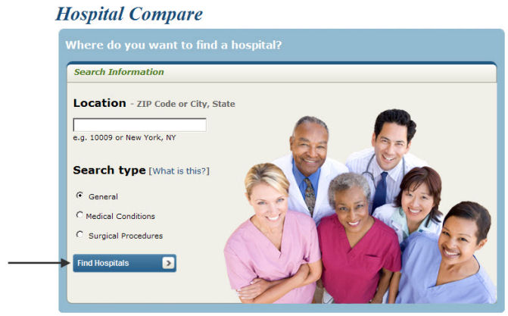




Those who pay for care are now writing the “Quality Agenda” using data

Slide 48

Healthcare Quality – Keep it Patient Focused
Doing the right thing,
the right way,
at the right time,
in the right amount,
for the right patient
that does not result
in harm to the patient

Slide 49
US Hospital Care.
The Best on Earth,
but Not the Best it Could Easily Be!
Most American hospitals are safe for the vast majority of patients, the vast majority of time
The vast majority of patient care givers are well trained and conscientious
Western medicine’s ability to save and extend human life is nothing short of miraculous… however…
    ~100 K avoidable hospital deaths
    Hospital medical errors costing between $20 – 30 billion
    2+ million hospital acquired infections
    5% to 7% of all hospital admissions involve an adverse drug event (ADE) and another 10% experienced the risk of an ADE

Slide 50

Quality and Patient Safety
If the patient is not safe from accidental harm, then high-quality healthcare cannot exist

Slide 51
What do we mean by Patient Safety?
    A culture that embraces the reduction of medical errors, complications, and other unanticipated adverse events which contributes to improved clinical outcomes through the adoption and management of evidence-based practices, processes, and systems

Slide 52
What do we mean by Patient Safety?
Distinction between patient safety issues (errors) and quality concerns
  Operating on the wrong knee (error) vs. not using the proper surgical approach (quality)
  Overdosing a diabetic patient on insulin (error) vs. failing to properly control a patient’s diabetes (quality)
  Illegible prescription order (error) vs. not prescribing the most effective antibiotic (quality)

Slide 53
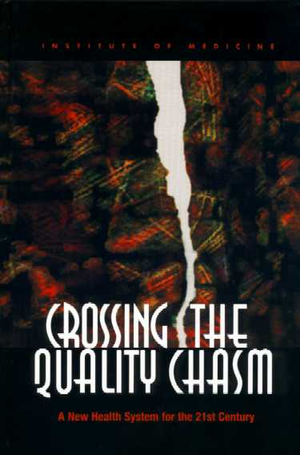
Characteristics of a Quality Healthcare System when the Appropriate Systems are in Place
It is safe
It is effective
It is efficient
It is patient centered
It is equitable
It is timely
Institute of Medicine
2001

Slide 54
The Need for Systems
Factors that create the fertile ground for
medical errors and mistakes:
Our God given inherent limitations of human performance
The evolution of our present healthcare culture

Slide 55
Our God Given Inherent Limitations of Human Performance
Errors happen to human beings all the time… that’s why we’re human
We can only hold 5 to 7 pieces of information in our short term memory
Complexity of healthcare today is staggering
Fatigue: 24 hours without sleep
Pace + Complexity + Human Limits = fertile ground for patient safety errors and mistakes
  pharmaceuticals, bio-technology, use of complex technology, and increasing types of modalities

Slide 56
The Evolution of Our Healthcare Culture
“Culture has a profound influence on individual behavior”
Focus on individual performance and individual patient outcomes
Errors, mistakes, and “near misses” rarely disclosed or admitted to
Hierarchical and Authority Issues
Difference in communication styles

Slide 57
It’s the System…
Most medical errors are made by well intentioned, well educated, well trained human beings who have become accustomed small glitches, routine foul-ups, and a culture that suppresses doing anything much about them in the name of overriding goals

Slide 58

If we don’t focus on systems and processes, errors are destined to be repeated
Human Factors Error Reduction Strategies incorporated into processes and systems
    Avoid reliance on memory
    Standardization
    Checklists
    Forcing Functions
    Checklists
    Eliminate look-alikes
    Create redundancy

Slide 59
The end!
Be and do your very best everyday to serve the patient, and make informed choices on reform!

Slide 60
Bibliography
Keimig, H John, (2011), Quality, Safety and Reliability in Healthcare Delivery, Northeast Regional Patient Safety & Quality Improvement Conference, Retrieved February 4, 2012
Ledford, Meredith King, et al., (2008) The Health Care Delivery System: A Blueprint for Reform, retrieved February 4 2012 from http://www.americanprogress.org/issues/2008/10/health_care_delivery.html
Roby, Dylan H, (unknown), The U.S. Healthcare System Health Policy and Potential for Reform, presentation provided February 2012 by New York Methodist Hospital School of Clinical Laboratory Sciences
Tachman, Mary, et al., (March 2011) Re-Forming Health Care Delivery Systems: A Summary of a Forum for States and Health Centers, National Academy for State Health Policy Forum, June 2010, retrieved February 4, 2012 from http://www.nashp.org/publication/re-forming-health-care-delivery-systems
The Heritage Foundation, retrieved February 4, 2012 from http://www.heritage.org/issues/health-care/health-care-reform/federal-health-care-proposals/obamacare
The Joint Commission Quality Check, retrieved February 4, 2012 from http://www.qualitycheck.org/consumer/searchResults.aspx?ddstatelist2=RI&ddcitylist=&st_cd=&st=RI&st_nm=RHODE+ISLAND&cty_nm=&cty_id=-1&provId=2&provIdtracker=2
The Leapfrog Group, retrieved February 4, 20012 from http://www.leapfroggroup.org/cp?frmbmd=cp_listings&find_by=city&city=Boston&state=MA&cols=oa
U.S. Department of Health & Human Services, retrieved February 4, 2012 from http://www.hospitalcompare.hhs.gov/Hospital/Search/compareHospitals.asp

