Slide 1
Immunology/Serology Week 4 Seminar
Christina A Nevel-McGarvey, PhD, MS, MT(ASCP)

Slide 2
Week 3 Quiz
REVIEW

Slide 3
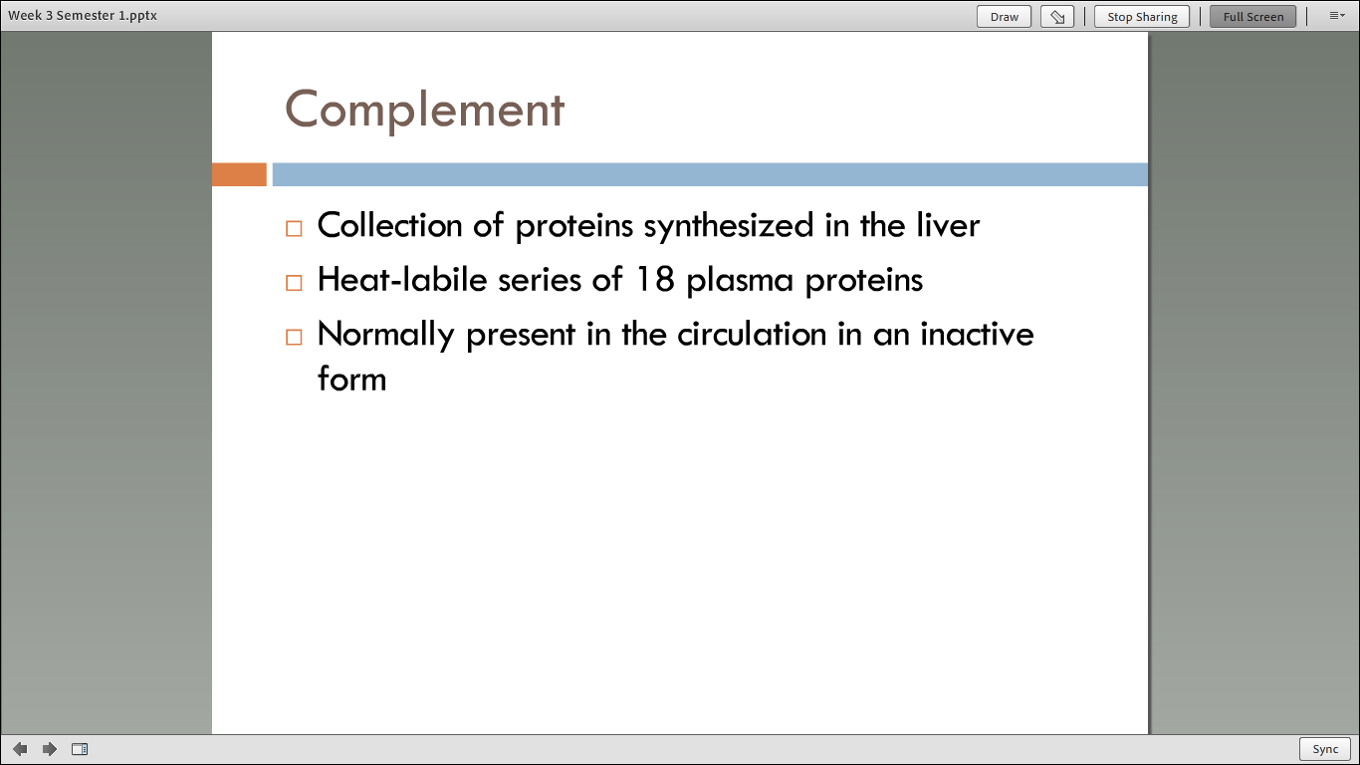

Slide 4
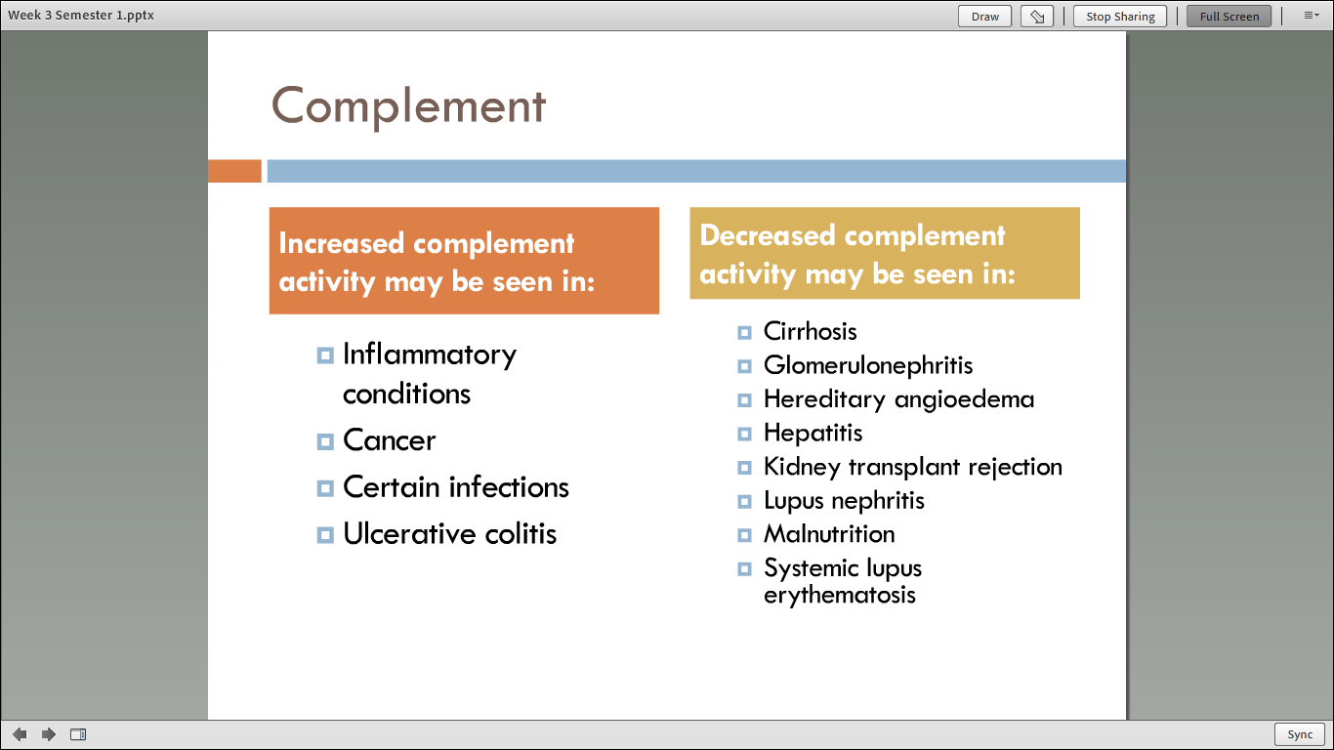

Slide 5
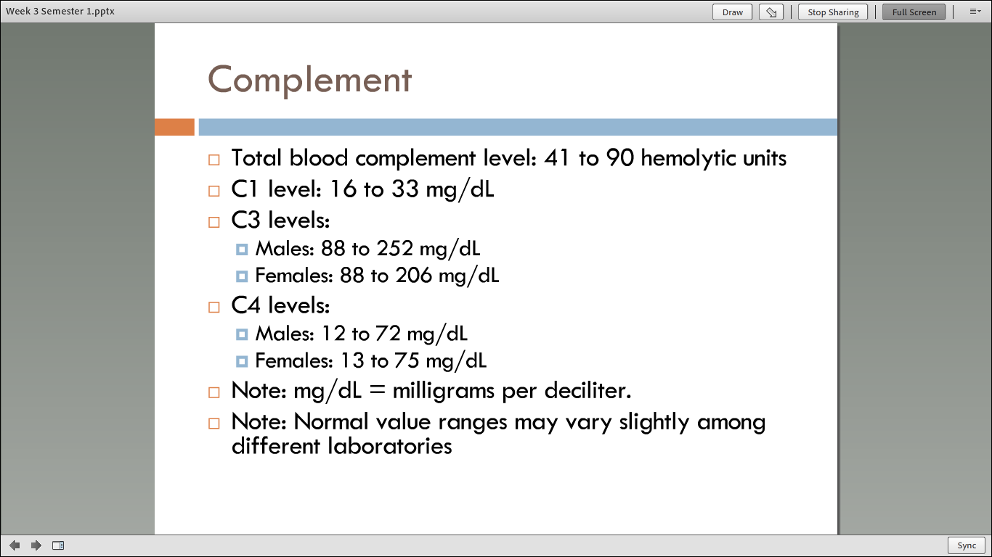

Slide 6
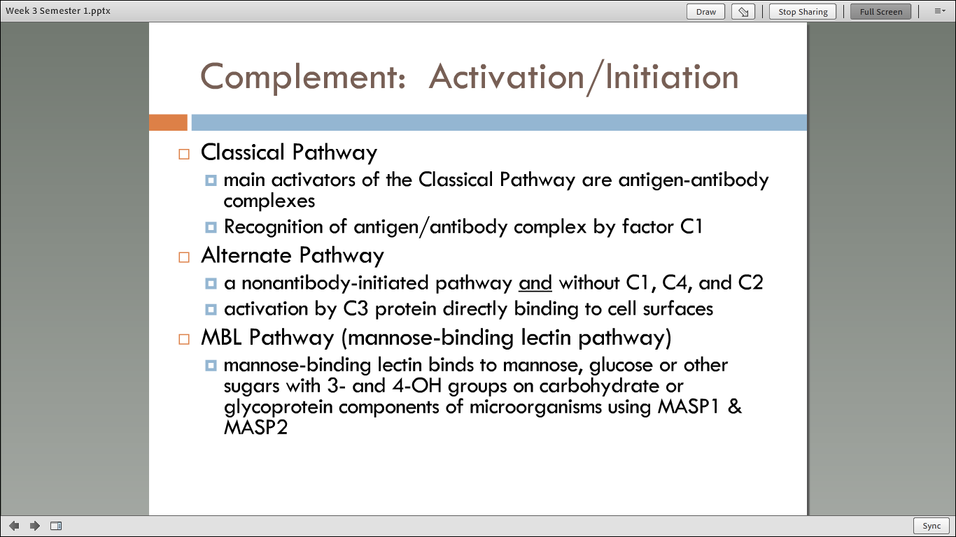

Slide 7
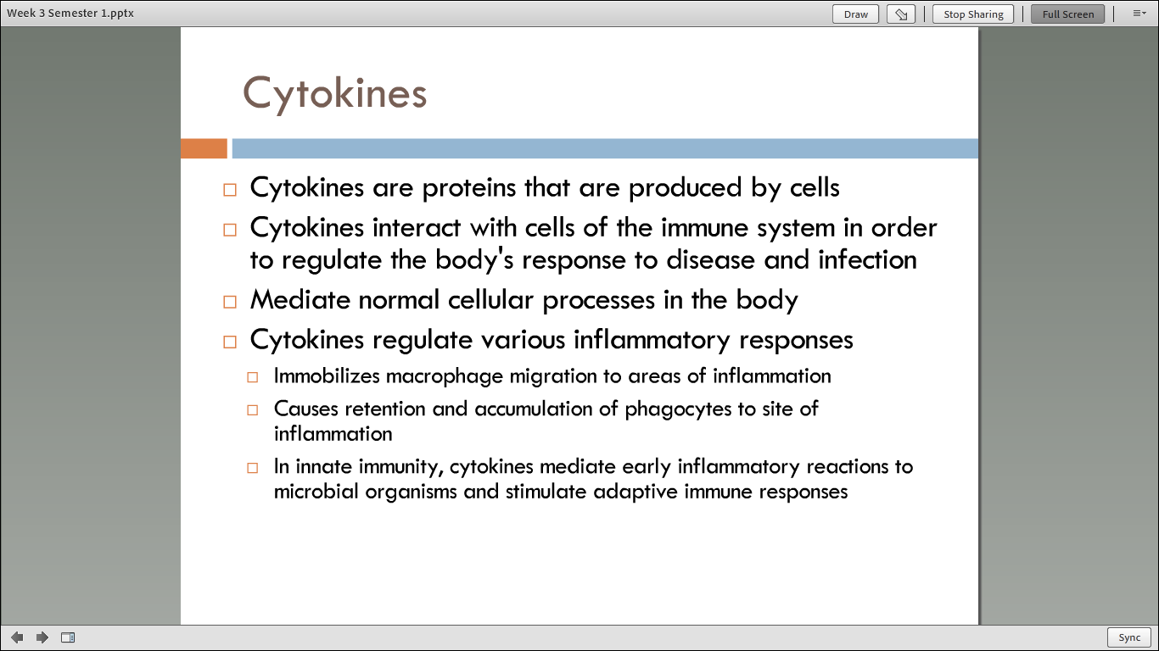

Slide 8
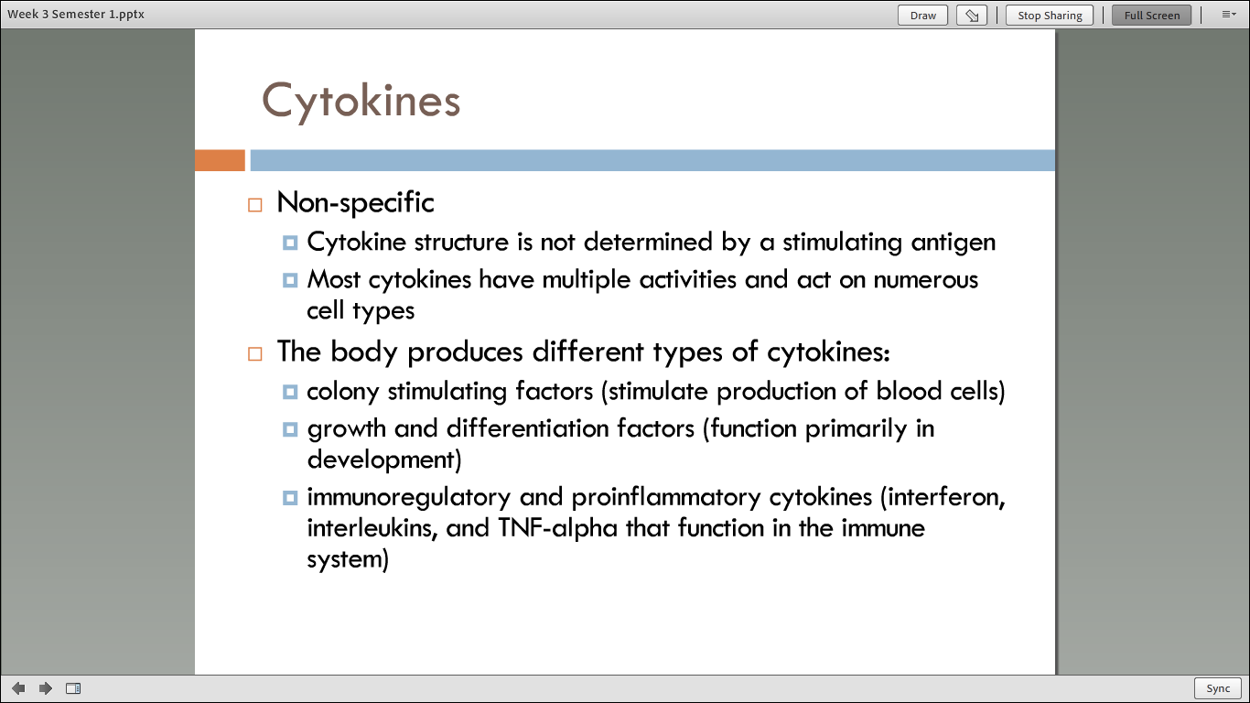

Slide 9
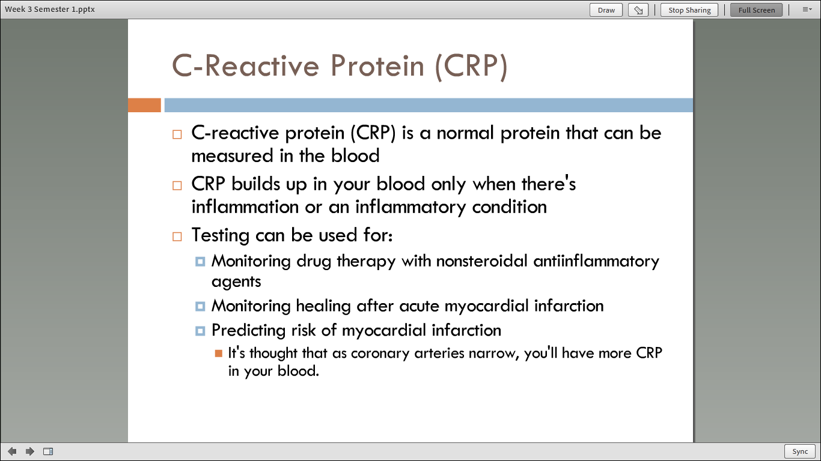

Slide 10
Week 4 Vocabulary
REVIEW

Slide 11
WEEK 4 Content
REVIEW

Slide 12
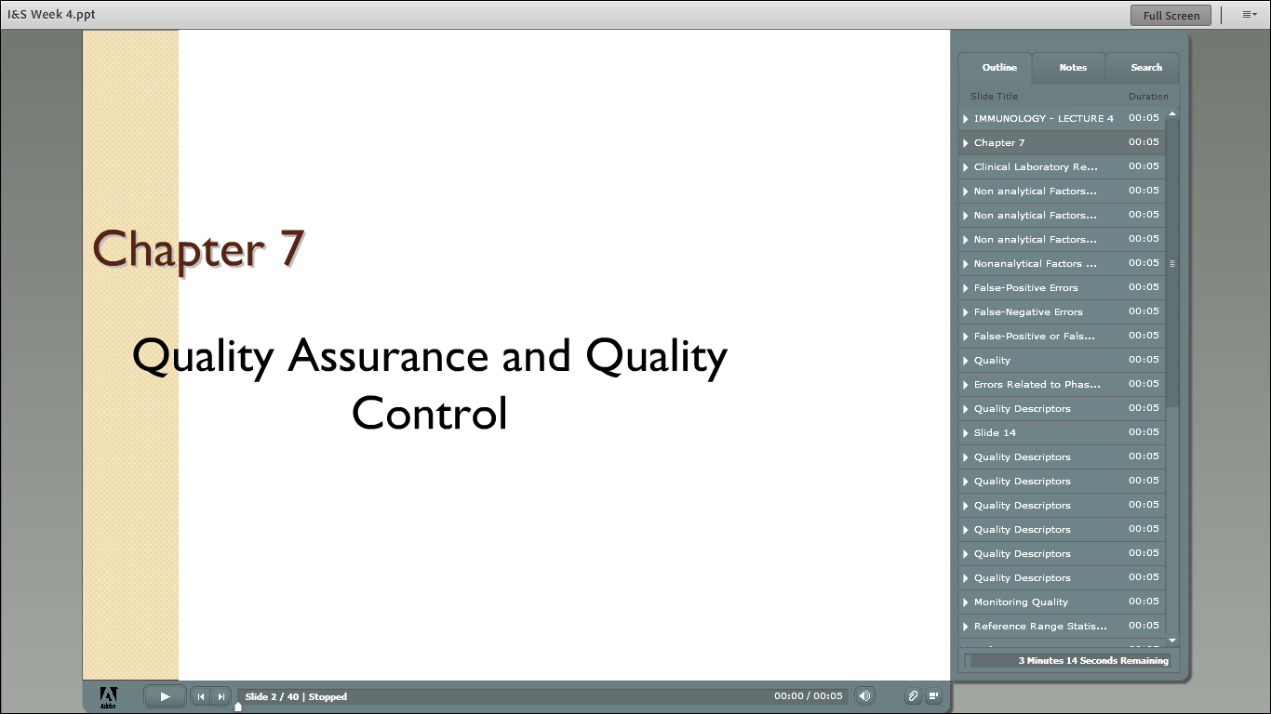

Slide 13
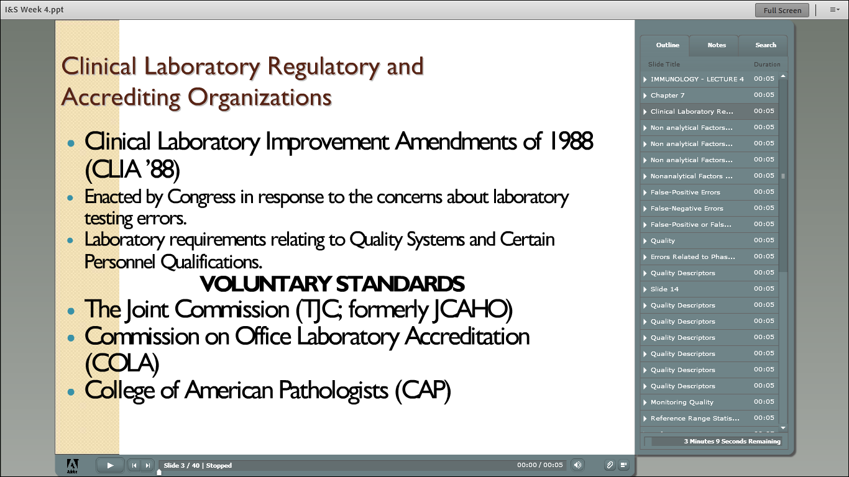

Slide 14
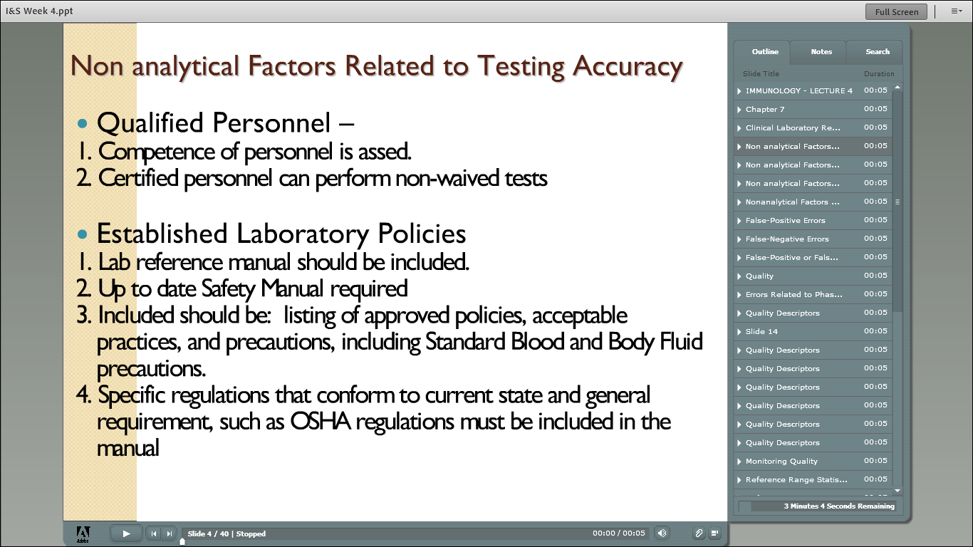

Slide 15
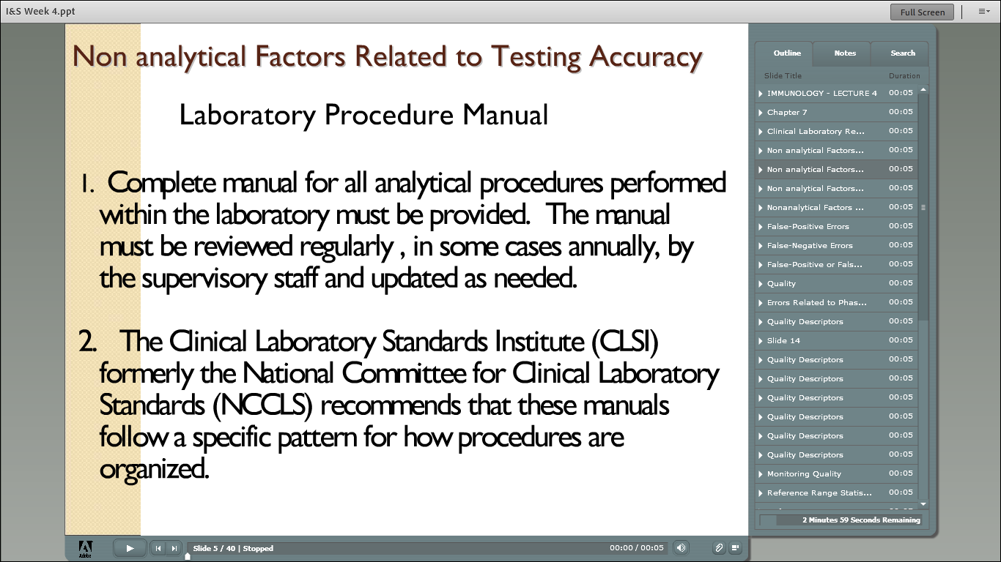

Slide 16
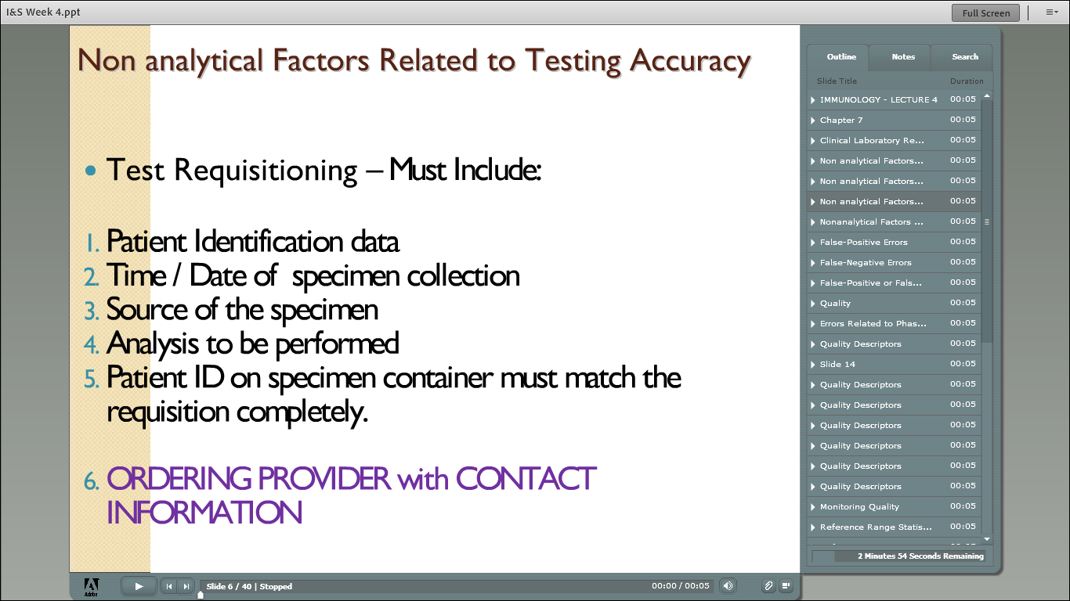

Slide 17
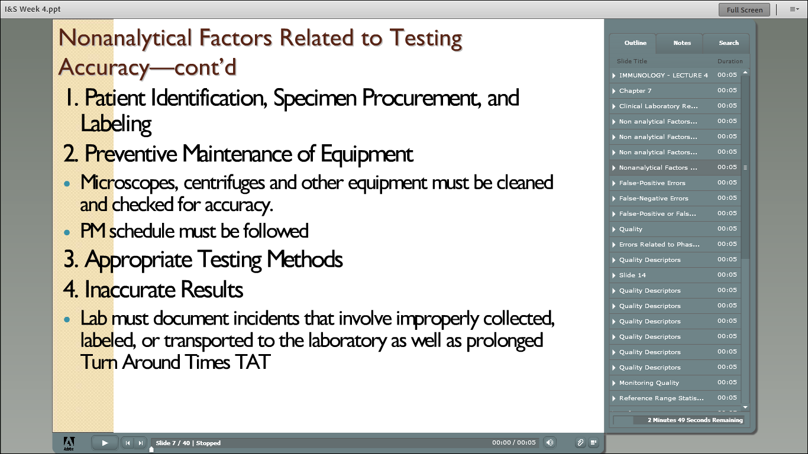

Slide 18
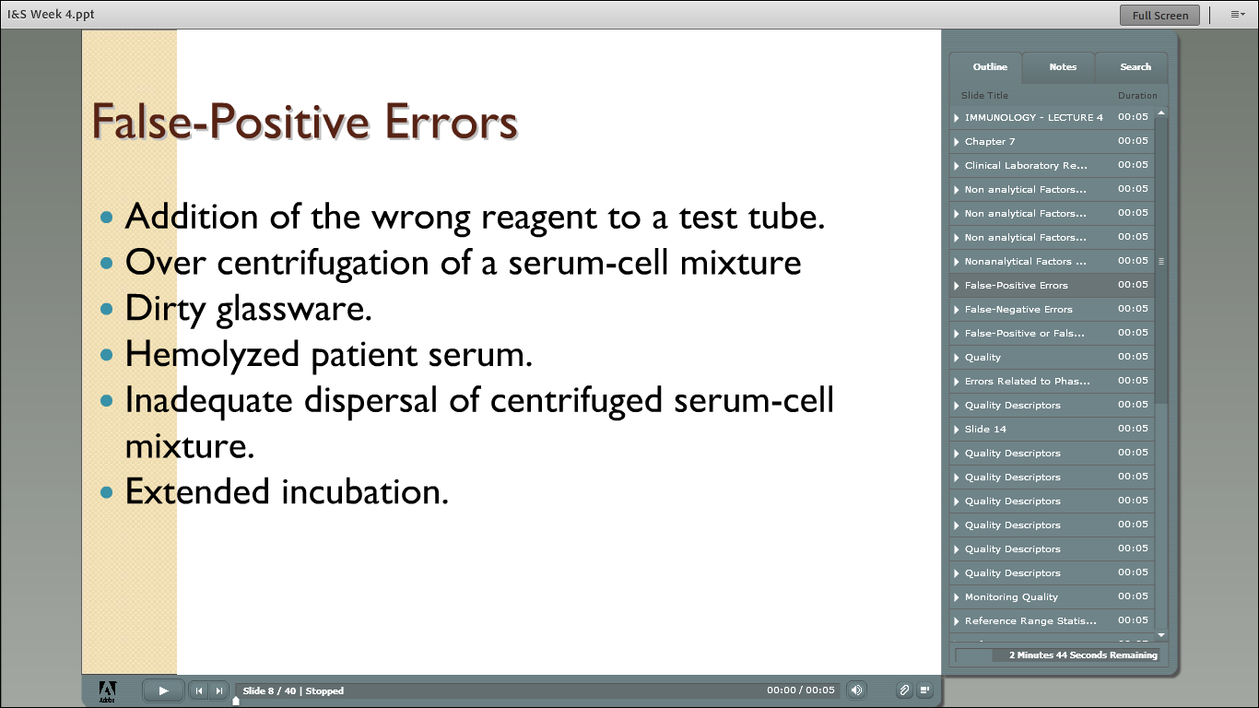

Slide 19
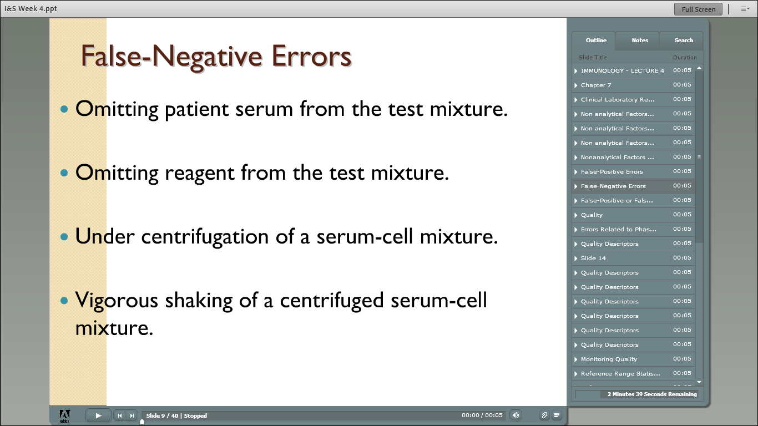

Slide 20
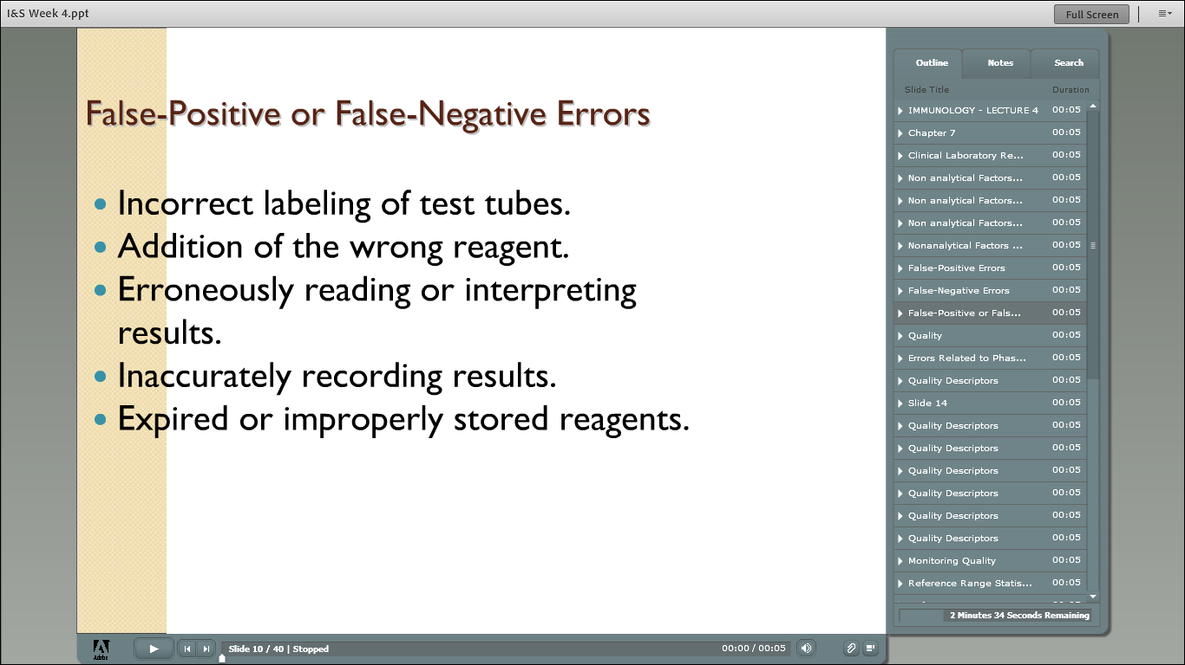

Slide 21
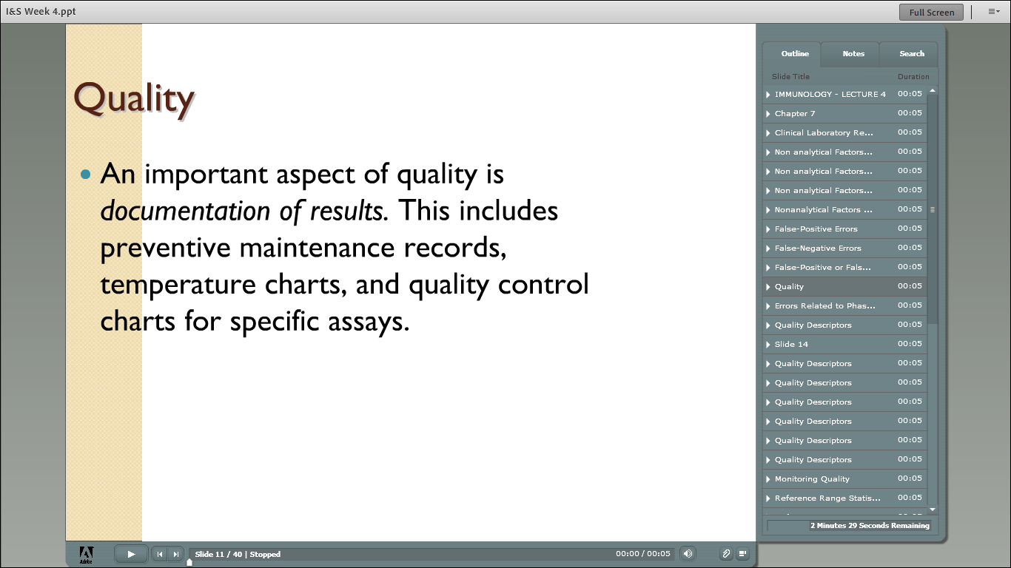

Slide 22
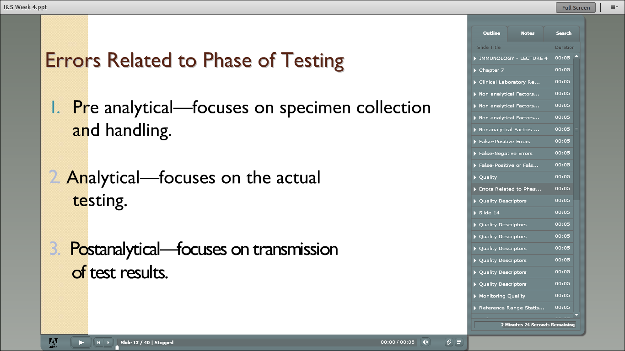

Slide 23
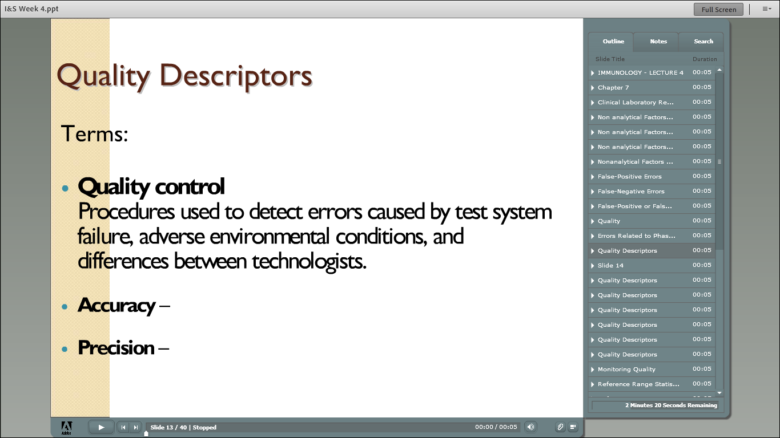

Slide 24
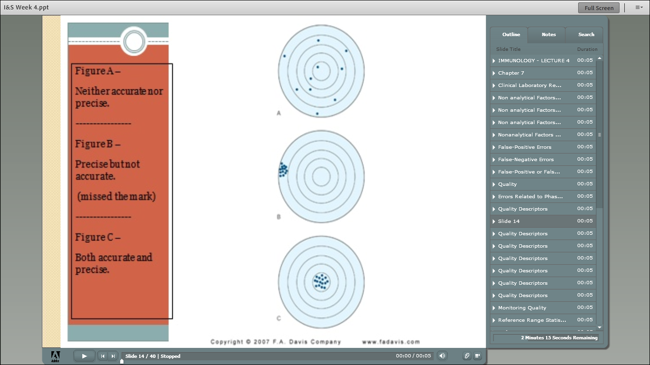

Slide 25
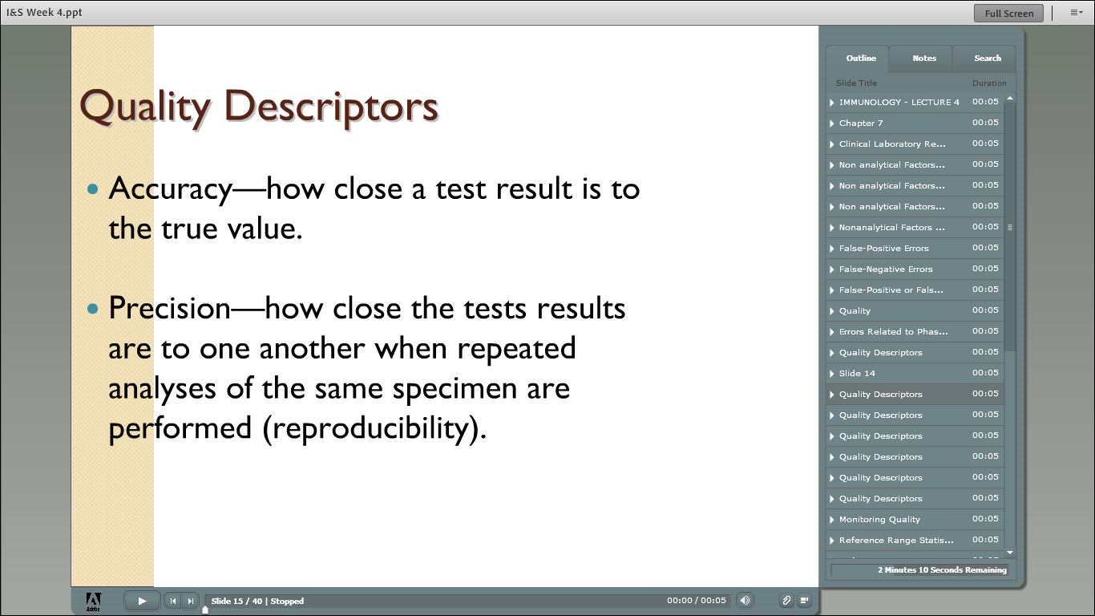

Slide 26
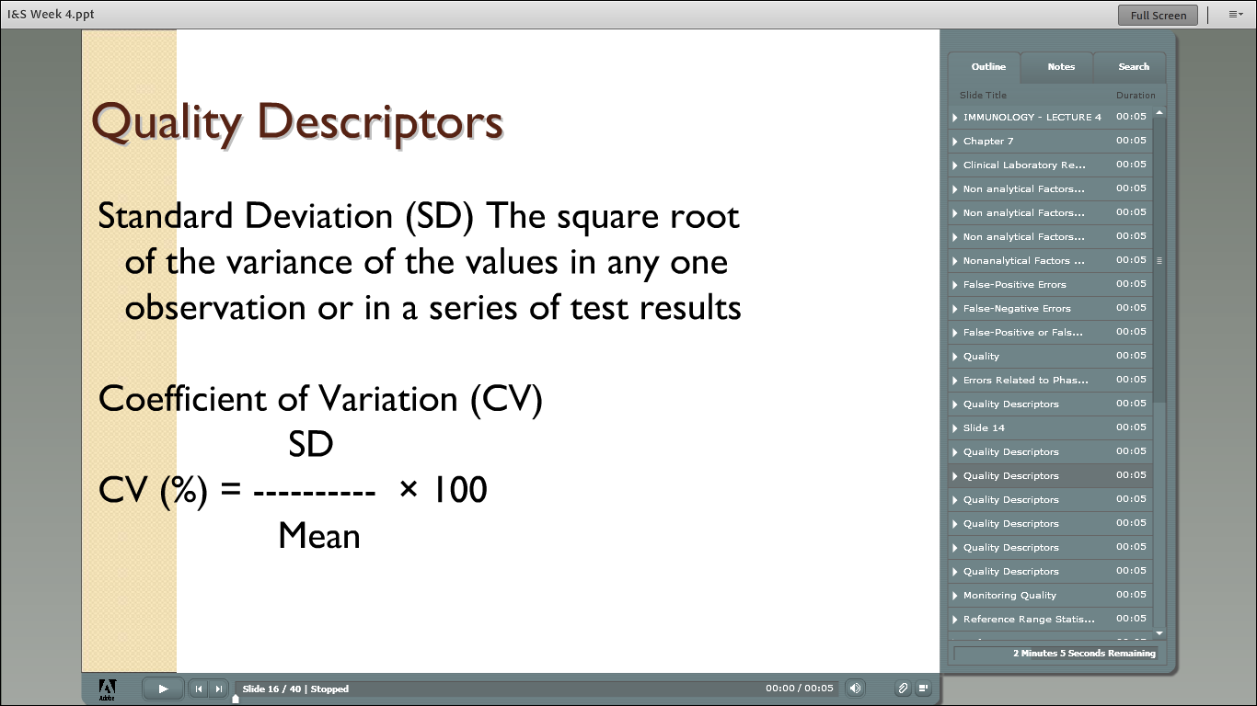

Slide 27
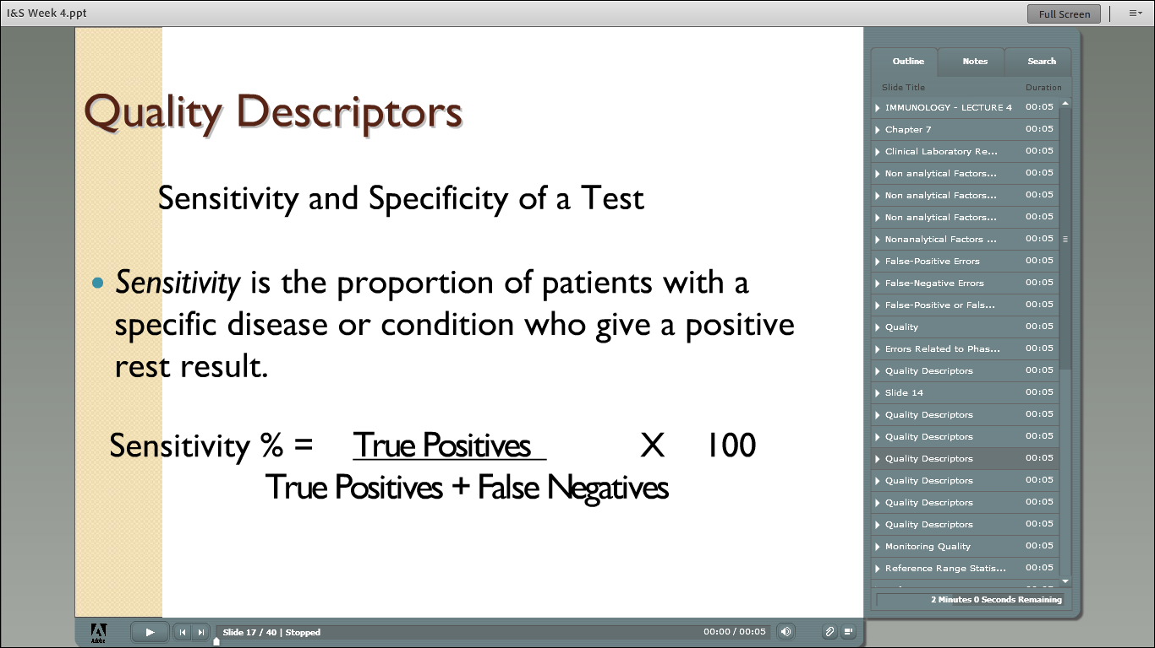

Slide 28
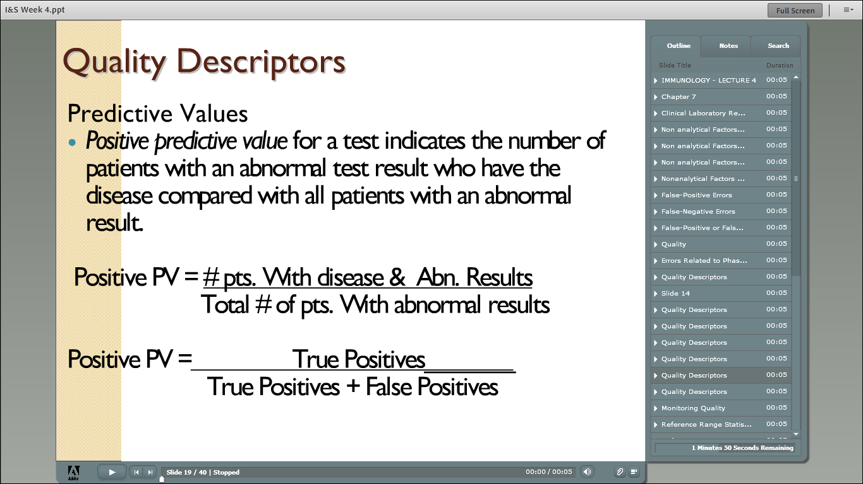

Slide 29
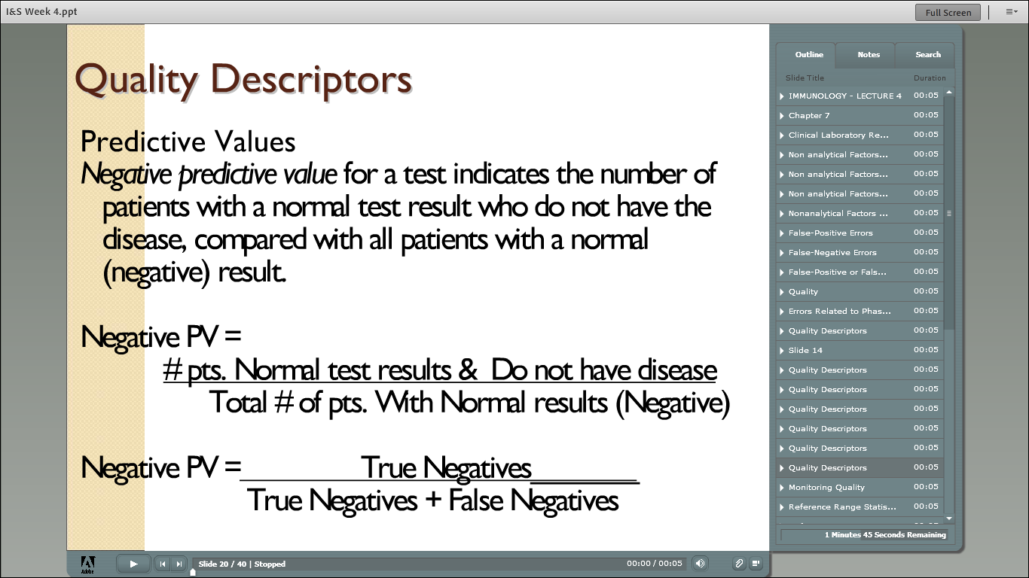

Slide 30
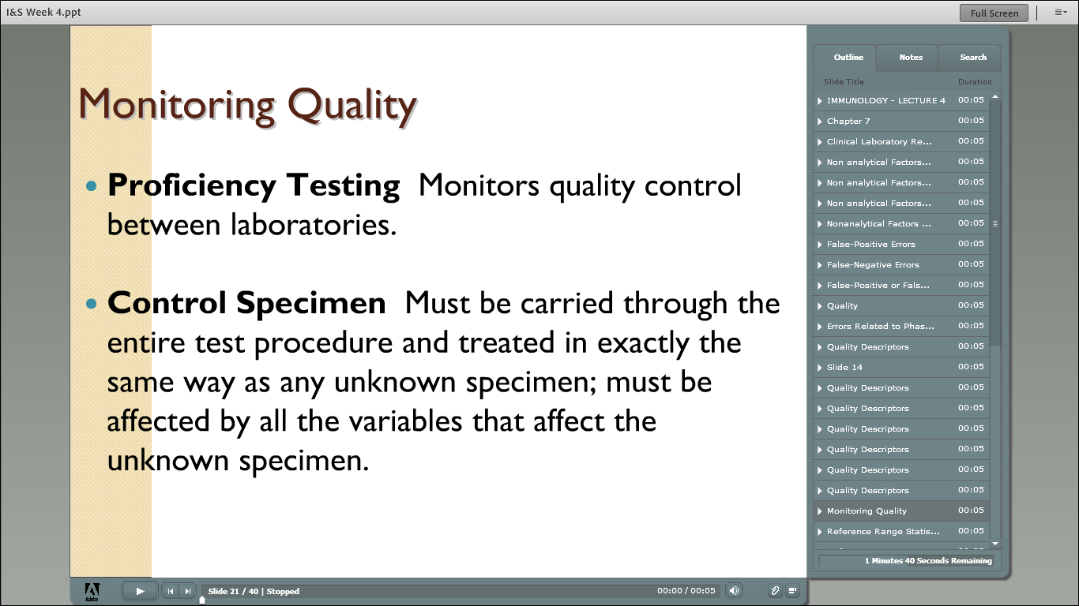

Slide 31
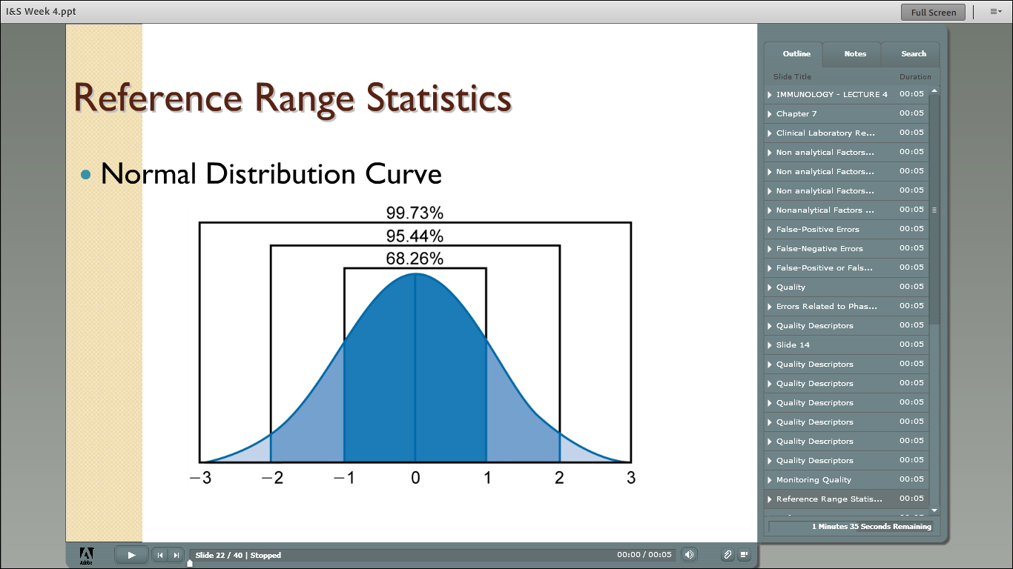

Slide 32
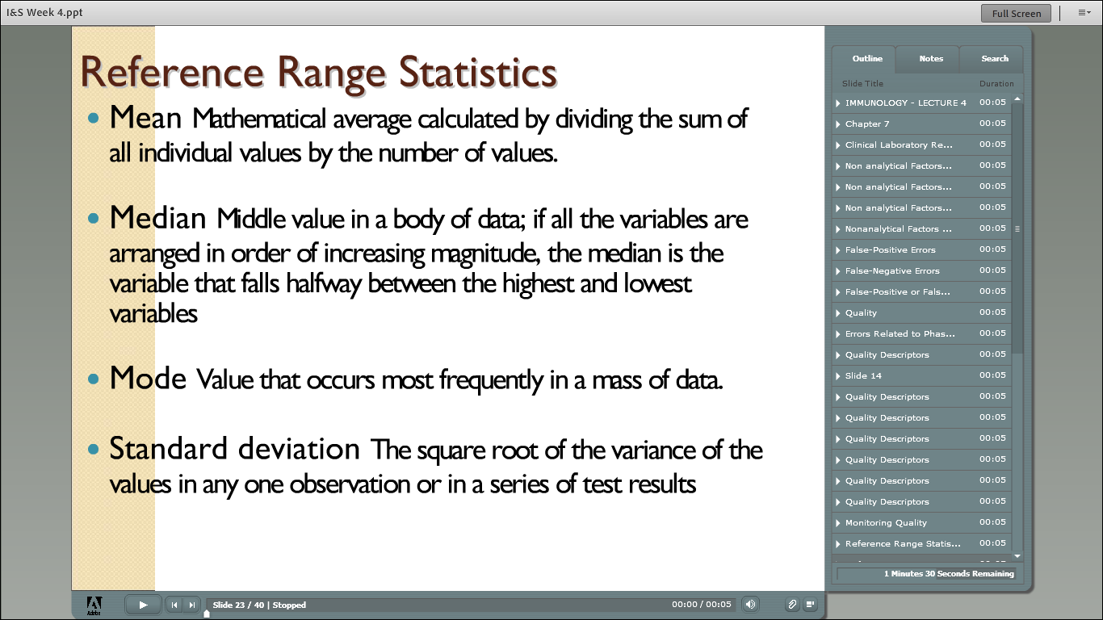

Slide 33
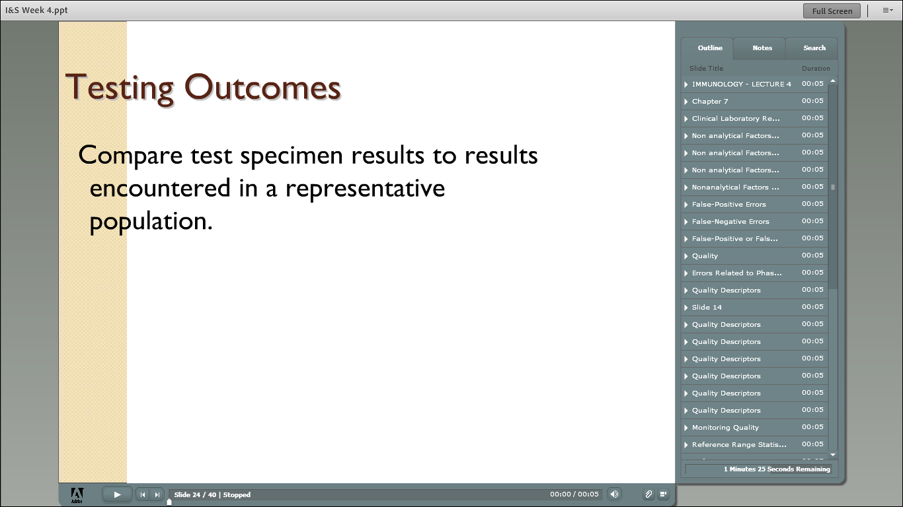

Slide 34
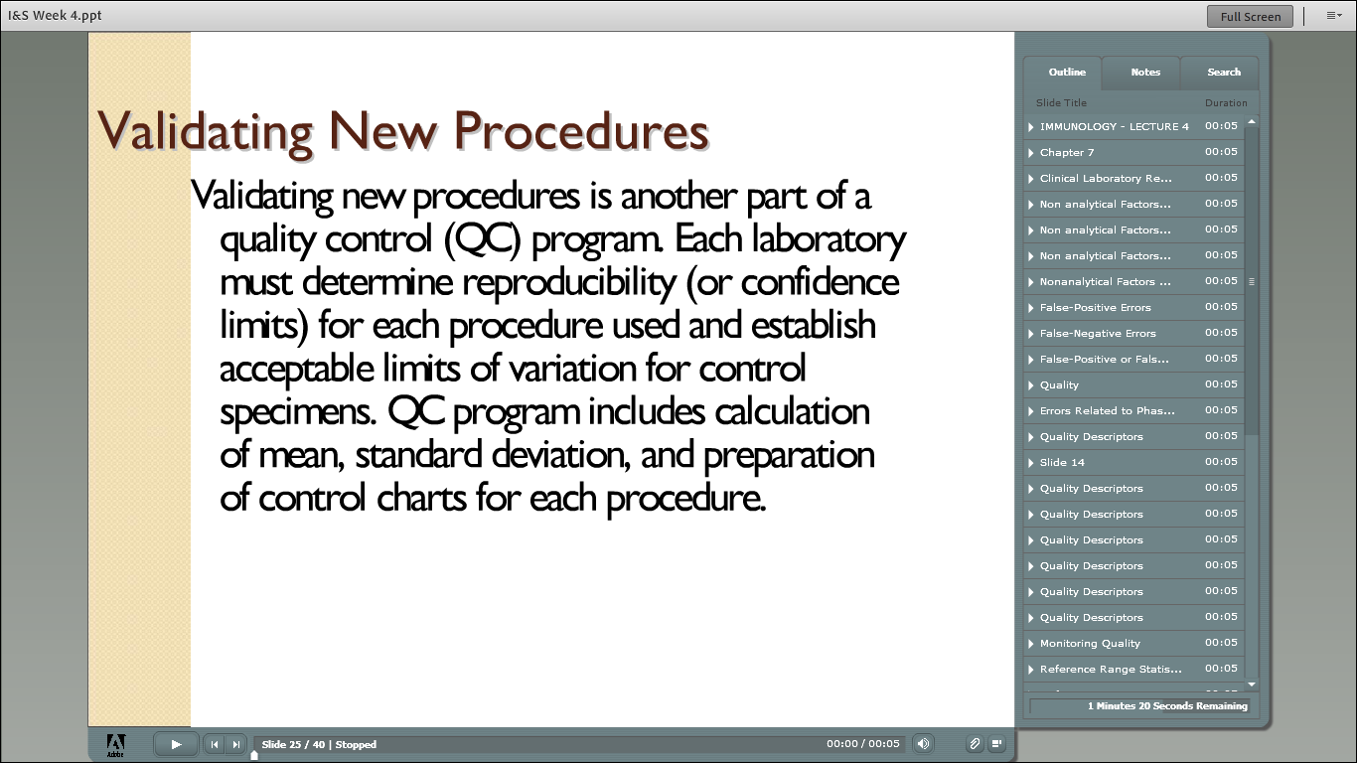

Slide 35
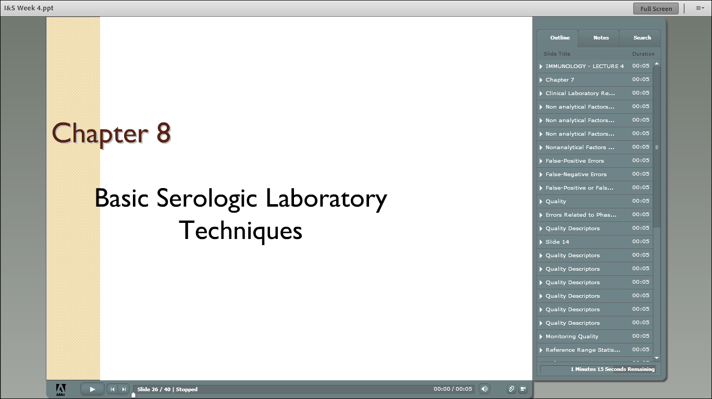

Slide 36
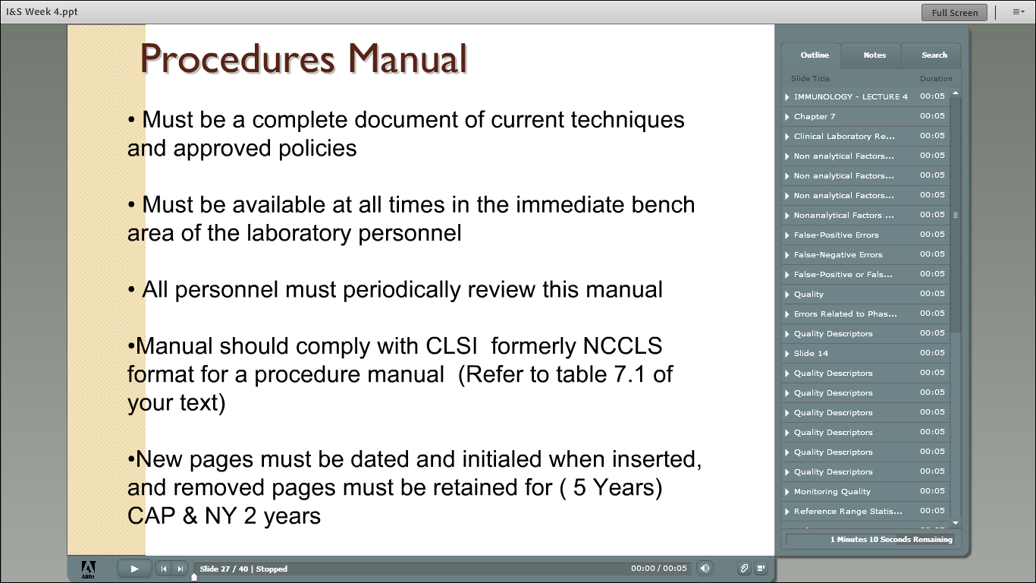

Slide 37
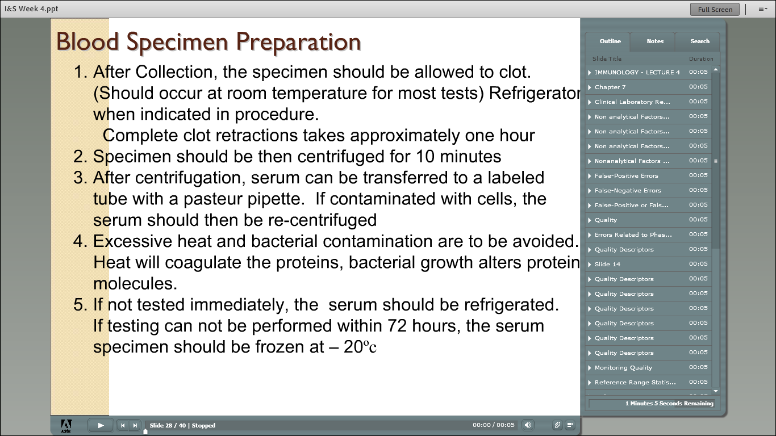

Slide 38
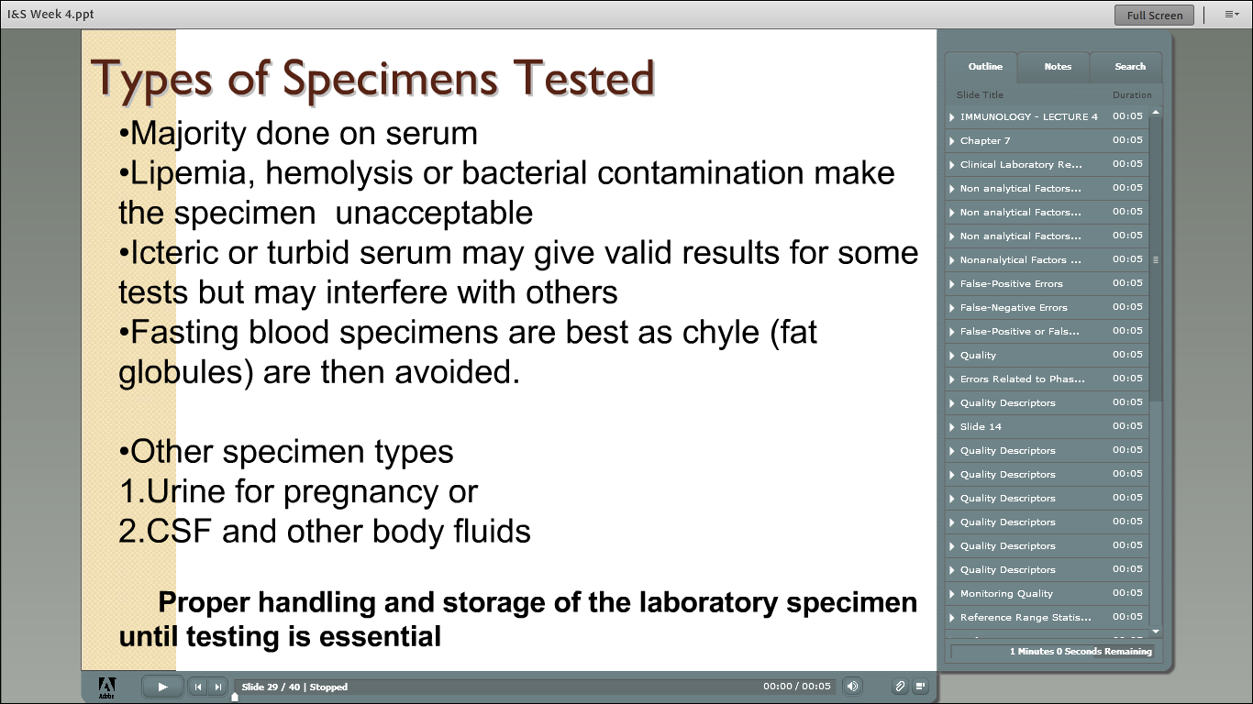

Slide 40
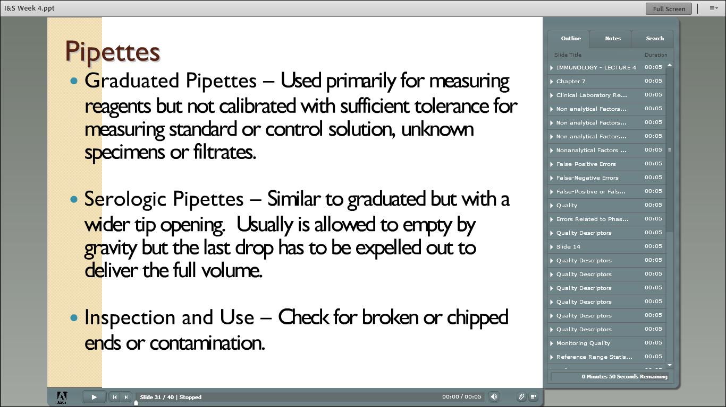

Slide 41
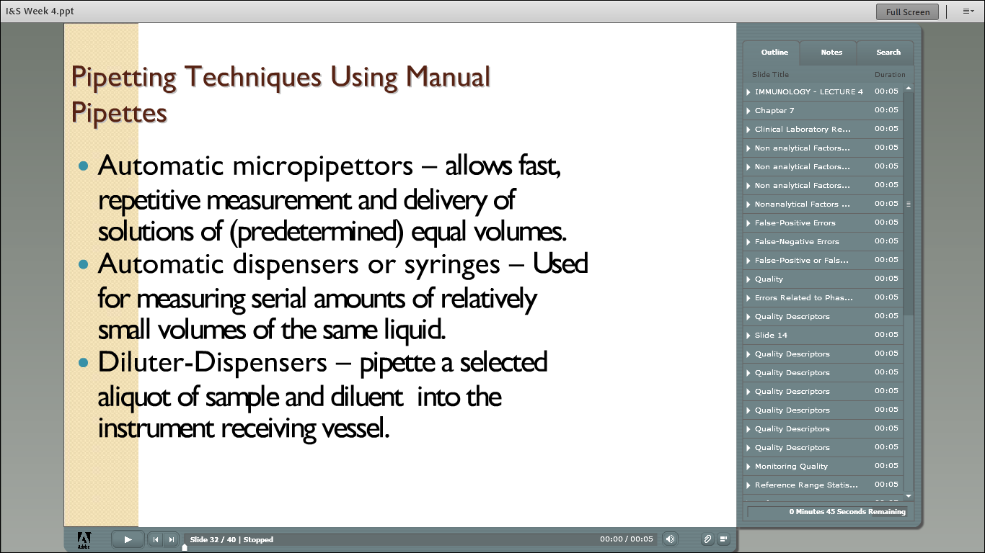

Slide 42
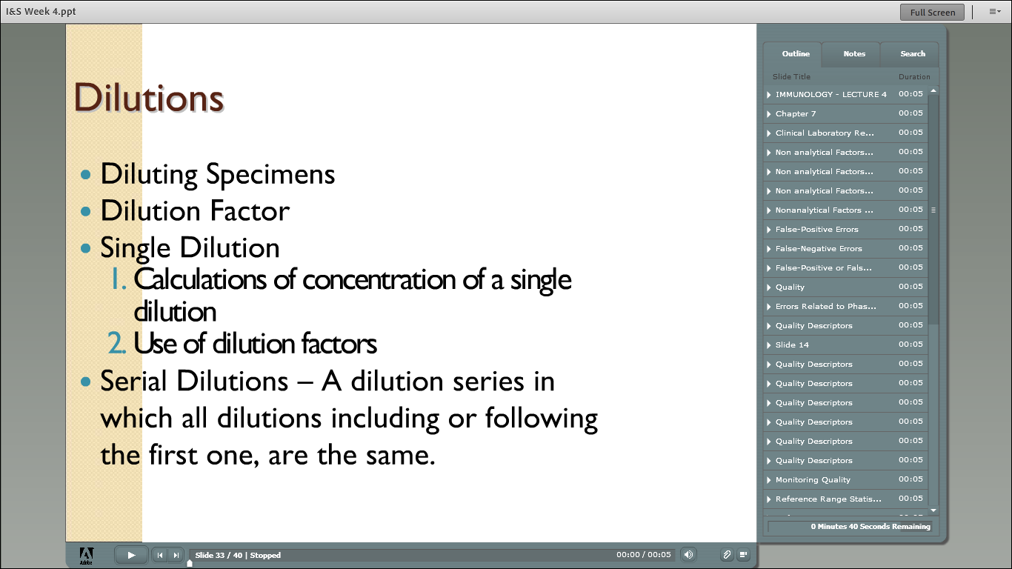

Slide 43
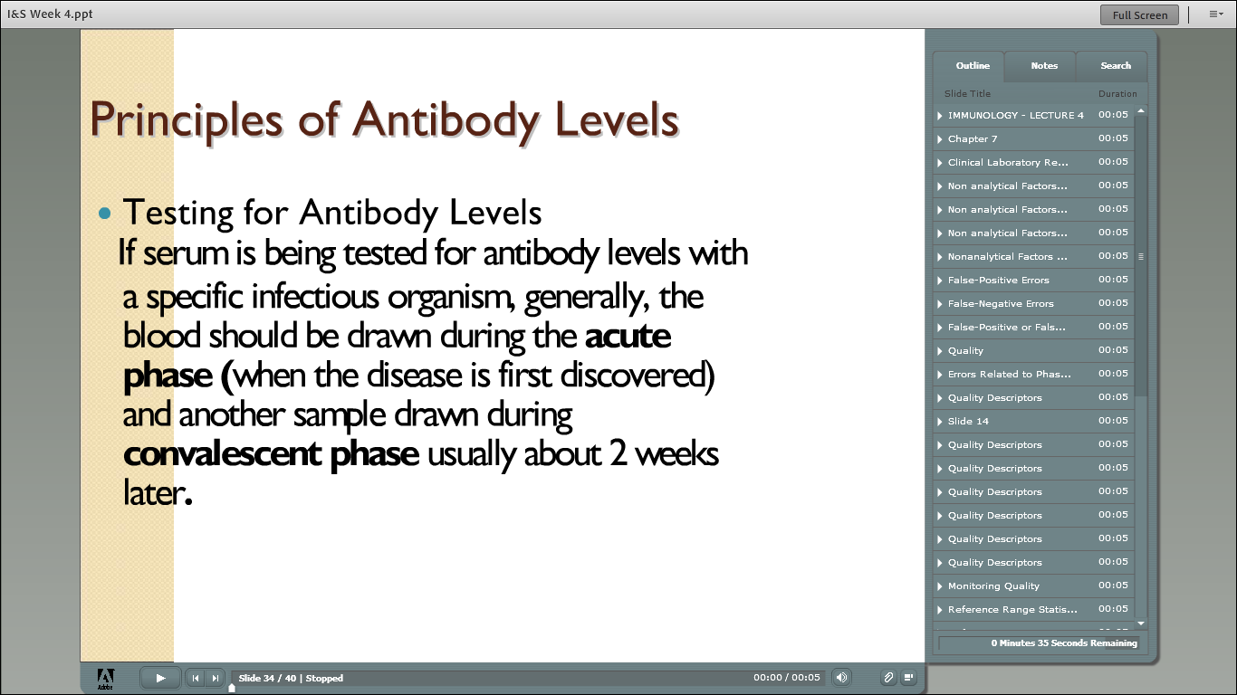

Slide 44
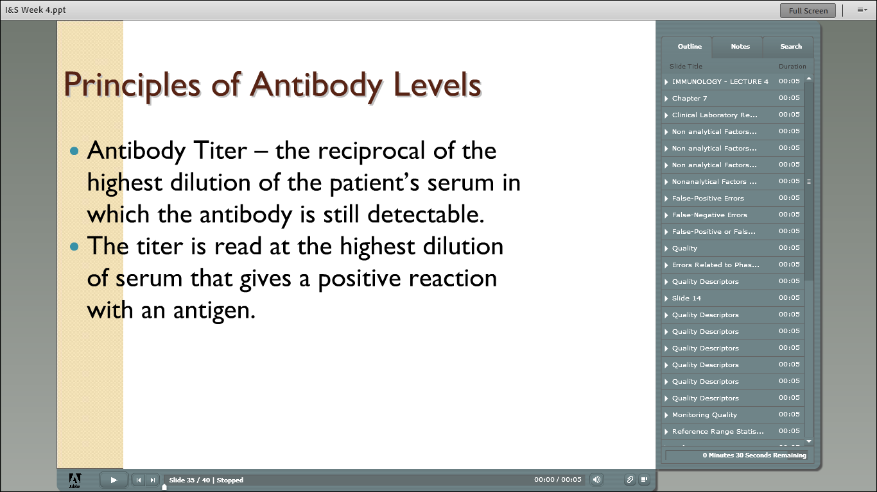

Slide 45
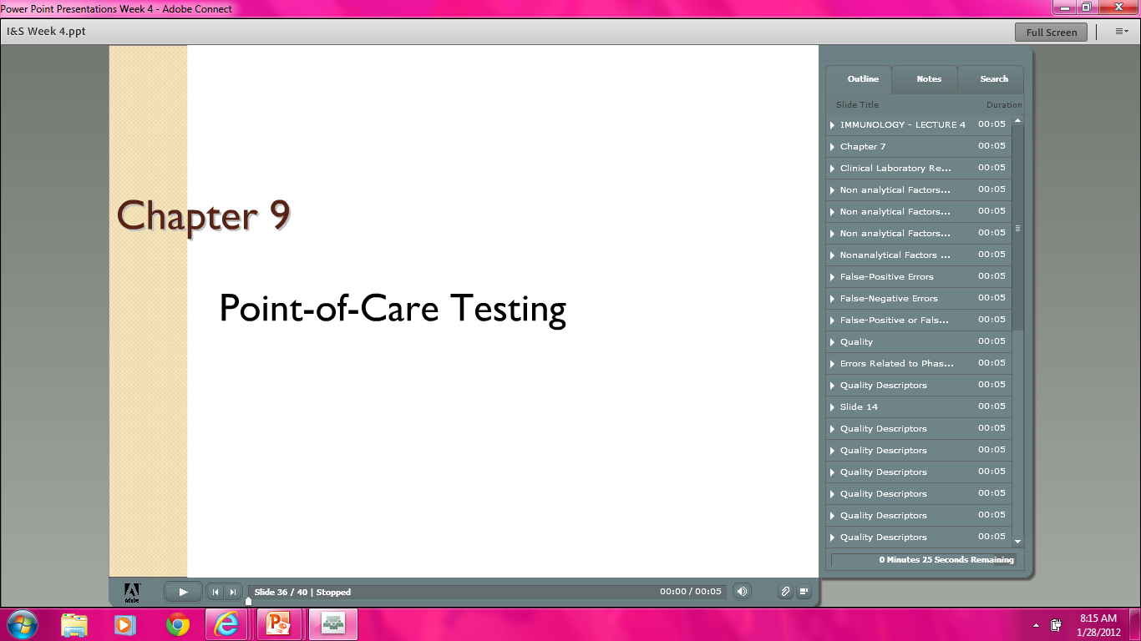

Slide 46
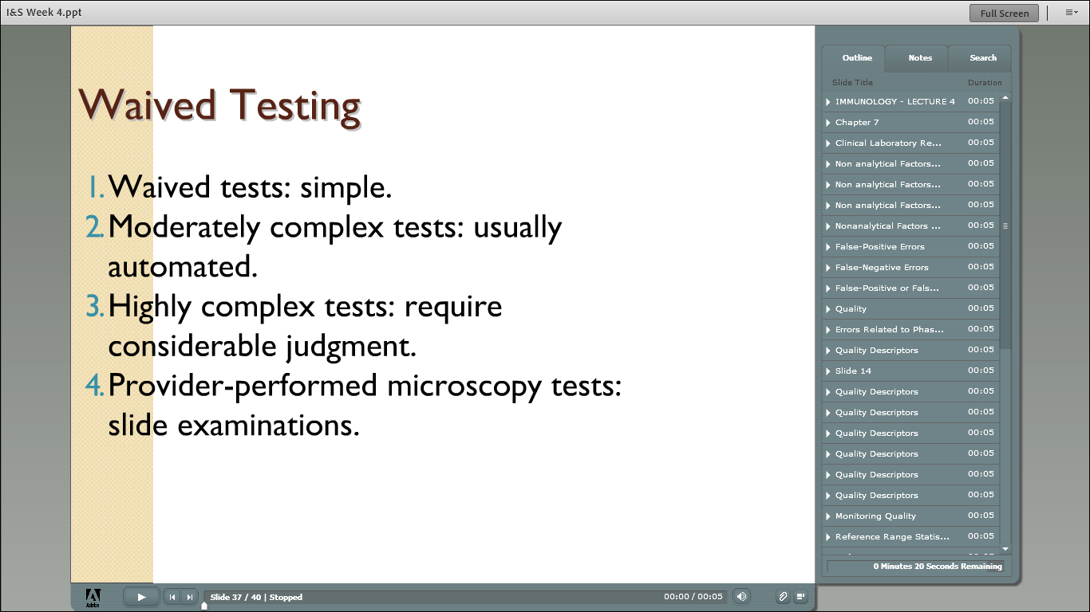

Slide 47
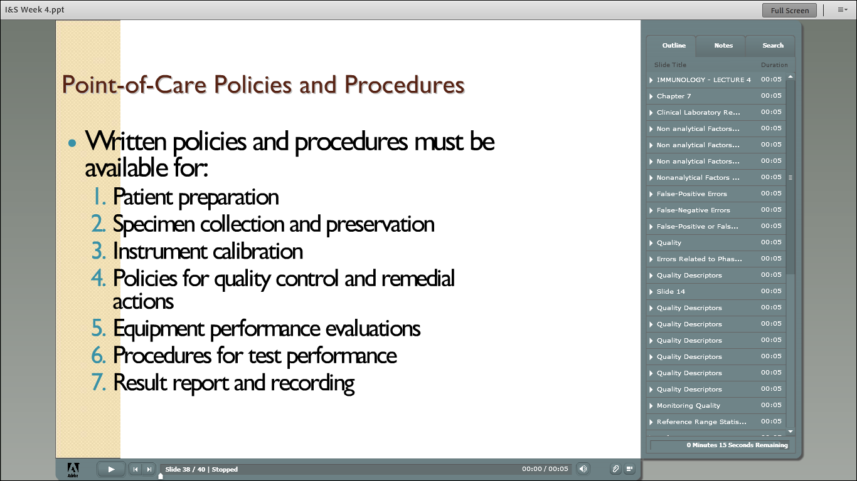

Slide 48
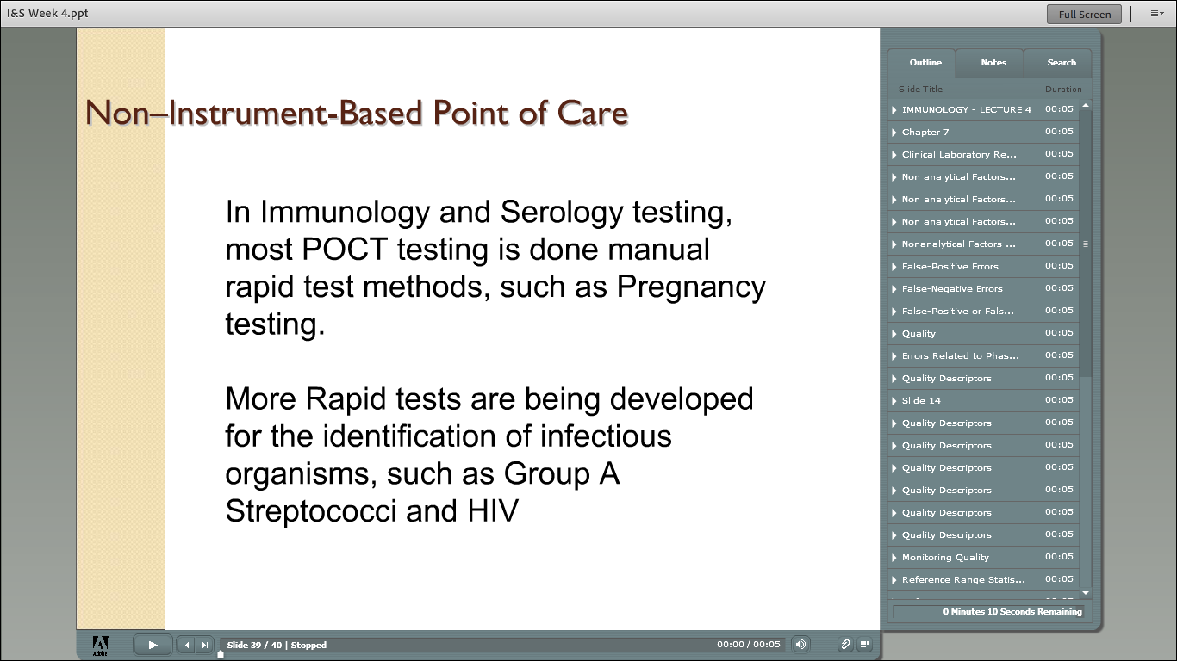

Slide 49


Slide 50
Quiz Bowl
FUN!

Slide 51
1.
Nonanalytical factors in quality assessment include:
A) Qualified personnel.
B) Established laboratory policies.
C) Quality control charts.
D) Both a and b.

Slide 52
1.
Nonanalytical factors in quality assessment include:
A) Qualified personnel.
B) Established laboratory policies.
C) Quality control charts.
D) Both a and b.

Slide 53
2.
An example of a preanalytical error is:
A) Specimen obtained from the wrong patient.
B) Lack of frequent preventive maintenance.
C) Reporting of laboratory results by phone.
D) Poorly trained phlebotomists.

Slide 54
2.
An example of a preanalytical error is:
A) Specimen obtained from the wrong patient.
B) Lack of frequent preventive maintenance.
C) Reporting of laboratory results by phone.
D) Poorly trained phlebotomists.

Slide 55
3.
Quality assessment programs include:
A) Patient identification.
B) Specimen procurement.
C) Specimen transportation and processing procedures.
D) All the above.

Slide 56
3.
Quality assessment programs include:
A) Patient identification.
B) Specimen procurement.
C) Specimen transportation and processing procedures.
D) All the above.

Slide 57
4.
For testing of moderate complexity, quality control requires:
A) Using fresh reagent daily.
B) Performing control procedures monthly.
C) Performing control procedures using at least two levels of control material each day of testing.
D) Both a and c.

Slide 58
4.
For testing of moderate complexity, quality control requires:
A) Using fresh reagent daily.
B) Performing control procedures monthly.
C) Performing control procedures using at least two levels of control material each day of testing.
D) Both a and c.

Slide 59
5.
Sensitivity is defined as the:
A) Proportion of subjects with the specific disease or condition who have a positive test result.
B) Proportion of subjects without the specific disease or condition who have a negative test result.
C) Proportion of a population who have the disease.
D) Number of patients with a normal test result who do not have the disease.

Slide 60
5.
Sensitivity is defined as the:
A) Proportion of subjects with the specific disease or condition who have a positive test result.
B) Proportion of subjects without the specific disease or condition who have a negative test result.
C) Proportion of a population who have the disease.
D) Number of patients with a normal test result who do not have the disease.

Slide 61
6.
Specificity is defined as the:
A) Proportion of subjects with the specific disease or condition who have a positive test result.
B) Proportion of subjects without the specific disease or condition who have a negative test result.
C) Proportion of a population who have the disease.
D) Number of patients with a normal test result who do not have the disease.

Slide 62
6.
Specificity is defined as the:
A) Proportion of subjects with the specific disease or condition who have a positive test result.
B) Proportion of subjects without the specific disease or condition who have a negative test result.
C) Proportion of a population who have the disease.
D) Number of patients with a normal test result who do not have the disease.

Slide 63
7.
Match the term with the definition.
A. How close a test result is to the true value
B. Highly purified substances of a known composition
C. A specimen with a known value that is similar in composition to the test specimen
D. How close the test results are to one another when repeated analyses of the same material are performed Accuracy Precision Control Standard

Slide 64
7.
Match the term with the definition.
A. How close a test result is to the true value
B. Highly purified substances of a known composition
C. A specimen with a known value that is similar in composition to the test specimen
D. How close the test results are to one another when repeated analyses of the same material are performed Accuracy =A Precision =D Control =C Standard =B

Slide 65
8.
Fill in the blanks, choosing the correct temperature. Bence Jones (BJ) proteins are soluble at room temperature, become insoluble near (1) _______, and then resolubilize at (2) ________.
A) 37° C
B) 50° C
C) 60° C
D) 80° C

Slide 66
9.
Complement can be inactivated in human serum by heating to _____° C.
A) 25
B) 37
C) 45
D) 56

Slide 67
9.
Complement can be inactivated in human serum by heating to _____° C.
A) 25
B) 37
C) 45
D) 56

Slide 68
10.
Complement can be inactivate in human serum by heating (° C) for _______ minutes.
A) 5
B) 10
C) 15
D) 30

Slide 69
10.
Complement can be inactivate in human serum by heating (° C) for _______ minutes.
A) 5
B) 10
C) 15
D) 30

Slide 70
11.
A specimen should be reinactivated when more than ______ hour(s) has/have elapsed since inactivation.
A) 1
B) 2
C) 4
D) 8

Slide 71
11.
A specimen should be reinactivated when more than ______ hour(s) has/have elapsed since inactivation.
A) 1
B) 2
C) 4
D) 8

Slide 72
12.
A meniscus is the:
A) Curvature in the top surface of a liquid.
B) Zero mark on a pipette.
C) Last marking on a serologic pipette.
D) Flat line of liquid in a pipette.

Slide 73
12.
A meniscus is the:
A) Curvature in the top surface of a liquid.
B) Zero mark on a pipette.
C) Last marking on a serologic pipette.
D) Flat line of liquid in a pipette.

Slide 74
13.
A dilution is a(n):
A) Ratio of volume or number of parts of the substance to be diluted in the total volume, or parts, of the final solution.
B) Indication of relative concentration.
C) Frequently used measure in serologic testing.
D) All the above.

Slide 75
13.
A dilution is a(n):
A) Ratio of volume or number of parts of the substance to be diluted in the total volume, or parts, of the final solution.
B) Indication of relative concentration.
C) Frequently used measure in serologic testing.
D) All the above.

Slide 76
14.
Serum for detection of antibodies should be drawn during the:
A) Acute phase of illness only.
B) Acute and convalescent phases of illness.
C) Convalescent phase of illness only.
D) Acute and convalescent phases, as well as 6 months after an illness.

Slide 77
14.
Serum for detection of antibodies should be drawn during the:
A) Acute phase of illness only.
B) Acute and convalescent phases of illness.
C) Convalescent phase of illness only.
D) Acute and convalescent phases, as well as 6 months after an illness.

Slide 78
15.
A central concept of serologic testing is:
A) Antigen-antibody interaction.
B) Determination of antibody composition.
C) Determination of antigen titer.
D) Rise in antibody titer.

Slide 79
15.
A central concept of serologic testing is:
A) Antigen-antibody interaction.
B) Determination of antibody composition.
C) Determination of antigen titer.
D) Rise in antibody titer.

Slide 80
16.
The term antibody titer is defined as:
A) The reciprocal of the highest dilution of the patient’s serum.
B) A change in antibody strength.
C) The response to an antigen.
D) Both b and c.

Slide 81
16.
The term antibody titer is defined as:
A) The reciprocal of the highest dilution of the patient’s serum.
B) A change in antibody strength.
C) The response to an antigen.
D) Both b and c.

Slide 82
17.
Ultimate responsibility and control of POCT reside within the CLIA-certified laboratory.
A) True
B) False

Slide 83
17.
Ultimate responsibility and control of POCT reside within the CLIA-certified laboratory.
A) True
B) False

Slide 84
18.
A minimum of two laboratory staff members are required to be responsible for each POCT program.
A) True
B) False

Slide 85
18.
A minimum of two laboratory staff members are required to be responsible for each POCT program.
A) True
B) False

Slide 86
19.
Written policies and procedures must be available to all laboratory personnel for patient preparation and for specimen collection and preservation.
A) True
B) False

Slide 87
19.
Written policies and procedures must be available to all laboratory personnel for patient preparation and for specimen collection and preservation.
A) True
B) False

Slide 88
20.
The greatest source of error is preanalytical error, such as patient identification and specimen collection.
A) True
B) False

Slide 89
20.
The greatest source of error is preanalytical error, such as patient identification and specimen collection.
A) True
B) False

Slide 90
21.
A major advantage of POCT is:
A) Faster turnaround time.
B) Lower cost.
C) No need for quality control monitoring.
D) Both a and c.

Slide 91
21.
A major advantage of POCT is:
A) Faster turnaround time.
B) Lower cost.
C) No need for quality control monitoring.
D) Both a and c.

Slide 92
22.
Any over-the-counter test approved by the U.S. Food and Drug Administration (FDA) is automatically placed into the category of:
A) Waived tests.
B) Moderately complex tests.
C) Highly complex tests.

Slide 93
22.
Any over-the-counter test approved by the U.S. Food and Drug Administration (FDA) is automatically placed into the category of:
A) Waived tests.
B) Moderately complex tests.
C) Highly complex tests.

Slide 94
23.
Match the category of testing with the appropriate description.
A. More complex than waived tests but usually automated.
B. Usually nonautomated or complicated tests requiring considerable judgment.
C. Simple procedures.
D. Slide examinations. Waived tests Moderately complex tests Highly complex tests Provider-performed microscopy tests

Slide 95
23.
Match the category of testing with the appropriate description.
A. More complex than waived tests but usually automated.
B. Usually nonautomated or complicated tests requiring considerable judgment.
C. Simple procedures.
D. Slide examinations. Waived tests Moderately complex tests Highly complex tests Provider-performed microscopy tests

