Slide 1
Immunology/Serology
Week 2 Seminar
Christina A Nevel-McGarvey, PhD, MS, MT(ASCP)

Slide 2
Week 1 Quiz
REVIEW
Put a hold on this until next week!!!!!!

Slide 3
Week 2 Vocabulary
Review

Slide 4
Week 2 Vocab Review
Hematopoiesis
Hematopoietic
Margination
Diapedesis
Leukotrienes
Interleukin-1
Histamine
Chemotaxis
Fc Receptor
Complement receptor
Opsonization
Opsonins
Phagosome
Major Histocompatibility Complex
Mononuclear Phagocyte System
Inflammation
Sepsis
Neutropenia
Metastasis
Chediak-Higashi Syndrome
Chronic Granulomatous Disease
Complement Receptor 3 Deficiency
Myeloperoxidase Deficiency
Specific Granule Deficiency
Gaucher’s Disease
Niemann-Pick Disease
Leukocyte Adhesion Deficiency

Slide 5
Week 2 Vocab Review
T Lymphocytes
B Lymphocytes
Progenitor Cells
Lymphoblasts
Primary Lymphoid Tissue
Thymus
Bone Marrow
Immunocompetent
Secondary Lymphoid Tissues
Lymph Nodes
Spleen
Gut Associated Lymphoid Tissue (GALT)
Thoracic Duct
Mucosal Associated Lymphoid Tissue (MALT)
Bronchus Associated Lymphoid Tissue (BALT)
Skin Associated Lymphoid Tissue
Langerhan’s Cells
Blood
Lymphocyte Recirculation
Afferent Lymphatic Duct
Efferent Lymphatic Duct
Monoclonal Antibody
Cluster of Differentiation
Clonal Selection
Helper T Lymphocytes (TH1, TH2, T reg)
Cytotoxic T Lymphocytes
Suppressor Lymphocytes
Antigen Presenting Cells
Cell Adhesion Molecules (CAM)
Natural Killer Cell
K Lymphocytes

Slide 6
Week 2 Vocab Review
Surface Immmunoglobulin
Isotype
Memory Cells
Plasma Cells
Complement
DiGeorge’s Syndrome
Nezelof Syndrome
Severe Combined Immunodeficiency
Chronic Mucocutaneous Candidiasis
Bruton’s X-Linked Agammaglobulinemia
Common Variable Immundeficiency
Selective IgA Deficiency
Immunodeficiency with Elevated IgM
Transient Hypogammaglobulinemia of Infancy
X-Linked Lymphoproliferative Disease (Duncan’s Disease)
Wiskott-Aldrich Syndrome
Hereditary Ataxia-Telangiectasia
Hyperimmunoglobulinemia E Syndrome
T cell
Activation Defects
Complement Deficiency

Slide 7
Week 2 Presentation
Quick Review

Slide 8
Chapter 3
Cells and Cellular Activities of the Immune System: Granulocytes and Mononuclear Cells

Slide 9
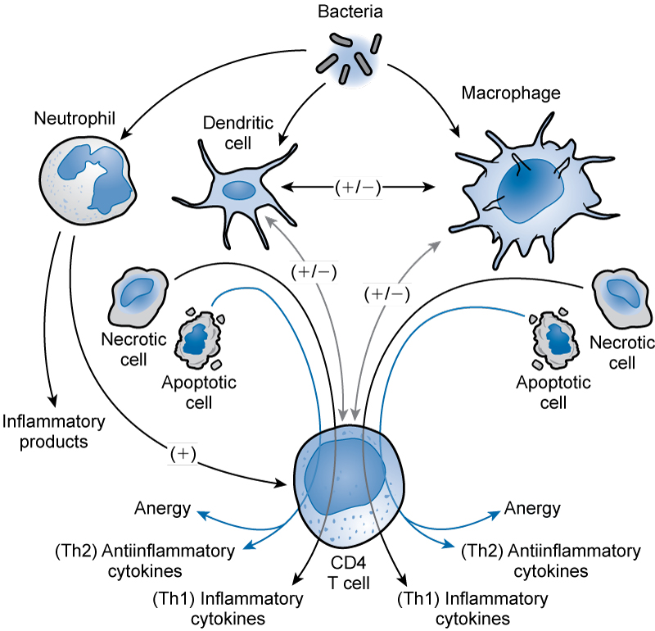
Cross-Talk among Immune Cells
(From Hotchkiss RS, Karl IE: The pathophysiology and treatment of sepsis, N Engl J Med 48[2]:138 150, 2003.)

Slide 10
Origin and Development of
Blood Cells
2-8 weeks of life: erythroblasts formed in islets of yolk sac.
2-5 months of gestation: liver and spleen are major sites of hematopoiesis.
  Granular leukocytes also appear.
Fourth month of gestation: bone marrow begins to produce blood cells.
Fifth month of gestation: bone marrow assumes ultimate role as primary site of hematopoiesis.

Slide 11
Granulocytic Cells
Neutrophils provide host defense against bacterial and fungal infections.
Eosinophils are homeostatic regulators of inflammation; play role in host defense because of ability to kill certain parasites.
Basophils play role in acute, systemic hypersensitivity reactions.

Slide 12
Process of Phagocytosis
Chemotaxis
Adherence
Engulfment
Digestion
Subsequent phagocytic activity

Slide 13
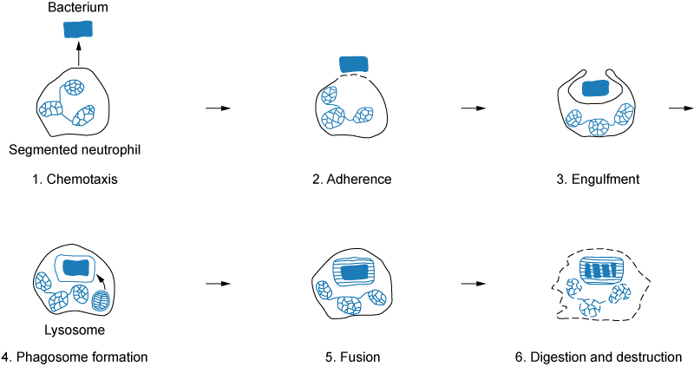
Process of Phagocytosis
(Redrawn from Turgeon ML: Clinical hematology: theory and procedures, ed 3, Philadelphia, 2000, Lippincott–Williams & Wilkins.)

Slide 14
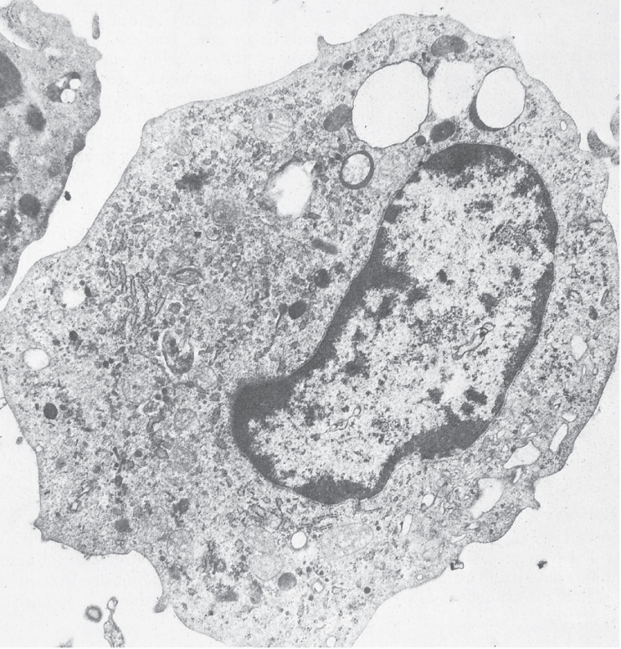
Monocytes and Macrophages
(From Barrett JT: Textbook of immunology, ed 5, St Louis, 1988, Mosby.)

Slide 15
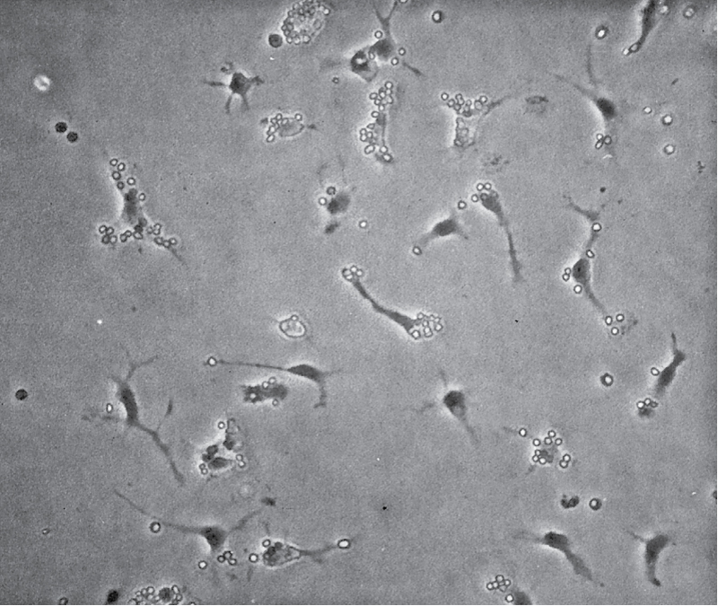
Monocytes and Macrophages
(From Barrett JT: Textbook of immunology, ed 5, St Louis, 1988, Mosby.)

Slide 16
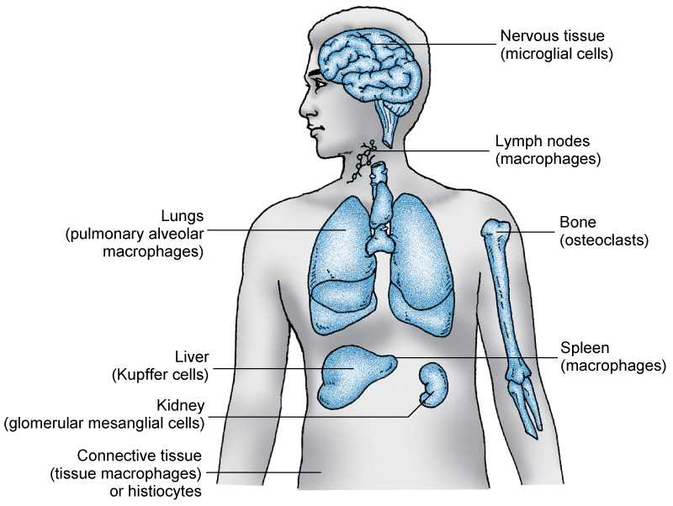
Monocytes and Macrophages
(Modified from Roitt IM: Essential immunology, ed 5, Oxford, 1984, Blackwell Scientific.)

Slide 17
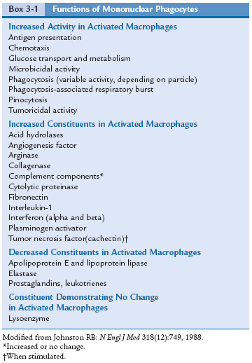
Monocytes and Macrophages
Functions of Monocytes and Macrophages in Host Defense
(Modified from Johnston RB:
Monocytes and macrophages,
N Engl J Med 318[12]:749, 1988.)

Slide 18
Monocytes and Macrophages
Antigen presentation: induction of the immune response
Secretion of biologically active molecules

Slide 19
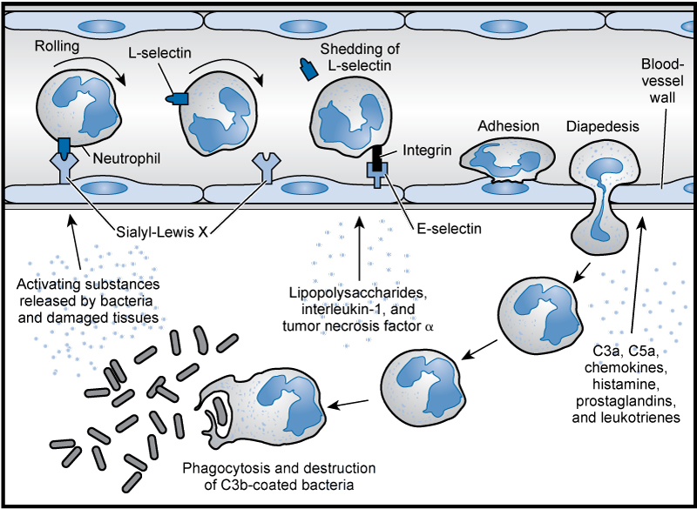
Acute Inflammation
(From Delves PJ, Roitt, IM: The immune system. Part I, N Engl J Med 343[1]:37-49, 2000.)

Slide 20
Sepsis
Sepsis is an infection-induced syndrome defined as the presence of two or more of the following:
Fever or hypothermia
Leukocytosis or leukopenia
Tachycardia and tachypnea
Supranormal minute ventilation

Slide 21
Cell Surface Receptors
Three protein families are associated in a network of cellular interactions:
Immunoglobulin family
Integrin family
Selectin family

Slide 22
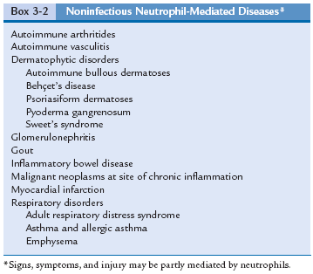
Disorders of Neutrophils
Neutrophils as Mediators of Noninfectious Inflammatory Diseases

Slide 23
Disorders of Neutrophils
Signs and Symptoms of Abnormal Neutrophil Function
  Quantitative problem (neutropenia)
  Qualitative defect (leukocyte mobility)

Slide 24
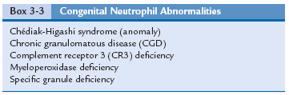
Disorders of Neutrophils
Congenital Abnormalities of Neutrophil Structure and Function

Slide 25
Monocyte-Macrophage Disorders
Gaucher’s disease represents a deficiency of beta-glucocerebrosidase (enzyme).
Niemann-Pick disease represents a deficiency of sphingomyelinase (enzyme).

Slide 26
Disease States Involving the Leukocyte Integrins
Leukocyte adhesion deficiency (LAD) is characterized by impaired leukocyte adhesion that leads to recurrent and often fatal bacterial and fungal infections.

Slide 27
Chapter 4
Cells and Cellular Activities of the Immune System:
Lymphocytes and Plasma Cells

Slide 28
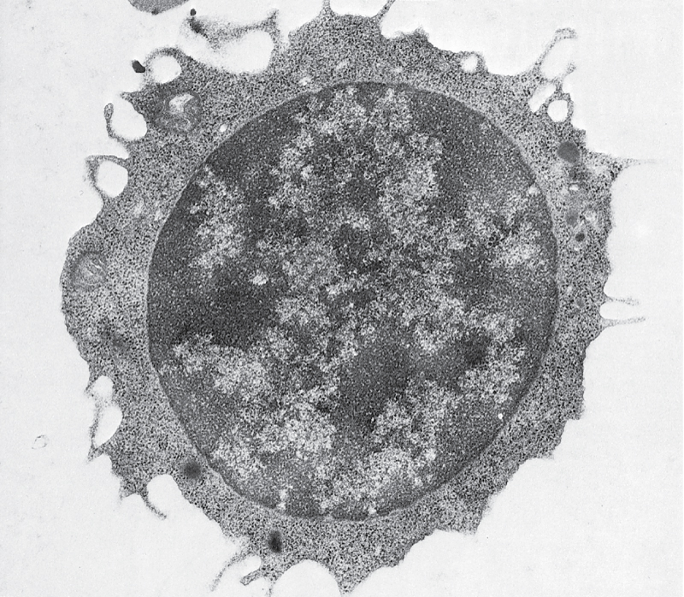
Lymphocytes and Plasma Cells
(From Barrett JT: Textbook of immunology, ed 5, St Louis, 1988, Mosby.)

Slide 29
Lymphocytes and Plasma Cells
Anatomic Origin and Development of Lymphocytes

Slide 30
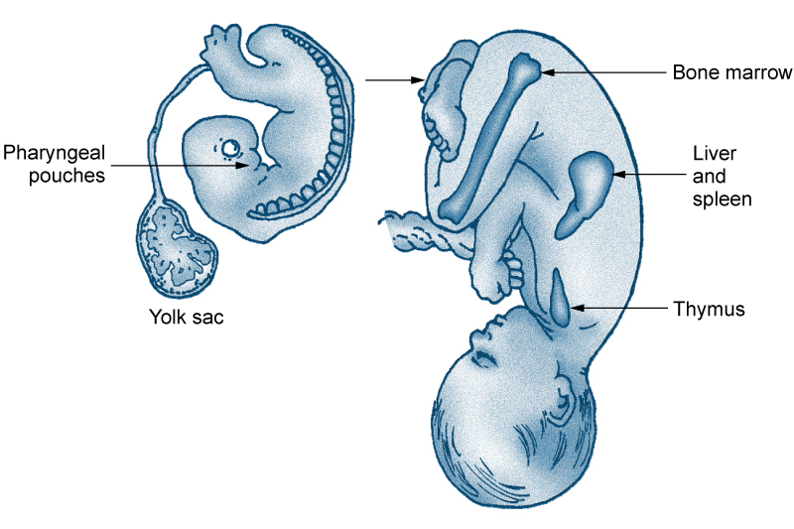
Lymphocytes and Plasma Cells
Sites of Lymphocytic Development

Slide 31
Lymphocytes and Plasma Cells
Primary Lymphoid Tissue in Mammals
Bone marrow and/or fetal liver
Thymus

Slide 32
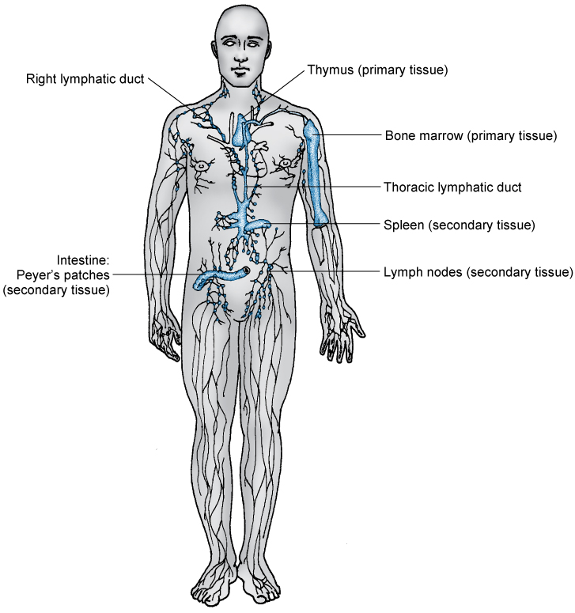
Lymphocytes and Plasma Cells
(Redrawn from Turgeon ML: Clinical hematology: theory and procedures, ed 4, Philadelphia, 2005, Lippincott–Williams & Wilkins.)

Slide 33
Lymphocytes and Plasma Cells
Secondary Lymphoid Tissues
  Lymph nodes
  Spleen
  Gut-associated lymphoid tissue
  Bronchus-associated lymphoid tissue
  Skin-associated lymphoid tissue
  Thoracic duct
  Blood

Slide 34
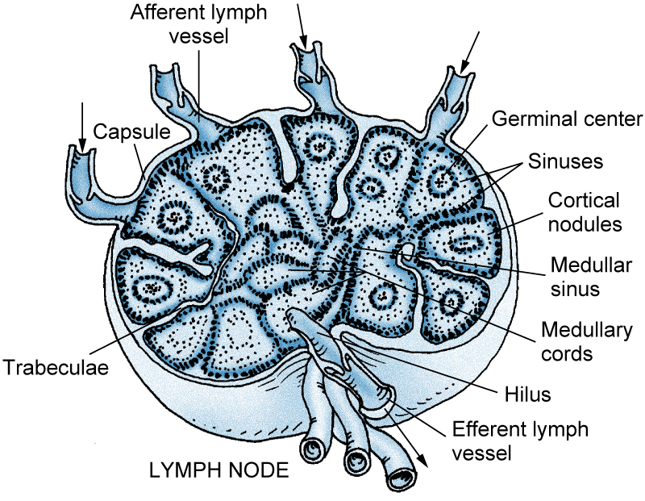
Lymphocytes and Plasma Cells
Circulation of Lymphocytes
(Redrawn from Anthony CP, Thibodeau GA: Textbook of anatomy and physiology, ed 12, St Louis, 1987, Mosby.)

Slide 35
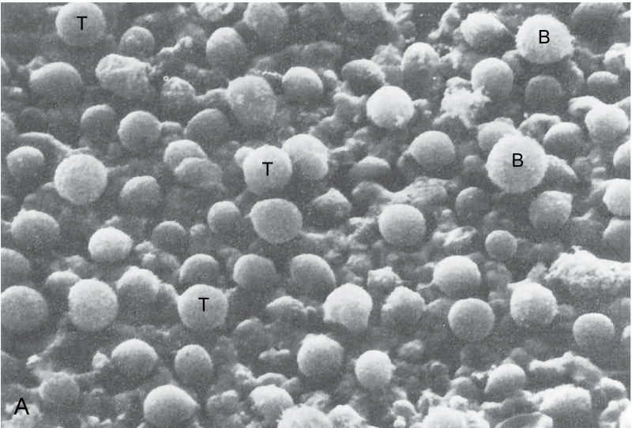
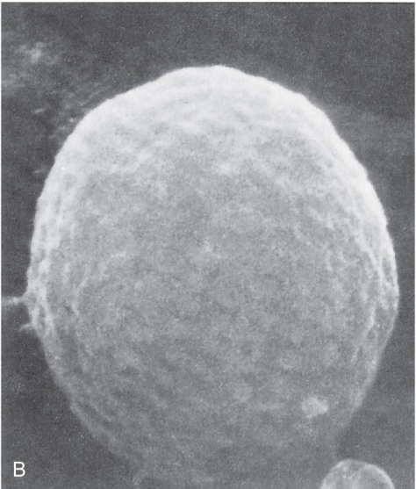
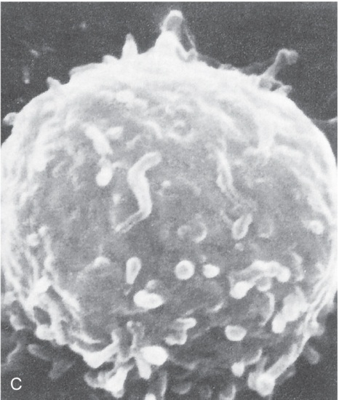
Lymphoid and Nonlymphoid Surface Membrane Markers

Slide 36
T Lymphocytes
Cluster designation (CD) antigens—promote cell-to-cell interactions and adhesion.
Transduction of signals that lead to lymphocyte activation.

Slide 37
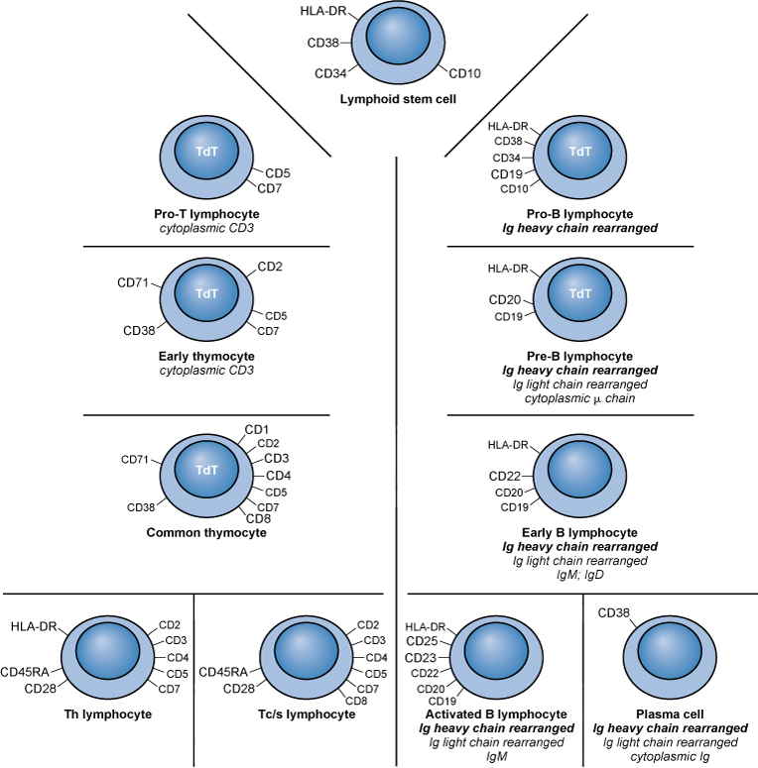
T Lymphocytes

Slide 38
T-Lymphocyte Subsets
Helper T (Th) lymphocytes
    Th1: cell-mediated effector mechanisms.
    Th2: regulation of antibody production.
    Treg (regulatory T cells): an immunoregulatory type of Th cell
    Cytotoxic T (Tc) lymphocytes: capable of directly destroying virally infected target cells.
    Suppressor T (Ts) lymphocytes: downregulate actions of other T and B cells.

Slide 39
T Lymphocytes
Antigen Processing and Antigen Presentation to T Cells
  Endogenous pathway
  Exogenous pathway

Slide 40
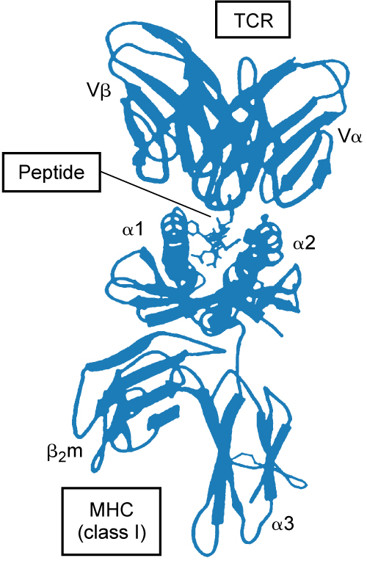
Antigen Recognition by T Cells
  T cells undergo antigen presentation only by self-MHC molecules.
  (Redrawn from Bjorkman PJ: MHC restriction in
  three dimensions: a view of T cell receptor/ligand
  interactions, Cell 89:167-170, 1997. © Cell Press;
  with permission.)

Slide 41
When activated by the proper signals, T cells may:
  Proliferate.
  Differentiate.
  Produce cytokines.
  Develop effector function.

Slide 42
T Lymphocytes
T-Independent Antigen Triggering
Some antigens (e.g., dextran) can trigger B cells without help from T cells; these are T-independent antigens.
Generally, these antigens are not strong, provoke mainly IgM responses, and induce little immunologic memory.

Slide 43
Natural Killer and K-Type Lymphocytes
Natural killer (NK) cells: destroy target cells through an extracellular, nonphagocytic mechanism called cytotoxic reaction, MHC-unrestricted cytolysis.
K-type lymphocytes: mononuclear cells that can kill target cells sensitized with antibody engaged by their Fc receptors.

Slide 44
B Lymphocytes
B1 cells possess CD5 marker.
B2 cells account for the majority of B lymphocytes in adults.

Slide 45
B Lymphocytes
Cell Surface Markers
  Ig receptor: an antibody molecule with antigenic specificity.
  Fc receptor: specifically binds the Fc portion of IgG antibody; may aid B cells in binding to antigen already bound to antibody.

Slide 46
B Lymphocytes
Cell Surface Markers
  Receptor that binds fragments of the cleaved complement component C3; binds C3b, iC3b (inactivated C3b), and C3d; function not understood.
  B-cell surface antigens: coded by major histocompatibility complex (MHC) class II genes.

Slide 47
B Lymphocytes
B-Cell Activation
  B cells can be stimulated in their resting state to:
  Enlarge.
  Develop synthetic machinery.
  Divide.
  Mature.
  Secrete antibody.

Slide 48
Other Types of Lymphocytes
Virgin or naive lymphocytes: have not encountered their specific antigen.
Memory cells: long-lived T or B cells that have been stimulated by antigen.

Slide 49
Plasma Cell Biology
Function is synthesis and excretion of immunoglobulins.
Plasma cells arise as end stage of B-cell differentiation.
Pathway from B cell to plasma cell occurs when B cell is antigenically stimulated and undergoes transformation as a result of stimulation of various interleukins.

Slide 50
Alterations in Lymphocyte Subsets
The ratio of T-helper to T-suppressor lymphocytes (Th/Ts ratio) is about 2:1.

Slide 51
Changes in Lymphocyte Subpopulations with Aging
Older adults: increase in Th cells and decrease in Ts cells.
B cells: total number remains unchanged.

Slide 52
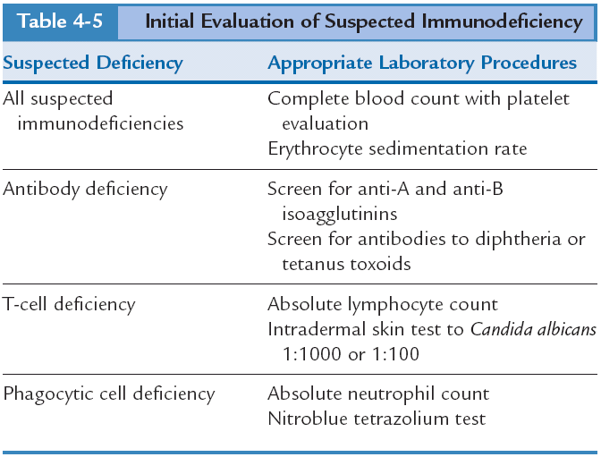
Evaluation of Suspected Defects

Slide 53
Basic Evaluation
A complete blood count (CBC) and erythrocyte sedimentation rate (ESR) are cost-effective screening tests.
Calculate the absolute lymphocyte count.

Slide 54
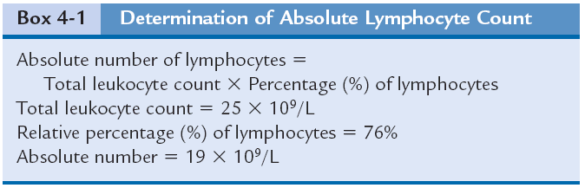
Absolute Lymphocyte Count

Slide 55
Evaluation of Suspected Defects: Cell-Mediated Immune System

Slide 56
Disorders with Immunologic Origins
Immune Disorders

Slide 57
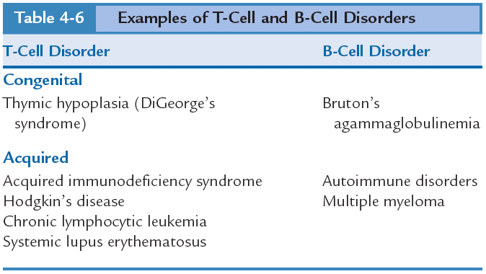

Slide 58
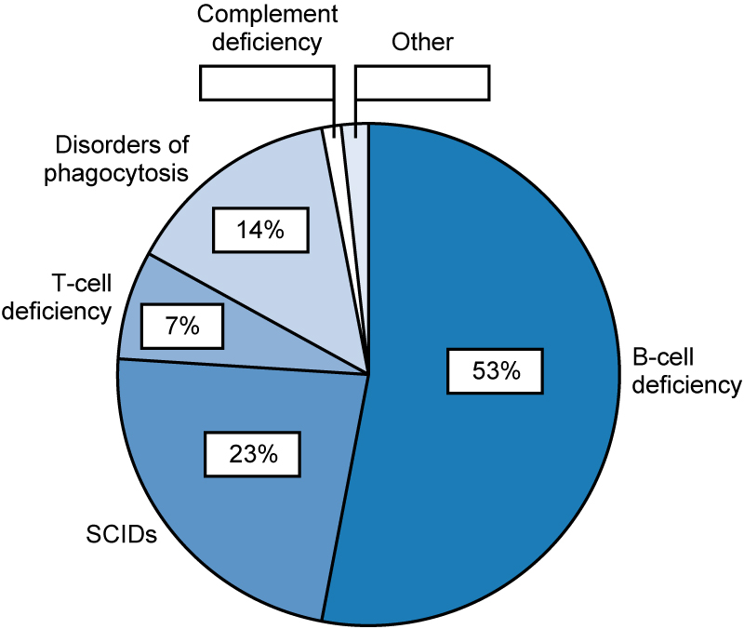
Primary Immune Disorders

Slide 59
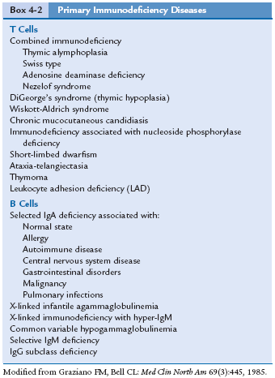
(Modified from Graziano FM, Bell CL: The normal immune response and what can go wrong. In Corman LC, Katz D, editors: Symposium on clinical immunology I, Philadelphia, Saunders; Med Clin North Am 69[3]:445, 1985.)

Slide 60
T-Cell Activation Defects
  Defective surface expression of CD3–T-cell antigen receptor complex.
  Defective signal transduction from T-cell antigen receptor to intracellular metabolic pathways.
  Pretranslational defect in interleukin-2 (IL-2) and/or other cytokine production.

Slide 61
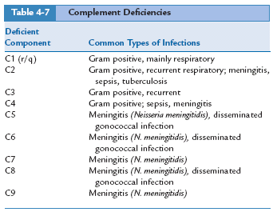
Other Primary Immunodeficiencies

Slide 62
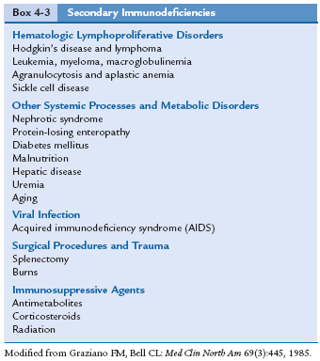
Secondary Immunodeficiencies
(Modified from Graziano FM, Bell CL: The normal immune response and what can go wrong. In Corman LC, Katz D, editors: Symposium on clinical immunology I, Philadelphia, Saunders; Med Clin North Am 69[3]:445, 1985.)

Slide 63
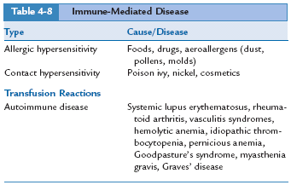
Immune-Mediated Disease

Slide 64
Case Study
Can you make the diagnosis?

Slide 65
Case Study
History and Physical Examination
Ms. C.A., a 38-year-old dancer, went to the emergency department one night after work. She reported a worsening condition of shortness of breath with an unproductive cough, mild chest pain, and tiredness. She also reported persistent diarrhea for the past 6 weeks and weight loss (without dieting) of 16 pounds.
She had no history of smoking or of previous respiratory illness. Her medical history included genital herpes and gonorrhea within the past 2 years. She has had unprotected intercourse with numerous sexual partners.
A complete blood count (CBC), electrocardiogram (ECG), and chest radiograph were ordered. Subsequent to the chest film report of diffuse, bilateral, interstitial shadowing, a bronchoscopy with bronchoalveolar lavage (BAL) was performed.

Slide 66
Case Study
Laboratory Data
Assay Patient Result Reference Range
Hemoglobin 11.5 g/dL 13.5-17.5
Hematocrit 38% 39-51
Total WBC 5.8 × 10⁹/L 4.5-11.0
Absolute lymphocyte count 0.75 × 10⁹/L 1.6-3.5
T lymphocytes
CD4+ 0.13 × 10⁹/L 0.7-1.1
CD8+ 0.42 × 10⁹/L 0.5-0.9
B lymphocytes 0.10 × 10⁹/L 0.2-0.5
BAL Positive for Pneumocystis carinii

Slide 67
Case Study
1. Is this patient immunodeficient?
a. Yes
b. No
c. Needs to be determined
d. Cannot be determined
2. What further diagnostic assays would be useful in establishing a diagnosis?
a. ELISA assay for antibodies to gp41
b. ELISA assay for antibodies to p24
c. Polymerase chain reaction (PCR) to demonstrate HIV-1
d. Alf the above
3. What opportunistic pathogens are typically associated with patients who have an immunodeficiency?
a. Cryptococcus neoformans
b. Cytomegalovirus
c. Hepatitis B virus
d. Both a and b
Diagnosis?

Slide 68
Case Study
1. Is this patient immunodeficient?
a. Yes
b. No
c. Needs to be determined
d. Cannot be determined
2. What further diagnostic assays would be useful in establishing a diagnosis?
a. ELISA assay for antibodies to gp41
b. ELISA assay for antibodies to p24
c. Polymerase chain reaction (PCR) to demonstrate HIV-1
d. All of the above
3. What opportunistic pathogens are typically associated with patients who have an immunodeficiency?
a. Cryptococcus neoformans
b. Cytomegalovirus
c. Hepatitis B virus
d. Both a and b
Diagnosis: AIDS

Slide 69
Quiz Bowl!
FUN!

