Slide 1
Immunology/Serology Seminar Week 3
Christina A Nevel-McGarvey, PhD, MS, MT(ASCP)

Slide 2
YOUR Week 1 Quiz
REVIEW

Slide 3
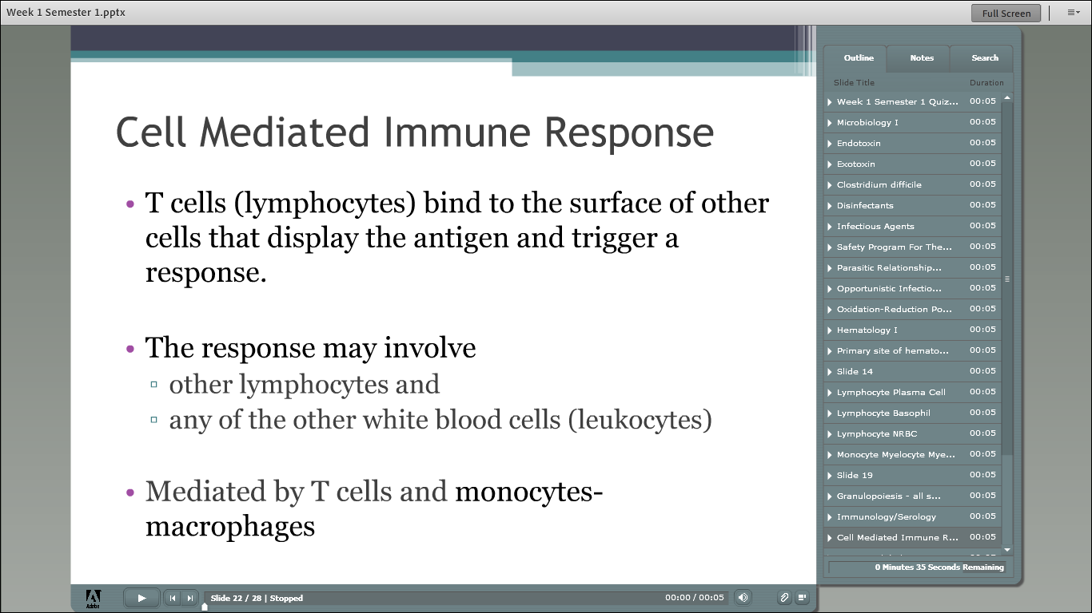

Slide 4
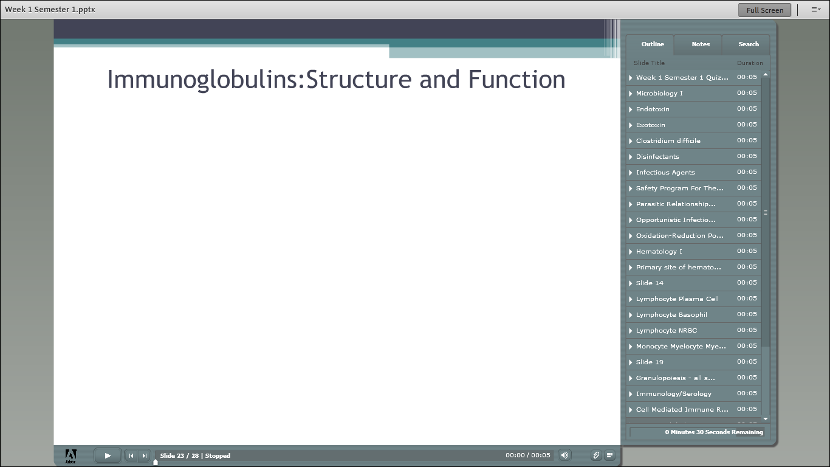

Slide 5
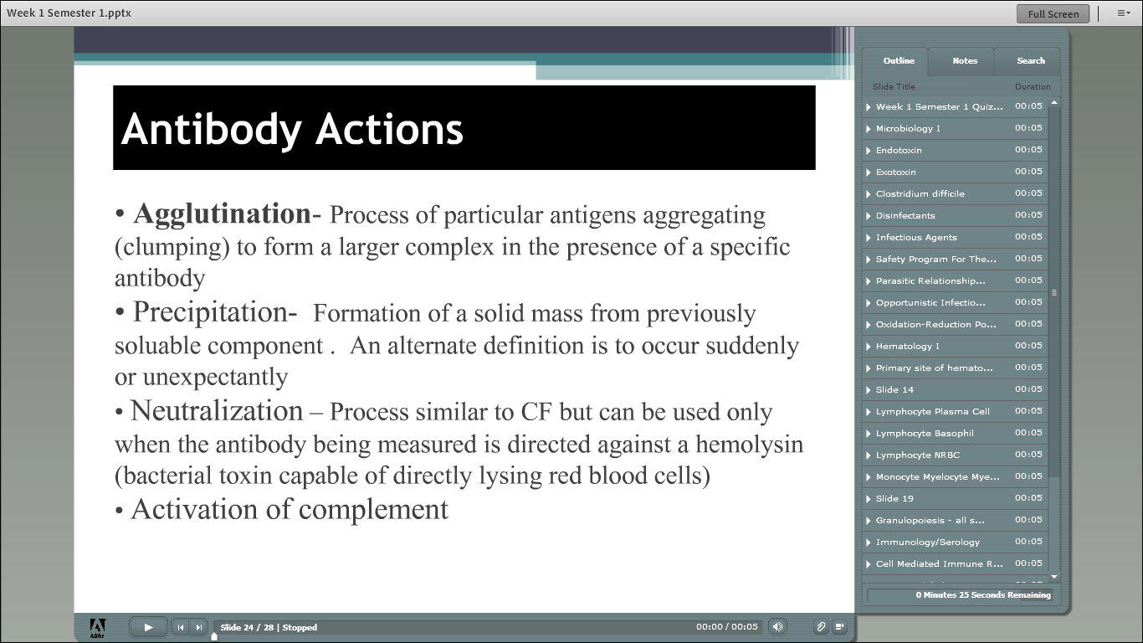

Slide 6
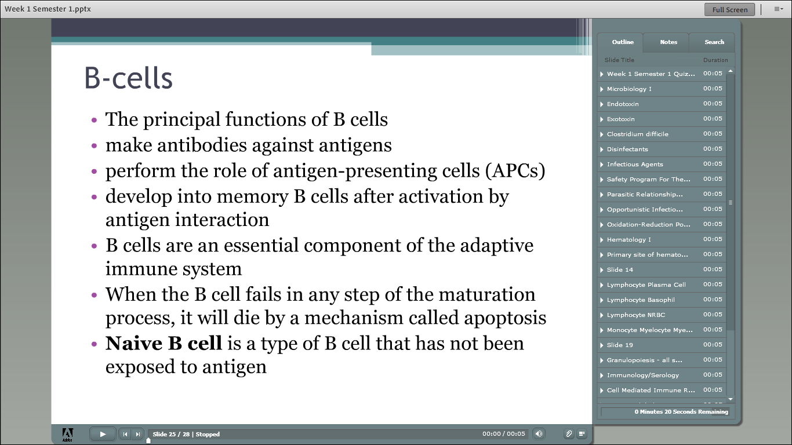

Slide 7
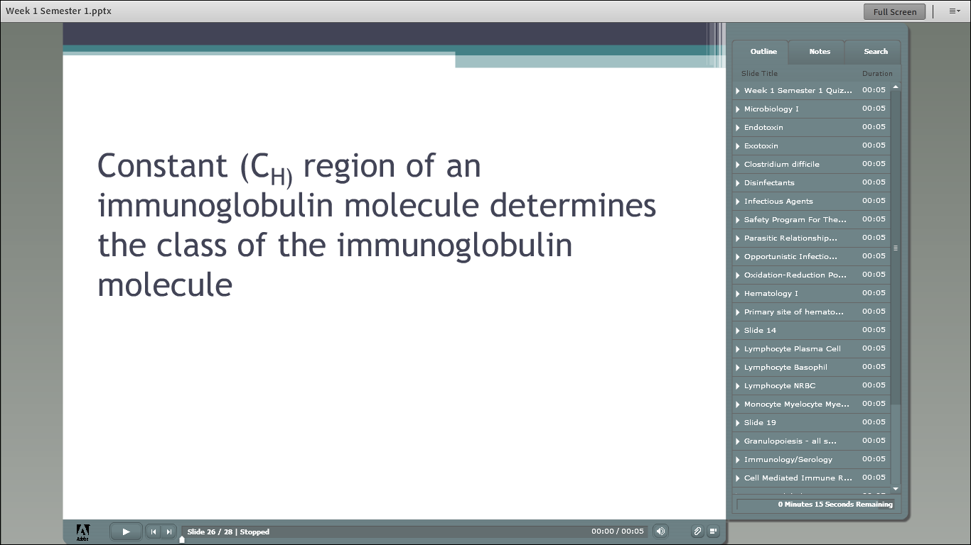

Slide 8
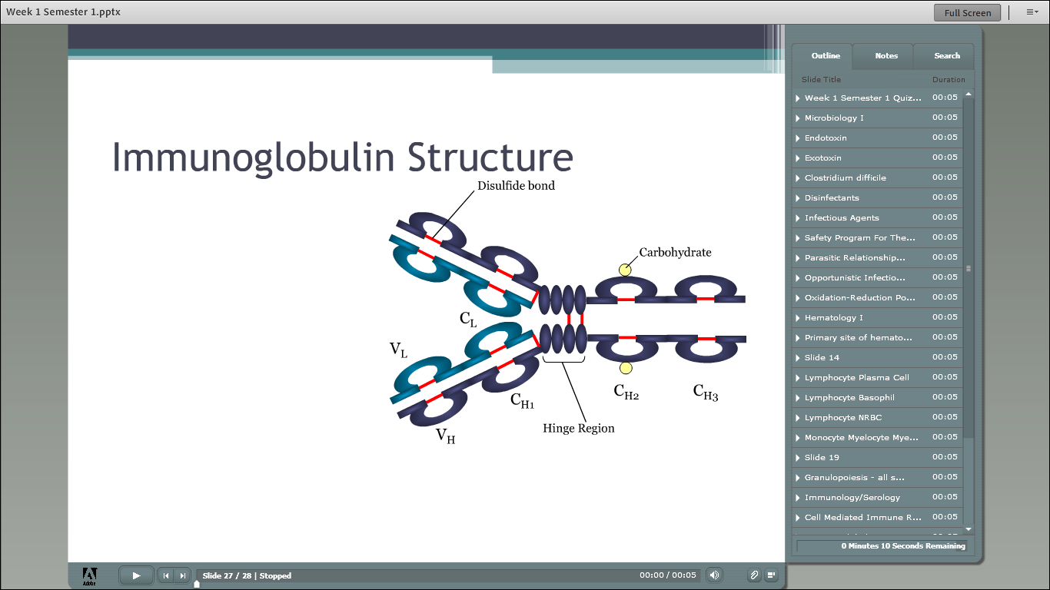

Slide 9
LAST SEM’s Week 2 Quiz
REVIEW

Slide 10
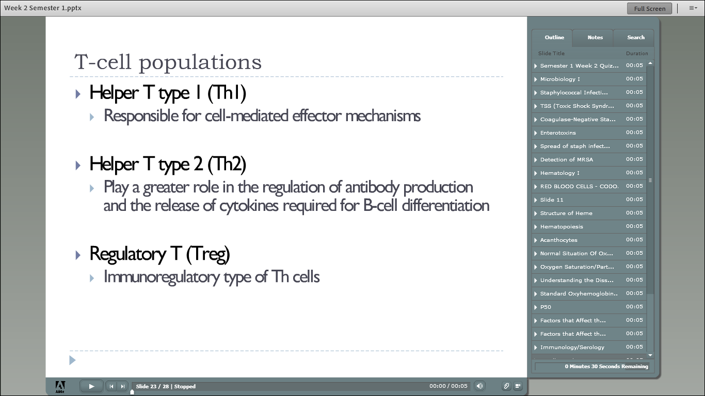

Slide 11
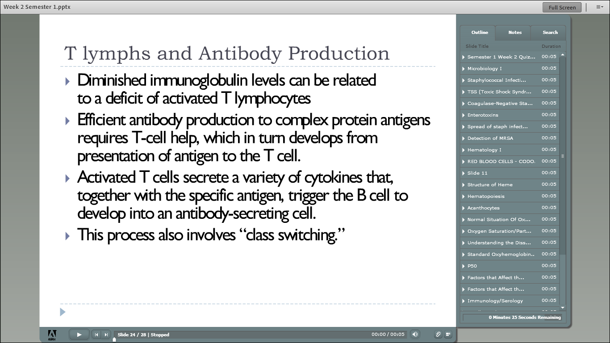

Slide 13
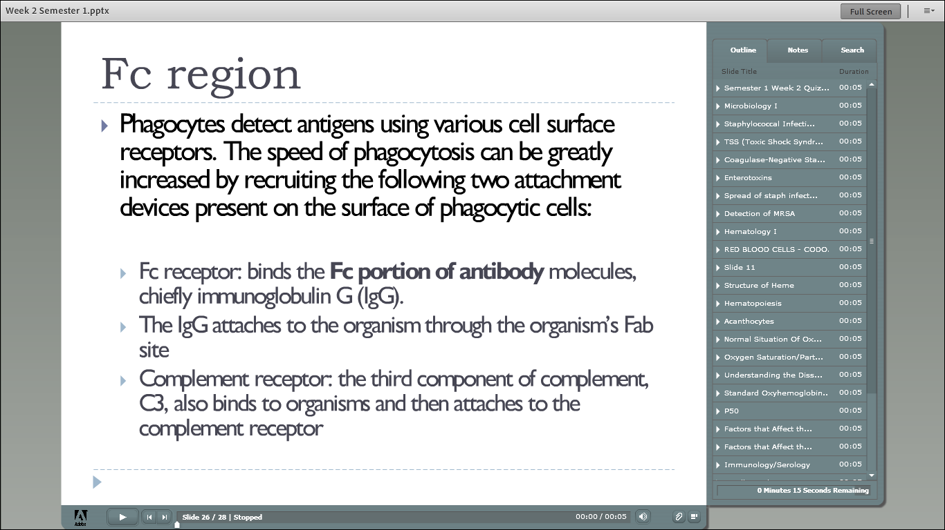

Slide 14
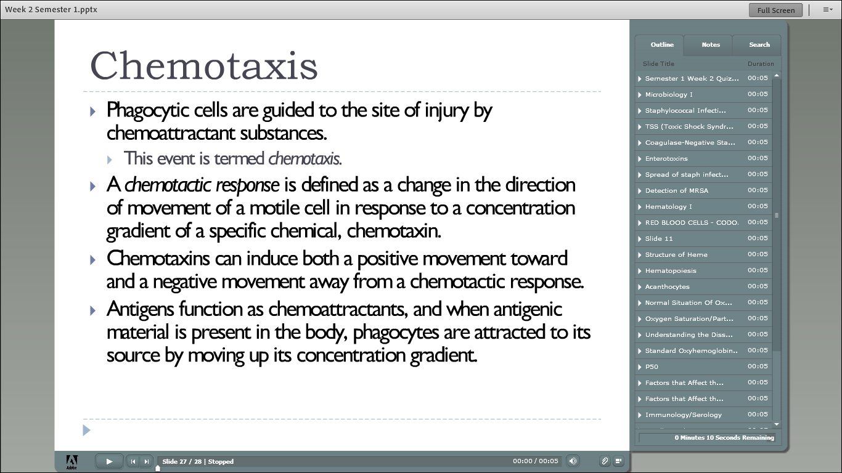

Slide 15
Chapter 5 Vocabulary
REVIEW

Slide 16
Soluble Mediators of the Immune system
CHAPTER 5 REVIEW

Slide 17
Complement System
Three main physiologic activities of the complement system:
Host defense against infection
Interface between innate and adaptive immunity
Disposal of waste

Slide 18
The Complement System
Classic Pathway
Alternate Pathway
Mannose-Binding Lectin Pathway

Slide 19
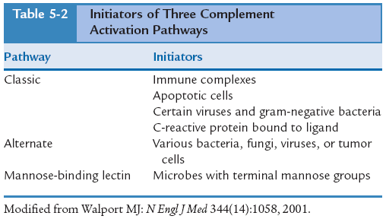
Initiators of the Three Activation Pathways of Complement

Slide 20
The Complement System
Activation of Complement
Normally, complement components are present in the circulation in an inactive form.

Slide 21
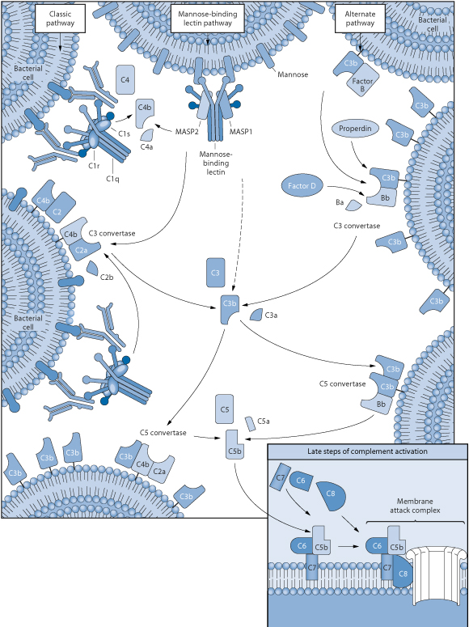
Three Activation Pathways of Complement
(Redrawn from Walport MJ: Complement, N Engl J Med 344[14]:1058, 2001.)

Slide 22
Enzyme activation occurs after complement is initially activated;
Each enzyme precursor is activated by the previous complement component or complex.
The pathways leading to the cleavage of C3 are triggered enzyme cascades.

Slide 23
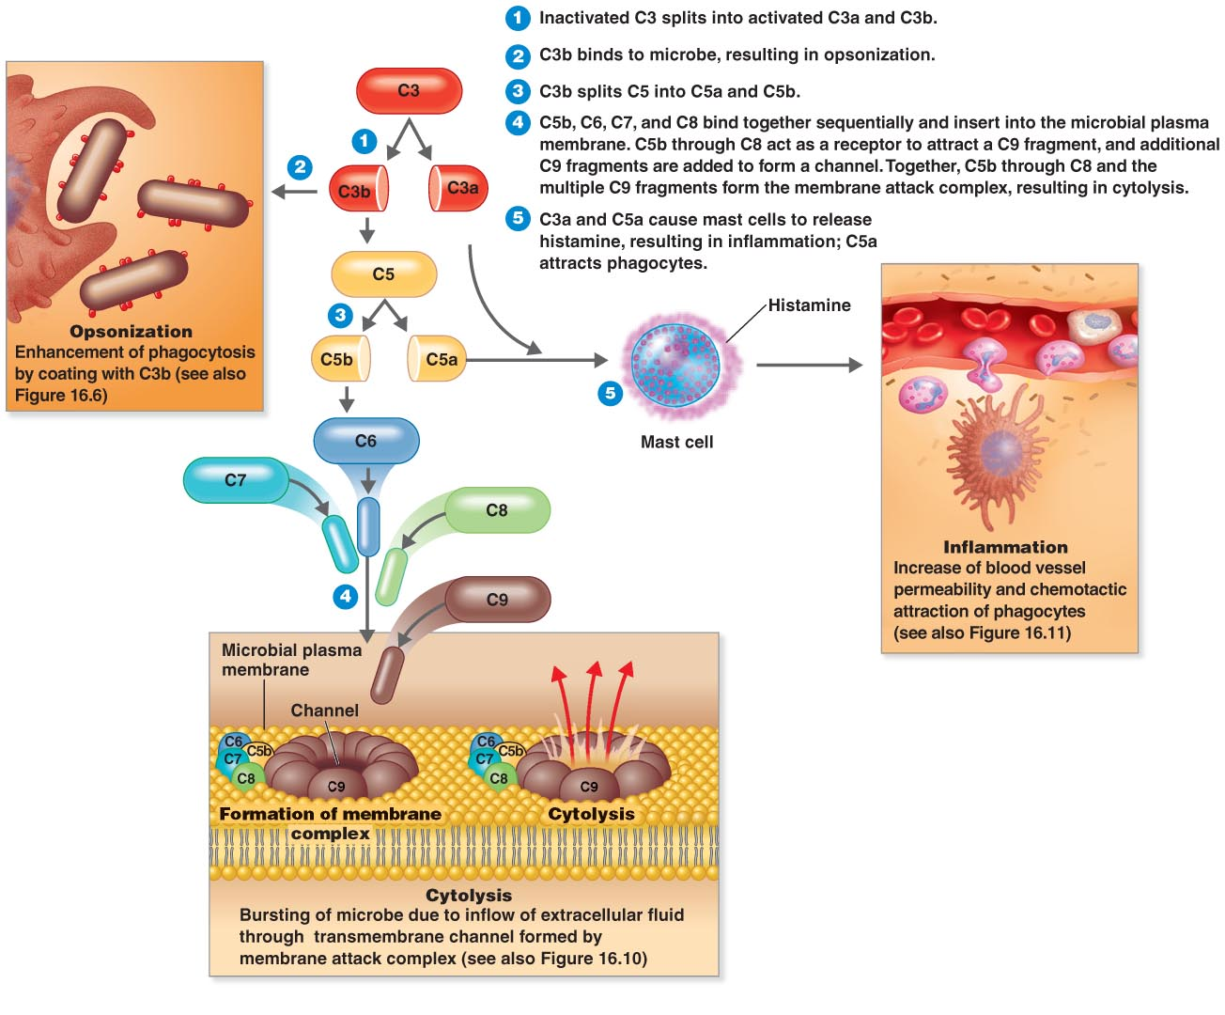
The Complement System
Figure 16.9

Slide 24
Complement receptors: various cell types express surface membrane glycoproteins that react with one or more of the fragments of C3 produced during complement activation and degradation.
Effects of Complement Activation:
Production of inflammatory mediators
Cell membrane lysis of antibody-coated targets
Opsonization

Slide 25
Classic Pathway
Recognition
Amplification of Proteolytic Complement Cascade
Membrane Attack Complex

Slide 26
Alternate Pathway

Slide 27
Mannose-Binding Lectin Pathway

Slide 28
Biologic Functions of Complement Proteins
Two categories:
Cell lysis by the membrane attack complex (MAC)
Biologic effects of proteolytic fragments of complement

Slide 29
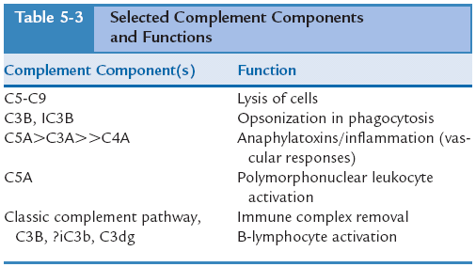

Slide 30
Alterations in Complement Proteins
Elevated Complement Levels
Increased in many inflammatory conditions. Limited clinical significance because separate complement components are acute-phase proteins.
Decreased Complement Levels
Decreased because of excessive activation, currently being consumed, or a single complement component is absent because of a genetic defect.

Slide 31
Three types of complement deficiency can cause increased susceptibility to pyogenic infections:
Deficiency of opsonic activities of complement.
Any deficiency that compromises the lytic activity of complement.
Deficient function of mannose-binding lectin pathway.

Slide 32
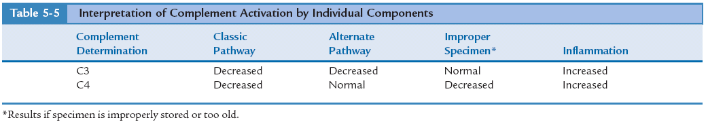
Diagnostic Evaluation
Assessment of Complement

Slide 33
Other Soluble Mediators of Immune Response
Cytokines are made and acted on by leukocytes.
Interleukins is alternate term for cytokines.

Slide 34
Common Properties of Cytokines
Secrete in response to cell activation.
Bind to specific membrane receptors on target cells.
Regulate receptor expression in T and B cells.
Act on different cell types
Excite same functional effects with multiple cytokines.
Act close to the site of synthesis.
Influence synthesis and actions of other cytokines.

Slide 35
Immunoregulatory Activity of Other Cytokines
Interferons: group of cytokines discovered in virally infected cultured cells; name derived from interference with viral replication.
Tumor necrosis factor (TNF): principal mediator of acute inflammatory response to gram-negative bacteria and other infectious microbes.
Stimulates recruitment of neutrophils and monocytes to sites of infection.
Activates neutrophils and monocytes to eradicate microbes.

Slide 36
Hematopoietic Stimulators
Stem cell factor (c-kit ligand)
Colony-stimulating factors
Transforming growth factor beta (TGF-β)
Chemokines

Slide 37
Hematopoietic Stimulators
Stem cell factor (c-kit ligand)
Colony-stimulating factors
Transforming growth factor beta (TGF-β)
Chemokines

Slide 38
Assessment of Cytokines
Traditional:
bioassays,
enzyme-linked immunosorbent assay (ELISA), intracellular staining,
ribonuclease protection assay,
polymerase chain reaction (PCR)
Newer methods:
multiplexed assay,
flow cytometry,
cord blood cell stimulation,
real-time PCR,
Eli spot assays,
enhanced immunoassays for cytokines,
high-sensitivity ELISA

Slide 39
Acute-Phase Proteins
Overview of Acute-Phase Proteins

Slide 40
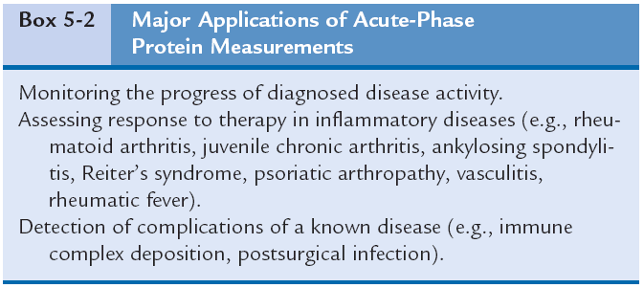

Slide 41
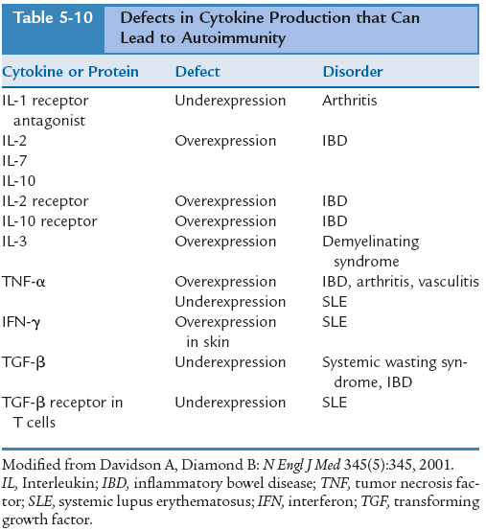

Slide 42
Synthesis and Catabolism of Acute-Phase Proteins
C-Reactive Protein
Significance of Other Acute-Phase Reactants
Acute-Phase Reactant Assessment Methods

Slide 43
Case study

Slide 44
History and Physical Examination
M.P. is a 2-year-old girl who came to the United States from India with her parents when she was a baby. Recently, her appetite has been poor, and she has been losing weight. Her mother has noticed that she is not as active as usual.
Physical examination revealed that the girl was underweight for her age. She had a slight cough, and her physician heard wheezes in her left lung.
A chest radiograph, gram stain, and sputum culture were ordered. The chest radiograph revealed an abnormality of the upper lobe of the left lung.
Laboratory Data
Sputum smear: positive for Mycobacterium tuberculosis

Slide 45
1. What types of cells of the immune system are active in an M. tuberculosis infection?
a. Neutrophils
b. Lymphocytes
c. Monocytes
d. Alveolar macrophages

Slide 46
1. What types of cells of the immune system are active in an M. tuberculosis infection?
a. Neutrophils
b. Lymphocytes
c. Monocytes
d. Alveolar macrophages

Slide 47
2. Why does M. tuberculosis survive phagocytic destruction?
a. Overcomes the action of oxygen and nitrogen radicals
b. Overcomes the action of lysosomal enzymes
c. Inhibits lysosomal fusion
d. All of above

Slide 48
2. Why does M. tuberculosis survive phagocytic destruction?
a. Overcomes the action of oxygen and nitrogen radicals
b. Overcomes the action of lysosomal enzymes
c. Inhibits lysosomal fusion
d. All of above

Slide 49
3. Cytotoxic T lymphocytes trigger _____________ in the pulmonary lesion of bacteria.
a. necrosis
b. bacterial multiplication
c. phagocytosis by alveolar macrophages
d. destruction

Slide 50
3. Cytotoxic T lymphocytes trigger _____________ in the pulmonary lesion of bacteria.
a. necrosis
b. bacterial multiplication
c. phagocytosis by alveolar macrophages
d. destruction

Slide 51
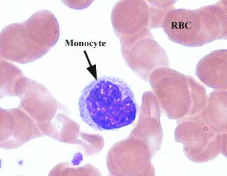

Slide 52
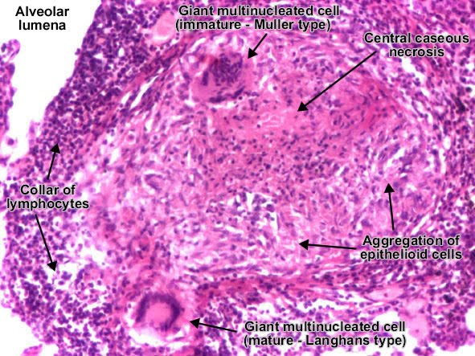

Slide 53
Quiz bowl!
FUN

Slide 54
Complement is characterized by all the following except:
A) Collection of proteins synthesized in the liver. B) Heat-labile series of 18 plasma proteins. C) Normally present in the circulation in an inactive form. D) Normally present in the circulation as an active enzyme.

Slide 55
Complement is characterized by all the following except:
A) Collection of proteins synthesized in the liver. B) Heat-labile series of 18 plasma proteins. C) Normally present in the circulation in an inactive form. D) Normally present in the circulation as an active enzyme.
Complement is a heat-labile series of 18 plasma proteins, many of which are enzymes or proteinases. Normally, complement components are present in the circulation in an inactive form.

Slide 56
Functions of the complement system include:
A) Host defense against infection, such as chemotaxis. B) Clearance of apoptotic cells. C) Clearance of immune complexes from the tissues. D) All the above.

Slide 57
Functions of the complement system include:
A) Host defense against infection, such as chemotaxis. B) Clearance of apoptotic cells. C) Clearance of immune complexes from the tissues. D) All the above.
Activity | Responsible Complement Protein
Host Defense against Infection
Opsonization | Covalently bonded fragments of C3 and C4
Chemotaxis and leukocyte activation | C5a, C3a, and C4a; anaphylatoxin leukocyte receptors
Lysis of bacterial and mammalian cells | C5-C9 membrane attack complex
Interface between Innate and Adaptive Immunity
Augmentation of antibody | C3b and C4b bound to immune complexes and to antigen
Responses | C3 receptors on B cells and antigen-presenting cells
Enhancement of immunologic memory | C3b and C4b bound to immune complexes and to antigen; C3 receptors on follicular dendritic cells
Disposal of Waste
Clearance of immune complexes from tissues Clearance of apoptotic cells | C1q; covalently bonded fragments of C3 and C4
Three Main Physiologic Activities of the Complement System
Modified from Walport MJ: N Engl J Med 344(14):1058, 2001.

Slide 58
The classic complement pathway is activated by:
A) Platelet factor 2. B) C3B. C) Factor B. D) Factor D

Slide 59
The classic complement pathway is activated by:
A) Platelet factor 2. B) C3B. C) Factor B. D) Factor D
The classic pathway is initiated by the bonding of the C1 complex, consisting of C1q, C1r, and C1s, to antibodies bound to an antigen on the surface of a bacterial cell.

Slide 60
The alternate complement pathway is activated by:
A) Bacterial exotoxins. B) Viruses. C) Antigen-antibody complexes. D) Haptens

Slide 61
The alternate complement pathway is activated by:
A) Bacterial exotoxins. B) Viruses. C) Antigen-antibody complexes. D) Haptens
The alternate pathway is initiated by contact with a foreign surface such as the polysaccharide coating of a microorganism and the covalent binding of a small amount of C3b to hydroxyl groups on cell surface carbohydrates and proteins. The pathway is activated by low-grade cleavage of C3 in plasma.

Slide 62
The physiologic or cellular consequences of complement activation can include:
A) Production of inflammatory mediators. B) Cytolysis or hemolysis. C) Opsonization. D) All the above.

Slide 63
The physiologic or cellular consequences of complement activation can include:
A) Production of inflammatory mediators. B) Cytolysis or hemolysis. C) Opsonization. D) All the above.
Physiologic consequences of the activation of complement and the products formed during the complement cascade include blood vessel dilation and increased vascular permeability. The cellular consequences include:
· Cell activation, such as production of inflammatory mediators.
· Cytolysis or hemolysis, if the cells are erythrocytes. The most important biologic role of complement in blood group serology is the production of cell membrane lysis of antibody-coated targets.
· Opsonization, which renders cells vulnerable to phagocytosis.

Slide 64
The membrane attack complex (MAC) is characterized by all the following except:
A) MAC components are the same in the final common pathway of complement activation. B) C5-8 complex polymerizes C9 to form a tubule known as MAC. C) MAC allows for the influx of Na⁺ and H₂O, which produces lysis. D) The complement cascade reaches full amplitude at this stage

Slide 65
The membrane attack complex (MAC) is characterized by all the following except:
A) MAC components are the same in the final common pathway of complement activation. B) C5-8 complex polymerizes C9 to form a tubule known as MAC. C) MAC allows for the influx of Na⁺ and H₂O, which produces lysis. D) The complement cascade reaches full amplitude at this stage
The MAC is a unique system that builds up a lipophilic complex in cell membranes from several plasma proteins. When fully assembled in the correct proportions, C7, C6, C5b, and C8 form the MAC. The C5bC6C7C7C8 complex polymerizes C9 to form a tubule (pore), which spans the membrane of the cell being attacked, allowing ions to flow freely between the cellular interior and exterior. By complexing with C9, the osmotic cytolytic reaction is accelerated. The consequence in a living cell is that the influx of sodium (Na⁺) ions and H₂O leads to disruption of osmotic balance, which produces cell lysis.

Slide 66
Increased susceptibility to pyogenic infections can be caused by:
A) Deficiency of the opsonic activities of complement. B) Any deficiency that compromises the lytic activity of complement. C) Deficient function of the mannose-binding lectin pathway. D) All the above.

Slide 67
Increased susceptibility to pyogenic infections can be caused by:
A) Deficiency of the opsonic activities of complement. B) Any deficiency that compromises the lytic activity of complement. C) Deficient function of the mannose-binding lectin pathway. D) All the above.
Increased susceptibility to pyogenic bacteria can result from a deficiency of the opsonic activities of complement, a deficiency that compromises lytic activity of complement, or deficient function of the mannose-binding lectin pathway.

Slide 68
Interferons:
A) Are the principal mediator of the acute inflammatory response to gram-negative bacteria. B) Mediate interactions between leukocytes. C) Mediate the early immune response to viral infections. D) Stimulate cell differentiation.

Slide 69
Interferons:
A) Are the principal mediator of the acute inflammatory response to gram-negative bacteria. B) Mediate interactions between leukocytes. C) Mediate the early immune response to viral infections. D) Stimulate cell differentiation.
A characteristic of interleukins (ILs) is that secreted peptides and proteins mediate local interactions between leukocytes but do not bind antigen. ILs include molecules that are made by and that act on lymphocytes. The interferons (IFNs) are a group of cytokines discovered in virally infected cultured cells. This interference with viral replication in the cells by another virus led to the name “interferons.” Type I IFNs mediate the early innate immune response to viral infections. Tumor necrosis factor is the principal mediator of the acute inflammatory response to gram-negative bacteria and other infectious microbes.

Slide 70
Which of the following characteristics is representative of C-reactive protein (CRP)?
A) The first acute-phase reactant to become elevated B) Nonspecific indicator of inflammation C) Acute-phase reactant D) All the above

Slide 71
Which of the following characteristics is representative of C-reactive protein (CRP)?
A) The first acute-phase reactant to become elevated B) Nonspecific indicator of inflammation C) Acute-phase reactant D) All the above
CRP is prominent among the acute-phase proteins because its changes show great sensitivity. CRP is a direct and quantitative measure of the acute-phase reaction and, as a result of its fast kinetics, provides adequate information of the actual clinical situation. In acute inflammation, CRP levels become elevated within the first 12 hours. CRP is nonspecific in terms of causation.

Slide 72
The measurement of C-reactive protein (CRP) can be used for all the following except:
A) Monitoring healing after acute myocardial infarction. B) Monitoring drug therapy with nonsteroidal antiinflammatory agents. C) Predicting risk of myocardial infarction. D) Diagnosis of viral septicemia.

Slide 73
The measurement of C-reactive protein (CRP) can be used for all the following except:
A) Monitoring healing after acute myocardial infarction. B) Monitoring drug therapy with nonsteroidal antiinflammatory agents. C) Predicting risk of myocardial infarction. D) Diagnosis of viral septicemia.
Traditionally, CRP has been used clinically for monitoring infection, autoimmune disorders, and more recently, healing after a myocardial infarction. Levels of CRP parallel the course of the inflammatory response and return to lower, undetectable levels as the inflammation subsides.

