Slide 1
Hematology
Week 11
Seminar

Slide 2
Week 10 Quiz
Review

Slide 3
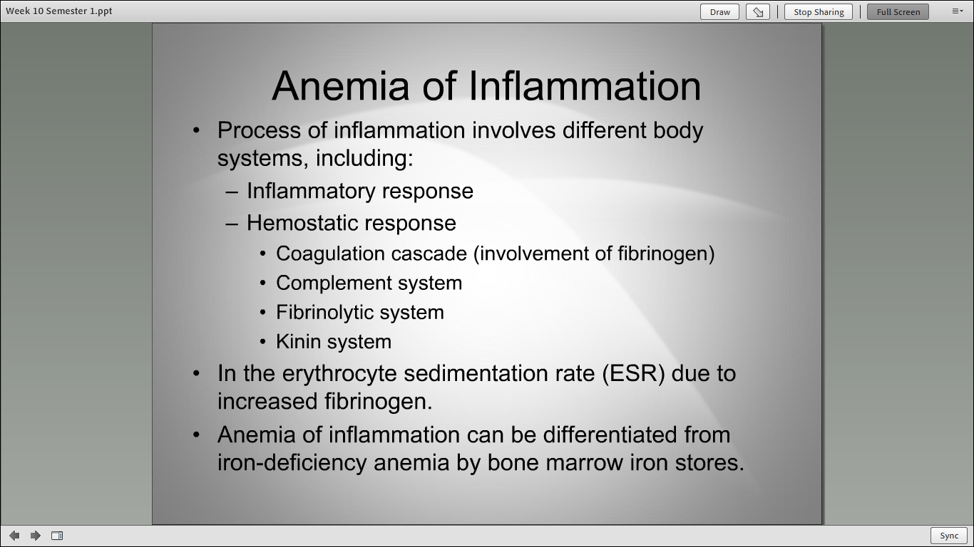

Slide 4
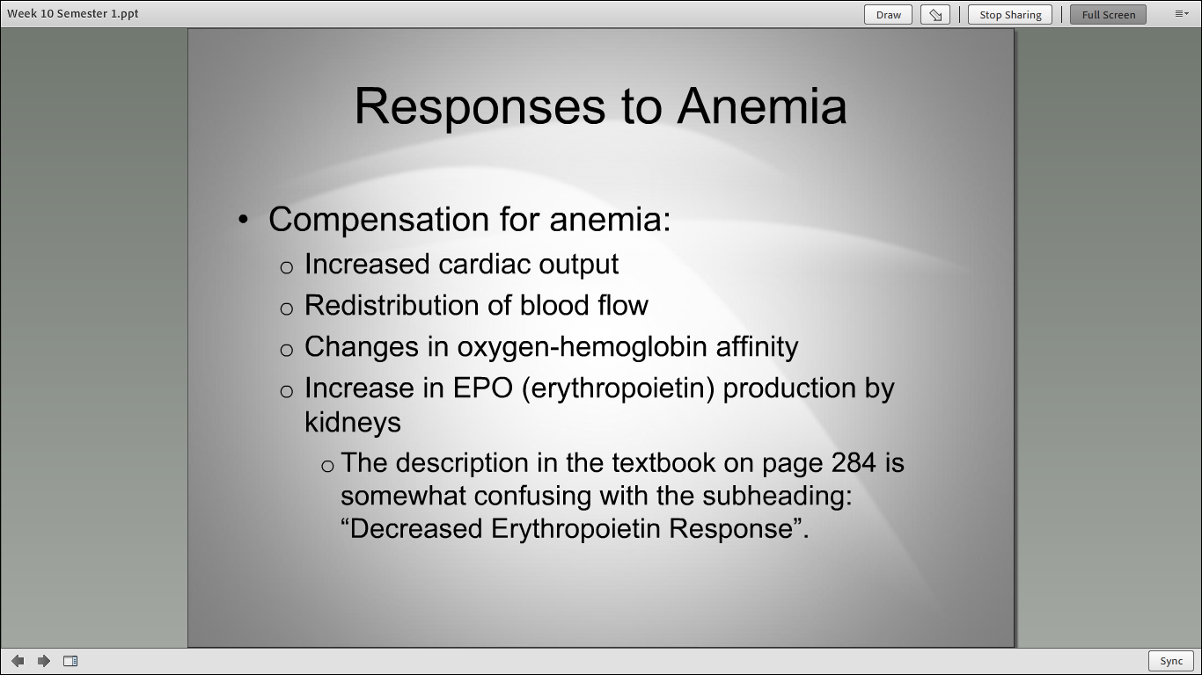

Slide 5
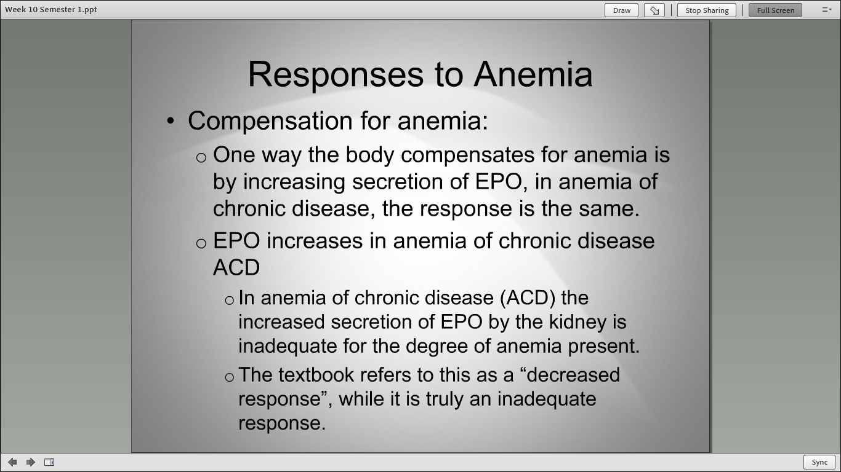

Slide 6
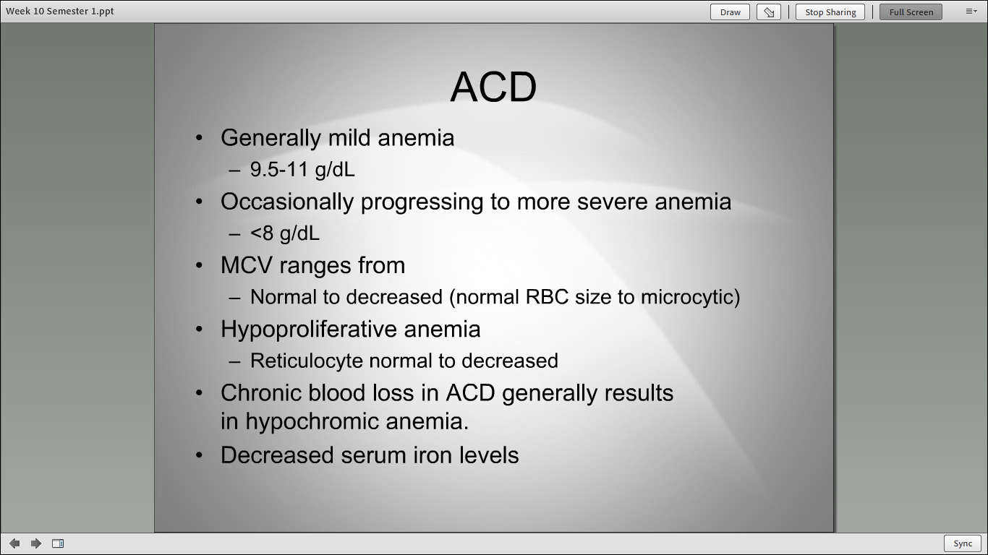

Slide 7
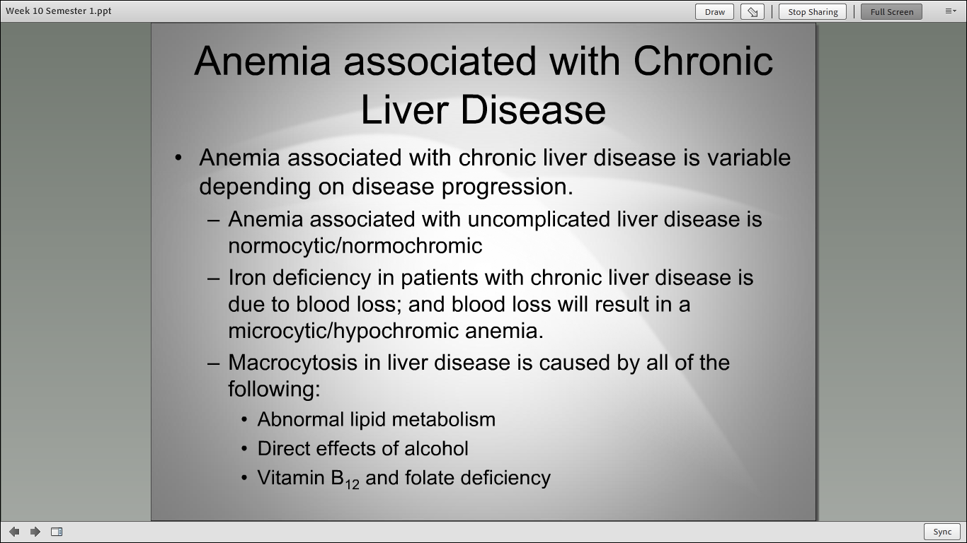

Slide 8
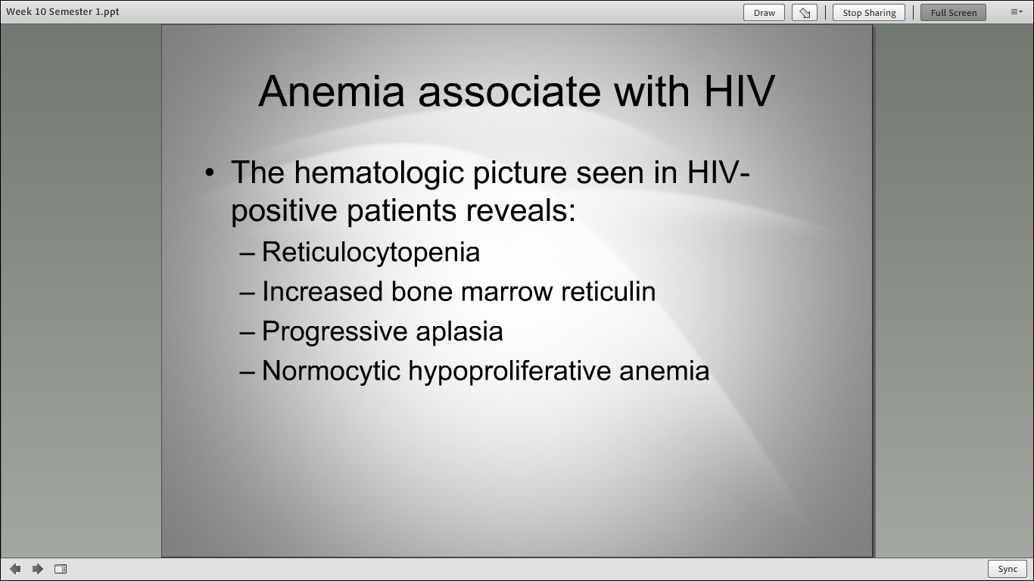

Slide 9
Week 11 Content
Review

