Slide 1
Hematology Week 11
Seminar

Slide 2
Week 10 Quiz
Review

Slide 3
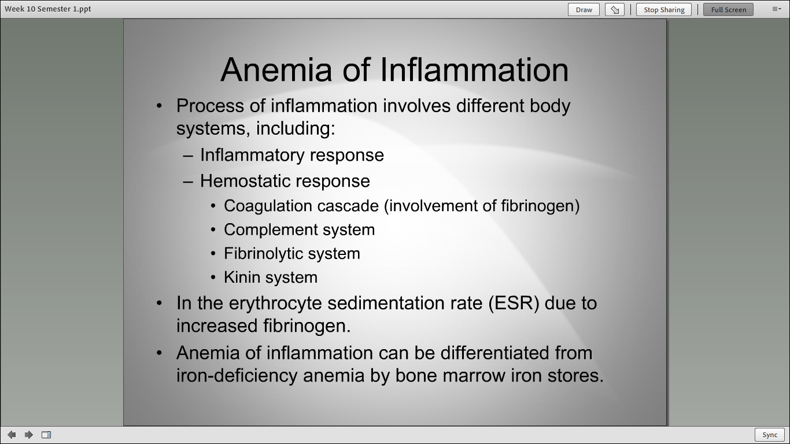

Slide 4
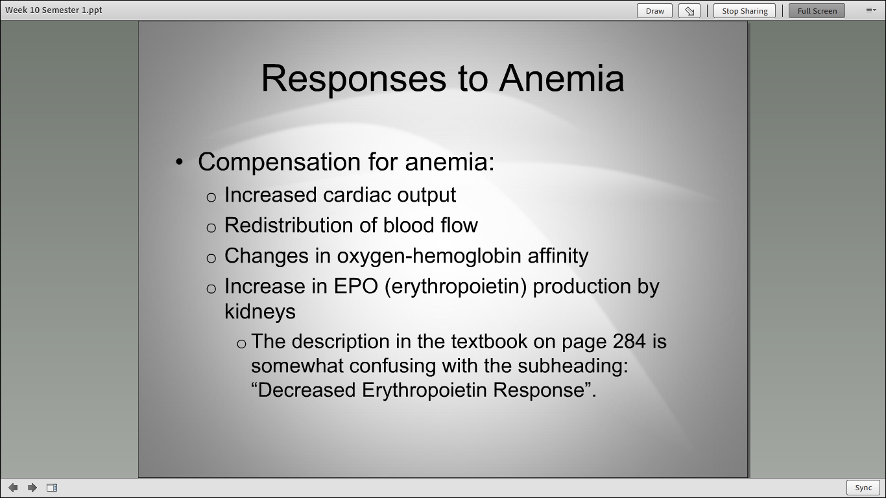

Slide 5
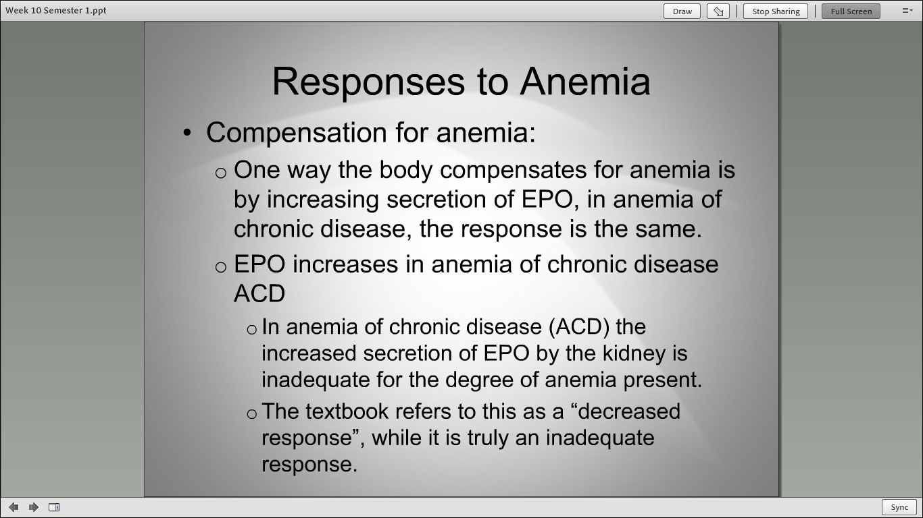

Slide 6
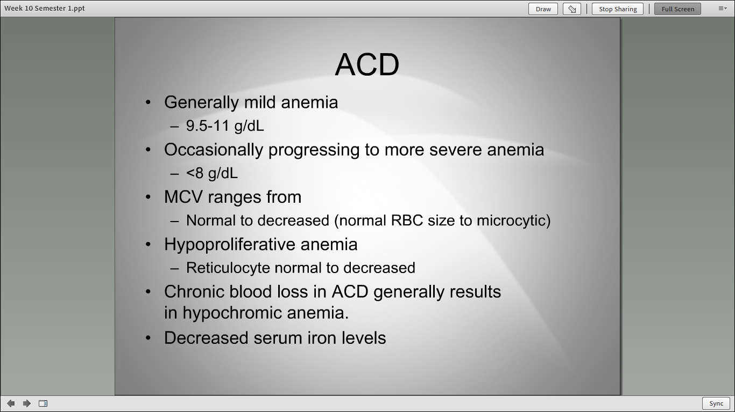

Slide 7
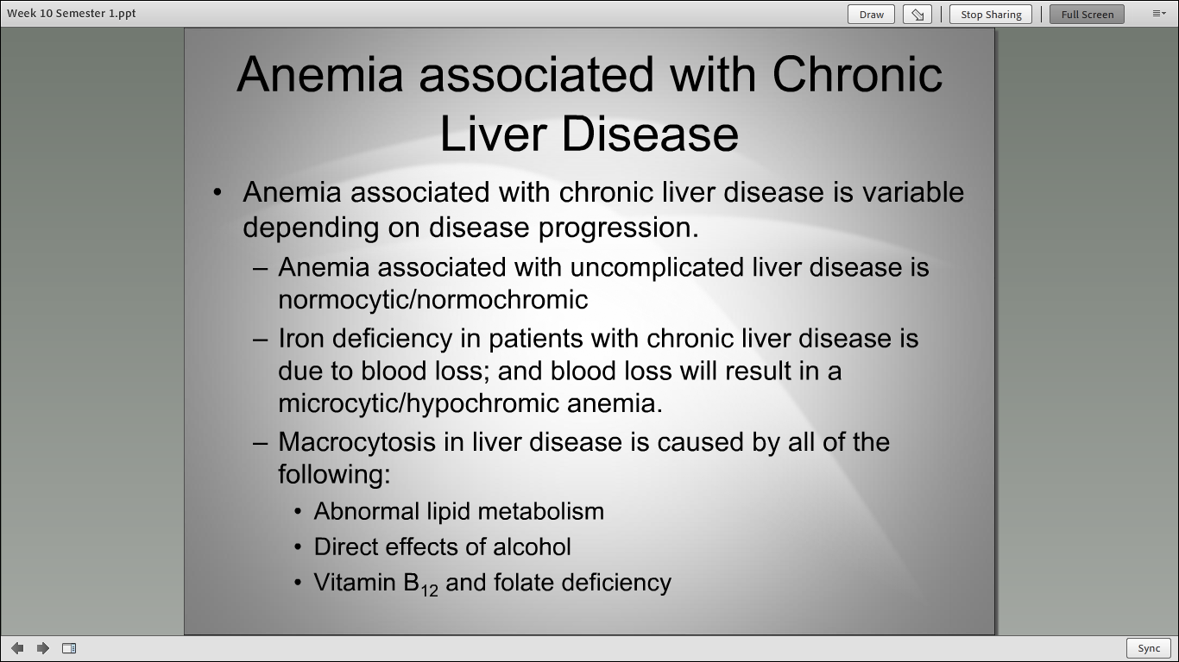

Slide 8
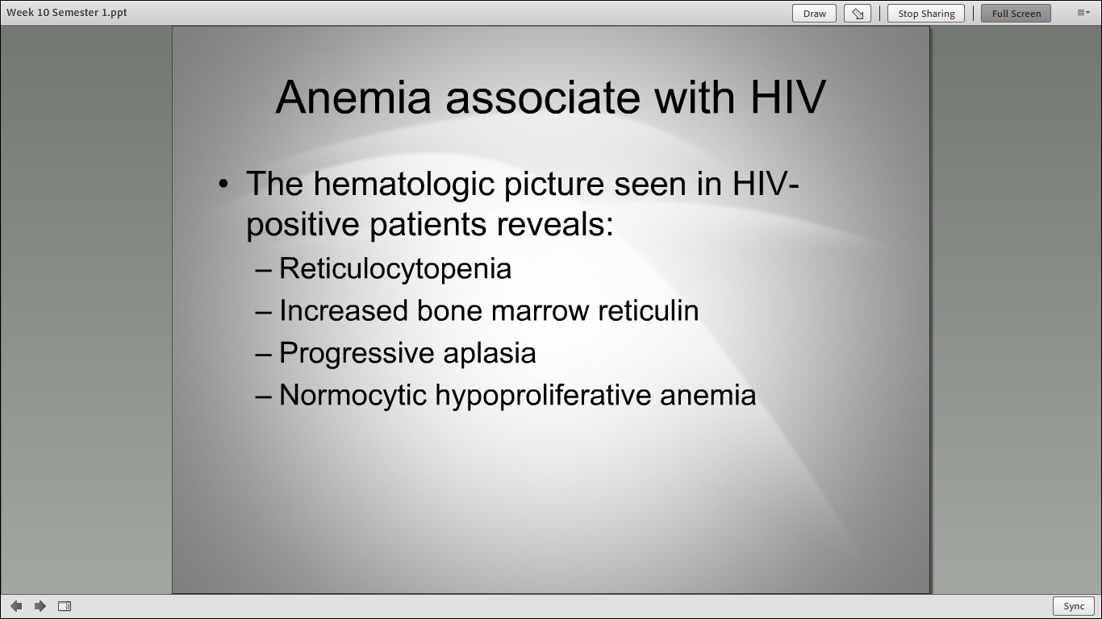

Slide 9
Week 11 Content
Review

Slide 10
Hematology Manual and Special Testing
Selected topics: Chapter 31
Chapter 32
Lynn Jones, BS, MT, ASCP
Assistant Program Director
Christina A Nevel-McGarvey, PhD, MS, MT(ASCP)
Professor, Clinical Laboratory Sciences

Slide 11
Specimen Collection
Pre-analytical Steps
Patient identification
Requisition Verification
Biosafety
Venipuncture
Most commonly from median cubital vein in arm
Vacutainer tubes containing Ethylene diaminetetraacetic acid (EDTA) anticoagulant
Capillary Puncture
Finger or heel

Slide 12
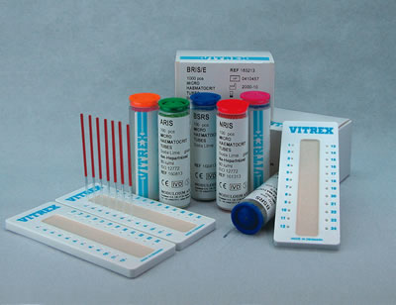
Microhematocrit (Hct) Tubes
Heparinized tubes for capillary blood
Non heparinized tubes for EDTA collected blood
Sealing clay

Slide 13
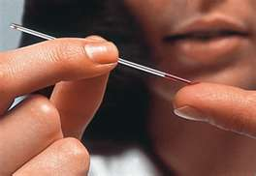
Finger Stick using Capillary Tube

Slide 14
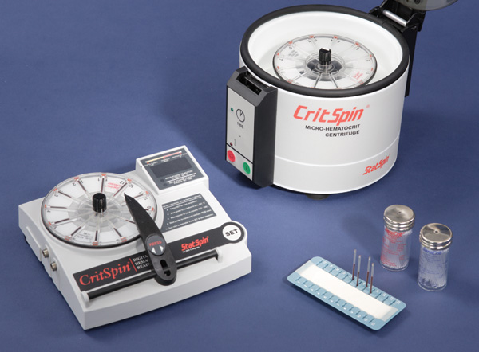
Microhematocrit Centrifuge Systems
Balance tubes
Centrifuge 5 min, at 14,500 rpm

Slide 15
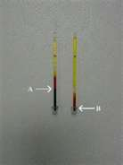
Hct After Centrifugation
Read packed red cell volume using microhematocrit reader
Do not include buffy coat
Hematocrit is reported as % rbc to total blood volume
Normals
Newborn: 53-65%
Infant: 30-43%
Adult male: 42-52%
Adult female: 37-47%

Slide 16
RBC Indices
Red blood Cell Indices
Measurements that describe the size and hemoglobin content of red blood cells. Used to detect and monitor Anemia.
Mean Corpuscular Hemoglobin (MCH)
A measurement of the average weight of hemoglobin in a red blood cell.
Mean Corpuscular Hemoglobin Concentration (MCHC)
The measurement of the average concentration of hemoglobin in a red blood cell.
Mean Corpuscular Volume (MCV)
A measure of the average volume of a red blood cell.
Red Cell Distribution Width (RDW)
A measure of the variation in size of red blood cells

Slide 17
RBC Indices
The calculations:-
MCV = hematocrit ÷ rbc count x 10
MCH = hemoglobin ÷ rbc count x 10
MCHC = hemoglobin ÷ hematocrit x 100
The ASCP usually has one or two index calculations on the exam

Slide 18
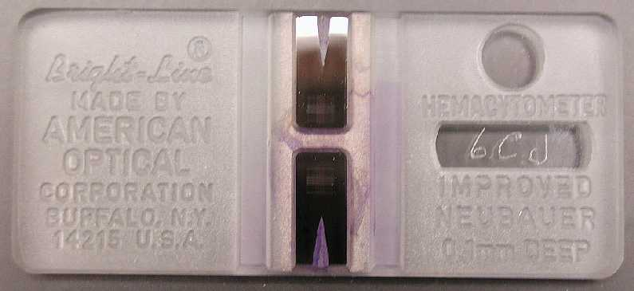
Manual Cells Counts
Hemocytometer
2 square-ruled areas separated by an H shaped moat
Must use standardized coverslip
Depth of chamber is 0.1mm
Counting area is 3mm x3mm

Slide 19
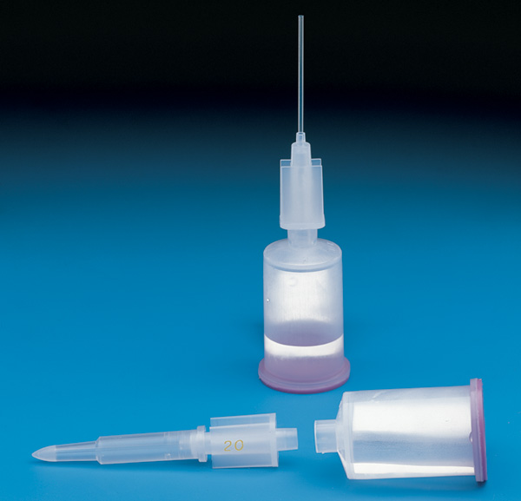
Unopette System
Ensures precise dilution and charging of sample
Calibrated micropipette
Sealed diluent reservoir
RBC will be lysed for WBC and Platelet Count
Pipet shield/puncture tool

Slide 20
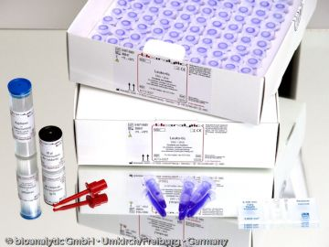
Unopette Replacements

Slide 21
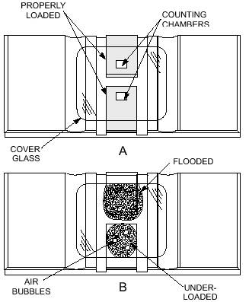
Charging the Hemocytometer

Slide 22
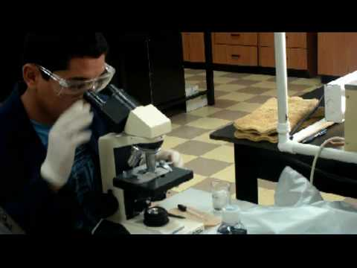
Microscopic Counting!

Slide 23
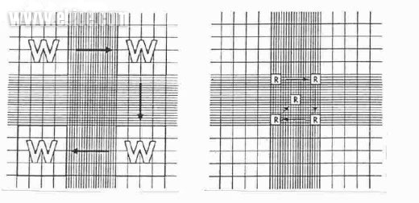
Neubauer Ruling
WBC
Count 4 corner Primary Squares
RBC
Count 5 secondary squares in center primary square
Triple Boundary Lines-
Count all cells within squares including those touching middle line
Double Boundary Lines-
Count all cells within square and those touching innermost line

Slide 24
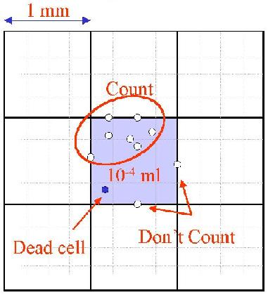
Don’t count dead cells or cells touching the lower & right boundary line!

Slide 25
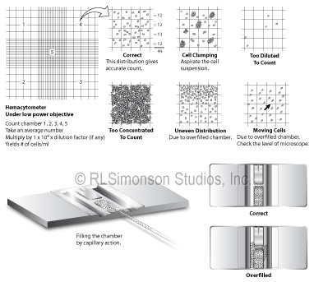
Proper charging and distribution of cells is of utmost importance in accurate counting!

Slide 26
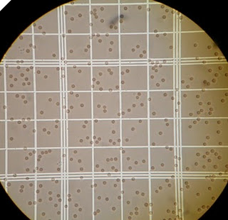

Slide 27
Red Blood Cell Count
RBC/mm³ = #RBC Counted x Depth factor x Dilution Factor
Area
Depth factor = 10
Dilution factor =200
Area=0.2
Therefore, we can formulate to a factor of 10,000
Example: Counted 600 Cells
600 x 10,000 = 6.0 x 10⁶/mm³ or 6.0 x 10¹²/L
Normals:
Newborn 4.4--5.8 x 10¹²/L
Infant/Child 3.8--5.5 x 10¹²/L
Adult Male 4.7--6.1 x 10¹²/L
Adult Female 4.2--5.4 x 10¹²/L

Slide 28
White Blood Cell Count
WBC/mm³ = #WBC Counted x Depth factor x Dilution Factor
Area
Depth factor = 10, Dilution factor =100, Area=4
Therefore, we can formulate to a factor of 250
Example: Counted 50 Cells
50 x 250 = 12.5 x 10³/mm³ or 12,500/μl
Normals:
Newborn 9,000--30,000/μl
1 week old 5,000--21,000/μl
1 month old 5,000--19,500/μl
6-12 months 6,000--17,500/μl
2yrs 6,200--17,000/μl
Child/Adult 4,800--10,800/μl

Slide 29
Platelet Count
Count ALL 25 squares of the Center Primary Square
Platelets /mm³ = #Platelets x Depth factor x Dilution Factor
Area
Depth factor = 10
Dilution factor =100
Area= 1.0
Therefore, we can formulate to a factor of 1,000
Example: Counted 200 Platelets
200 x 1,000 = 200 x 10³/mm³ or 200,000/μl or 200 x 10⁹/L
Normals:
Normal 150,000—450,000/μl

Slide 30
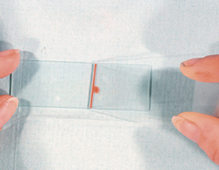
Preparing a Manual Smear
Many whole blood determinations require preparation of a manual smear with properly distributed cells a short distance inward from the feathered edge

Slide 31
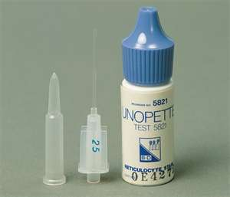
Reticulocyte Unopette

Slide 32
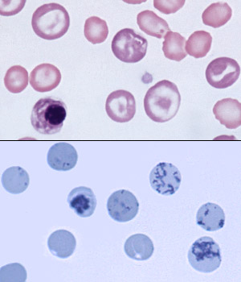
Reticulocytes: Giemsa vs. Supravital Stain
Polychromasia
Precipitate of RNA & organelles

Slide 33
Reticulocyte Reporting
Recticulocyte Count= #Retics x 100
1000
Corrected Reticulocyte Count= %Retic x Patient Hct%
45%
Compares patient Hematocrit with Normal Hematocrit
Absolute Reticulocyte Count= %Retic x RBC count
100
Multiply by RBC Count to convert to Absolute Retic Value
Reticulocyte Production Index (RPI)=
%Retic x patient Hct% / 45%
Reticulocyte maturation time at the patient Hct
Accounts for presence of Shift, takes into account corrected retic count and maturation time of retics based upon patient Hct

Slide 34
Reticulocyte Normals
Reticulocyte Count
Newborn= 2.6—6.0%
Adult = 0.5—2.0%
Absolute Reticulocyte Count= 24—80 x 10⁹/L
RPI = 3 or greater
Maturation Time for Reticulocytes
45% Hct = 1 day
35% Hct = 1.5 days
25% Hct = 2 days
15% Hct = 3 days

Slide 35
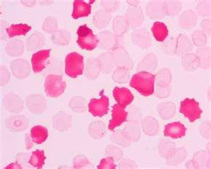
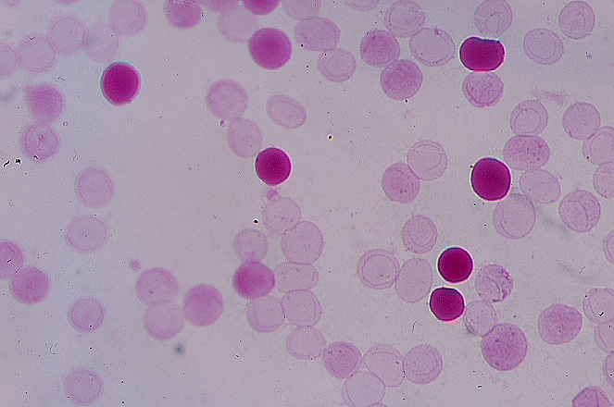
Kleihauer-Betke/ Acid Elution for Fetal Hemoglobin/K-B
Peripheral blood smear is exposed to acidified buffer before staining
Fetal hemoglobin does not elute
Other hemoglobin elute from cells
Fetal cells stain bright red
Staining of postpartum maternal blood for identification of percentage of fetal cells present.
Determine possible fetal maternal hemorrhage in the newborn
Assess the magnitude of fetal maternal hemorrhage to calculate dosage of Rh immune globulin to be administered.
Staining of peripheral blood to aid in diagnosis of certain types of anemia
Ex. Hereditary Persistence of Fetal Hemoglobin (HPFH)

Slide 36
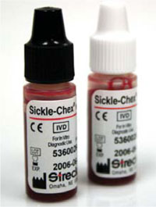
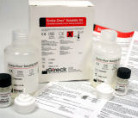
Detection of Hemoglobinopathy: Sickle Solubility Kits

Slide 37
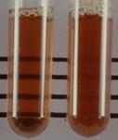
Sickle Solubility Test
RBC are lysed by surfactant
Released hemoglobin is reduced by sodium hydrosulfite
Hemoglobin A is soluble
See through the tube
Hemoglobin S is insoluble
Cannot see through tube

Slide 38
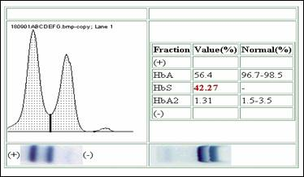
Determination of Hemoglobinopathy: Hemoglobin Electrophoresis
RBC lysate applied to electrophoretic support and proteins separated by charge.
Acid and alkaline buffers produce different banding patterns to analyze after protein staining.

Slide 39
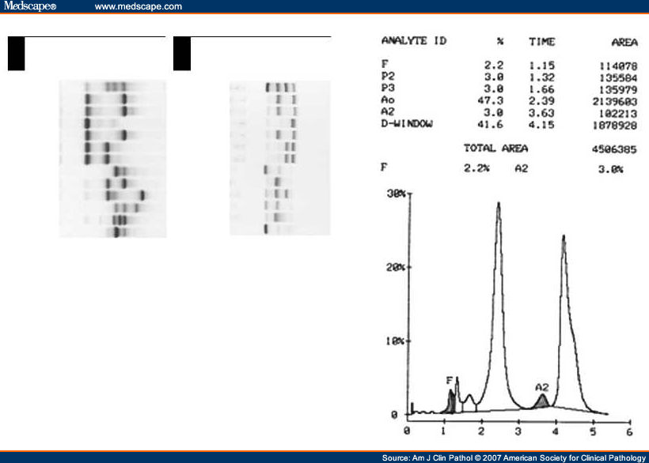
Hemoglobin Analysis via Electrophoresis & Densitometry

Slide 40
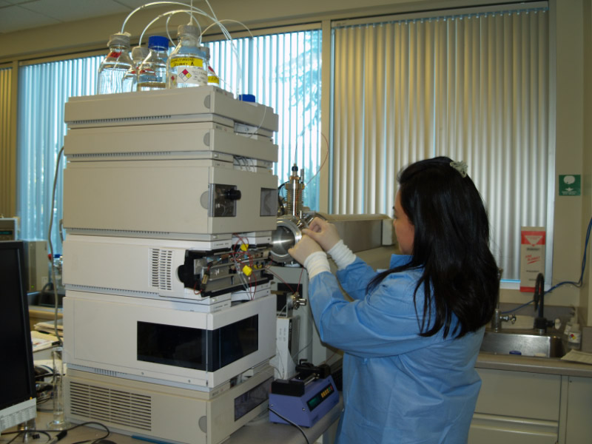
Automated Hemoglobin Analysis - HPLC

Slide 41
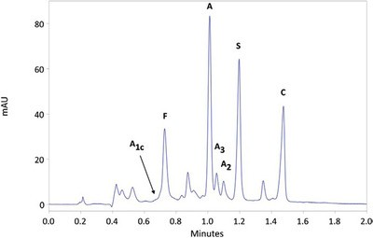
Separation of Hemoglobin Variants HPLC

Slide 42
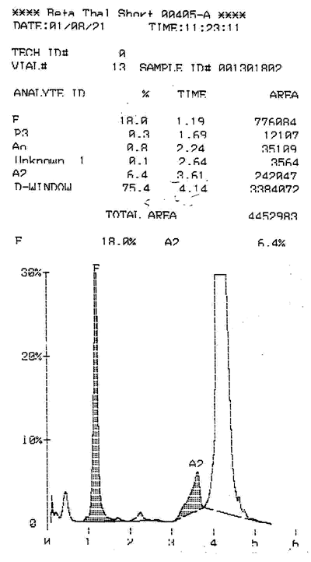
HPLC- Beta Thalassemia

Slide 43
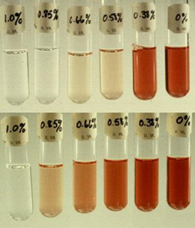
Osmotic Fragility Test
Determines resistance of RBC to hemolysis in varying concentrations of hypotonic saline at room temperature
Increased Osmotic Fragility
Hereditary Spherocytosis
Thalassemia
Sickle Cell Anemia

Slide 44
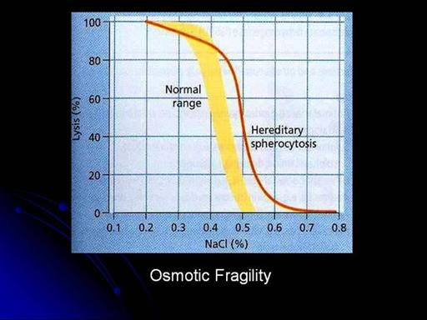
Osmotic Fragility Curve

Slide 45
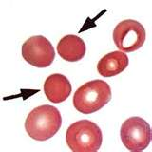
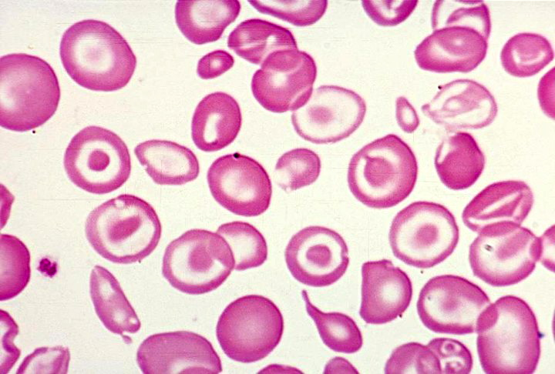
Increased Osmotic Fragility
Spherocytes
Thalassemia

Slide 46
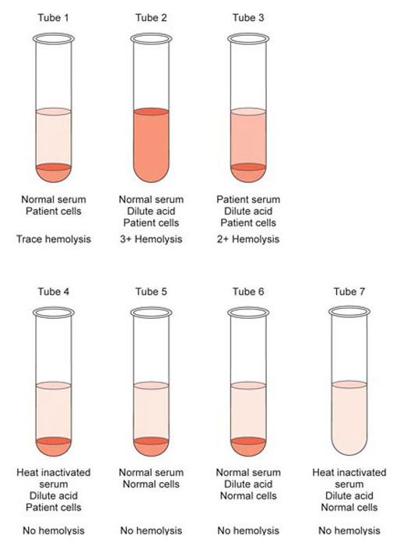
Ham’s Test
Detects RBC Membrane Defects
Diagnostic for Paroxysmal Nocturnal Hemoglobinuria (PNH)
Patient RBC exposed to normal serum and patient’s serum, both acidified to pH 6.5—7.0
Acid activates complement in serum and lyses PNH cells
Controls include heat inactivated serum and normal RBC

Slide 47
Sugar Water Test
Detects RBC Membrane Defects
Diagnostic for Paroxysmal Nocturnal Hemoglobinuria (PNH)
Sucrose provides low ionic strength
This promotes complement binding to RBC’s resulting in hemolysis

Slide 48
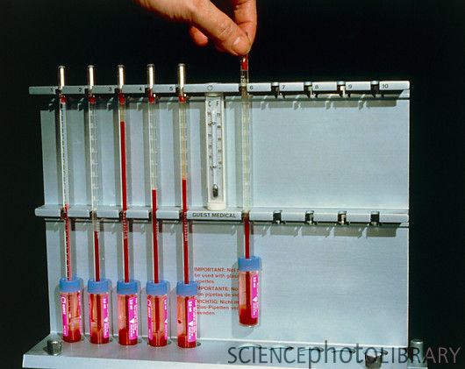
Erythrocyte Sedimentation Rate (ESR)
Inflammation changes the proteins in and surrounding red blood cells
This causes RBC to bind to one another in clumps, making them denser than normal RBC
An ESR test simply measures the rate which RBC sink to the bottom of a test tube
The faster the RBC fall, the more inflammation is present in the body

Slide 49
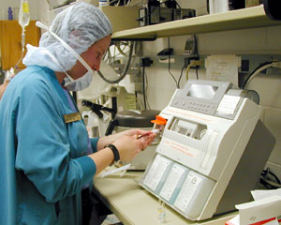
Arterial Blood Gases-ABG’s
2-3 ml arterial blood must be collected in a sealed anaerobic syringe with small amount of heparin, placed on ice
Automated Analysis
Measures Acid/Base status and respiratory gases in the arterial blood
pH, pCO₂, pO₂ (and HCO₃)
paO₂ measures oxygen saturation, overall adequacy of gas exchange
paO₂ affected by altitude and age of patient
Normal paO₂ = 70-100 mm Hg
ppO₂ is measured with pulseoximeter

Slide 50
Arterial Blood Gases
pH
The measure of how acidic or basic the blood is
Normal pH 7.35—7.45
Lower pH = Acidosis
Higher pH = Alkalosis
pCO2
The pressure of carbon dioxide gas dissolved in blood
It tells us how much breathing we are doing
Normal CO₂ = 35—45 mmHg
Less breathing=moreCO₂=More Acid=Lower pH
More breathing = less CO₂=Less Acid=Higher pH
HCO3
How much bicarbonate is dissolved in the blood
It is a buffer that combines with acid and decreases its ability to lower pH
Kidneys control pH by excreting or retaining bicarbonate
Normal HCO₃ = 22—26 mEq

Slide 51
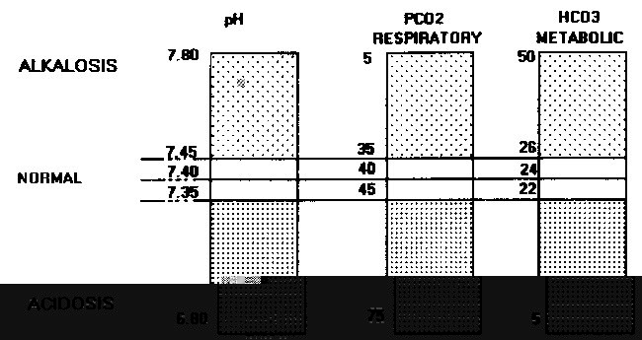
Using Acid-Base Map to Analyze Arterial Blood Gases

Slide 52
Arterial Blood Gas Analysis
pH tells you if the blood gas will be acidotic, alkalotic or normal.
The CO₂ and HCO₃ together tell you why the pH is like it is. The total range of your choices in the interpretation of blood gases is contained in the following list:
Normal
Respiratory Alkalosis
Metabolic Alkalosis
Respiratory Acidosis
Metabolic Acidosis
Combined Respiratory and Metabolic Alkalosis
Combined Respiratory and Metabolic Acidosis
Partially Compensated Respiratory Alkalosis
Partially Compensated Metabolic Alkalosis
Partially Compensated Respiratory Acidosis
Partially Compensated Metabolic Acidosis
Compensated Respiratory Alkalosis
Compensated Metabolic Alkalosis
Compensated Respiratory Acidosis
Compensated Metabolic Acidosis

Slide 53
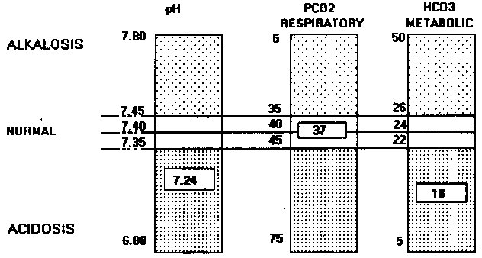
Example of using Acid-Base Map to interpret ABG Analysis
The pH of 7.24 is in the acidosis region, as is the HCO₃ of 16. The CO₂ of 37 is normal. This tells us that the acidosis is not respiratory, but metabolic in origin : A METABOLIC ACIDOSIS

Slide 54
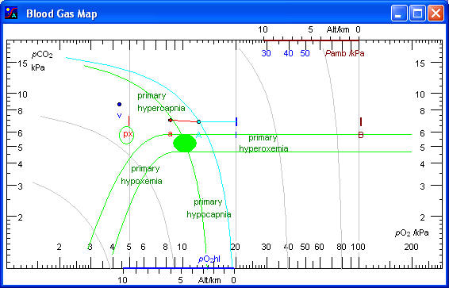

Slide 55
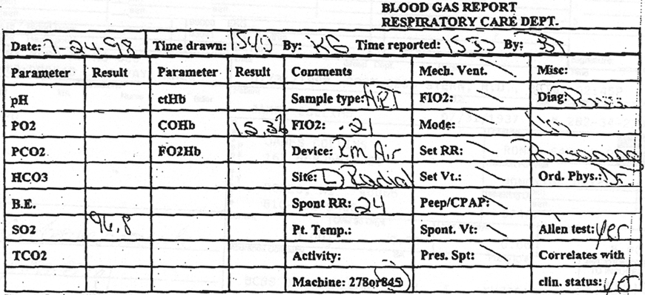
Blood Gases Report

Slide 56
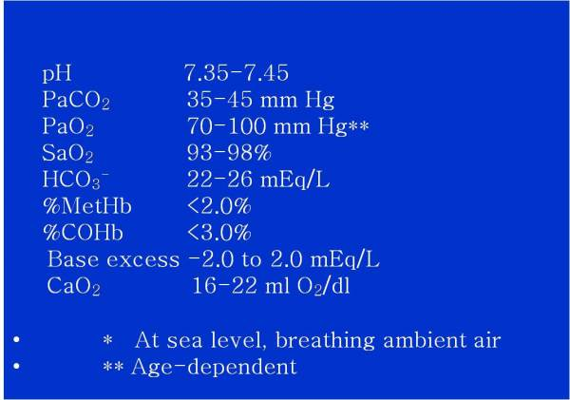
ABG Reference Ranges

Slide 57
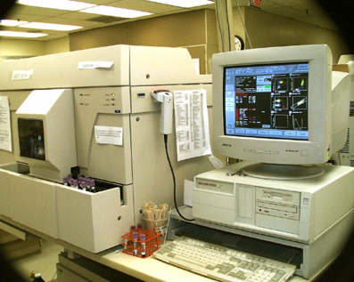
Automated Hematology Technology BAYER Flow Cytometric Instrument

Slide 58
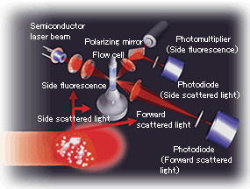
Automated Cytometric Methodology
Cells pass through laser beam
Laser light scatter is measured
Cell size is measured
Cell surface markers can be detected with tagged markers
Cells can be separated into populations

Slide 59
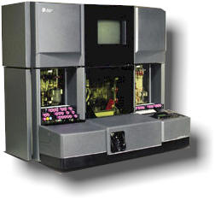
Beckman Coulter Counter Instrumentation

Slide 60
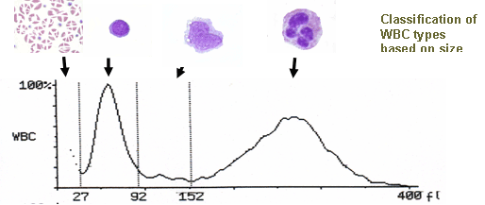
WBC Histogram

Slide 61
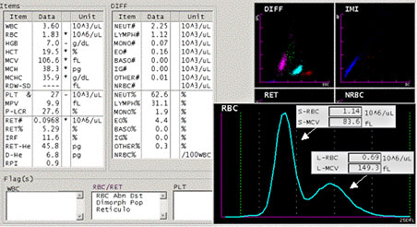
RBC Histogram Showing 2 RBC Populations

Slide 62
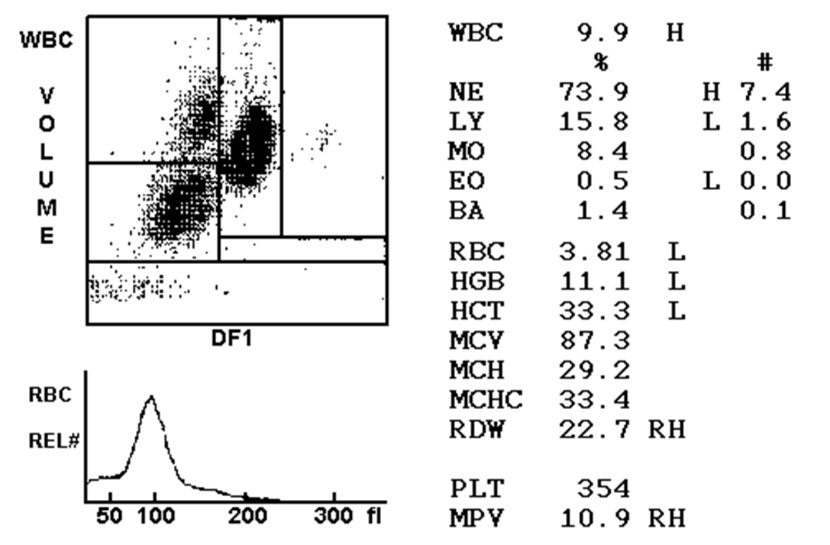
WBC Scattergram with RBC Histogram

Slide 63

Platelet Histogram

Slide 64

5 Part Automated Differential

Slide 65

Scattergram

Slide 66

Bayer Scattergram

Slide 67

VCS Technology
Volume
Physically measure the volume that the entire cell displaces in an isotonic diluent. This method accurately sizes all cell types regardless of their orientation in the light path.

Slide 68

VCS Technology
Conductivity
Alternating current in the radio frequency (RF) range short circuits the bipolar lipid layer of a cell's membrane, allowing the energy to penetrate the cell. This powerful probe is used to collect information about cell size and internal structure, including chemical composition and nuclear volume.

Slide 69

VCS Technology
Scatter
When a cell is struck by the coherent light of a LASER beam, the scattered light spreads out in all directions. Using a proprietary new detector, median angle light scatter (MALS) signals, are collected to obtain information about cellular granularity, nuclear lobularity and cell surface structure.

Slide 70

VCS Technology
Simultaneous Measurements
VCS is the only single channel analysis that uses 3 independent energy sources working in concert with each other. These three measurements are taken simultaneously.

Slide 71

VCS Technology
Distinct cell clusters
Software analyzes these clusters for:
Quantity: in %
Position: indicates morphology
Density: cell populations
Deviation of these clusters from their normal quantity, shape, position or density are an indication of a distributional or morphological abnormality.
A comprehensive set of flags is used to point the medical technologist toward the most likely cause of these abnormalities.

Slide 72

Manual Cell Counter

Slide 73

Clinical Laboratory Scientist

Slide 74

What type of cells do you see?

Slide 75

Proficiency Testing! What is this?

Slide 76

Be sure to keep reviewing your Atlas of Hematology!

Slide 77
End Week 11…. But week 12 Discussion topics next!

Slide 78
Week 12 Discussion Topic A
Topic A: Which of the topics that were covered in this course did you find the easiest and most difficult to understand?
~Identify the specific week(s) in which the easiest and most difficult topic(s) arose.
~Identiy the specific topic(s).
~Why do you think that you found the identified topics easier than other topics which arose in the course?
~Why do you think that you found the identified topics more difficult than other topics which arose in the course?
~For the topics that you found most difficult in this course, it is very important to have a plan in place to make sure that you fully understand these topics before moving on to more difficult topics. What plan do you have in place to accomplish this?

Slide 79
Week 12 Discussion Topic B
Topic B: Which of the topics that were covered in this course do you predict will be most applicable to the area of clinical laboratory science that you intend on pursuing?
~Identify the specific week(s) in which the topic(s) arose.
~Identify the specific topic(s).
~Identify the specific area of clinical laboratory science that you would like to specialize in.
~Make relevant connections between the identified topic(s) and the area of clinical laboratory science that you would like to specialize in.

