Slide 1
Hematology I Seminar
Week 3
Christina A Nevel-McGarvey, PhD, MS, MT(ASCP)

Slide 2
YOUR Week 1 quiz
REVIEW

Slide 3
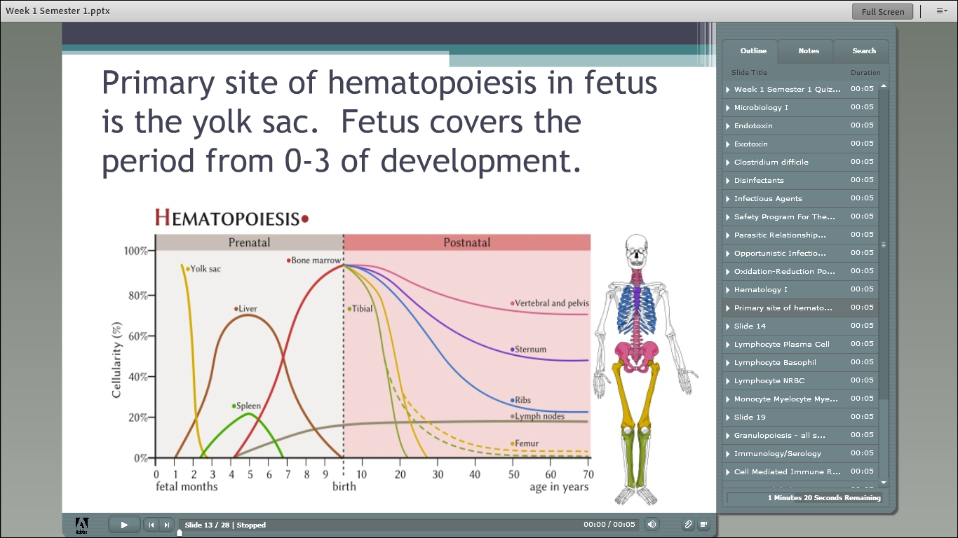

Slide 4
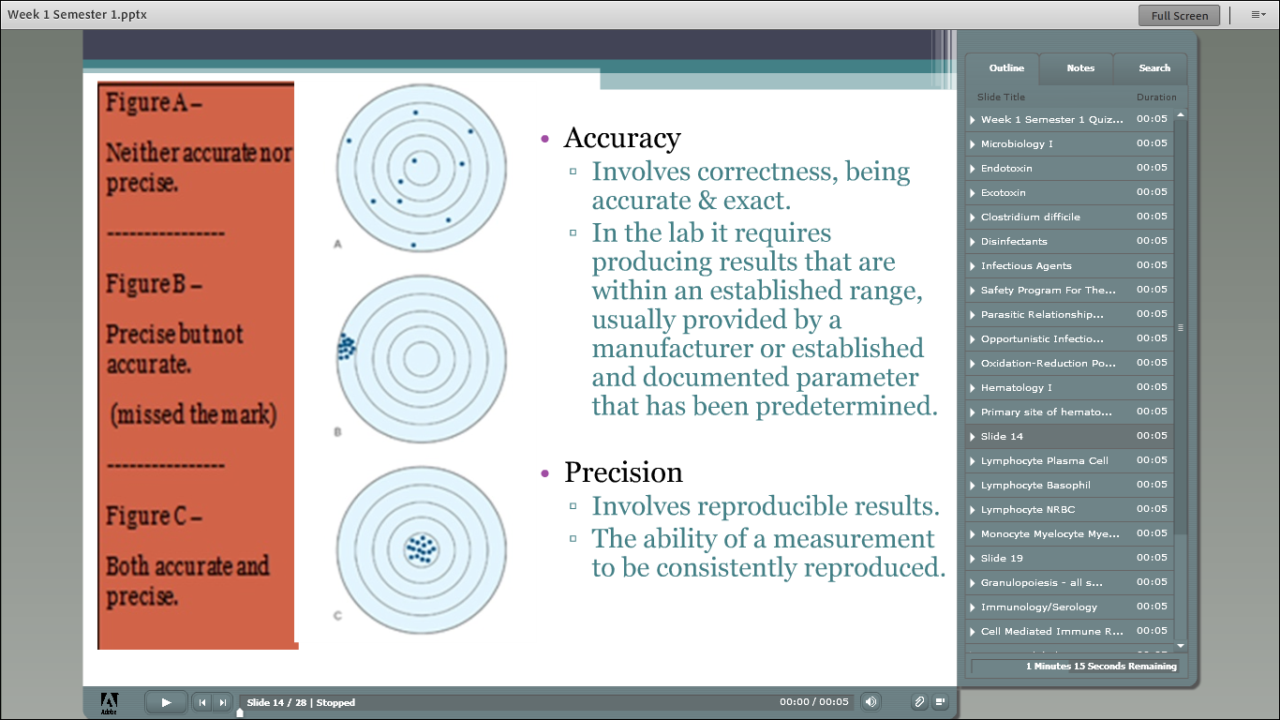

Slide 5
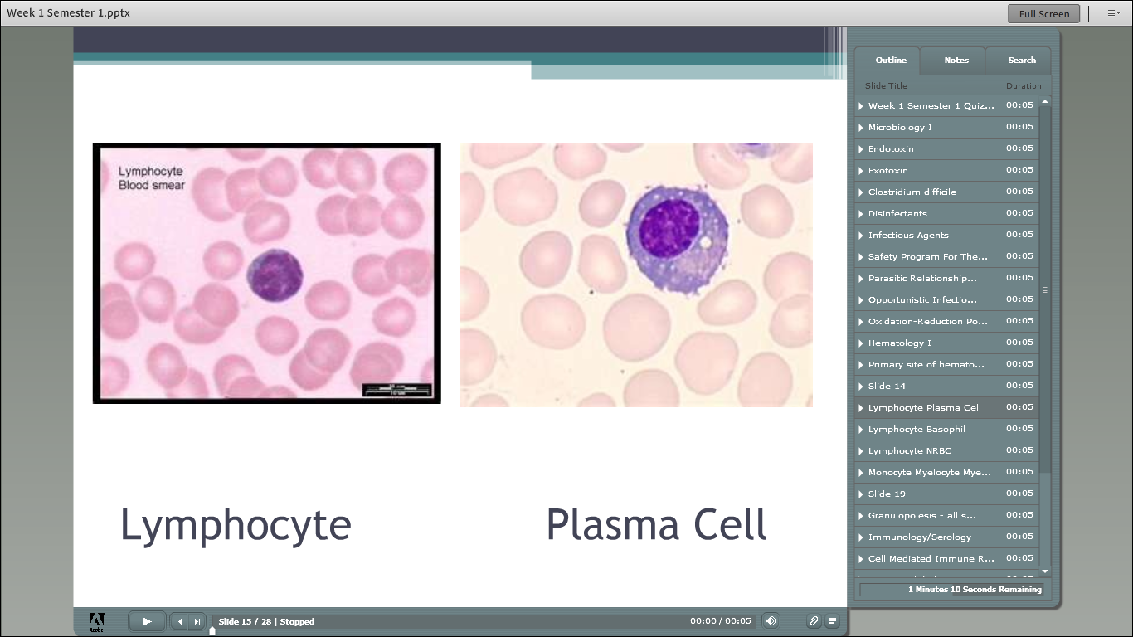

Slide 6
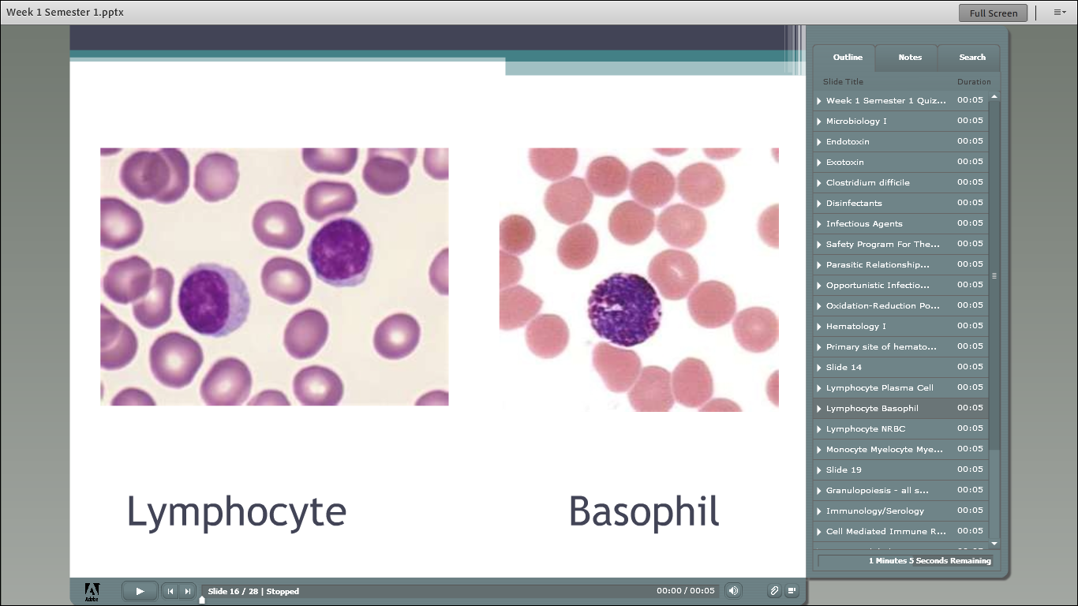

Slide 7
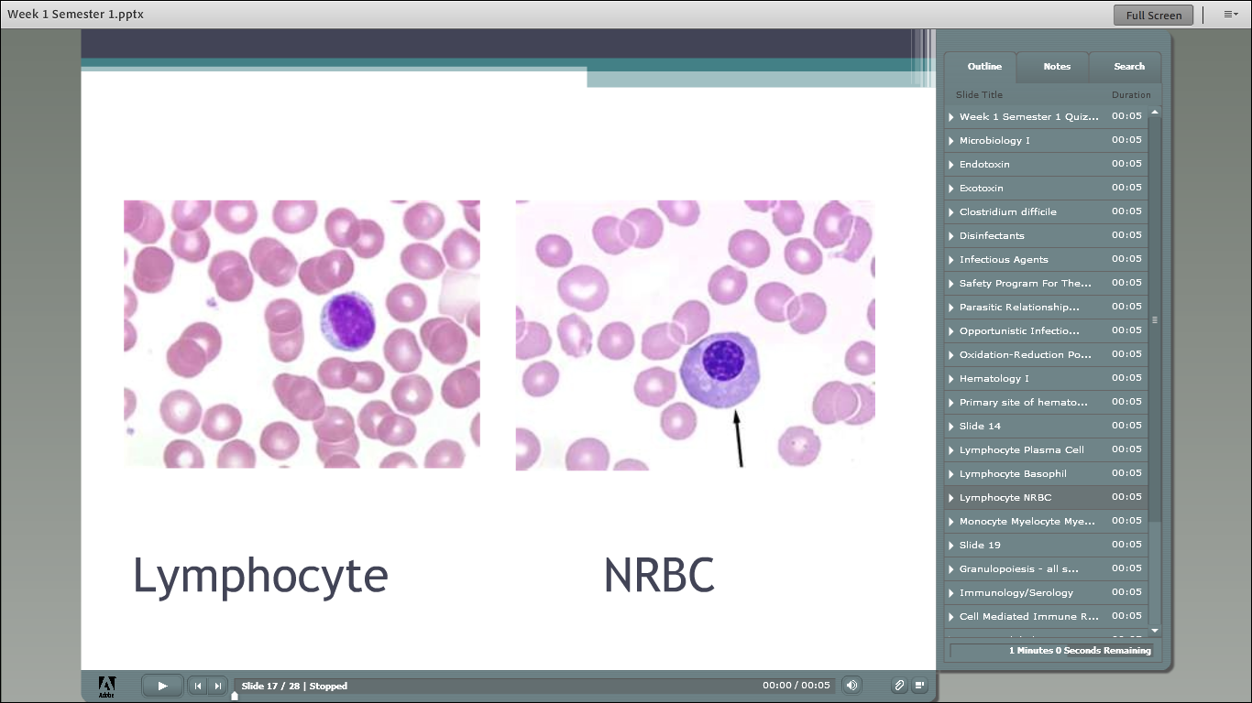

Slide 8
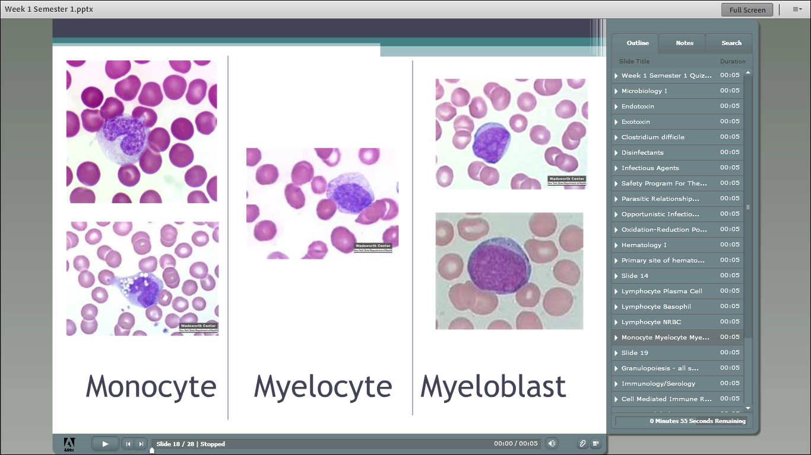

Slide 9
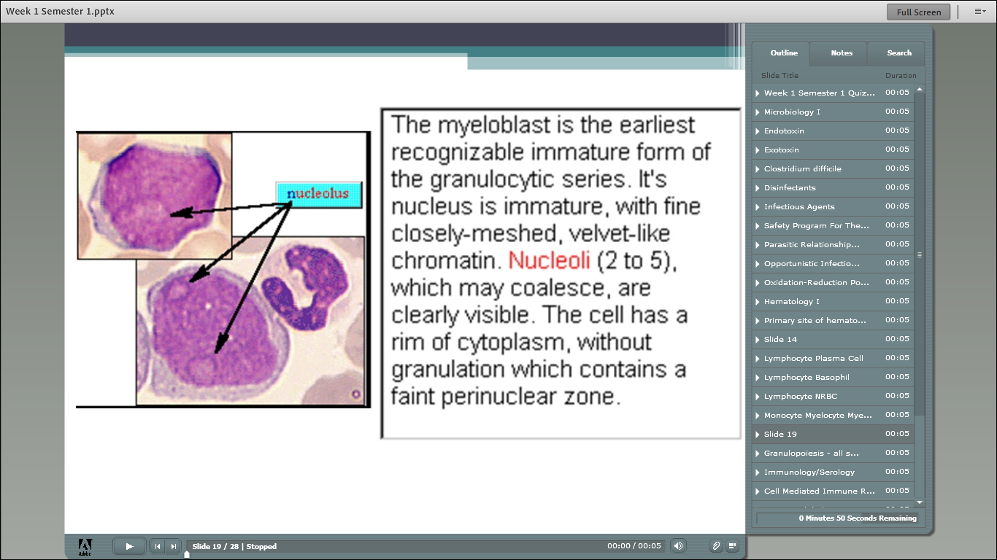

Slide 10
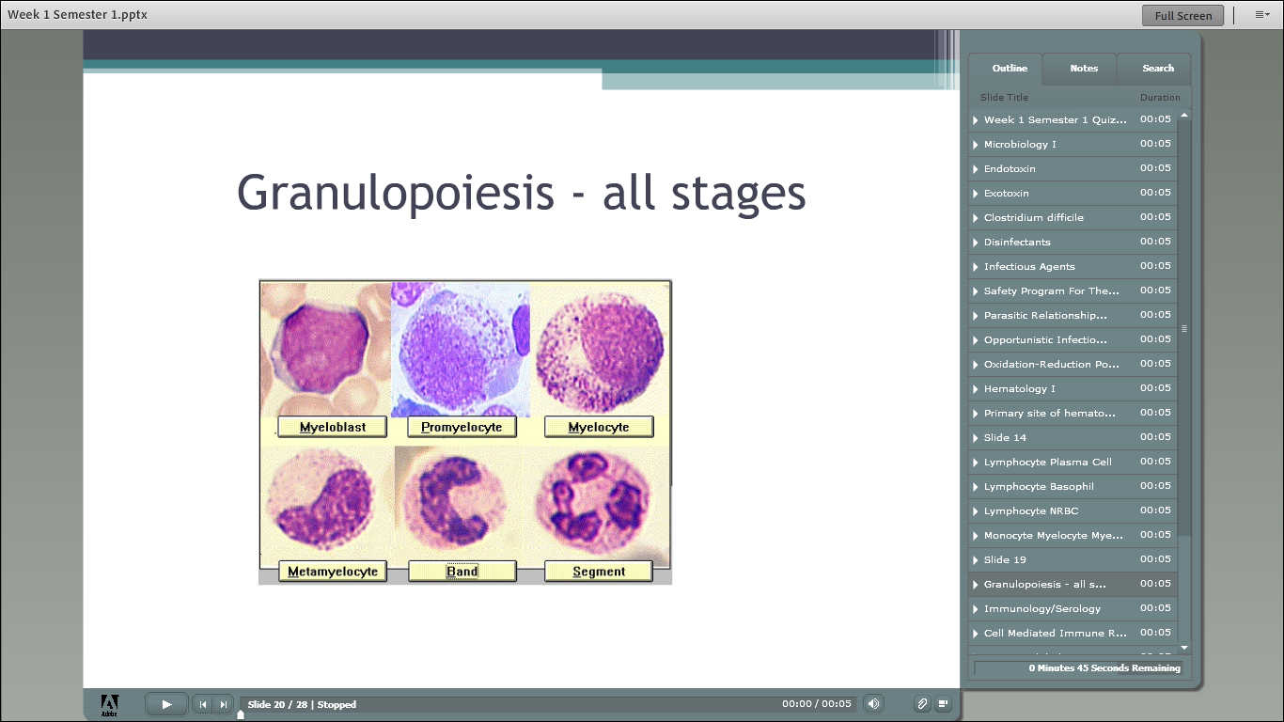

Slide 11
Week 2 quiz
(from last semester’s class)
REVIEW

Slide 12
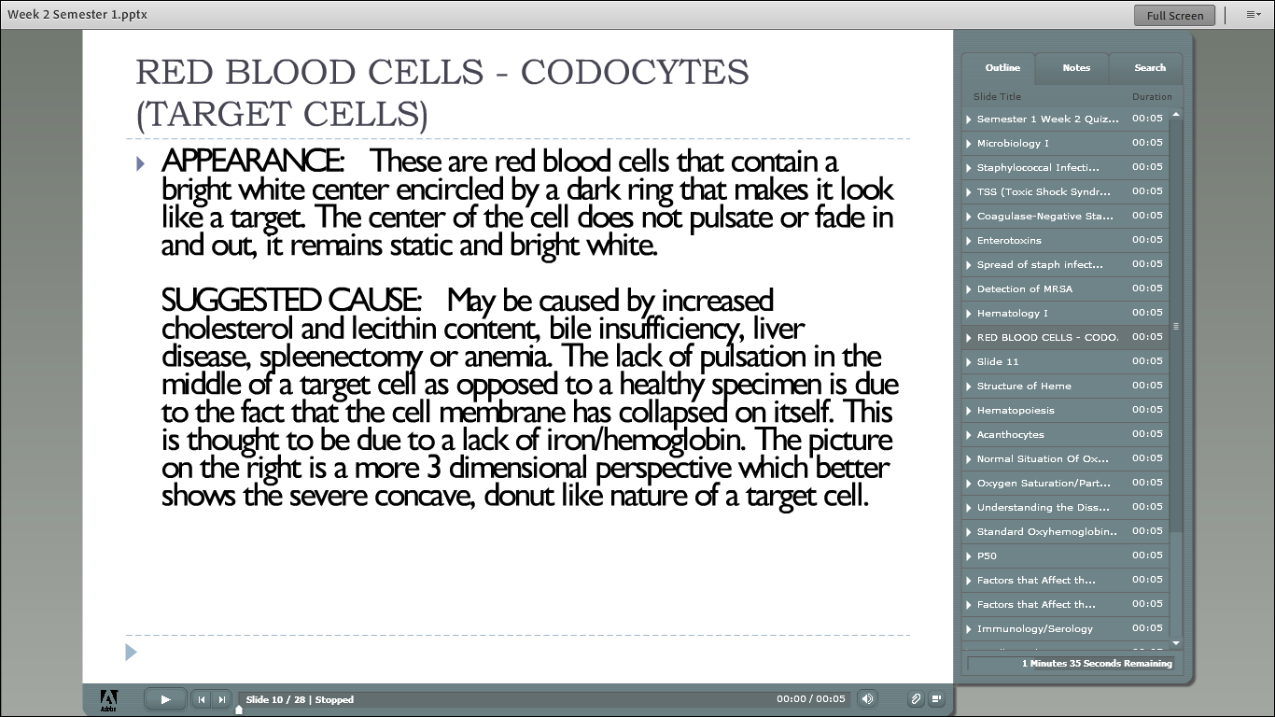

Slide 13
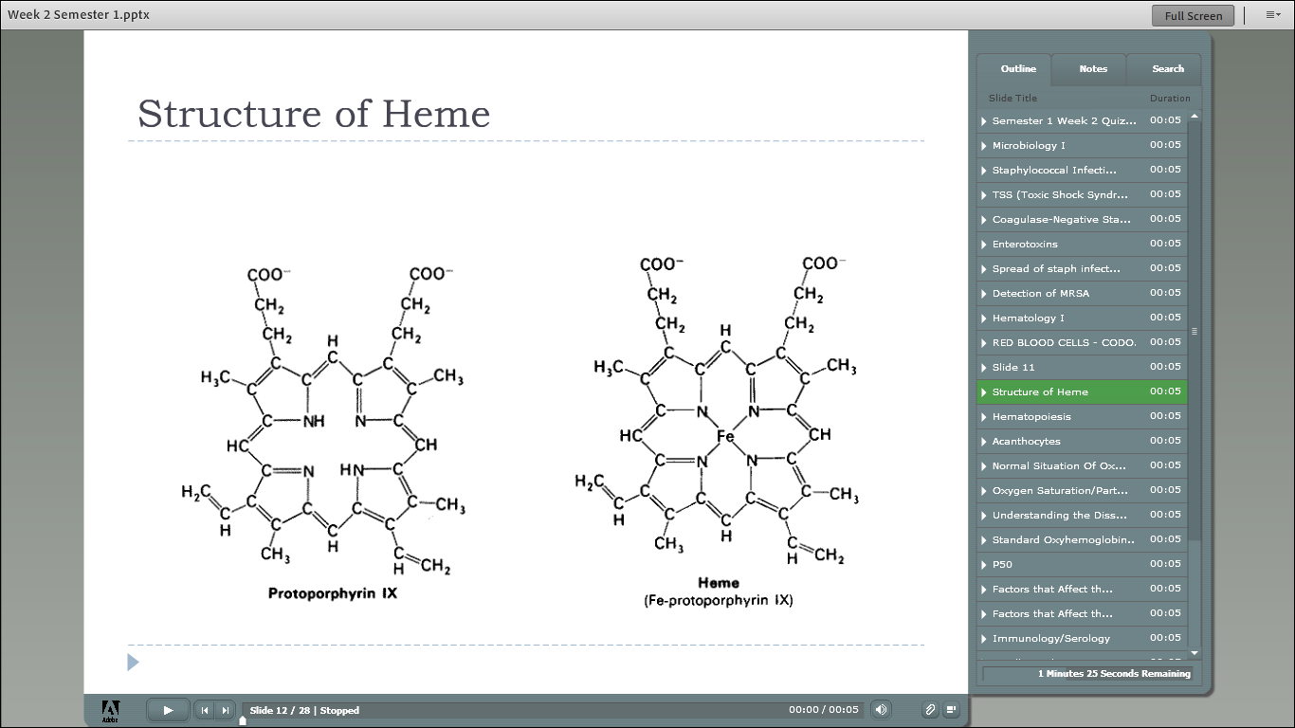

Slide 14
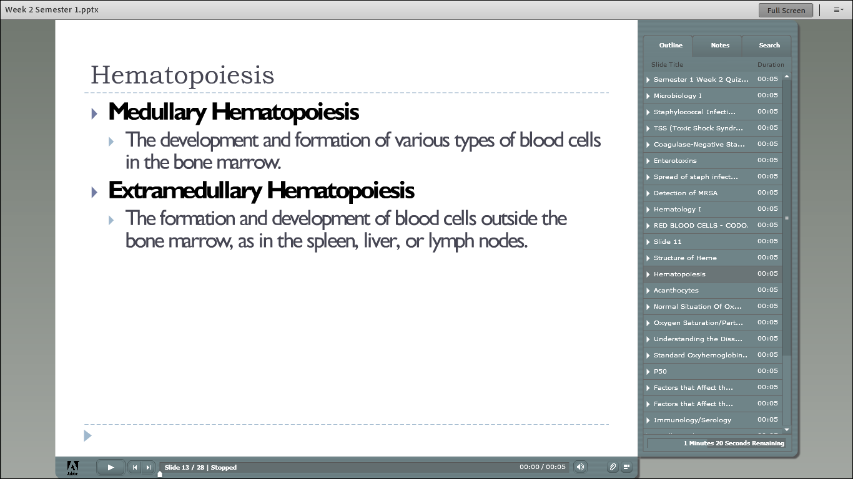

Slide 15
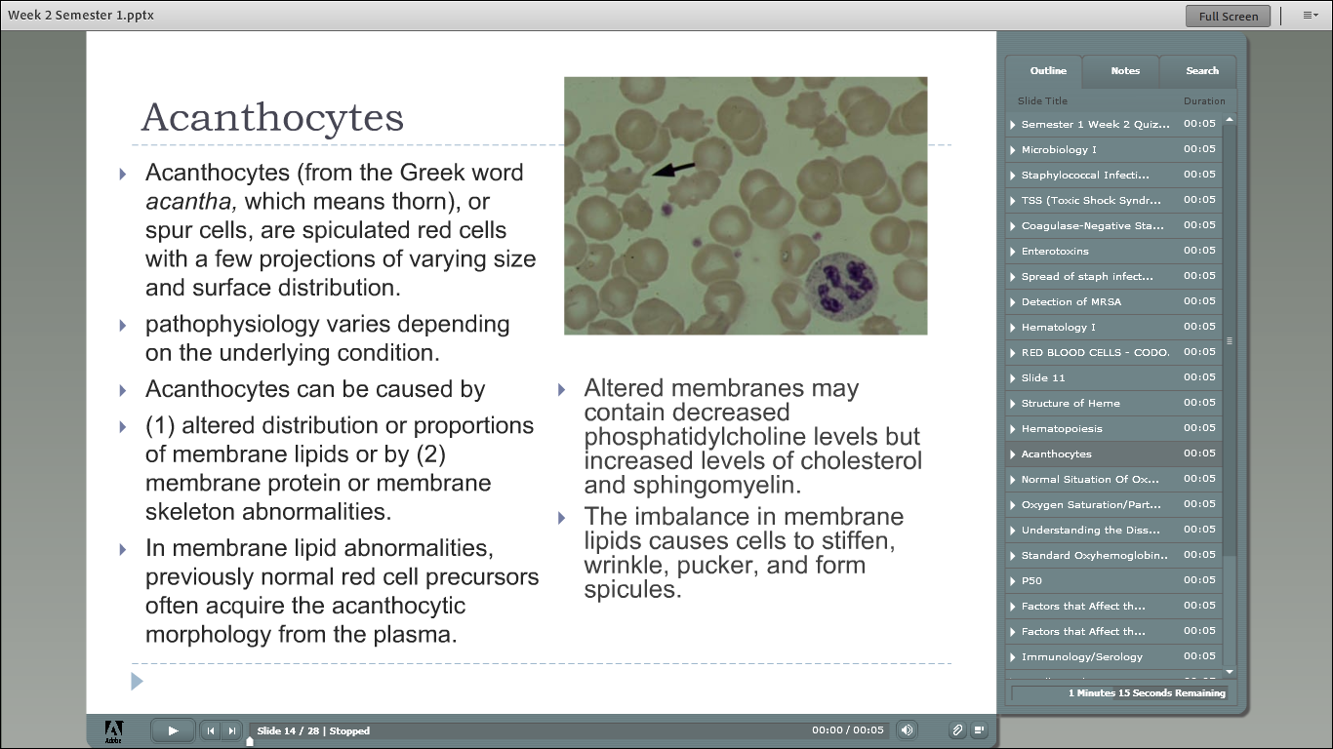

Slide 16
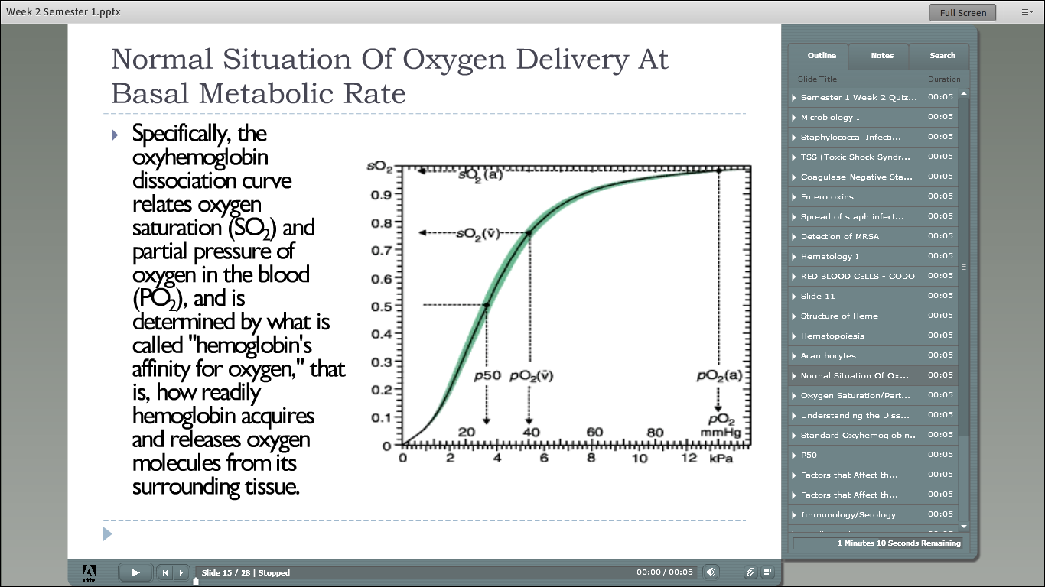

Slide 17
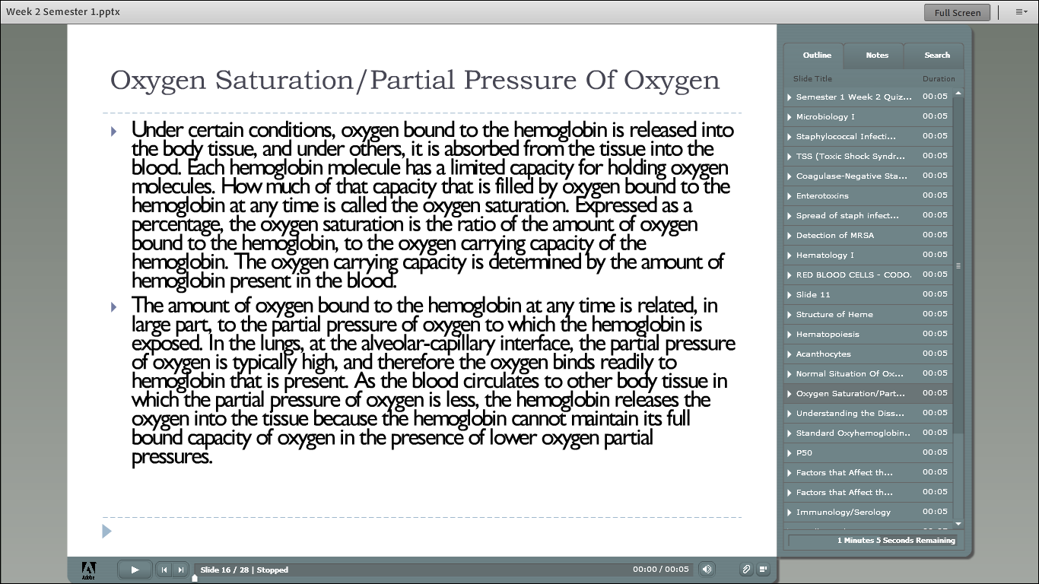

Slide 18
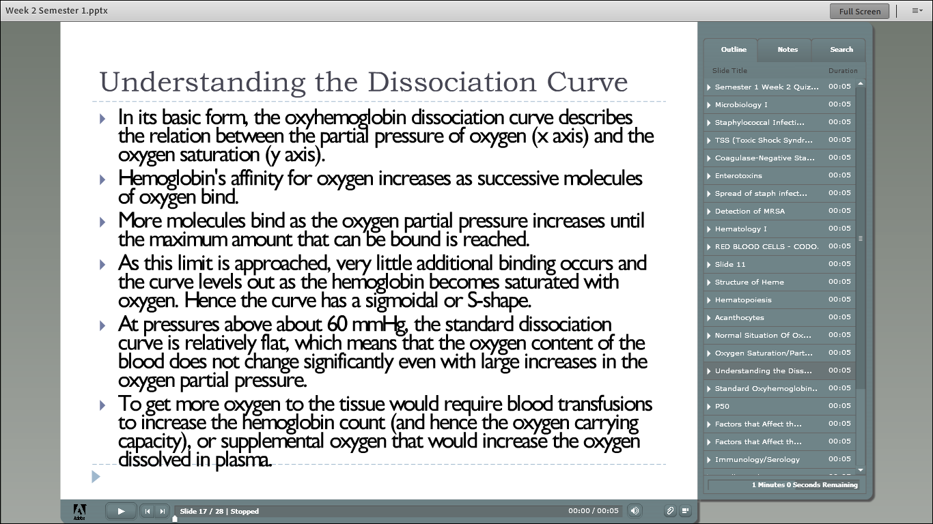

Slide 19
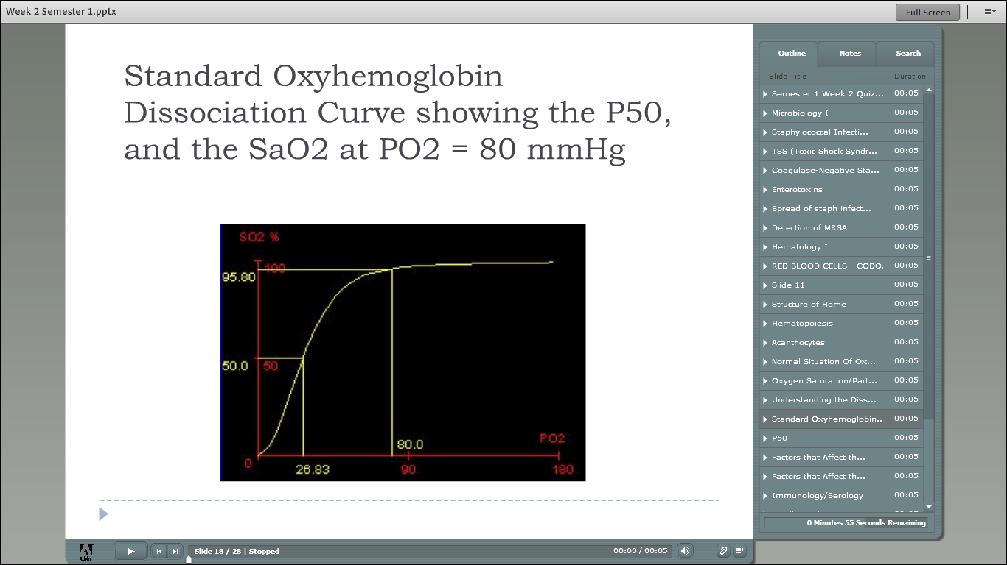

Slide 20
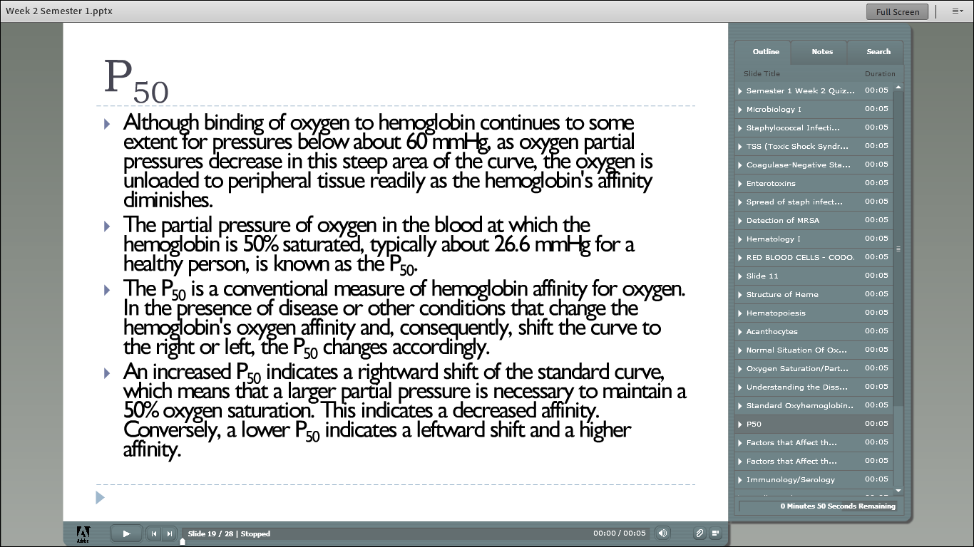

Slide 21
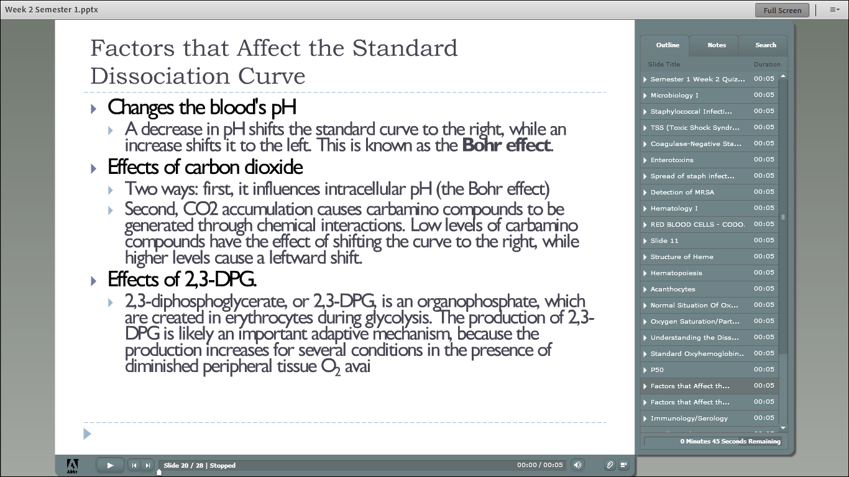

Slide 22
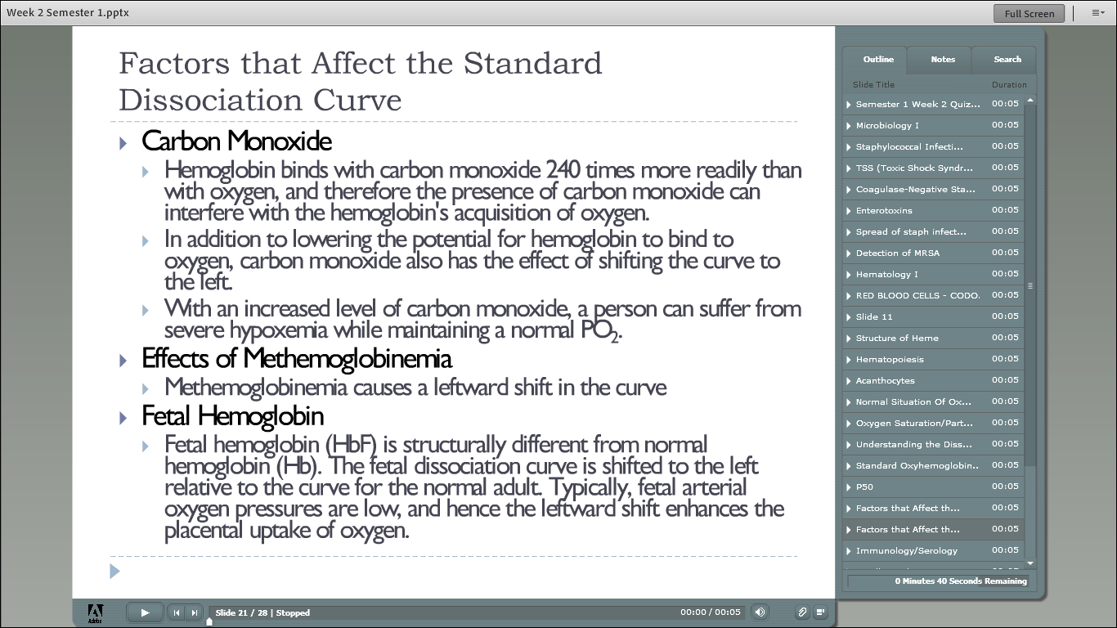

Slide 25
Anemia diagnosis & clinical considerations
CHAPTER 4

Slide 26
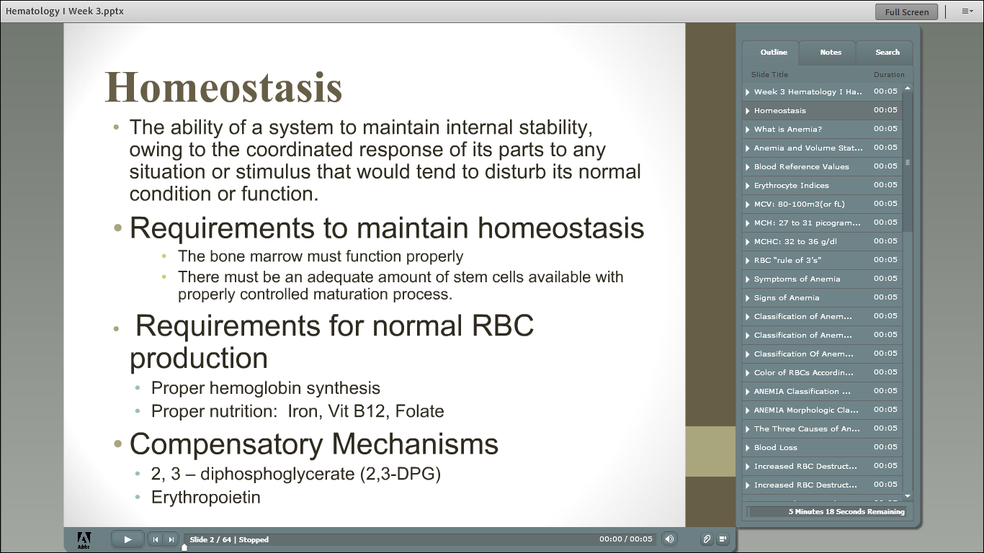

Slide 27
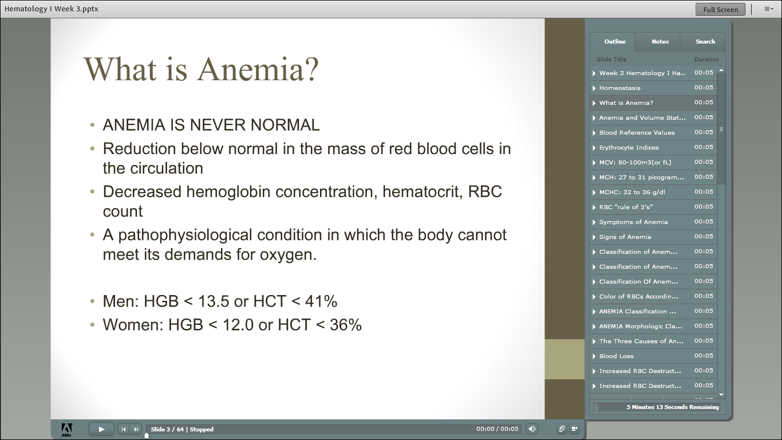

Slide 28
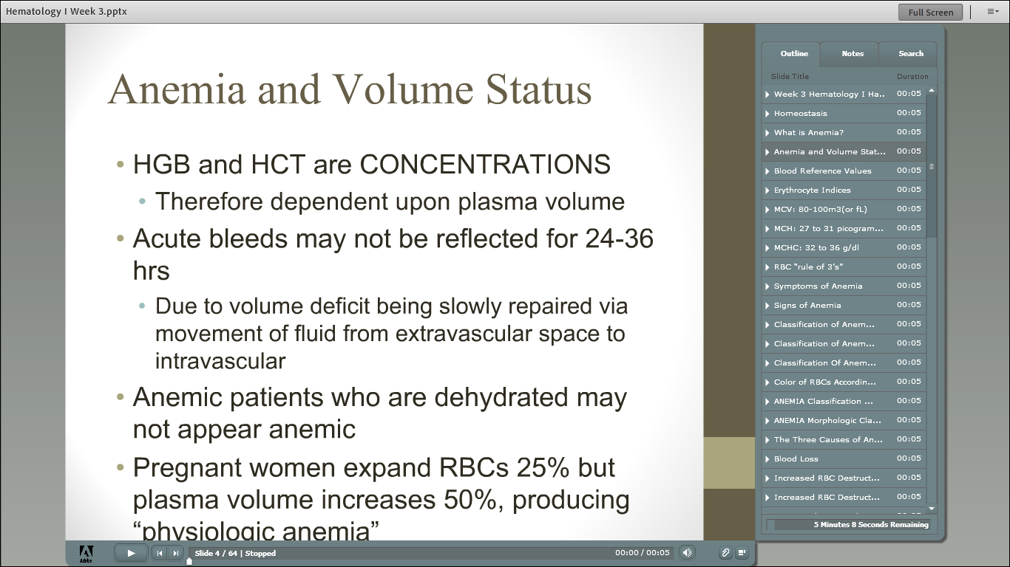

Slide 29
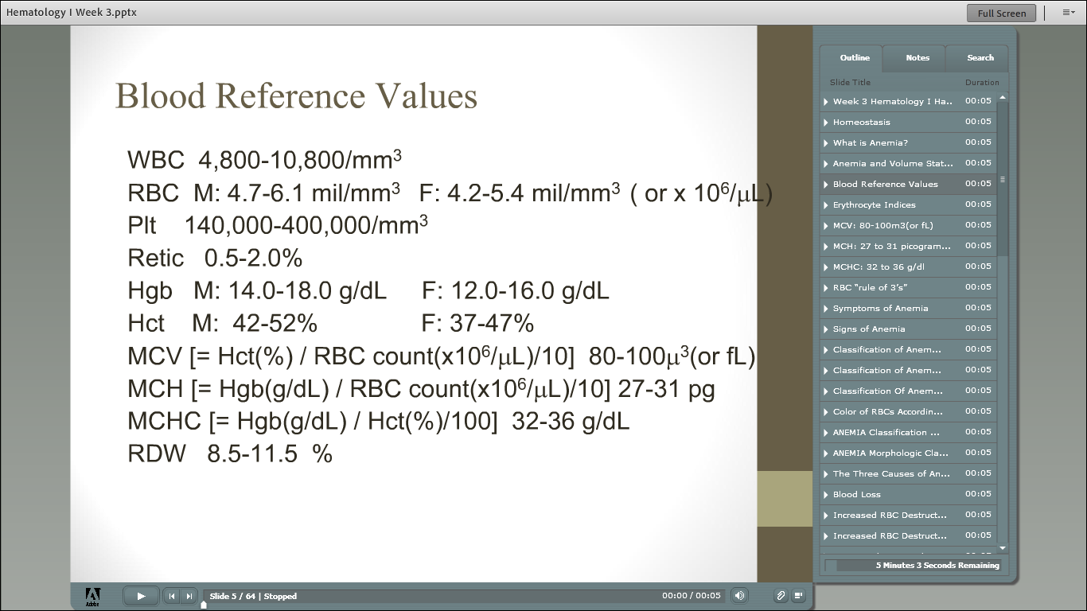

Slide 30
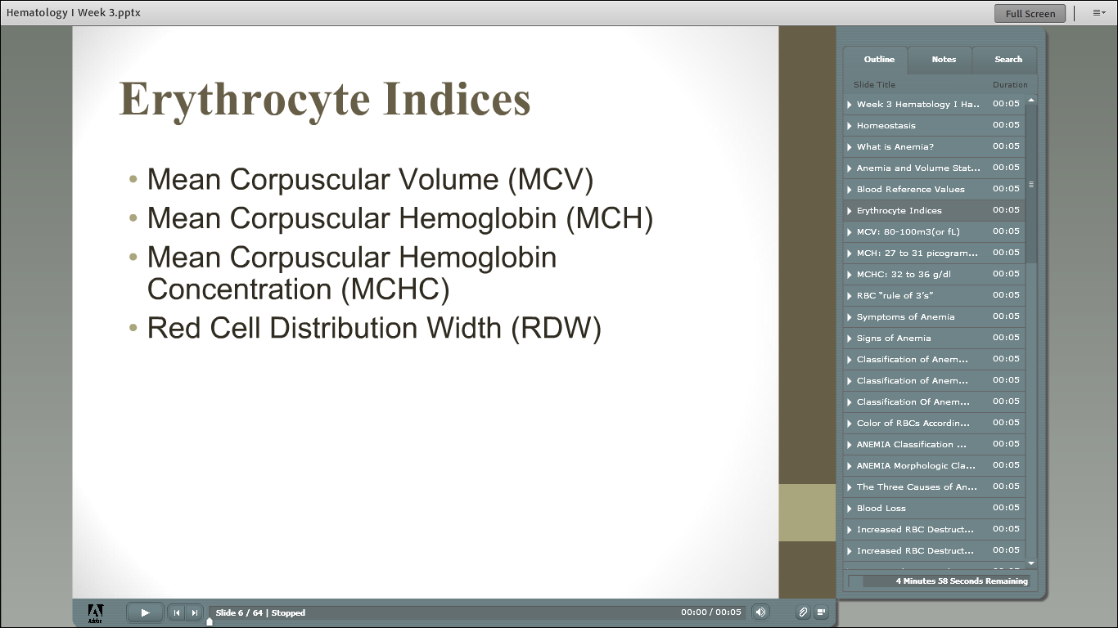

Slide 31
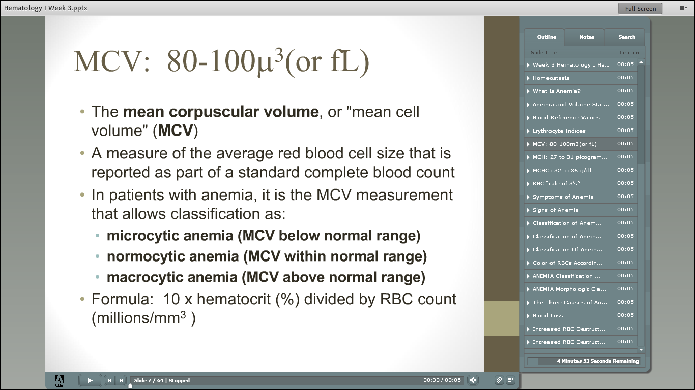

Slide 32
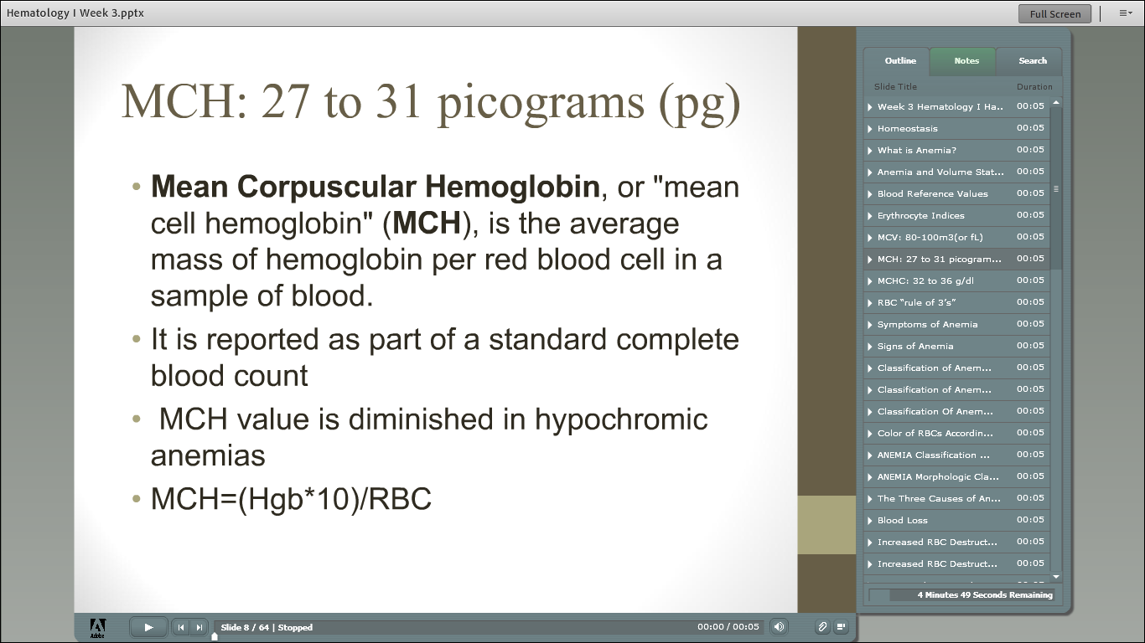

Slide 33
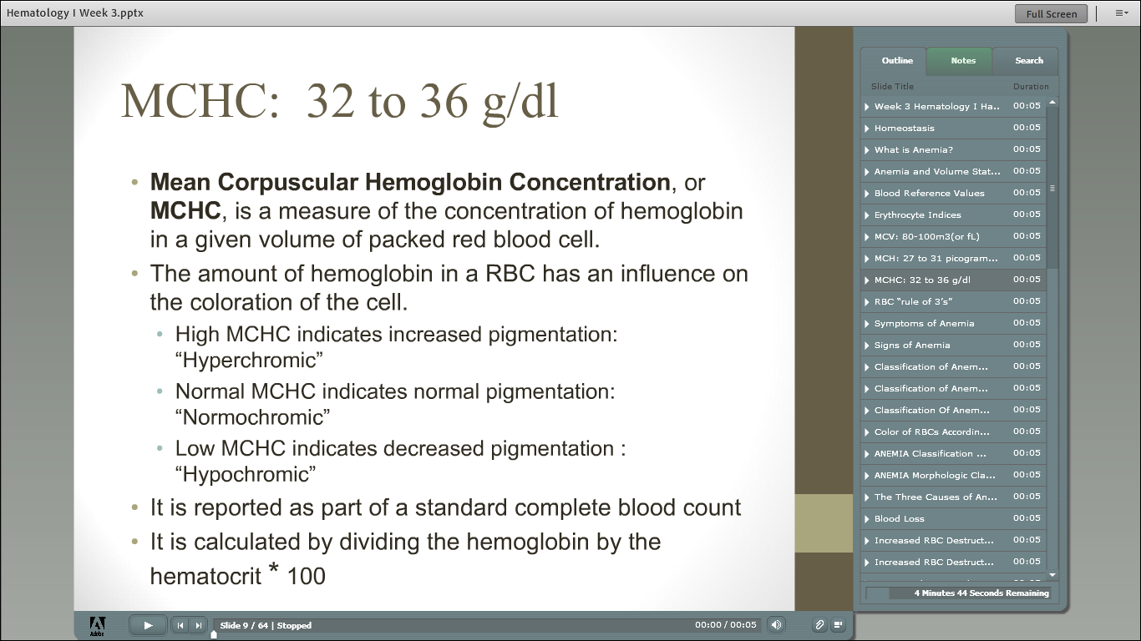

Slide 34
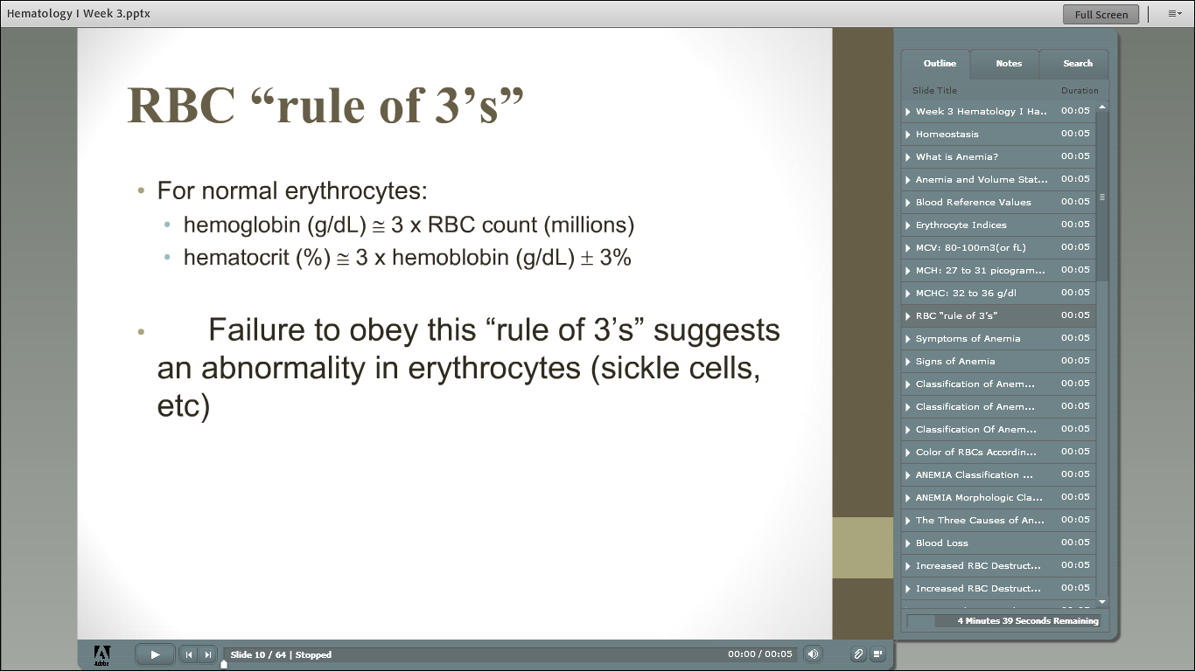

Slide 35
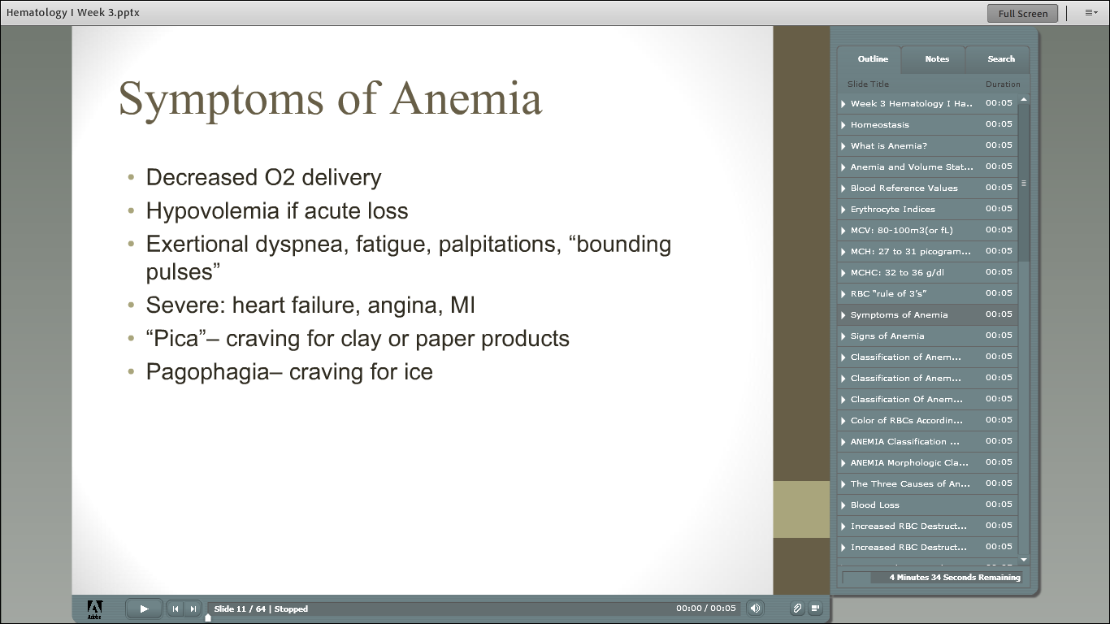

Slide 36
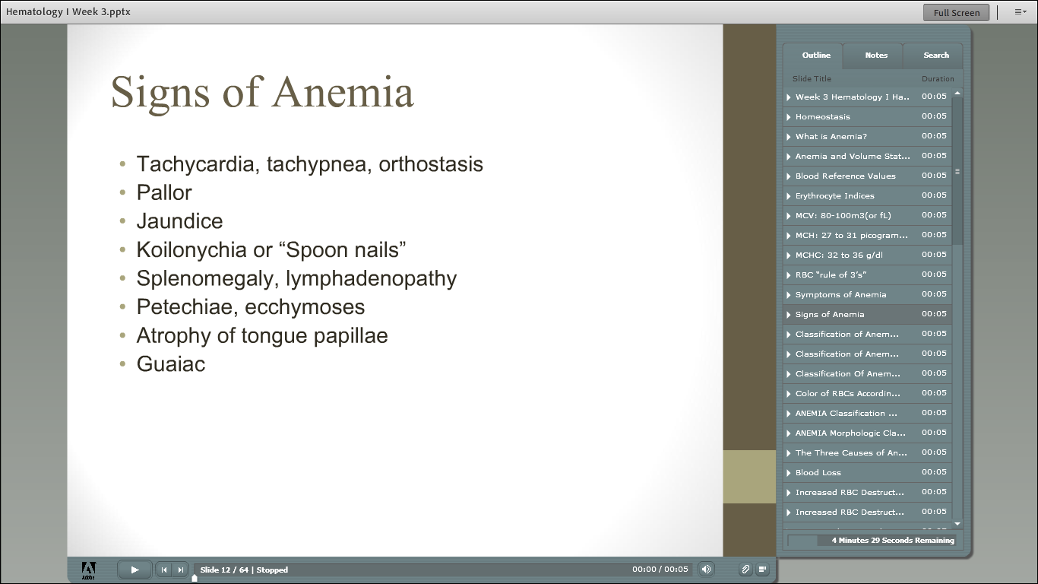

Slide 37
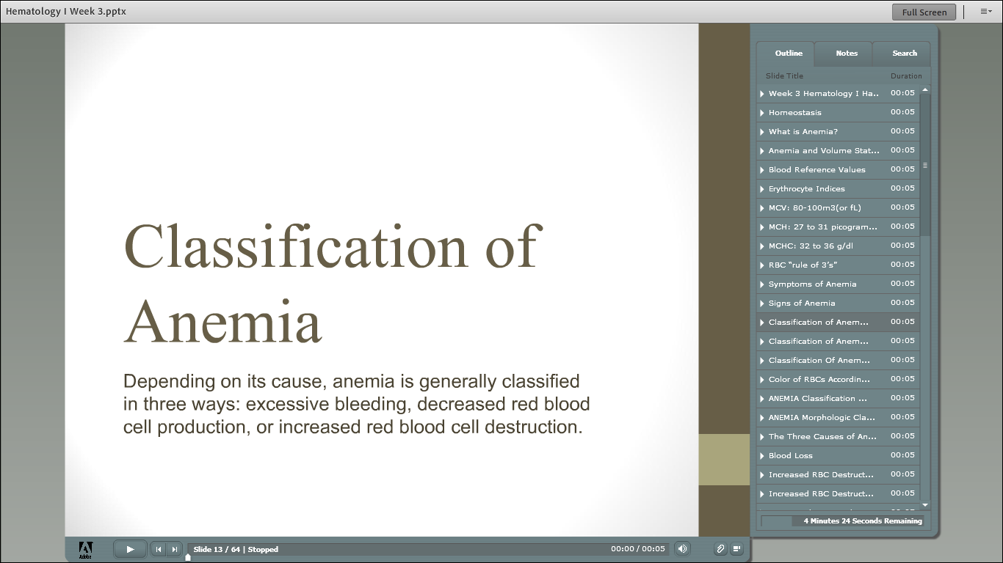

Slide 38
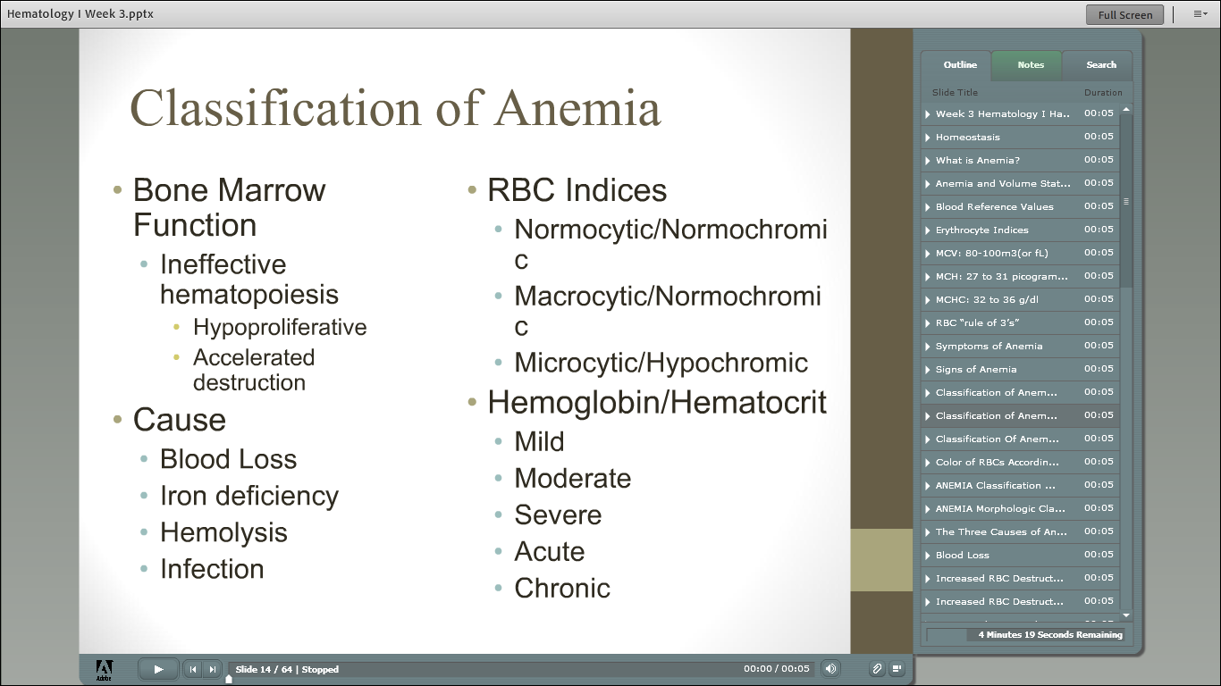

Slide 39
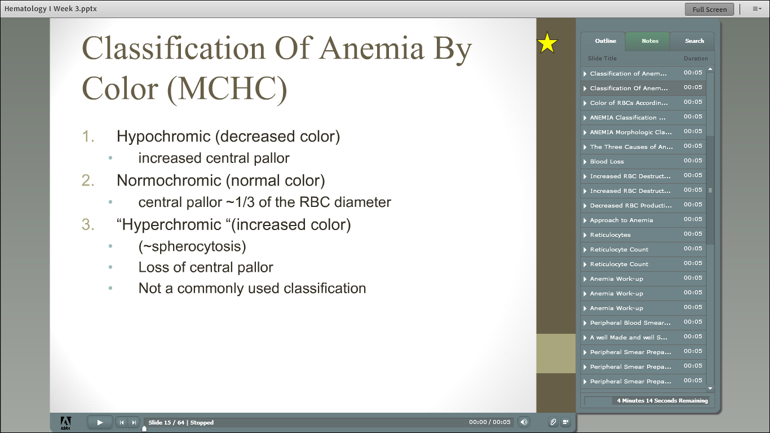

Slide 41
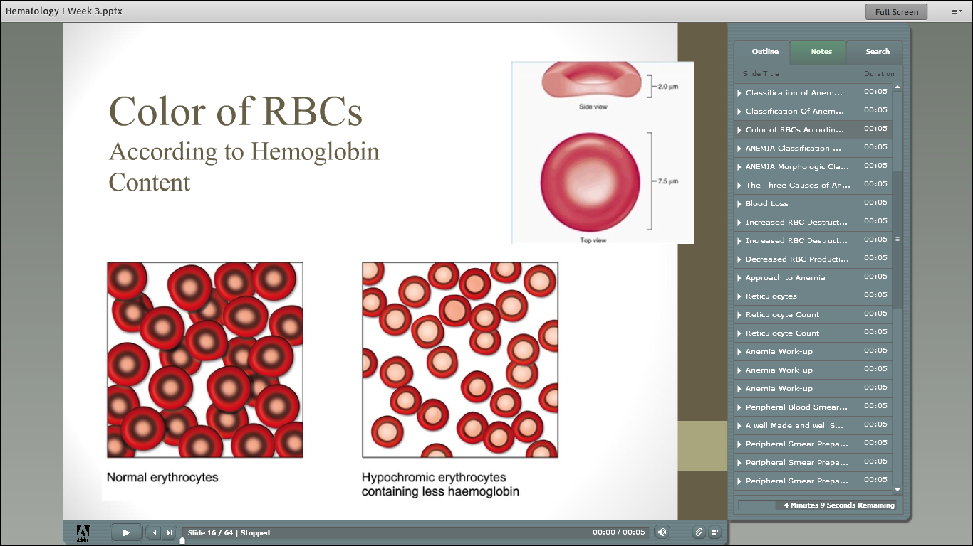

Slide 42
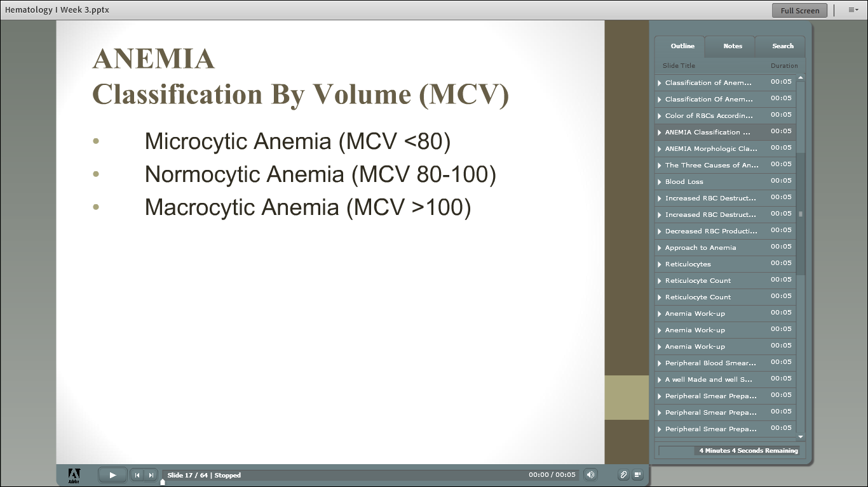

Slide 43
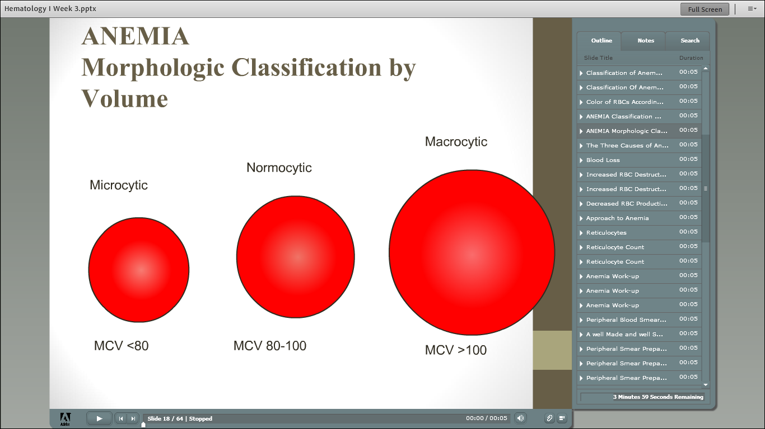

Slide 44
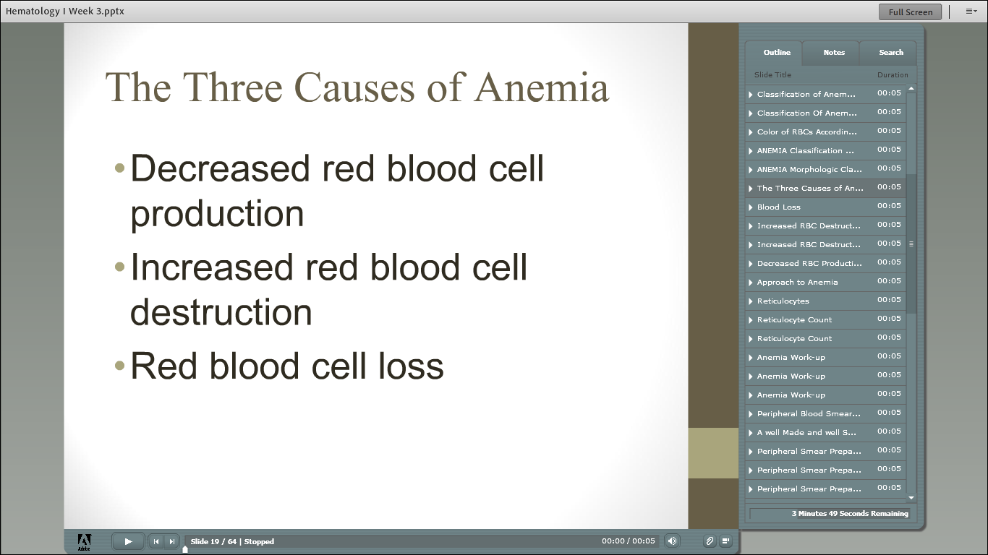

Slide 45
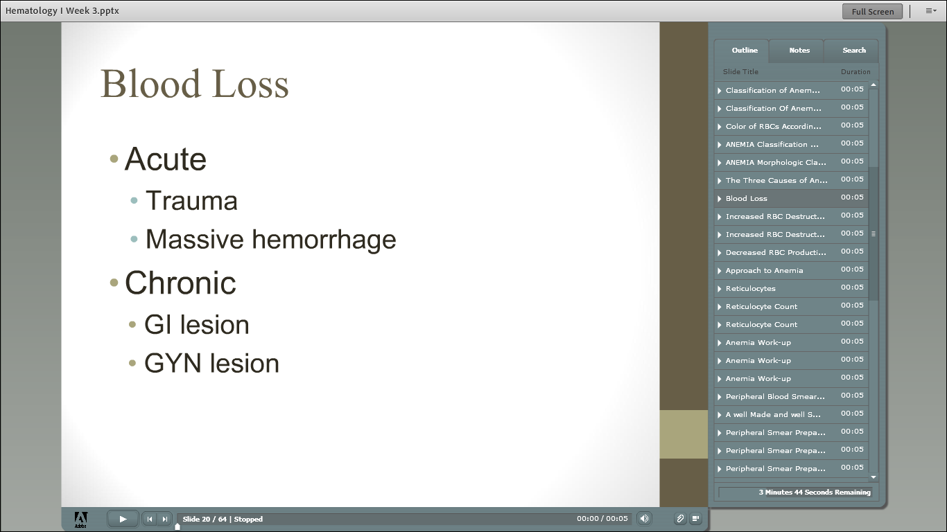

Slide 46
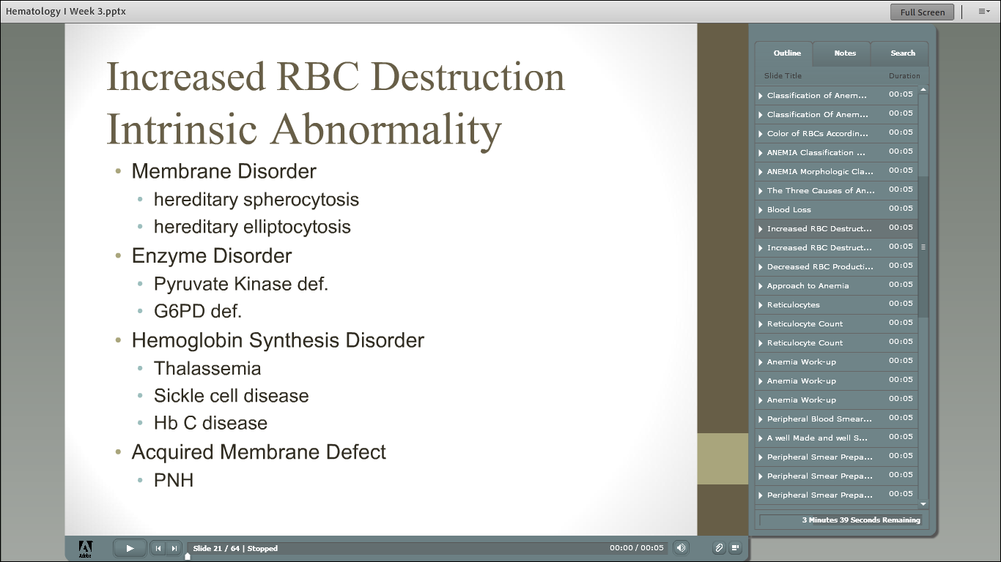

Slide 47
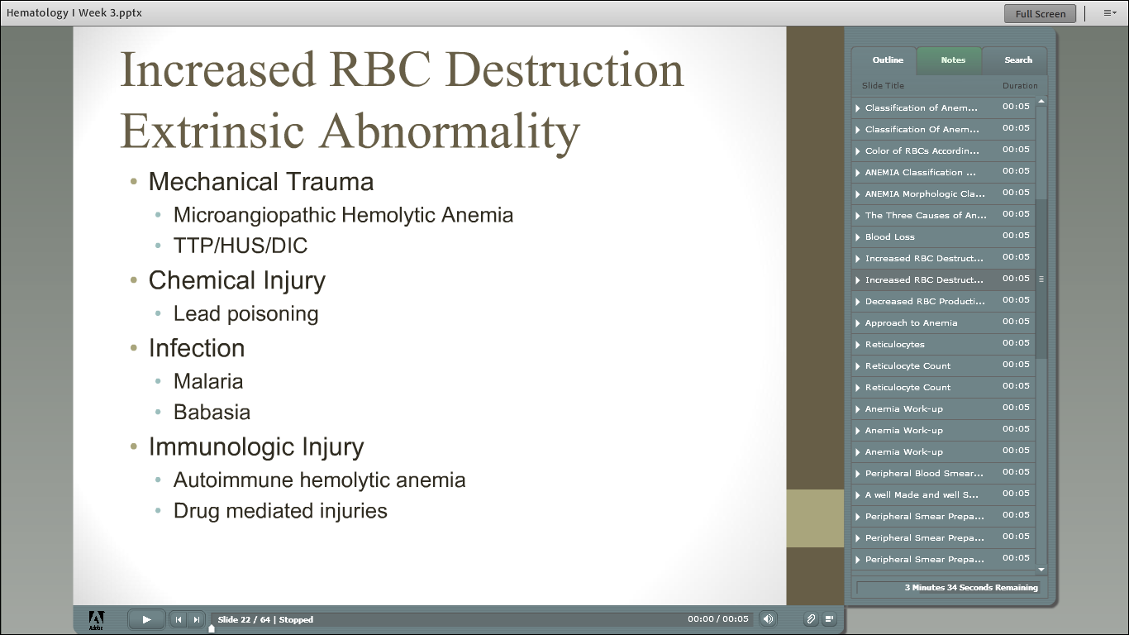

Slide 48
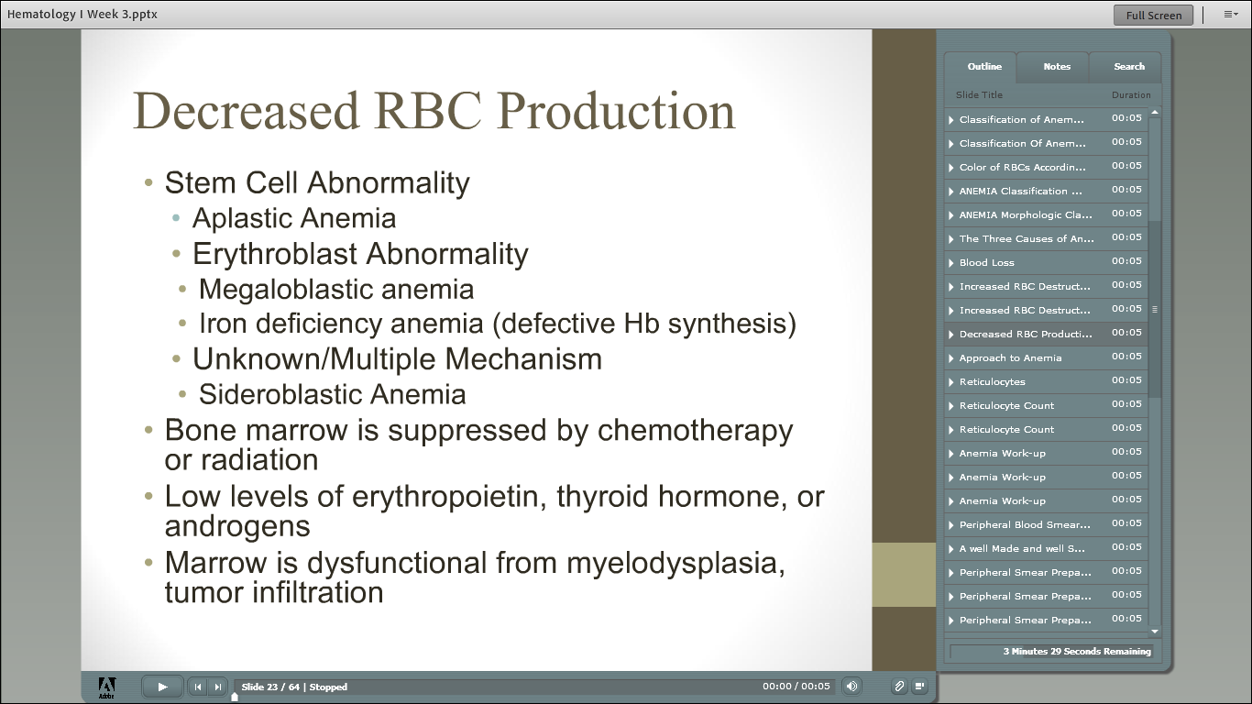

Slide 49
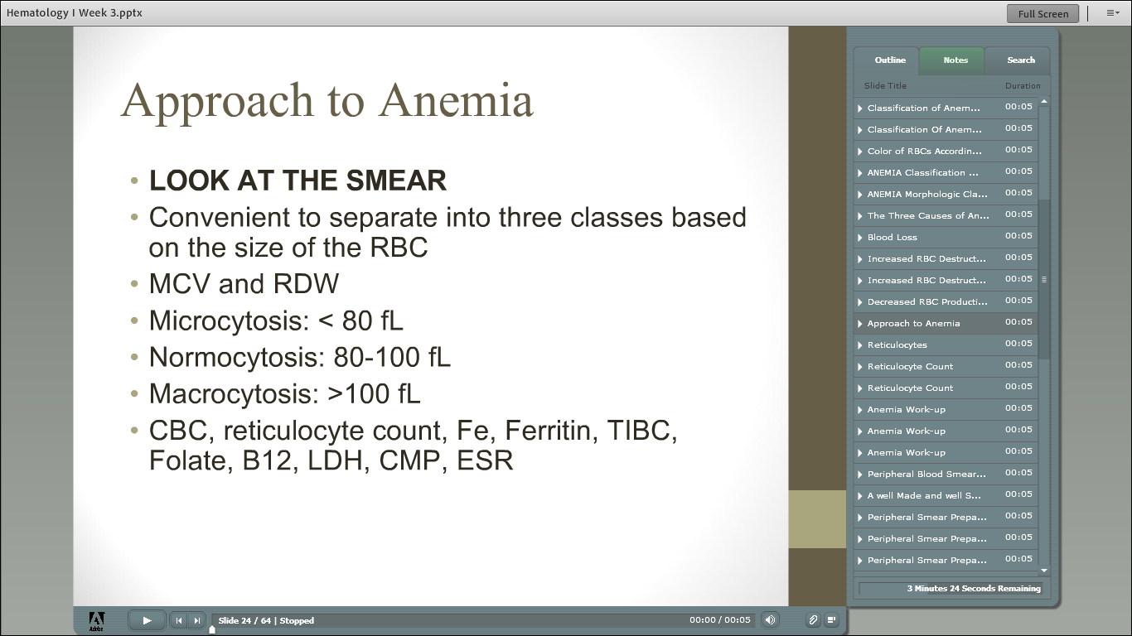

Slide 52
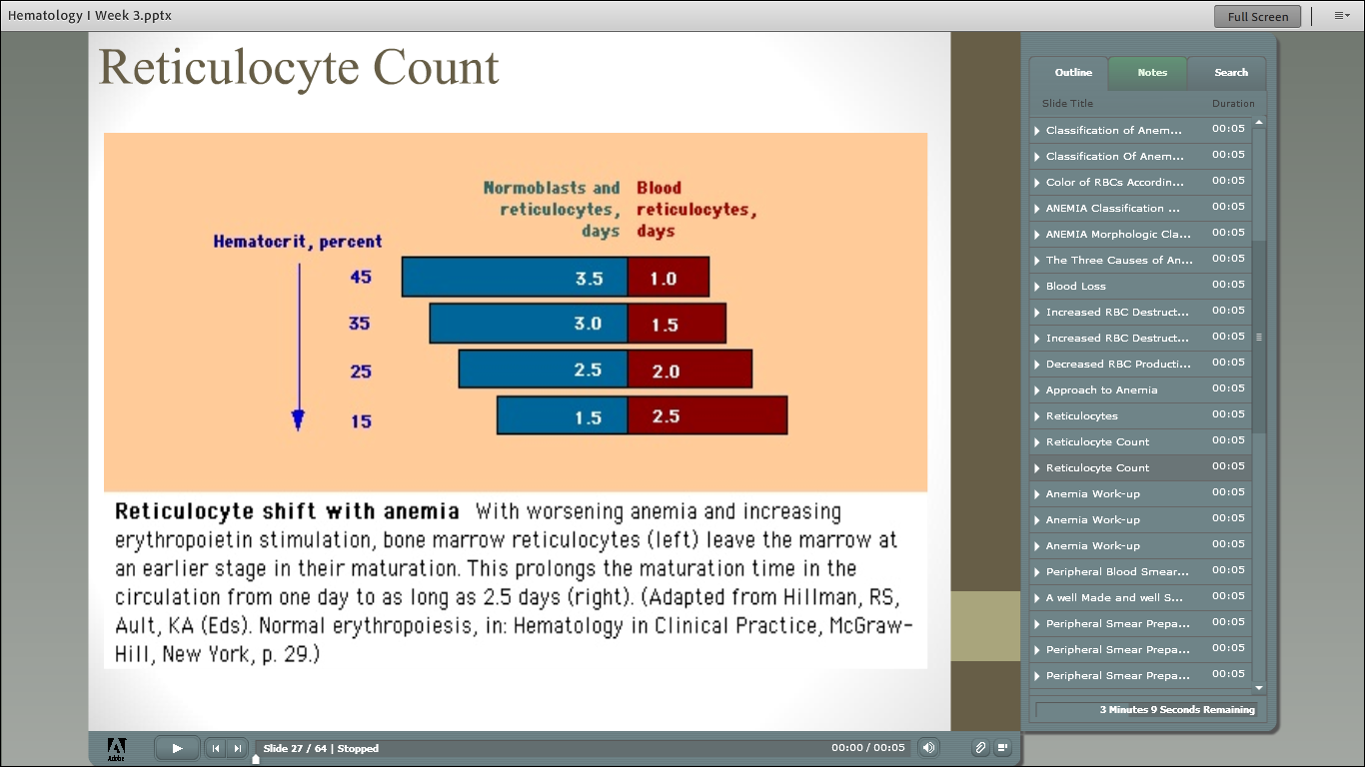

Slide 53
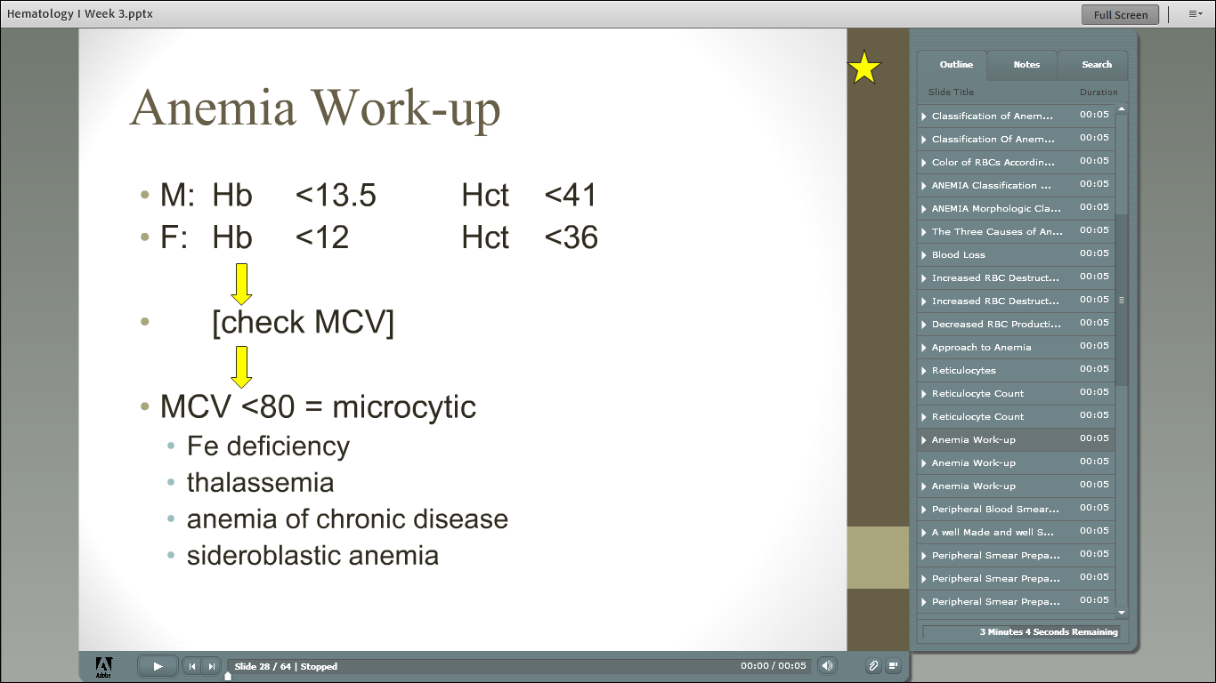

Slide 55
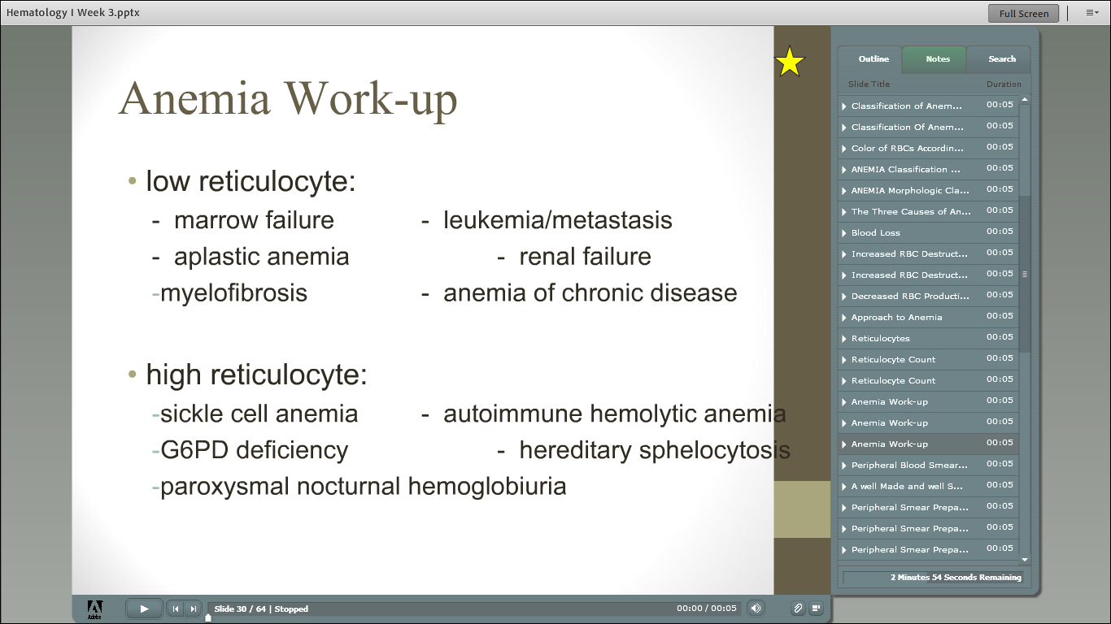

Slide 56
Peripheral blood smears
CHAPTER 5

Slide 57
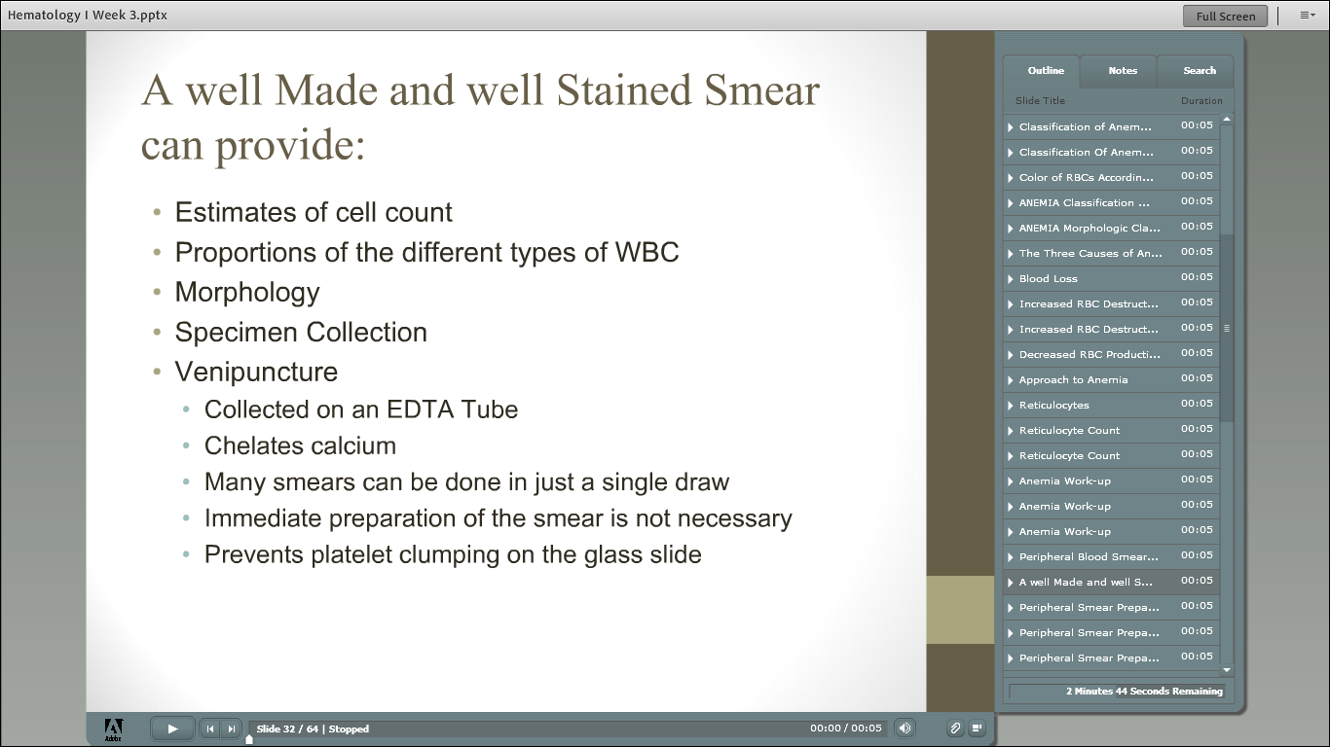

Slide 58
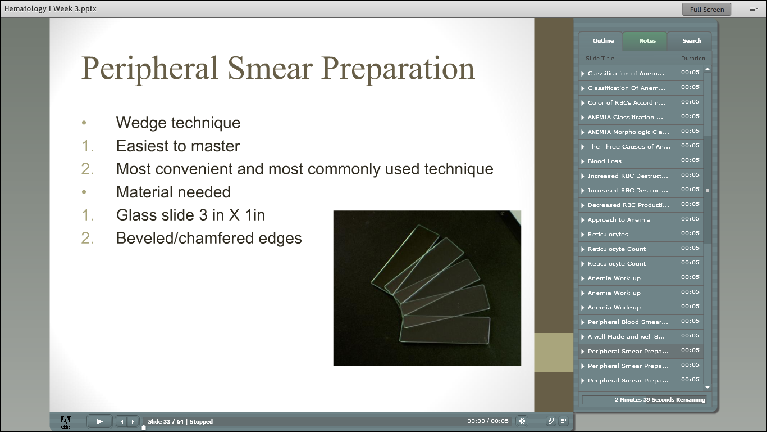

Slide 59
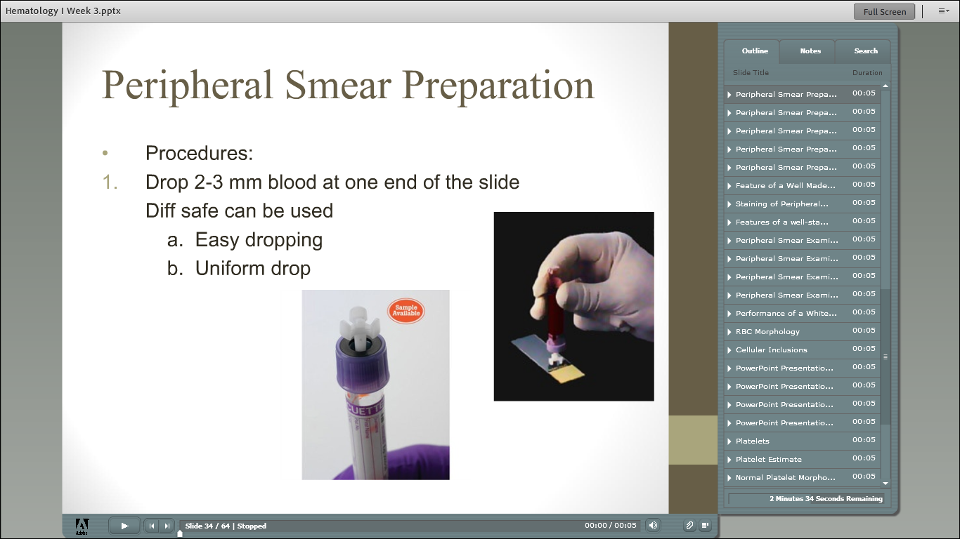

Slide 60
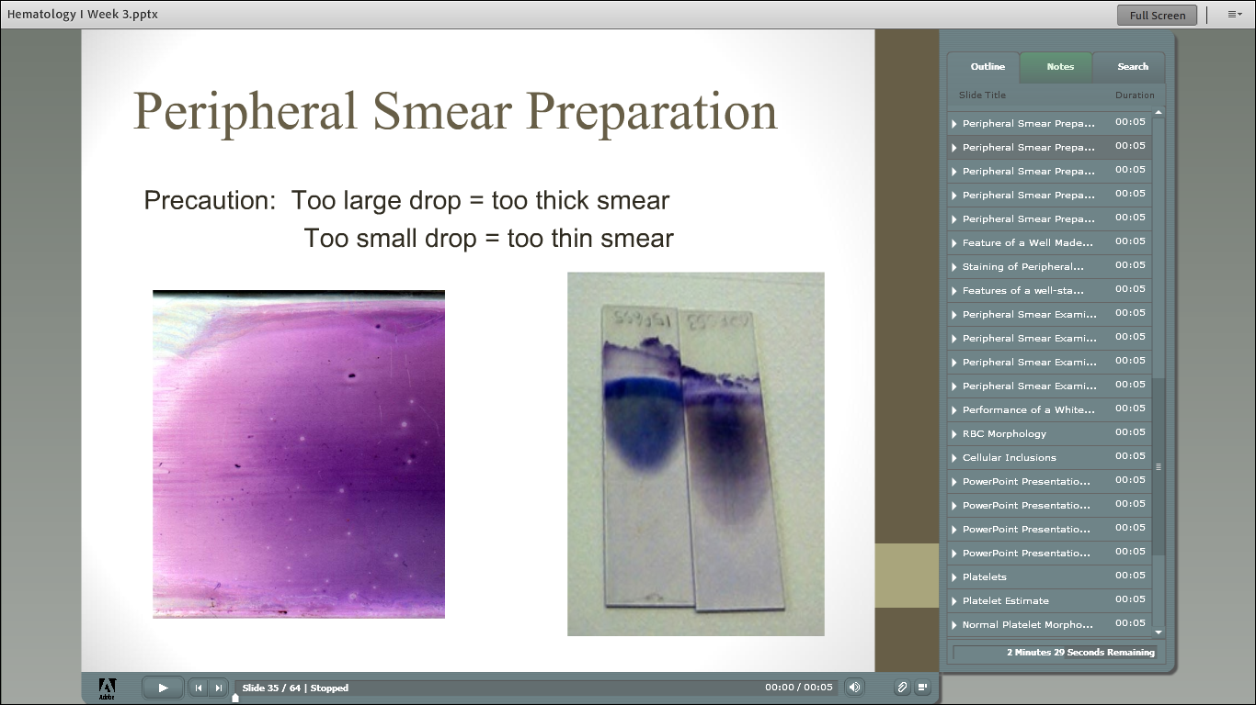

Slide 61
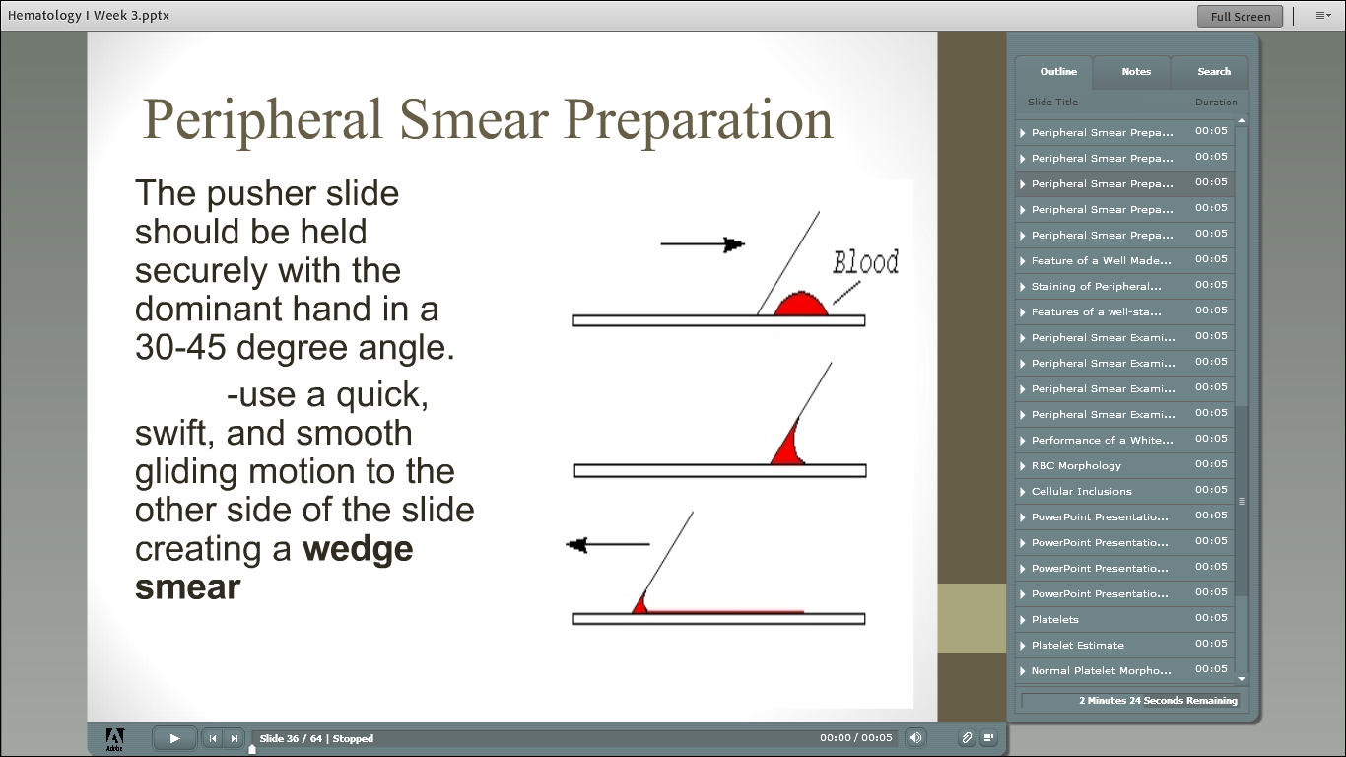

Slide 62


Slide 63


Slide 64


Slide 65


Slide 66


Slide 67


Slide 68


Slide 69


Slide 70


Slide 71


Slide 72


Slide 73


Slide 74


Slide 75


Slide 76


Slide 77


Slide 78


Slide 79


Slide 80


Slide 81


Slide 82


Slide 83


Slide 84


Slide 85


Slide 86


Slide 87


Slide 88


Slide 89
Quiz bowl
FUN!

Slide 90


Slide 91
Normocytes

Slide 92


Slide 93
Microcytes

Slide 94


Slide 95
Macrocytes

Slide 96


Slide 97
Anisocytosis-Dimorphic Population

Slide 99
Anisocytosis-Dimorphic Population

Slide 100


Slide 101
Hypochromic

Slide 102


Slide 103
Polychromasia

Slide 104


Slide 105
Acanthocytes, also Target Cells

Slide 106


Slide 107
Burr Cells

Slide 108


Slide 109
Spherocytes, (also stomatocyte)

Slide 110


Slide 111
Spherocytes

Slide 112


Slide 113
Target Cells (also a stomatocyte)

