Slide 1
Hemo I Week 2 Seminar
Christina A Nevel-McGarvey, PhD, MS, MT(ASCP)

Slide 2
Week 1 quiz
REVIEW

Slide 3
Week 1 Quiz Review
The primary site of hematopoiesis in the fetus (0-3mos) is the yolk sac.
Accuracy: how close to the real value the test is able to detect
Precision: how reproducible the test results are
Lymphocyte:
Plasma cell:

Slide 4
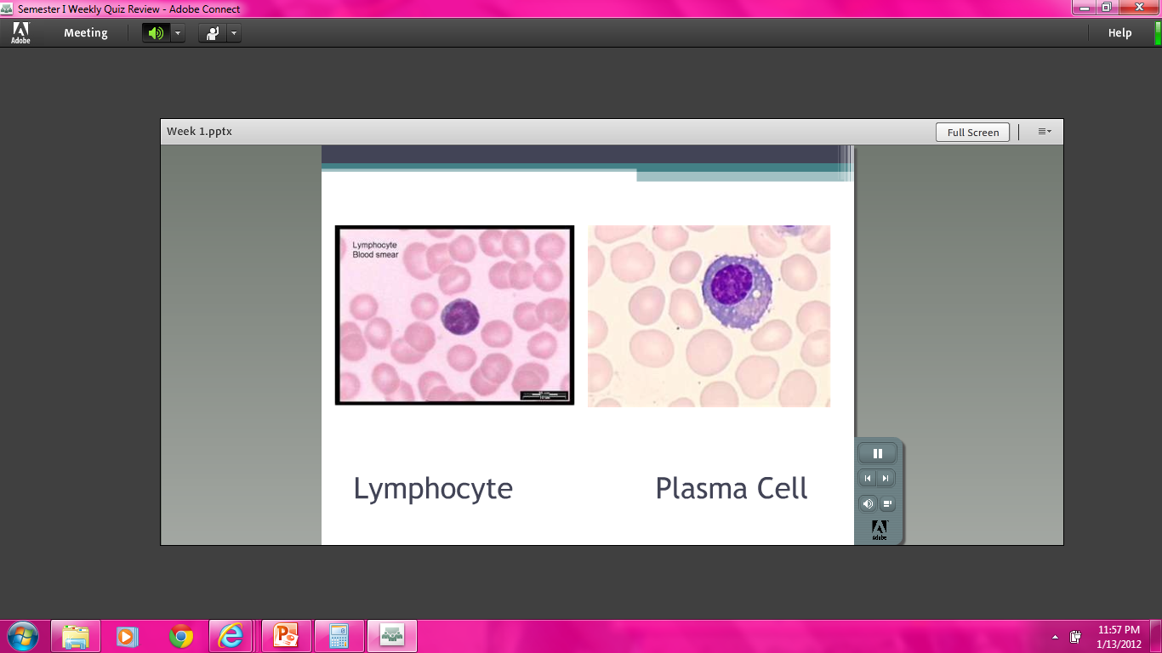

Slide 5
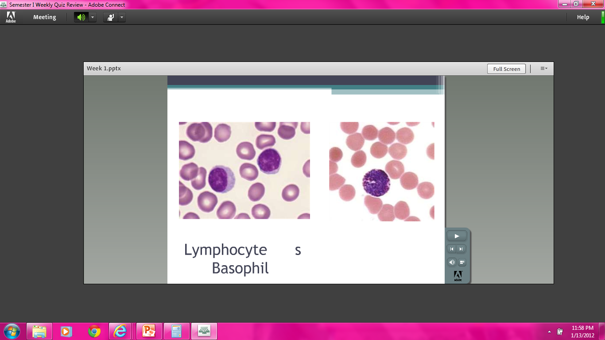

Slide 6
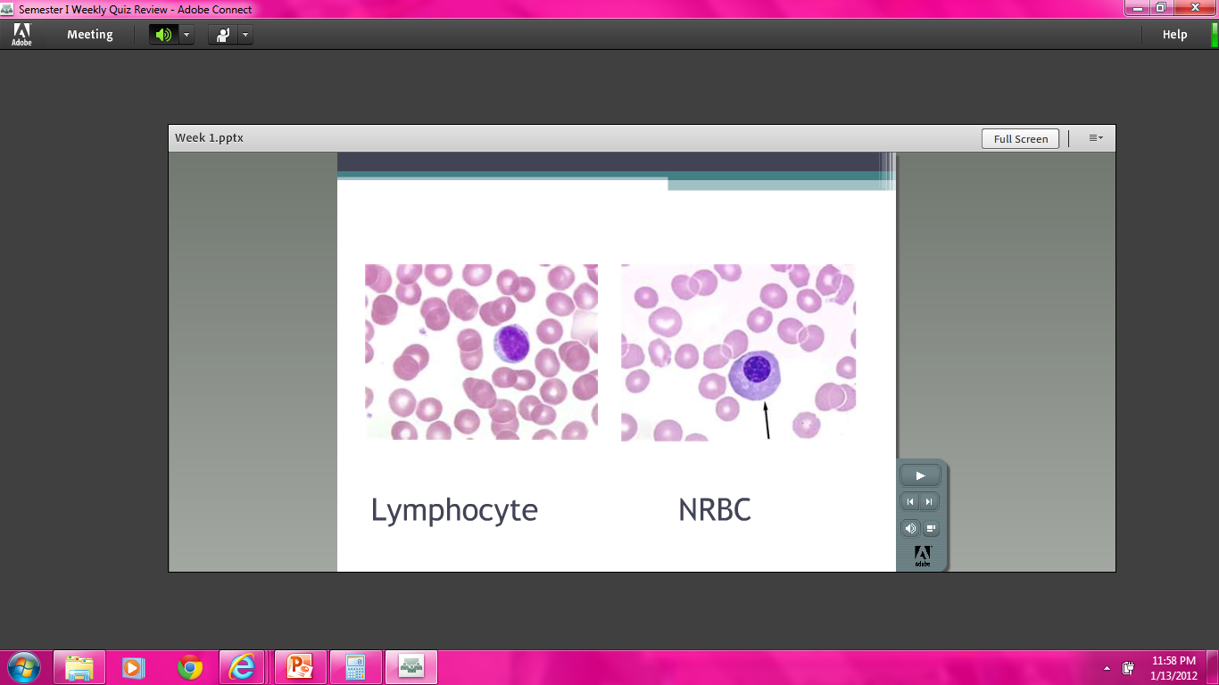

Slide 7
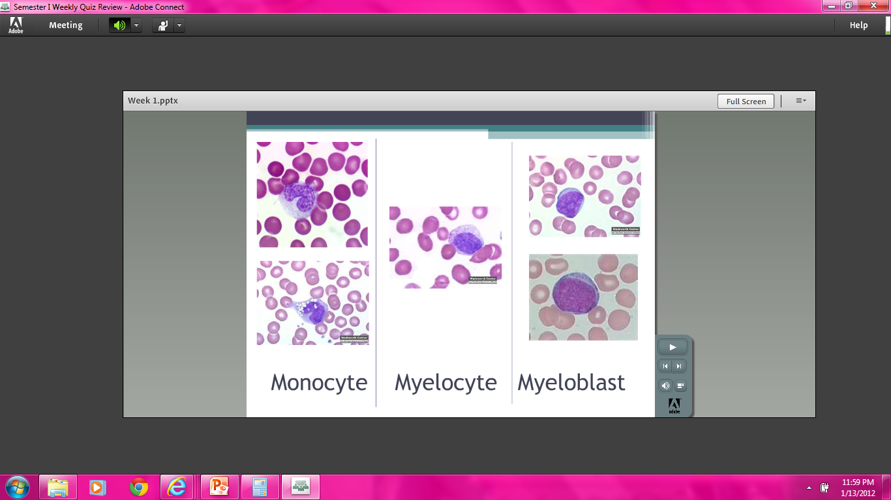

Slide 8
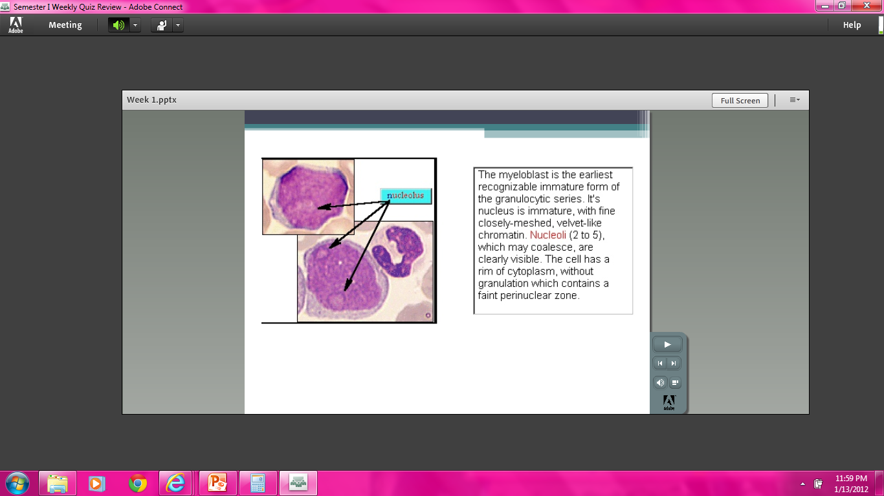

Slide 9
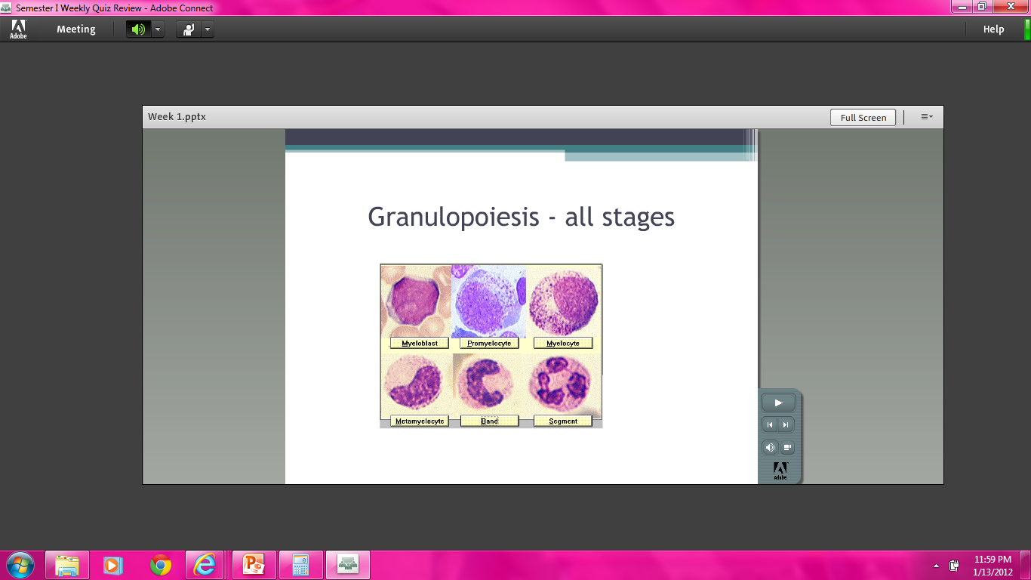

Slide 10
Week 2 Vocabulary
REVIEW

Slide 11
Week 2 Vocab
Bone marrow structure
Erythropoiesis
Granulocytopoiesis
Megakaryocytopoiesis
Lymphopoiesis
Stem Cells
Antigen Independent Progenitor
Antigen Dependent Effector
Hematogone
Marrow Stromal Cells
Mast Cells
Osteoblasts
Osteoclasts
Bone Marrow Biopsy
Aspirate
Core Biopsy
Trephine Biopsy
Red Blood Cell Membrane
Integral membrane proteins
Glycophorin
Band 3
Peripheral membrane proteins
Spectrin
Ankyrin
Membrane skeleton
Deformability

Slide 12
Week 2 vocab
Permeability
Phospholipids
Glycolipids
Cholesterol
Hemoglobin (Synthesis)
Iron Delivery (ferric->ferrous)
Protoporphyrins
Globin

Slide 13
WEEK 2 PRESENTATION
QUICK REVIEW

Slide 14
BONE MARROW
CHAPTER 2

Slide 15
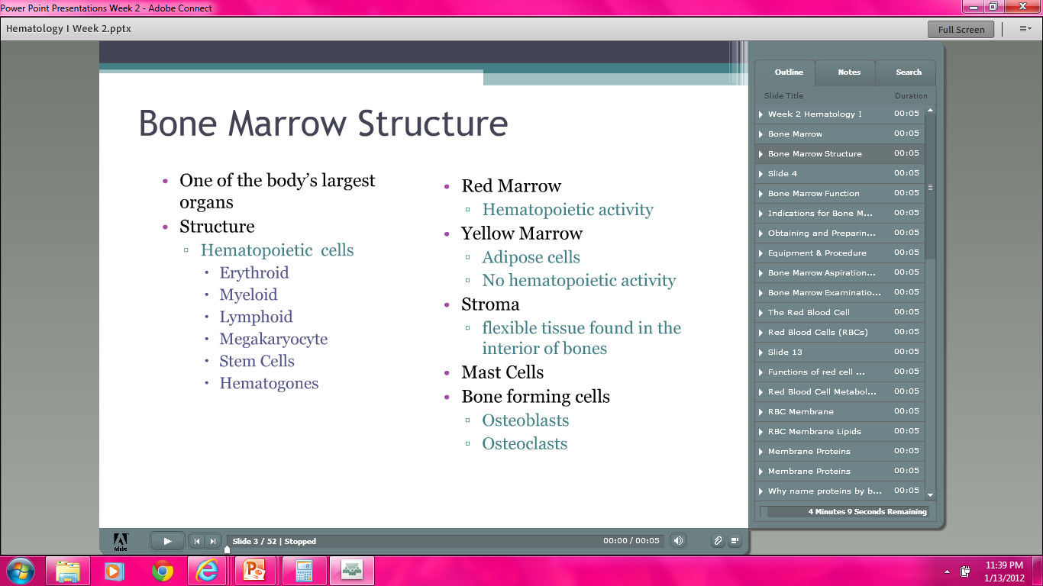

Slide 16
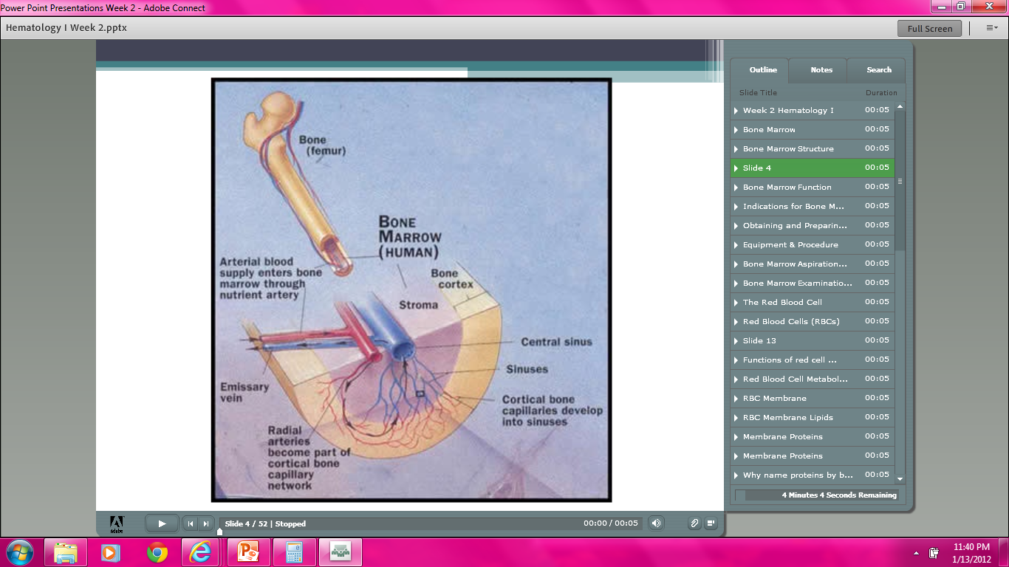

Slide 17
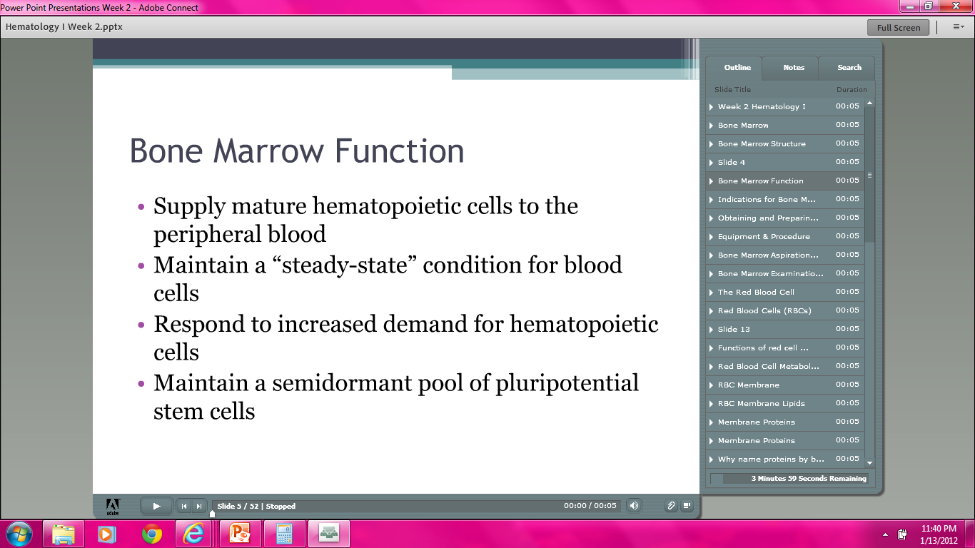

Slide 18
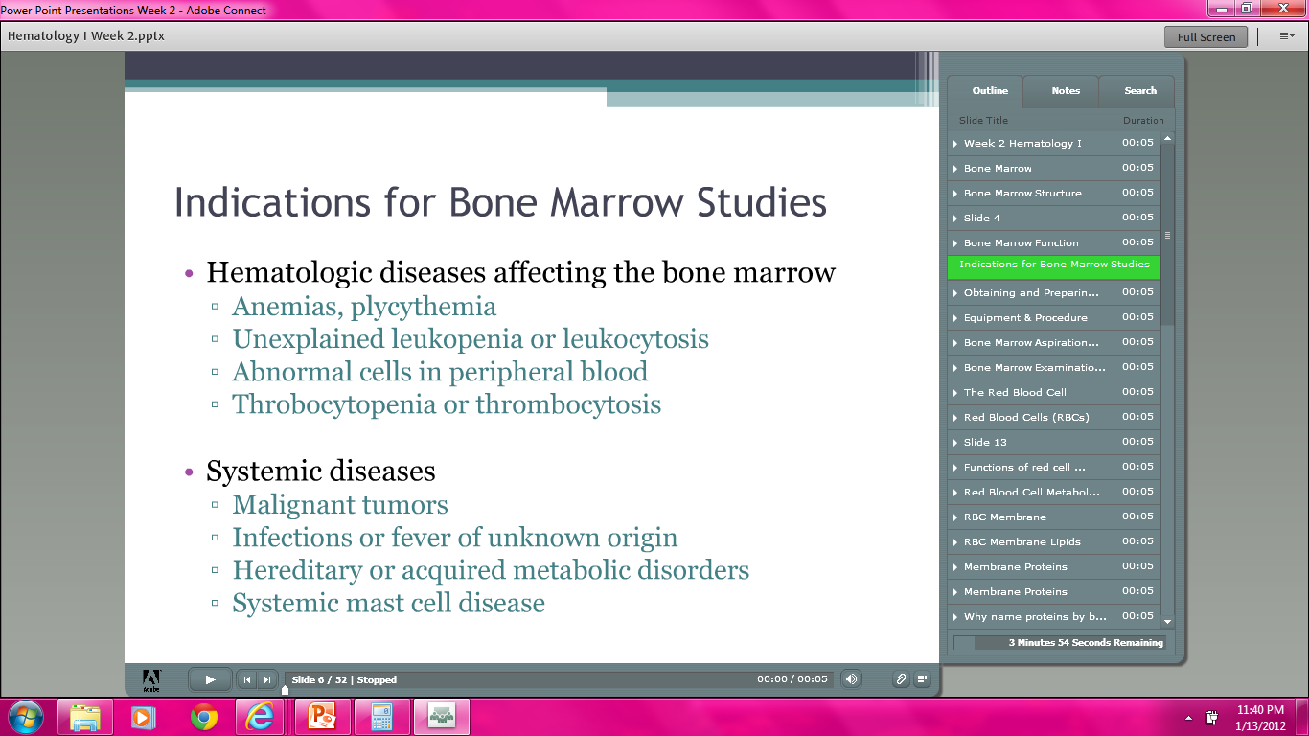

Slide 19
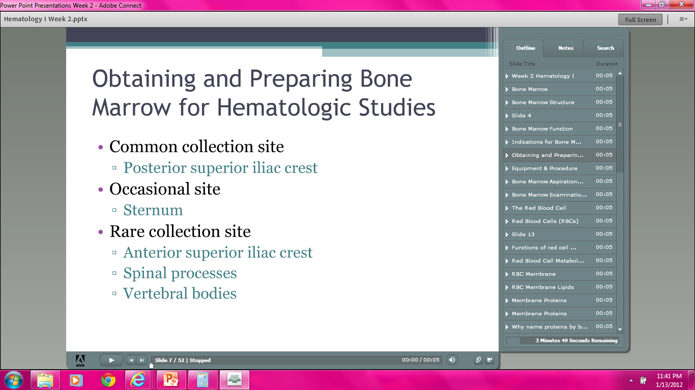

Slide 20
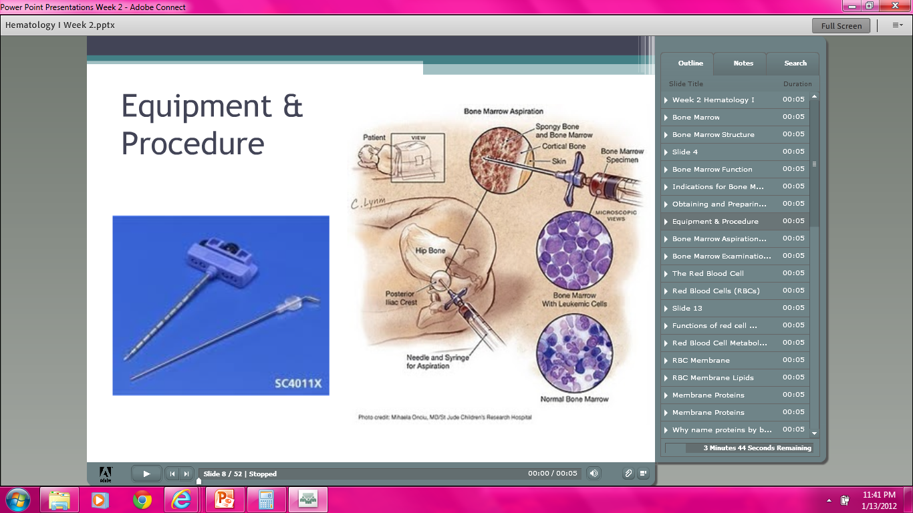

Slide 21
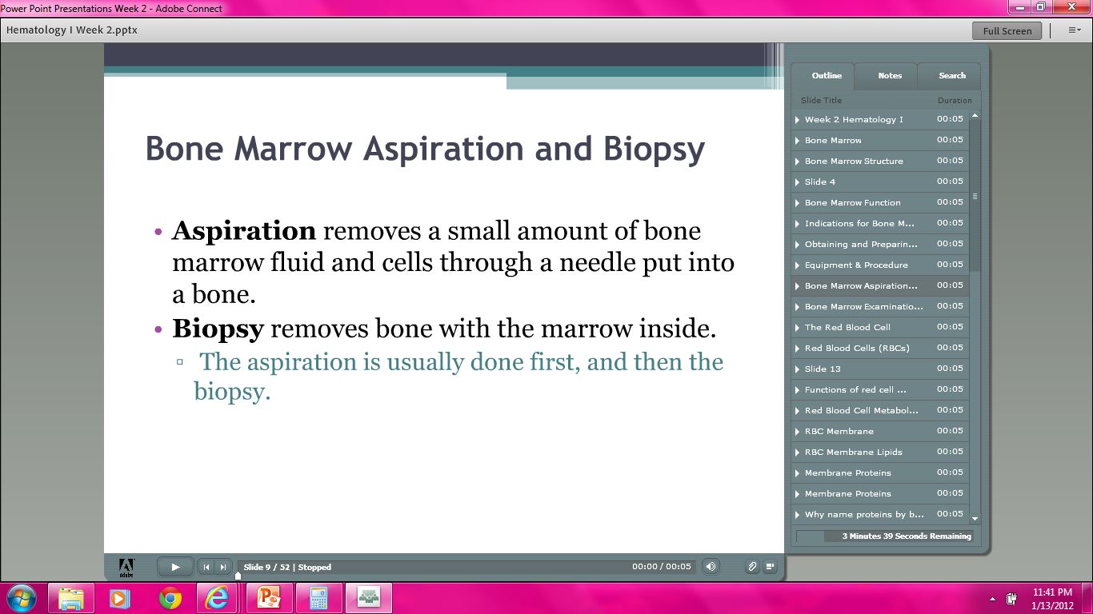

Slide 22
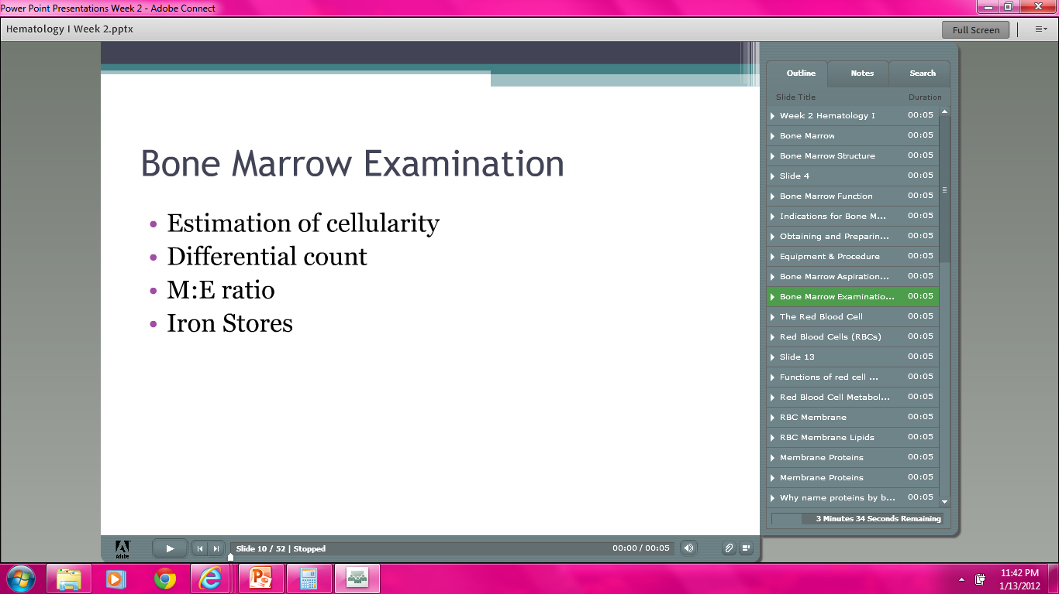

Slide 23
THE RED BLOOD CELL
CHAPTER 3

Slide 24
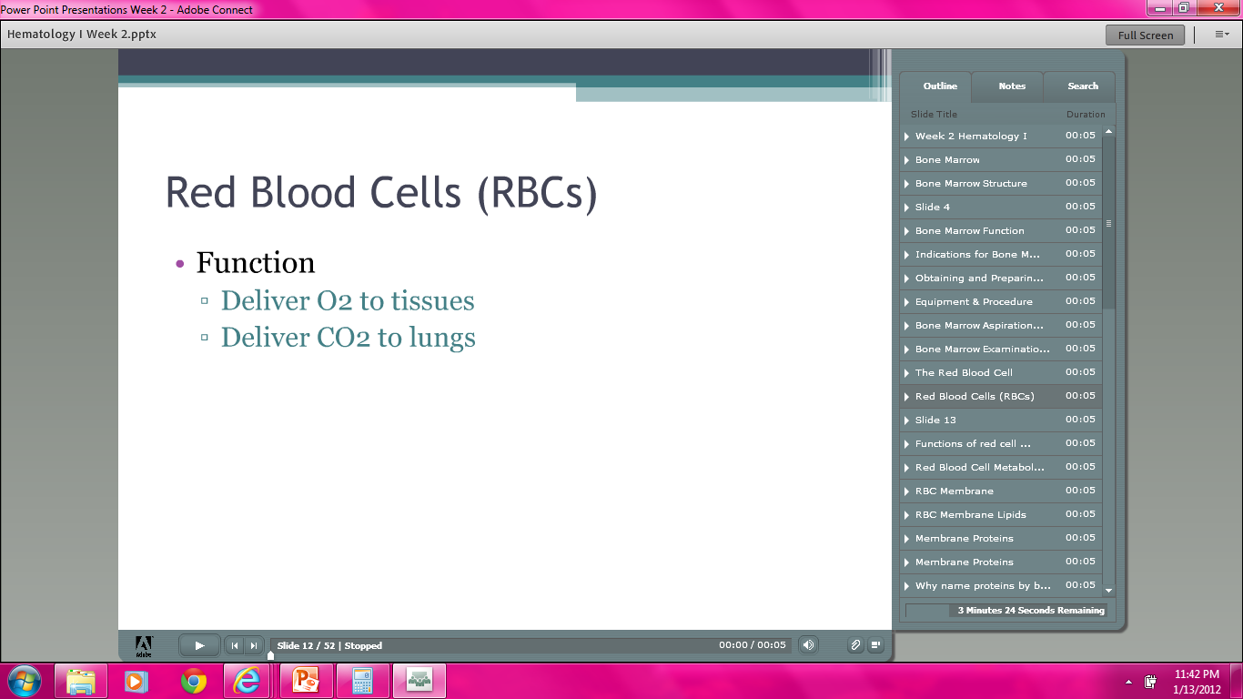

Slide 25
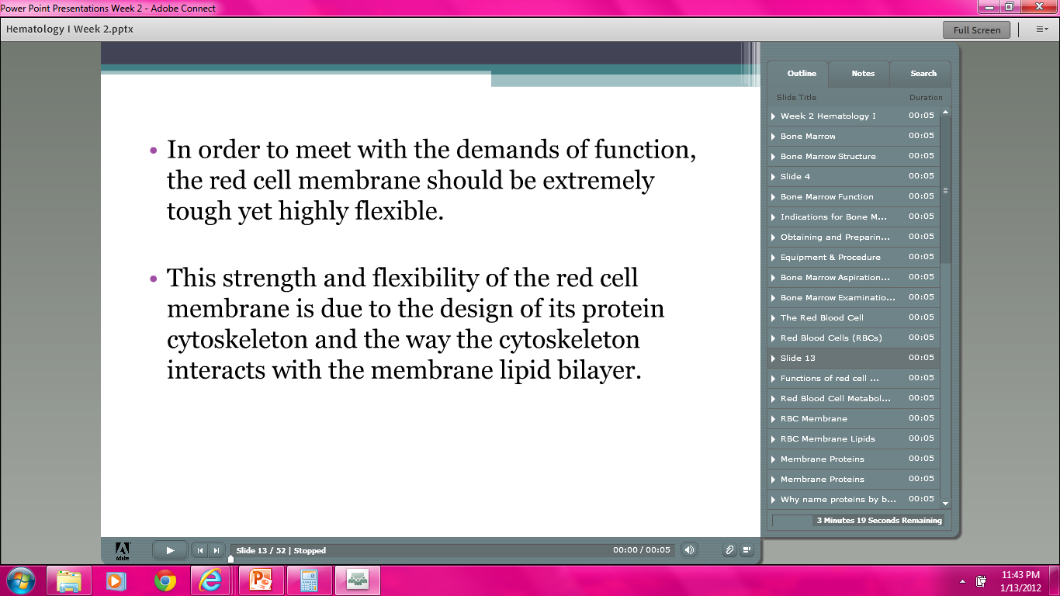

Slide 26
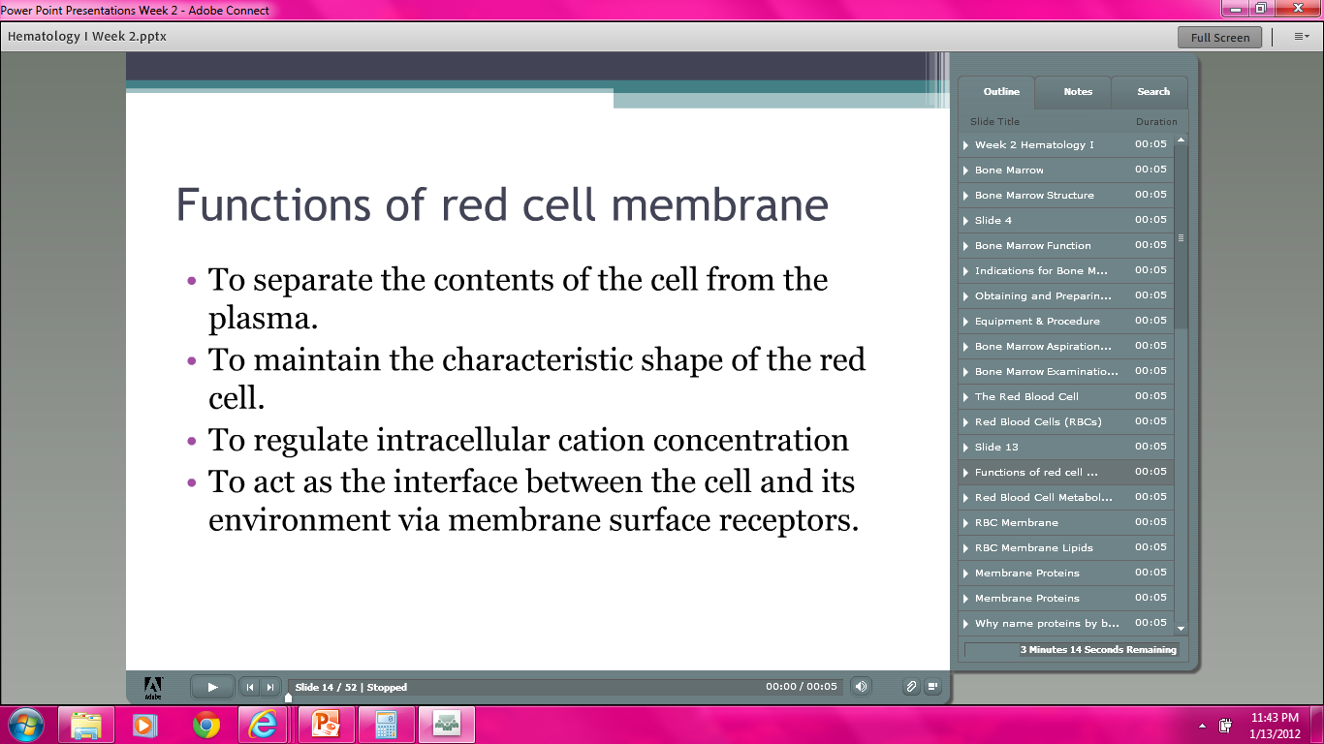

Slide 27
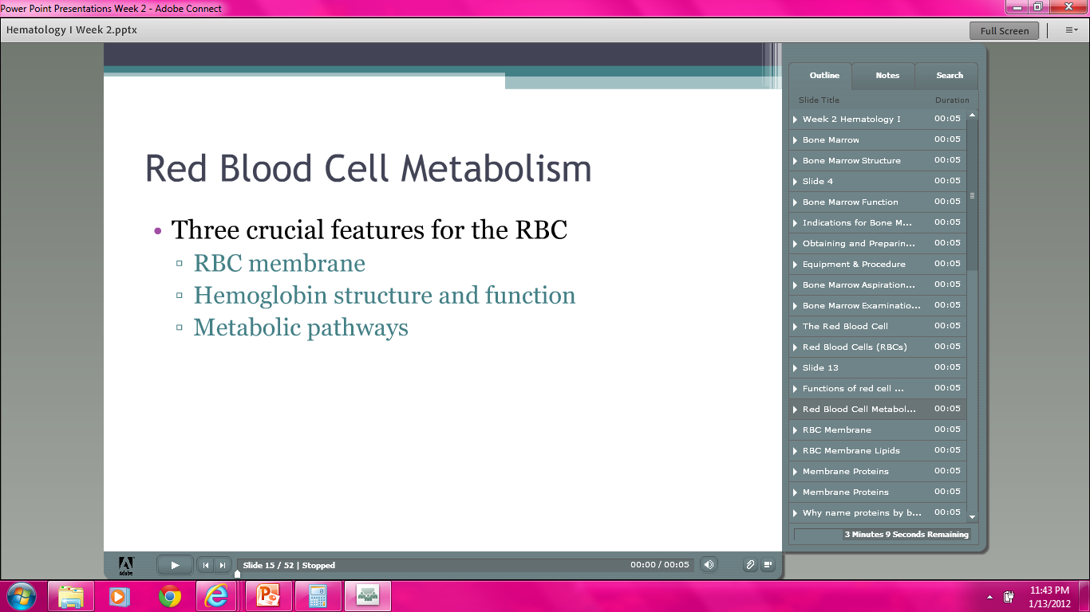

Slide 28
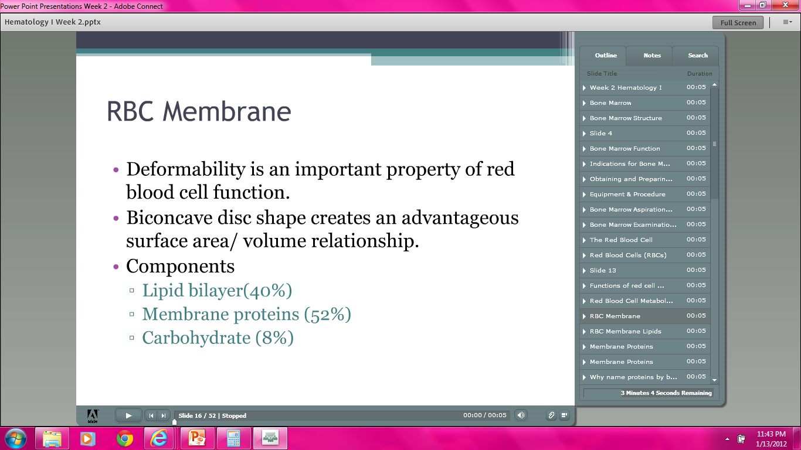

Slide 29
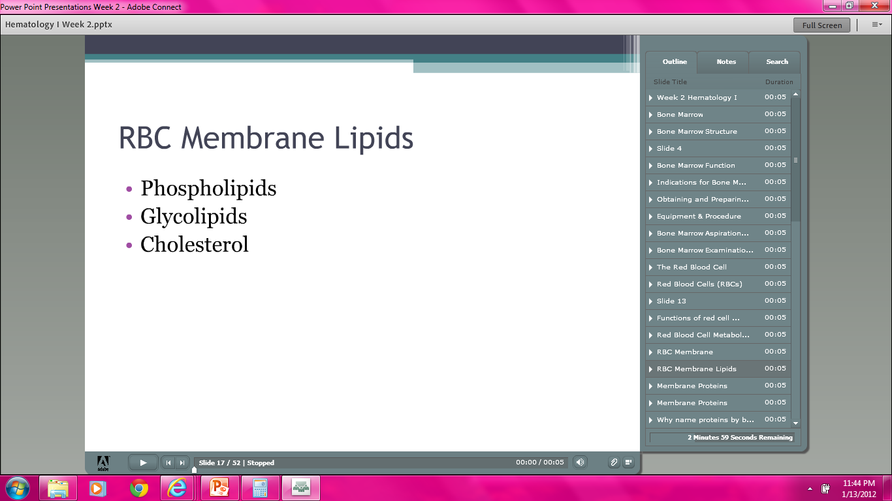

Slide 30
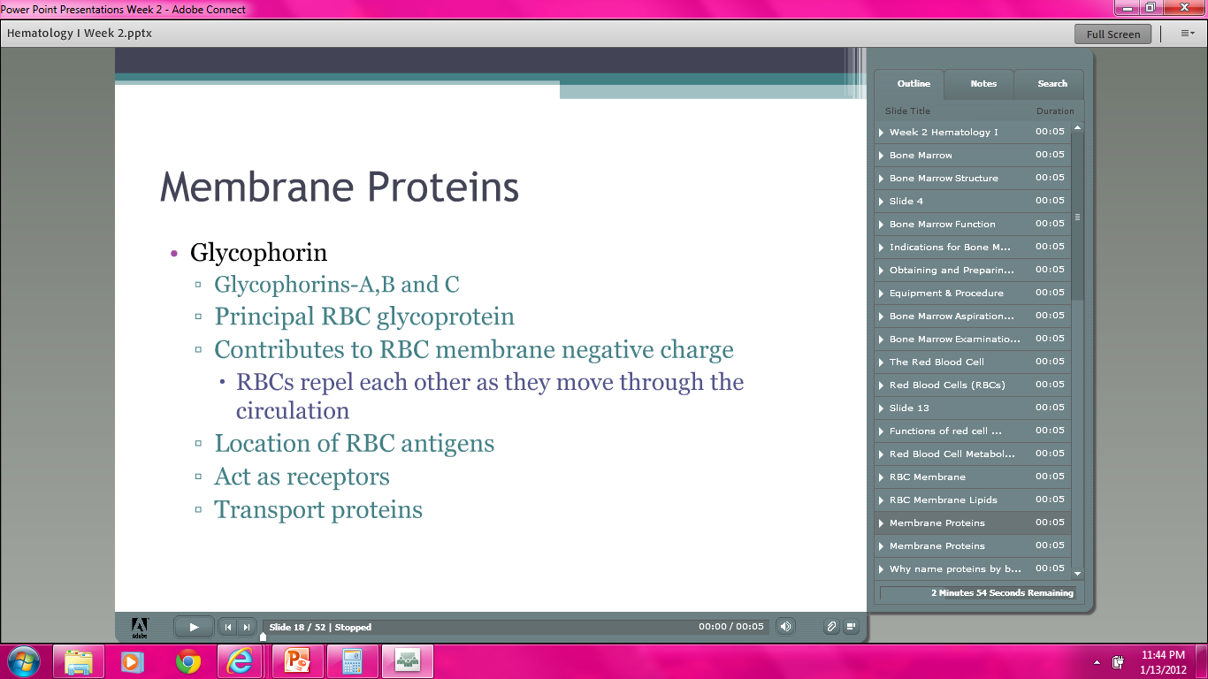

Slide 31
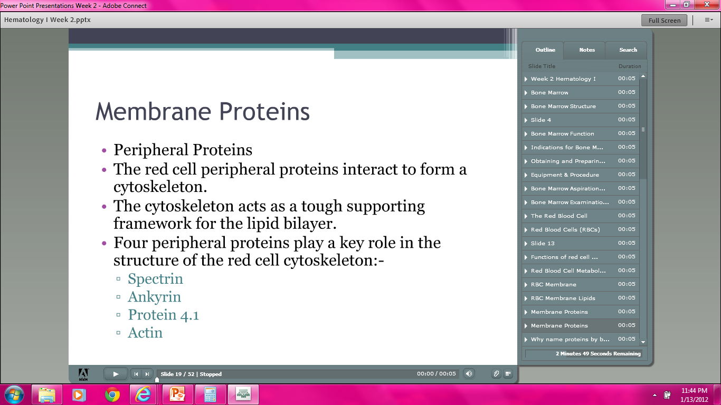

Slide 32
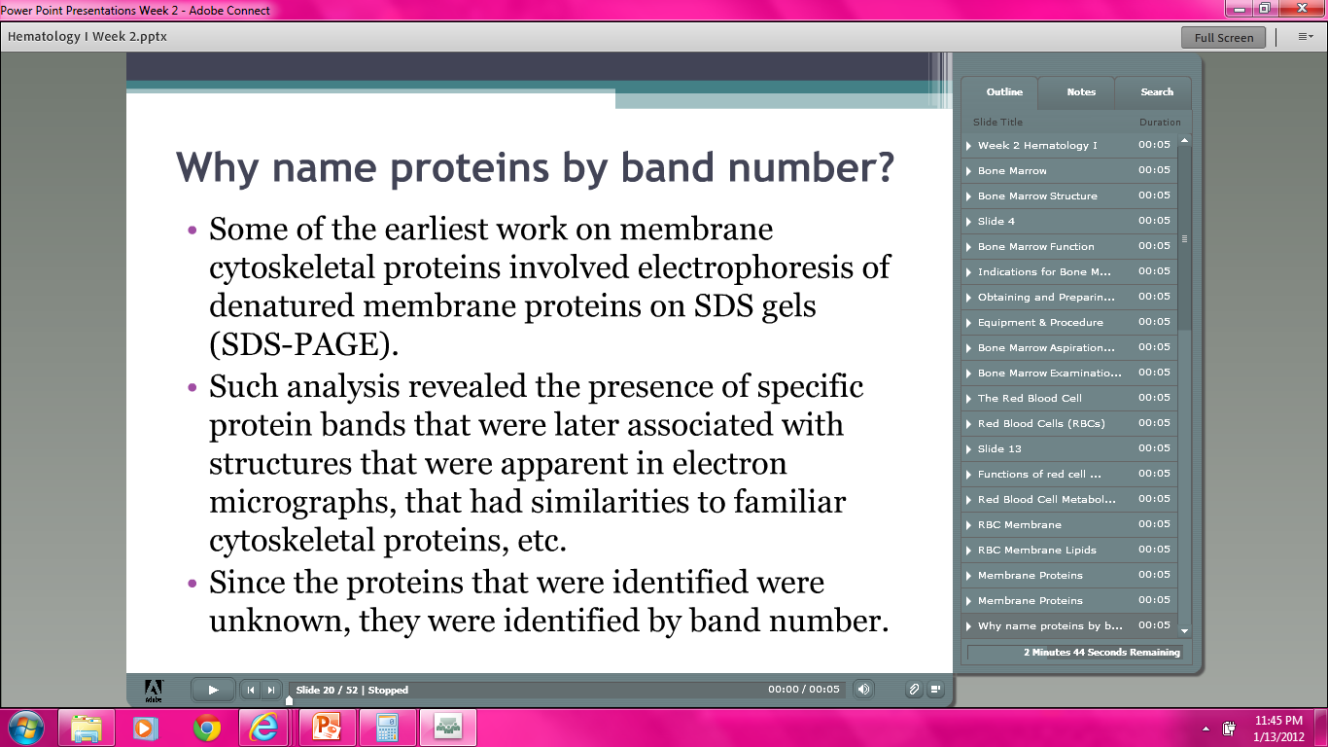

Slide 33
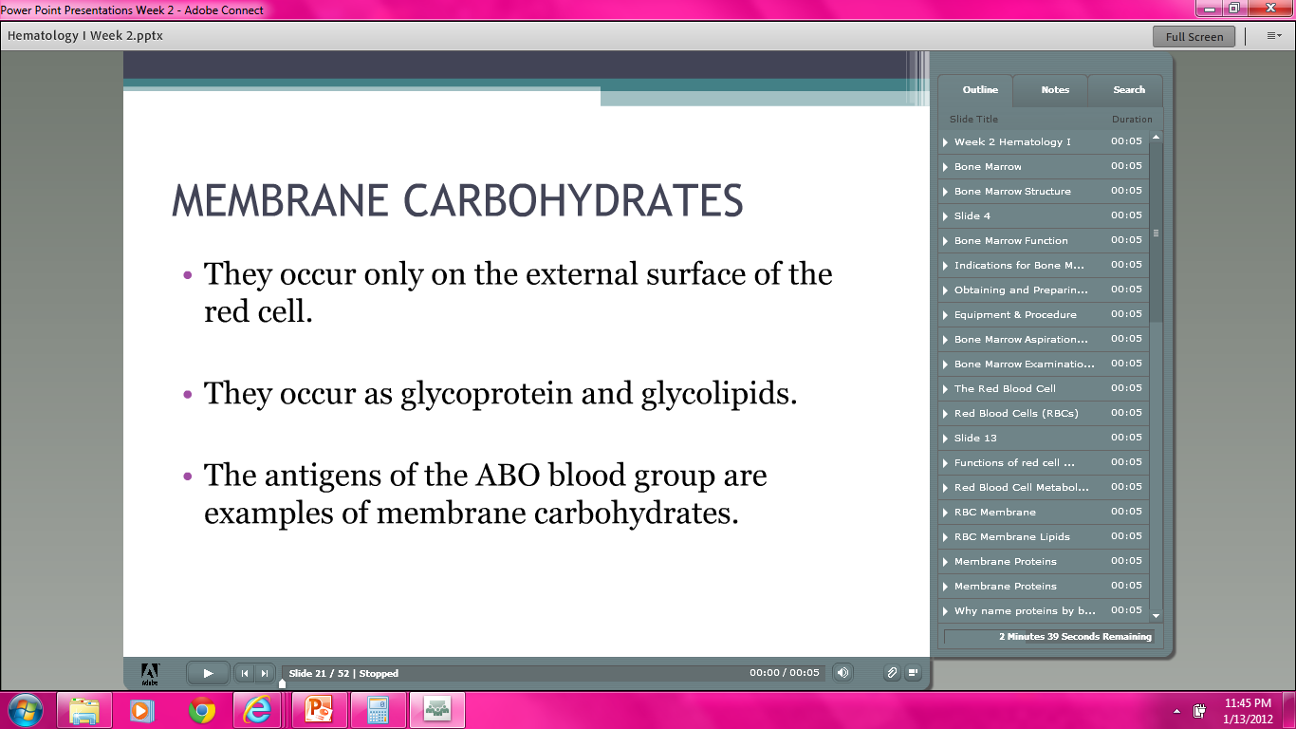

Slide 34
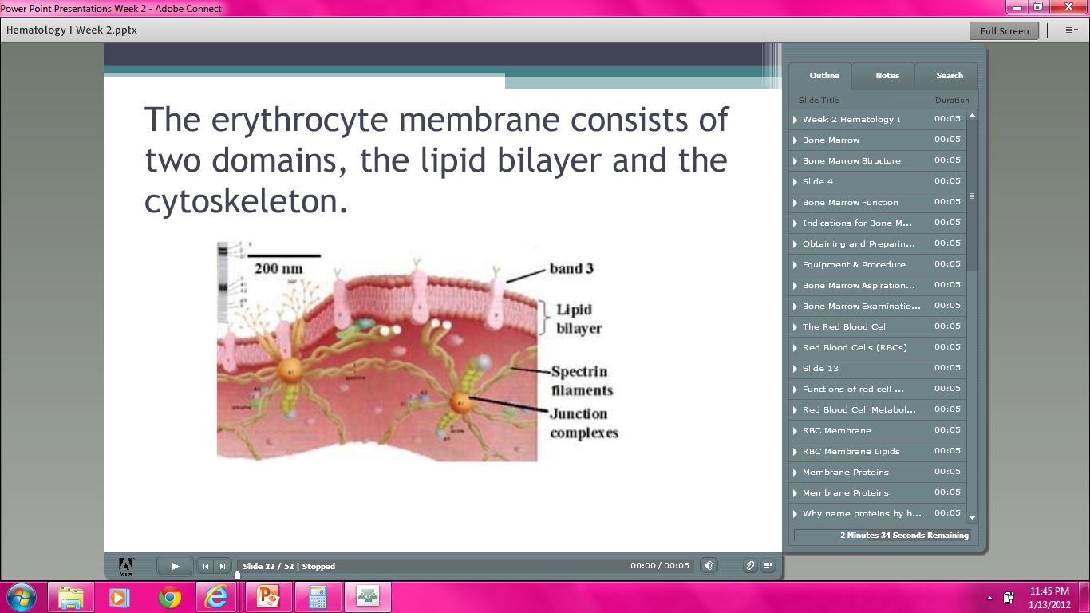

Slide 35
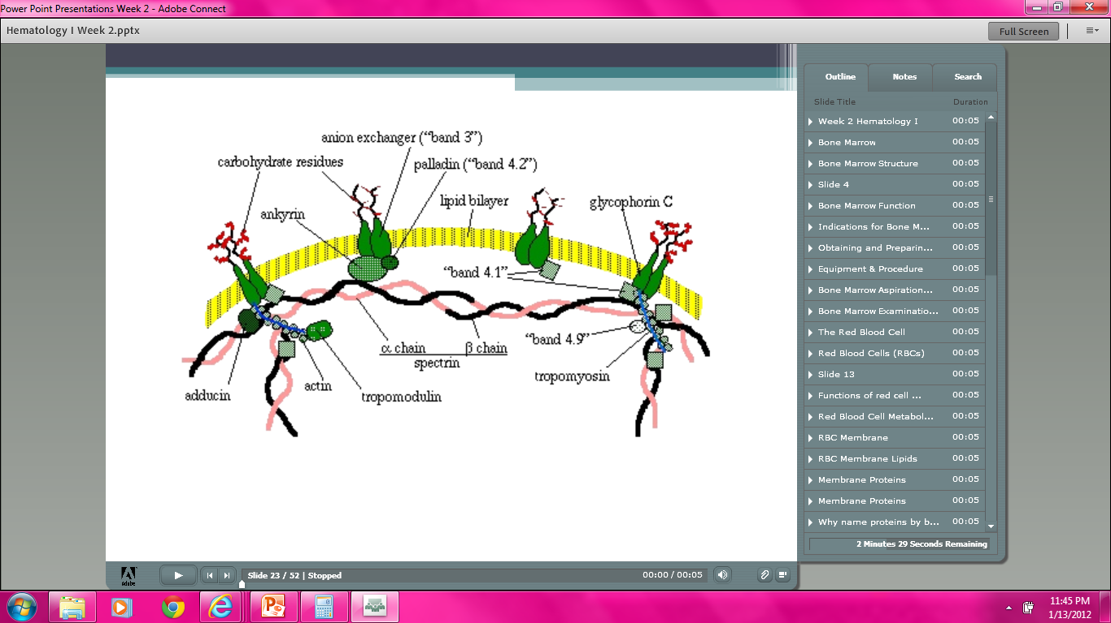

Slide 36
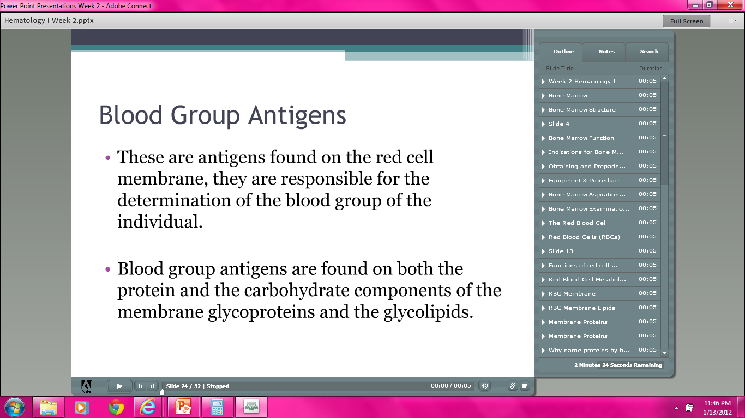

Slide 37
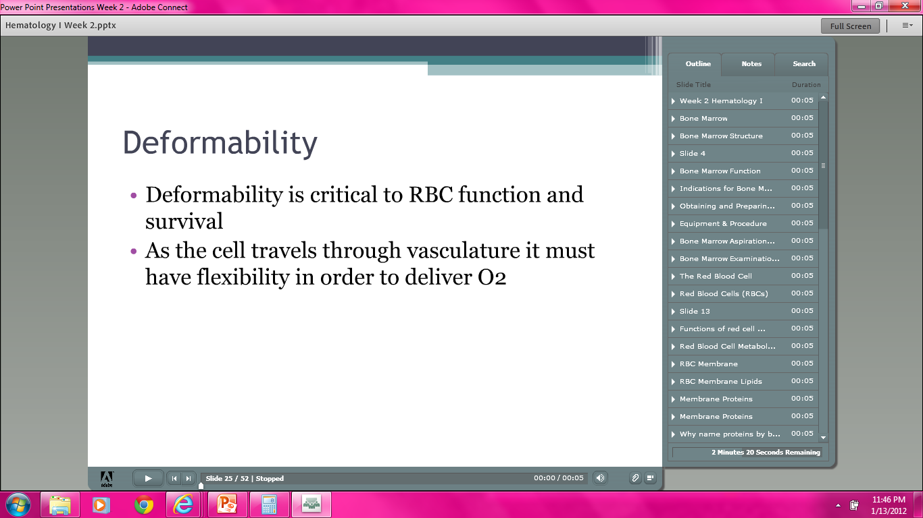

Slide 38
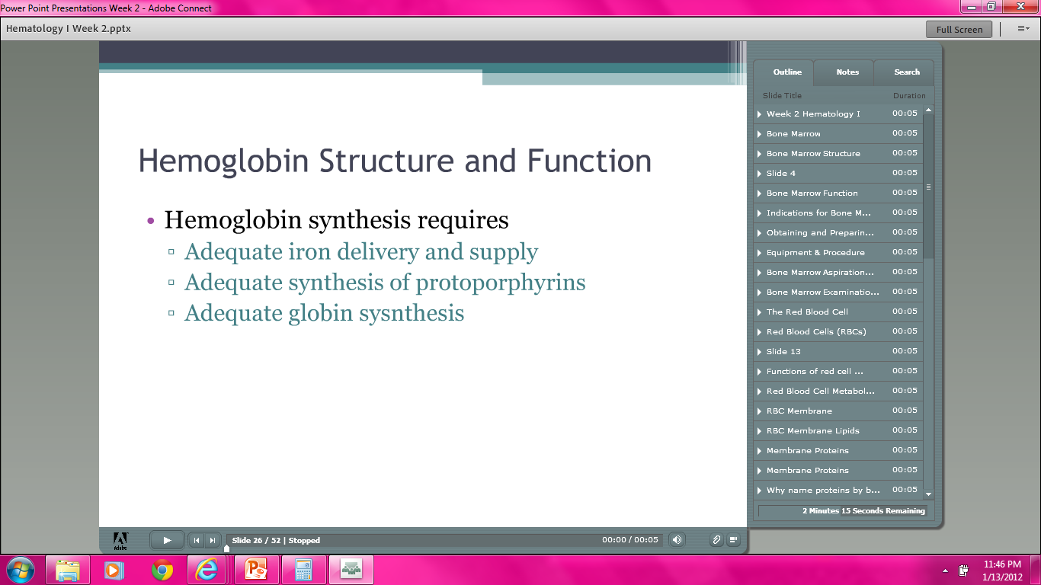

Slide 39
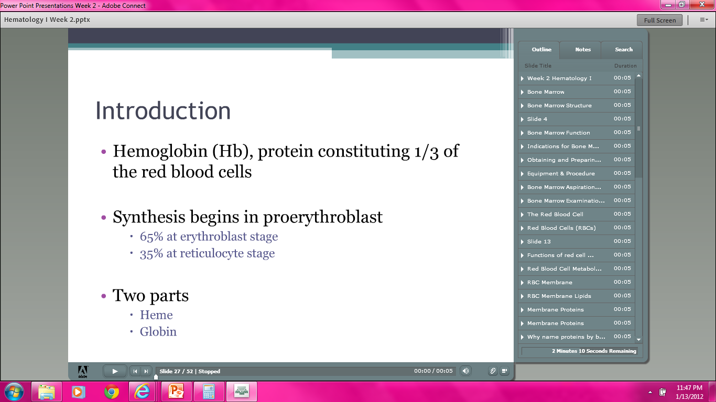

Slide 40
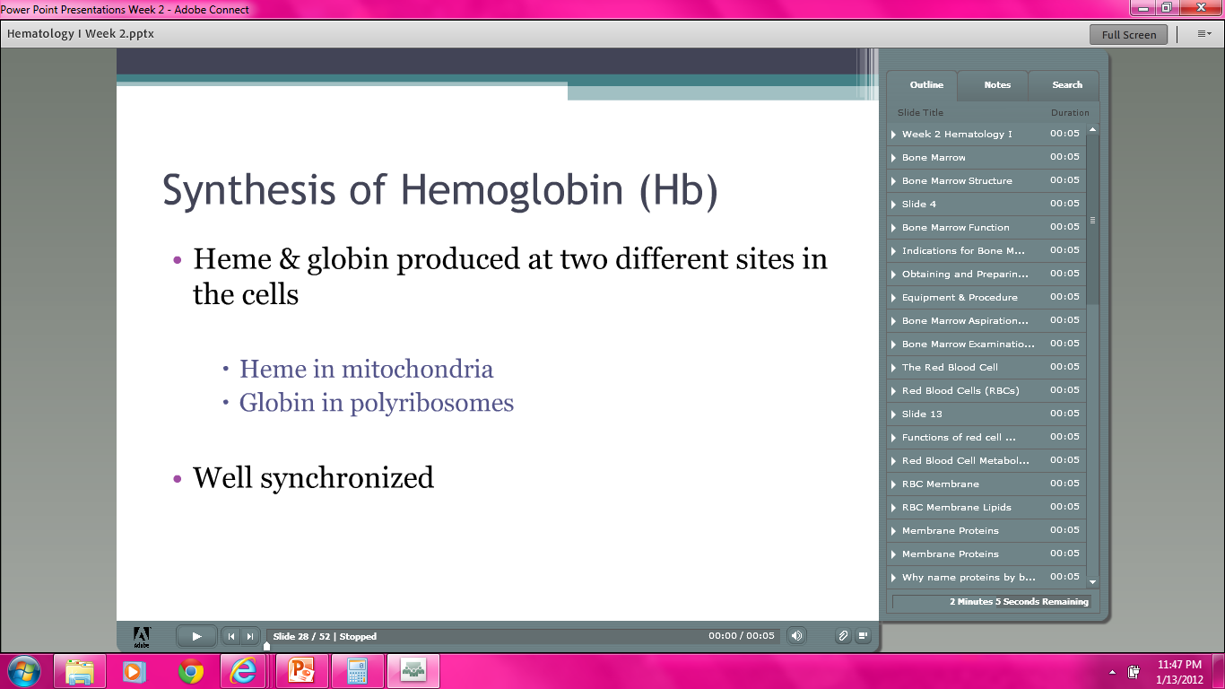

Slide 41
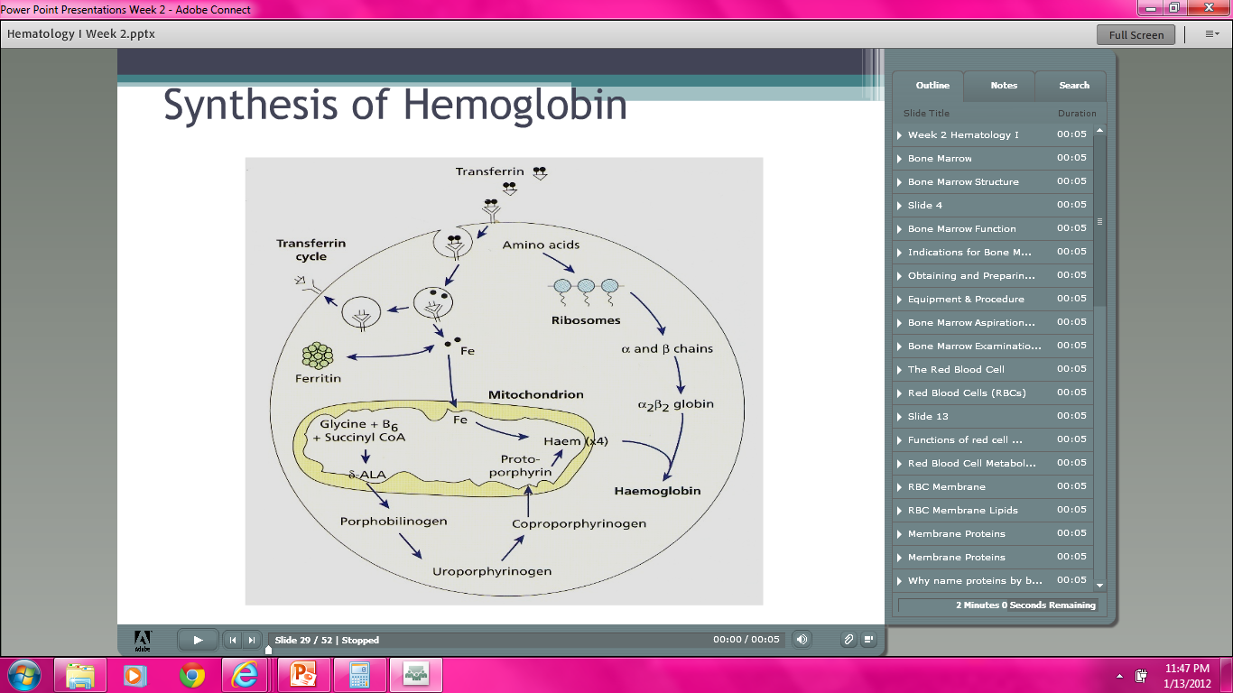

Slide 42


Slide 43
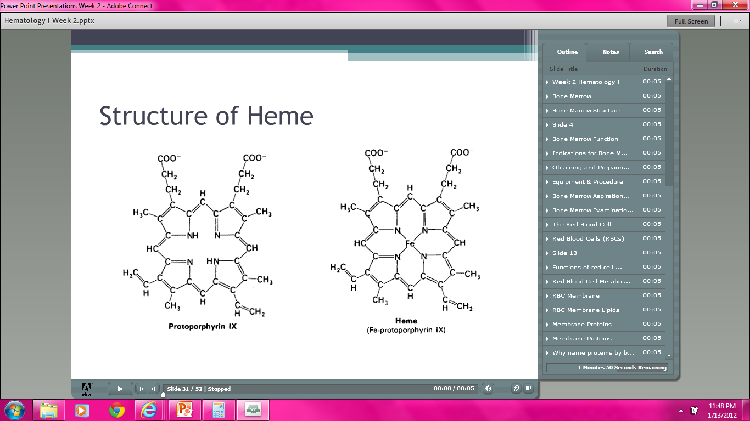

Slide 44
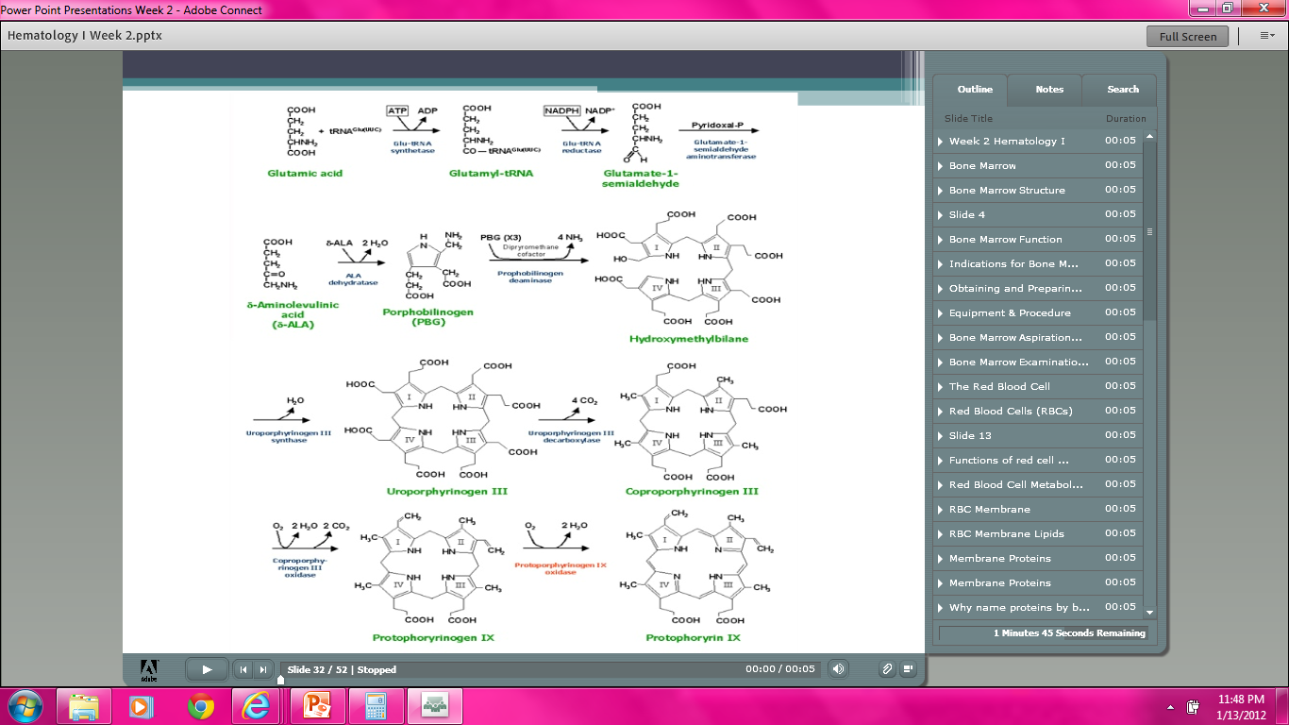

Slide 45
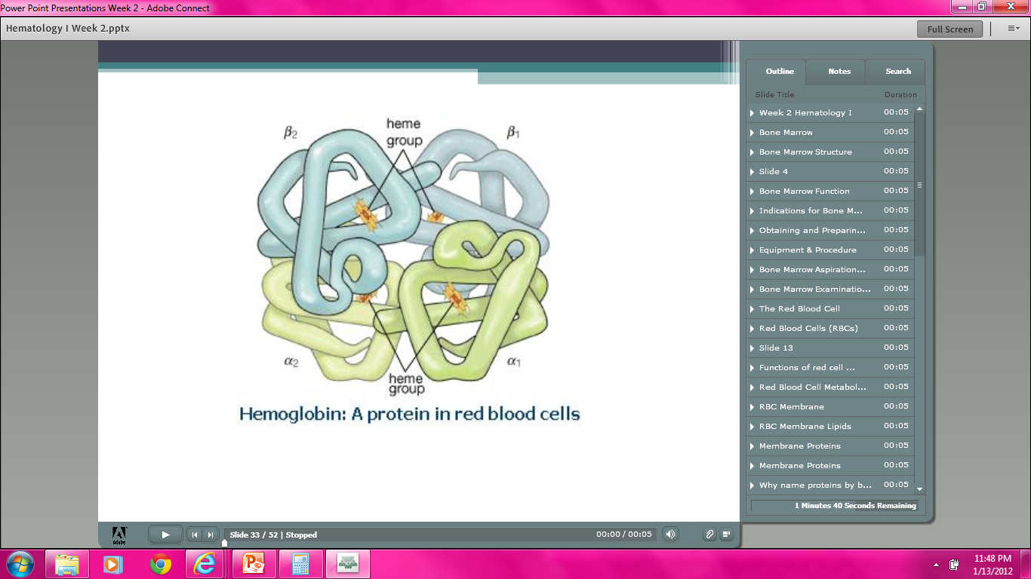

Slide 46
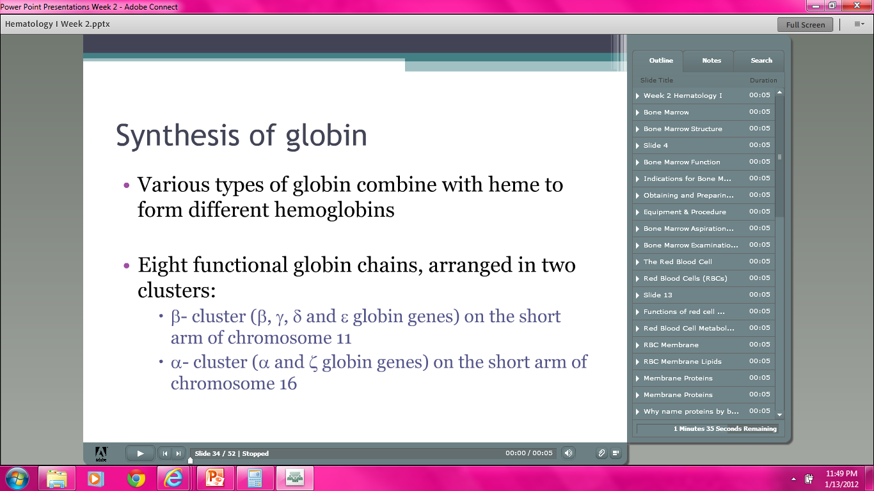

Slide 47
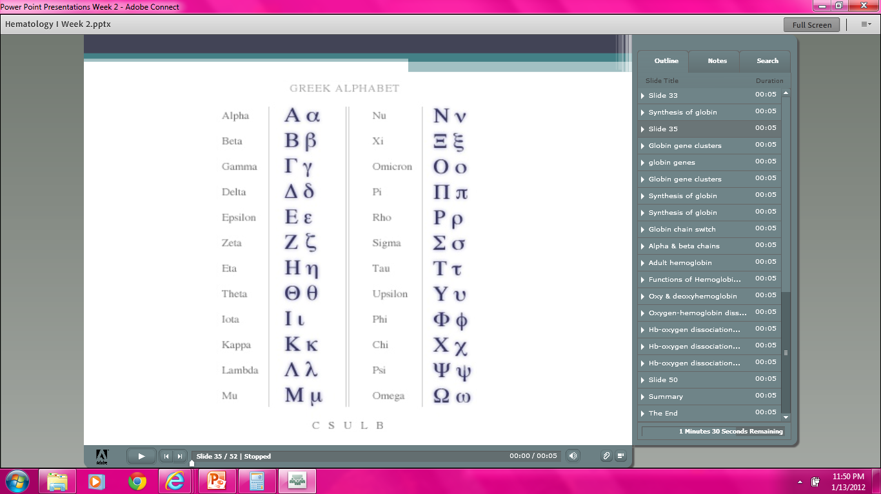

Slide 48
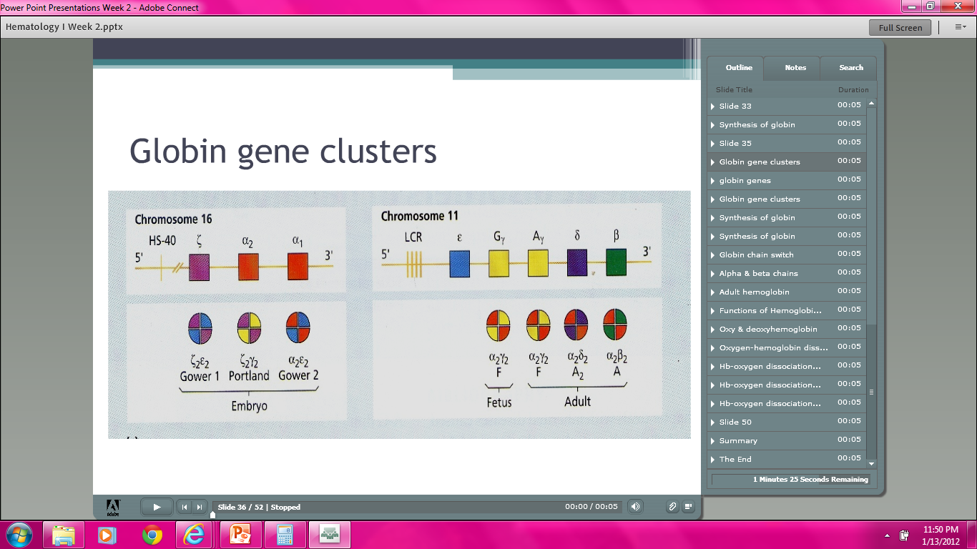

Slide 49
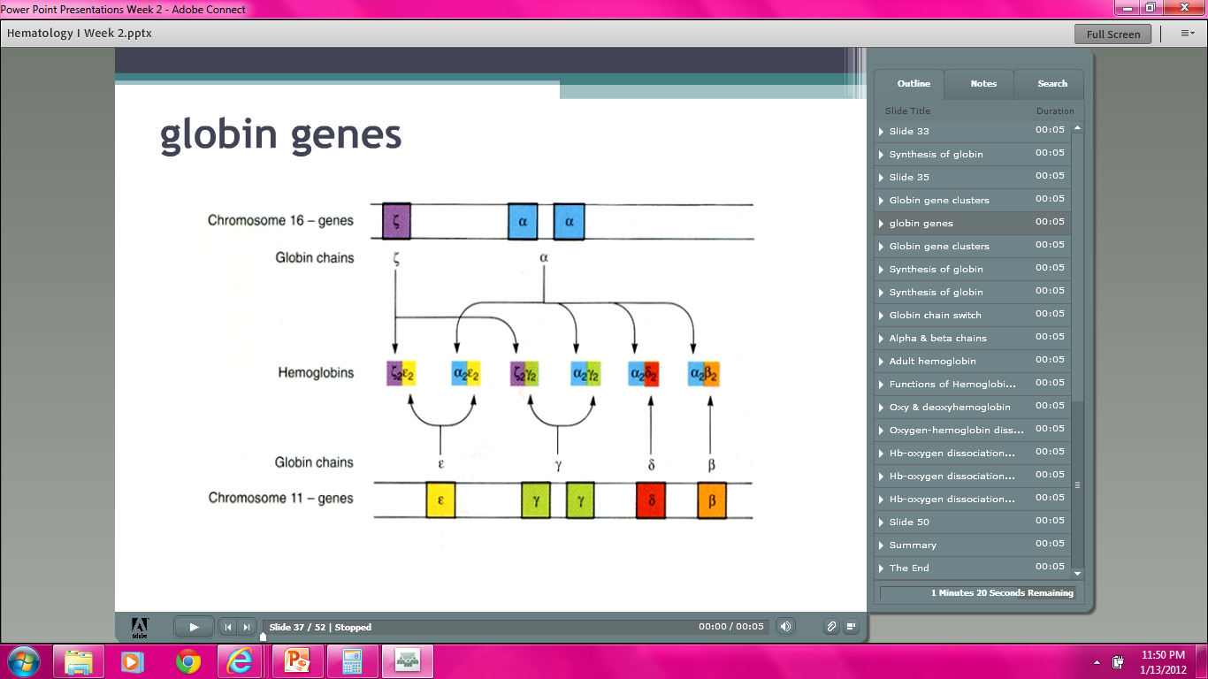

Slide 50
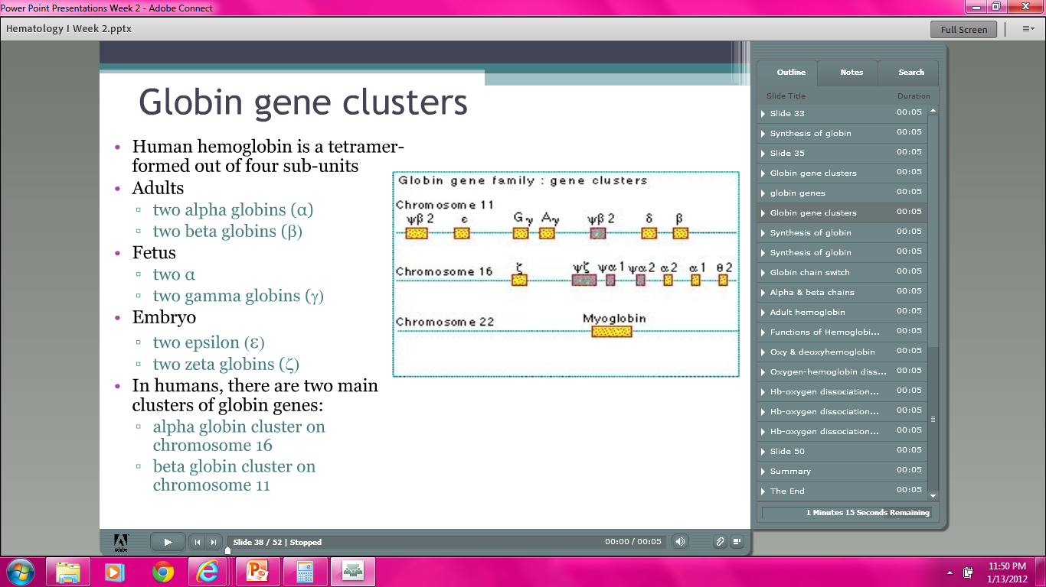

Slide 51
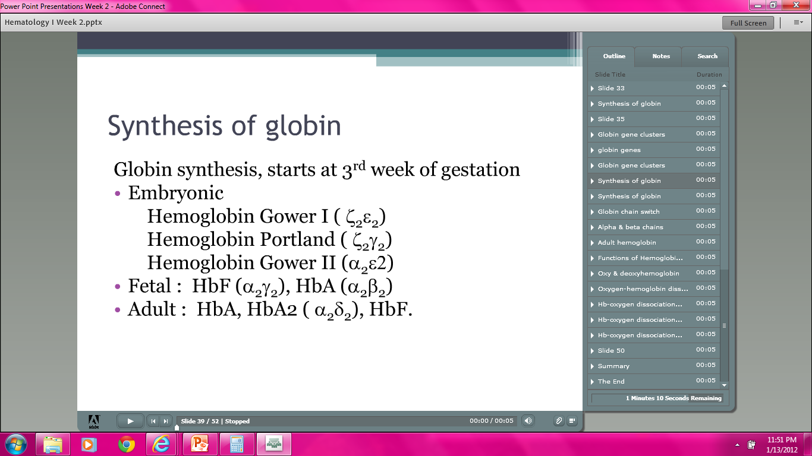

Slide 52
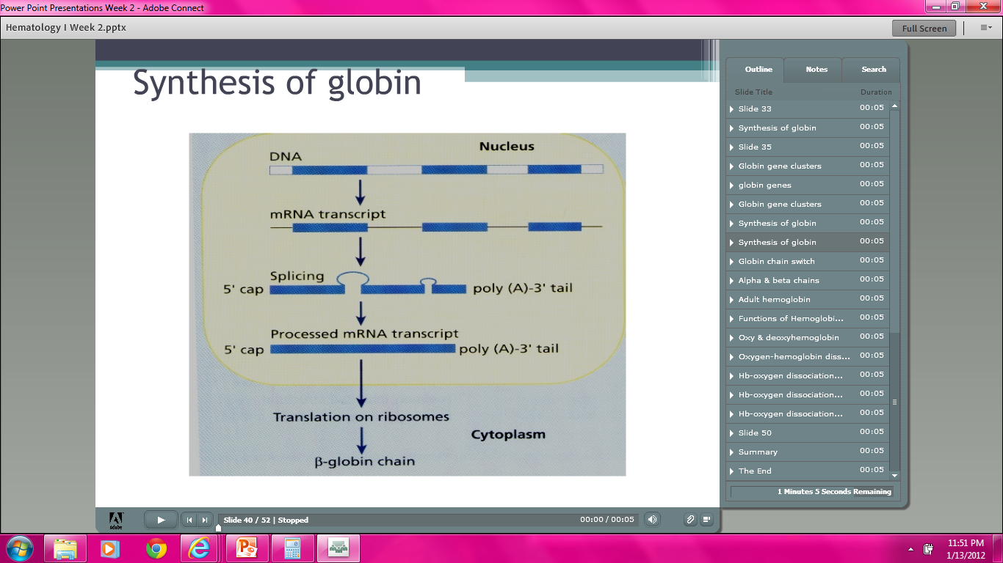

Slide 53
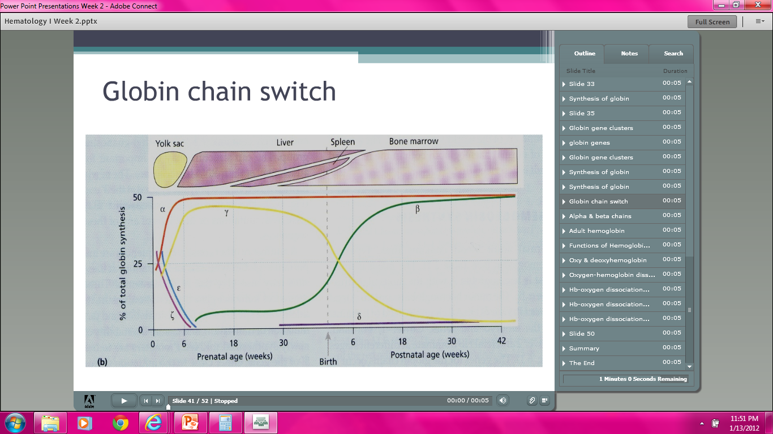

Slide 54
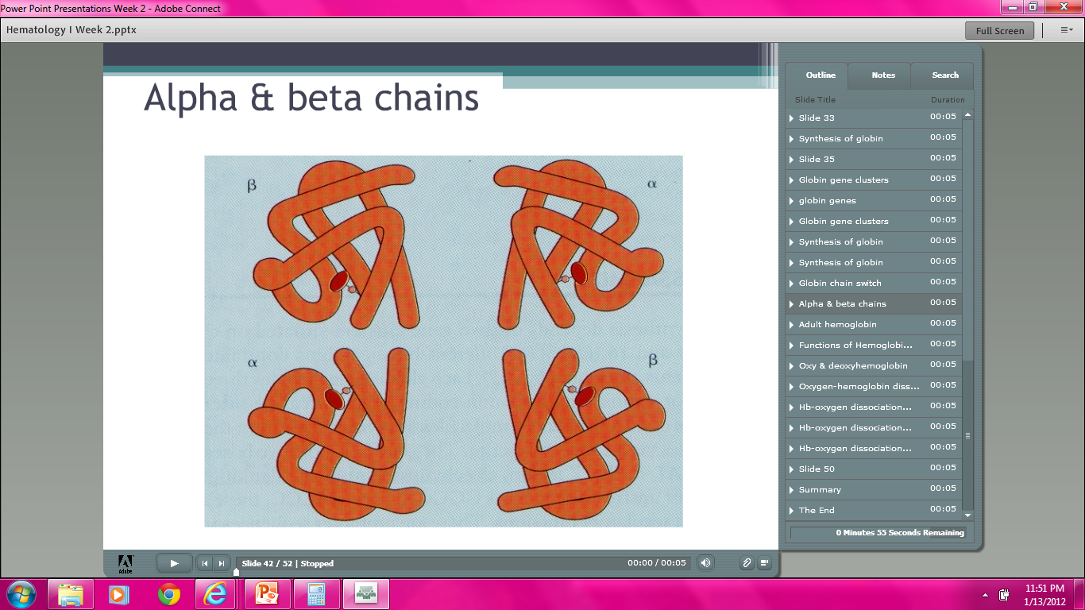

Slide 55
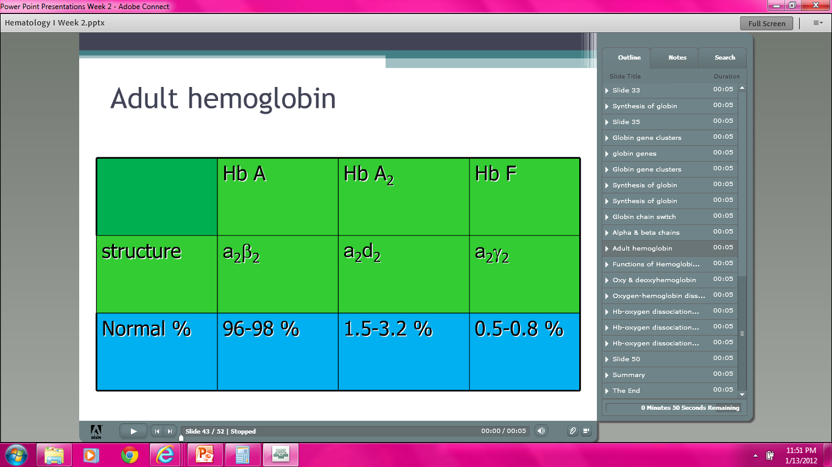

Slide 56
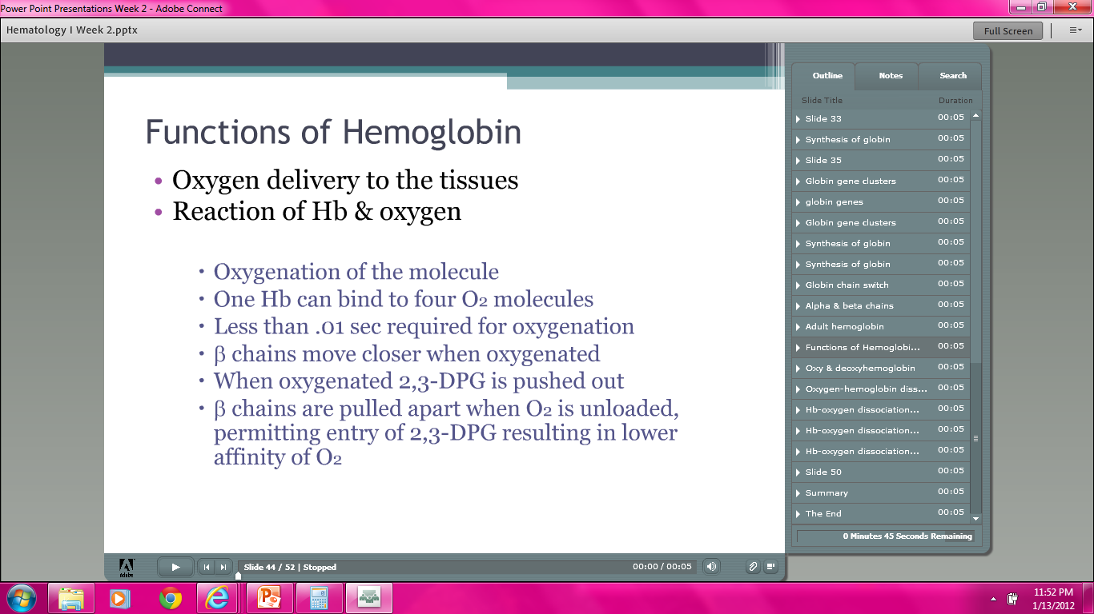

Slide 57
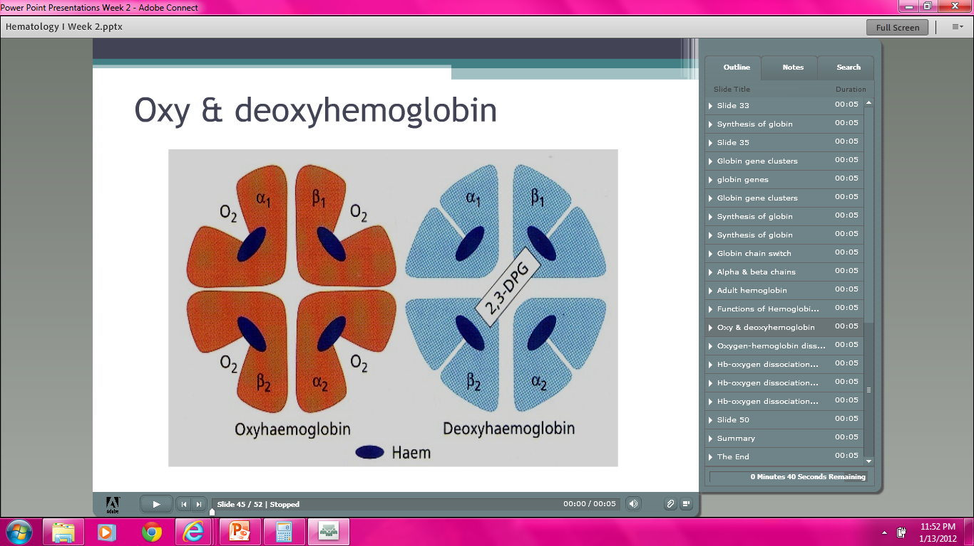

Slide 58
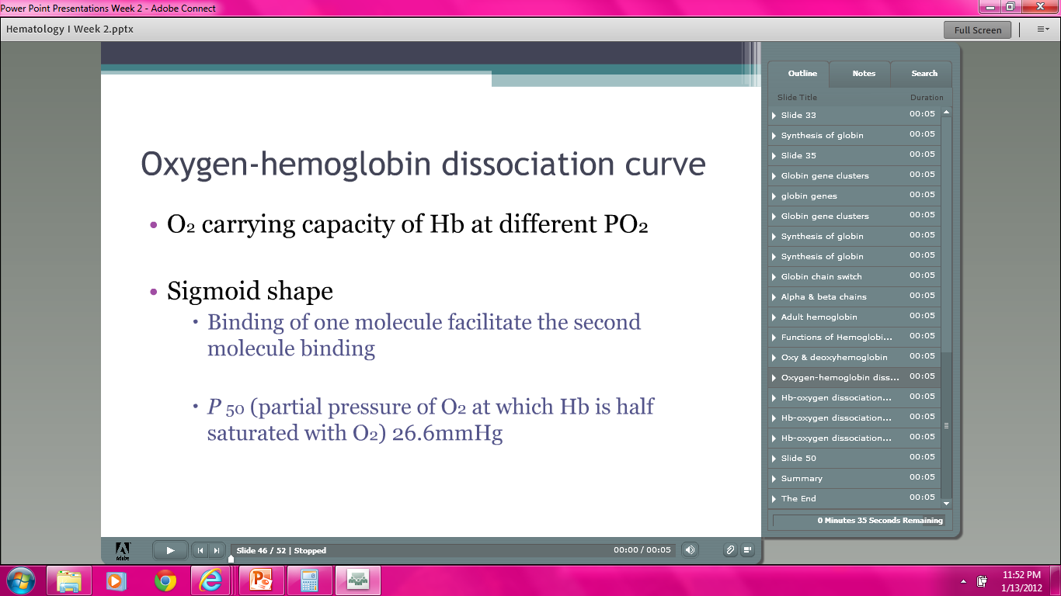

Slide 59
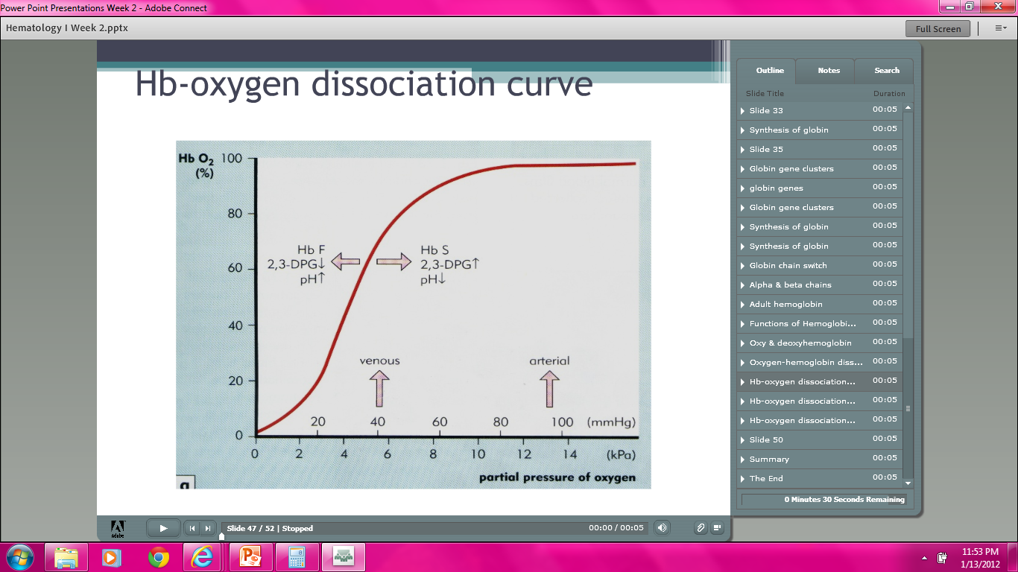

Slide 60
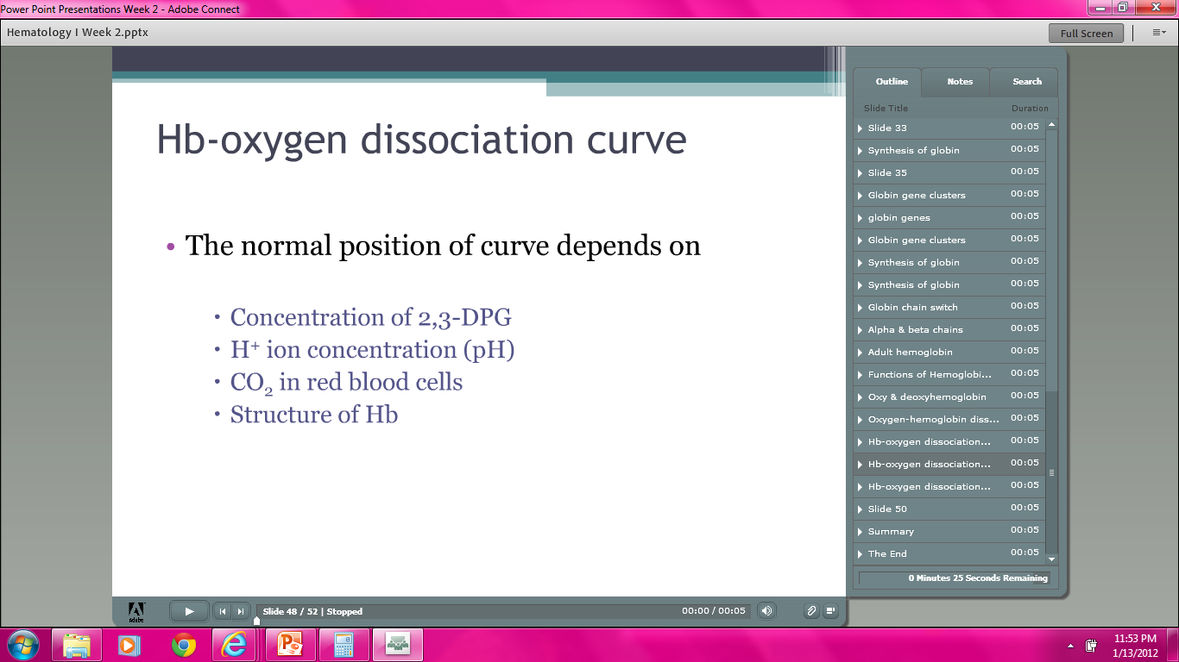

Slide 61


Slide 62


Slide 63


Slide 64


Slide 65


Slide 66


Slide 67


Slide 68
QUIZ BOWL!
FUN!

