Slide 1
Immunohematoloy week 2 Seminar
Christina A Nevel-McGarvey, PhD, MS, MT(ASCP)

Slide 2
Chapter 1 Immunology
Basic Principles and Applications in the Blood Bank

Slide 3
Vocabulary Words
Innate Immunity
Phagocytic cells
Chemical Mediators
Vasodilatation
Edema
Neutrophil
Acquired Immunity
Lymphocytes (T and B)
Mononuclear phagocytes
Antigen Presenting Cell
Polymorphonuclear Leukocytes
Humoral Immunity
Cellular Immunity
Stem Cell
Naïve Lymphocytes
Cytokines
Colony-stimulating factor
Hematopoiesis
Plasma cell
Antibody
Antigen
Antigenic determinants
Epitopes
Clone
Memory cells

Slide 4
Vocab
Affinity Maturation
T helper cells
T cytotoxic cells
Major histocompatibility complex
Cluster of differentiation
CD 4
CD8
Complement
Membrane attack complex
Hemolysis
Classical pathway
Alternative pathway
Anaphylatoxins
Vasoactive amines
Chemotactic
Opsonin
Receptors
Immunogen
Protein>Carb>Lipid
Red Blood Cell Antigens
29 Blood Group Systems!
>250 unique rbc antigens
Glycoproteins
Glycolipids
Agglutination

Slide 5
Vocab
Human Leukocyte Antigens
Allogenic
Refractoriness
Platelet antibodies
Alloantbodies
Immunoglobulin
Heavy Chain, G,A,M,D,E
Light Chain, K,L
Variable Region
Constant Region
Idiotope
Hinge region
Bivalent
Pentameric
Primary Immune Response
Anamnestic Response
Immune Complex
Affinity
Avidity
In vivo
Antibody Screen Test
Mononuclear Phagocyte System
In vitro

Slide 6
Vocab
Sensitization
Lattice Formation
Serum to Cell Ratio
Temperature
Incubation Time
Immmediate Spin
pH
Ionic Strength
Zeta Potential
Zone of Equivalence
Prozone
Postzone
Grading Agglutination Reactions
Direct Antiglobulin Test
Indirect Antiglobulin Test
Autoimmune hemolytic anemia
False Negative
False Positive
Antibody Potentiators
Proteolytic Enzymes
Low Ionic Saline
Bovine Serum Albumin
Polyethylene Glycol

Slide 7
Overview of the Immune System
Innate and acquired immunity
Innate or natural immunity is nonspecific and provides the first line of defense against invading pathogens
The innate response includes phagocytic cells, chemical mediators, and promotion of the inflammatory response

Slide 8
Inflammation
Inflammation is marked by the following:
Vasodilation: Increased blood flow and increased temperature to an area
Edema: Increased capillary permeability with an increase in fluid
Phagocyte migration into tissue: With accumulation of neutrophils in the area of injury

Slide 9
Acquired Immunity
In acquired or adaptive immunity, a specific response is enlisted
The cells involved have the ability to recognize the specific agent and mount a powerful response

Slide 10
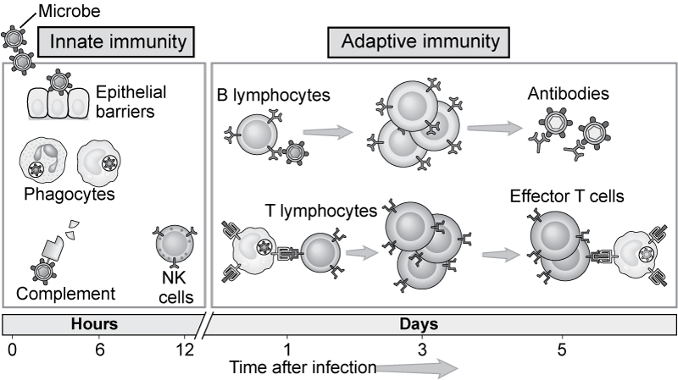
Figure 1-1
From Abbas AK, Lichtman AH: Basic immunology, ed 2, Philadelphia, 2004, Saunders.

Slide 11
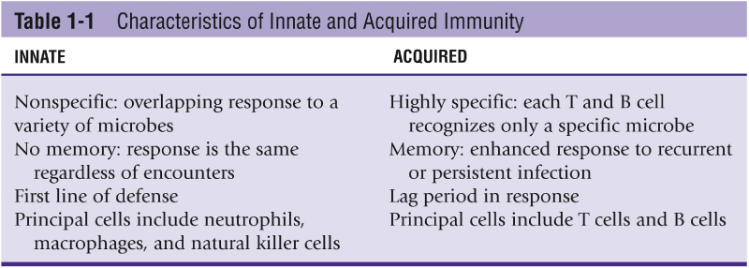
Table 1-1

Slide 12
Cells and Mediators of the Immune System
Mononuclear phagocytic cells
Monocytes in the blood
Macrophages in tissues
Macrophages are antigen-presenting cells (APCs) because they present foreign material to lymphocytes that will initiate the adaptive immune response

Slide 13
Lymphocytes
The adaptive immune system depends on lymphocytes, particularly T lymphocytes and B lymphocytes
T lymphocytes (T cells) generally combat intracellular pathogens. T-cell activity is usually referred to as cellular immunity
B lymphocytes (B cells) clear extracellular material and are part of humoral immunity

Slide 14
Stem Cells
Cells of the immune system are all products of the same stem cells or precursor cells originating in the bone marrow
B cells remain in the bone marrow to mature
T cells migrate to and mature in the thymus
Both T and B cells express antigen receptors that can be activated by encountering a matching antigen

Slide 15
B Cells – Humoral Immunity
Once a B cell encounters its matching antigen, it changes into an activated B cell, or plasma cell
The plasma cell manufactures antibodies that specifically target the antigen that elicited the response
Antibodies are found in body fluids. Humoral is derived from the Latin term humor, meaning “body fluid”

Slide 16
T Cells – Cell-Mediated Immunity
There are two types of T cells, each with unique surface receptors and functions
T helper cells recognize and interact with antigen and produce cytokines that activate and help other cells, such as B cells and T cytotoxic cells in the immune response
T cytotoxic cells are involved in the direct destruction of viral infected cells, tumor cells, and cells of foreign tissue

Slide 17
Lymphocyte Differentiation
Lymphocytes are differentiated by reagents that react with the lymphocyte’s unique membrane molecules and are grouped into a common cluster of differentiation (CD)
A lymphocyte with a CD4 marker functions as a T helper cell
T cytotoxic cells have a CD8 marker

Slide 18
CD4-to-CD8 Ratio
The ratio of CD4 to CD8 T cells is normally 2:1
This ratio is altered in acquired immunodeficiency disease or autoimmune disease

Slide 19
Cytokines
Cytokines are molecules that are released by a variety of cells involved in the immune response
Cytokines function as signals between cells
Cytokines may regulate the intensity of a reaction, initiate inflammation, cause fever, and stimulate the bone marrow to produce more cells

Slide 20
Complement Proteins
A group of proteins that have a number of biological roles, including:
Antigen clearance
Cell lysis
Vasodilatation

Slide 21
Complement and Cell Lysis
Nine components of complement: C1-C9
Activation of C1q creates a cascade reaction that results in the final formation of a membrane attack complex that causes cell lysis
The classical pathway is activated by antibody-bound antigen. The alternative pathway does not require antibody for activation

Slide 22
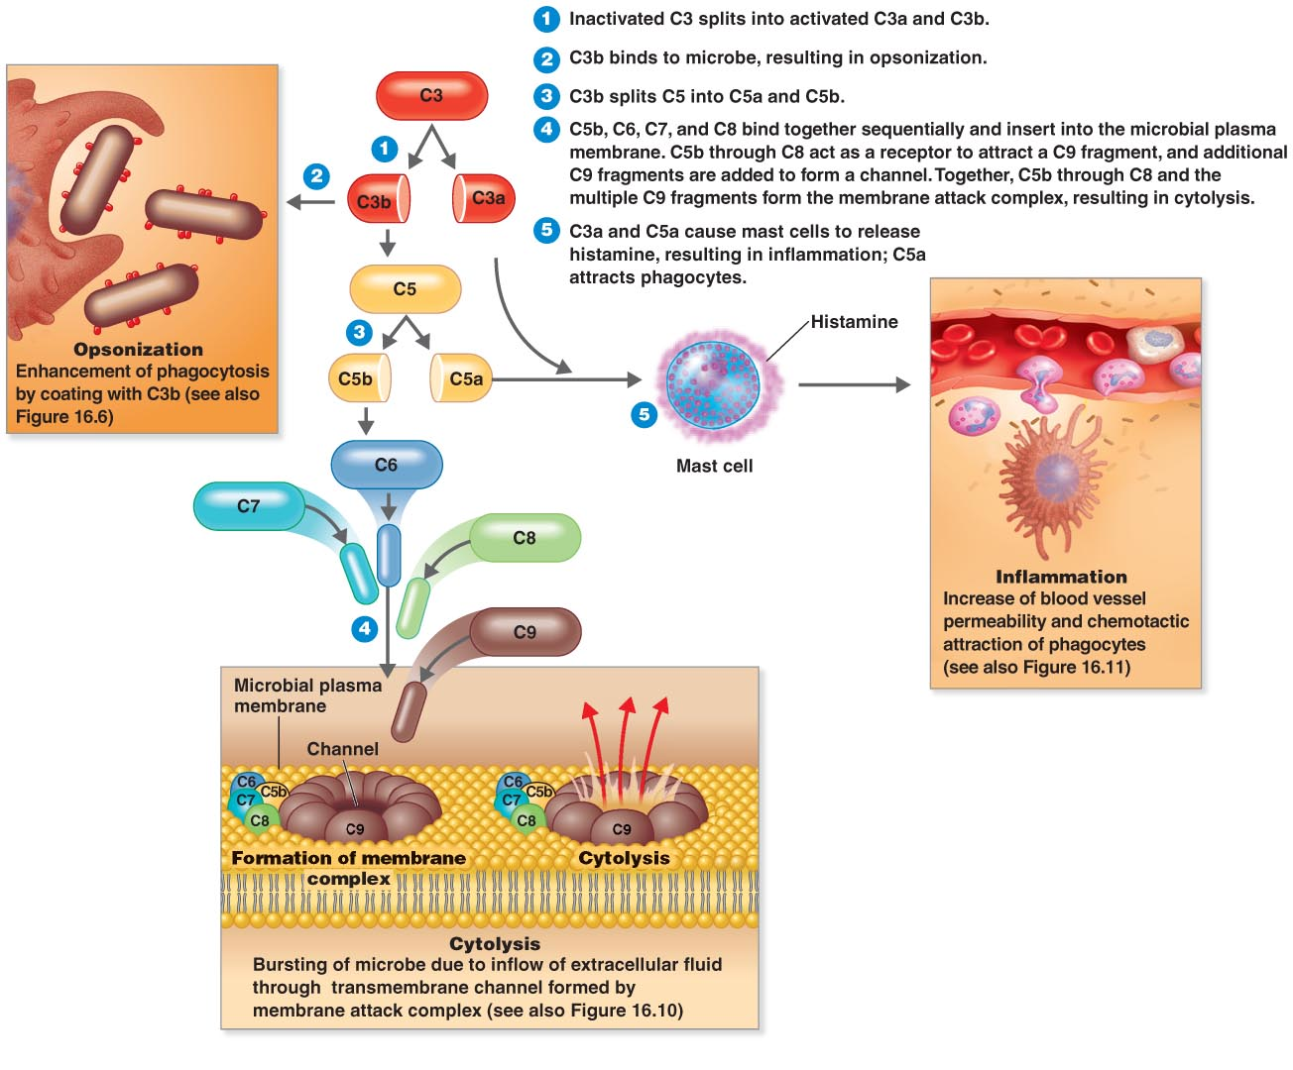
The Complement System
Figure 16.9

Slide 23
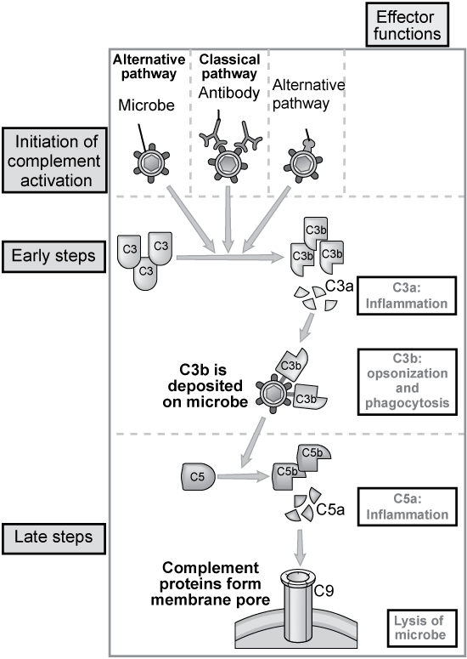
Figure 1-7
From Abbas AK, Lichtman AH: Basic immunology, ed 2, Philadelphia, 2004, Saunders.

Slide 24
Characteristics of Antigens
Can also be called immunogens because they elicit an immune response
Combine with an antibody or T cell
Proteins are the most immunogenic, followed by carbohydrates
Lipids tend to be inert

Slide 25
Specific Classes of Antigens
Red cell antigens; more than 250 unique red cell antigens have been recognized
Human leukocyte antigens are found on the surface of nucleated cells
Platelet antigens can also elicit a response

Slide 26
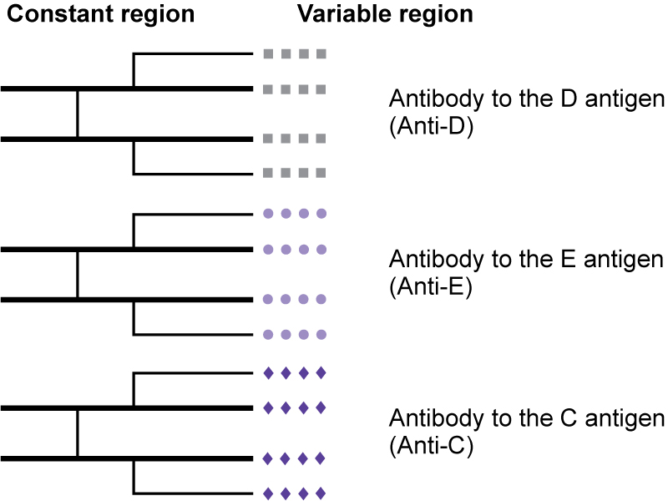
Characteristics of Antibodies
Consist of two pairs of polypeptide chains
Contain one pair of heavy chains, which determine the classification
Five classifications: IgG, IgA, IgM, IgD, and IgE
One pair of light chains
Light chains are of two types: kappa or lambda

Slide 27
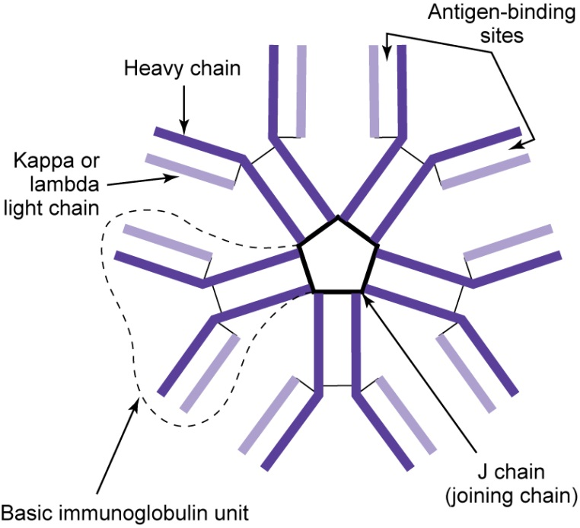
Ig M Antibodies
The first class of antibody produced by B cells or plasma cells when an antigen is encountered
Is referred to as a pentamer because it is made up of five basic units held together by a J chain
Capable of agglutination of red cells in saline
Constitute 5% to 10% of total serum antibody

Slide 28
Ig G Antibodies
Consist of a single four-chain unit
Not effective in agglutinating red cells in saline
Can cross the placenta and cause hemolytic disease of the fetus and newborn (HDFN)
Constitute 80% of antibody concentration in serum

Slide 29
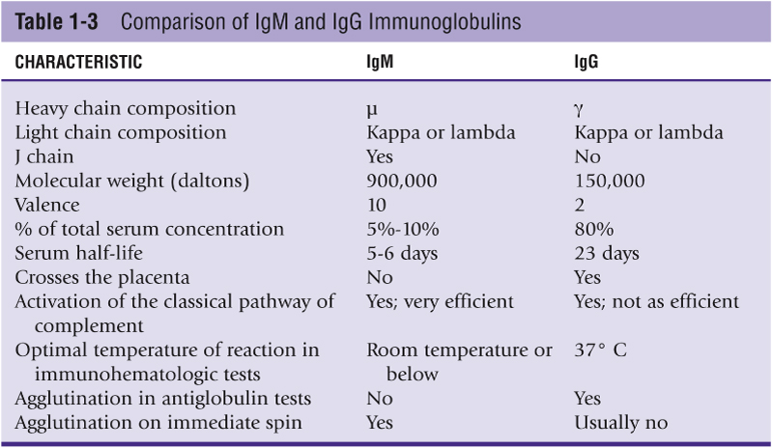
Table 1-3

Slide 30
Primary and Secondary Immune Response
A primary response is elicited on first exposure to a foreign antigen
Lag phase of 5 to 7 days before antibody can be detected in the host
Following the lag period, antibody levels rise, plateau, and then decline
IgM antibodies are produced first; then IgG are produced

Slide 31
Secondary Immune Response
Also known as an anamnestic response because there are memory cells
Within 1 to 2 days of antigen exposure, there is a significant amount of antibody production
The principal antibody is IgG, unlike a primary response, in which IgM is the principal antibody
1000 times more antibody and a slow decline

Slide 32
Properties That Influence Antigen-Antibody Binding
Goodness of fit
Strength and rate of reaction
Size, shape, and charge
Affinity: The strength of binding between a single antibody and epitope of an antigen
Avidity: The overall strength of reactions between several epitopes and antibodies

Slide 33
Antibody-Antigen Reactions In Vivo
Transfusion of blood and blood products can expose a recipient to potentially foreign antigens on red cells, white cells, and platelets
Immunization can also occur during pregnancy when fetal blood cells cross the placenta

Slide 34
Antigen-Antibody Reactions In Vitro
Reactions in laboratory testing are detected by visible agglutination or evidence of hemolysis
The first stage of in vitro antibody-antigen binding is usually not visible
The first stage is influenced by cell-to-serum ratio, temperature, incubation time, pH, and ionic strength

Slide 35
Lattice Formation
Crosslinking of antibody-coated red cells is necessary for visualization of red cell agglutination; for this to occur, the following factors are important:
Distance between red cells must overcome the zeta potential (the force of repulsion between red cells in a saline solution)
Optimal amounts of antibody and antigen

Slide 36
Zone of Equivalence
Maximum agglutination occurs when the concentrations of antibodies and antigens fall within the zone of equivalence
A prozone occurs when the concentration of antibody exceeds antigen concentration
A postzone occurs when the concentration of antigen exceeds antibody concentration

Slide 37
Grading Agglutination Reactions
Time and speed of centrifugation are important
Reactions are graded on a 0 to 4+ scale
Hemolysis is also an indicator of antigen-antibody reactions

Slide 38
Antiglobulin Testing
The test is based on a reagent prepared by injecting animals such as rabbits with human antibody and complement proteins
The animals produce antibodies to the human antibodies and complement proteins
These antibodies, called antihuman globulin (AHG), will react with human antibody and complement on red cells or in serum

Slide 39
Direct Antiglobulin Testing (DAT)
Used to identify red cells that have been sensitized to IgG or complement in vivo
Cells must be thoroughly washed to ensure that all excess antibody is removed so as not to neutralize the AHG (Coombs) reagent
Used to investigate autoimmune hemolytic anemia, HDFN, transfusion reactions, and drug-related mechanisms

Slide 40
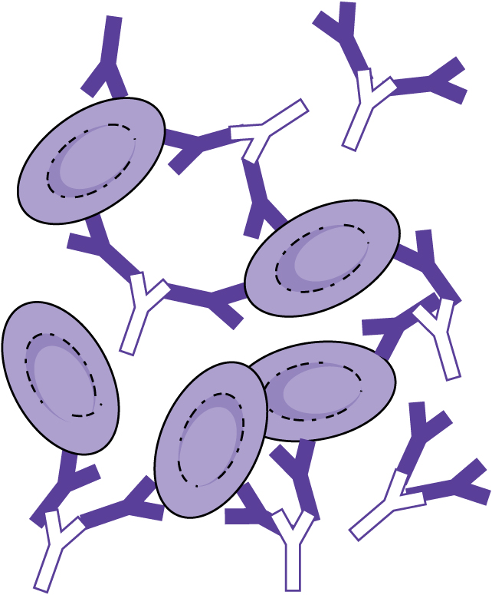
Figure 1-19
Modified from Stroup MT, Treacy M: Blood group antigens and antibodies, Raritan, NJ, 1982, Orthro Diagnostic Systems, Inc.

Slide 41
Indirect Antiglobulin Test (IAT)
Designed to detect in vitro sensitization of red cells
Two-step method by which serum is incubated at body temperature, with a red cell source allowing for binding of antibody
Excess antibody is thoroughly washed, and the AHG reagent is added
Aggultination indicates a positive result

Slide 42
Applications of IAT
Antibody screening
Antibody identification
Compatibility testing
Antigen typing

Slide 43
Sources of Error in Antiglobulin Testing
False negatives
False positives
Common sources of error include inadequate washing of cells, failure to add reagent, improper centrifugation, and cell suspension not being 2% to 5% concentration
Auto control must be run

Slide 44
Antibody Potentiators
Reagents are selected to adjust the in vitro environment and promote agglutination and include:
Low–ionic strength solution, increases rate of binding
Bovine serum albumin, reduces zeta potential
Polyethylene glycol additive, concentrates antibody
Proteolytic enzymes, reduce zeta potential

Slide 45
QUIZ BOWL
FUN!

Slide 46
Why do ig M antibodies have the ability to directly aggutinate rbc’s and cause visible agglutination?
A. IgM antibodies are larger molecules an have the ability to bind more antigen
B. IgM antibodies tend to clump together more readily to bin more antigen
C. IgM antibodies are found in greater concentrations than IgG molecules
D. IgM antibodies are not limited by subclass specificity

Slide 47
Why do ig M antibodies have the ability to directly aggutinate rbc’s and cause visible agglutination?
A. IgM antibodies are larger molecules an have the ability to bind more antigen
B. IgM antibodies tend to clump together more readily to bin more antigen
C. IgM antibodies are found in greater concentrations than IgG molecules
D. IgM antibodies are not limited by subclass specificity

Slide 48
Which of the following enhancement mediums descreases the zeta potential allowing antibody an antigen to come closer together?
A. Low Ionic Saline Solution
B. Polyethylene glycol
C. Anti human globulin

Slide 49
Which of the following enhancement mediums descreases the zeta potential allowing antibody an antigen to come closer together?
A. Low Ionic Saline Solution
B. Polyethylene glycol
C. Anti human globulin

Slide 50
This type of antibody response is analogous to an anamnestic antibody reaction:
A. Primary
B. Secondary
C. Tertiary
D. Anaphylactic

Slide 51
This type of antibody response is analogous to an anamnestic antibody reaction:
A. Primary
B. Secondary
C. Tertiary
D. Anaphylactic

Slide 52
Which antibodies to a component of complement are contained in the rabbit polyspecific antihuman globulin reagent for Detection of in vivo sensitization?
A. Anti-IgG and anti-C3a
B. Anti-Ig G and anti-C3d
Anti-IgG and anti-IgM
All of the above

Slide 53
Which antibodies to a component of complement are contained in the rabbit polyspecific antihuman globulin reagent for Detection of in vivo sensitization?
A. Anti-IgG and anti-C3a
B. Anti-Ig G and anti-C3d
Anti-IgG and anti-IgM
All of the above

Slide 54
In a hemagglutination test, the antigen is
A. Secreted by the red cell
B. In the plasma or serum
C. On the red cell membrane
D. In the red cell nucleus

Slide 55
In a hemagglutination test, the antigen is
A. Secreted by the red cell
B. In the plasma or serum
C. On the red cell membrane
D. In the red cell nucleus

Slide 56
Hemaglutination can be enhance by increasing
A. The temperature above 37 degrees C
B. The incubation time
C. Antigen concentrations
D. pH above 7

Slide 57
Hemaglutination can be enhance by increasing
A. The temperature above 37 degrees C
B. The incubation time
C. Antigen concentrations
D. pH above 7

Slide 58
Why are patient red cells washed before the addition of antihuman globulin reagents in the direct Antiglobulin test?
A. To remove traces of bacterial proteins
B. To wash away traces of free hemoglobin
C. To expose additional antigen sites
D. To remove unbound serum proteins

Slide 59
Why are patient red cells washed before the addition of antihuman globulin reagents in the direct Antiglobulin test?
A. To remove traces of bacterial proteins
B. To wash away traces of free hemoglobin
C. To expose additional antigen sites
D. To remove unbound serum proteins

Slide 60
The indirect antiglobulin test requires incubation at 37. What is the purpose of this step?
A. To allow time for IgM antibodies to attach to antigens on the rbc
B. To allow time for IgG antibodies to attach to antigens on the rbc
C. To allow time for the antiglobulin reagent to react with the rbc
D. To allow time for neutralization of AHG reagent

Slide 61
The indirect antiglobulin test requires incubation at 37. What is the purpose of this step?
A. To allow time for IgM antibodies to attach to antigens on the rbc
B. To allow time for IgG antibodies to attach to antigens on the rbc
C. To allow time for the antiglobulin reagent to react with the rbc
D. To allow time for neutralization of AHG reagent

Slide 62
How does peg enhance the agglutination reaction?
A. It increases the dielectric constant of the medium
B. It reduces the net negative charge on the re cells
C. It concentrates the antibodies in the test environments
D. It reduces the pH of the test environment

Slide 63
How does peg enhance the agglutination reaction?
A. It increases the dielectric constant of the medium
B. It reduces the net negative charge on the re cells
C. It concentrates the antibodies in the test environments
D. It reduces the pH of the test environment

Slide 64
How does ficin enhance the antigen-antibody complex formation?
A. By removing negative charges from the red cell membrane
B. By reducing the ionic strength of the test environment
C. By forming a bridge between sensitized red cells
By reducing the pH of the test environment

Slide 65
How does ficin enhance the antigen-antibody complex formation?
A. By removing negative charges from the red cell membrane
B. By reducing the ionic strength of the test environment
C. By forming a bridge between sensitized red cells
By reducing the pH of the test environment

Slide 66
The end! Good night!

