Slide 1
Immunohematology Week 3 Seminar
Christina A Nevel-McGarvey, PhD, MS, MT(ASCP)

Slide 2
LAST SEMESTER’s Week 1 Quiz
Review

Slide 3
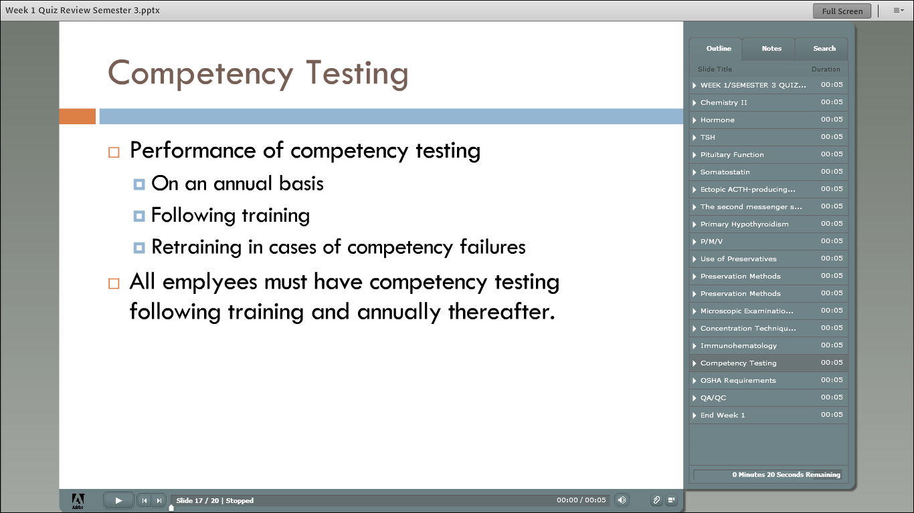

Slide 4
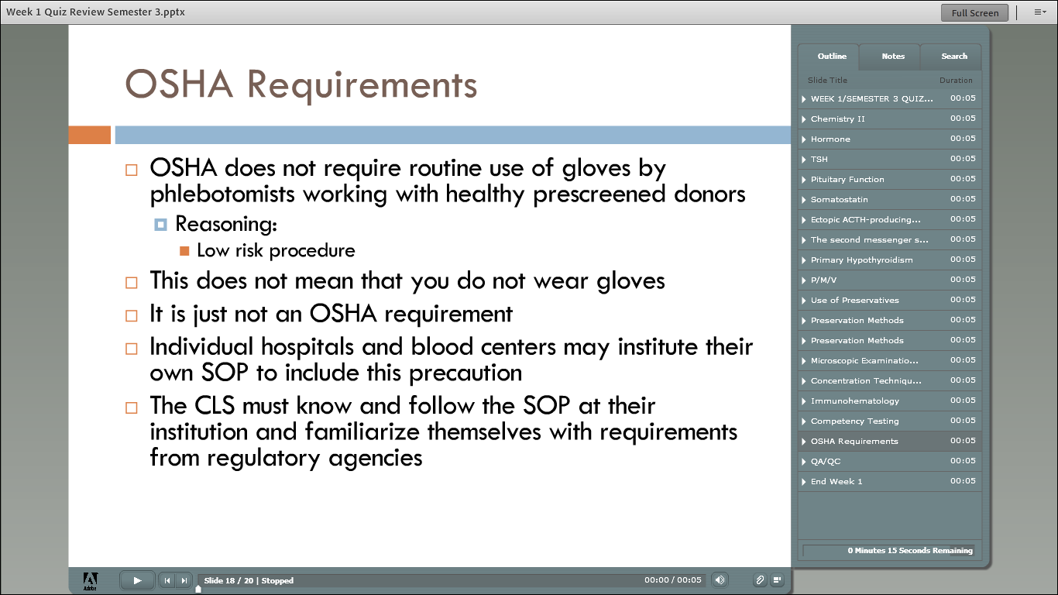

Slide 5
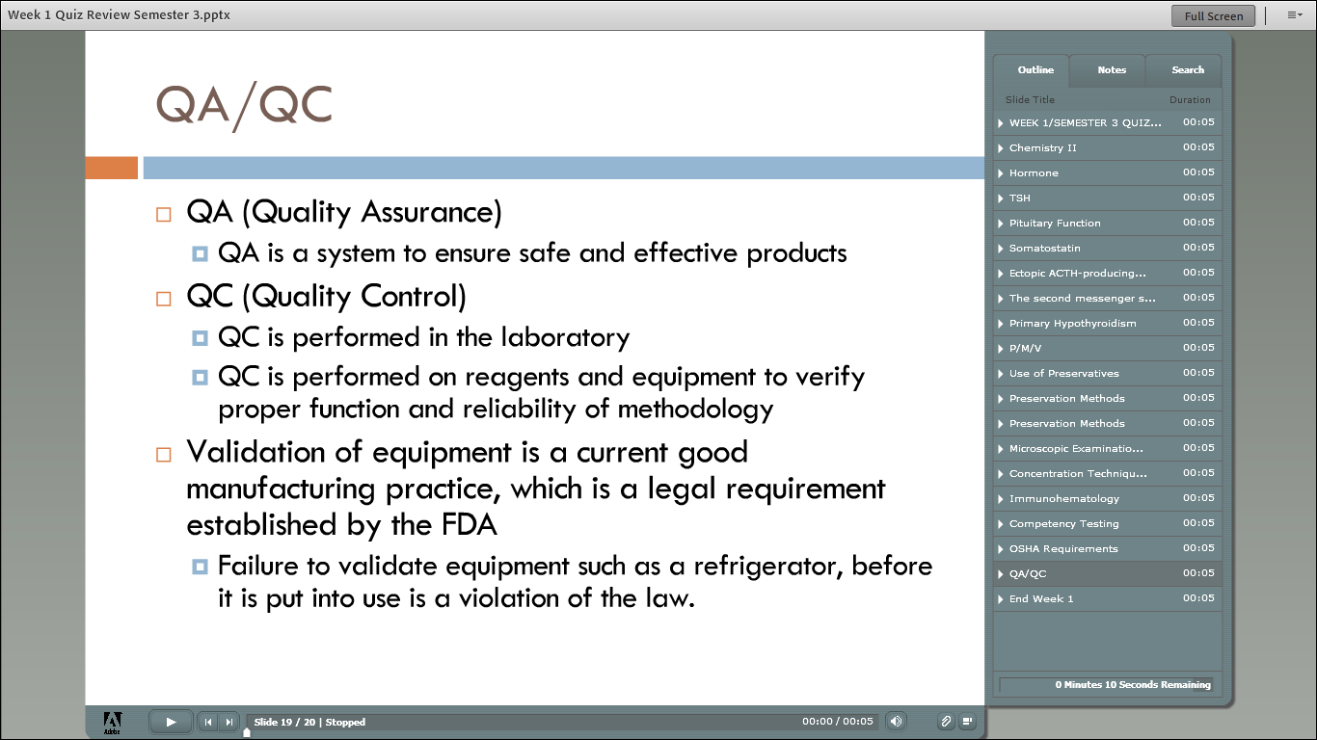

Slide 6
LAST SEMESTER’s Week 2 Quiz
Review

Slide 7
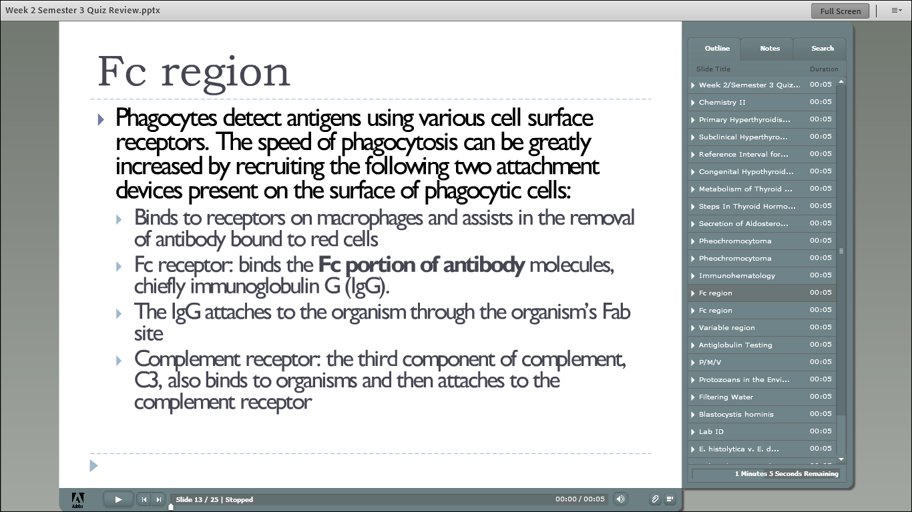

Slide 8
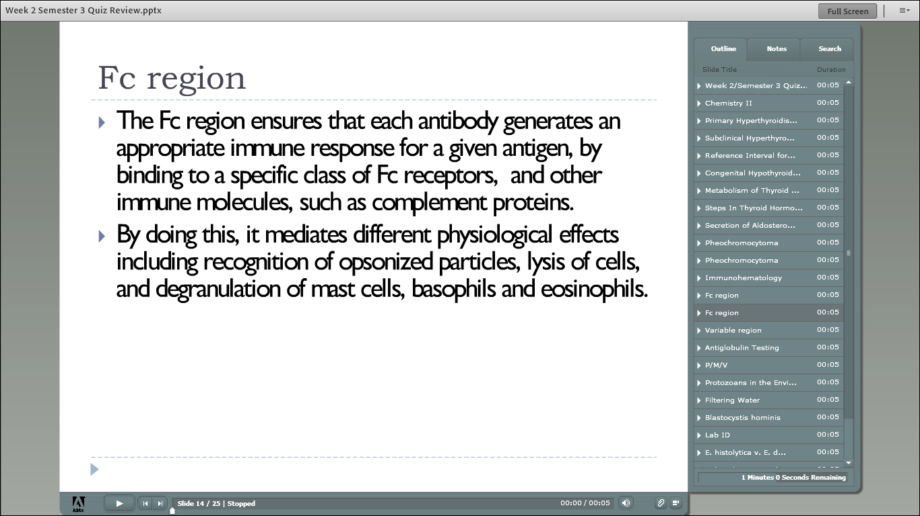

Slide 9
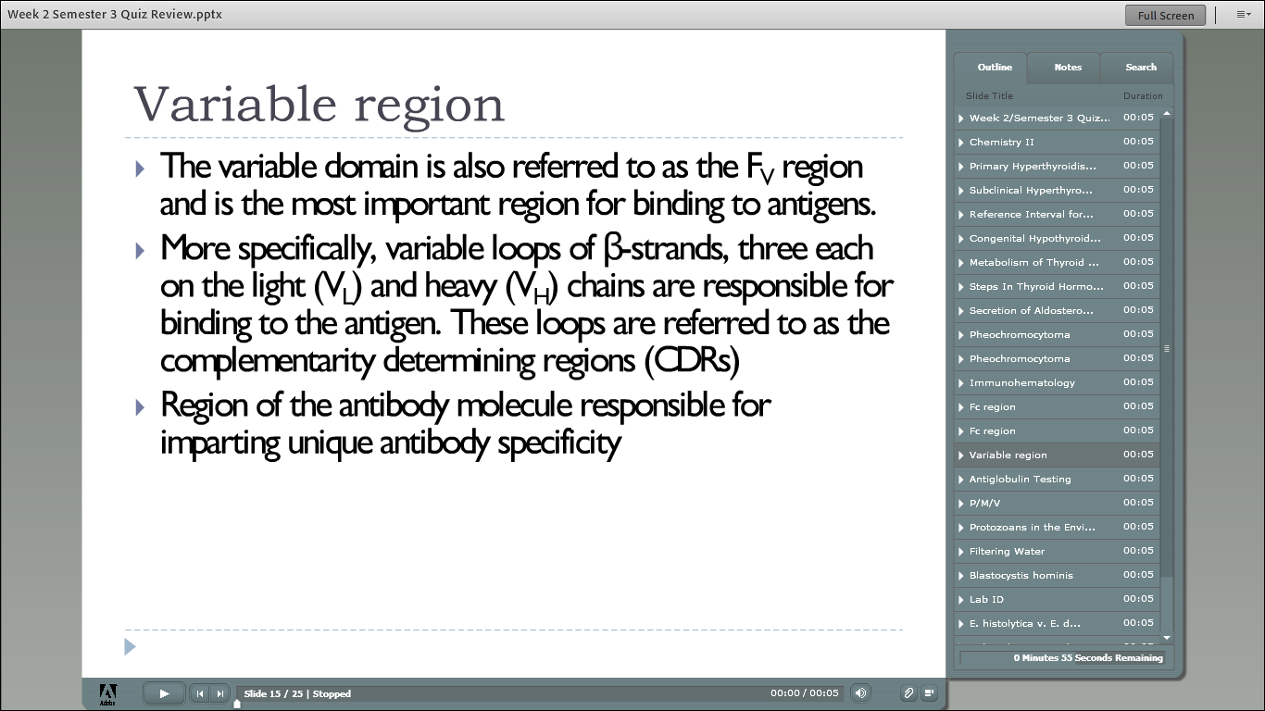

Slide 10
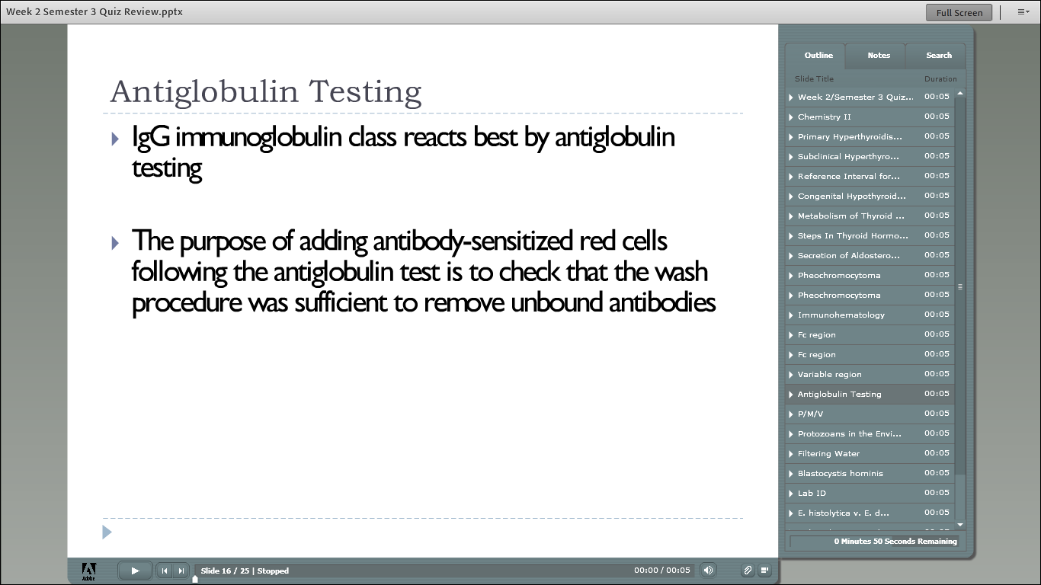

Slide 11
Week 3 Vocabulary
REVIEW

Slide 12
Week 3 Vocab Review
Antibody Screen
Antibody Identification
Crossmatch
Food and Drug Administration
Specificity
Potency
Standard Operating Procedures
Quality Control
Polyclonal Antisera
Monoclonal Antisera
Hybridoma
AABB
Immediate Spin Phase
ABO Antibodies
Blue???
Yellow???
Standards for Blood Banks and Transfusion Services
High Protein Reagents
Low Protein Reagents
Autoantibodies
Polyspecific AHG
Differential DAT
Monospecific AHG

Slide 13
Week 3 Vocab Review
Intravascular Hemolysis
Extravascular Hemolysis
Recipient
Antigram
Lectin
Blood Group Systems
Chromosomes
Mitosis
Meiosis
Phenotype
Genotype
Pedigree Chart
Punnett Square
Genes
Genetic Loci
Alleles
Antithetical
Polymorphic
Dominant
Recessive
Codominant
Amorphic

Slide 14
Week 3 vocab review
Independent Segregation
Independent Assortment
Autosomes
Homozygous
Heterozygous
Dosage Effect
Cis
Trans
Linked
Haplotypes
Linkage Disequilibrium
Crossing Over
Suppressor Genes
Gene Frequencie
Combined Phenotype Calculation
Parentage Teting
Direct Exclusion
Alleged Father
Indirect Exclusion
Paternity Index
Random Man
Nucleotides
Hybridization
Nucleic Acid Probe
Amplification/Mplicon

Slide 15
Chapter 2 Blood Banking Reagents
Overview & Applications

Slide 16
Routine Testing
Based on the principle of placing a source of antigen and a source of antibody and detecting a reaction
Sources of antigen include reagent, patient, and donor red cells
Sources of antibody include commercial antisera containing known antibodies and patient serum or plasma

Slide 17
Routine Testing Procedures
Procedures include:
ABO and D testing for A, B, and D antigens
ABO serum testing for ABO antibodies
Antigen testing in patient and donor samples
Antibody screen for preformed antibody as a result of pregnancy or previous transfusions

Slide 18
Routine Procedures (cont’d)
Also include:
Antibody identification of antibodies detected during the antibody screen procedure
Crossmatch is the serologic check of compatibility between a donor unit and the patient before transfusion

Slide 19
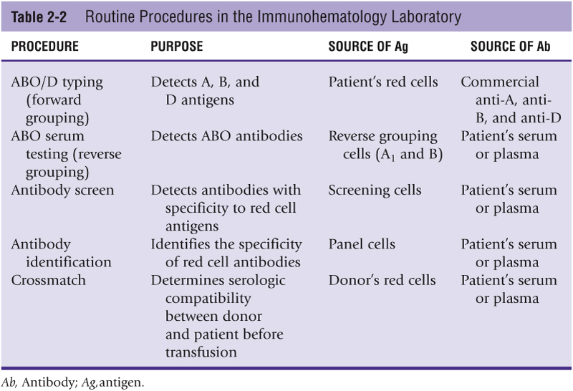
Table 2-2

Slide 20
Regulation of Reagent Manufacture
Commercial antisera and reagent red cell products are licensed by the FDA
Products must meet minimum standards for specificity and potency
Laboratory standard operating procedures are written to reflect manufacturer product inserts

Slide 21
Quality Control Programs
Include:
Criteria for acceptable reagent performance
Documentation of reagent use
Appropriate corrective actions for reagents that do not meet performance requirements

Slide 22
Polyclonal and Monoclonal Reagents
Polyclonal reagents are usually derived from the injection of animals or humans with purified antigens
The polyclonal product contains several clones of B-cell antibody
Monoclonal antibody is a created clone that contains antibodies of a defined specificity
Monoclonal antibody is produced in vitro

Slide 23
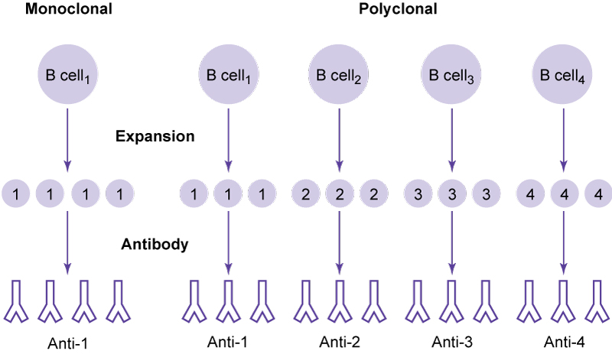
Figure 2-3

Slide 24
Reagents for ABO Antigen Typing
Anti-A and anti-B commercial sera are used to determine A or B antigens on donor or patient (unknown antigen) red cells
Originally used polyclonal reagents pooled from human plasma
Today commercial sera is monoclonal
Anti-A has blue dye and anti-B has yellow dye added

Slide 25
Reagents for Rh Antigen Typing
D is the most important Rh antigen in routine blood bank testing
Two types of reagent sources: high protein and low protein
High-protein reagents were the first used and contained human polyclonal sources
Low-protein reagents using monoclonal sera have replaced the high-protein reagents

Slide 26
Antiglobulin Reagents
Polyspecific AHG reagents are used primarily in direct antiglobulin testing (DAT) testing and contain antibodies to both IgG and C3d
Monospecific reagents are prepared by separating the polyspecific products into either IgG AHG or C3d AHG
AHG is commercially available as polyclonal or monoclonal serum based

Slide 27
IgG-Sensitized Cells
The AABB Standards for Blood Banks and Transfusion Services requires a control system for all AHG tests that are interpreted as negative
Commercially prepared type O cells that have been sensitized with IgG are used
Also known as check cells
Ensures in all negative AHG tests that in fact AHG was added, cells were washed sufficiently, and AHG would be able to react
Check cells should give a positive reaction

Slide 28
Reagent Red Blood Cells
Commercial group A1 and group B red cells used to confirm the ABO typing performed on the patient’s red cells
Known as ABO reverse grouping
Patients produce ABO antibodies in their serum directed against the ABO antigens they lack on their red cells
Prepared in a 2% to 5% preservative solution

Slide 29
Screening Cells
Used in antibody screen tests
Obtained from type O individuals
Available as two- or three-vial sets
FDA requires that the cells detect the most clinically significant antibodies

Slide 30
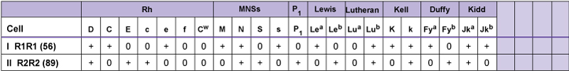
Figure 2-10

Slide 31
Panel Cells
Used to determine the specificity of an antibody when an antibody screen detects the presence of an unexpected antibody
Uses type O donors, like the screening cells
Packaged in sets of 10 or more vials
An antigenic profile of each donor is included

Slide 32
Lectins
Useful alternatives to antisera for blood typing purposes
Derived from plant extracts; no antibody is contained in these reagents
Can be useful in identifying antigens present on patient or donor red cells
One example: A lectin extracted from the seeds of the plant Dolichos biflorus has anti-A₁ specificity

Slide 33
Gel Technology Methods
Gel technology uses dextran acrylamide gel particles to trap agglutinated red cells
The cards are incubated and centrifuged
Phenotyping cards are used for ABO, D, and other Rh typing
AHG cards are used for antibody screen, antibody identification, compatibility testing, and DAT

Slide 34
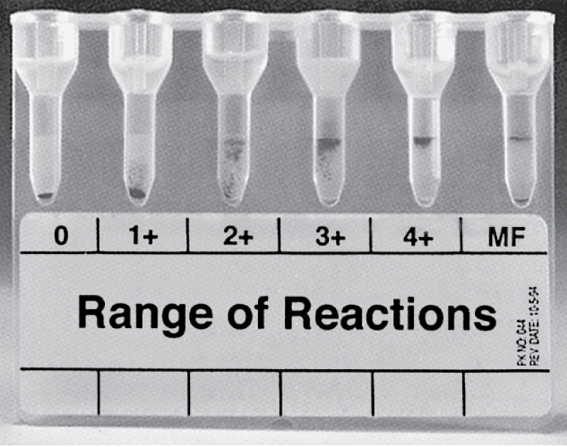
Figure 2-12
Courtesy Ortho-Clinical Diagnostics, Raritan, NJ, and Micro Typing Systems, Pompano Beach, Fla.

Slide 35
Other Methods of Detecting Antigen-Antibody Reactions
Microplate testing uses a plate with 96 wells that substitute for test tubes
Small quantities of serum and red cells are added to the wells and incubated, then centrifuged
The red cell buttons are resuspended and can be read manually or with a photometric device

Slide 36
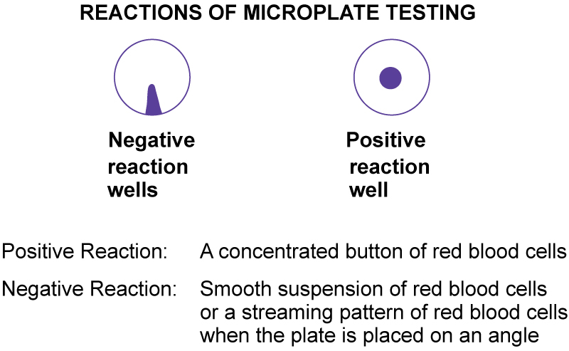
Figure 2-13

Slide 37
Solid-Phase Methods
Solid-phase red cell adherence methods use microplate test wells with immobilized red cells, which are bound to polystyrene and adhered to the microplate
The plates have low ionic solution added and are incubated, washed, and centrifuged

Slide 38
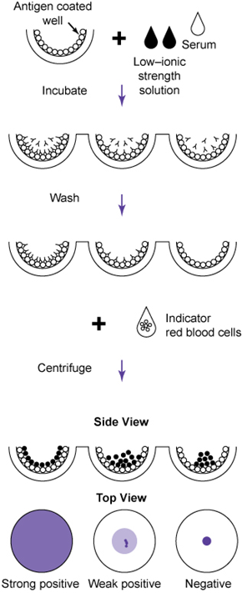
Figure 2-14
Courtesy Immucor, Norcross, Ga.

Slide 39
Chapter 3
Genetic Principles in Blood Banking

Slide 40
Genetic Terminology
Genes are units of inheritance that encode for certain traits or visible characteristics
Genetic information is carried on double strands of DNA known as chromosomes
Chromosomes are found within the nucleus
Humans have 23 pairs of chromosomes: 22 pairs of autosomes and 1 pair of sex chromosomes

Slide 41
Phenotype
Serologic testing determines the presence or absence of antigens on red cells
The phenotype is the physical expression of inherited genes
More specifically, the antigens found on red cells

Slide 42
Genotype
The actual genes inherited from each parent
Can be inferred only from the phenotype
Family studies are required to determine the actual genotype
Predicting the genotype from a phenotype is important in paternity studies or when determining a fetus’ probable phenotype

Slide 43
Pedigree Charts
Examination of family history
Allows the important elements of patterns to become more visibly apparent
Can illustrate the difference between genotype and phenotype

Slide 44
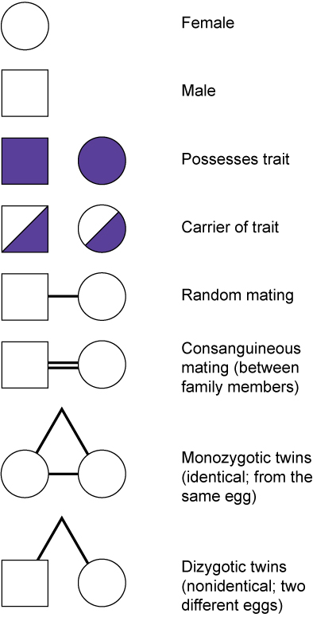
Figure 3-1

Slide 45
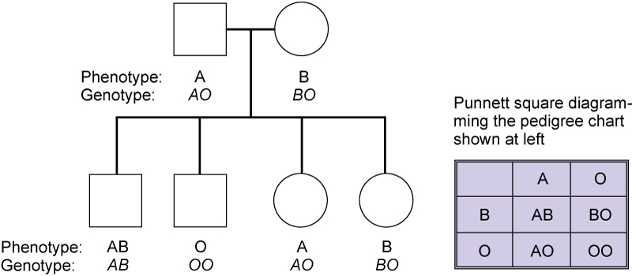
Figure 3-2

Slide 46
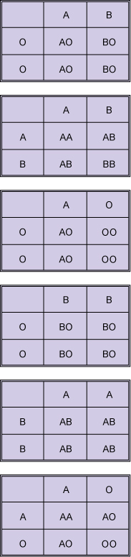
Punnett Squares
Figure 3-4
A Punnett square illustrates the probabilities of phenotypes from known or inferred genotypes
Portrays the potential offspring’s phenotypes or parent’s probable genotype

Slide 47
Genes, Alleles, and Polymorphism
Genes are found in specific locations called genetic loci
Several different forms of a gene called alleles may exist in each locus
For example A, B, and O are alleles on the ABO gene
The term polymorphic refers to a genetic system that expresses two or more phenotypes

Slide 48
Inheritance Patterns
In most cases, blood group antigens are expressed as codominant or the equal expression of both inherited alleles
Recessive or dominant inheritance patterns are uncommon
Amorphic genes do not express any detectable product

Slide 49
Heterozygosity and Homozygosity
Homozygous expression means that both parents contributed the same gene, giving a double dose of antigen
This double dose of antigen in some cases can result in stronger red cell antigen, called dosage effect
Hetrozygosity refers to different blood system alleles from each parent

Slide 50
Gene Frequency
The Hardy-Weinberg law
Statistical formulas used to estimate the frequency of genetic diseases
Establish probability tables for forensic and paternity calculations

Slide 51
Parentage Testing
Red cell and human leukocyte antigens are easily identifiable and follow Mendelian laws of inheritance
Useful in paternity analysis
Even though molecular methods are being used more frequently, blood groups are still very useful

Slide 52
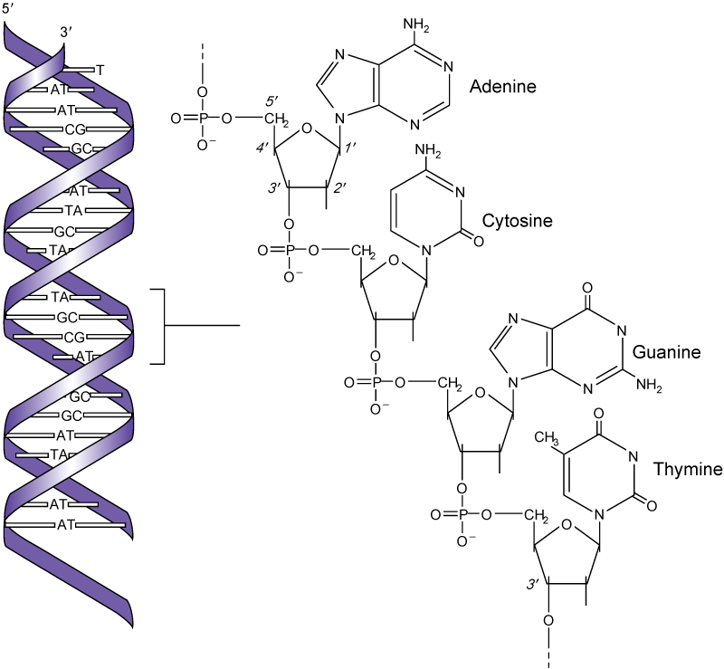
Molecular Genetics
Procedures based on the detection or analysis of DNA or RNA
Before a cell divides, it duplicates its DNA in a process called replication
Figure 3-13
From Gelehrter TD: Principles of medical genetics, Baltimore, 1990, Williams & Wilkins.

Slide 53
Molecular Diagnostic Techniques
Exploit the properties of DNA replication and protein synthesis to identify and synthesize nucleic acids for viral marker and antigen testing
Hybridization is the binding of two complementary pairs of DNA

Slide 54
Nucleic Acid Probe
Short segment of DNA with a known sequence
Can be labeled with a marker such as a radioisotope, a fluorochrome, an enzyme, or a chemiluminescent substrate
Hybridization will take place between the complementary base pairs, and the segment can be identified

Slide 55
Amplification
Amplification techniques replicate the target RNA or DNA sequence, the probe, or the signal
Useful when amount of nucleic acid is low
Polymerase chain reaction (PCR) is an example of an amplification reaction
Used to screen for viral materials; also called nucleic acid testing (NAT)

Slide 56
Restriction Fragment Length Polymorphism Analysis (RFLPs)
Southern blotting

Slide 57
Polymerase Chain Reaction
Biochemical technique that can synthesize millions of copies of a target DNA sequence
Allows for the ability to start out with a small sample
Relatively simple reaction consisting of five components
20 to 40 cycles may be performed
Next the amplicon must be detected

Slide 58
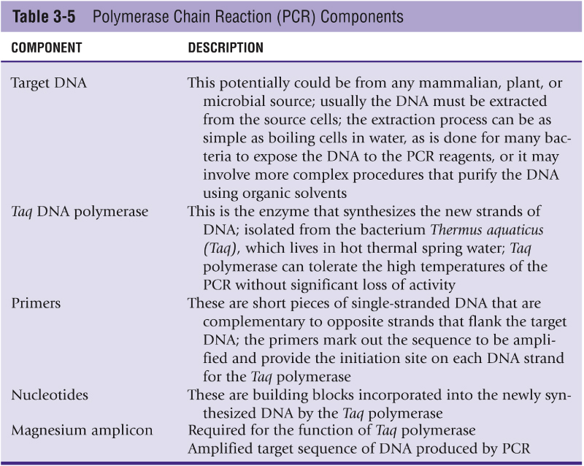
Table 3-5

Slide 59
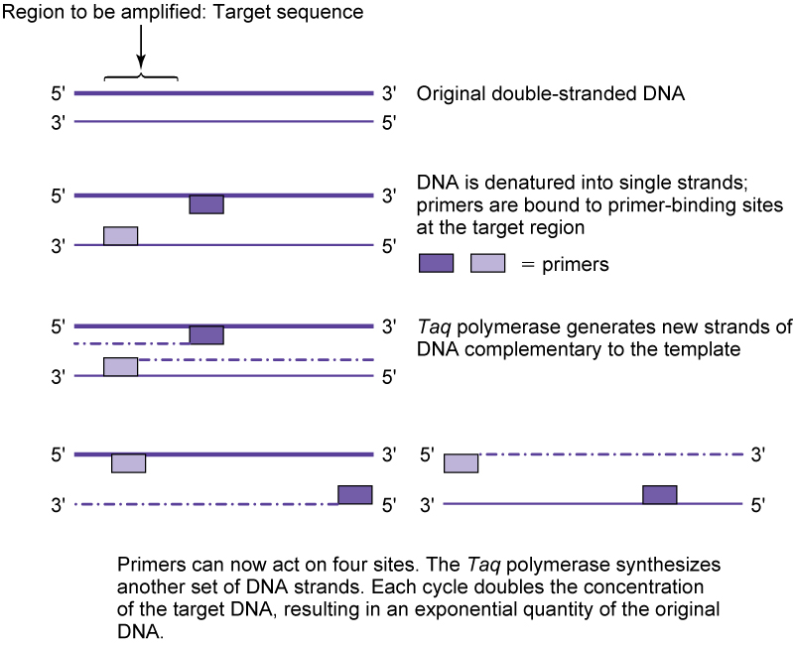
Figure 3-16

Slide 60
Application of Molecular Genetics to Blood Bank
RFLP is used for DNA testing in blood bank settings
Primarily in paternity testing and transplantation studies
PCR methods are beginning to replace RFLP methods, particularly NAT testing for viral agents

Slide 61
Critical thinking questions

Slide 62
EXERCISE 2-1
The quality-control procedure for commercial anti-A and anti-B is performed
by reacting each antiserum with A 1 and B cells. The results of the daily quality
control for ABO reagents for your facility are presented in the following chart.
Do the quality-control results meet acceptable performance criteria, or are they unacceptable for the commercial antisera? Discuss your answer.
Reagent antisera Antisera with Reverse Cells
A 1 cells B cells
Anti-A 4+ 0
Anti-B 0 4+

Slide 63
The data show 3+ reactions with both anti-A and anti-B reagents when reacted with the appropriate antigen-positive reagent red cell and no agglutination with the corresponding antigen-negative reagent red cell.
These reactions demonstrate both potency and specificity of the antisera. Typically, ABO antisera will give strong agglutination reactions with antigen-positive red cells.
Specificity is demonstrated with the lack of agglutination with the antigen-negative reagent red cell.
The only unknown information in this problem is the laboratory’s defi nition of acceptable performance outlined in a quality-control procedure. This information is necessary to determine the acceptable performance for the commercial antisera within the clinical facility.

Slide 64
EXERCISE 3-1
Given the following pedigree for a family study involving the ABO system,
determine the phenotype and the probable genotype of the father:
? -----------------O
A A O O

Slide 65
probable phenotype: A
probable genotype: AO

Slide 66
EXERCISE 3-3
Is a person who typed M+, N− homozygous or heterozygous for the M gene?
Would you expect reactions with this person’s red cells to be stronger or weaker than those of someone who tested M+, N+?

Slide 67
This is a homozygous inheritance of M and would appear stronger in testing for the
M antigen than someone who is M+, N+, which is the heterozygous expression.

