Slide 1
New Testament Syntax Daniel B. Wallace Grant G. Edwards
Chapter 10
The Indicative Mood

Slide 2
Introduction: Moods
A mood is the feature of the verb that presents the verbal action or state with reference to its actuality or potentiality (GGBB 443).

Slide 3
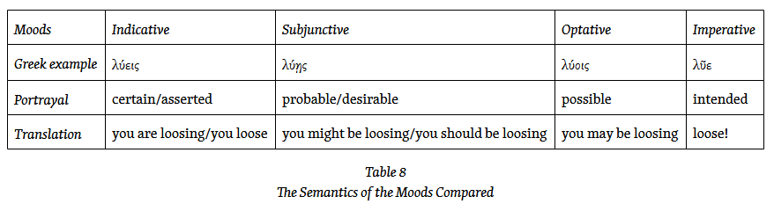
Introduction: Moods
This table is very much of an oversimplification - a handle on the basic forces of the various moods.

Slide 4
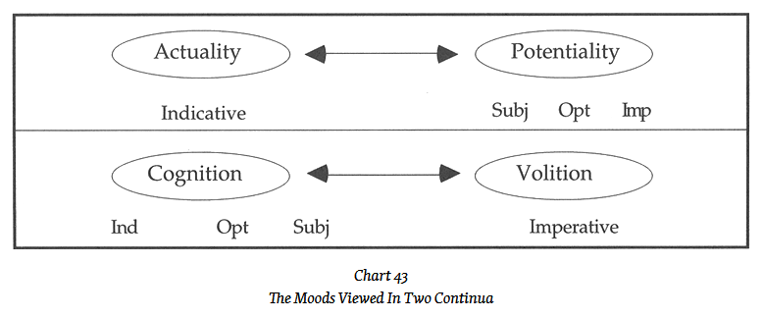
Introduction: Moods
The moods affirm various degrees of certainty.
The imperative mood is normally used to address the volition, while the optative, subjunctive, and especially indicative address cognition.

Slide 5
Introduction: Moods
The moods affirm various degrees of certainty.
The imperative mood is normally used to address the volition, while the optative, subjunctive, and especially indicative address cognition.
The significance of this dual matrix is that an author often does not have a choice in the mood used.

Slide 6
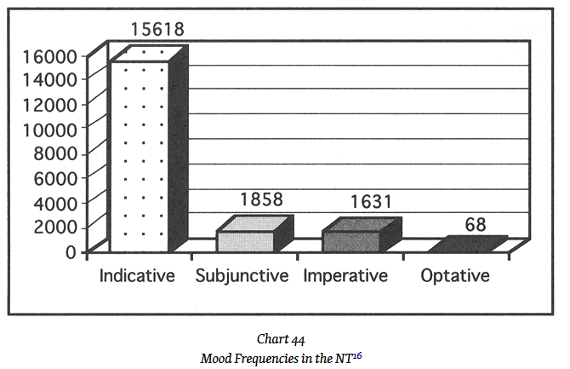
Introduction: Mood Frequency

Slide 7
The Indicative Mood
Declarative Indicative – The indicative is routinely used to present an assertion as a non-contingent (or unqualified) statement.
ἐξῆλθεν ὁ σπείρων σπεῖραι
the sower went out to sow
Mark 4:3

Slide 8
The Indicative Mood
Interrogative Indicative – The question expects an assertion to be made; it expects a declarative indicative in the answer.
By way of contrast, the subjunctive, which asks a question of moral “oughtness” or obligation, or asks whether something is possible.

Slide 9
The Indicative Mood
Interrogative Indicative – The question expects an assertion to be made; it expects a declarative indicative in the answer.
σὺ εἶ ὁ βασιλεὺς τῶν Ἰουδαίων;
Are you the king of the Jews?
Matt 27:11

Slide 10
The Indicative Mood
Conditional Indicative – This is the use of the indicative in the protasis (the “if” clause) of conditional sentences.
The conditional element is made explicit with the particle εἰ.
First and Second class conditional sentences use the indicative.

Slide 11
The Indicative Mood
Conditional Indicative – This is the use of the indicative in the protasis (the “if” clause) of conditional sentences.
εἰ ἐπιστεύετε Μωϋσεῖ, ἐπιστεύετε ἂν ἐμοί
If you believed Moses, you would believe me
John 5:46

Slide 12
The Indicative Mood
Potential Indicative – The indicative is used with verbs of obligation, wish, or desire, followed by an infinitive.
Verbs indicating obligation (such as ὀφείλω, δεῖ), wish (e.g., βούλομαι), or desire (e.g., θέλω) are used with an infinitive.
This usage is really a subcategory of the declarative indicative.

Slide 13
The Indicative Mood
Potential Indicative – The indicative is used with verbs of obligation, wish, or desire, followed by an infinitive.
ταῦτα ἔδει ποιῆσαι
It was necessary [for you] to have done these things.
Luke 11:42

Slide 14
The Indicative Mood
Indicative with Ὃτι – There are three broad groups: substantival, epexegetical, and causal.

Slide 15
The Indicative Mood
Indicative with Ὃτι –substantival.
ὁ λαβὼν αὐτοῦ τὴν μαρτυρίαν ἐσφράγισεν [ὅτι ὁ θεὸς ἀληθής ἐστιν]
The one who receives his testimony has sealed [that God is true].
John 3:33. The ὅτι functions as a direct object of ἐσφράγισεν .

Slide 16
The Indicative Mood
Indicative with Ὃτι (epexegetical) – The ὅτι clause explains or clarifies or completes a previous word or phrase.
εἶπεν πρὸς αὐτούς· τί [ὅτι ἐζητεῖτέ με;]
He said to them, “How is it
[that you were seeking me?]”
Luke 2:49

Slide 17
The Indicative Mood
Indicative with Ὃτι (causal) – ὅτι introduces a dependent causal clause. In such instances ὅτι should be translated because or for.
μακάριοι οἱ πτωχοὶ τῷ πνεύματι, ὅτι αὐτῶν ἐστιν ἡ βασιλεία τῶν οὐρανῶν
Blessed are the poor in spirit, because the kingdom of heaven is theirs.
Matt 5:33

