Slide 1
THE RISE OF CHRISTIANITY
Roman and Eastern Worlds

Slide 2
An Urban Religion
Cities become centers of the new faith: Jerusalem, Antioch, Ephesus, Alexandria, Rome and Constantinople
Large communities of Hellenized Jews in the cities – Greek-speaking
Conversion of middle and upper classes in the cities – also Greek-speaking
Growth rate thought to be by 40% a year for the first two hundred years

Slide 3
Factors Impelling Growth
Missionary work focused on cities
Healing ministries during times of plague in cities gave Christians visibility
Prohibitions on abortion, infanticide and birth control increased number of Christians in cities
Martyrdom in the urban arenas caused many to embrace the faith
Women were valued and had a role in worship leading to conversion of many women – women ran house churches in cities

Slide 4
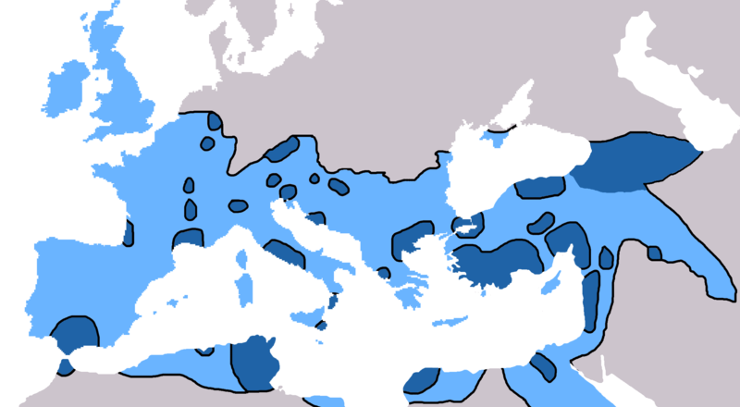
Spread of Christianity in the West to 600AD

Slide 5
Periods of Early Growth
Apostolic Age – First Century, when apostles were leading the early church
Ante-Nicene Age – Second and Third Centuries, before conversion of Constantine in 325 AD
301 AD – Christianity becomes state religion in Armenia
313 AD – Emperor Constantine issues Edict of Milan and calls Council of Nicea in 325 AD
330 AD -- Christianity becomes state religion in Ethiopia
380 AD – Christianity becomes state religion of Roman Empire

Slide 6
Apostolic Age
Church founded in Jerusalem and Antioch, where adherents identified as Christians
Faith spreads to Egypt, Ethiopia, Arabia, Persia, India, and Europe
Persecution under Emperor Nero (64 AD) after Great Fire of Rome
Destruction of Jerusalem in 70 AD leads to separation from Judaism and dominance of Gentile church

Slide 7
Jews and Christians
Christians adopted the following practices from Judaism: worship services that consist of singing hymns and reading scripture, baptism, and use of altar and incense (Syrian Malabar Nasrani)
Old Testament (Septuagint) formed the basis of the biblical canon
Many Christians worshipped in synagogues for centuries
Early disputes over circumcision, Sabbath observance and the date of Easter
Romans refer to Christians as distinct from Jews by 96 AD – Christians do not pay “Jewish” tax

Slide 8
Ante-Nicene Age
Debates over episcopal structure: Bishops, Presbyters, Deacons
New Testament canon solidified by 200 AD
Greek and Latin Fathers (Irenaeus, Clement, Tertullian) combat heresies of Arianism (trinity), Montanism (continuing revelation), and Gnosticism (canon)

Slide 9
The Church of the East
Used Aramaic language instead of Greek
Mesopotamia and Persia under the Parthian and Sassinid Empires – Assyrian Church of the East centered in Edessa
India (Kerala) – St. Thomas Church
China and Central Asia under Tang Dynasty and Mongol rule – Luminous Religion

Slide 10
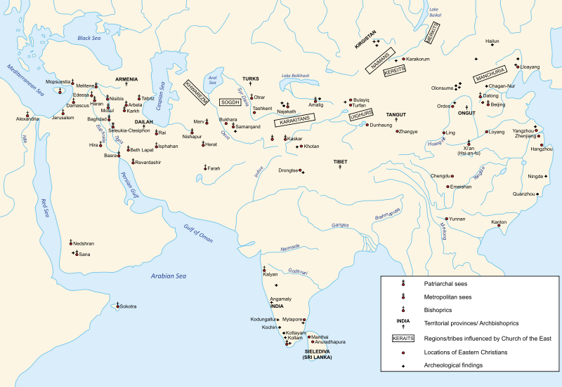
Spread of Christianity in the East to 1,300 AD

