Slide 1
ASHOKA
MAURYAN EMPEROR, 304-232 B.C.

Slide 2
MAURYAN DYNASTY
Founded by Chandragupta Maurya in 313 B.C.
His son, Bindusara, ruled until 273 B.C.
Ashoka was the son of a low ranked wife of Bindusara
From an early age, Ashoka was known as a fearless hunter, great warrior and ruthless general
Myths note that he killed 99 brothers to ascend the throne

Slide 3
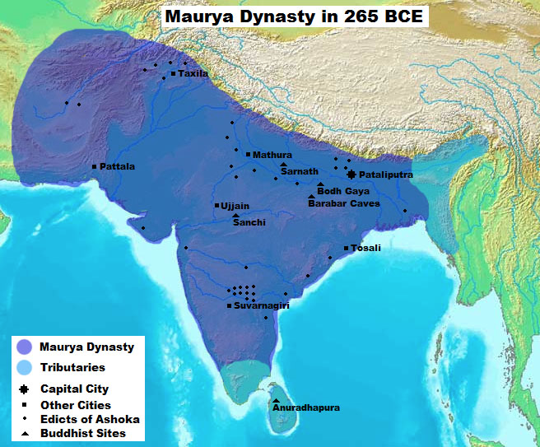
MAURYAN EMPIRE UNDER ASHOKA

Slide 4
EXPANSION OF EMPIRE
Ashoka’s conquests created the modern idea of a unified India
In the east, he conquered Bengal (Bangladesh) and Assam
In the west, he conquered modern day Pakistan and much of Afghanistan
In the south, he conquered Tamil Nadu and Andhra Pradesh

Slide 5
CONQUEST OF KALINGA
Kalinga comprised modern day Odisha and northern Andhra Pradesh
The state was a monarchical republic
100,000 soldiers died in one battle and 150,000 civilians deported as slaves
Ashoka was sickened by the sight of the dead

Slide 6
ASHOKA’S REMORSE
“What have I done? If this is a victory, what’s a defeat then? Is this justice or injustice? Is this gallantry or a rout? Is it valor to kill innocent children and women? Did I do it to widen the empire and for prosperity or to destroy the other’s kingdom and splendor? . . . What’s this debris of the corpses? Are these marks of victory or defeat?”

Slide 7
CONVERSION TO BUDDHISM
Embraces Buddhism after the war
Promotes the expansion of Buddhism throughout the empire and throughout Southeast Asia
Establishes the model for Buddhist kingship (practiced in Thailand and Cambodia today)
Adopts pacifism as imperial policy

Slide 8
BUDDHIST MISSIONARY WORK
Ashoka’s son, Mahinda, and daughter, Sanghamitra, prominent in missionary work, converting Sri Lanka to Buddhism
Built Buddhist monasteries, funded the construction of stupas and supported the ordination of monks
While he expressed support for all faiths, he may have persecuted Jains and he banned Vedic animal sacrifices
Afghanistan may have “converted” through persecution
Missionaries sent to Persia, Syria, Egypt, Greece, Rome, Nepal, China, Mongolia, Cambodia, Laos, Burma, Thailand, Vietnam

Slide 9
Buddhist Kingship
King’s authority not derived from divine power, but by earning the approval of the Buddhist sangha
King plays major role in settling disputes within the sangha
Ultimately, the king became both the religious and secular authority (King is upasaka—a monk)
King is familiar with sacred Buddhist texts
Ashoka stressed “Dhamma”—qualities of the heart that underlie moral action or duty—”Dharma”

Slide 10
PACIFISM
Maintained strong military control throughout his reign
Banned hunting and meat eating on holidays and considered animals as citizens
Erected hospitals to give free medical care to all people AND animals

Slide 11

ASHOKA CHAKRA
The Wheel of Ashoka
24 spokes – 24 hours
12 spokes of dhamma (love, courage, patience, etc.)
12 spokes of dharma
Symbol on flag of modern India

Slide 12
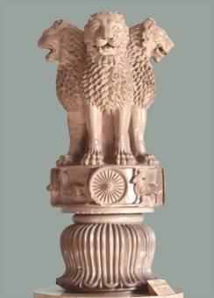
PILLARS
Pillars throughout northern India containing the edicts of Ashoka: 40 to 50 ft high and weighing 50 tons
Pillars contain first written language in India since Harrappan civilization (Prakrit)
Official emblem of modern India: Lion Pillar

