Slide 1


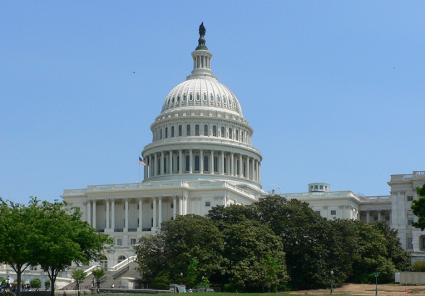
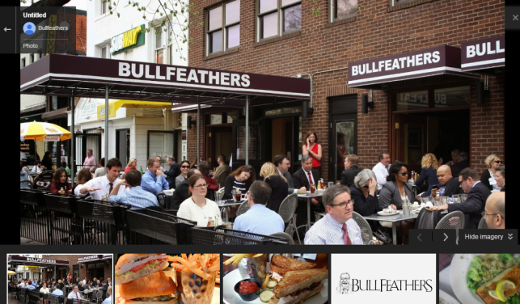
The Week
Sales Meetings
Phones
Capitol Hill and Dinner

Slide 2
Points for Class
V02 Action Plan- 100 points
DEAC Form Completion and Submitted to Doc Share- 100 Points
Pre-Homework Completed for Class – 100 Points
Friday Group Presentations – 100 Points
Capitol Hill Conference Interaction in Lobby Office – 50 points
Final Quiz- 50 points
Total V02 weekly points toward graduation - 500 Points

Slide 3
Homework Assignment V-2 (located on the Academy Site)
1. Most Current Months Financial Statement
2. Other income and deductions.
  Investigate the new vehicle sources and deductions to this account
  a. DOC Fees
    b. Factory incentives and programs
    c. Distributor payments
    Total all additions to income attributable to new vehicle sales ____________________
3. Investigate how holdback is accounted for on your financial statement.
4. What is your dealerships ideal months’ supply of new vehicles? Prepare to defend this number. _______________________________________

Slide 4
Homework Assignment V-2
5. New Vehicle Inventory sorted by age (2 copies)
  Run right before class… does not need to match with the statement)
    Subtotal in following age buckets (calculate units and dollars for each bucket)
      0-30 days
      31-45 days
    46-60 days
    61-90 days
    91-120 days
    Over 120 days
6 .Determine your dealerships floor plan financing interest rate: _________ %
  Does the dealership earn incentives based on retail contract penetration?_____________________________________________________________________
  Briefly describe your New Vehicle floor plan assistance program:__________________________________________________ _______________________________________________________ _______________________________________________________

Slide 5
Homework Assignment V-2
7. Print and bring your New Car Area of Responsibility Map (available from your manufacturer).
8. Bring sales effectiveness report card from your manufacturer, including pump in and pump out information, owner loyalty/customer retention and units in operation. (5, 7, 10 year) If OEM grants access to most current information, please bring login information.
9. Bring Power Information Network (PIN) username and password if participating.
10. What is the size of your active unique owner base? ___________
11. Have a printed copy of a ‘worksheet’ / ‘buyers order’ / ‘computer printout’ utilized in the sales department when working a deal with a customer. Prepare to share the process and overcoming customer objections with the class.

Slide 6
Homework Assignment V-2
12. Copies of Pay Plans and job descriptions for GSM, Sales Managers, Finance Manager(s) and Salespeople. Prefer that these be posted to DOC sharing, Pay plans and JD class website.
What is the total number of employees that left dealership employment during the previous 12 months? ______________________ How many left voluntarily? ______________________
What is the total percentage of ‘mini’s’ paid to the sales force on new car sales for the last 12 months.
15. Complete a DMS audit of third party access to your dealer database, including how many vendors are currently active. Determine why and how these vendors use our customer information and what level of access they have, IE how much of a customers’ data is shared. Bring representative list to share with class.
16. Bring CRM login information to class. Have URL, ID and password.
  a. Print and Bring Salesperson “Daily Task List” for any 3 days in one week.
  b. Access your “sales process” for sold customers in your CRM settings and print “process steps”.

Slide 7
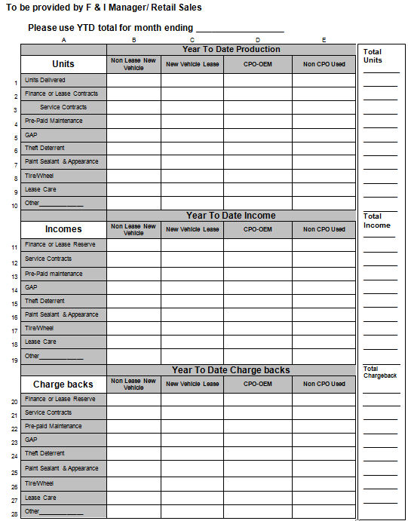
Homework Assignment V-2
17. Bring current phone call guides used by Sales Consultant when taking incoming sales calls and for placing outbound internet phone calls
18. How much time does it take to purchase a vehicle at your store? ______
19. Bring a completed F & I Menu (if you are using one and I hope you are!)
20. Complete F & I performance data (form attached).
Notes:
Bring current phone call guides used by Sales Consultant when taking incoming sales calls and for placing outbound internet phone calls
How much time does it take to purchase a vehicle at your store? ______________________
Bring a completed F & I Menu (if you are using one and I hope you are!)
Complete attached F & I performance data form attached.
Does every retail customer go through the F & I office at time of sale?__________________ If not, what percentage do? _________________
What are the goals of the F & I office in your dealership, financial and otherwise? ______________________________________________________________________________________________________________________________________________________
Review meetings at your dealership (Sales, service, management) for content, effectiveness and level of participant satisfaction. What would you do differently?
________________________________________________________________________________________________________________________________________________________________________________________________________________________________________________
Who represents your district in Congress? ________________________________________
What are the major legislative issues on a Federal basis that directly affect you and your dealership? _______________________________________________________________________________________________________________________________________________________________________________________________________________________________________________________________________________________________________________________________________________________________________________________
Notes: Class will conclude by noon on Friday. Book travel accordingly. Thursday PM Field trip to Capitol Hill Office will require business casual dress at a minimum. Also remember the classroom can be cool, come prepared. And most importantly, travel safely.

Slide 8
Homework Assignment V-2
21. Does every retail customer go through the F & I office at time of sale?__________________ If not, what percentage do? ________________
What are the goals of the F & I office in your dealership, financial and otherwise? __________________________________________
Review meetings at your dealership (Sales, service, management) for content, effectiveness and level of participant satisfaction. What would you do differently?_____________________________________________________
24. Who represents your district in Congress? _______________________
What are the major legislative issues on a Federal basis that directly affect you and your dealership? _____________________
Notes: Class will conclude by noon on Friday. Book travel accordingly. Thursday PM Field trip to Capitol Hill Office will require business casual dress at a minimum. Also remember the classroom can be cool, come prepared. And most importantly, travel safely.
Notes:
Bring current phone call guides used by Sales Consultant when taking incoming sales calls and for placing outbound internet phone calls
How much time does it take to purchase a vehicle at your store? ______________________
Bring a completed F & I Menu (if you are using one and I hope you are!)
Complete attached F & I performance data form attached.
Does every retail customer go through the F & I office at time of sale?__________________ If not, what percentage do? _________________
What are the goals of the F & I office in your dealership, financial and otherwise? ______________________________________________________________________________________________________________________________________________________
Review meetings at your dealership (Sales, service, management) for content, effectiveness and level of participant satisfaction. What would you do differently?
________________________________________________________________________________________________________________________________________________________________________________________________________________________________________________
Who represents your district in Congress? ________________________________________
What are the major legislative issues on a Federal basis that directly affect you and your dealership? _______________________________________________________________________________________________________________________________________________________________________________________________________________________________________________________________________________________________________________________________________________________________________________________
Notes: Class will conclude by noon on Friday. Book travel accordingly. Thursday PM Field trip to Capitol Hill Office will require business casual dress at a minimum. Also remember the classroom can be cool, come prepared. And most importantly, travel safely.

